Slide 1
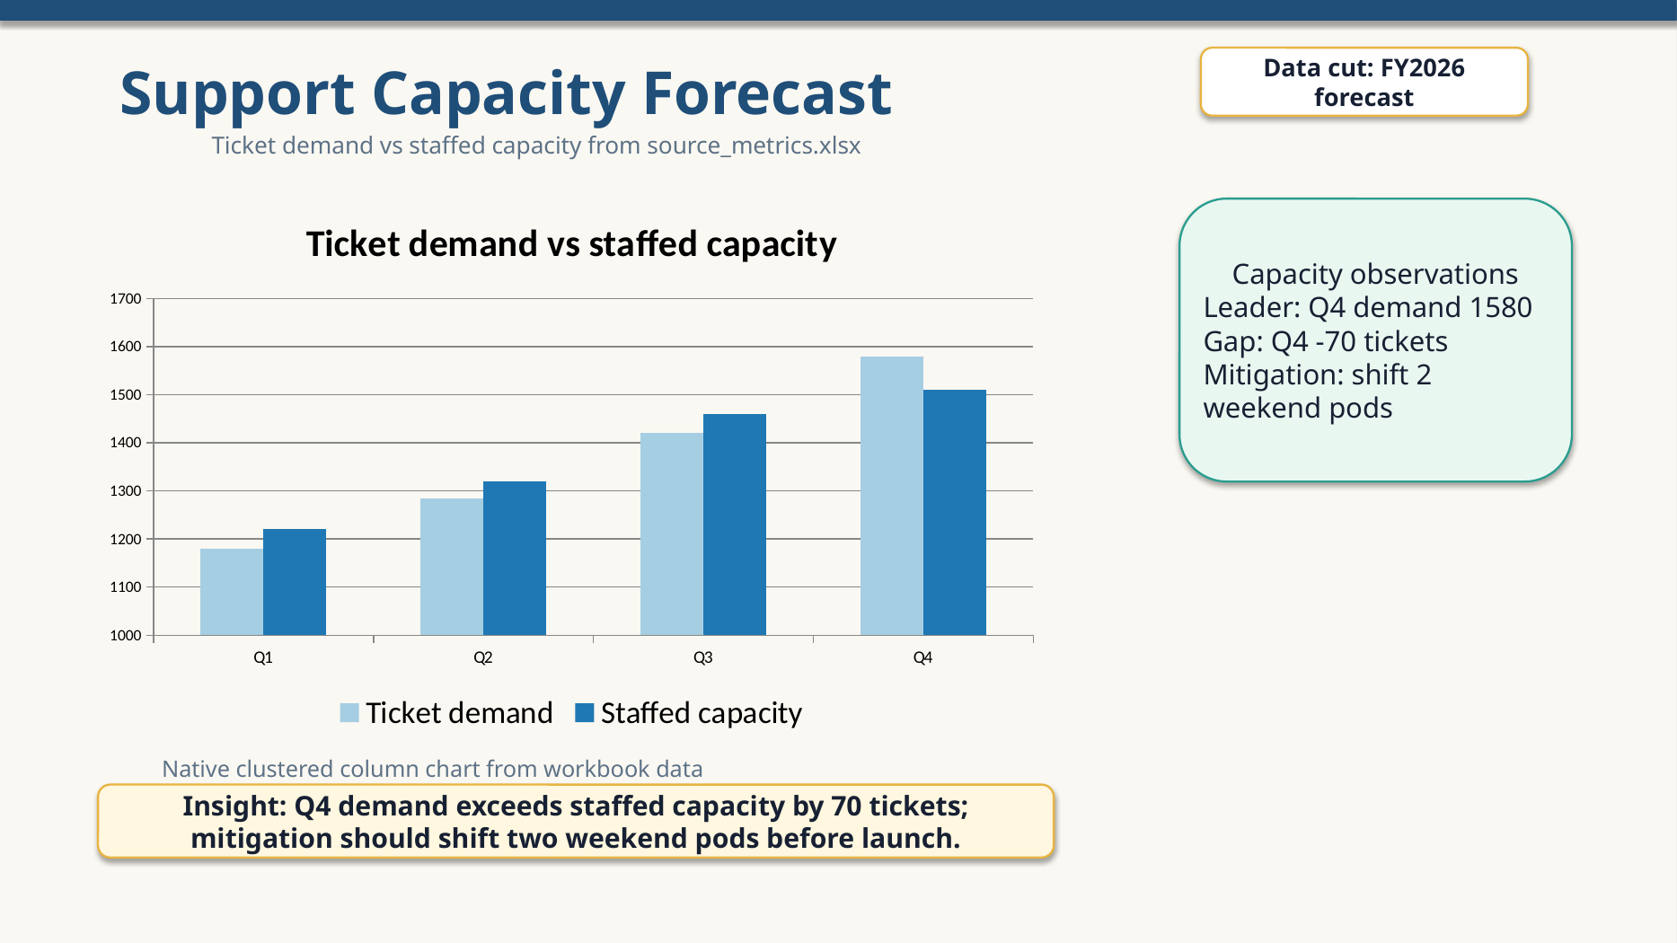
Support Capacity Forecast
Data cut: FY2026 forecast
Capacity observations
Leader: Q4 demand 1580
Gap: Q4 -70 tickets
Mitigation: shift 2 weekend pods
Insight: Q4 demand exceeds staffed capacity by 70 tickets; mitigation should shift two weekend pods before launch.

Slide 2
Workbook audit
Source data: support capacity forecast
Q1 1180 1220 +40
Q2 1285 1320 +35
Q3 1420 1460 +40
Q4 1580 1510 -70

Slide 3
Do not edit: native chart package invariant

