Slide 1
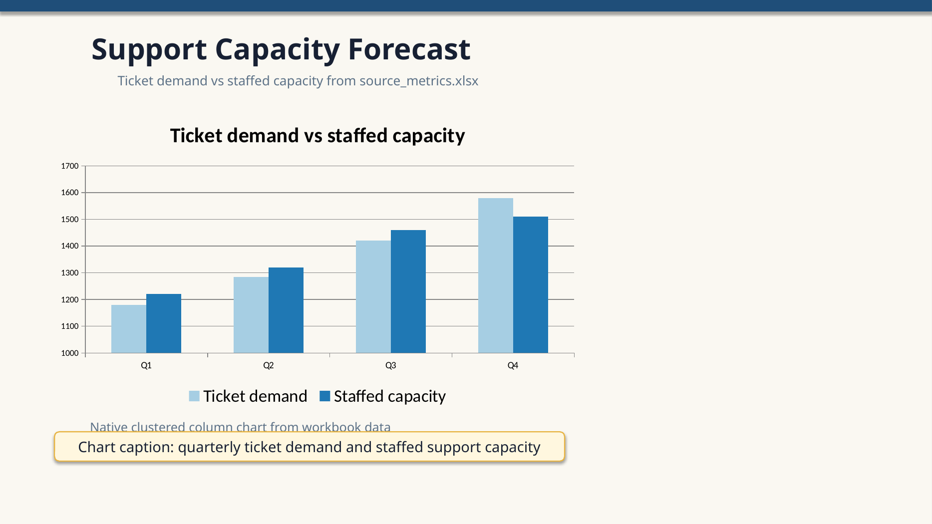
Support Capacity Forecast
Ticket demand vs staffed capacity from source_metrics.xlsx
Chart caption: quarterly ticket demand and staffed support capacity

Slide 2
Workbook audit
Source data: support capacity forecast
Q1 1180 1220 +40
Q2 1285 1320 +35
Q3 1420 1460 +40
Q4 1580 1510 -70

Slide 3
Do not edit: native chart package invariant

