Slide 1
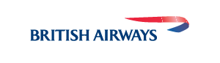
WEB SCRAPING TO GAIN CUSTOMER INSIGHTS
24/06/2024

Slide 2
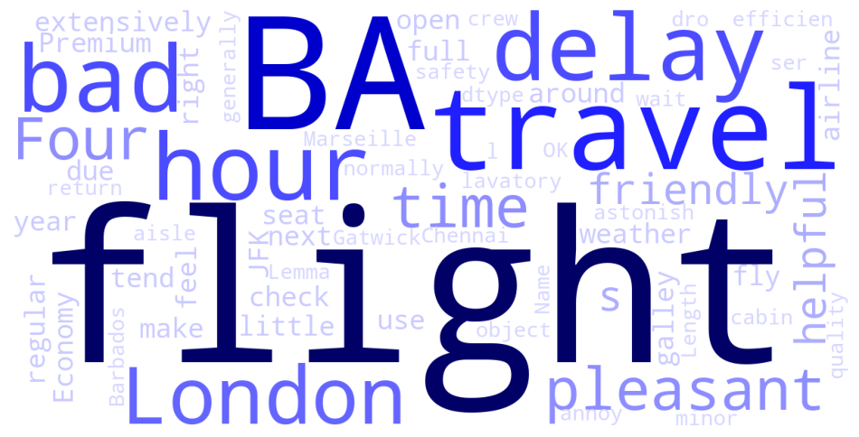
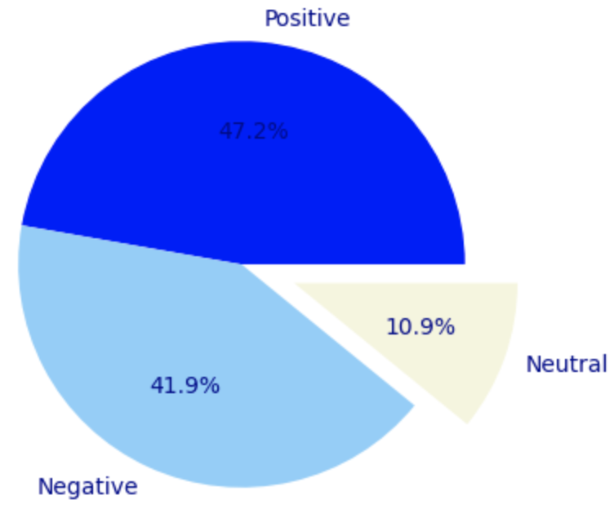
CUSTOMER REVIEWS INSIGHTS
Key insights from the 1000 customer reviews from Skytrax:
Positive Reviews 472
Negative Reviews 419
Netural Reviews 109
Keywords used in reviews

