Slide 1

CUSTOMER BEHAVIOR PREDICTION
24/06/2024

Slide 2
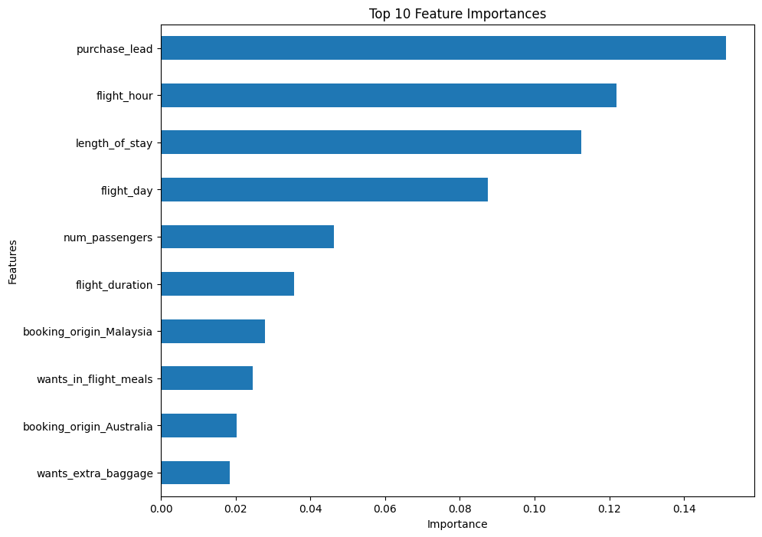
Influential Factors of Customer Behaviour
Key insights
The most important features identified by the Random Forest Classifier Model was purchase lead, which is the number of days between travel date and booking date
Flight hour, length of stay, flight day was also significant
Origin of the customer was not important
The accuracy of this model is approximately: AUC Score: 0.55 Precision: 0.50 Recall: 0.13
This model has limited effectiveness in correctly predicting and classifying the positive class, which requires more improvement.
I suggest adding more customer-centric features into the model for future prediction.

