Slide 1
Multi-signature schemes
Improving Omniledger performance

Slide 2
Distributed Ledger systems
Irrefutable truth
e.g. Blockchain
e.g. Bitcoin
Do not scale
Every participant has to partake in every transaction

Slide 3
OmniLedger
Distributed Ledger
Scalability via sharding
Visa levels of throughput
Secure with randomness from RandHound

Slide 4
RandHound
Unbiased randomness
Requires multi-signatures

Slide 5
Research
>70% of OmniLedger runtime is RandHound
Multi-signature algorithms
Elliptic Curve
Schnorr scheme
Focus on performance

Slide 6
In This Presentation
Elliptic Curves
Algorithm comparison
Related work

Slide 7

Elliptic Curves
Of the form $y^{2}=x^{3}+Ax+B$
Requires ${4A}^{3}+27B^{2}≠0$
No cusps
No self-intersections
No isolated points
Includes a point “at infinity” $E=\{(x,y):y^{2}=x^{3}+Ax+B\} U \{O\}$

Slide 8
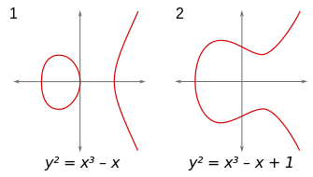
Examples

Slide 9
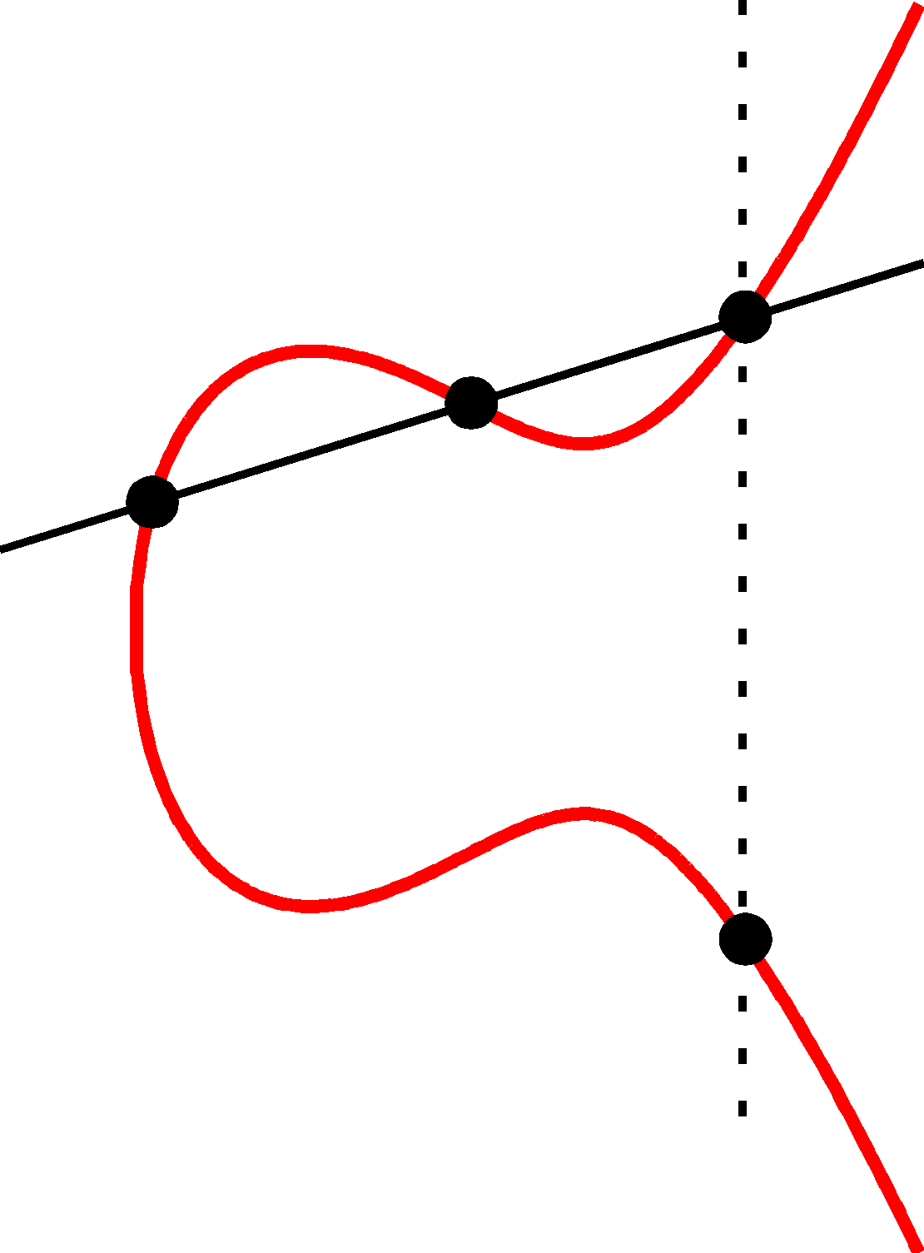
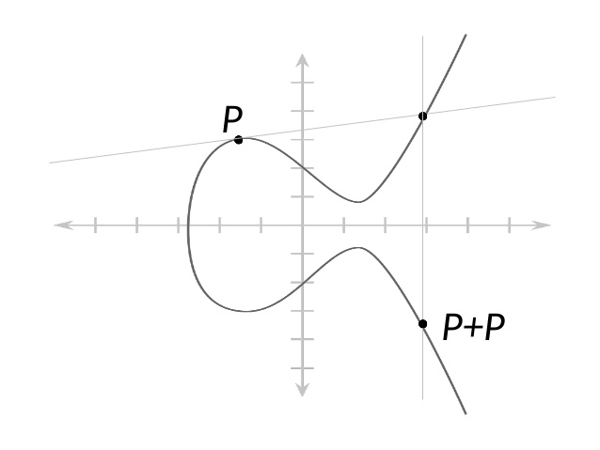
Group action

Slide 10

Weil Pairing
$e:E\left[m\right]×E[m]→μ_{m}$
$E\left[m\right]=\left\{P:mP=O\right\}$
$μ_{m}=\{c∊ℂ:c^{m}=1\}$
Bilinear
$e\left(S_{1}+S_{2},T\right)=e\left(S_{2},T\right)e\left(S_{2},T\right)$
$e\left({S,T}_{1}+T_{2}\right)=e\left(S,T_{2}\right)e\left(S,T_{2}\right)$

Slide 11
Signature schemes
Sign a digital message
Three stages
Key generation
Message signing
Signature verification

Slide 12
Multisignatures
Efficient way to have a message signed by a group of people
Limited in performance by the communication required

Slide 13
Studied schemes
Scheme based on the Weil pairing on Elliptic Curves
Scheme based on the Schnorr signature scheme

Slide 14
BLS Multi-signature
Signature element of elliptic curve group
Verification with Weil pairing
Multi-signature created after each participant has published own signature
Therefore one roundtrip needed
Can be produced as long as the signatures remain

Slide 15

Schnorr Group
Primes $p$ and $q$ such that $p=qr+1$
${g=h}^{r}≢1(mod p)$ is the generator of the Schnorr group

Slide 16
Schnorr Multi-signature
Works on groups, often a Schnorr group
Verification via an easy comparison
Uses three roundtrips to create a multi-signature

Slide 17
Comparison
Security proofs on the same basis
BLS requires less communication
Making it faster
Remains stable

Slide 18
Conclusion
BLS multi-signature algorithm is the best choice to improve the performance of RandHound, and therefore the performance of OmniLedger

Slide 19
Related work
OmniLedger
BLS multi-signature
Schnorr multi-signature

Slide 20
Thank you

