Slide 2
Introduction
Elliptic Curves
Comparison of multisignature algorithms

Slide 3
Motivation
Distributed ledger systems
Blockchain; irrefutable truth
Do not scale with users
Every user needs to take part in everything

Slide 4
OmniLedger
Distributed Ledger
Scalability via sharding
Achieved Visa levels of throughput

Slide 5
Research
Large portion of the running time is needed for multisignature algorithms
An improvement in the performance of the algorithm improves OmniLedger

Slide 6
Signature schemes
Allows to sign a digital message to prove identity and authenticity
Three stages
Key generation
Message signing
Signature verification

Slide 7
Multisignatures
Efficient way to have a message signed by a group of people
Limited in performance by the communication required

Slide 8
Studied schemes
Scheme based on the Weil pairing on Elliptic Curves
Scheme based on the Schnorr signature scheme

Slide 9
Elliptic Curves
Of the form y^2=x^3+Ax+B
Requires 4A^3+27B^2 nonzero
Includes a point “at infinity” E={(x,y):y^2=x^3+Ax+B} U {O}

Slide 10
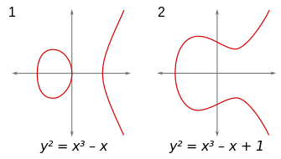
Examples

Slide 11
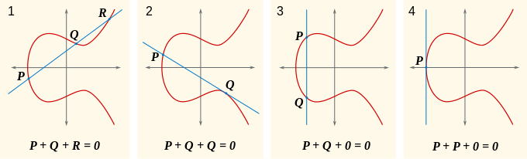
Group action

Slide 12
Weil Pairing
Bilinear
Efficiently computable

Slide 13
BLS Multisignature
Works on groups, therefore elliptic curves
Weil pairing used to verify
Aggregated signature after every participant has published his
Only one round of communication

Slide 14
Schnorr Group
Primes p and q such that p=qr+1
Generator of the Schnorr group is found

Slide 15
Schnorr Multisignature
Works on groups, often a Schnorr group
Verification via an easy comparison
Uses three roundtrips during message signing

Slide 16
Comparison
Security proofs on the same basis
BLS is requires less communication
Making it faster
Remains stable

Slide 17
Conclusion
The BLS multisignature scheme is most suitable to improve OmniLedger

Slide 18
Thank you

