Slide 1
Final Report Presentation :
A Hybrid Scoring Framework for Jira Requirement Quality:
Integrating Domain Rules with Machine Learning Classification
KAMTHEKAR PRASANNA YESHWANTRAO
BITS ID: 2024DA04180
M.Tech. Data Science & Engineering
BITS PILANI - WILP DIVISION

Slide 2
Table of Contents
Introduction – Problem Statement
Objectives & Scope
Research Methodology
Literature Review
Three-Layer Architecture Diagram
Data Preparation and Ingestion
Rule Engine – Syntactic Gates
Feature Engineering
ML Transparency: Model Comparison , Performance Results
Hybrid Score Engine with Tunable Parameters
UI – Insights, Dashboard
Conversational Chatbot
Demo
Conclusion

Slide 3

Problem Statement : Semantically Hollow Jira Requirements
Example of Semantic Hollowness: "Fix the issues found during testing so that the application is stable"
Why It's Hollow:
No specific issue identified
No scope defined
No acceptance criteria referenced
Developer has to guess what to fix
Impact:
Sprint spillover
Developer time goes in clarifying the issue.
Audit Issue – No traceable evidences
Time-Consuming
Jira Reviews
Difficulty Extracting
Insights
The Problem:
Semantic
Hollowness
Limitations of
Existing Solutions
Stakeholders—including project managers, product owners, scrum masters, and developers—currently lose 4–6 hours per sprint manually validating documentation or scheduling clarification meetings.
Raw Jira data is dense
and lacks actionable
insights, hindering
effective analysis and
decision-making.
Current Jira plugins and
academic work focus on
structural completeness,
not semantic depth,
failing to detect non-
actionable language.
Requirements are
structurally sound but
lack meaningful,
actionable information,
as exemplified by vague
statements.

Slide 4
Objectives & Scope
Objectives
Primary Objective: Build hybrid scoring framework that combines rule-based validation with machine learning classification.
Train ML classifier using TF-IDF vectorization and multiple ML model on labeled Jira issues.
Develop a hybrid scoring engine that optimizes weights between rule-based and ML-based scores through cross-validation.
To build a Stream lit dashboard that allows users to upload Jira exports, view quality scores with explanations, filter by status and priority, and export results to CSV.
To test the hypothesis that hybrid scoring captures atleast 20% additional issues with “BAD” quality label compared to rule-only scoring.
Research Questions –
  Does Rule engine + ML Classifier improve quality?
  How to identify Semantic hollowness in Jira requirements - where issues are structurally complete but lack meaningful, actionable information.
Scope
Rule Engine: A Python module that evaluates Jira issues against 10 syntactic rules, including user story syntax, acceptance criteria presence etc.
Machine Learning Classifier: A TF-IDF vectorizer combined with ML model such as Logistic Regression trained on 525 labeled Jira issues.
Hybrid Scorer: A scoring system that combines rule scores and ML scores into a final quality score with explainable output.
Dashboard: A Streamlit with dashboard, analysis and chatbot.
Validation Results: Comparative analysis using accuracy, precision, recall, F1 score, and false negative rate.

Slide 5





Research Methodology & Plan of Work
Phase1:
Discovery &
Define Problem Statement
Phase 2:
Research, Design & Data
Collection
Phase3 :
Development &
Integration
Phase 4:
Validation &
Testing
Phase 5:
Finalization
Identify Problem
statement, assess
potential solution,
Discuss with
supervisor
Research,
Data Collection,
Data Labeling,
Documentation
Rule Engine Development,
ML Classifier Development
Hybrid Scorer Development,
Stream lit Dashboard Development.
Evaluation on test
set, using metrices – Accuracy, F1, Recall
Hypothesis validation
Results documentation.
Dissertation Writing,
Review, and Final
Submission.
5 Phase Project Development Approach

Slide 6
Literature Review (1/2)
Commercial Tools and Their Limitations
The Limitation: Commercial Jira plugins (like Script Runner, Automation for Jira) treat requirement validation as a single-axis problem. They only perform static, syntactic checks, such as verifying if a field is empty, if word count targets are met, or if standard templates are used
Key Finding: While these tools excel at workflow automation and field-level validation, they cannot distinguish between structurally complete and semantically actionable requirements. A requirement with all fields populated may still be semantically hollow—containing phrases like "as discussed in the meeting" with no actionable detail.
The "Structural Blindness" justifies ML Classifier
Fragmented Metrics requires "Hybrid" architecture
The "Black Box" Problem justifies explainable interactive dashboard
Lack of Domain Specificity as these tools offers generalize solution.
Tool | Primary Function | Limitations
Script Runner | Custom validation scripts | Requires coding; no pre-built domain specific rules
Automation for Jira | Field validation and workflow rules | Only checks empty fields, not content quality
Jira Quality Checker | Basic syntax validation | No ML, no domain-specific rules

Slide 7
Literature Review (2/2)
Academic Research
Research Paper Name | Details | Relevance | Gap
NLP for Requirements Engineering: Mapping Study (Zhao et al., 2021) | Comprehensive review of 404 studies revealing a heavy academic focus on formal requirements in lab settings | Validates the core necessity of using automated semantic analysis and text vectorization to detect ambiguities against real-world practical application. | Severe lack of practical industrial applications; oversaturation of formal specifications instead of messy, agile Jira artifacts
USeR: A Web-based User Story eReviewer (Hallmann et al., 2025) | Web tool evaluating user stories using a mix of syntactic checks (plain code) and machine learning (SVMs, TF-IDF) | Proves that combining rule-based logic with ML works. Directly informs your 10-Gate Syntactic Rule Engine | Focuses heavily on structural templates; fails to detect "semantic hollowness" specially in banking project domain
QualiTagger: Automating software quality detection (Shivashankar et al., 2025) | Detects quality attributes directly in unstructured issue trackers using Deep Learning (Transformer models) | Demonstrated that ML models can effectively identify quality issues in issue trackers. | Operates as an unexplainable "black box", requires massive datasets, and focuses on open-source rather than highly regulated banking domains
SPRINT: Assistant for Issue Report Management (Adnan et al., 2025) | Deep-learning GitHub assistant that predicts issue severity, flags duplicates, and localizes buggy code | Demonstrates the practical value and viability of deploying automated issue management tools in agile workflows | Manages triage and structural completeness but remains blind to evaluating the semantic depth and actionability of the requirement itself
Mining Issue Trackers: Concepts & Techniques (Montgomery et al., 2024) | Outlines how to extract and manage vast, complex ecosystems of data within modern agile platforms | By excluding the unstructured NLP mining concepts, this paper acts as the academic blueprint for Data Ingestion Module and 10-Gate Syntactic Rule Engine | The "Hybrid Integration" Gap: There is no proposition of a unified, dual-layered system. Dissertation solves this by taking the structural metadata compliance outlined in this paper and mathematically blending it with semantic quality predictions to output a single, operational Hybrid Score

Slide 8
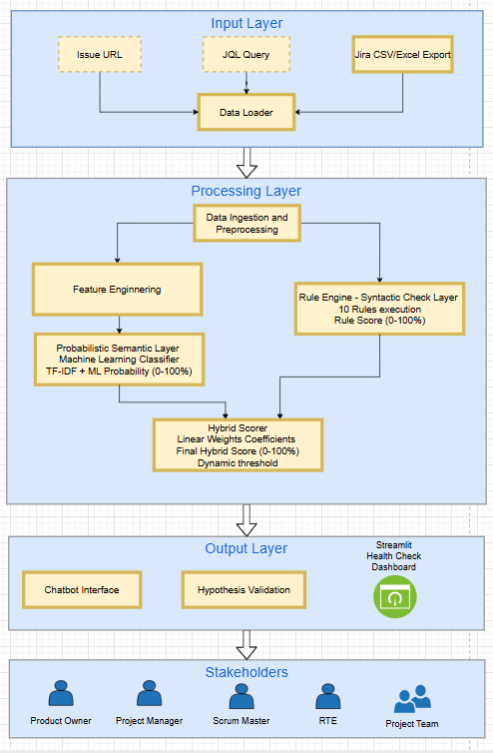
Three-Layer Architecture Diagram
Layer-1: Input layer
  Three ingestion mechanisms support the workflow: Issue URL (direct API retrieval), JQL Query (batch extraction), and Jira CSV Export (file upload). A Data Loader normalizes all inputs into a standardized format.
  Note – for dissertation, only Jira Export in CSV/Excel format is referred.
Layer-2: Processing layer
  All core components processes the input data and assign final quality score -
  Data preprocessing & Feature engineering,
  Rule based scoring module,
  Machine learning scoring module and
  Hybrid scoring module
Layer-3: Output layer
  Chatbot Interface – Conversational query engine supporting natural language questions about quality metrics (average scores, blocked tickets, anomalies, ticket lookup).
  Hypothesis Validation – Empirical module for comparative model evaluation against labeled data.
  Health-check Dashboard – Insightful summary dashboard of data received from user
User/Stakeholder
Key users of this application –
Product Owner - Manages & prioritizes the backlog.
Scrum Master – Sprint readiness validation and conduct sprint ceremonies.
Project Manager – Portfolio and project level metrics monitoring
RTE- Release Train Engineer – Cross-Team management
Scrum Team – Developers who execute the work.

Slide 9
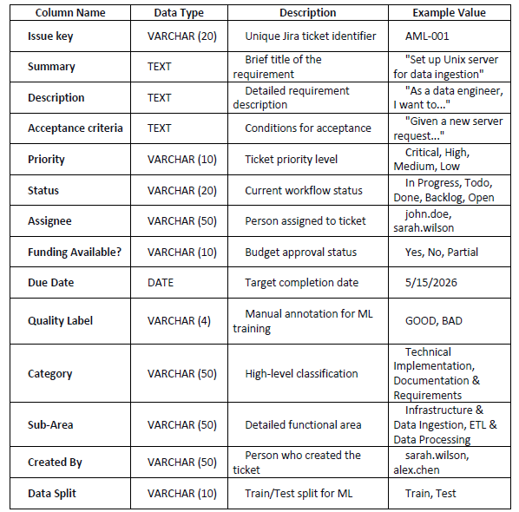
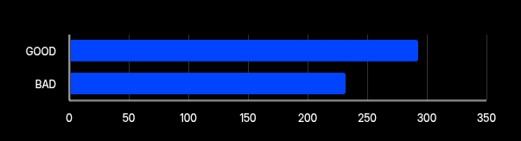
Data Preparation and Ingestion
Domain-Specific AML Jira Ticket Project Issues Extract
Total
Training
Test
Dataset Details
525
378
147
Tickets created Manually and got it reviewed by supervisor
Dataset Classification Distribution
Out of 525 Total tickets,
293 (55.8%) are 'GOOD’ and 232 (44.2%) are 'BAD’ labelled tickets.
Out of 378 Training tickets,
231(61.1 %) are 'GOOD’ and 147(38.9%) are 'BAD’ labelled tickets.
Out of 147 Test tickets,
62(42.2 %) are 'GOOD’ and 85(57.7%) are 'BAD’ labelled tickets.
Exceeded the >500 tickets feedback threshold while maintaining domain specificity and balance across AML requirements.

Slide 10
Rule Engine – Syntactic Gates
Deterministic 10-Gate Syntactic Rule Engine Module
# | Rule Name | Weightage (%) | What It Checks | Justification
1 | User Story Syntax | 15 | "As a... I want... So that..." format | Ensures requirements follow the standard agile user story format which forces authors to clearly specify the user role, desired action, and business outcome. This format directly addresses the "who, what, why" of a requirement, reducing ambiguity and ensuring all stakeholder perspectives are considered.
2 | Acceptance Criteria Present | 15 | At least one AC with Given/When/Then | Acceptance criteria are non-negotiable for development completion. Without clearly defined acceptance criteria, teams cannot determine when a story is "done," leading to ambiguous completion standards, scope creep, and rework. This field is the primary source of test case creation.
3 | Description Length | 15 | More than 50 characters | One-line descriptions are almost always incomplete
4 | Acceptance Criteria Format | 10 | Gherkin format check | Gherkin format enables automated test creation and provides unambiguous acceptance conditions. "Given-when-then" removes interpretation ambiguity by specifying clear preconditions, actions, and expected outcomes. This structured approach significantly reduces misunderstanding between business and technical teams.
5 | Summary Length | 10 | More than 20 characters | Incomplete Summary like "Fix reported issue" requires additional attention to elaborate
6 | Priority Assigned | 10 | explicitly priority set for each issue (Critical, High, Medium, Low). | Unprioritized issues cause planning chaos
7 | Due Date | 10 | Project has valid due date | Missing or invalid due dates disrupt sprint planning and release management. Without a target completion date, teams cannot prioritize work effectively or manage stakeholder expectations regarding delivery timelines. This is essential for capacity planning and risk assessment.
8 | Assignee Assigned | 5 | Someone is responsible | An assigned owner ensures accountability and prevents tickets from falling through the cracks.
9 | Category is assigned | 5 | Category should be populated | helpful for MI to generate insights of work distributed across category
10 | Sub-area is assigned | 5 | Sub-area should be populated | helpful for MI to generate insights of work distributed across Sub-area
Rule Score = {sum of all passed rules weightage}

Slide 11
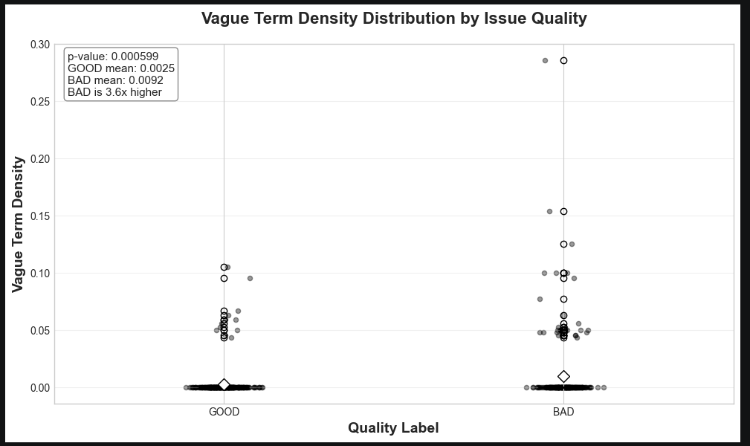
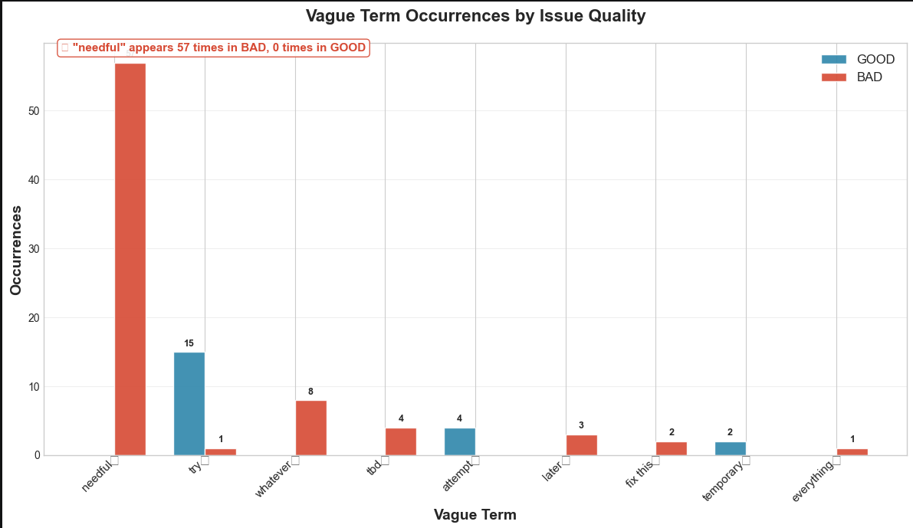
Feature Engineering – Correlation Analysis (1/3)
Vague Term Density - Developed a key metric called "Vague Term Density," which calculates the proportion of a requirement that is composed of a curated list of vague words (e.g., "needful," "whatever," "fix later," "tbd").
The Finding: BAD requirements have 3.6 times higher density of vague terms than GOOD requirements.
Feature | Description | Purpose
Word count | Number of words in description | Longer descriptions generally contain more actionable detail
Vague Term Count | Number of vague terms detected | High count indicates semantic hollowness
Vague Term Density | Vague terms per 100 words : Vague Term Count / Word Count | Normalizes for varying description length

Slide 12
Feature Engineering – Correlation Analysis (2/3)
Text Corpus Aggregation In agile environments, Product Owners, Business Analysts often split vital context across multiple Jira fields (e.g., placing the user story in the Description but technical constraints in the Acceptance Criteria).
To prevent data fragmentation, the system concatenates the Summary, Description, and Acceptance Criteria into a single, unified text corpus per ticket. This ensures complete contextual analysis.
Combined = { Summary + Description + Acceptance Criteria }
Linguistic Preprocessing:
Implemented custom stop word removal filtering 150+ standard grammatical noise words (e.g., 'the', 'is', 'for', 'and’).
Extracted Unigrams and Bigrams from the combined Summary, Description, and Acceptance Criteria fields.

Slide 13
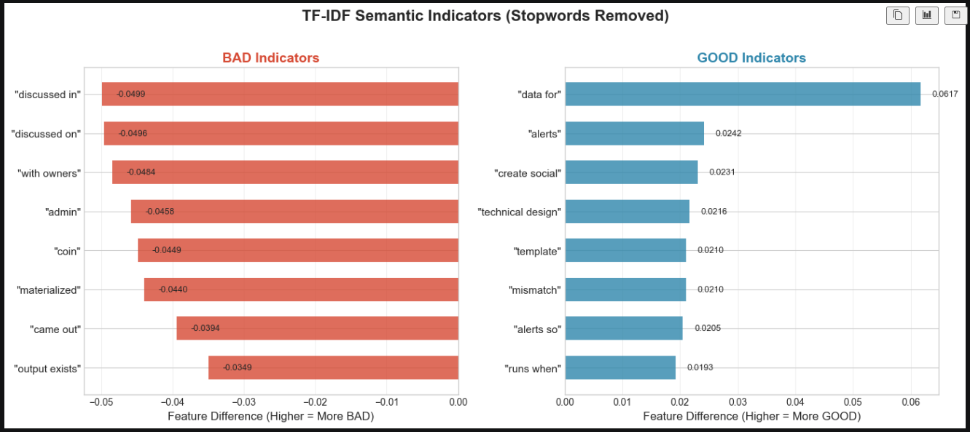
Feature Engineering – Correlation Analysis (3/3)
Semantic Vectorization (TF-IDF Bounding) : Beyond fixed phrases, the cleaned unified text is processed through a TF-IDF vectorizer. To mathematically prevent the downstream models from overfitting.
The feature space is strictly capped at max_features = 1000. This bounds the data, forcing the classifiers (SVM, Random Forest) to learn generalized semantic patterns of requirement quality rather than memorizing the training dataset.

Slide 14


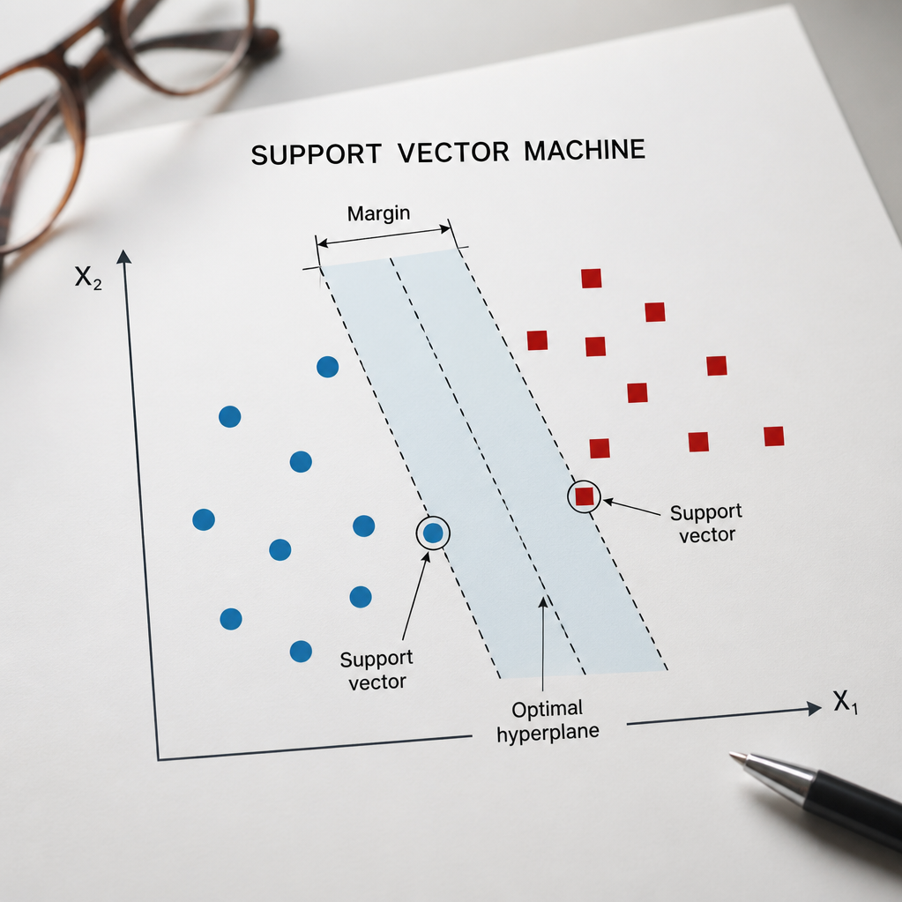

ML Transparency: Model Selection
Logistic Regression
Random Forest
SVM Variants
Feature Engineering
Linear, RBF, and Poly kernels
evaluated for optimal
decision boundaries.
Vague_term_density with Min_max scaler, TF-IDF transformation with
max_features=1000 to
prevent overfitting.
Baseline model for
requirement classification.
Ensemble learning for high-
dimensional feature sets.

Slide 15
Evolution Setup
Stage -1 : Hold-Out Test Set
  Reserved 147 issues from our dataset of 525 as a completely unseen test set. The remaining 378 issues were used for training. This provides a realistic picture of how the model would perform on new, unseen data.
Stage 2: Cross-Validation for Robustness
  5-fold stratified cross-validation on the training data. This means we split the 378 training issues into 5 different groups, training on 4 groups and testing on the 5th, repeating the process 5 times. Each issue gets tested exactly once, and average the results.
  Detects overfitting The average across 5 folds gives us a truer picture of how the model will perform in production.
Overfitting Prevention Measures:
Parameter | Value | Purpose
max_features | 1,000 (TF-IDF) | Prevents memorization of rare, noisy jargon.
sublinear_tf | True | Dampens logarithmic impact of frequent terms.
class_weight | Balanced | Penalizes minority class misclassification.
SMOTE | Synthetic Oversampling | Ensures balanced representation across targets.

Slide 16
Model Performance Results
Stage | Model | Accuracy | Precision | Recall | F1_Score | FNR | Confusion Matrix
Stage -1 :Model Performance on hold-out data | Random Forest | 0.918367 | 0.875 | 0.955 | 0.913043 | 0.0455 | TN=72 | FP=9 | FN=3 | TP=63
 | Logistic Regression | 0.918367 | 0.875 | 0.955 | 0.913043 | 0.0455 | TN=72 | FP=9 | FN=3 | TP=63
 | SVM (Linear) | 0.92517 | 0.898551 | 0.939 | 0.918519 | 0.0606 | TN=72 | FP=7 | FN=4 | TP=62
Stage -2 :Cross-Validation Performance | Random Forest | 0.9333 | 0.9339 | 0.9494 | 0.9416 | 0.0506 | TN=210 | FP=18 | FN=4 | TP=293
 | Logistic Regression | 0.9524 | 0.9362 | 0.9831 | 0.9589 | 0.0169 | TN=208 | FP=20 | FN=3 | TP=294
 | SVM (Linear) | 0.9505 | 0.9393 | 0.9763 | 0.9572 | 0.0237 | TN=209 | FP=19 | FN=5 | TP=292
Model Performance Highlights
Best Performing Model: Logistic Regression achieved the highest F1-Score (0.959) and Recall (0.983) in cross-validation, demonstrating excellent ability to identify BAD-quality requirements.
No Overfitting Issue: Cross-validation results consistently improved over the hold-out test (F1 improvement: +2.9% to +4.6%), confirming models are learning genuine patterns, not memorizing training data.
Robust Detection: All models achieved FNR below 5.1% in cross-validation, with Logistic Regression reaching the lowest FNR of 1.69%—meaning it misses fewer than 2 out of every 100 BAD requirements.
Consistent Performance: Low standard deviation across 5 folds (±0.02) confirms models perform reliably regardless of which data split is used.
Test Scenarios – Refer below scenarios verified to test the performance of model -
Logistic Regression model outperformed other candidates with high accuracy, F1 Score & low FP, demonstrating that the underlying text features are highly linearly separable.

Slide 17
Hybrid Score Engine with Tunable Parameters
Assigned final score as
Final Score = ((Rule_Score * rule weight) + (ML Classifier Score * ML Classifier Weight))
Default configuration : Rule weight = 60% and ML classifier weight = 40%
Metric And Parameter Gate Considerations
Dynamic Weight Balancing Sliders - The system allows user to dynamically adjust the balance between the two core components:
  - Increasing the Rule Engine Weight provides strict, consistent enforcement of structural standards and mandatory field population across teams.
  - Increasing the Machine Learning Weight allows the system to focus heavily on semantic content.
Actionable Quality Threshold Score (%) Gate - This parameter serves as the gatekeeper for requirement quality. If an issue's hybrid score falls below the threshold, it is automatically flagged as BAD (hollow) and blocked from development.

Slide 18
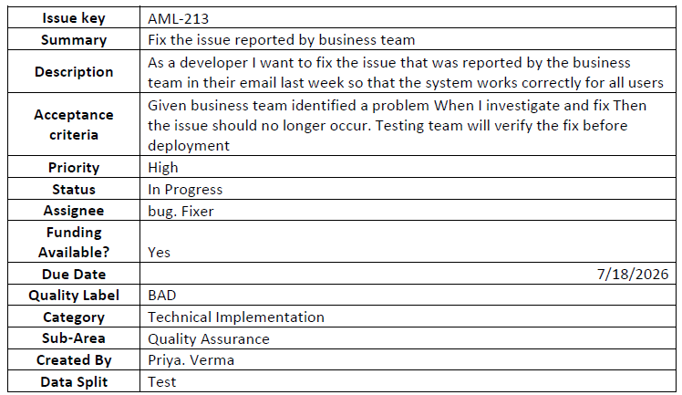
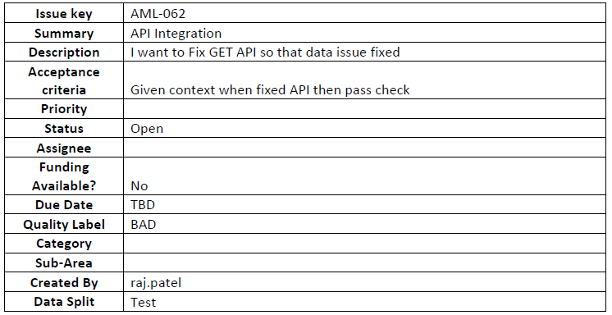
Case Study - Scenarios Validation
Full-spectrum quality coverage through layered validation
Scenario 1 (ML Trigger)
Scenario 2 (Rule Trigger)
Valid structure, hollow text content—Correctly flagged by ML.
Rule Engine score – 100 | ML Score – 0.35 | Hybrid (final score) – 60.14
Explanation - Semantic hollowness: Vague statement detected
Valid text but missing operational fields-Correctly caught by the 10-Gate Rule Engine.
Rule Engine score – 45 | ML Score – 82.94 | Hybrid (final score) – 60.17
Explanation - Missing User Story format | Due date is missing or invalid | Missing Priority | Missing Category | Missing Assignee | Missing Sub-area

Slide 19
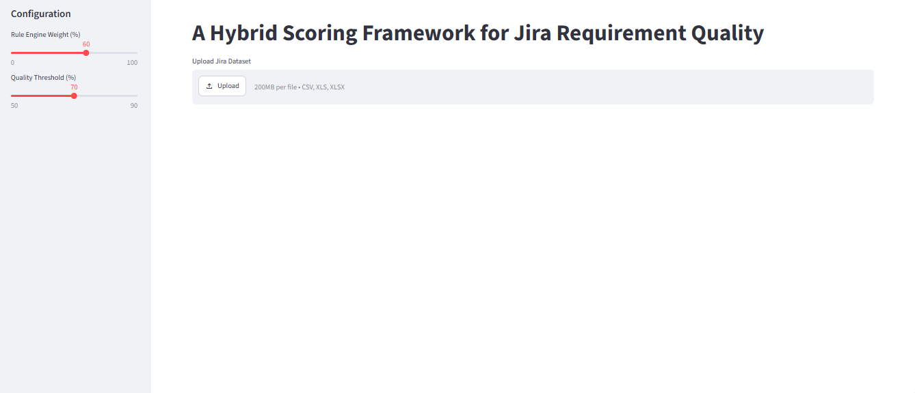
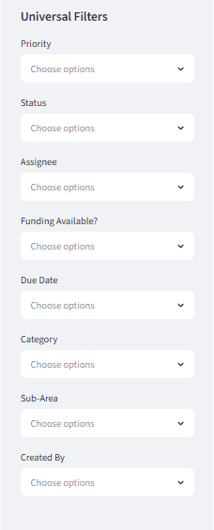
UI – Landing Page
UI Layout
Filters

Slide 20
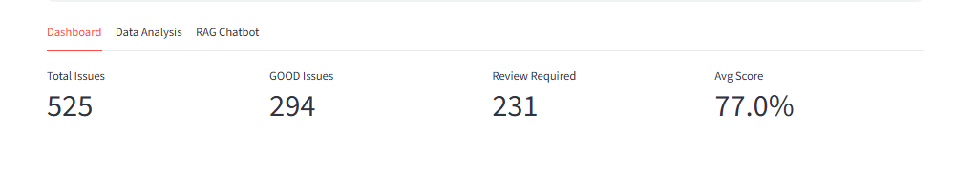
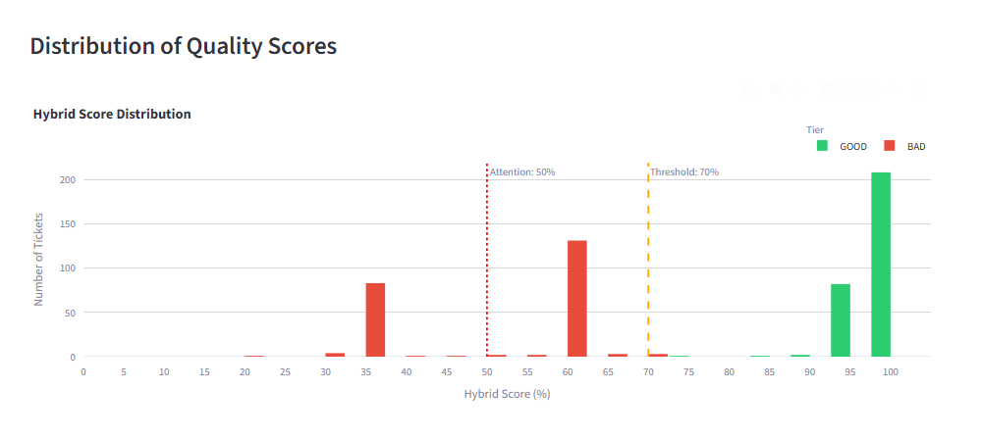
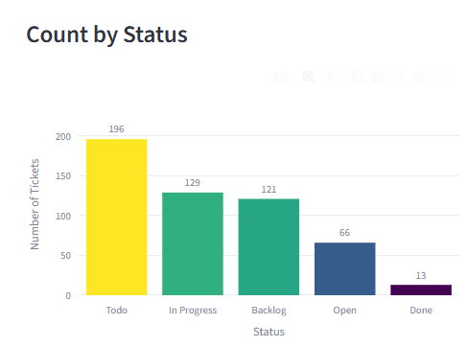
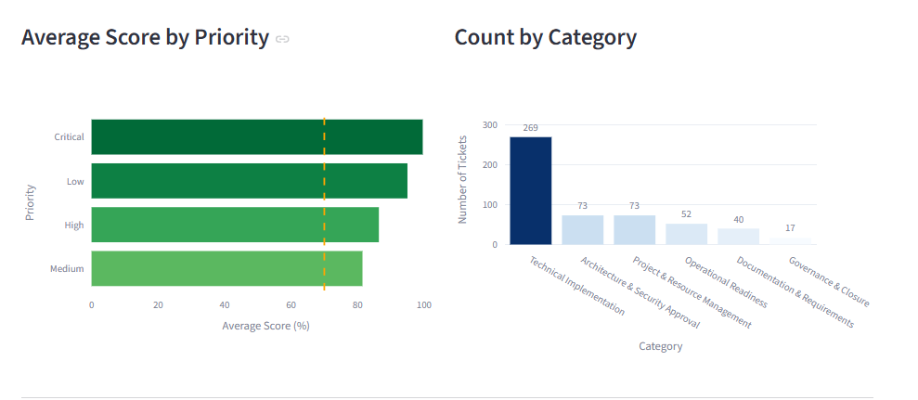
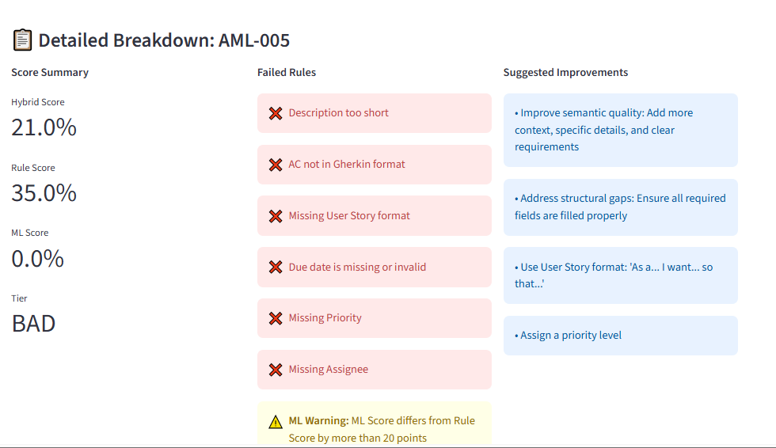
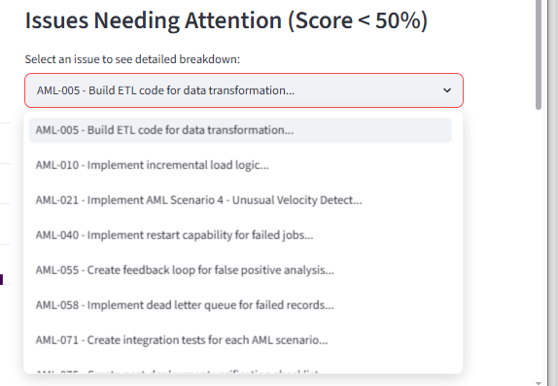
UI – Insights, Dashboard
Dashboard – Data insights

Slide 21
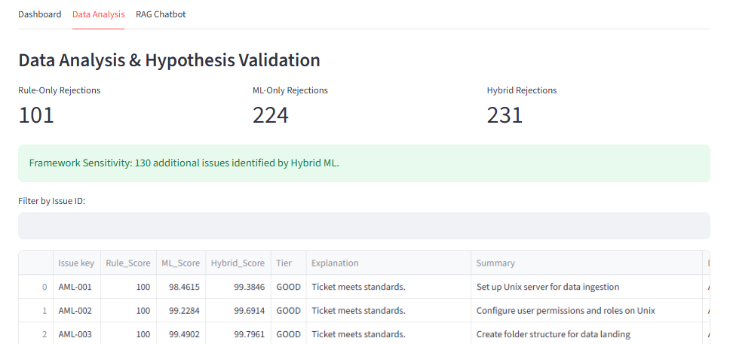
UI – Data analysis & Hypothesis validation
Dashboard – Data Analysis & Hypothesis Validation
Hypothesis Proven –
More than 50% additional issues are captured by ML Model as BAD ticket and requires review against hypothesis of 20% and above assumed at start.

Slide 22
Conversational Chatbot : Hybrid RAG Execution Pipeline
Purpose : Natural Language interface for Jira ticket analysis.
5-stage Hybrid RAG pipeline - Combining Deterministic Filtering, LLM Intent Parsing and vector search for tabular Jira data
If LLM unavailable
Direct Fast Path
• Regex intercepts Ticket IDs (e.g., AML-123)
• Bypasses LLM entirely
• Result: Sub-200ms in-memory Pandas lookup.
Local Llama3
Validates query
Extracts strict JSON: Intent (list, avg, count, etc.) & Filters (Priority, Status, Date).
Structured Filter
Pandas SQL-like filtering on DataFrame columns.
Crucial Safety Gate: If JSON returns empty Filters, pivot to generic help message
Semantic Vector Search
Hybrid Fallback
Cosine-similarity search against Summary + Description embeddings.
Structural Fallback (Resilience)
Activated if Ollama is offline or times out.
Hardcoded Regex + difflib fuzzy matcher (handles typos like crticl).
Handles basic queries: "average score", "list overdue", "count backlog".
If empty
Result

Slide 23
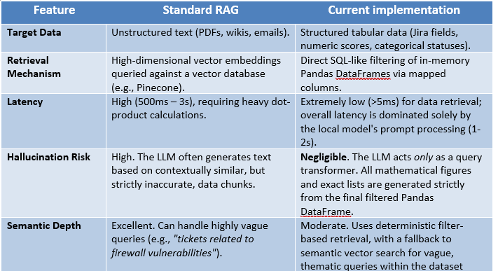
Chatbot : Core capability & Industry Comparison
Functional Capabilities & Benchmarking (Industry comparison)
Intent Classification & Complex Aggregations : The LLM engine is capable of classifying user queries into intents (list, count, avg, dist, or detail) and a set of applicable filters (priorities, statuses, score thresholds, and date constraints).
Generic Fuzzy Typo Correction Instead of hardcoding regular expressions for anticipated misspellings the module integrates Python’s difflib.get_close_matches(). This allows the structural parser to dynamically correct user typos in filter values

Slide 24
Demo

Slide 25
Conclusion
Key Findings:
Hybrid Approach Superiority: The hybrid model significantly outperforms pure rule-based, validating the core research hypothesis.
Complementary Detection: The rule engine catches structural issues (missing fields, format violations) that ML misses, while ML detects semantic hollowness (vague language, non-actionable content) that rules cannot identify.
Optimal Configuration: The 60% Rule / 40% ML weight configuration with a 70% threshold provides the best balance of accuracy (92.51%), precision (89.85%), and recall (93.9%).
Domain-Specific Effectiveness: The custom vague term library and rule configurations, developed specifically for the AML domain, contribute significantly to the system's effectiveness.
Summary
The developed Hybrid Scoring Framework successfully demonstrates that combining deterministic rule-based validation with probabilistic machine learning significantly enhances requirement quality assessment.
By automating the detection of semantically hollow requirements, teams can reduce the time spent in manual reviews and minimize sprint spillover.
Recommendation: Future iterations should focus on integrating this framework directly into the Jira webhook API to provide real-time, 'as-you-type' feedback to creators.

Slide 26
Questions and Suggestions

Slide 27
THANK YOU
KAMTHEKAR PRASANNA YESHWANTRAO
BITS ID: 2024DA04180

