Slide 1



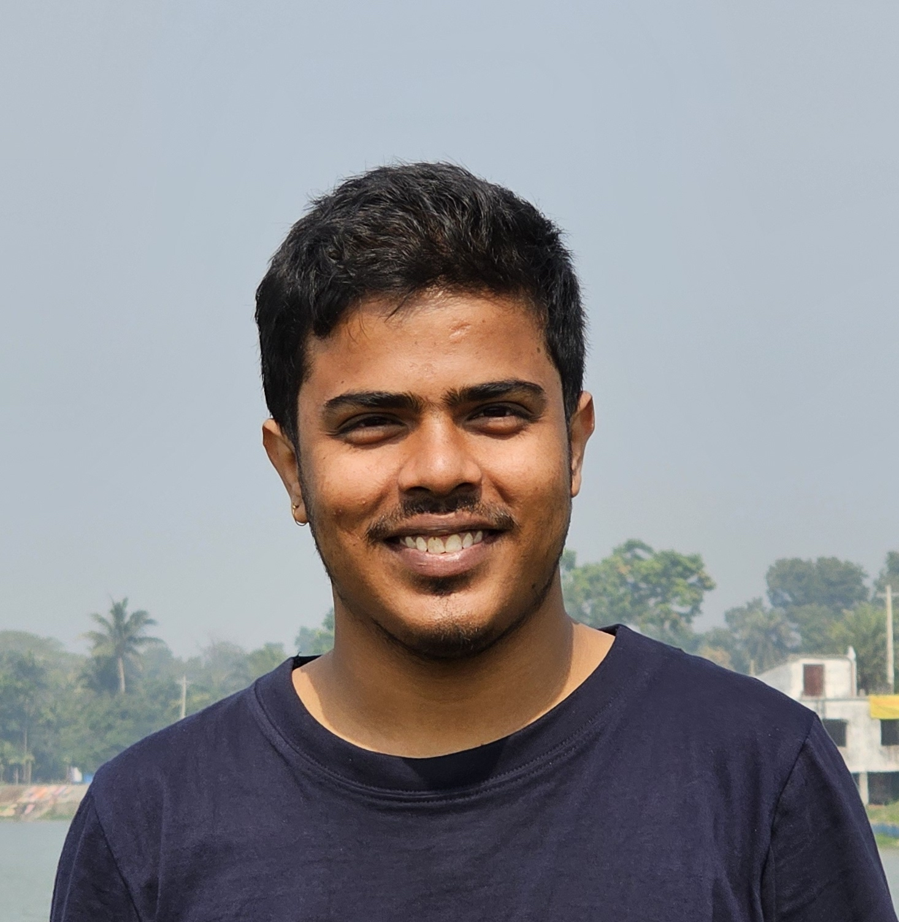




Biduyt Das
das1907118@stud.kuet.ac.bd 01637793410
Dr. M A Rashid Hall, KUET, Khulna-9203
Experience
Education
Assistant Editor I Nod Publishers
Khulna University of Engineering & Technology
4/2021 – 1/2023
2020 – 2025
Experienced in managing editorial processes and coordinating with authors, editors, and designers to ensure timely and high-quality book production
3.17 CGPA
Bachelor of Science in Computer Science and Engineering
Software Engineer (level 2) I REVsystem
Skills
1/2023 – 9/2024
Experienced in developing app including dbms, front End.
Programming
Expert in MERN, JAVA, Python, NodeJS, Swift
experienced working with Word, Excel, PowerPoint
Devolpment History
Multilingual
English, Hindi, and Spanish
Roles
Team manager, 1 year, KUET developers.
Web developer, 2 years, enosis.
General Secretary, 1 Year, CSE
Association, KUET

