Slide 1
Carbohydrates

Slide 2
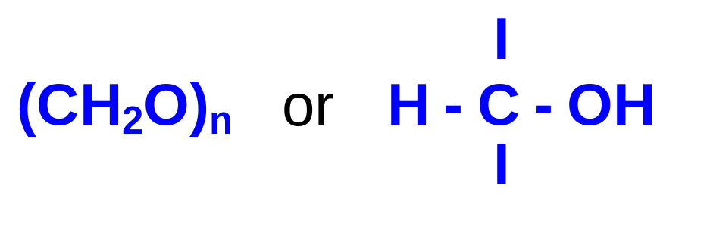
Carbohydrates (glycans) have the following basic composition:
Monosaccharides - simple sugars with multiple OH groups. Based on number of carbons (3, 4, 5, 6), a monosaccharide is a triose, tetrose, pentose or hexose.
Disaccharides - 2 monosaccharides covalently linked.
Oligosaccharides - a few monosaccharides covalently linked.
Polysaccharides - polymers consisting of chains of monosaccharide or disaccharide units.

Slide 3
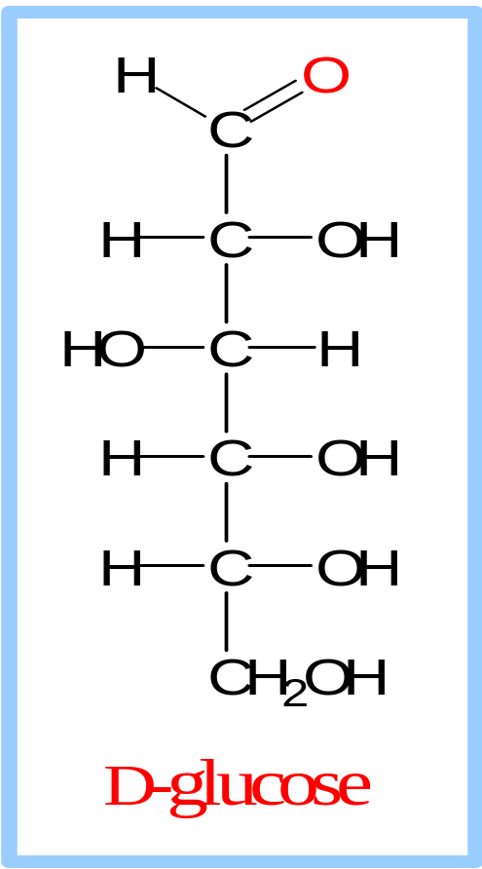
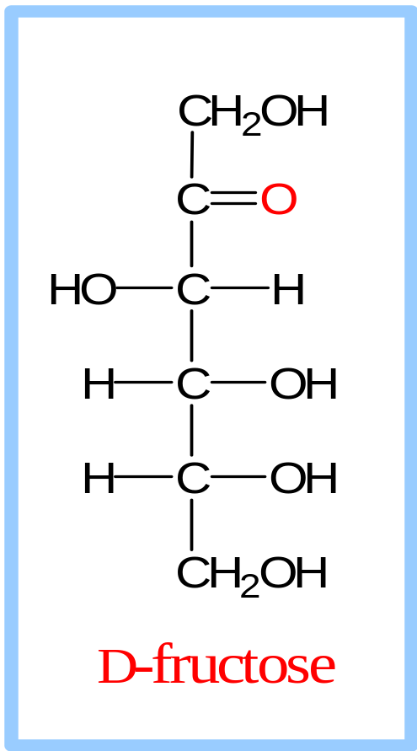
Monosaccharides
Aldoses (e.g., glucose) have an aldehyde group at one end.
Ketoses (e.g., fructose) have a keto group, usually at C2.

Slide 4
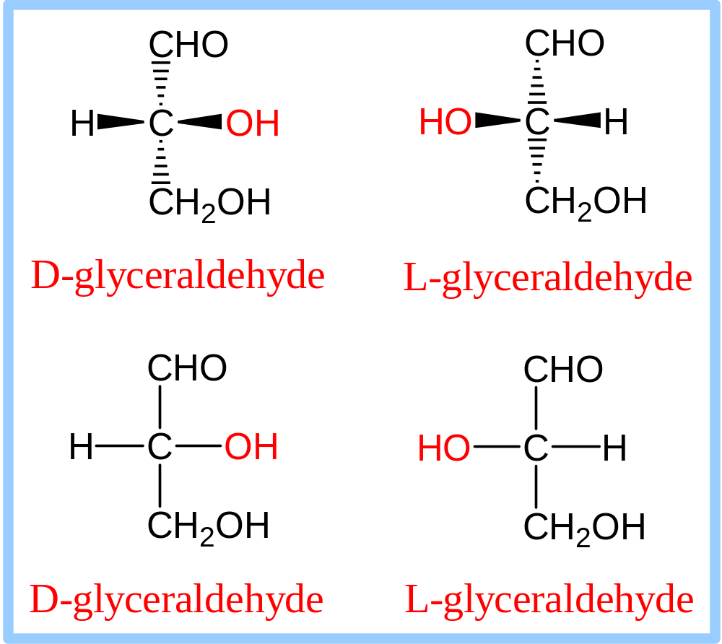
D vs L Designation
D & L designations are based on the configuration about the single asymmetric C in glyceraldehyde.
The lower representations are Fischer Projections.

Slide 5
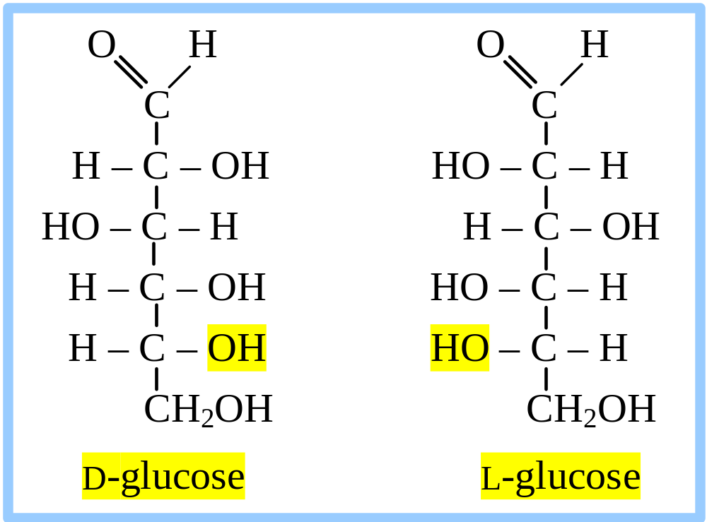
Sugar Nomenclature
For sugars with more than one chiral center, D or L refers to the asymmetric C farthest from the aldehyde or keto group.
Most naturally occurring sugars are D isomers.

Slide 6
D & L sugars are mirror
images of one another.
They have the same
name, e.g., D-glucose
& L-glucose.
Other stereoisomers
have unique names,
e.g., glucose, mannose,
galactose, etc.
The number of stereoisomers is 2^{n}, where n is the number of asymmetric centers.
The 6-C aldoses have 4 asymmetric centers. Thus there are 16 stereoisomers (8 D-sugars and 8 L-sugars).

Slide 7
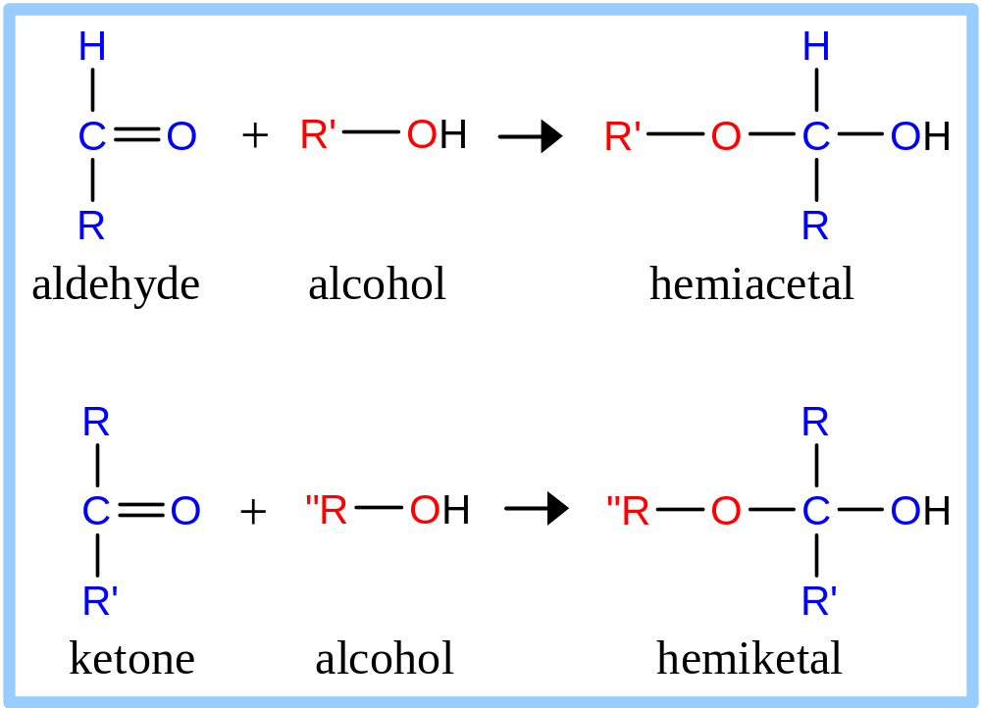
Hemiacetal & hemiketal formation
An aldehyde can react with an alcohol to form a hemiacetal.
A ketone can react with an alcohol to form a hemiketal.

Slide 8
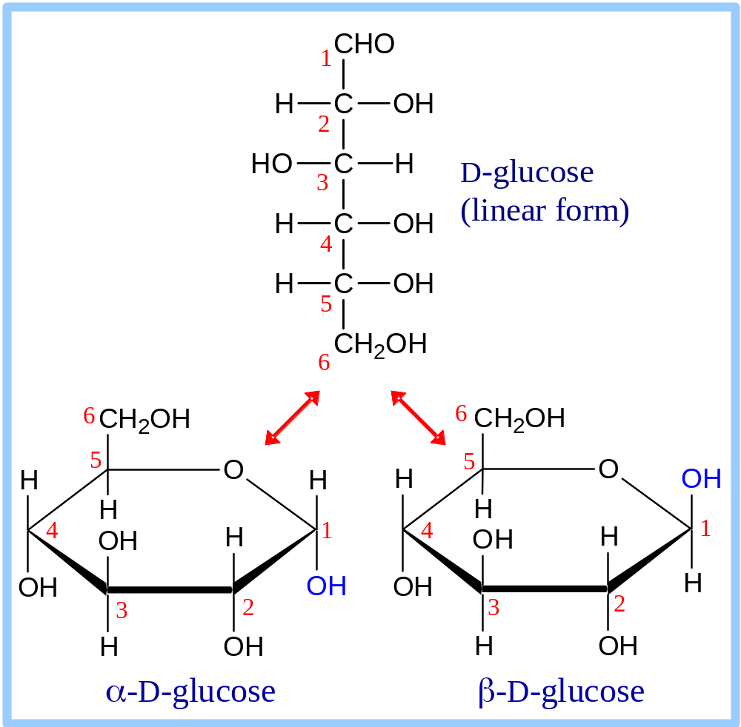
Pentoses and hexoses can cyclize as the ketone or aldehyde reacts with a distal OH.
Glucose forms an intra-molecular hemiacetal, as the C1 aldehyde & C5 OH react, to form a 6-member pyranose ring, named after pyran.
These representations of the cyclic sugars are called Haworth projections.

Slide 9
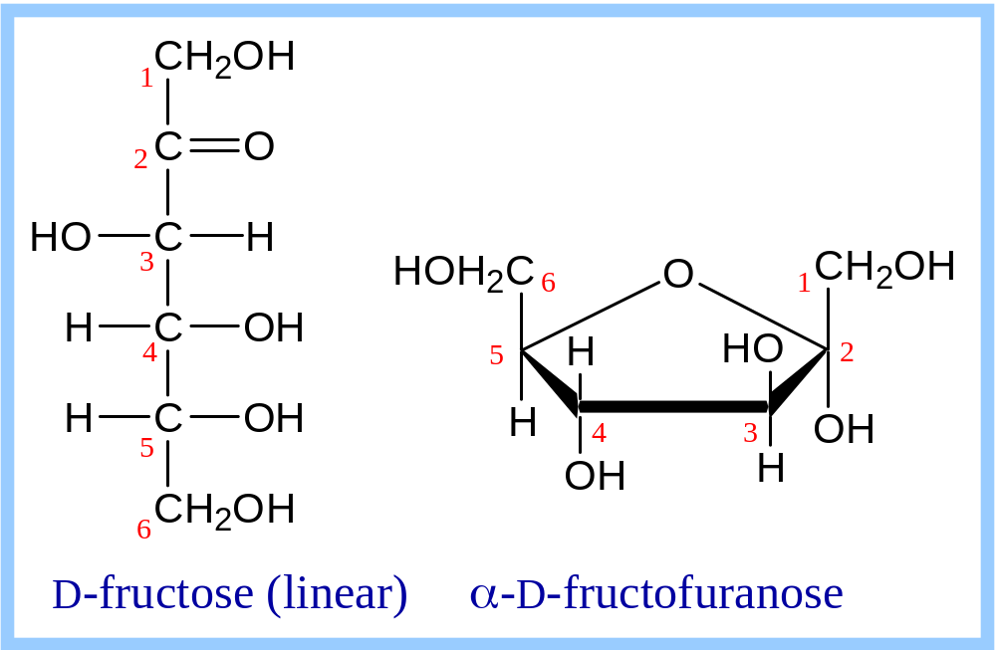
Fructose forms either
a 6-member pyranose ring, by reaction of the C2 keto group with the OH on C6, or
a 5-member furanose ring, by reaction of the C2 keto group with the OH on C5.

Slide 10
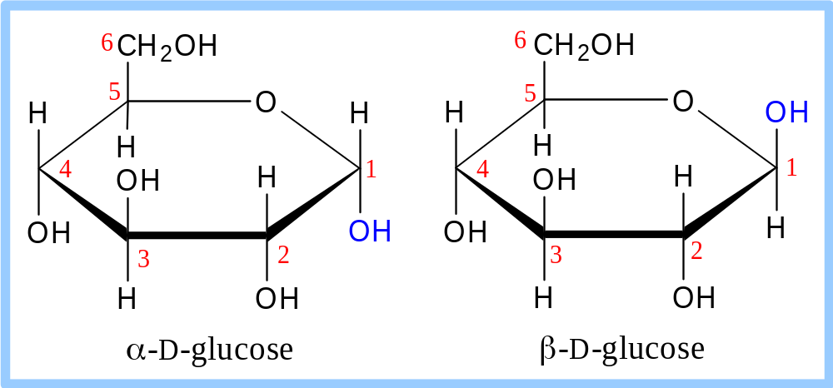
Cyclization of glucose produces a new asymmetric center at C1. The 2 stereoisomers are called anomers, α & β.
Haworth projections represent the cyclic sugars as having essentially planar rings, with the OH at the anomeric C1:
  α (OH below the ring)
  β (OH above the ring).

Slide 11
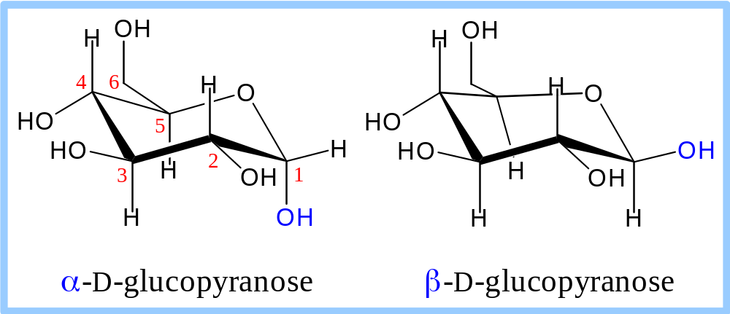
Because of the tetrahedral nature of carbon bonds, pyranose sugars actually assume a "chair" or "boat" configuration, depending on the sugar.
The representation above reflects the chair configuration of the glucopyranose ring more accurately than the Haworth projection.

Slide 12
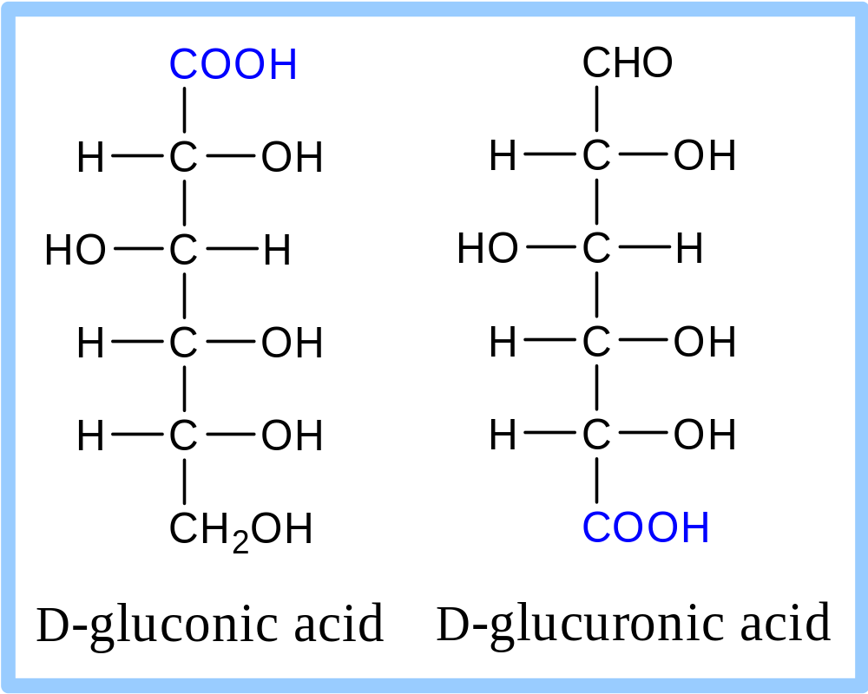
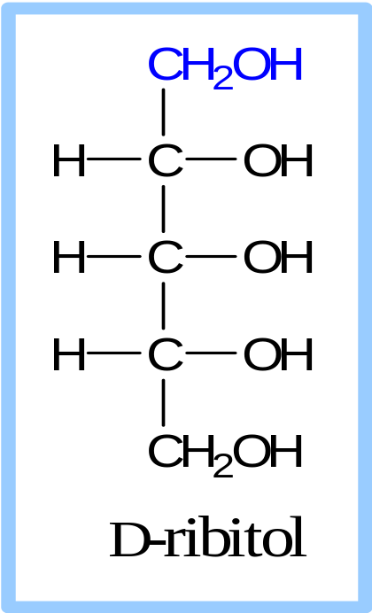
Sugar derivatives
sugar alcohol - lacks an aldehyde or ketone; e.g., ribitol.
sugar acid - the aldehyde at C1, or OH at C6, is oxidized to a carboxylic acid; e.g., gluconic acid, glucuronic acid.

Slide 13
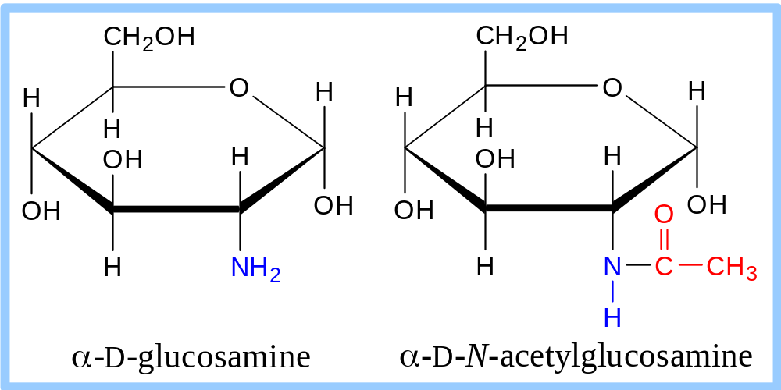
Sugar derivatives
amino sugar - an amino group substitutes for a hydroxyl. An example is glucosamine.
The amino group may be acetylated, as in N-acetylglucosamine.

Slide 14
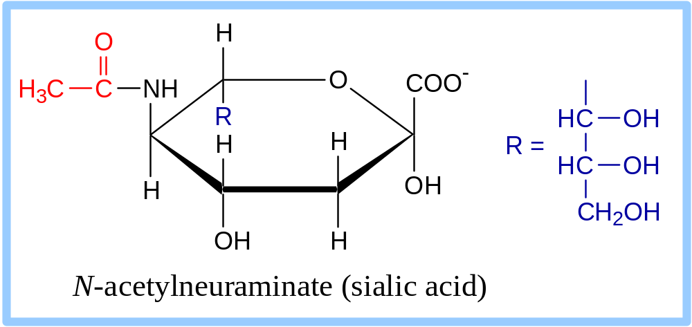
N-acetylneuraminate (N-acetylneuraminic acid, also called sialic acid) is often found as a terminal residue of oligosaccharide chains of glycoproteins.
Sialic acid imparts negative charge to glycoproteins, because its carboxyl group tends to dissociate a proton at physiological pH, as shown here.

Slide 15
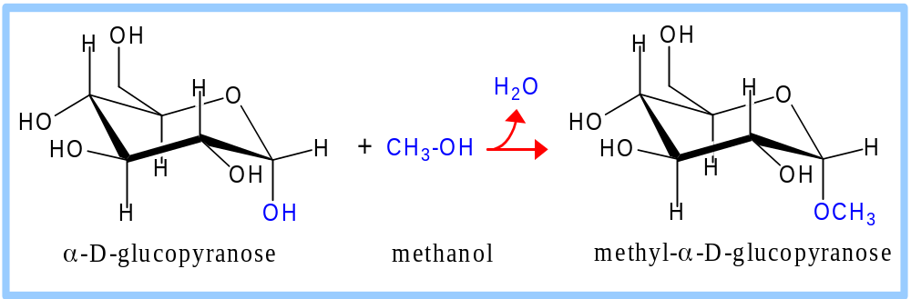
Glycosidic Bonds
The anomeric hydroxyl and a hydroxyl of another sugar or some other compound can join together, splitting out water to form a glycosidic bond:
R-OH + HO-R' → R-O-R' + H₂O
E.g., methanol reacts with the anomeric OH on glucose to form methyl glucoside (methyl-glucopyranose).

Slide 16
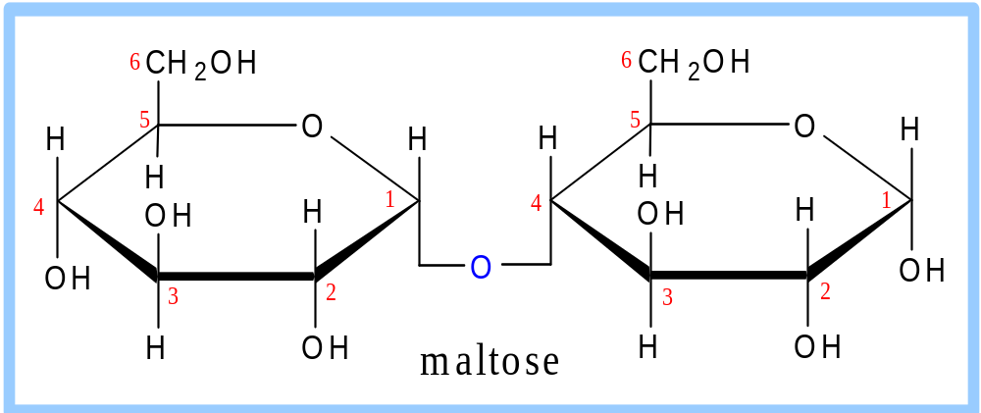
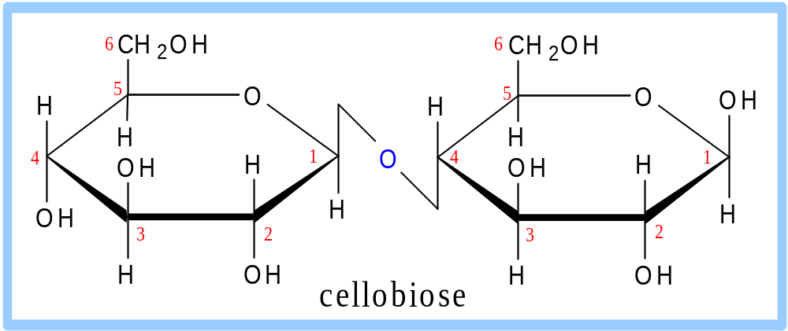
Disaccharides:
Maltose, a cleavage product of starch (e.g., amylose), is a disaccharide with an α(1→ 4) glycosidic link between C1 - C4 OH of 2 glucoses.
It is the α anomer (C1 O points down).
Cellobiose, a product of cellulose breakdown, is the otherwise equivalent β anomer (O on C1 points up).
The β(1→ 4) glycosidic linkage is represented as a zig-zag, but one glucose is actually flipped over relative to the other.

Slide 17
Other disaccharides include:
Sucrose, common table sugar, has a glycosidic bond linking the anomeric hydroxyls of glucose & fructose.
Because the configuration at the anomeric C of glucose is α (O points down from ring), the linkage is α(1→2).
The full name of sucrose is α-D-glucopyranosyl-(1→2)-β-D-fructopyranose.)
Lactose, milk sugar, is composed of galactose & glucose, with β(1→4) linkage from the anomeric OH of galactose. Its full name is β-D-galactopyranosyl-(1→ 4)-α-D-glucopyranose

Slide 18
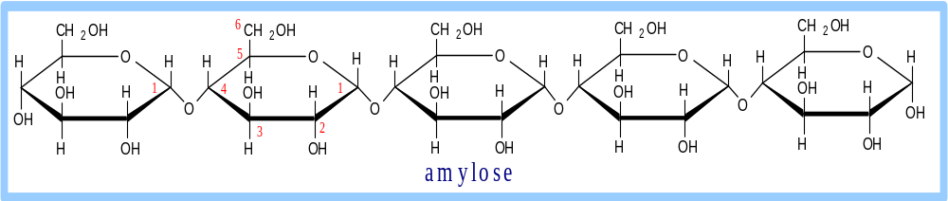
Polysaccharides:
Plants store glucose as amylose or amylopectin, glucose polymers collectively called starch.
Glucose storage in polymeric form minimizes osmotic effects.
Amylose is a glucose polymer with α(1→4) linkages.
The end of the polysaccharide with an anomeric C1 not involved in a glycosidic bond is called the reducing end.

Slide 19
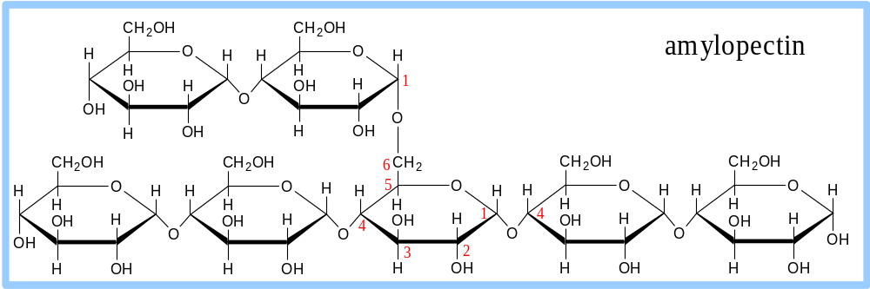
Amylopectin is a glucose polymer with mainly α(1→4) linkages, but it also has branches formed by α(1→6) linkages. Branches are generally longer than shown above.
The branches produce a compact structure & provide multiple chain ends at which enzymatic cleavage can occur.

Slide 20
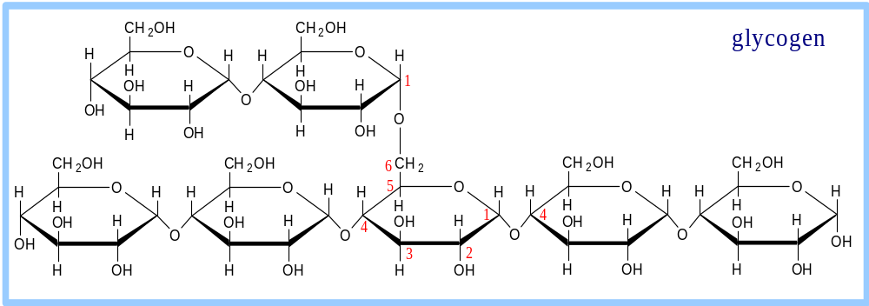
Glycogen, the glucose storage polymer in animals, is similar in structure to amylopectin.
But glycogen has more α(1→6) branches.
The highly branched structure permits rapid glucose release from glycogen stores, e.g., in muscle during exercise.
The ability to rapidly mobilize glucose is more essential to animals than to plants.

Slide 21
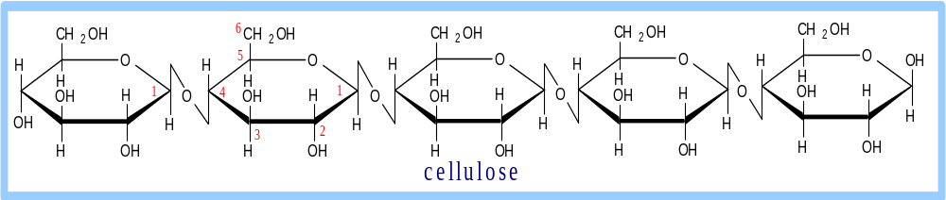
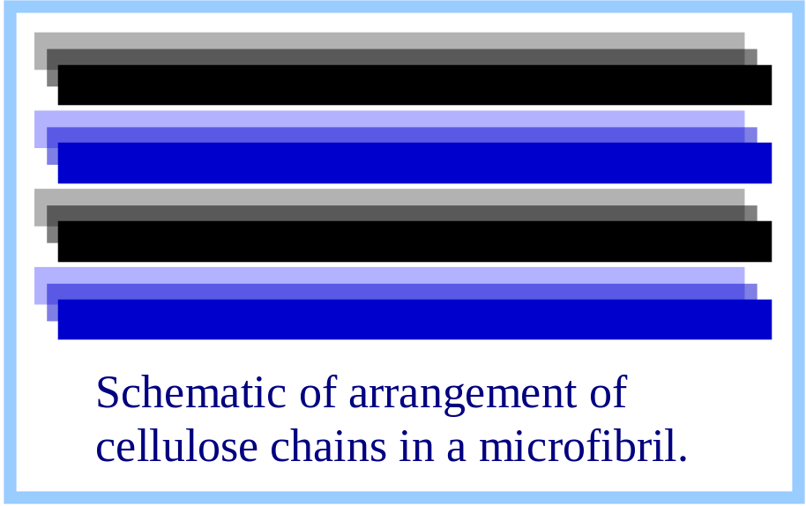
Cellulose, a major constituent of plant cell walls, consists of long linear chains of glucose with β(1→4) linkages.
Every other glucose is flipped over, due to β linkages.
This promotes intra-chain and inter-chain H-bonds and
van der Waals interactions, that cause cellulose chains to be straight & rigid, and pack with a crystalline arrangement in thick bundles - microfibrils.
See: Botany online website; website at Georgia Tech.

Slide 22
Multisubunit Cellulose Synthase complexes in the plasma membrane spin out from the cell surface microfibrils consisting of 36 parallel, interacting cellulose chains.
These microfibrils are very strong.
The role of cellulose is to impart strength and rigidity to plant cell walls, which can withstand high hydrostatic pressure gradients. Osmotic swelling is prevented.
Explore and compare structures of amylose & cellulose using Chime.

Slide 23
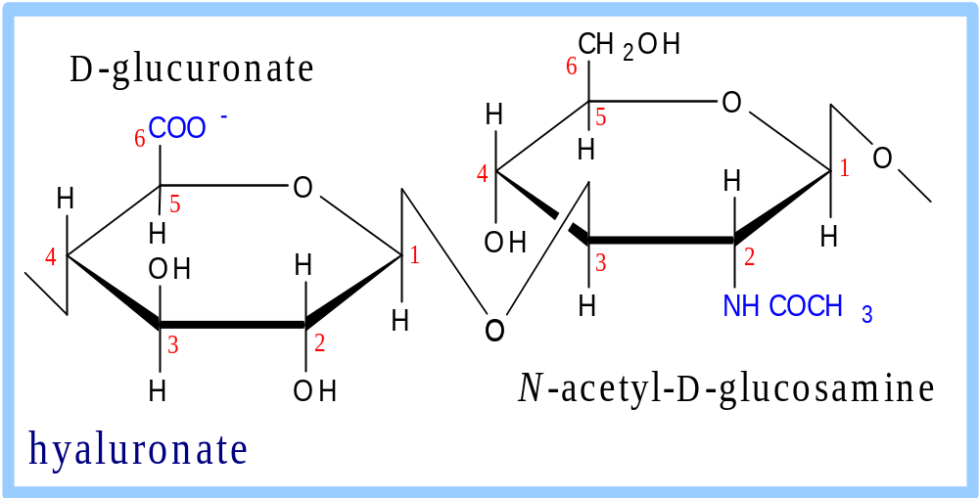
Glycosaminoglycans (mucopolysaccharides) are linear polymers of repeating disaccharides.
The constituent monosaccharides tend to be modified, with acidic groups, amino groups, sulfated hydroxyl and amino groups, etc.
Glycosaminoglycans tend to be negatively charged, because of the prevalence of acidic groups.

Slide 24
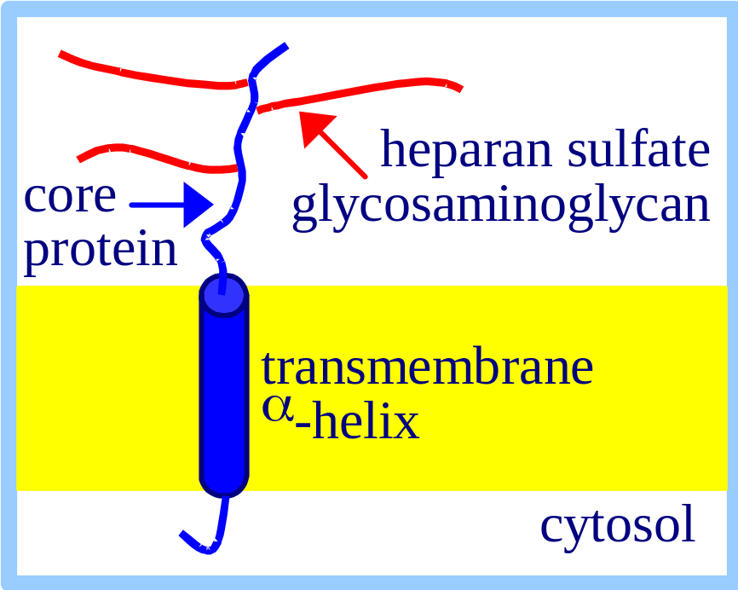
Proteoglycans are glycosaminoglycans that are covalently linked to serine residues of specific core proteins.
The glycosaminoglycan chain is synthesized by sequential addition of sugar residues to the core protein.

Slide 25
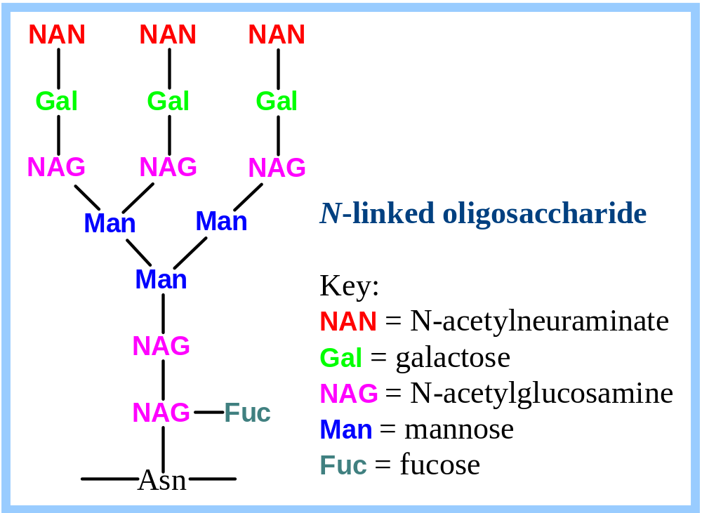
Additional monosaccharides are added, and the N-linked oligosaccharide chain is modified by removal and addition of residues, to yield a characteristic branched structure.

Slide 26
Lectins are glycoproteins that recognize and bind to specific oligosaccharides.
Concanavalin A & wheat germ agglutinin are plant lectins that have been useful research tools.
The C-type lectin-like domain is a Ca⁺⁺-binding carbohydrate recognition domain in many animal lectins.
Recognition/binding of CHO moieties of glycoproteins, glycolipids & proteoglycans by animal lectins is a factor in:
  cell-cell recognition
  adhesion of cells to the extracellular matrix
  interaction of cells with chemokines and growth factors
  recognition of disease-causing microorganisms
  initiation and control of inflammation.

Slide 27
Examples of animal lectins:
Mannan-binding lectin (MBL) is a glycoprotein found in blood plasma.
It binds cell surface carbohydrates of disease-causing microorganisms & promotes phagocytosis of these organisms as part of the immune response.

Slide 28
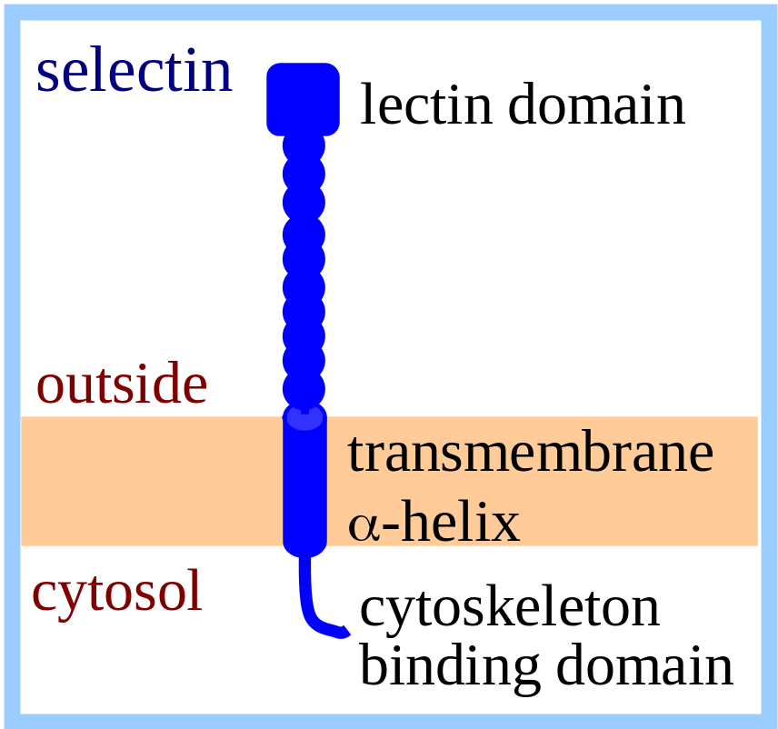
Selectins are integral proteins of mammalian cell plasma membranes with roles in cell-cell recognition & binding.
The C-type lectin-like domain is at the end of a multi-domain extracellular segment extending out from the cell surface.
A cleavage site just outside the transmembrane α-helix provides a mechanism for regulated release of some lectins from the cell surface.
A cytosolic domain participates in regulated interaction with the actin cytoskeleton.

