Slide 1
HSRW DATATHON 2026, KLEVE
From messy factory data
to actionable insight
24 hours, 20 raw files and real production data from BBMED, a cosmetics manufacturer. What we found, and what we would tell the plant.
Pablo De Villota and Ahmed Azzeh

Slide 2
THE CHALLENGE
One plant, three systems that don't agree
5
20
43,848
24 h
packaging lines: 2 bottle, 3 tube
raw files from MES, ERP, Excel and energy meters
stoppage records, codes half-documented
from data release to jury presentation
The brief: understand performance, stoppages, staffing and energy on the lines, and fix how the data is collected. Every team got the same data. Saying this can't be answered yet was allowed, if we explained why.
HSRW Datathon 2026 | BBMED Production Data Challenge | Pablo De Villota and Ahmed Azzeh
02 / 13

Slide 3
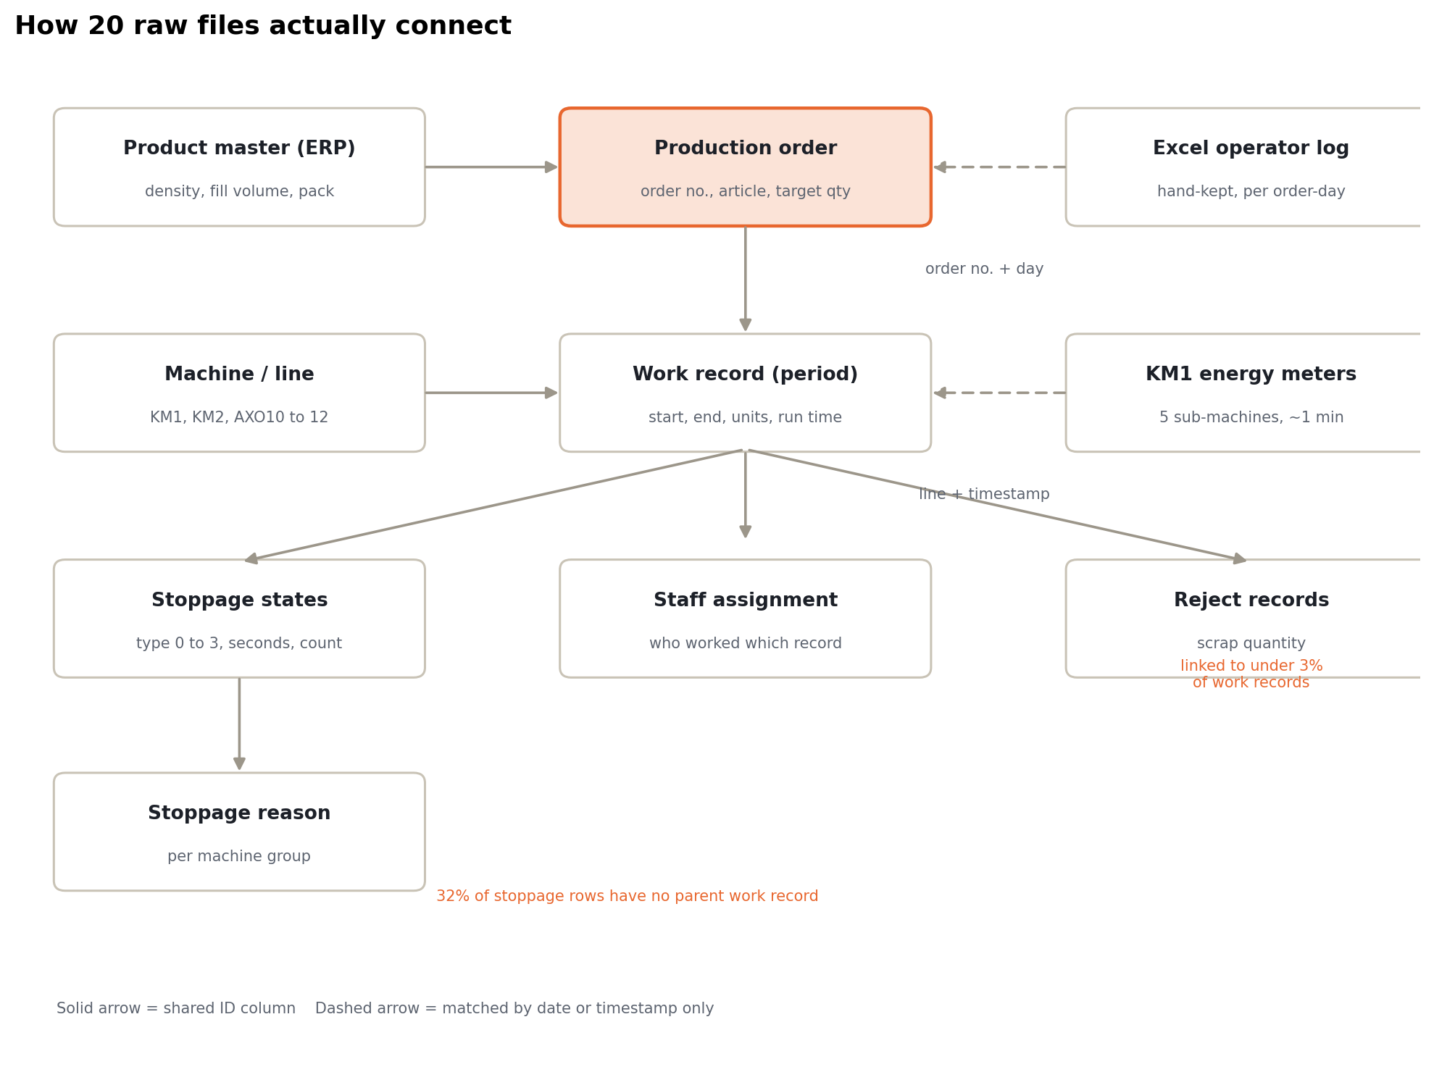
THE DATA MODEL
How 20 raw files actually connect
HSRW Datathon 2026 | BBMED Production Data Challenge | Pablo De Villota and Ahmed Azzeh
03 / 13

Slide 4
STEP ONE
Before any chart: map how the tables connect
Joined by shared IDs
Joined by time or date only
Gaps we documented
Production order to work records (one per continuous run)
Work records to stoppages, staff, rejects
Article no. to ERP product master (density, volume)
Excel operator log: order no. plus calendar day
KM1 energy meters: line plus timestamp
No shared ID, so every match is a deliberate rule
32% of stoppage rows have no parent record
Scrap data on under 3% of work records
20 orders with stale target rates
HSRW Datathon 2026 | BBMED Production Data Challenge | Pablo De Villota and Ahmed Azzeh
04 / 13

Slide 5
FINDING 1, OEE
The machines are fast. They just don't run enough.
43.5%
Performance, speed while running
95%
Availability, share of time running
46%
fleet OEE (availability times performance) across 889 clean orders
Every line hits 90 to 97% of target speed. The loss is time stopped, not slow running.
HSRW Datathon 2026 | BBMED Production Data Challenge | Pablo De Villota and Ahmed Azzeh
05 / 13

Slide 6
FINDING 1, BY LINE
Uptime decides the ranking, not speed
KM1
89.7%
OEE 49.9%
55.2%
KM2
94.1%
OEE 44.1%
46.8%
AXO12
95.7%
OEE 39.4%
40.6%
AXO11
96.1%
OEE 38.8%
39.7%
AXO10
96.8%
OEE 38.1%
38.7%
Performance
Availability
HSRW Datathon 2026 | BBMED Production Data Challenge | Pablo De Villota and Ahmed Azzeh
06 / 13

Slide 7
FINDING 2, ORDER SIZE
Bigger orders run better, purely through uptime
+17.6 pp
51.1%
44.7%
OEE gap between the smallest and largest quarter of orders. Speed is flat; fixed setup and cleaning time gets spread over more units.
40.1%
33.5%
Lever: batch small repeat orders.
Smallest 25%
Small-mid
Mid-large
Largest 25%
HSRW Datathon 2026 | BBMED Production Data Challenge | Pablo De Villota and Ahmed Azzeh
07 / 13

Slide 8
FINDING 3, DOWNTIME
Lines stop for changeovers, not breakdowns
AXO12
82%
18%
AXO11
78%
22%
AXO10
77%
23%
KM2
57%
43%
KM1
41%
59%
Organisational: changeover, cleaning, breaks
Technical: faults, maintenance
Setup and cleaning is the top stoppage reason on every line. KM1 is the exception, where labeller and carton-folder faults lead.
HSRW Datathon 2026 | BBMED Production Data Challenge | Pablo De Villota and Ahmed Azzeh
08 / 13

Slide 9
FINDING 4, DATA TRUST
Can the plant trust its own records? Mostly.
0.65%
9 orders drag the mean up to 30%
MES shows up to 55x the Excel quantity. Looks like record splitting, not a broken system.
median quantity gap between MES and the hand-kept Excel log. 90% of 263 shared orders agree within +/-10%.
Excel starts about 5 minutes earlier
Operators write the shift start; MES logs the first booked minute.
MES keeps the clock running overnight
Durations run to 06:00 next day, inflating time and deflating rates.
HSRW Datathon 2026 | BBMED Production Data Challenge | Pablo De Villota and Ahmed Azzeh
09 / 13

Slide 10
FINDING 5, ENERGY ON KM1
Two sub-machines draw 61% of the line's power
Capper
1.11 kW
ONE ORDER, TRACED END TO END
Carton folder
0.86 kW
2.8 kWh
Filler
0.74 kW
Bottle feeder
0.37 kW
per 1,000 bottles, order 702026, 9,112 units
About a third of it was drawn while the line was stopped. Power barely moves (+/-5%) whether bottles flow or not.
Labeller
0.12 kW
5 meters, about 1 reading per minute, about 3.2 kW combined
HSRW Datathon 2026 | BBMED Production Data Challenge | Pablo De Villota and Ahmed Azzeh
10 / 13

Slide 11
FOLLOW-UP
The "broken" stoppage table, decoded
On the day, undefined codes and 18-day stoppages made the table look unusable. Tested record by record afterwards, it is a clean state-time ledger:
TYPE 3
TYPE 1
TYPE 0
TYPE 2
Producing
Classified stops
Micro-stops
Idle before start
Equals production time on 6,023 of 6,023 records
One row per reason code, per machine group
Short stops never given a reason
Matches the gap since the last run (r = 0.92)
HSRW Datathon 2026 | BBMED Production Data Challenge | Pablo De Villota and Ahmed Azzeh
11 / 13

Slide 12
RECOMMENDATIONS
What we would tell the plant
Batch small orders
Changeover study on the tube lines
The cheapest lever: +16 pp availability between smallest and largest orders.
77 to 82% of AXO downtime is organisational: setup, cleaning, staging.
KM1: standby and targeted maintenance
Fix the data at the source
Idle standby for capper and folder; focus on labeller and folder faults.
Order no. on every table, continuous energy logging, validation rules.
HSRW Datathon 2026 | BBMED Production Data Challenge | Pablo De Villota and Ahmed Azzeh
12 / 13

Slide 13
TAKEAWAYS
01
Map the data before you measure it.
02
Medians before means on operational data.
03
"The data is broken" is a hypothesis, not a conclusion.
Pablo De Villota and Ahmed Azzeh
Full case study and repo linked on LinkedIn
HSRW Datathon 2026, Kleve. Data provided by BBMED

