Slide 1
Free energy computation

Slide 2
Free Energy Calculation
The Free energy is often considered to be the most important
thermodynamic quantity. From the knowledge of Free energy various
thermodynamic quantities can be calculated. They also tells us
The relative stability of various phases. To be specific: if a system is in
contact with with a heat bath, such that temperature T, volume V,
number of particles N are fixed, then the Helmholtz free energy
F=E-TS is at minimum in equilibrium. Similarly for a system of N
particles at constant pressure P and temperature T, the Gibb’s free
energy G=F+PV is at a minimum. So if we want to study the relative
stabilty of two phases, we should simply compare either Helmholtz
or Gibb’s free energy of these two phases. But we can not calculate
The free energy directly in simulation.

Slide 3
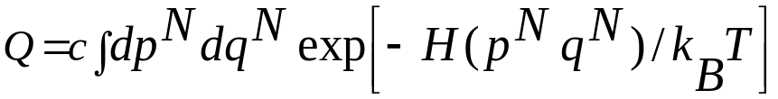
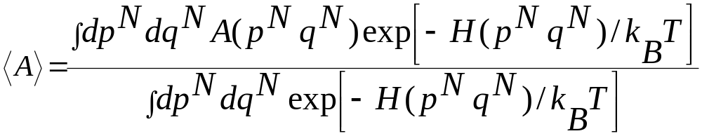
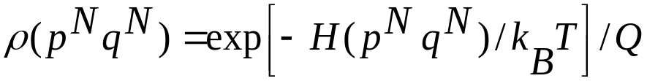

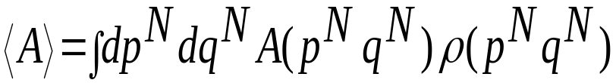
The classical expression for the partition function is given by
In general it is not possible to compute the above integral either through
MC or MD. The ensemble average of any quantity A is given by
This is the ratio of two integrals and Monte Carlo methods can be used
to efficiently compute the ratio.
This the probability of the state with energy

Slide 4
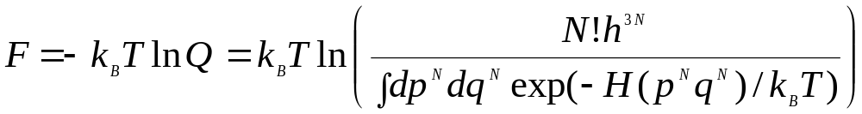
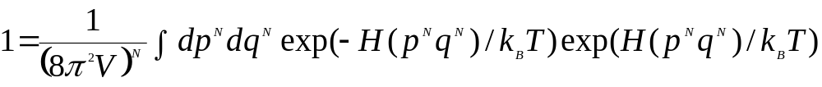
In terms of the probability density we can write the free energy also
Use the following identity
To get
The configuration with high energy make a significant contribution
To the intgral (to free energy) due to exponential term. A MC or MD
preferentially samples lower-energy regions of phase space. An
Ergodic trajectory would of course visit all the phase space, but in
Practice will never be adequately sampled by real simulation. So
Computed free energy will be poorly converged and inaccurate

Slide 5
Free Energy Calculation from Molecular Simulations
Perturbation Method (Thermodynamic integration, Umbrella Sampling)
  Applicable to most problems
  Require long simulations to maintain “reversibility”
Test Particle Method (insertion or deletion)
  Good for low density systems
Nonequilibrium Method (Jarzinski’s equality)
  Obtaining differential equilibrium properties from irreversible processes
  Require multiple samplings to ensure good statistics
Normal model Method
  Good for gas and solids
  Fast
  Not applicable for liquids
Reference: Frenkel, D.; Smit, B. Understanding Molecular Simulation from Algorithms to Applications. Academic press: Ed., New York, 2002.
McQuarrie, A. A. Statistical Mechanics. Harper & Row: Ed., New York, 1976.
Jarzynski, C. Nonequilibrium Equality for Free Energy Differences. Phys. Rev. Lett. 1997, 78, 2690.

Slide 6

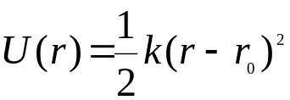
Umbrella sampling (Torrie and Valleau 1977)
Umbrella sampling attempts to overcome the sampling problem by
modifying the potential function so that the unfavorable states are
sampled sufficiently. The modification of the potential can be written
as a perturbation and is given by
U(r^{N}) is the Umbrella potential and could be a function of some order
parameter or reaction coordinate
Quite often it is taken to be Quadratic form
For configuration that are far from the equilibrium state r0 the Umbrella
Potential will be large and so a simulation using the modified potential
Will be biased along some relevant reaction coordinate away

Slide 7
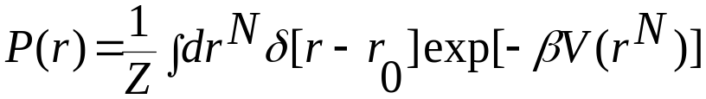
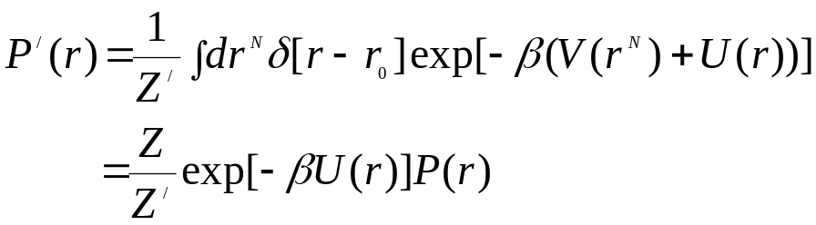
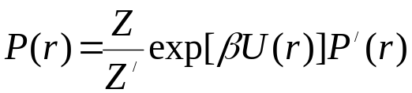

The probability distribution is given by
The probability distribution in the presence of Umbrella
potential is given by
Thus the original distribution function P(r) can be obtained
(to within a multiplicative constant)
The Helmholtz free energy

Slide 8
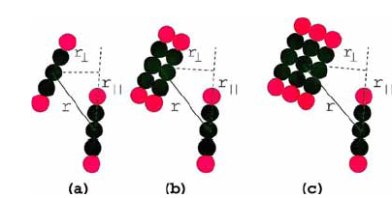
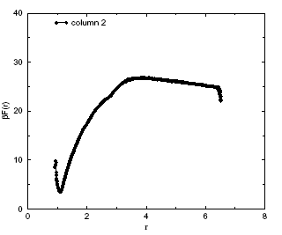
Calculating potential of mean force of two chromonic liquid crystal
in water

Slide 9
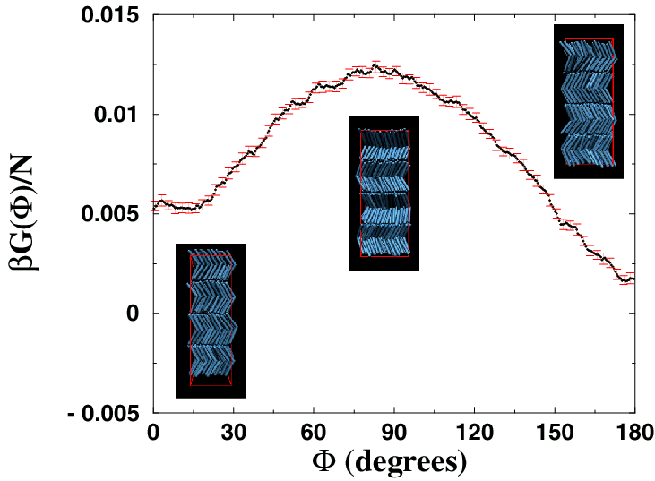
Nature of the SmAP phase
Free energy calculation using umbrella sampling
Ψ = 120º at P* = 7.5 (middle of the SmAP phase)
Entropic effects stabilize the antipolar SmAP phase

Slide 10

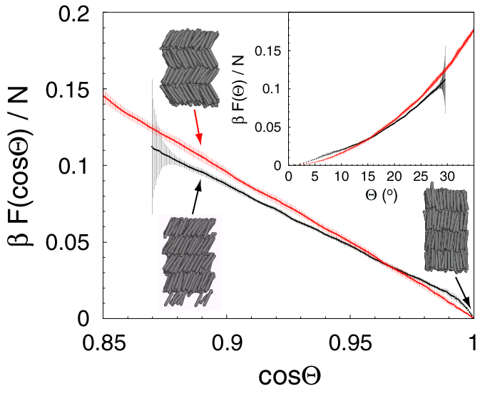


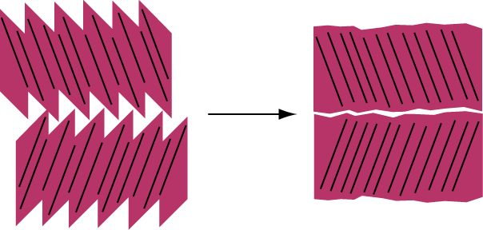
Sawtooth Model
high entropy
low entropy

Slide 11
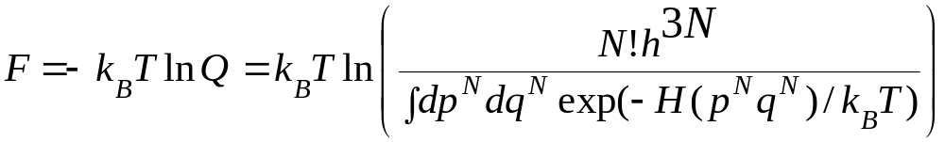
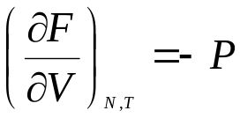
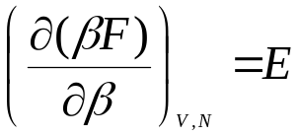
Thermodynamic integration
Q(N,V,T) is not of the form of canonical average over the phase
space and so F can not be measured directly in a simulation.
In experiment also we determine various derivative of free energy
like
So in simulation we can compute P and E and the Free energy can be computed by integration of the equation provided we have a reversible path in the V-T plane that links the state under consideration to a state of known free energy.
Problem: There are only few thermodynamic states for which the
free energy of a given materials is known

Slide 12

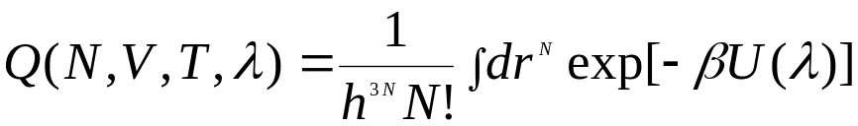
In general the Potential energy U depends on the coupling parameter
λ: λ=0 correspond to the Reference state I and λ=1 corresponds to
the state of interest II
The partition function for a system with a potential energy function that corresponds to a value of λ between 0 and 1 is

Slide 13
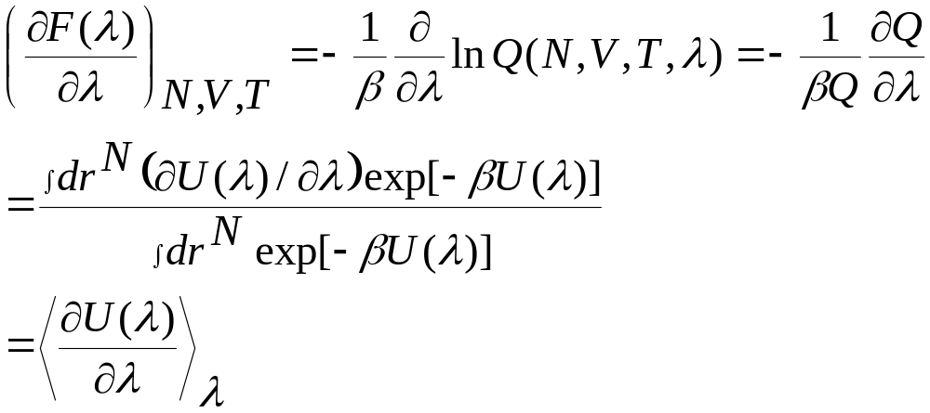
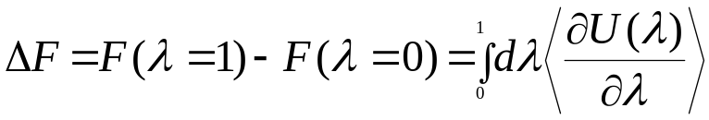
The derivative of Helmholtz free energy F(λ) wrt λ can be written as an ensemble average
Free energy difference between states II and I can be written as
Free energy difference is expressed in terms of an ensemble average:
and that can be computed directly in simulation.

Slide 14


Jarzynski inequality
Jarzynski, Non-equlibrium Eqality for Free energy differences, PRL, 78, 2690 (1997)
It relates the total work W done on the system to the equilibrium free energy difference ΔF between states A and B
The result is independent of the path from A to B and the rate at which the parameters are changed along the path. Like the rate of forcing for the forcing experiment.
We can extract equilibrium information ΔF from the ensemble of nonequilibrium measurement.

Slide 15
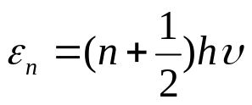
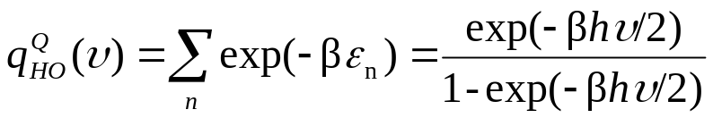
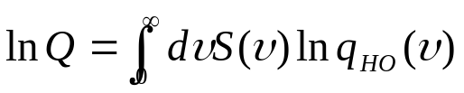
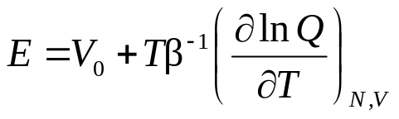
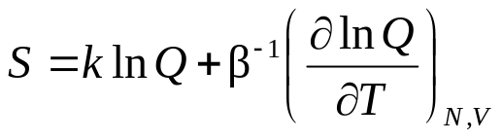
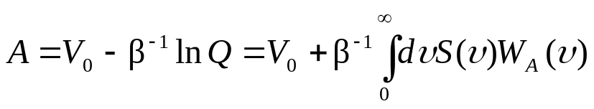
From Normal Modes to Free Energy (courtesy Shiang-Tai Lin)
Total number of normal modes = 3N, N=number of particles
  For an isolated molecule with N atoms
  3 translation, 3 rotation (or 2 for linear molecules, 0 for monoatomic molecules), 3N -6 vibration
  For a crystal with N particles
  3 translation (acoustic modes), 3N-3 vibrational modes
Each vibrational mode can be treated as a harmonic oscillator
The partition function is the sum of contributions from HOs
All the thermodynamic properties are defined

Slide 16
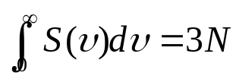
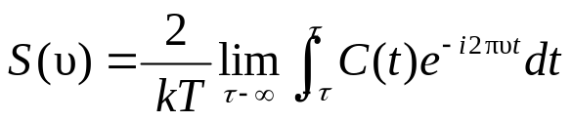

Determine Normal Modes from Molecular Simulations
The density of states S(υ)
  S(υ)dυ number of modes between υ and υ+dυ
Determination of S(υ)
  The eigenvalues of the Hessian matrix (vibrational analysis, phonon spectrum )
  Covariance matrix of atomic position fluctuations
  Fourier transform of velocity autocorrelation function

Slide 17
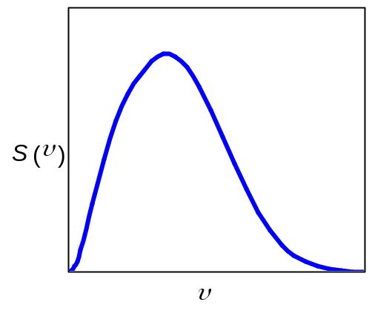
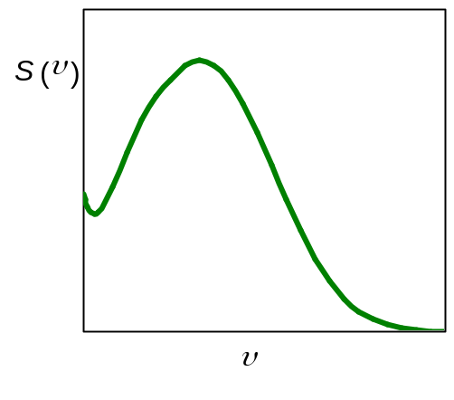
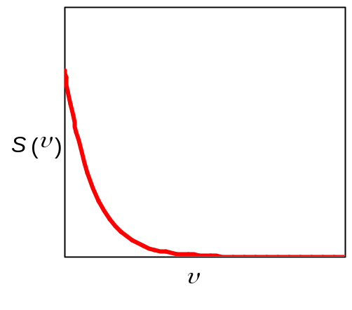
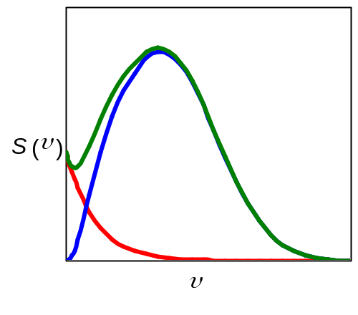
The Density of States Distribution S(υ)
Solid
Liquid
Gas
Debey crystal
S(v) ~υ²
exponential
decay
Singularity at zero frequency
Strong anharmonicity at low frequency regime
The 2PT idea: Liquid ≡ Solid+Gas
Decompose liquid S(v) to a gas and a solid contribution
S(0) attributed to gas phase diffusion
Gas component contains anharmonic effects
Solid component contains quantum effects
Two-Phase Thermodynamics Model (2PT)
solid-like
gas-like

Slide 18

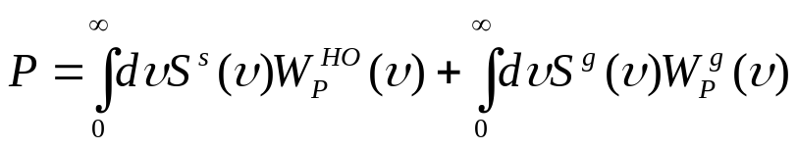
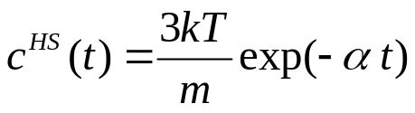

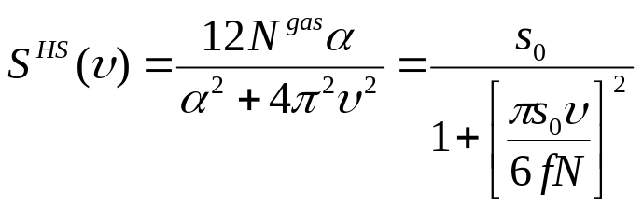
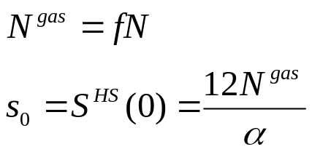
The 2PT Method
The basic idea
  The DoS
  Thermodynamic properties
The gas component
  VAC for hard sphere gas
  DoS for hard sphere gas
  Two unknowns (α and N^{gas}) or (s_{o} and f)
Lin, S. T.; Blanco, M.; Goddard, W. A. The Two-Phase Model for Calculating Thermodynamic Properties of Liquids from Molecular Dynamics: Validation for the Phase Diagram of Lennard-Jones Fluids. J. Chem. Phys. 2003, 119, 11792.
Gas
S₀
f

Slide 19

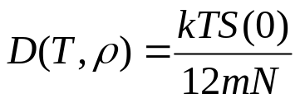
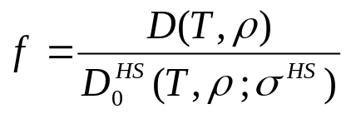
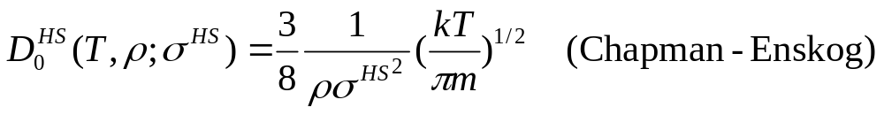
Determining s_{o} and f from MD Simulation
s_{o} (DoS of the gas component at υ=0)
  completely remove S(0) of the fluid
f (gas component fraction)
  T→∞ or ρ→0 : f→1 (all gas)
  ρ→∞ : f→0 (all solid)
  one unknown σ^{HS}

Slide 20
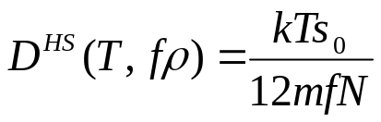
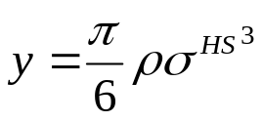
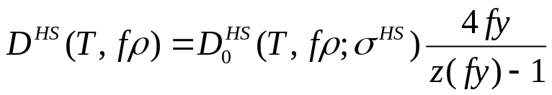
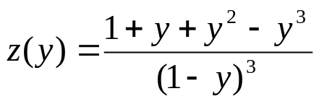
Determining σ^{HS}
σ^{HS} (hard sphere radius for describing the gas molecules)
  gas component diffusivity should agree with statistical mechanical predictions at the same T and ρ
  gas component diffusivity from MD simulation
  HS diffusivity from the Enskog theory

Slide 21
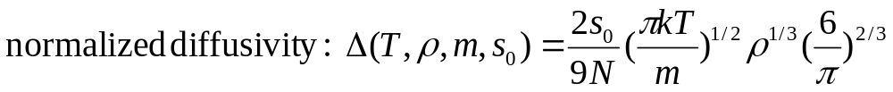
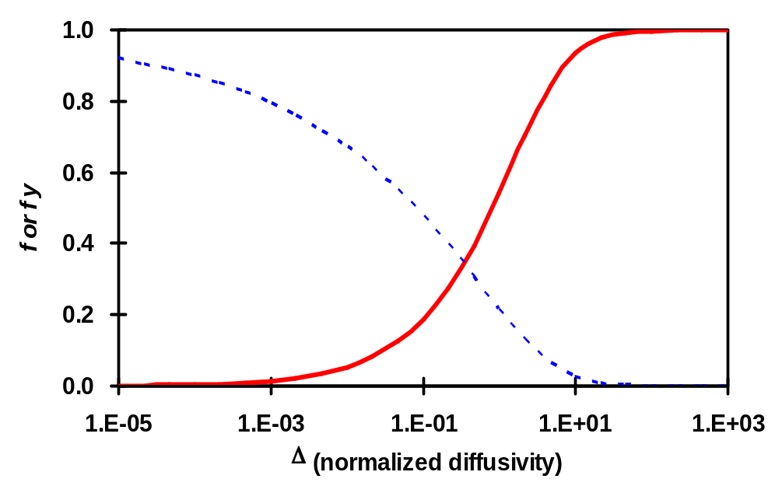
At Last…
A universal equation for f
Graphical representation
f
fy

Slide 22
Comparison of the 1PT and 2PT methods
Run a MD simulation
(trajectory information saved)
Calculate VAC
Apply HO approximation
To S(υ)
1PT thermodynamic predictions
Calculate DoS (FFT of VAC)
Calculate S(0) and Δ
Solve for f
Apply HO statistics
To S^{solid}(υ)
Apply HS statistics to S^{gas}(υ)
2PT thermodynamic predictions
Determine S^{gas}(υ), S^{solid}(υ)

Slide 23
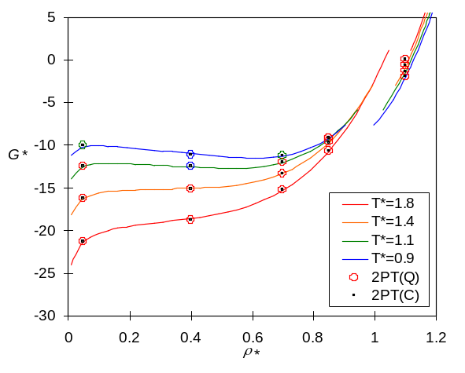
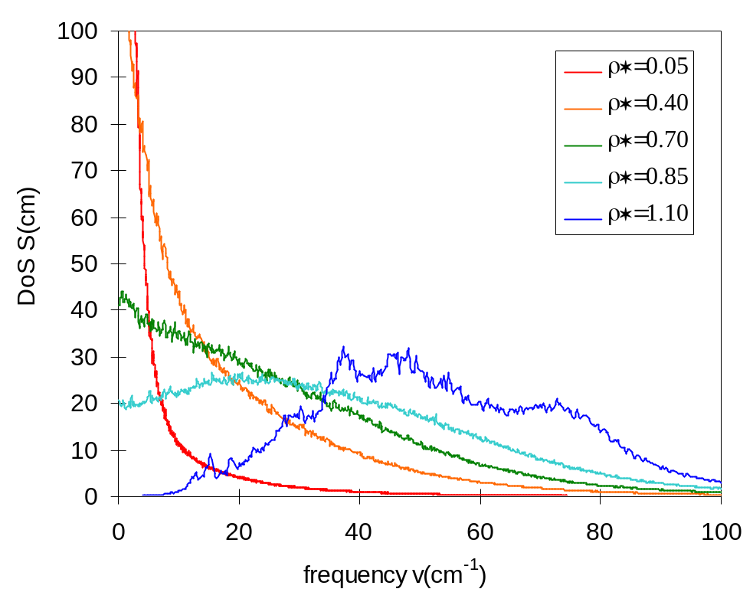
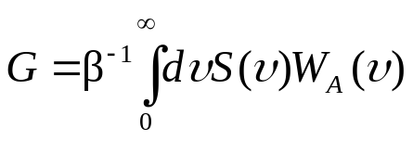
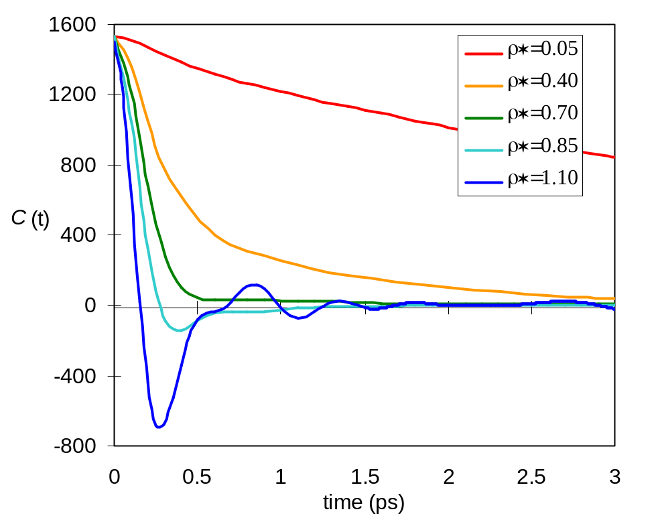
An Overview of the 2PT Method
To
Phase Behaviors
DoS
From
MD Simulations
VAC
MD simulations

Slide 24





Test the 2PT Method Using the LJ System
Intermolecular potential
Phase diagram
V(r)
r = σ
0
-ε
r
stable
metastable
unstable
critical point
triple point
Supercritical Fluid
Gas
Liquid
Solid
(T*=kT/ε ρ*=ρσ³)

Slide 25
VAC and DoS of LJ Fluids
Velocity Autocorrelation
Density of States
gas
liquid
solid
gas
liquid
solid

Slide 26



2PT DoS Decomposition
Examples
gas
liquid
solid
solid-like
gas-like
solid-like
gas-like
gas-like
solid-like

Slide 27



Pressure and Energy
Pressure
Total Energy
Pressures and MD Energies agree with EOS values
Quantum Effect (ZPE) most significant for crystals (~2%)

Slide 28


Entropy
1PT
2PT model
gas
crystal
liquid
Overestimate entropy for low density gases
Underestimate entropy for liquids
Accurate for crystals
Accurate for gas, liquid, and crystal
Accurate in metastable regime
Quantum Effects most important for crystals (~1.5%)

Slide 29


Gibbs Free Energy
1PT
2PT model
liquid
crystal
gas
Underestimate free energy for low density gases
overestimate entropy for liquids
Accurate for crystals
Accurate for gas, liquid, and crystal
Accurate in metastable regime

Slide 30



Why does 2PT work?
HS fy = 0.036
HS fy = 0.309
gas
QHO
CHO
liquid
1PT overestimates W_{s}^{gas} for gas for modes < 5 cm⁻¹
1PT underestimates W_{s}^{gas} for liquid for modes between 5 and 100 cm⁻¹
2PT properly corrects these errors

Slide 31

Convergence of 2PT
For gas, the entropy converges to within 0.2% with 2500 MD steps (20 ps)
For liquid, the entropy converges to within 1.5% with 2500 MD steps (20 ps).
gas (ρ*=0.05 T*=1.8)
liquid (ρ*=0.85 T*=0.9)

Slide 32


2PT for Melting and Solidification
Initial amorphous structure is used in the cooling process
The fluid remains amorphous in simulation even down to T*=0.8 (supercooled)
The predicted entropy for the fluid and supercooled fluid agree well with EOS for LJ fluids
Simulation conditions
supercritical fluid
metatstable
unstable
supercritical
fluid
solid
solid
starting with amorphous liquid
Initial fcc crystal is used in the heating process
The crystal appears stable in simulation even up to T*=1.8 (superheated)
The predicted entropies for the crystal and superheated crystal agree well with EOS for LJ solids
Entropy
starting with
fcc crystal

Slide 33

Extension to Mixtures
LJ Mixtures at T*=0.85
Combination Rules:
σ_{ij}= l_{ij} ( σ_{ii}+ σ_{jj})/2
ε_{ij}= b_{ij} ( ε_{ii}+ ε_{jj})^{1/2}
σ₂₂/σ₁₁=0.80
ε₂₂/ε₁₁=0.85
l₁₂=0.95
b₁₂=0.70
2PT Literature
x₁(I) ~0.02 0.04
x₁(II) ~0.79 0.84

Slide 34




Efficiency of 2PT for Mixtures
400 ps
100 ps
25 ps
12.5 ps

Slide 35
An Overview of the 2PT Method
To
Phase Behaviors
DoS
From
MD Simulations
VAC
MD simulations

Slide 36
Summary of 2PT
Thermodynamic and transport properties are determined simultaneously.
Only short simulation times (20 ps) are needed to obtain high accuracy. For a system with N particles, we expect 2PT to be N times faster than methods such as particle insertion and thermodynamic integration.
The efficiency of 2PT does not deteriorate with increasing density (a severe limitation in most other techniques).
The properties are obtained under real equilibrium conditions (no perturbation in the simulation itself).
Zero point energy and corrections for quantum effects are included.
2PT can be used to determine the properties in metastable and unstable regimes.
2PT could also be used for nonequilibrium systems to estimate effects of transient effects, reaction, and phase transitions, since it is only necessary to have stabilities over time scales of ~20 ps.

Slide 38
Term paper/projects for PH322
Comparison of various water models: TIP3P, TIP4P, TIP5P, SPC/E, F3C
Potential of mean force between two colloids/or two rigid bodies in water using Umbrella sampling
Simulating B-DNA to characterize the basic DNA properties (you need to compute all the helicoidal parameters).
Simulating water diffusion in a carbon nanoring
Surface tension of liquid/vapor interface and surfactant monolayer in between oil/water interface using coarse-grained model
Studying Isotropic-Nematic-Smectic transition in confined geometry using spherocylinder model.
Comparison of various charge schemes: Mulliken, ESP, and Qeq and its effect on the structural properties.
Comparative study of the efficiency and accuracy of cut-off methods using various switching function (including higher order polynomial) and Ewald and Particle-Mesh Ewald method.

