Slide 1
Isotropic – Nematic – Smectic Transition in Confined System
BIMAN JANA,
SSCU
S.R. No. = 4410-112-051-04184

Slide 2
Outline
Introduction
Computational model
Brief literature review
My work
Conclusion

Slide 3
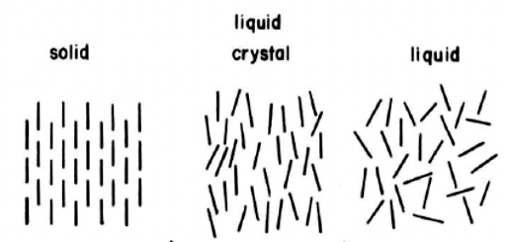
Introduction
Liquid crystals have more degrees of freedom than crystals but less than liquid.
It usually have small latent heat of transition.
Usually phases are described by the average orientation of the molecules.

Slide 4

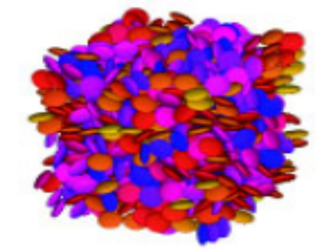
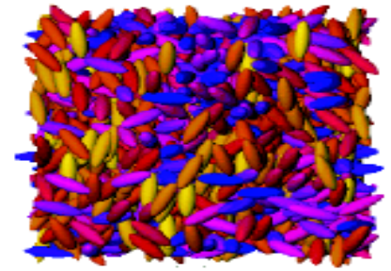
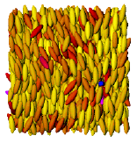
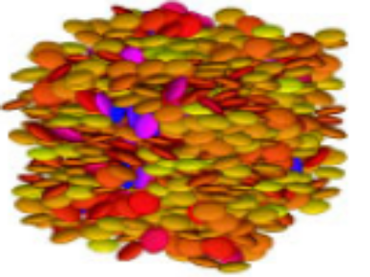
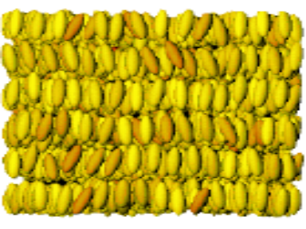
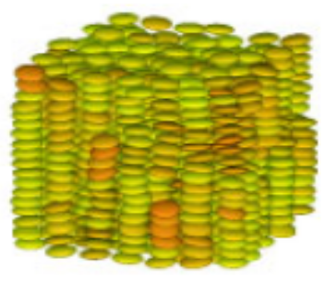
Mesophases of liquid crystals
Calimatic system
Discotic system
Isotropic
Isotropic
Nematic
Nematic
Smectic
Columnar

Slide 5
Transition between mesophases may happen due to
1) by increasing pressure
2) by decreasing temperature
Transition between mesophases can be characterized by
1) order parameter variation
2) orientational correlation function
3) pattern of orientational non-Gaussian parameter

Slide 6
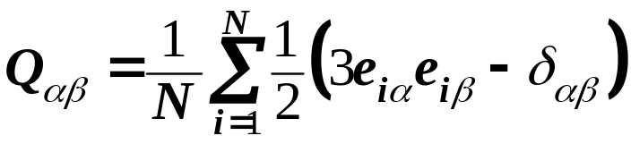
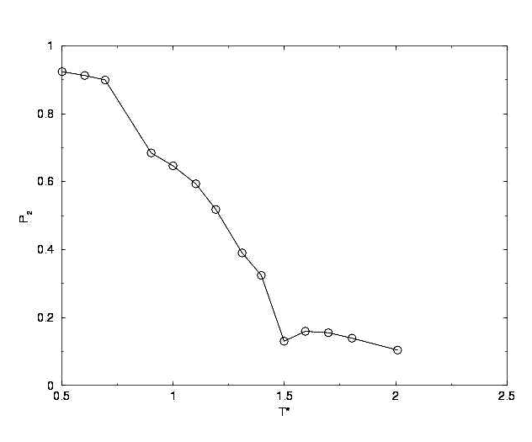
Orientational order parameter
we can define a tensor Q for the liquid crystalline system
P₂ = highest positive eigenvalue of Q

Slide 7
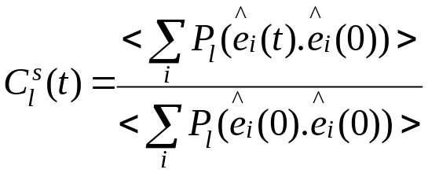
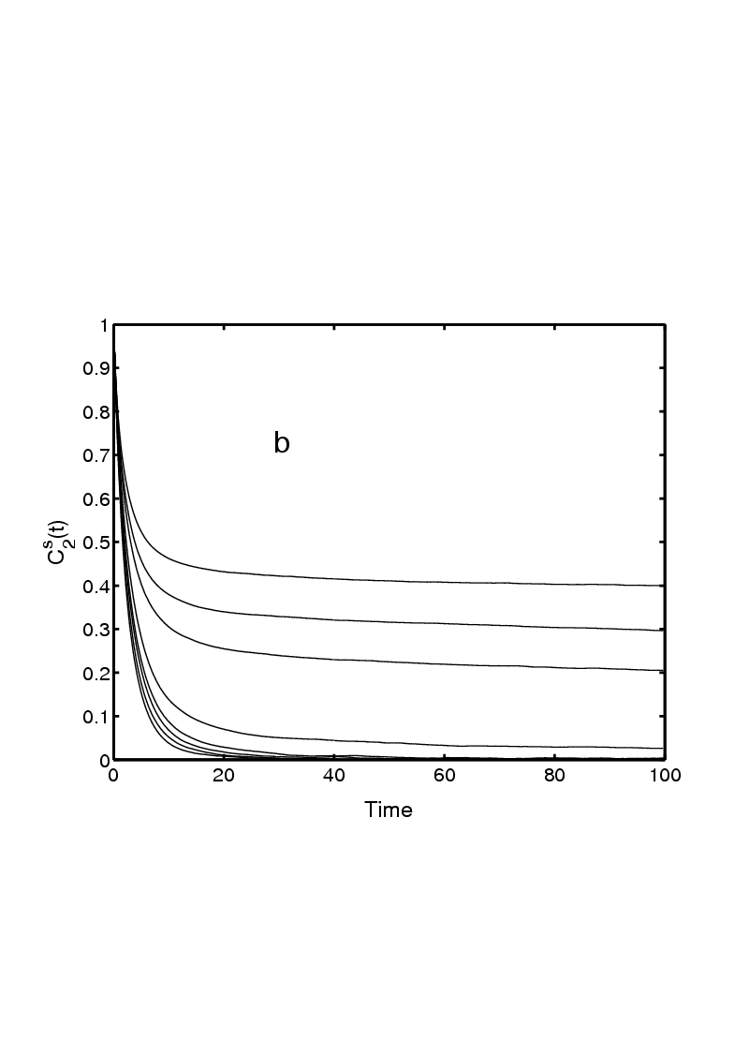
Orientational correlation function
can be defined as

Slide 8
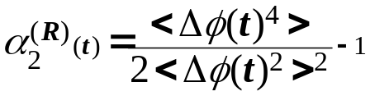
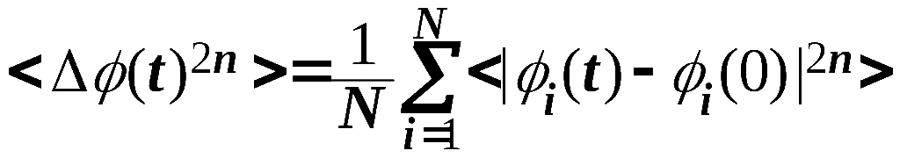
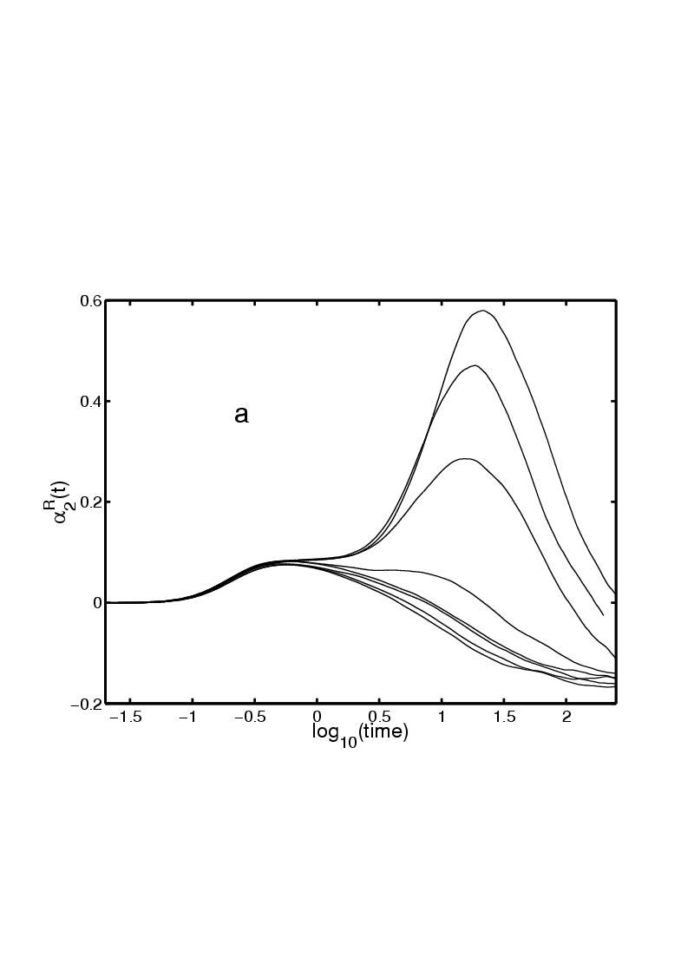
3) Rotational Non-Gaussian Parameter
It can be defined as
where

Slide 9
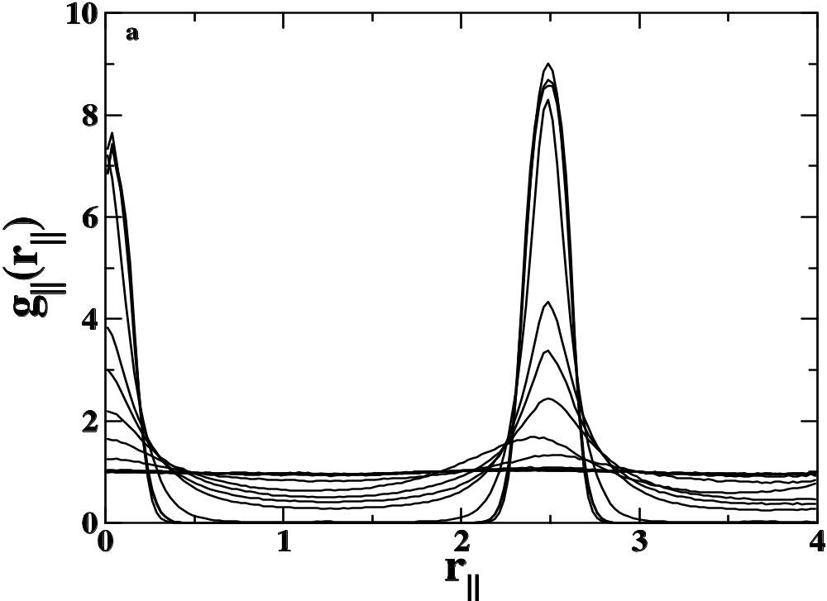
also nematic to smectic transition can be characterize by
the growth of the translational order as nematic phase is going to smectic phase

Slide 10
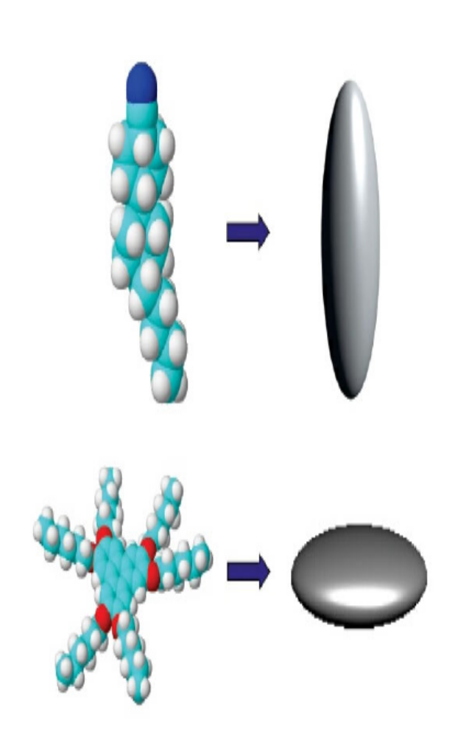
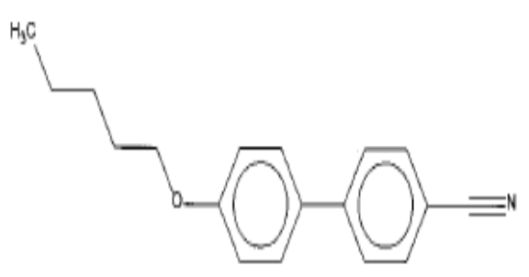
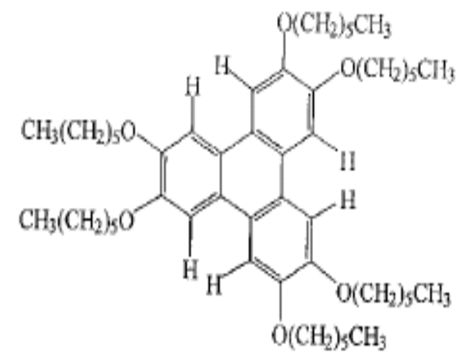
Computational models

Slide 11
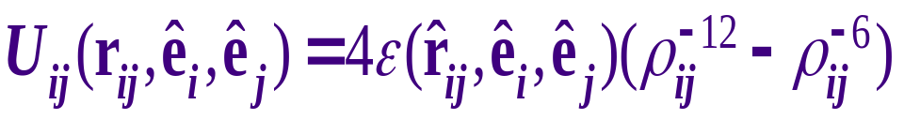
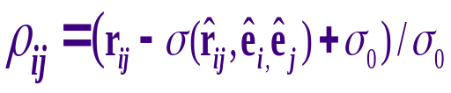
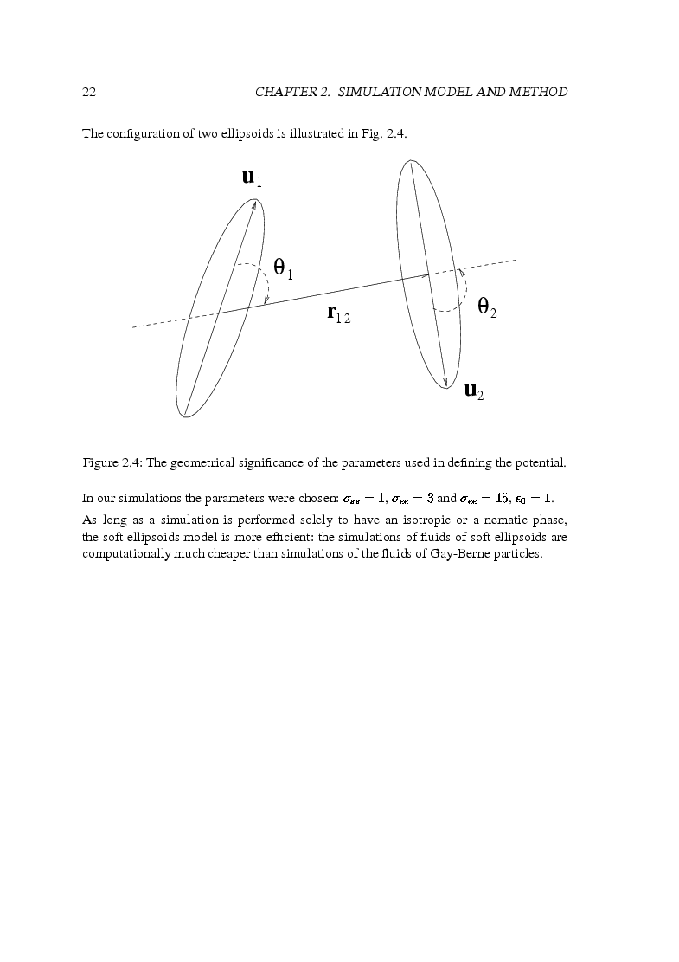
Calimatic system: Gay-Berne model
Ellipsoids of revolution, which have a single-site representation, interact among themselves through the Gay-Berne potential:
,
where .
e₁
e₂
Gay and Berne, J. Chem. Phys. 74, 3316 (1981).

Slide 12
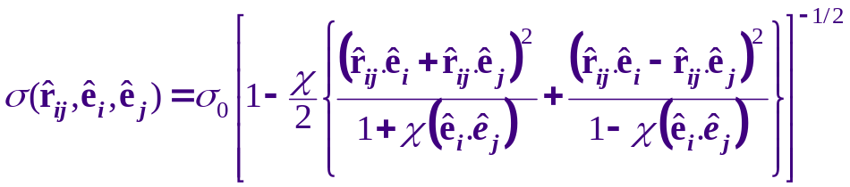


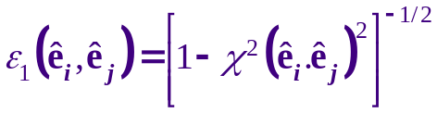
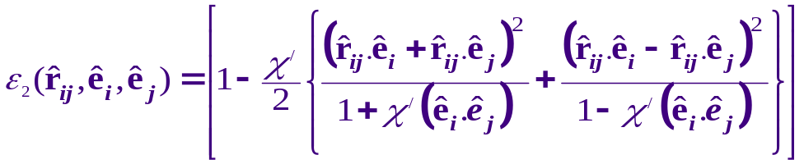



Gay-Berne model
Here the molecular shape parameter
with , and the energy parameter
where the exponents μ and ν are adjustable, and
and
with .
Aspect ratio and the energy anisotropy parameter

Slide 13
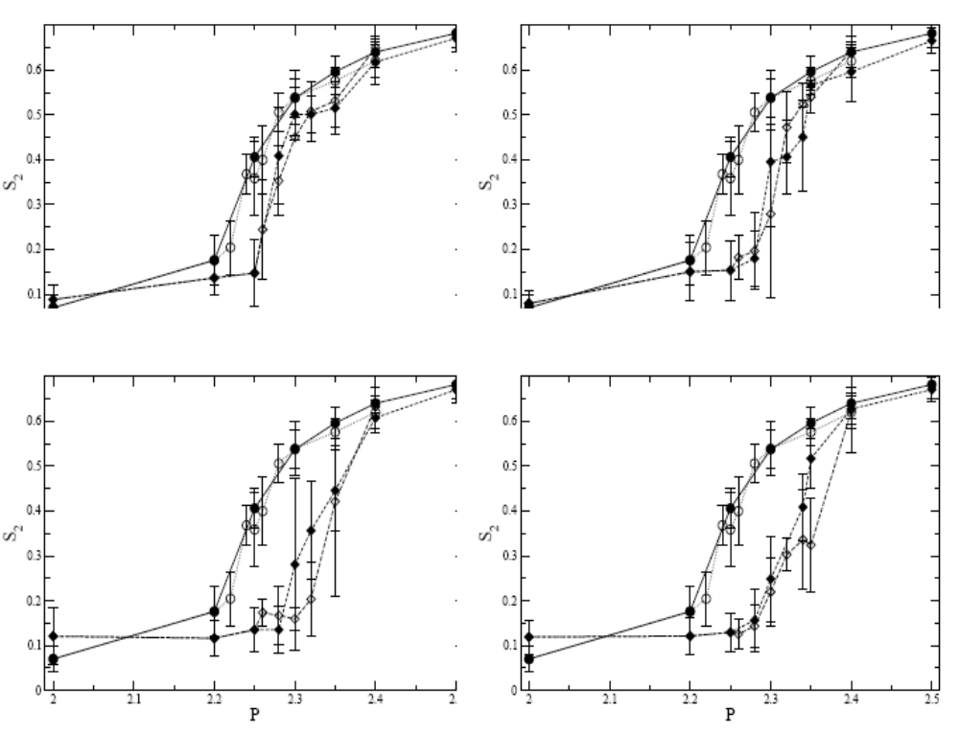
I-N transition confined in a rough wall ( Schmidt et. al. cond-mat

Slide 14
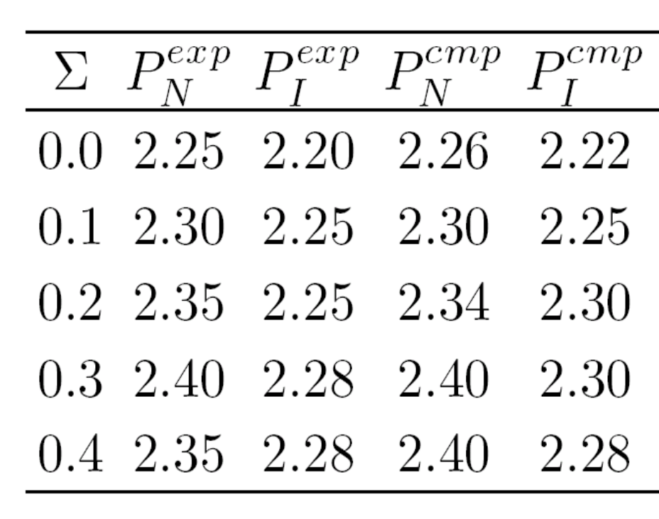
as roughness increases from Σ = 0.0 to 0.3 P_{I-N} increases.
as roughness increases from Σ = 0.3 to 0.4 there is no significant change because roughness is getting saturated.

Slide 15
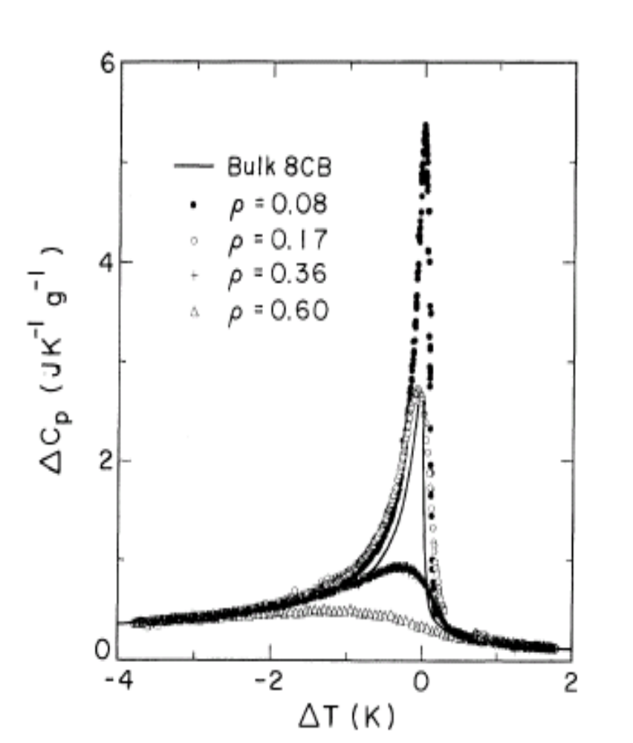
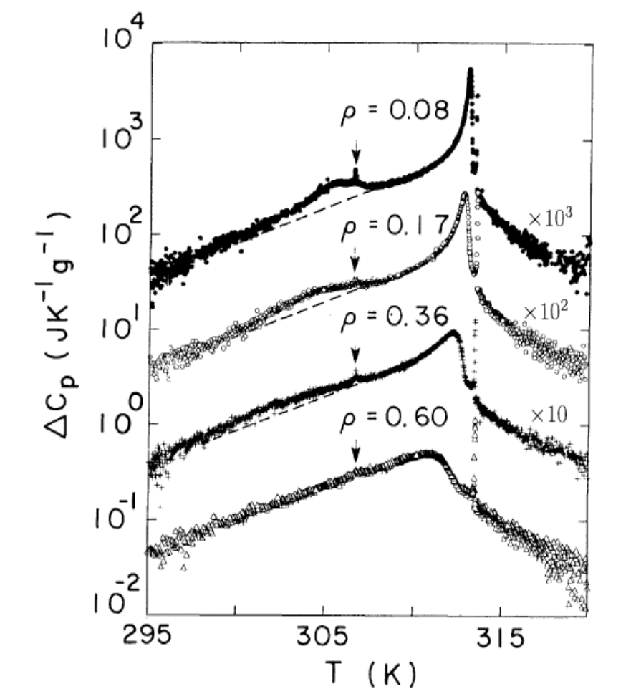
I-N and N-S transition in silica aerogels ( Garland et.al. Phys. Rev. E)

Slide 16
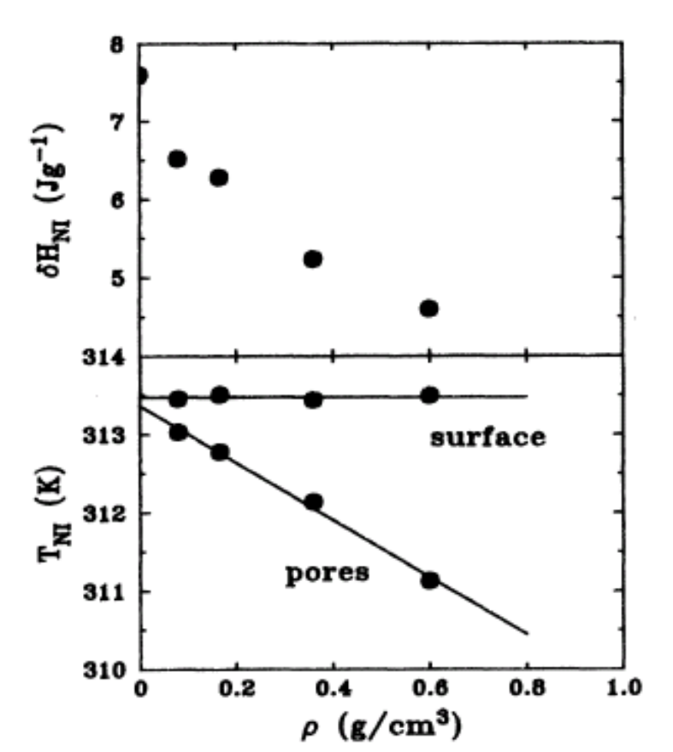
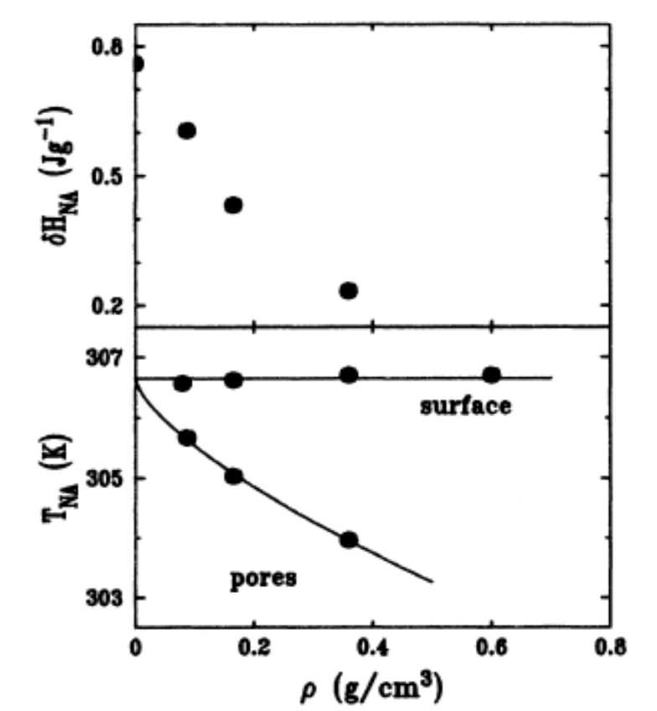

Slide 17
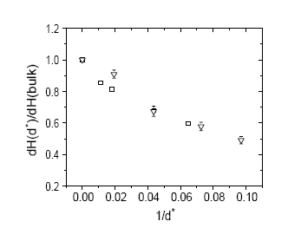
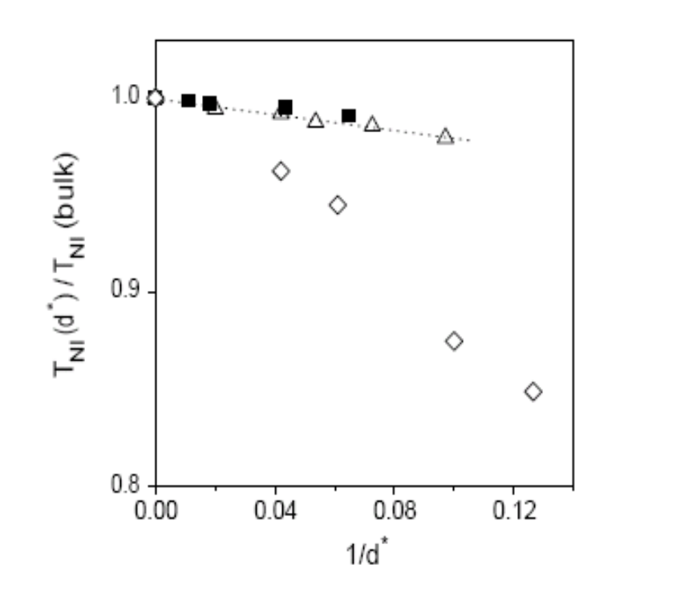
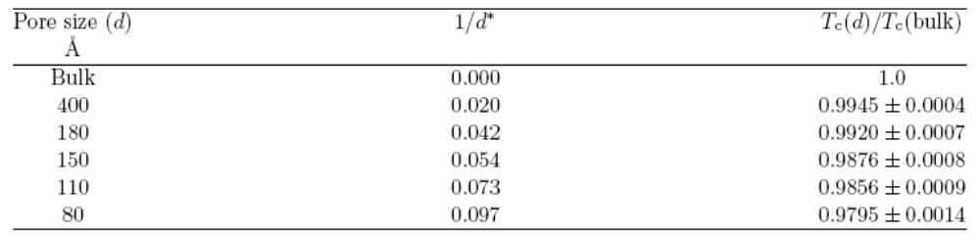
I-N transition in porous media– a MC study (Murthy et. al. Europhys. Lett.)

Slide 18
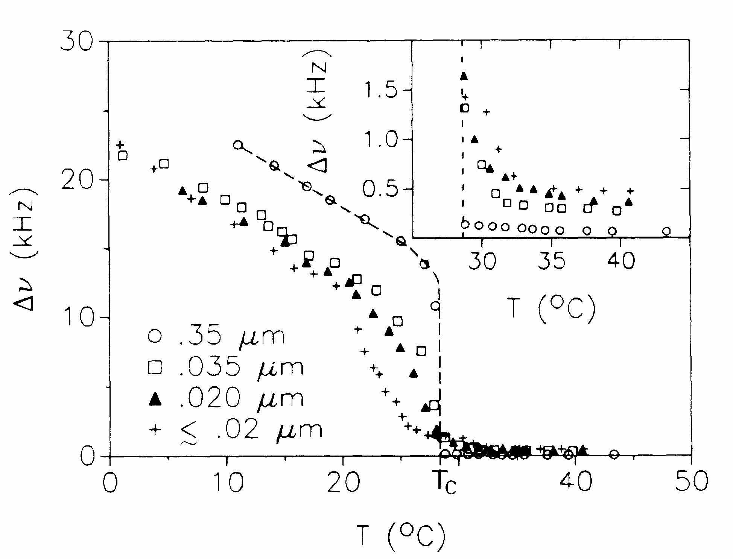
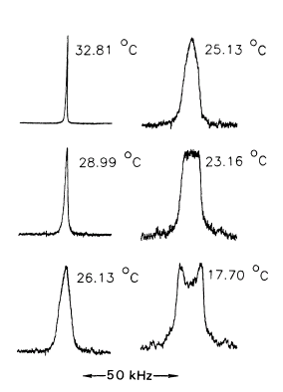
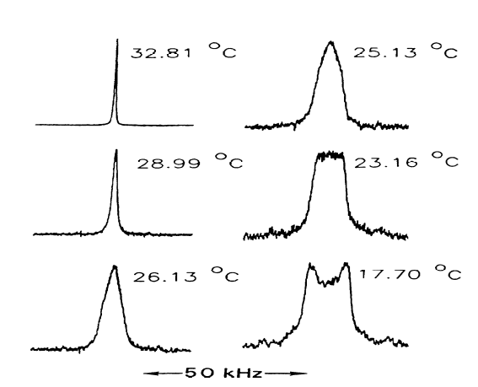
Effect of confinement on the order of the I-N transition(Doane et. al Phys. Rev. Lett.)

Slide 19
My work
I have used calimatic model system of liquid crystal and Gay-Berne potential for NVE simulation.
System has periodic boundary conditions along X & Y direction, but along Z direction I have used reflecting boundary condition to confine the system along this direction.
The result is compared with the system with the periodic boundary condition implemented in all the three directions.
Simulation details
Number of particles = 500
κ = 3.0 , κ’ = 5.0 , μ = 1.0 ,ν = 2.0
Cutoff distance = κ +1.0
Reduced density (d*) = 0.32
Reduced temperature (T*) = 2.0 to 0.4
Integration method I employed is velocity varlet.

Slide 20
Fragment of code where I have employed the reflecting boundary condition along the Z-direction
At the time of updating the position and velocity
do i= I,npart
rx(i) = rx(i) +halfdt*vx(i) +halfdtsq2*fz(i)/mass
ry(i) = ry(i) +halfdt*vy(i) +halfdtsq2*fz(i)/mass
rz(i) = rz(i) +halfdt*vz(i) +halfdtsq2*fz(i)/mass
rx1(i) = rx(i) +halfdt*vx(i) +halfdtsq2*fz(i)/mass
ry1(i) = ry(i) +halfdt*vy(i) +halfdtsq2*fz(i)/mass
rz1(i) = rz(i) +halfdt*vz(i) +halfdtsq2*fz(i)/mass
vx(i) = vx(i) +halfdt*fx(i)/mass
vy(i) = vy(i) +halfdt*fy(i)/mass
vz(i) = vz(i) +halfdt*fz(i)/mass
If (abs(rz(i)) >boxlh) then
vz(i) = -1.0*vz(i)
endif

Slide 21
if (rz1(i)>boxlh)then
rz1(i)=(2.0*boxlh –rz1(i))
else
if (rz1(i)< -1.0*boxlh) then
rz1(i) = -1.0*(rz1(i)+ 2.0*boxlh)
endif
endif
call force ()
vx(i) = vx(i) +halfdt*fx(i/mass
vy(i) = vy(i) +halfdt*fy(i)/mass
vz(i) = vz(i) +halfdt*fz(i)’/mass
if (abs(rz(i) < boxlh . And .abs(rz1(i)) >boxlh) then
vz(i)= -1.0*vz(i)
endif
enddo

Slide 22
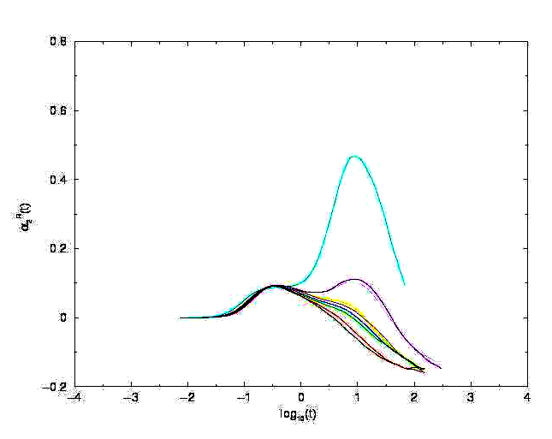
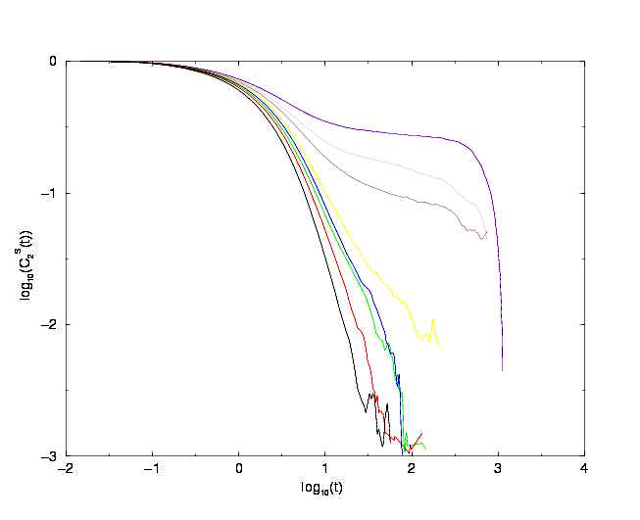

Slide 23
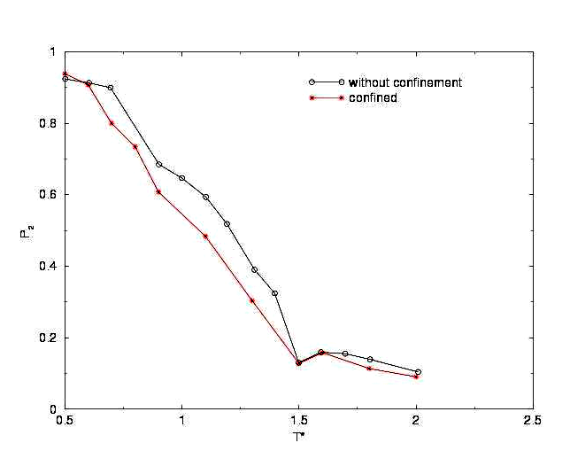

Slide 24
Conclusion
by confining the system transition temperature is lowered and transition pressure is increased.
Due to confinement the transition is becoming more and more continuous ; becoming more and more weakly first order.
one can vary the condition of the confinement to get a different nematic temperature rangre and soften the transition which is technically much more important

Slide 25
Acknowledgements
Prof. Prabal Maiti
Mr. Bharat Adkar and Mr. Chaitanya

Slide 26
THANK YOU

