Slide 1
Thermostat and Barostat

Slide 2
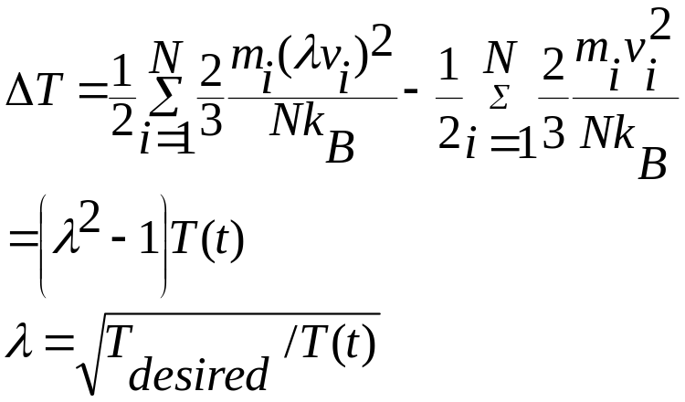
Velocity rescaling method
Temperature of the system during the simulation is calculated from the kinetic energy KE=3/2Nk_{B}T
Simplest way to maintain a constant T is to rescale the velocities consistent with the desired temperature
Suppose at time t temperature is T(t) and the velocities are multiplied by a factor λ. Then the change in temperature is
At each time step multiply the velocities by λ. T(t) is calculated from the KE at time t

Slide 3


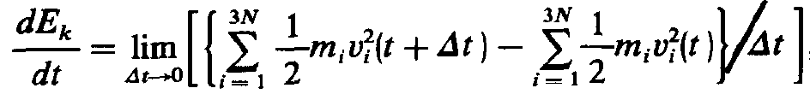
Berendsen Temperature coupling
JCP, 81, 3684 (1984)
Berendsen algorithm mimics weak coupling to a an external heat bath at constant temperature T₀ . Such a coupling can be accomplished by inserting a stochastic and friction term in equation of motion
Where γ_{i} is damping constant which determine the strength of the coupling with the heat bath. For time being consider γ_{i} = γ (friction constant equal for all particles). R(t) is a Gaussian stochastic variable satisfying following relation
Time dependence of the total kinetic energy is given by
N is the number of particles

Slide 4
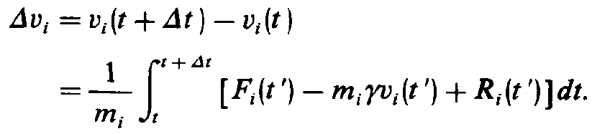

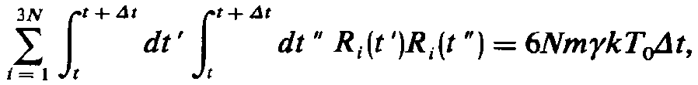

Slide 5
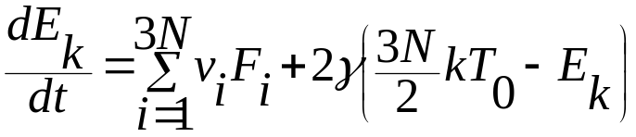
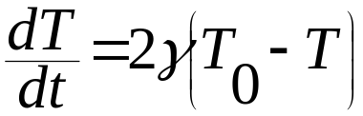
JCP, 81, 3684 (1984)
So we have
You can recognize the first term: it is just equal minus the time derivative of potential energy. Second term is the coupling to the heat bath and we can associate this with time dependence of the system temperature
Time constant for the coupling τ_{T} is equal to (2γ)⁻¹

Slide 6
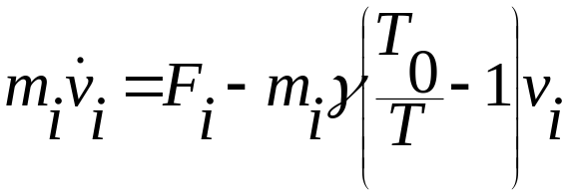
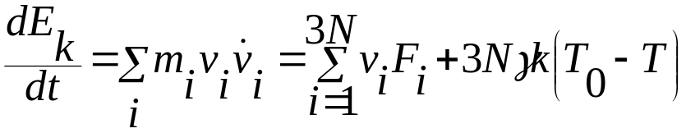
So the temperature deviation decays exponentially with time with time constant τ_{T} and the equation of motion can be written as
From the above equation we have
This is equivalent to the original stochastic equation

Slide 7
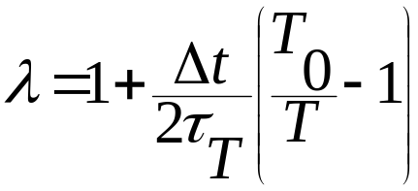
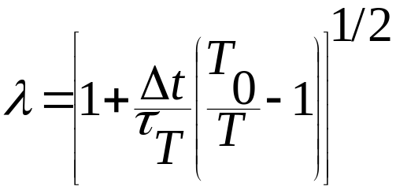
So the temperature is controlled by scaling the velocities of the particle as each time step with a time dependent constant given by
more general expression
If τ_{T} is large, then the coupling will be weak. If τ_{T} is small, the coupling will be strong and when the coupling parameter equal to integration time step (τ_{T} =δt) then this algorithm is equivalent to simple velocity rescaling method. A good value is 0.5 –1 ps when δt = 1 fs.

Slide 8
Advantage:
Strength of the coupling can be varied and adapted to the use requirement
Very easy to code
Very efficient to bring the system to a desired temperature.
Disadvantage:
Does not represent a true canonical ensemble. Velocity rescaling artificially prolongs any temperature difference among components of the system, which can lead to the phenomena of ‘hot solvent’ and ‘cold solute’, even though the temperature of the system is at its desired value. This can be avoided by having separate temperature coupling to the solute and solvent, but this leads to the unequal distribution of energy among various components.
Solution: Extended system method, like Nose-Hoover thermostat

Slide 9
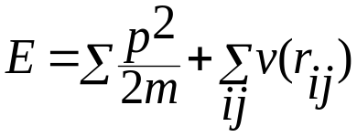
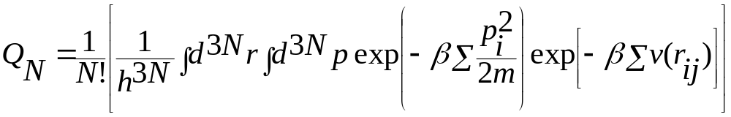
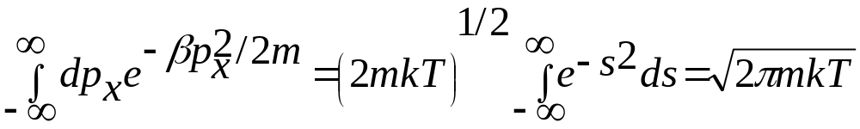
For pair wise interaction the energy of the system of N particles is given by
Partition function is given by
The momentum integral can easily be carried out

Slide 10
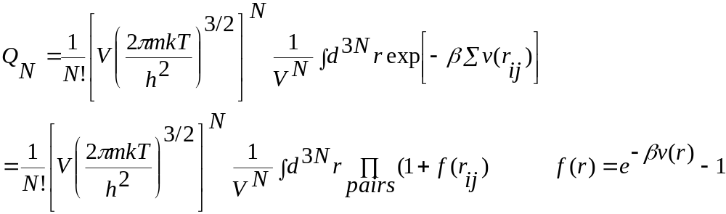
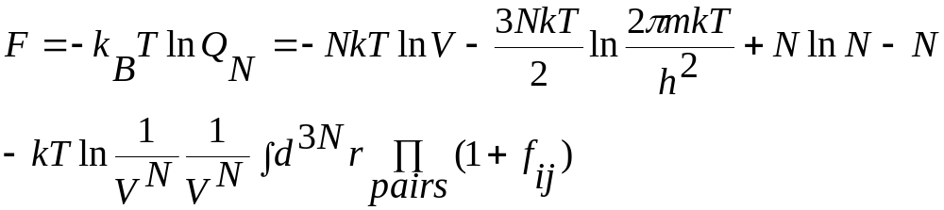
So the partition function becomes
The Free energy can be written as

Slide 11
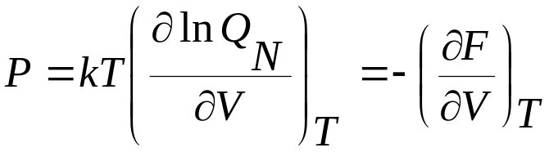
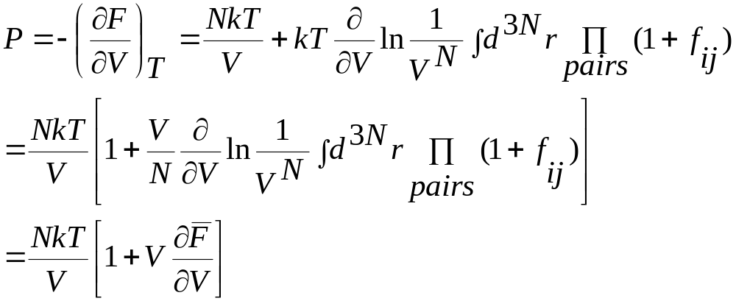
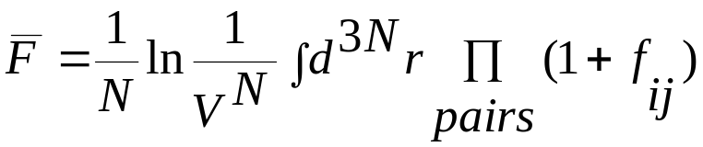
Thermodynamically pressure is defined as
where

Slide 12
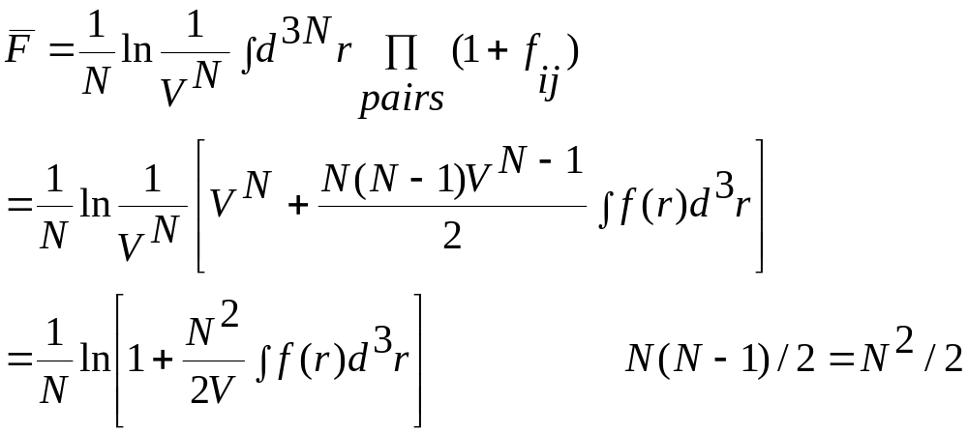
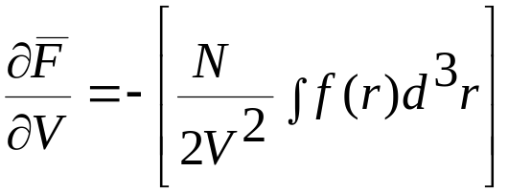
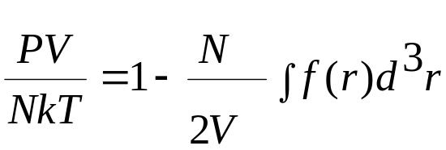
In general we can not evaluate the above expression exactly for any v(r_{ij}). If we assume v(r_{ij}) is small and so is f(r_{ij}). Then we can simply the above equation keeping only first order terms
Taking derivative and keeping first order term we have
Virial equation

Slide 13
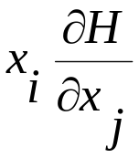
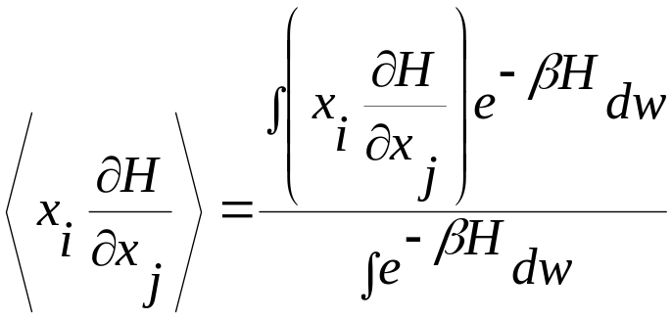
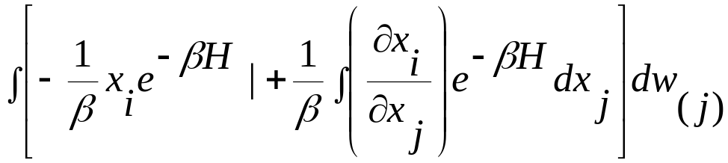
Equipartition and virial theorem
We want to compute the expectation value of In the canonical ensemble it is given by
Integrate by parts over x_{j} (the numerator only)
First part vanishes because whenever any of the coordinates takes an extreme value the Hamiltonian of the system becomes infinite.

Slide 14
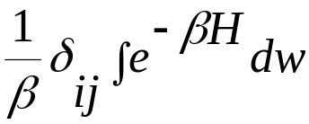
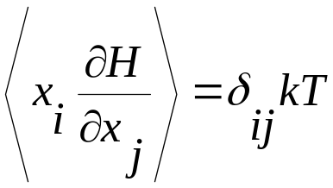
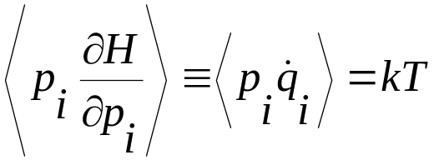
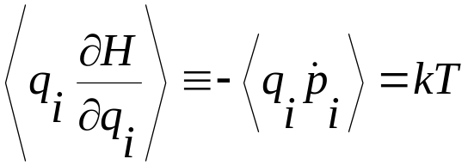
Second term becomes
So the expectation value becomes
This gives

Slide 15
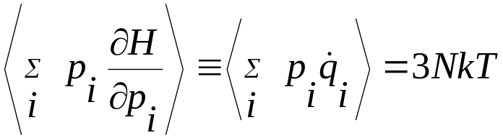
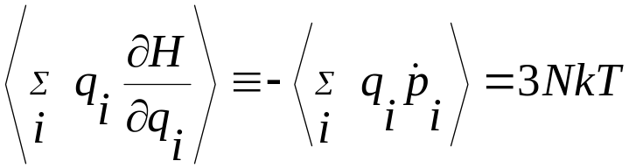
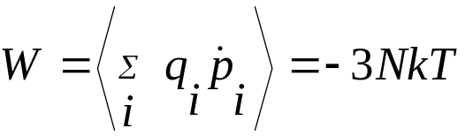
Summing over all i from i=1.. 3N
Virial theorem states that
Virial has two component: one from the external forces W^{ext} (like the pressure exerted by the wall of the container) and W^{int} arising from the forces between the particles.

Slide 16
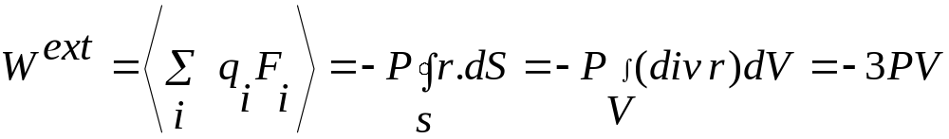
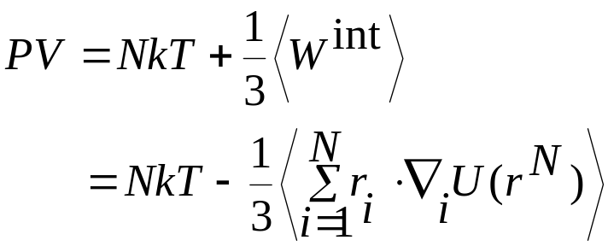
So we have virial equation
More details Allen and Tildesley , section 2.4

Slide 17
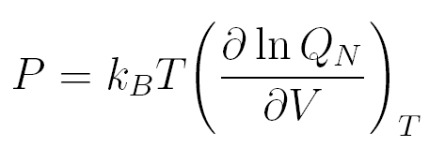

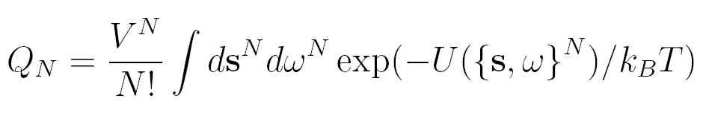
Computation of the pressure for the rigid molecules
The thermodynamic definition of the pressure
In order to derive the molecular expression for the pressure we explicit the volume dependence of the configurational integral by introducing dimensionless positional variable s_{i}, defined as
for i = 1, … N
In terms of this new variable the partition function becomes

Slide 18
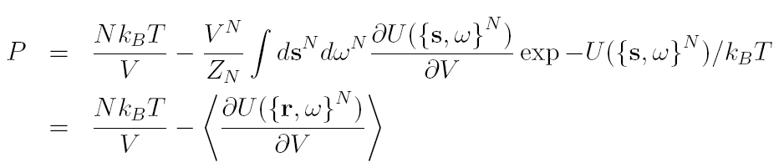
We have the pressure expression given by

Slide 19
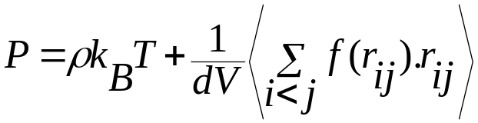
Constant pressure simulation (NPT ensemble)
Pressure during the simulation can be computed from the virial. For a pairwise additive interactions

Slide 20
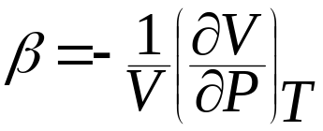
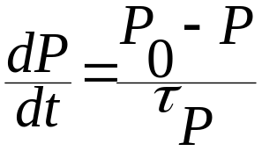
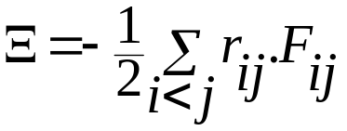
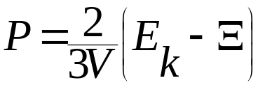
Constant pressure simulation (NPT ensemble)
Easiest way to maintain constant pressure is by changing the volume of the simulation cell. The volume fluctuation is related to the isothermal compressibility
In the same way as the temperature coupling, the system can be coupled to pressure path to control the pressure of the system: at each time step both the coordinates and box size will be rescaled. To achieve this an extra term is added to the equation of motion
Pressure can be computed as
where
is the internal virial

Slide 21
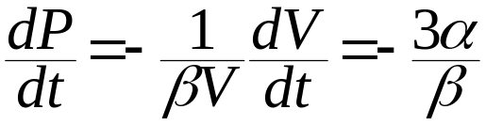
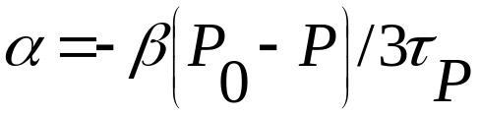
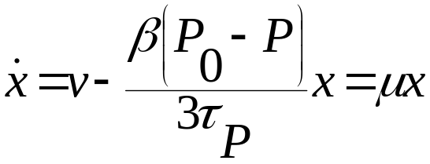
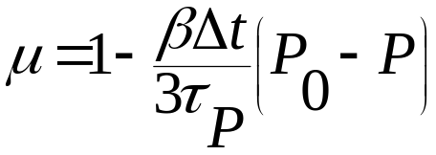
The pressure change is related to the isothermal compressibility β as follows:
With α given by
So the modified equation of motion is given by
With μ given by
So at each time step x is scaled by μx and length of the simulation box is scaled by μl

Slide 22
The Update algorithm
Given
Positions r of all the atoms at time t
Velocities v of all atoms at time t-dt/2
Accelerations F/m on all atoms at time t
Total kinetic energy and virial
Compute the scaling factors λand μ
2. Update and scale velocities: v’ = λ(v+adt)
3. Compute new unconstrained coordinates: r’=r+v’dt
4. Scale coordinates and box: r = μr’ and b = μb

Slide 23
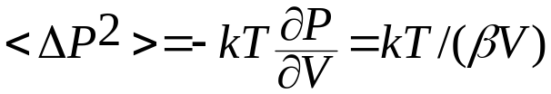

Pressure fluctuations
So
For water β= 44.6x10⁻⁶/bar

Slide 24
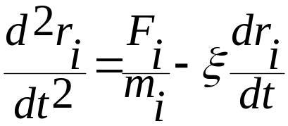
Nose-Hoover thermostat
In the extended ensemble approach the system Hamiltonian is extended by introducing a thermal reservoir and a friction term in the equation of motion. The friction force is proportional to the product of each particle velocity and a friction parameter ξ. The friction parameter is a fully dynamic quantity with its own equation of motion; the time derivative is calculated from the difference between the current and reference temperature

