Slide 1
Monte Carlo Simulation
Part of the materials are directly taken from Prof. Kofke’s Lectures

Slide 2
Outline
Basic statistical mechanics
Why Monte Carlo technique?
Random vs Importance Sampling
Metropolis Method
Basic Algorithm
Simulating hard fluids
Configurational bias Monte Carlo

Slide 3
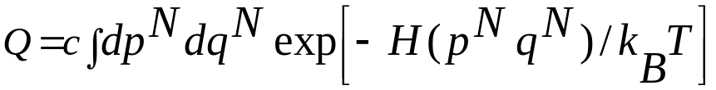

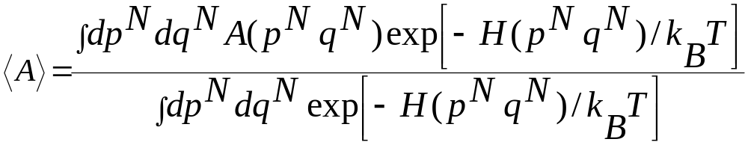
The classical expression for the partition function is given by
In general it is not possible to compute the above integral either through
MC or MD. is the Hamiltonian of the system. C = 1/(h^{3N}N!)
The ensemble average of any quantity A is given by
Integration on p can be carried out easily as Hamiltonian has a quadratic dependence on p. The integration on q is hard to evaluate.

Slide 4
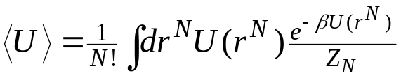


Review
We want to apply Monte Carlo simulation to evaluate the configuration integrals arising in statistical mechanics
Importance-sampling Monte Carlo is the only viable approach
  unweighted sum of U with configurations generated according to distribution
Markov processes can be used to generate configurations according to the desired distribution π(r^{N}).
  Given a desired limiting distribution, we construct single-step transition probabilities that yield this distribution for large samples
  Construction of transition probabilities is aided by the use of detailed balance:
  The Metropolis recipe is the most commonly used method in molecular simulation for constructing the transition probabilities
π(r^{N})

Slide 5
Markov Processes
Stochastic process
  movement through a series of well-defined states in a way that involves some element of randomness
  for our purposes,“states” are microstates in the governing ensemble
Markov process
  stochastic process that has no memory
  selection of next state depends only on current state, and not on prior states
  process is fully defined by a set of transition probabilities π_{ij}
    π_{ij} = probability of selecting state j next, given that presently in state i.
    Transition-probability matrix Π collects all π_{ij}

Slide 6
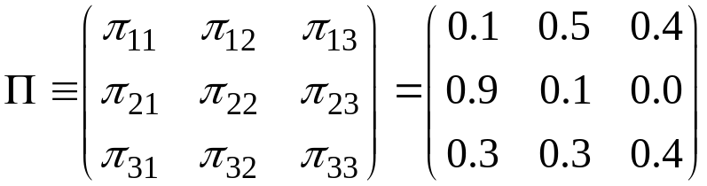
Transition-Probability Matrix
Example
  system with three states
Requirements of transition-probability matrix
  all probabilities non-negative, and no greater than unity
  sum of each row is unity
  probability of staying in present state may be non-zero
If in state 1, will stay in state 1 with probability 0.1
If in state 1, will move to state 3 with probability 0.4
Never go to state 3 from state 2

Slide 7
Distribution of State Occupancies
Consider process of repeatedly moving from one state to the next, choosing each subsequent state according to Π
  1→ 2 → 2 → 1 → 3 → 2 → 2 → 3 → 3 → 1 → 2 → 3 → etc.
Histogram the occupancy number for each state
  n₁ = 3 π₁ = 0.25
  n₂ = 5 π₂ = 0.42
  n₃ = 4 π₃ = 0.33
After very many steps, a limiting distribution emerges
2
1
3

Slide 8

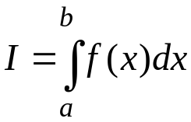

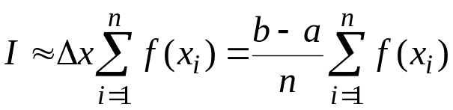
Suppose we want to evaluate such integral by using numerical quadrature, for example using Simpson’s rule
Quadrature formula
Sum areas of shapes approximating shape of curve
Evaluating the general integral
n uniformly separated points

Slide 9
Suppose we want to carry out the qudrature by evaluating the integrand on a mesh of points in the DN dimensional configuration space (3N for 3-d system).
If we take n equidistant points along each coordinate axis, the total number of point at which the integrand needs to be evaluated is n^{DN}.
If we have 100 particles in in 3-d and if we take n = 5 (very small ) then we have to evaluate 5³⁰⁰, this is impossible to compute and also not desirable.

Slide 10
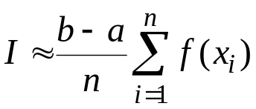

Monte Carlo Scheme (random sampling)
Stochastic approach
Same quadrature formula, different selection of points
n points selected from uniform distribution π(x)
As n →∞ this will give the correct value of the integral. However, like the previous quadrature method this is of little use because most of the computing is spent on points where Boltzmann factor is negligible

Slide 11
Solution : Importance sampling
Sample many points where Boltzmann factor is large and fewer points in other regions: basic idea behind Importance sampling

Slide 12
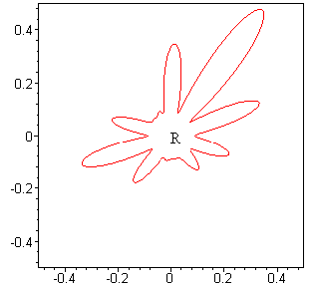
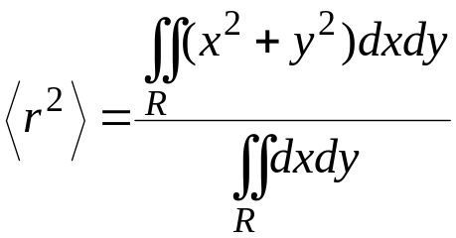
Shape of High-Dimensional Regions
Two (and higher) dimensional shapes can be complex
How to construct and weight points in a grid that covers the region R?
Example: mean-square distance from origin

Slide 13

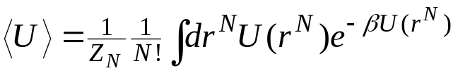
Shape of High-Dimensional Regions
Two (and higher) dimensional shapes can be complex
How to construct and weight points in a grid that covers the region R?
  hard to formulate a methodical algorithm in a complex boundary
  usually do not have analytic expression for position of boundary
  complexity of shape can increase unimaginably as dimension of integral grows
We need to deal with 100+ dimensional integrals
Example: mean-square distance from origin

Slide 14
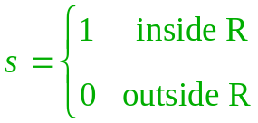
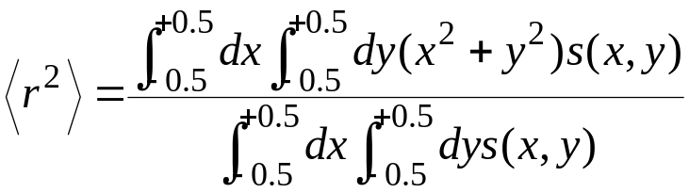
Integrate Over a Simple Shape? 1.
Modify integrand to cast integral into a simple shaped region
  define a function indicating if inside or outside R
Difficult problems remain
  grid must be fine enough to resolve shape
  many points lie outside region of interest
  too many quadrature points for our high-dimensional integrals)

Slide 15
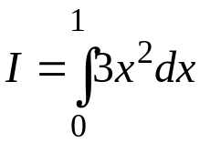

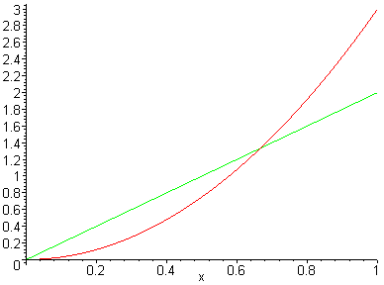

Importance Sampling
Put more quadrature points in regions where integral receives its greatest contributions
Return to 1-dimensional example
Most contribution from
region near x = 1
Choose quadrature points
not uniformly, but according
to distribution π(x)
  linear form is one possibility
How to revise the integral to
remove the bias?

Slide 16
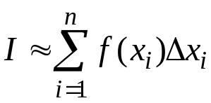
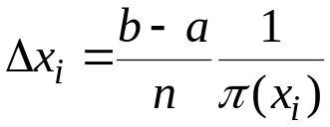




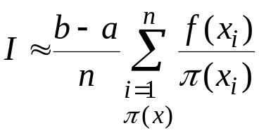
The Importance-Sampled Integral
Consider a rectangle-rule quadrature with unevenly spaced abscissas
Spacing between points
  reciprocal of local number of points per unit length
Importance-sampled rectangle rule
  Same formula for MC sampling
…
Greater π → more points → smaller spacing
choose x points according to π

Slide 17
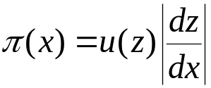



Generating Nonuniform Random Deviates
Probability theory says...
  ...given a probability distribution u(z)
  if x is a function x(z),
  then the distribution of π(x) obeys
Prescription for π(x)
  solve this equation for x(z)
  generate z from the uniform random generator
  compute x(z)
Example
  we want on x = (0,1)
  then
  so x = z^{1/2}
  taking square root of uniform deviate gives linearly distributed values
Generating π(x) requires knowledge of
a and c from “boundary conditions”

Slide 18
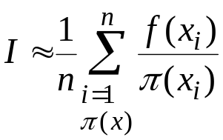
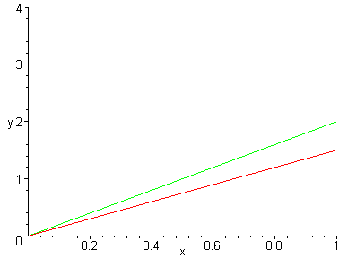
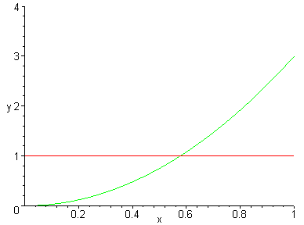
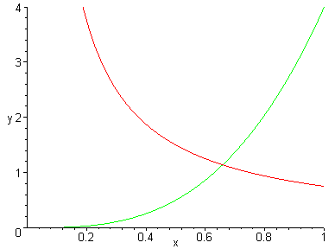





Choosing a Good Weighting Function
MC importance-sampling quadrature formula
Do not want π(x) to be too much smaller or too much larger than f(x)
  too small leads to significant contribution from poorly sampled region
  too large means that too much sampling is done in region that is not (now) contributing much

Slide 19
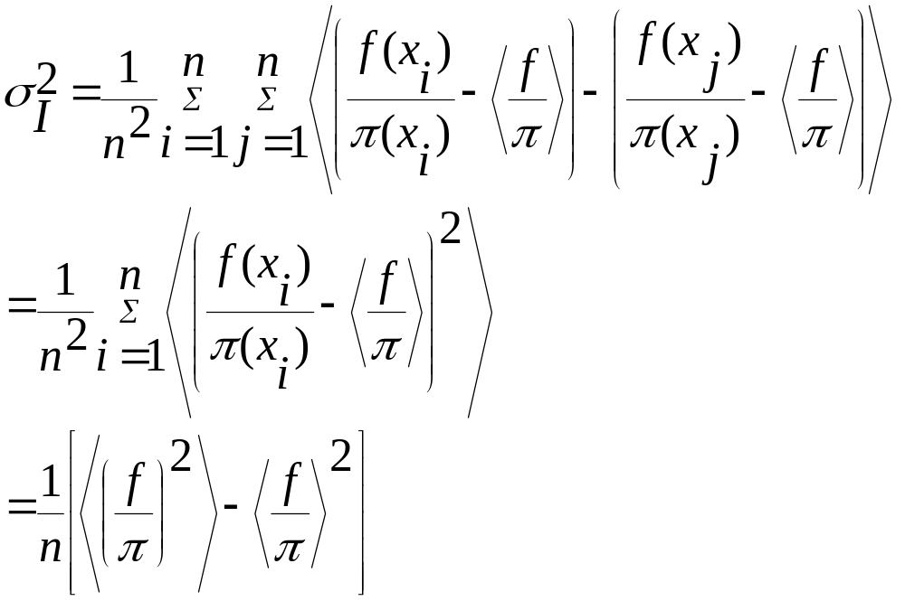
Variance determines the choice of weighting function
Variance still goes as 1/n, but the magnitude of this variance can be reduced dramatically by choosing π(x) such that f(x)/ π(x) is a smooth function of x.

Slide 20

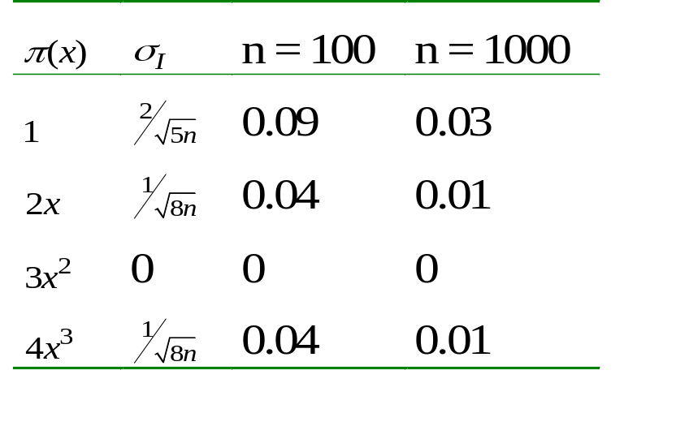
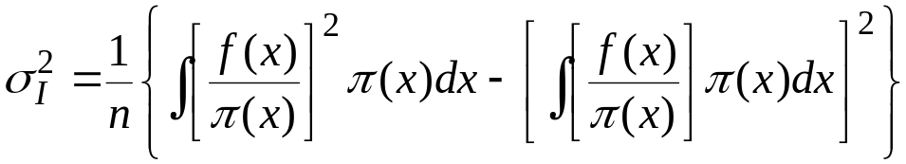

Variance in Importance Sampling Integration
Choose π to minimize variance in average
Smallest variance in average corresponds to π(x) = c × f(x)
  not a viable choice
  the constant here is selected to normalize π
  if we can normalize π we can evaluate
  this is equivalent to solving the desired integral of f(x)

Slide 21
The Metropolis Method
The classical expression for the partition function is given by
In general it is not possible to compute the above integral either through
MC or MD. The ensemble average of any quantity A is given by
This is the ratio of two integrals and Metropolis showed that Monte Carlo methods can be used to efficiently compute the ratio.

Slide 22
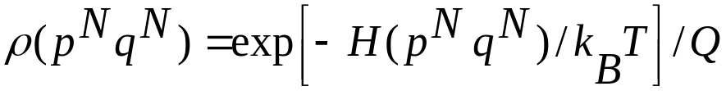
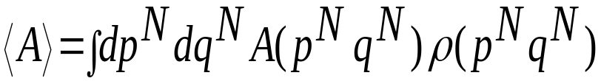
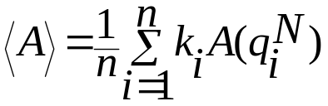
Let us define the probability density ρ of finding the system in a configuration (q^{N})
In terms of this probability density the configuration average of any quantity A is given by
So if by some means we can generate points in the configuration space according the the above probability density we can evaluate the above average as
k_{i} is the number of points generated per unit volume around a point q^{N} and is equal to nρ (n is the total number of points)

Slide 23
How to generate points in configuration space

Slide 24

Metropolis Algorithm 1.
Prescribes transition probabilities to satisfy detailed balance, given desired limiting distribution
Recipe:
From a state i…
  with probability τ_{ij}, choose a trial state j for the move (note: τ_{ij} = τ_{ji})
  if π_{j} > π_{i}, accept j as the new state
  otherwise, accept state j with probability π_{j}/π_{i}
    generate a random number R on (0,1); accept if R < π_{j}/π_{i}
  if not accepting j as the new state, take the present state as the next one in the Markov chain
Metropolis, Rosenbluth, Rosenbluth, Teller and Teller, J. Chem. Phys., 21 1087 (1953)

Slide 25
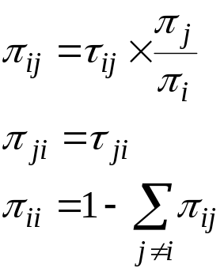

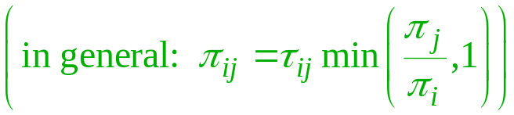
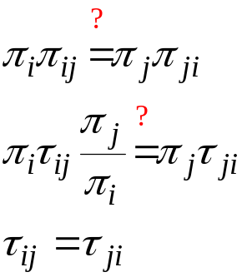
Metropolis Algorithm 2.
What are the transition probabilities for this algorithm?
  Without loss of generality, define i as the state of greater probability
Do they obey detailed balance?
Yes, as long as the underlying matrix Τ of the Markov chain is symmetric
  this can be violated, but acceptance probabilities must be modified

Slide 26
π(o→n) is the transition probability to go from o (old) to n (new)
π(n→o) is the transition probability to go from n (new) to o (old)
N(o) and N(n) are the probability of finding the system in configuration o and n
Detailed balance requires
N(o) π(o→n) =N(n) π(n→o)
Denote the transition matrix that determines the probability of performing a trial move from o to n by α(o→n) where α is the underlying matrix of the Markov chain. We also denote the probability of accepting a trial move from o to n by acc(o→n).
π(o→n) = α(o→n) acc(o→n)
In the original Metropolis scheme α was chosen to be symmetric :
α(o→n)= α(n→o). In terms of α we have
N(o) acc(o→n) =N(n) acc(n→o)

Slide 27
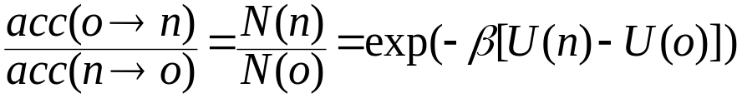
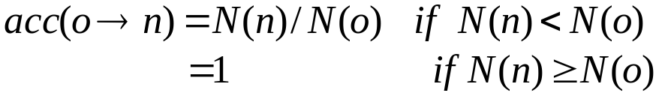
From the above equation we have
Various choices of the acceptance probability satisfy the above condition. Metropolis choose the following
So the transition probability for going from a state o to a state n is given by
π(o→n) = α(o→n) N(n) ≥N(o)
= α(o→n) [N(n)/N(o)] N(n) <N(o)
π(o→n) =1-∑_{n≠o} π(o→n)

Slide 28
The Algorithm
Select a particle at random and calculate its energy U(r^{N})
Give the particle a random displacement r’=r+dr and rotation if (linear and non-linear molecule and compute the new energy U(r’^{N})
Accept the move from r^{N} to r’^{N} with probability
acc(o→n) =min(1,exp{-β[U(r’^{N})-U(r^{N})]})

Slide 29
Generating trial displacement
for (j = 0; j < NDIM; ++j) {
dr[j] = (2.0 * ran3(i_ran) - 1.0) * dr_max;
mol_coords_trial[j] += dr[j];
}

Slide 30
Generating trial rotation
do {
mag2 = 0.0;
for (i = 1; i < 4; ++i){
q[i] = (2.0 * ran3(i_ran) - 1.0) * du_max;
mag2 += SQR(q[i]);
} } while (mag2 > 1.0);
q[0] = sqrt(1 - mag2);
/* Compute the elements of the rotation matrix. */
a11 = SQR(q[0]) + SQR(q[1]) - SQR(q[2]) - SQR(q[3]);
a12 = 2.0 * q[1] * q[2] + 2.0 * q[0] * q[3];
a13 = 2.0 * q[1] * q[3] - 2.0 * q[0] * q[2];
a21 = 2.0 * q[1] * q[2] - 2.0 * q[0] * q[3];
a22 = SQR(q[0]) - SQR(q[1]) + SQR(q[2]) - SQR(q[3]);
a23 = 2.0 * q[2] * q[3] + 2.0 * q[0] * q[1];
a31 = 2.0 * q[1] * q[3] + 2.0 * q[0] * q[2];
a32 = 2.0 * q[2] * q[3] - 2.0 * q[0] * q[1];
a33 = SQR(q[0]) - SQR(q[1]) - SQR(q[2]) + SQR(q[3]);

Slide 31
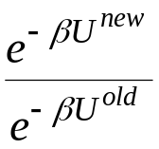
Monte Carlo Simulation
State k
MC techniques applied to molecular simulation
Almost always involves a Markov process
  move to a new configuration from an existing one according to a well-defined transition probability
Simulation procedure
  generate a new “trial” configuration by making a perturbation to the present configuration
  accept the new configuration based on the ratio of the probabilities for the new and old configurations, according to the Metropolis algorithm
  if the trial is rejected, the present configuration is taken as the next one in the Markov chain
  repeat this many times, accumulating sums for averages
State k+1

Slide 32
Trial Moves
A great variety of trial moves can be made
Basic selection of trial moves is dictated by choice of ensemble
  almost all MC is performed at constant T
    no need to ensure trial holds energy fixed
  must ensure relevant elements of ensemble are sampled
    all ensembles have molecule displacement, rotation; atom displacement
    isobaric ensembles have trials that change the volume
    grand-canonical ensembles have trials that insert/delete a molecule
Significant increase in efficiency of algorithm can be achieved by the introduction of clever trial moves
  reptation, crankshaft moves for polymers
  multi-molecule movements of associating molecules
  many more

Slide 33
Displacement Trial Move
1. Specification
Gives new configuration of same volume and number of molecules
Basic trial:

Slide 34
Displacement Trial Move
1. Specification
Gives new configuration of same volume and number of molecules
Basic trial:
  displace a randomly selected atom to a point chosen with uniform probability inside a cubic volume of edge 2δ centered on the current position of the atom
Select an atom at random

Slide 35
Displacement Trial Move
1. Specification
Gives new configuration of same volume and number of molecules
Basic trial:
  displace a randomly selected atom to a point chosen with uniform probability inside a cubic volume of edge 2δ centered on the current position of the atom
2δ
Consider a region about it

Slide 36
Displacement Trial Move
1. Specification
Gives new configuration of same volume and number of molecules
Basic trial:
  displace a randomly selected atom to a point chosen with uniform probability inside a cubic volume of edge 2δ centered on the current position of the atom
Consider a region about it

Slide 37
Displacement Trial Move
1. Specification
Gives new configuration of same volume and number of molecules
Basic trial:
  displace a randomly selected atom to a point chosen with uniform probability inside a cubic volume of edge 2δ centered on the current position of the atom
Move atom to point chosen uniformly in region

Slide 38
Displacement Trial Move
1. Specification
Gives new configuration of same volume and number of molecules
Basic trial:
  displace a randomly selected atom to a point chosen with uniform probability inside a cubic volume of edge 2δ centered on the current position of the atom
Consider acceptance of new configuration
?

Slide 39
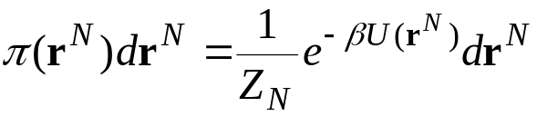
Displacement Trial Move
1. Specification
Gives new configuration of same volume and number of molecules
Basic trial:
  displace a randomly selected atom to a point chosen with uniform probability inside a cubic volume of edge 2δ centered on the current position of the atom
Limiting probability distribution
  canonical ensemble
  for this trial move, probability ratios are the same in other common ensembles, so the algorithm described here pertains to them as well
Examine underlying transition probabilities to formulate acceptance criterion
?

Slide 40
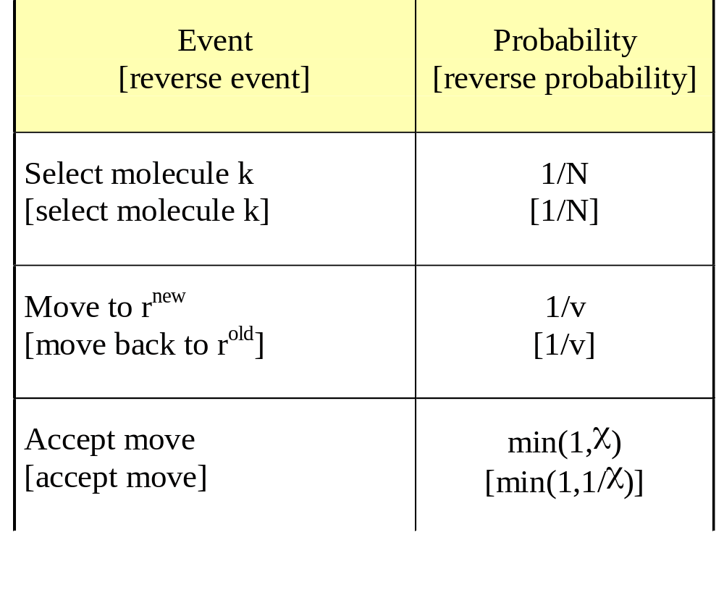
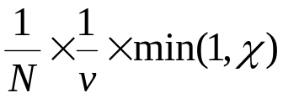
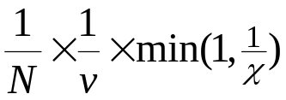
Displacement Trial Move
2. Analysis of Transition Probabilities
Detailed specification of trial move and transition probabilities
Forward-step transition probability
Reverse-step transition probability
v = (2δ)^{d}
χ is formulated to satisfy detailed balance

Slide 41
Displacement Trial Move
3. Analysis of Detailed Balance
Forward-step transition probability
Reverse-step transition probability
Detailed balance
π_{i}
π_{ij}
=
π_{j}
π_{ji}
Limiting distribution

Slide 42
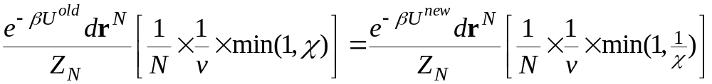
Displacement Trial Move
3. Analysis of Detailed Balance
Forward-step transition probability
Reverse-step transition probability
Detailed balance
π_{i}
π_{ij}
=
π_{j}
π_{ji}
Limiting distribution

Slide 43

Displacement Trial Move
3. Analysis of Detailed Balance
Forward-step transition probability
Reverse-step transition probability
Detailed balance
π_{i}
π_{ij}
=
π_{j}
π_{ji}
Acceptance probability

Slide 44
Displacement Trial Move
5. Tuning
Size of step is adjusted to reach a target rate of acceptance of displacement trials
  typical target is 50%
  for hard potentials target may be lower (rejection is efficient)
Large step leads to less acceptance but bigger moves
Small step leads to less movement but more acceptance

Slide 45
Volume-change Trial Move
1. Specification
Gives new configuration of different volume and same N and s^{N}
Basic trial:

Slide 46
Volume-change Trial Move
1. Specification
Gives new configuration of different volume and same N and s^{N}
Basic trial:
  increase or decrease the total system volume by some amount within ±δV, scaling all molecule centers-of-mass in proportion to the linear scaling of the volume
+δV
−δV
Select a random value for volume change

Slide 47
Volume-change Trial Move
1. Specification
Gives new configuration of different volume and same N and s^{N}
Basic trial:
  increase or decrease the total system volume by some amount within ±δV, scaling all molecule centers-of-mass in proportion to the linear scaling of the volume
Perturb the total system volume

Slide 48
Volume-change Trial Move
1. Specification
Gives new configuration of different volume and same N and s^{N}
Basic trial:
  increase or decrease the total system volume by some amount within ±δV, scaling all molecule centers-of-mass in proportion to the linear scaling of the volume
Scale all positions in proportion

Slide 49
Volume-change Trial Move
1. Specification
Gives new configuration of different volume and same N and s^{N}
Basic trial:
  increase or decrease the total system volume by some amount within ±δV, scaling all molecule centers-of-mass in proportion to the linear scaling of the volume
Consider acceptance of new configuration
?

Slide 50
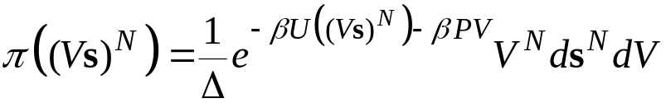
Volume-change Trial Move
1. Specification
Gives new configuration of different volume and same N and s^{N}
Basic trial:
  increase or decrease the total system volume by some amount within ±δV, scaling all molecule centers-of-mass in proportion to the linear scaling of the volume
Limiting probability distribution
  isothermal-isobaric ensemble
Examine underlying transition probabilities to formulate acceptance criterion
Remember how volume-scaling was used in derivation of virial formula

Slide 51
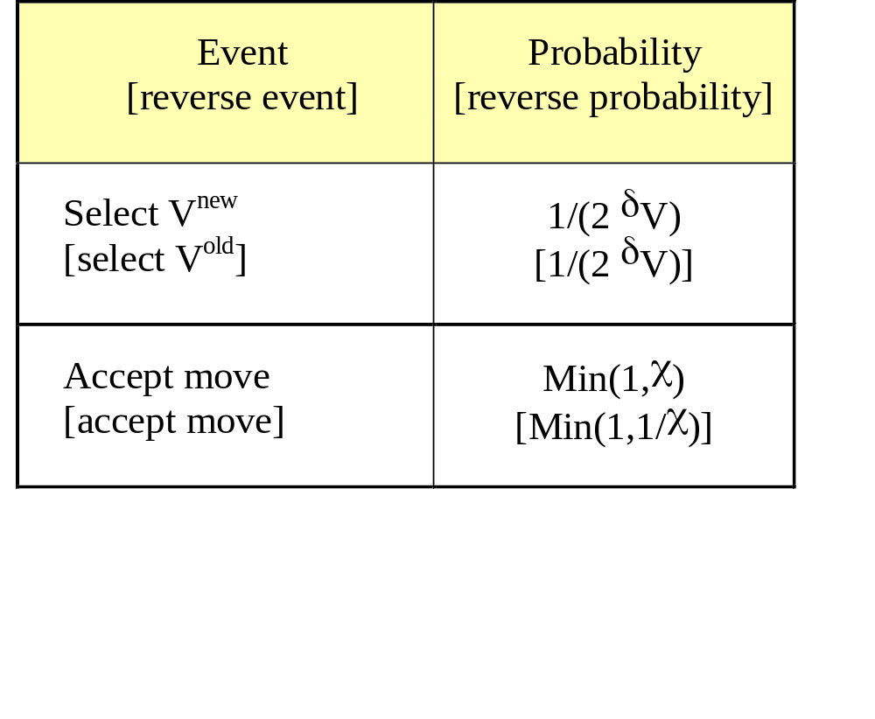
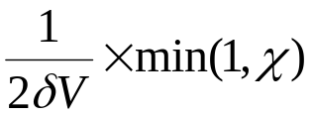
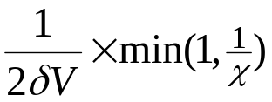
Volume-change Trial Move
2. Analysis of Transition Probabilities
Detailed specification of trial move and transition probabilities
Forward-step transition probability
Reverse-step transition probability
χ is formulated to satisfy detailed balance

Slide 52
Volume-change Trial Move
3. Analysis of Detailed Balance
Forward-step transition probability
Reverse-step transition probability
Detailed balance
π_{i}
π_{ij}
=
π_{j}
π_{ji}
Limiting distribution

Slide 53
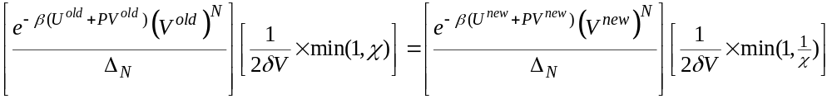
Volume-change Trial Move
3. Analysis of Detailed Balance
Forward-step transition probability
Reverse-step transition probability
Detailed balance
π_{i}
π_{ij}
=
π_{j}
π_{ji}
Limiting distribution

Slide 54
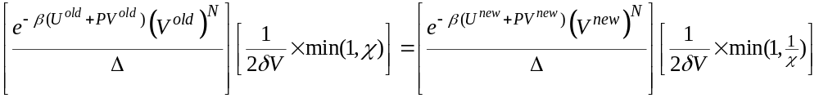
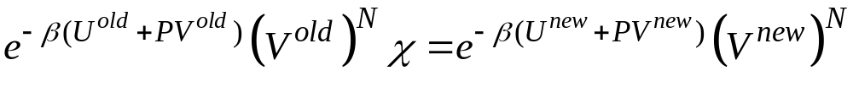
Volume-change Trial Move
3. Analysis of Detailed Balance
Forward-step transition probability
Reverse-step transition probability
Detailed balance
π_{i}
π_{ij}
=
π_{j}
π_{ji}
Acceptance probability

Slide 55
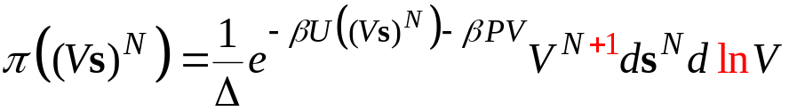


Volume-change Trial Move
4. Alternative Formulation
Step in ln(V) instead of V
  larger steps at larger volumes, smaller steps at smaller volumes
Limiting distribution
Trial move
Acceptance probability min(1,χ)

Slide 56
Summary
Monte Carlo simulation is the application of MC integration to molecular simulation
Trial moves made in MC simulation depend on governing ensemble
  many trial moves are possible to sample the same ensemble
Careful examination of underlying transition matrix and limiting distribution give acceptance probabilities
  particle displacement
  volume change

