Slide 1
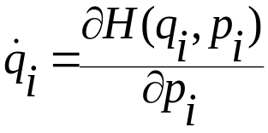
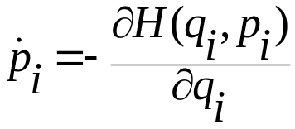
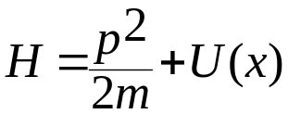

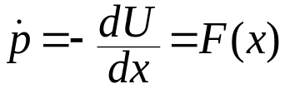
Review of Hamiltonian Dynamics and Operators in Classical Mechanics
For a classical system, specifying the instantaneous positions and momenta of all the particles constituting the system can specify the microstate at any time t. For N particles there are 3N coordinates q₁,q₂ ...q_{3N} and 3N conjugate momenta p₁,p₂ ...p_{3N}. The equations of motion are ﬁrst order differential equations
Let us consider a simple one-particle system in one dimension with a Hamiltonian
The equations of motion are

Slide 2
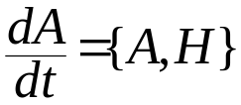
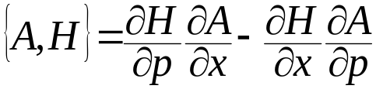
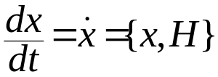
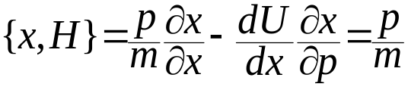


Now Liouville’s theorem says that any phase space function A(x, p) evolves as
where the the {A, H} is the Poisson bracket given by
The evolution equation gives back Hamilton’s equation of motion: To see that take A(x,p) =x. Then
So we have
Since
= 0

Slide 3
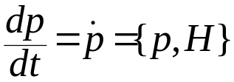
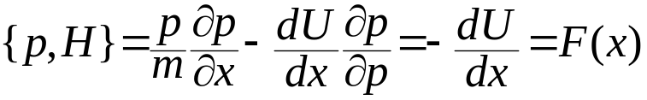

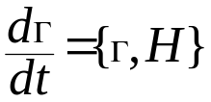
Similarly if we take A(x,p) = p
So we have
As expected evolution equation gives back Hamilton’s equation of motion
Now define a two-dimensional phase space vector Γ=(x,p). Hamilton’s equation of motion for this Γ is
Now we define Liouville operator L such that iLΓ ={Γ,H}

Slide 4
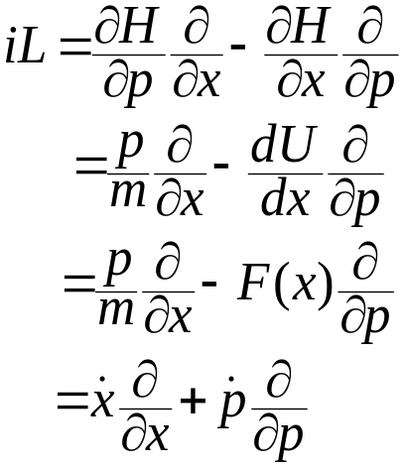
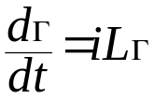

iL can be expressed as differential operator using Hamilton’s equation
The equation of motion in operator form is given by
which can be solved to give
The operator exp(iLt) is called the classical propagator and the presence of i gives a nice analogy with the QM propagator exp(-iHt/ħ)

Slide 5
Properties of Liouville Operator and propagator
It is Hermitian: L† = L
Prove this? (Home work)
The propagator U(t) ≡ exp(iLt) is a unitary operator
U†(t)U(t) = I
Prove this? (Home work)
The unitarity of the propagator implies time reversal symmetry in the equations of motion. If the system is propagated forward in time up to a time t and then the clock is allowed to run backwards for a time –t, the system will evolve according to the same equations of motion but the direction of the velocities will be reversed, so that the system will simply return to its initial condition.
U(-t) = exp(-iLt)
Now apply U(t) on Γ(0) to get Γ(t) followed by U(-t) : Γ(t) = U(t) Γ(0)

Slide 6
U(-t) U(t) Γ(0) = e^{-iLt} e^{iLt}Γ(0)= Γ(0)
So U(-t) U(t) = I ⇒ U(-t) = U†(t) since U(t) is unitary
Since U†(t) is equivalent to backward propagation in time, it implies time reversibility since U†(t)U(t) = I
Another important property of the unitary operator U(t) is that its determinant is 1 (Homework)
Unitarity of the propagator is consistent with the fact the volume in phase space is preserved under Hamilton’s equation (Homework)

Slide 7
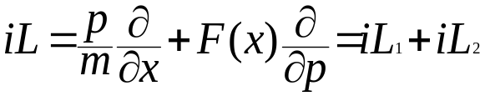
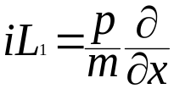
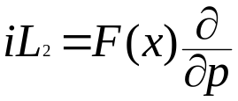
Trotter Theorem
We have the evolution of the phase space vector
In general it is difficult to evaluate exp(iLt) the reason for which will be clear from the following discussion
Remember iL can be written as
The difficulty in the any computation arises from the fact that iL₁ and iL₂ do not commute : [iL₁,iL₂] ≠0
Show that iL₁ and iL₂ do not commute : [iL₁,iL₂] ≠0 (Homework)

Slide 8
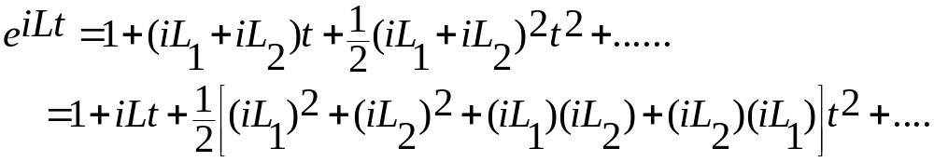
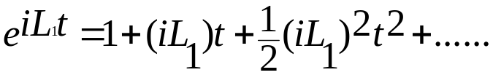
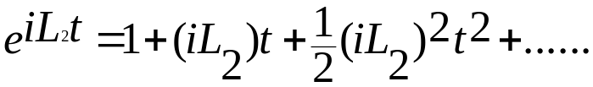
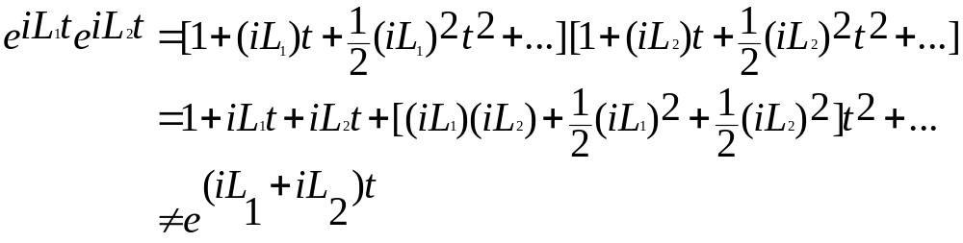
Since they don’t commute
exp(iL₁t+iL₂t) ≠ exp(iL₁t)exp(iL₂t)
We can see this easily if we expand both side by Taylor expansion
Now

Slide 9
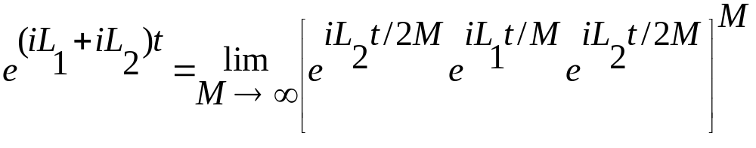
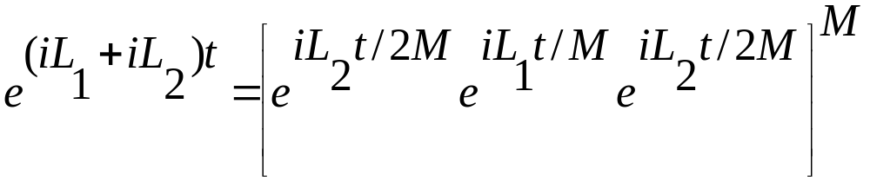
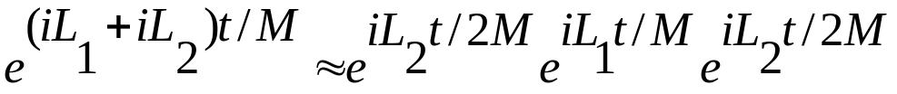
Trotter theorem comes to our rescue
For a proof see Techniques and Applications of Path Integral by L. S. Schulman
For large but finite M above equation can be approximated as
The expression on the left looks like approximate propagation of the system up to time t by M application of the operator in the bracket. If we interpret t/M as single time step, δt, then we have

Slide 10
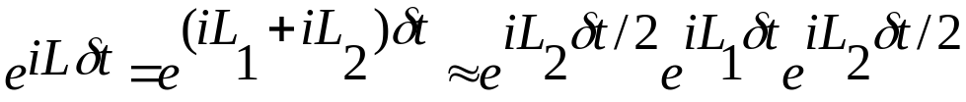
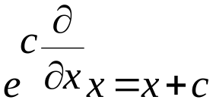
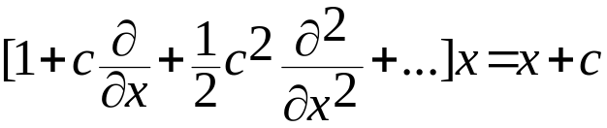
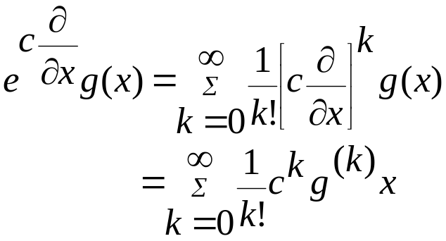
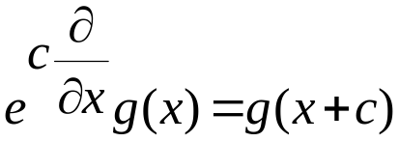
This is the propagator U(δt) for the time step δt. Like U(t), U(δt) is unitary and preserve the time reversibility of the dynamics
Show U†(δt)= U(-δt) = U⁻¹(δt)
and U(-δt) U(δt) = I (Homework)
Now let us see what is the effect of the propagator U(δt) on the coordinates and momenta of the particles
Some useful identity
This is just the Taylor series of g(x+c) so

Slide 11
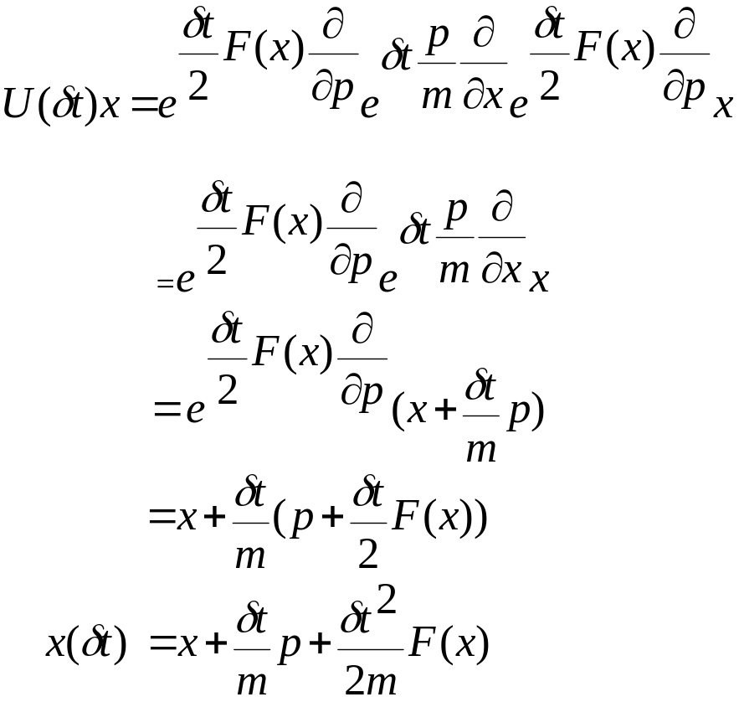
Note that the action of exp(a∂/∂p) on x or g(x) has no effect: it acts like identity operator
First operator acting on x has no effect, it involves only momentum derivative
Second operator changes x to x+δt p/m
Last operator acting on x has no effect. It acts on p and changes p to p+δt F(x)/2

Slide 12
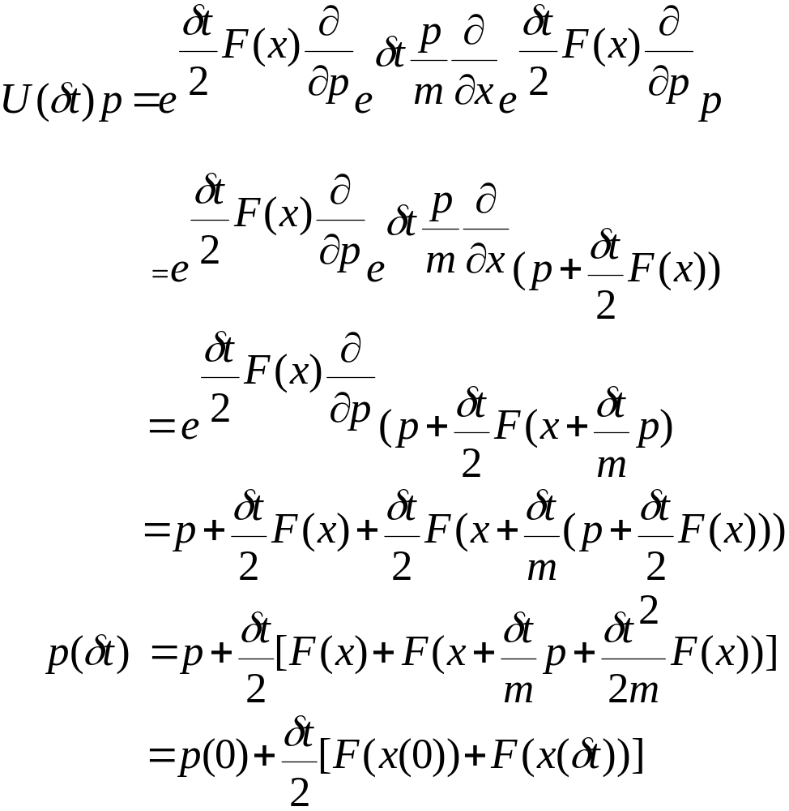
Similarly we can apply U(δt) on p to get
First operator acting on p changes p to p+δt F(x)/2
Next operator acting on F(x) changes it to F(x+δt p/m)
Last operator acting on p changes p to p+δt F(x)/2
Argument of the second force in the above expression is just x(δt )

Slide 13
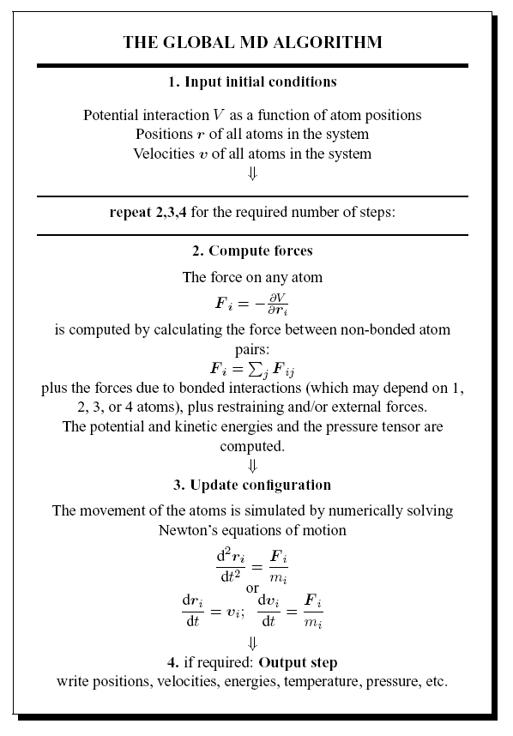

Slide 14
Verlet Algorithm: Flow Diagram
t-δt t t+δt
r
v
F
Given current position and position at end of previous time step
Schematic from Allen & Tildesley, Computer Simulation of Liquids
Slide from Kofke Lecture

Slide 15
Verlet Algorithm: Flow Diagram
t-δt t t+δt
r
v
F
Compute the force at the current position
Schematic from Allen & Tildesley, Computer Simulation of Liquids
Slide from Kofke Lecture

Slide 16
Verlet Algorithm: Flow Diagram
t-δt t t+δt
r
v
F
Compute new position from present and previous positions, and present force
Schematic from Allen & Tildesley, Computer Simulation of Liquids
Slide from Kofke Lecture

Slide 17
Verlet Algorithm : Flow Diagram
t-2δt t-δt t t+δt
r
v
F
Advance to next time step,
repeat
Schematic from Allen & Tildesley, Computer Simulation of Liquids
Slide from Kofke Lecture

Slide 18

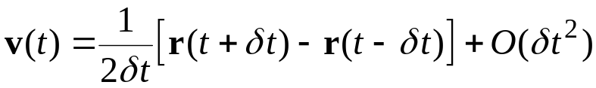
Verlet Algorithm: Loose Ends
Initialization
  how to get position at “previous time step” when starting out?
  simple approximation
Obtaining the velocities
  not evaluated during normal course of algorithm
  needed to compute some properties, e.g.
    temperature
    diffusion constant
  finite difference

Slide 19

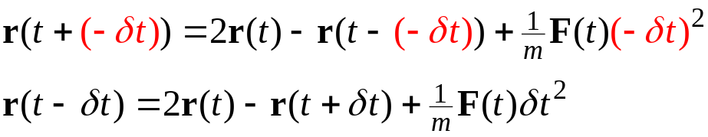
Verlet Algorithm Performance Issues
Time reversible
  forward time step
  replace δt with −δt
  same algorithm, with same positions and forces, moves system backward in time
Numerical imprecision of adding large/small numbers
O(δt¹)
O(δt¹)
O(δt⁰)
O(δt¹)
O(δt²)

Slide 20

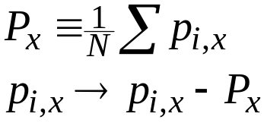
Initial Velocity
Random direction
  randomize each component independently
  randomize direction by choosing point on spherical surface
Magnitude consistent with desired temperature. Choices:
  Maxwell-Boltzmann:
  Same for y, z components
Be sure to shift so center-of-mass momentum is zero

Slide 21
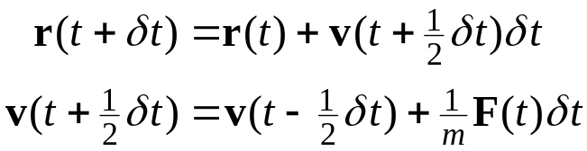
Leapfrog Algorithm
Eliminates addition of small numbers O(δt²) to differences in large ones O(δt⁰)
Algorithm

Slide 22
Leapfrog Algorithm
Eliminates addition of small numbers O(δt²) to differences in large ones O(δt⁰)
Algorithm
Mathematically equivalent to Verlet algorithm

Slide 23

Leapfrog Algorithm
Eliminates addition of small numbers O(δt²) to differences in large ones O(δt⁰)
Algorithm
Mathematically equivalent to Verlet algorithm
r(t) as evaluated from previous time step

Slide 24
Leapfrog Algorithm
Eliminates addition of small numbers O(δt²) to differences in large ones O(δt⁰)
Algorithm
Mathematically equivalent to Verlet algorithm
r(t) as evaluated from previous time step

Slide 25
Leapfrog Algorithm
Eliminates addition of small numbers O(δt²) to differences in large ones O(δt⁰)
Algorithm
Mathematically equivalent to Verlet algorithm
r(t) as evaluated from previous time step
original Verlet algorithm

Slide 26
Leapfrog Algorithm: Flow Diagram
t-δt t t+δt
r
v
F
Given current position, and velocity at last half-step
Schematic from Allen & Tildesley, Computer Simulation of Liquids

Slide 27
Leapfrog Algorithm: Flow Diagram
t-δt t t+δt
r
v
F
Compute current force
Schematic from Allen & Tildesley, Computer Simulation of Liquids

Slide 28
Leapfrog Algorithm: Flow Diagram
t-δt t t+δt
r
v
F
Compute velocity at next half-step
Schematic from Allen & Tildesley, Computer Simulation of Liquids

Slide 29
Leapfrog Algorithm: Flow Diagram
t-δt t t+δt
r
v
F
Compute next position
Schematic from Allen & Tildesley, Computer Simulation of Liquids

Slide 30
Leapfrog Algorithm: Flow Diagram
t-2δt t-δt t t+δt
r
v
F
Advance to next time step,
repeat
Schematic from Allen & Tildesley, Computer Simulation of Liquids

Slide 31

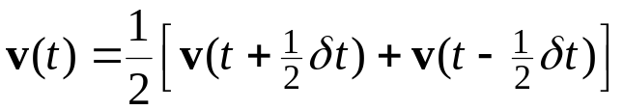
Leapfrog Algorithm Loose Ends
Initialization
  how to get velocity at “previous time step” when starting out?
  simple approximation
Obtaining the velocities
  interpolate

Slide 32
Velocity Verlet algorithm
r(δt) = r(0) + v(0) δt + 1/2 a(r(0)) δt ² + b(t) δt ³ + O(δt ⁴) good to 2nd order in δt
Do the Taylor expand for velocities
v(δt) = v(0) + δt a(r(0)) + + O(δt ²) good to 1st order in δt
To get V also accurate to the 2nd order in δt we consider starting from δt and applying the rule backward in time (I.e. for a time –δt) so that we end up back at
r(0) = r(δt) -v(δt) δt + 1/2 a(r(δt)) δt ²
v(δt) = (r(δt) - r(0))/(δt) + δt /2 a(r(δt))
Now using the position equation we have
r(δt) - r(0)= v(0) δt + 1/2 a(r(0)) δt ²
So we have v(δt) = v(0) + δt /2 [a(r(0)) + a(r(δt)) ]
Combining we have
r(δt) = r(0) + v(0) δt + 1/2 a(r(0)) δt ²
v(δt) = v(0) + δt /2 [a(r(0)) + a(r(δt)) ] Velocity Verlet

Slide 33
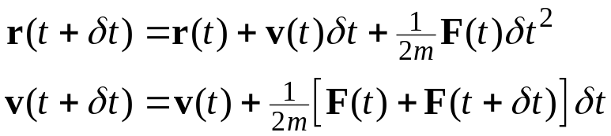
Velocity Verlet Algorithm
Round off advantage of leapfrog, but better treatment of velocities
Algorithm
Implemented in stages
  evaluate current force
  compute r at new time
  add current-force term to velocity (gives v at half-time step)
  compute new force
  add new-force term to velocity
Also mathematically equivalent to Verlet algorithm
(in giving values of r)

Slide 34
Velocity Verlet Algorithm Flow Diagram
t-δt t t+δt
r
v
F
Given current position, velocity, and force
Schematic from Allen & Tildesley, Computer Simulation of Liquids

Slide 35
Velocity Verlet Algorithm Flow Diagram
t-δt t t+δt
r
v
F
Compute new position
Schematic from Allen & Tildesley, Computer Simulation of Liquids

Slide 36
Velocity Verlet Algorithm Flow Diagram
t-δt t t+δt
r
v
F
Compute velocity at half step
Schematic from Allen & Tildesley, Computer Simulation of Liquids

Slide 37
Velocity Verlet Algorithm Flow Diagram
t-δt t t+δt
r
v
F
Compute force at new position
Schematic from Allen & Tildesley, Computer Simulation of Liquids

Slide 38
Velocity Verlet Algorithm Flow Diagram
t-δt t t+δt
r
v
F
Compute velocity at full step
Schematic from Allen & Tildesley, Computer Simulation of Liquids

Slide 39
Velocity Verlet Algorithm Flow Diagram
t-2δt t-δt t t+δt
r
v
F
Advance to next time step,
repeat
Schematic from Allen & Tildesley, Computer Simulation of Liquids

Slide 40
Lines of code for Leap-frog Verlet algorithm
/* Carry out half-timestep update of atomic velocities using old forces. */
velocity_step(n_atoms, atom_vels, atom_mass, delta, comp_forces);
/* Carry out full-timestep update of atomic positions using half-timestep velocities. */
position_step(n_atoms, atom_coords, atom_vels, atom_move,
scaled_atom_coords, h_inv, h, delta, neigh_switch);
/* Add short-range nonbonded forces to force accumulators. */
for (i = 0; i < n_atoms; ++i) {
for ( k = 0; k < NDIM; ++k)
comp_forces[i][k] += f_vdw_s[i][k] + f_coul_s[i][k];
}
/* Carry out half-timestep update of atomic velocities using new forces. */
velocity_step(n_atoms, atom_vels, atom_mass, delta, comp_forces);

Slide 41
void velocity_step(int n_atoms, double **atom_vels,
double *atom_mass, double delta, double **comp_forces)
{
int i, k;
double delta_over_2m;
/* Update velocities. */
for (i = 0; i < n_atoms; ++i) {
delta_over_2m = delta /(2*atom_mass[i]) ;
for ( k = 0; k < NDIM; ++k)
atom_vels[i][k] += delta_over_2m * comp_forces[i][k];
}
}

Slide 42
/* Carry out full-timestep update of atomic positions using half-timestep velocities. */
void position_step(int n_atoms, double **atom_coords,
double **atom_vels,
double **atom_move, double **scaled_atom_coords,
double **h_inv, double **h, double delta, int neigh_switch)
{
int i, k;
double dr[NDIM];
/* Update positions. */
for (i = 0; i < n_atoms; ++i) {
for (k = 0; k < NDIM; ++k) {
dr[k] = delta * atom_vels[i][k];
atom_coords[i][k] += dr[k];
} }
/* If we are using periodic boundary conditions, calculate scaled atomic coordinates. */
scaled_atomic_coords(n_atoms, h_inv, atom_coords, scaled_atom_coords);
periodic_boundary_conditions(n_atoms, h, scaled_atom_coords, atom_coords);
}

Slide 43
Velocity sampling routine
/* Sample atomic velocities from a Maxwellian distribution. */
void sample_velocities(long *idum, double **atom_vels, int n_atoms,
double *sqrt_kT_over_m)
{
int i, k;
double sqrt_kT_by_m;
/* Choose Gaussian-distributed cartesian velocity components for each
atom, with zero mean and standard deviation equal to sqrt(kT/m). */
for (i = 0; i < n_atoms; ++i) {
sqrt_kT_by_m = sqrt_kT_over_m[i];
for (k = 0; k < NDIM; ++k)
atom_vels[i][k] = sqrt_kT_by_m * gasdev(idum);
}
}

Slide 44
Other Algorithms
Leap Frog: This can be derived from Verlet algorithm. Velocities at half integer time step can be written as
v(t- δt/2) = [ r(t) - r(t- δt) ]/ δt
v(t+ δt/2) = [ r(t+δt) -r(t) ]/ δt
From the above two equation we get the expression for the new position
r(t+ δt) = r(t) + δt v(t+ δt/2)
To update the velocity we use the expression from Verlet algorithm
v(t+ δt/2) = v(t- δt/2) + δt a(t)
Note that velocities are not defined at the same time as the positions, so KE and PE are also not defined at the same time, and hence we can not directly compute the total energy in the Leap-Frog scheme

Slide 45
Leap-Frog cont.
How ever it is possible to cast it in a way to look more Verlet like
  r(t+ δt) = r(t) + δt [ v(t) +(δt /2) a(t)]
  Velocity update is done as follows
  v(t+ δt)=v(t) + (δt /2) [a(t+ δt)+ a(t)]
  New velocity computation requires new force and hence new positions
  In this form it is equivalent to velocity Verlet algorithm

Slide 46
Higher Order algorithm: Predictor-corrector
Consider the Taylor expansion of the r(t+ δt)
r(t+δt) = r(t) + v(t) δt + 1/2 a(t) δt ² + b(t) δt ³ + O(δt ⁴)

Slide 47
How to set the time step
Adjust to get energy conservation to 1% of kinetic energy.
Even if errors are large, you are close to the exact trajectory of a nearby physical system with a different potential.
Since we don’t really know the potential surface that accurately, this is satisfactory.
Leapfrog algorithm has a problem with round-off error.
Use the equivalent velocity Verlet instead:
  r(t+ δt) = r(t) + δt [ v(t) +(δt /2) a(t)]
  v(t+ δt /2) = v(t)+(δt /2) a(t)
  v(t+ δt)=v(t+ δt /2) + (δt /2) a(t+ δt)

Slide 48
Physical Quantities in Molecular Simulation
State variables
  each variable has an associated “conjugate” variable
    temperature ⇔ energy (kT,E)
    pressure ⇔ volume (P,V)
    chemical potential ⇔ number of molecules (μ,N)
  specification of state requires fixing one of each pair
  the dependent variable can be measured by the simulation
Configuration variables
  position, orientation, momentum of each atom or molecule
  energy, forces and torques
  time
Properties
  transport coefficients, free energy, structural quantities, etc.
Molecular model parameters
  characteristic energy, size, charge

Slide 49

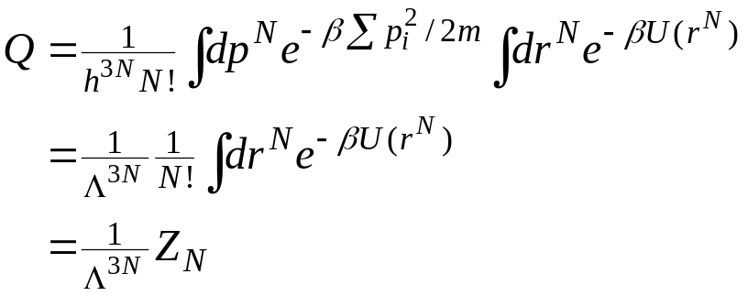

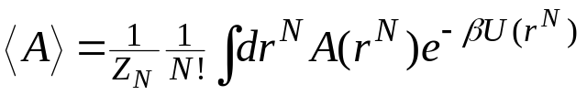
Separation of the Energy
Total energy is sum of kinetic and potential parts
  E(p^{N},r^{N}) = K(p^{N}) + U(r^{N})
Kinetic energy is quadratic in momenta
Kinetic contribution can be treated analytically in partition function
And it drops out of position averages
thermal de Broglie wavelength
configuration integral

Slide 50
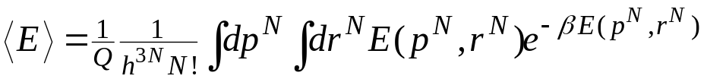
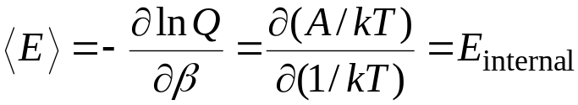
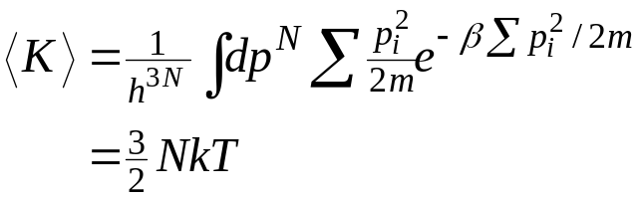
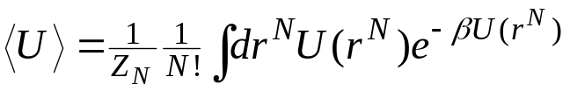
Simple Averages 1. Energy
Average energy
Note thermodynamic connection
Average kinetic energy
Average potential energy
Equipartition of energy: kT/2 for each degree of freedom

Slide 51
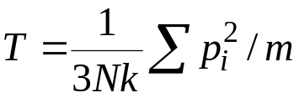

Simple Averages 2. Temperature
Need to measure temperature in microcanonical ensemble (NVE) simulations
Define instantaneous kinetic temperature
Thermodynamic temperature is then given as ensemble average
Relies on equipartition as developed in canonical ensemble
A better formulation has been developed recently (Thermostating)
More generally, divide by number of molecular degrees of freedom instead of 3N

Slide 52
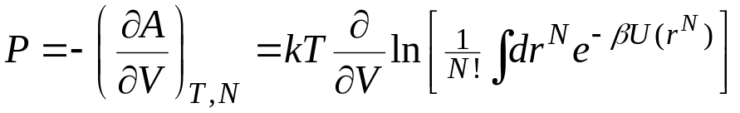
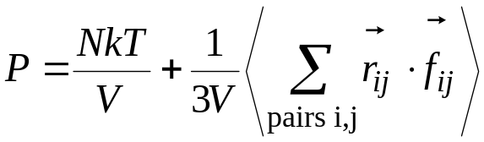
Simple Averages 3a. Pressure
From thermodynamics and bridge equation

Slide 53
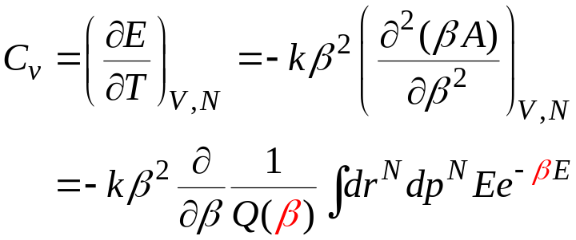

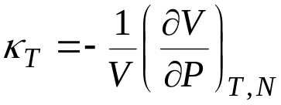
Simple Averages 4. Heat Capacity
Example of a “2nd derivative” property
Expressible in terms of fluctuations of the energy
Other 2nd-derivative or “fluctuation” properties
  isothermal compressibility
Note: difference between two O(N²) quantities to give a quantity of O(N)

Slide 54
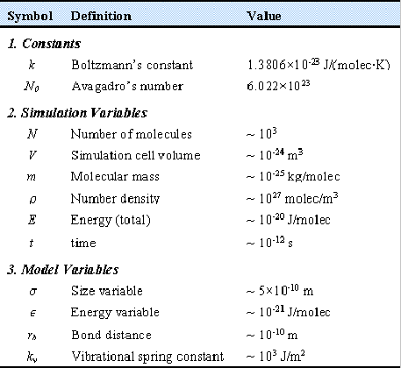
Dimensions and Units 1. Magnitudes
Important extensive quantities small in magnitude
  when expressed
  in macroscopic units
Small numbers are inconvenient
Two ways to magnify them
  work with atomic-scale units
    ps, amu, nm or Å
  make dimensionless with characteristic values
    model values of size, energy, mass

Slide 55
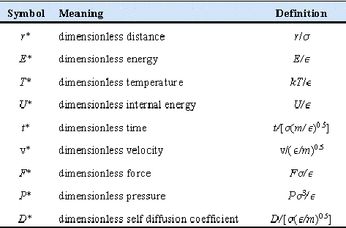
Dimensions and Units 2. Scaling
In simulations it is often convenient to express quantities such as temperature, density, pressure and the like in reduced units. This means that we choose a convenient unit of energy, length and mass and then express all the other quantities in terms of these basic units. A natural choice of our basic units is the following
  size σ
  energy ε
  mass m
In terms of these basic units, all other units follow

Slide 56
Why reduced Units?
Many combinations of ρ, T, ε and σ all correspond to the same state in reduced units. This is the law of corresponding states: the same simulation can of a LJ model can be used to study the Argon at 60 K and density 840 kg/m3 and Xe at 112 K and a density at 1617 kg/m3. In reduced unit both simulations corresponds to the state point ρ = 0.5 and T = 0.5. Scaling by model parameters
In reduced units almost all quantities of interest are of order 1 (say between 10-3 and 103). Hence if we suddenly find very large (or very small) number in our simulations, suspect some error somewhere.
Simulation results obtained in reduced units can be translated back into real units.
See the following table

Slide 57
Conversion of reduced Units to real Units for LJ argon system: ε/k_{B} = 119.8 K, σ=3.405x10⁻¹⁰ m, m = 0.03994 kg/mol
Quantity
Reduced Units
Real Units
Temperature
T* = 1
T = ε/k_{B} = 119.8 K
Density
ρ* = 1
ρ = 1680 kg/m³
Time
δt* = 0.005
δt=1.09 x 10⁻¹⁴s
Pressure
P*=1
P = 41.9 MPa

Slide 58


Dimensions and Units 3.
Conformal Solutions
Lennard-Jones potential in dimensionless form
Parameter independent!
Dimensionless properties must also be parameter independent
  convenient to report properties in this form, e.g. P*(ρ*)
  select model values to get actual values of properties
  Basis of corresponding states
Equivalent to selecting unit value for parameters

