Slide 1
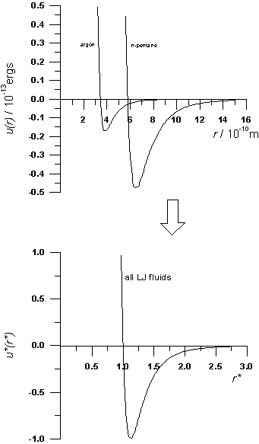
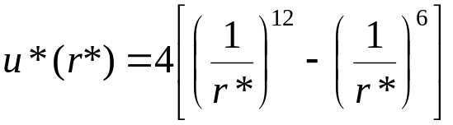
Dimensions and Units 3.
Conformal Solutions
Lennard-Jones potential in dimensionless form
Parameter independent!
Dimensionless properties must also be parameter independent
  convenient to report properties in this form, e.g. P*(ρ*)
  select model values to get actual values of properties
  Basis of corresponding states
Equivalent to selecting unit value for parameters

Slide 2

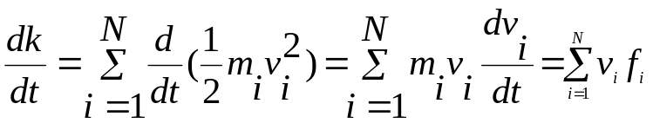

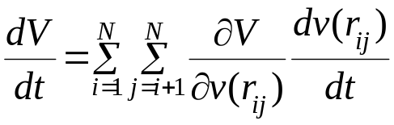
Energy conservation in Molecular dynamics
We want to derive an expression for the rate of change of
energy with time dE/dt. First we consider the kinetic energy
term
The potential energy is written as a series of pairwise
interaction
The derivative of the potential energy wrt to time is given by

Slide 3
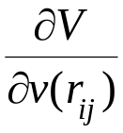
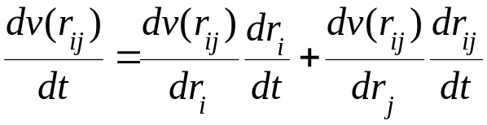
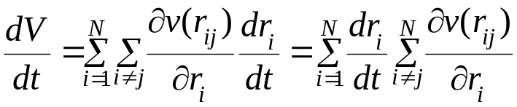
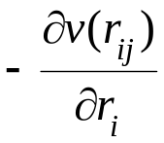
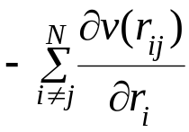
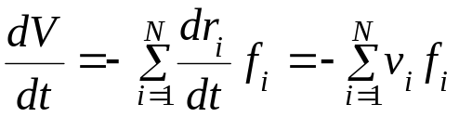
equals 1 for each pairwise combination i and j. Each term v(r_{ij}) is a function of the positions of atom i and j (r_{i} and r_{j}) and we can write
For a given atom i, there will be a total of N-1 terms of the form v(r_{ij}) in the expression for the potential energy due to the interactions between I and all other atoms j. Hence we can write dV/dt as follows
The force on atom I due to its interaction with atom j equals minus the gradient with respect to r_{i} or
Thus the total force on the atom is equal to
So we have
Thus dV/dt + dK/dt = dE/dt =0, which imply that energy is constant

Slide 4
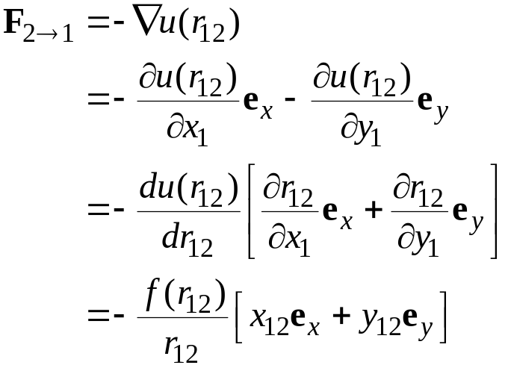
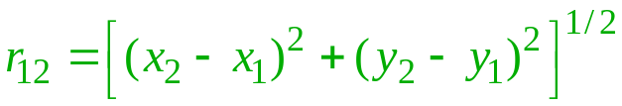
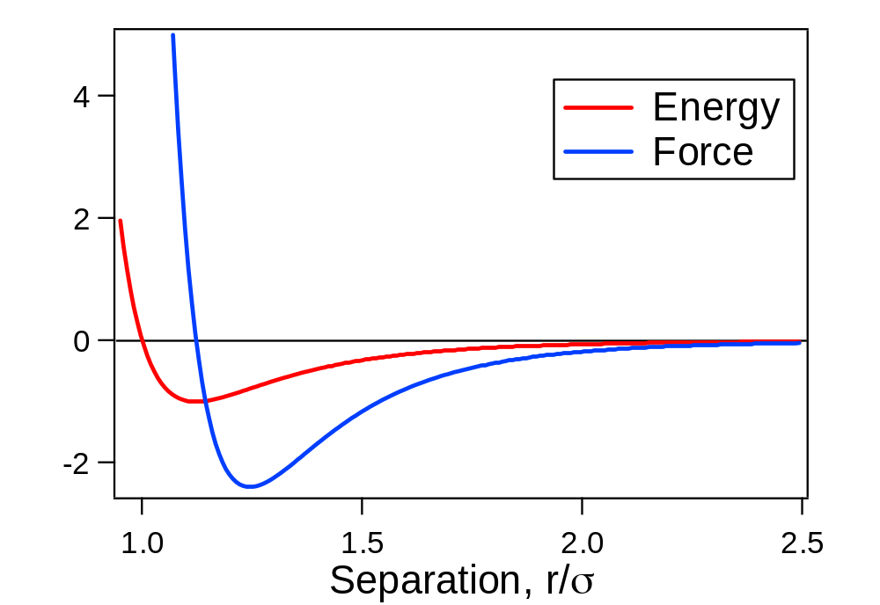

Forces 1. Formalism
x₁₂
Force is the gradient of the potential
1
y₁₂
r₁₂
2
Force on 1, due to 2

Slide 5
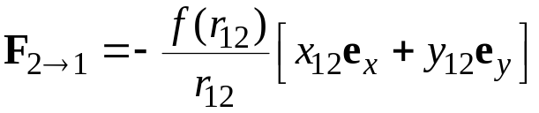
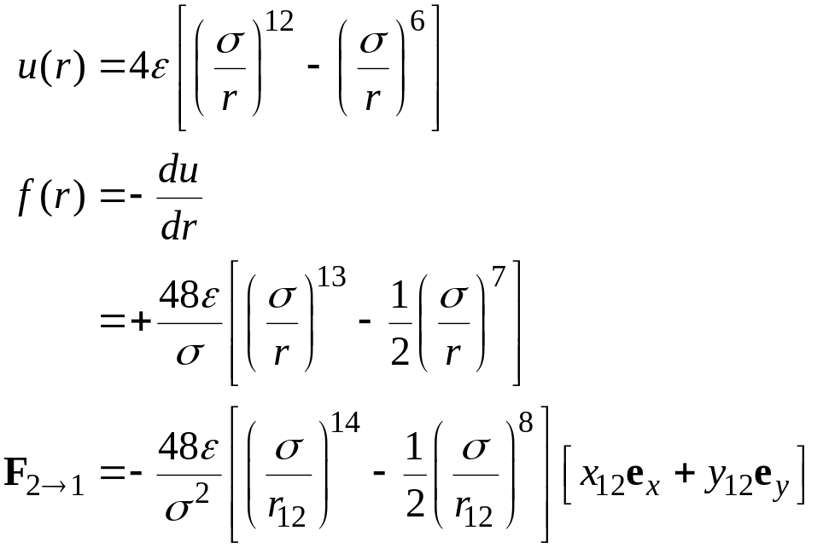
Forces 2. LJ Model
x₁₂
1
Force is the gradient of the potential
y₁₂
r₁₂
2
e.g., Lennard-Jones model

Slide 6
Boundary Conditions
Small system is simulated to study/mimic the bulk properties
Surface effect: a large fraction of the small sample lie on the surface. For example for 1000 molecules arranged in 10x10x10 cube, almost 400 molecules appear on the cube faces. Surface molecules/atoms experience different force than in the bulk.
Impractical to contain system with a real boundary
  Enhances finite-size effects
  Artificial influence of boundary on system properties

Slide 7
  Solution: Periodic boundary condition
The problem of surface effect can be overcome by using. “Periodic Boundary Conditions” (PBC). The bounding box is replicated throughout space to form an infinite lattice. In the course of simulation as a molecule moves in the original box, its periodic images in the each of the neighboring boxes
As the molecule leaves the central box, one of its image will enter through the opposite face.
No physical wall at the boundary and so no surface molecules.

Slide 8
Issues with Periodic Boundary Conditions
Suppress fluctuation that have wavelength greater than the length of the simulation cell. This could be problem near critical point where fluctuation plays dominant role.
new artificial correlations
It can also affect the rate at which a simulated liquid nucleates and forms a solid or glass when rapidly cooled (Honeycutt and Andersen 1984)
Artifact of PBC can be determined by performing simulations using a variety of cell sizes and shape

Slide 9
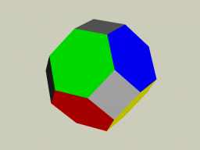
Issues with Periodic Boundary Conditions
Other issues arise when dealing with longer-range potentials
  accounting for long-range interactions
  nearest image not always most energetic
  splitting of molecules (charges)
  discuss details later
Other geometries possible
  any space-filling unit cell
    hexagonal in 2D
    truncated octahedron in 3D
    rhombic dodecahedron in 3D
  surface of a (hyper)sphere
  variable aspect ratio useful for solids
    relieves artificial stresses

Slide 10
Implementing Cubic Periodic Boundaries
How do we handle PBC and the minimum image convention
  Box origin
    center of box, coordinates range from -L/2 to +L/2. When a molecule leaves a box crossing one of the boundary, its image enters the box and is accomplished either by adding or subtracting L to the particle coordinate.
    If (drx[I] > L/2) rx[I] = rx[I] – L
    If (drx[I] > -L/2) rx[I] = rx[I] +L
A more convenient way to handle PBC as well as
minimum image convention is to use reduce
(scaled coordinates) in the range (-1/2,1/2)
  Box size
    unit box, coordinates scaled by box length
    sep[0] = sep[0] – NINT(sep[0])
    define NINT(x) ((x) < 0.0 ? (int) ((x) - 0.5) : (int) ((x) + 0.5))
-0.5
+0.5
+0.5
(0,0)
-0.5

Slide 11
Implementing Cubic Periodic Boundaries 3
void periodic_boundary_conditions(int n_atoms, double **h,
double **scaled_atom_coords, double **atom_coords)
{
int i, j;
for (i = 0; i < n_atoms; ++i) {
for (j = 0; j < NDIM; ++j)
scaled_atom_coords[i][j] -= NINT(scaled_atom_coords[i][j]);
atom_coords[i][0] = h[0][0] * scaled_atom_coords[i][0]
+ h[0][1] * scaled_atom_coords[i][1]
+ h[0][2] * scaled_atom_coords[i][2];
atom_coords[i][1] = h[1][1] * scaled_atom_coords[i][1]
+ h[1][2] * scaled_atom_coords[i][2];
atom_coords[i][2] = h[2][2] * scaled_atom_coords[i][2];
}}

Slide 12
Implementing Cubic Periodic Boundaries
void scaled_atomic_coords(int n_atoms, double **h_inv, double **atom_coords,
double **scaled_atom_coords)
{
int i;
for (i = 0; i < n_atoms; ++i) {
scaled_atom_coords[i][0] = h_inv[0][0] * atom_coords[i][0]
+ h_inv[0][1] * atom_coords[i][1]
+ h_inv[0][2] * atom_coords[i][2];
scaled_atom_coords[i][1] = h_inv[1][1] * atom_coords[i][1]
+ h_inv[1][2] * atom_coords[i][2];
scaled_atom_coords[i][2] = h_inv[2][2] * atom_coords[i][2];
}
}

Slide 13
Truncating the Potential
For system with pair wise additive interactions force on a particle I is computed by all its neighbors. This means for a system of N particles we have to evaluate N(N-1)/2 pair interactions. So the time needed for evaluation of energy/force scales as N². This is one of the main bottleneck in the simulation field.
Bulk system modeled via periodic boundary condition
  not feasible to include interactions with all images
  must truncate potential at half the box length (at most) to have all separations treated consistently
Contributions from distant separations may be important

Slide 14
Minimum image convention and Truncating the Potential
How do we evaluate force on the red atom in the simulation box. Assuming pair wise interaction we should include interaction of the red atom with all other atoms in the simulation box. There are N-1 such term. However, we must also include interaction coming from images lying in the surrounding boxes. That is an infinite number of terms.
Minimum image convention
Construct a simulation box of same size as the the original box with the red atom at its center. Now minimum image convention says that the red atom interact with those atoms which lie in this region, that is with the closest periodic images of the other N-1 atoms.
These two are same distance from central atom, yet:
Black atom interacts
Blue atom does not

Slide 15
Truncating the Potential
With the minimum image convention energy/force computation involves 1/2N(N-1) terms.This is significant for large system size.
For short range interaction major contribution comes from the neighbors close to the atom of interest. So use a spherical cutoff to truncate the interaction.
So the red atom interact only with the atoms lying inside the cutoff region (2 black and one blue)
Only interactions considered
Points to remember
The cutoff distance should be smaller than L/2 to be consistent with the minimum image convention
Thermodynamic properties are different for a truncated potential compared to a non-truncated case. However, we can apply long range correction to get back approximately the non-truncated properties.
Cutoff introduces discontinuity in the force and energy computation. This has serious consequences on the energy conservation and stability of the simulation

Slide 16
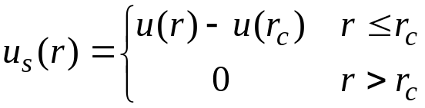
Truncating the Potential contd
Potential truncation introduces discontinuity
  Corresponds to an infinite force
  Problematic for MD simulations
    ruins energy conservation
Shifted potentials: a constant term is subtracted from the potential at all values
  Removes infinite force
  Still discontinuity in force: at the cutoff distance, the force will have a finite value which drops to zero just beyond the cutoff

Slide 17
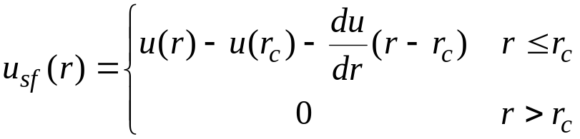
Truncating the Potential
Shifted-force potentials : a linear term can be added to the potential, making the derivative to be zero at the cutoff
  The discontinuity now appears in the gradient, not in the force itself. The force goes smoothly to zero at cutoff.
  The shift makes the potential deviate from the true potential, so the calculated thermodynamic properties will be changed
  True values can be retrieved but is difficult to do so, so rarely used in simulation
  Eliminate discontinuities in the energy and force by a switching function

Slide 18
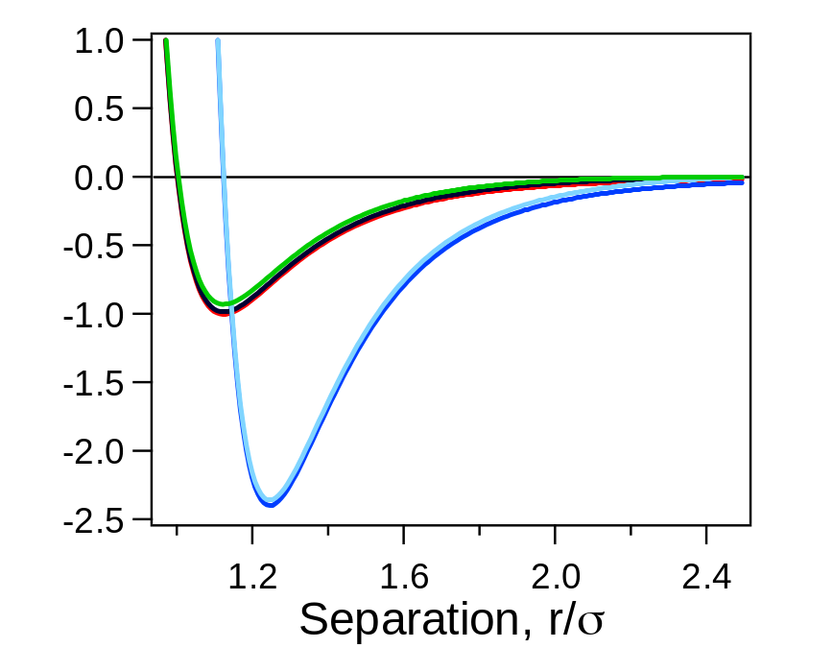
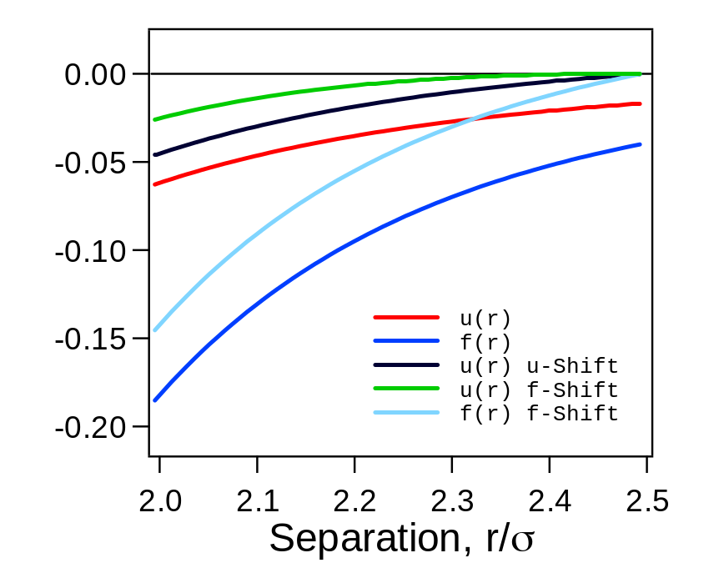
Truncating the Potential
Lennard-Jones example
  r_{c} = 2.5σ

Slide 19

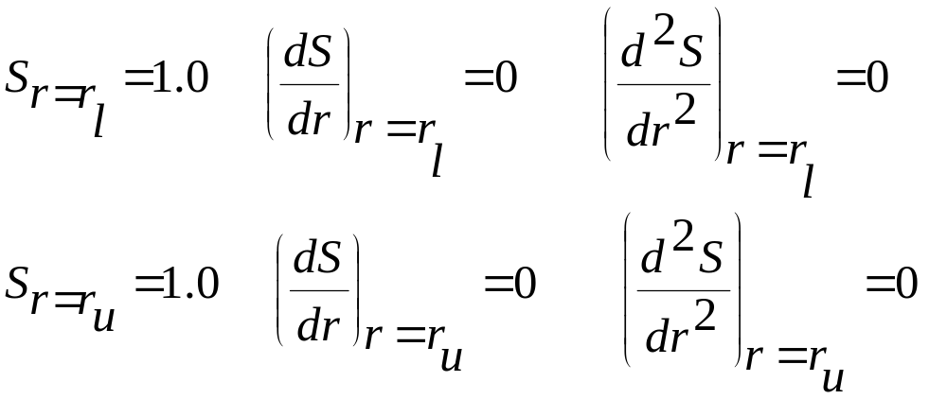
Switching function
Potential function is multiplied by a polynomial which is a function of distance
S(r) gradually taper the potential between two cutoff values : it smoothly changes its value of 1 to a value of 0 between two cutoff : r_{l} (lower cutoff) and r_{u} (upper cutoff) and satisfies the following criteria

Slide 20
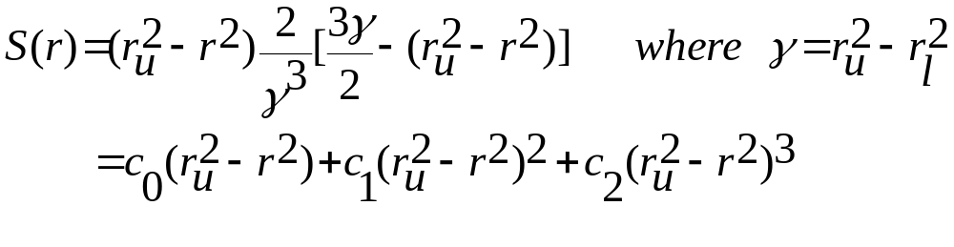
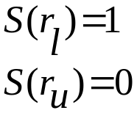
Switching function contd.
Zero first derivative ensures that the force approaches to zero smoothly at the cutoffs. A continuous second derivative ensures the stability of the integration algorithm.

Slide 21
/* Calculate pair interaction. The LJ pair potential is switched off smoothly between r_on and r_off. */
one_over_r2_sep = 1.0 / r2_sep;
rho_2 = comb_par[id_0][id_1][2] * one_over_r2_sep;
rho_6 = CUBE(rho_2);
rho_12 = SQR(rho_6);
*u_vdw = rho_12 - rho_6;
*f_vdw = rho_12 + *u_vdw;
four_epsilon = comb_par[id_0][id_1][3];
(*u_vdw) *= four_epsilon;
(*f_vdw) *= 6.0 * one_over_r2_sep * four_epsilon;
if (r2_sep > r2_on) {
sw1 = r2_off - r2_sep;
sw2 = two_over_gamma_cubed * sw1;
sw3 = sw1 * sw2 * (three_gamma_over_two - sw1);
sw4 = 6.0 * sw2 * (gamma - sw1);
*f_vdw = sw4 * (*u_vdw) + sw3 * (*f_vdw);
(*u_vdw) *= sw3;

Slide 22
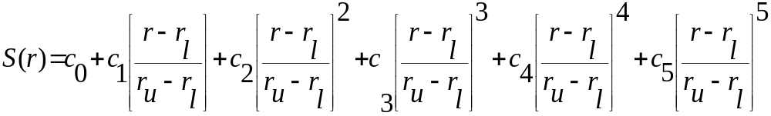
Switching function contd.
We can use higher order polynomial also
With the coefficients satisfying the previous criteria and that gives
C0=1, c1=0, c2=0, c3=-10, c4=15, c5=-6

Slide 23
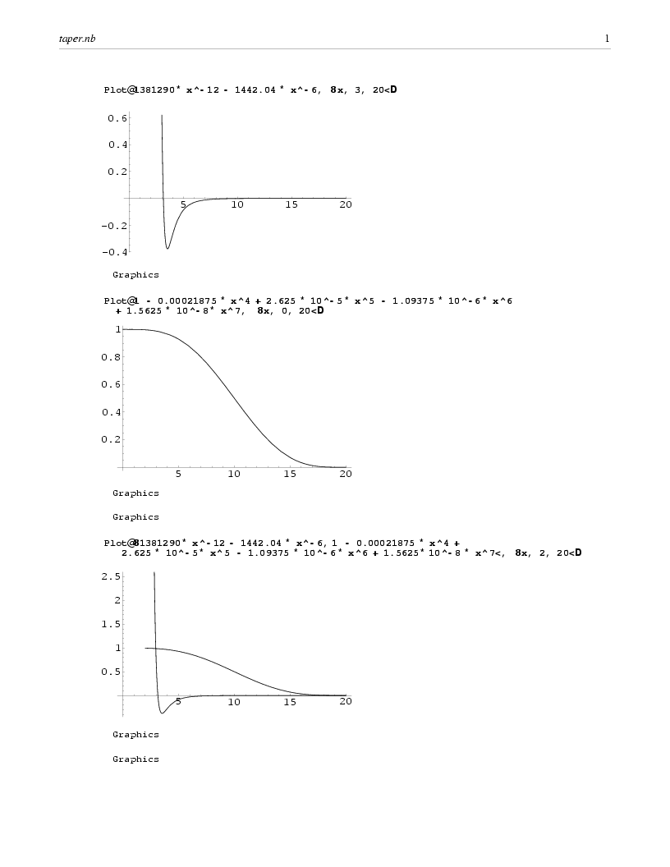

Slide 24
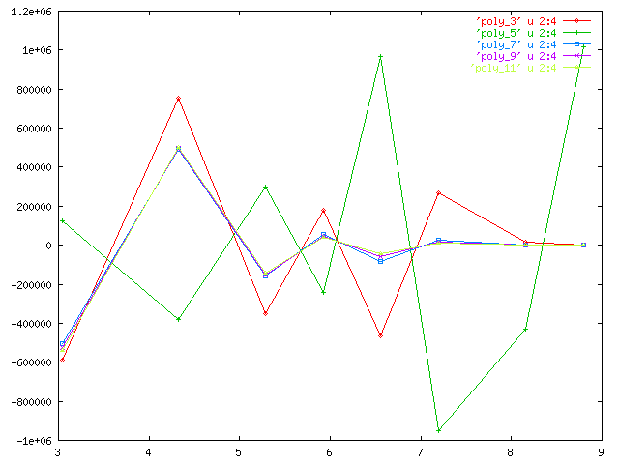

Slide 25
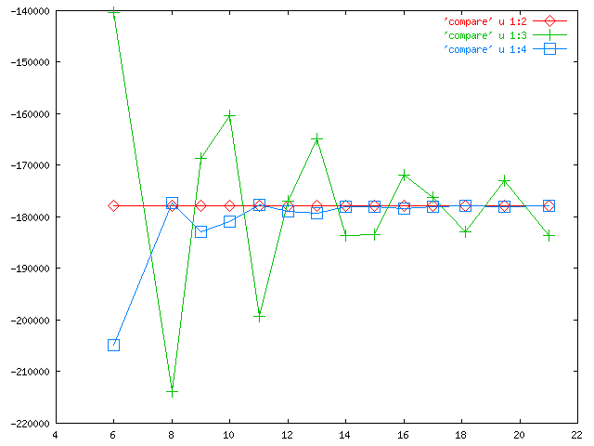

Slide 26
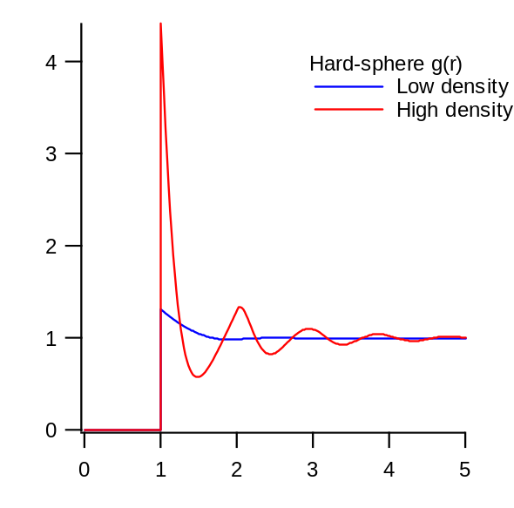
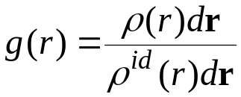

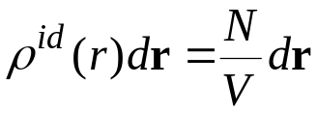
Radial Distribution Function
Radial distribution function, g(r)
  key quantity in statistical mechanics
  quantifies correlation between atom pairs
Definition
Number of atoms at r in actual system
Number of atoms at r for ideal gas

Slide 27
Verlet List
Particles outside cutoff do not contribute to the energy of the particle I.
Exclude those particles from the energy computation
Verlet List: Introduce a second cutoff radius r_{u} >r_{l}
Make a list of all the particles within a radius of r_{u} of particle i
If the maximum displacement of the particles is less than (r_{u} -r_{l}) we have to consider only the particles in this list for the energy/force computation
i
r_{l}
r_{u}
Update the Verlet list as soon as one of the particle is displaced more than (r_{u} -r_{l})
For MD it is sufficient to have a Verlet list with half the number of particles for each particle as long as interaction i-j is accounted for in either the list of particle i or that of j

Slide 28
6
r_{u}
The skin is thick enough such that when reconstructing an atom 7, which was not in the original list of atom 1can not penetrate the r_{c} sphere. Atom 3, 4 can move in and out but their interaction get counted as they are in the original list until the list get updated.
4
3
7
7’
1
r_{c}
2
5
The cutoff sphere and its skin around an atom 1. Atoms 2,3,4,5 and 6 are on the list of atom 1, but 7 is not. Among these only 2,3,4 are within the r_{c} when the list is made
From Allen and Tildesley

Slide 29
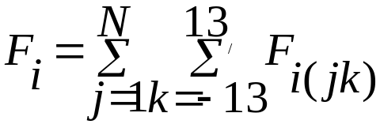
For a periodic system Verlet list has an elegant implementation due to Bekker et. al. (Mol. Sim. 14, 137-151, 1995)
In a periodic system total force on particle i can be written as
Where the prime denotes that summation is performed over the nearest image of the particle j in the central box (k=0) or in one of its 26 periodic images (or 8 in 2-d). (j.k) denotes the periodic image of particle j in box k. Box k is defined by the integer numbers n_{x}, n_{y}, n_{z}
k = 9n_{x}+3 n_{y} + n_{z}

Slide 30
Problem with Verlet List
As the size of the system increases neighbor list becomes too large to store easily
Also the testing of every pair separation is also very inefficient
Make the neighbor list using Cell list

Slide 31
Cell Lists or Linked-list
The simulation box is divided into cells with size equal to or slightly larger than the cutoff r_{c}
Distribute the particle to the cell according to their position
Each particle in a given cell interacts with only those particles in the same or neighboring cells
This scales as N
r_{c}
The simulation cell is divided into cells of size r_{c} x r_{c}, a particle i interacts with those particles in the same cell or neighboring cell (in 2D 9 cells; in 3D 27 cells)
i

Slide 32
The Cell list is created using the linked list methods:
Sorting of atoms to their respective cells
Two arrays are created (HEAD AND LIST)
HEAD (head of the chain) array has one element for each cell. This contains the identification number of one of the molecules sorted into that cell
LIST (linked list array) contains the number of next molecules in that cell.
HEAD (head of the chain) array element is used to address the LIST array element.
If we follow the trail of linked-list we will eventually reach an element of LIST which is zero. This indicates that there are no more molecules in that cell and we move on to the head of chain of the next cell.
See Allen and Tildesley for details

Slide 33
void neighbor_lists_period()
/* Purge neighbor lists. */
for (i = 0; i < n_atoms; ++i)
nl_tail[i] = NULL;
/* Update cell lists. */
update_cells(period_switch, n_atoms, h, scaled_atom_coords, atom_coords,
atom_cells, first, last, phantoms, kc, phantom_skip, nc, nc_p);
/* Update positions of phantom atoms. */
update_phantoms(n_atoms, atom_cells, phantom_skip, phantoms, atom_coords);
/* Loop over central atoms. */
for (i = 0; i < n_atoms; ++i) {
/* Get attributes of atom i. */
for (k = 0; k < NDIM; ++k)

