Slide 1
Complexity of Force Calculations
Complexity is defined as how a computer algorithm scales with the number of degrees of freedom (particles)
Number of terms in pair potential is N(N-1)/2 ≈ O(N²)
For short range potential you can use neighbor tables to reduce it to O(N)
  (Verlet) neighbor list for systems that move slowly
  bin sort list (map system onto a mesh and find neighbors from the mesh table)
Long range potentials with Ewald sums are O(N^{3/2}) but Fast Multipole Algorithms are O(N) for very large N.
http://www.cheme.buffalo.edu/courses/ce530

Slide 2
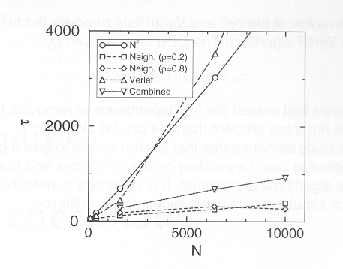
Comparison of timing for various non-bond computation methods
Figure from Frenkel and Smit
Comparison of various schemes to calculate the energy, time vs
Number of particles N: r_{c}=2.5σ and Verlet Radius r_{ν}=3.0σ

Slide 3
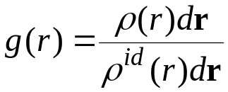
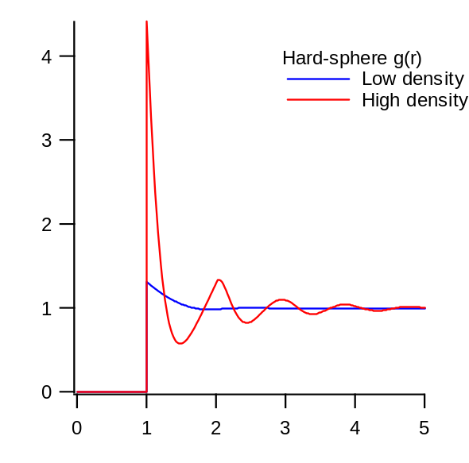

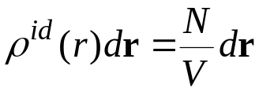
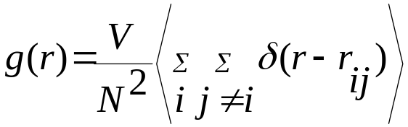
Radial Distribution Function
Radial distribution function, g(r)
  key quantity in statistical mechanics
  Gives the probability of finding a pair of atoms a distance r apart,relative to the probability expected for a completely random distribution at same density
Definition
Number of atoms at r in actual system
Number of atoms at r for ideal gas

Slide 4
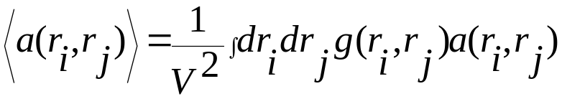
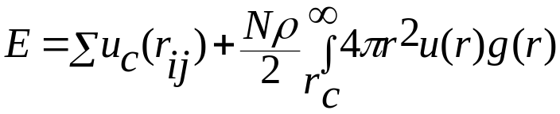
Various thermodynamic quantities in terms of g(r)
Ensemble average of any pair function can be expressed in terms
of g(r) as follows
For example we can write the energy as (assuming pair-wise additivity

Slide 5
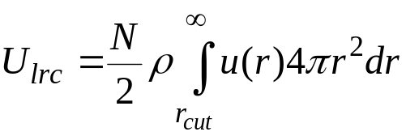
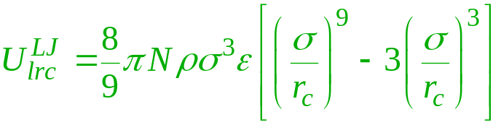
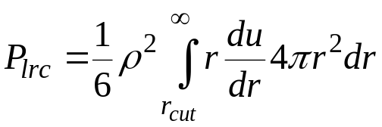
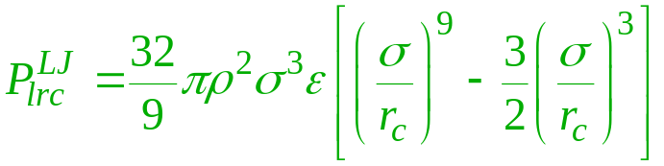
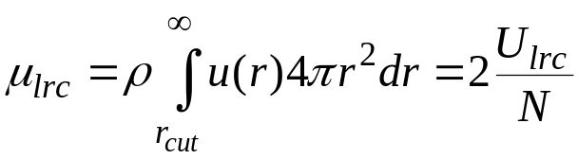
Simple Long-Range Correction
Approximate distant interactions by assuming uniform distribution beyond cutoff: g(r) = 1 r > r_{cut}
Corrections to thermodynamic properties
  Internal energy
  Virial
  Chemical potential
Expression for Lennard-Jones model
For r_{c}/σ = 2.5, these are about 5-10% of the total values

Slide 6
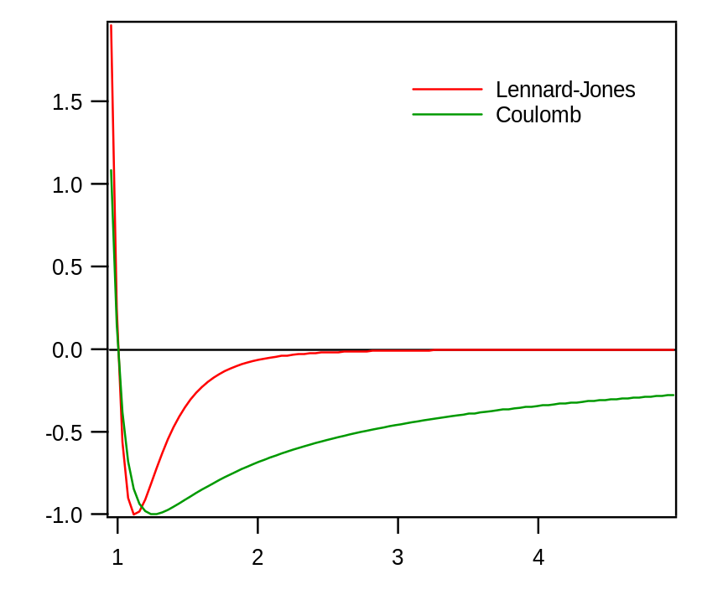
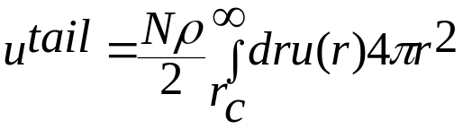
Coulombic Long-Range Correction
Coulombic interactions must be treated specially
  very long range
  1/r form does not die off as quickly as volume grows
  Tail correction diverges unless u(r) decays faster than r⁻³
  So we can not use truncation plus long range correction for Coulombic and dipolar interactions
Methods
  Full lattice sum (Ewald summation)
  Treat surroundings as dielectric continuum

Slide 7
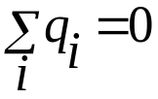
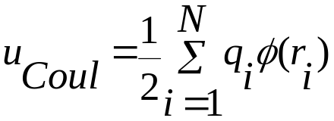
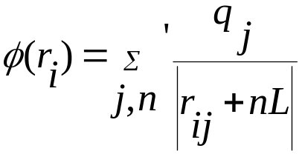
Ewald Sum (Frenkel + Smit, Ch 12)
Consider a system of N positively and negatively charged particles in a volume V (V=L³).
Assume charge neutrality
Coulomb energy of this N-particle system is given by
φ(r_{i}) is the electrostatic potential at the position of ion i
The prime on the summation indicates that the sum is over all periodic images n and over all particles j, except j =i if n=0. The sum is conditionally convergent. : it contains a mixture of positive and negative terms Separately both the positive and negative terms form a divergent series. The sum of a conditionally convergent series depents on the order in which its terms are considered.

Slide 8
+
+
-
-
+
+
+
+
+
Real Space
-
-
-
-
+
+
+
Reciprocal Space
-
-

Slide 9
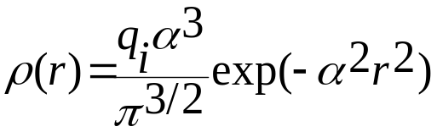
Now we have three contribution
Potential due to point charge q_{i}
Potential due to Gaussian screening charge cloud with charge –q_{i}
Potential due to compensating charge cloud with charge q_{i}
The contribution to the electrostatic potential at point r_{i} due to a set of screened charges can easily be computed by direct summation because the electrostatic potential due to screened charge is a rapidly decaying function of r. A Gaussian charge distribution of following form is
Commonly used

Slide 10
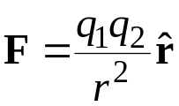

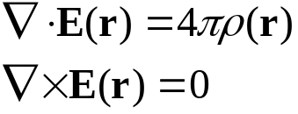




Review of Basic Electrostatics
Force between charges
In terms of electric field
Static electric field satisfies
Charge density ρ(r)
  for point charge q₂:
Electrostatic potential
  zero curl implies E can be written
  potential energy of charge q₁ at r, relative to position at infinity
Poisson’s equation

Slide 11
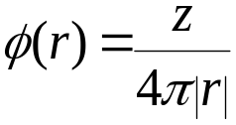
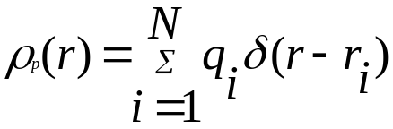
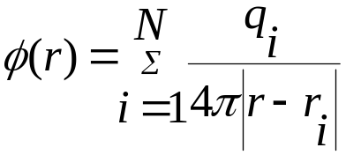
For a single charge z at the origin the solution of this equation is the Coulomb potential
For a collection of N point charges we can define a charge density
Potential at point r can be written as
Fourier transform allows us to cast these equations in a different form.Let us consider a periodic system with a cubic box of length and volume V. Any function f(r) that depends on the coordinates can be written as a Fourier series

Slide 12
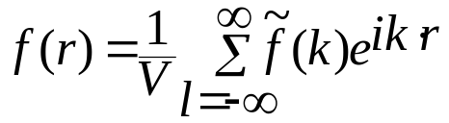

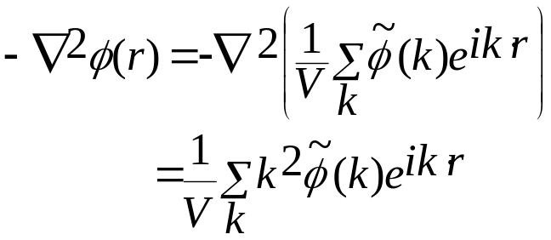
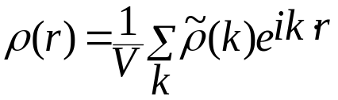
Where k=(2π/L)l with l=(l_{x},l_{y},l_{z}) are the lattice vectors in Fourier space.The Fourier coefficients f(k) are calculated using
Poisson’s equation in Fourier space takes the following form
If take the following form for Fourier space charge density

Slide 13

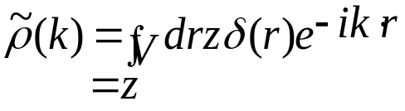
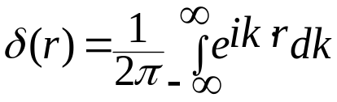
Poisson equation in Fourier space takes the following simple form
For example, to find the solution for Poisson’s equation for a point charge of strength z at the origin, we have to perform the Fourier transform of a delta function
Remember the following representation of the delta function

Slide 14
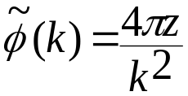
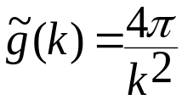

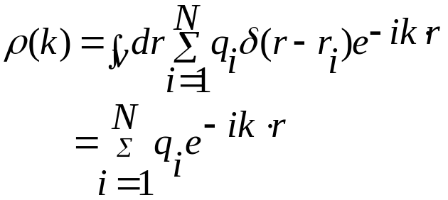

So the solution for Poisson’s equation becomes
Solution for a unit charge (often called Green’s function)
Now for a collection of point charges with charge density given by
the electrostatic potential is given by
with
So in Fourier space solution of Poisson’s equation is obtained by multiplying g(k) with ρ(k)

Slide 15
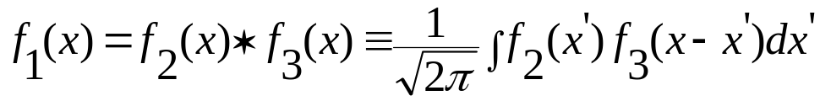

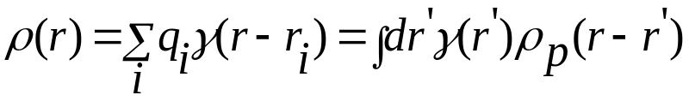
Convolution Theorem (Arfken Chapter 15)
If we have a function f₁(x) which is the convolution (*) of two other functions f₂(x) and f₃(x)
Then the Fourier coefficients of these functions are related by a simple multiplication
This is useful when we have a charge distribution that does not consist of simple point charges, but a more diffusive distribution
γ(r) is the shape of the single charge distribution

Slide 16

The solution of Poisson’s equation for such charge distribution becomes

Slide 17
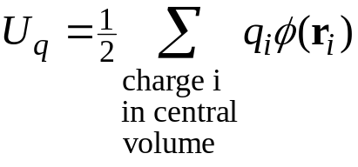
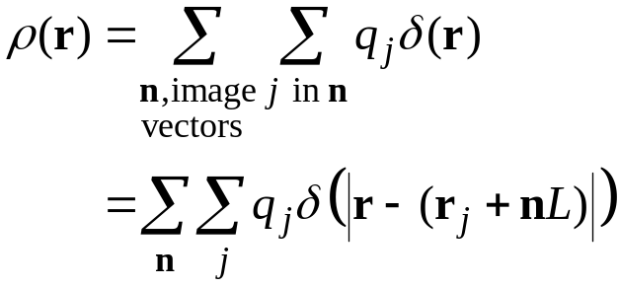
Ewald Sum
We want to sum the interaction energy of each charge in the central volume with all images of the other charges
  express in terms of electostatic potential
  the charge density creating the
  potential is
  this is a periodic function (of period L),
  but it is very sharp
    Fourier representation would never converge
-
+
-
+
-
+
-
+
-
+
-
+
-
+
-
+
-
+
-
+
-
-
-
-
-
+
+
+
+
+
-
+
-
+
-
+
-
+
-
+
-
+
-
+
-
+
-
+
-
+
-
-
-
-
-
+
+
+
+
+
-
+
-
+
-
+
-
+
-
+
-
+
-
+
-
+
-
+
-
+
-
-
-
-
-
+
+
+
+
+
-
+
-
+
-
+
-
+
-
+
-
+
-
+
-
+
-
+
-
+
-
-
-
-
-
+
+
+
+
+
-
+
-
+
-
+
-
+
-
+
-
+
-
+
-
+
-
+
-
+
-
-
-
-
-
+
+
+
+
+

Slide 18
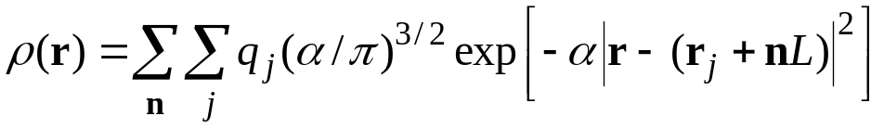


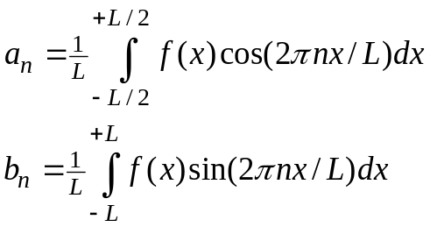
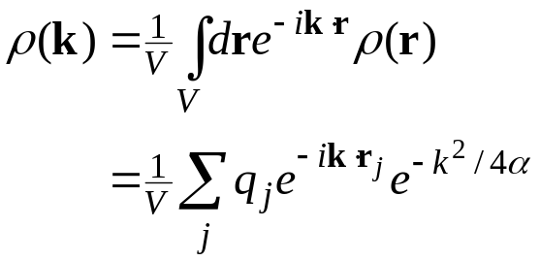
Ewald Sum: Fourier 1.
Compute field instead by smearing all the charges
Electrostatic potential via Poisson equation
  direct space form
  reciprocal space
Fourier transform the charge density
include n = 0
Large α takes ρ back to δ function

Slide 19
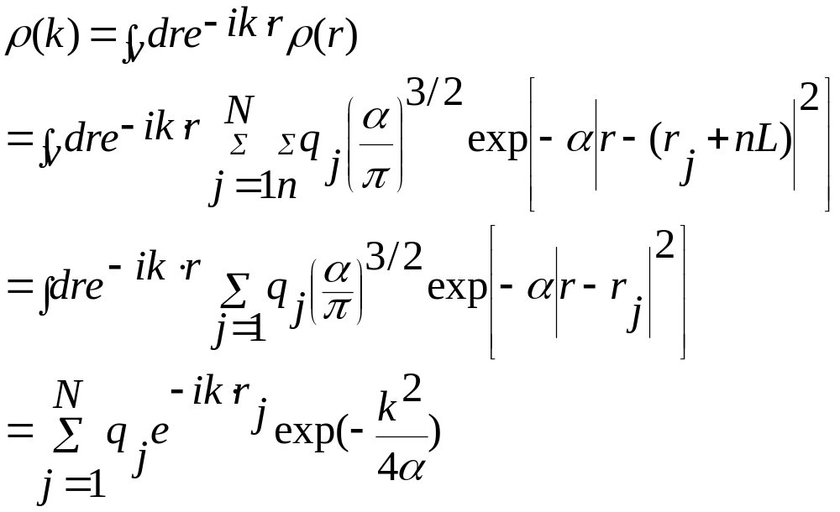

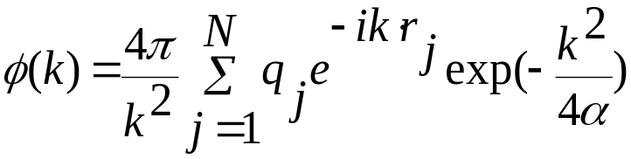
Charge density in the Fourier space
With the above charge density in Fourier space Poisson’s equation becomes

Slide 20
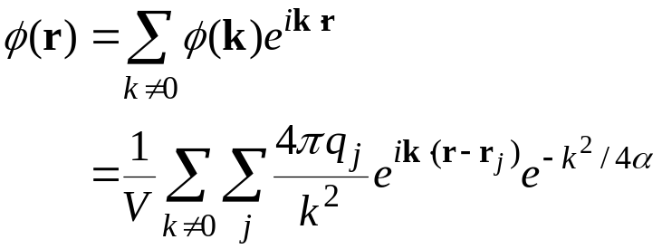
Invert transform to recover real-space potential
  in principle requires sum over infinite number of wave vectors k
  but reciprocal Gaussian goes to zero quickly if α is small

Slide 21
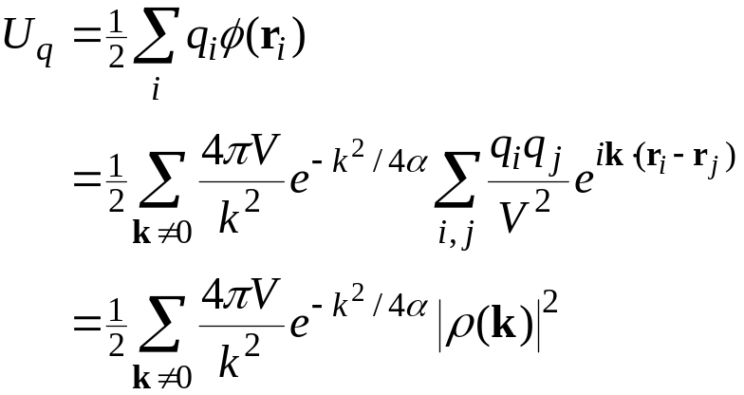
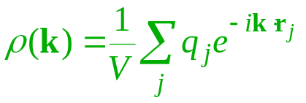
The electrostatic energy can now be obtained
  for point charges in potential of smeared charges
Two corrections are needed
  self interaction
  correct for smearing
product of identical sums

Slide 22

Ewald Sum. Self Interaction 1.
In Ewald sum, each point charge is replaced by smeared Gaussian centered on that charge
  this is done to estimate the electrostatic potential field
All point charges interact with the resulting field to yield the potential energy
  This means that the point charge
  interacts with its smeared
  representation
  We need to subtract this

Slide 23
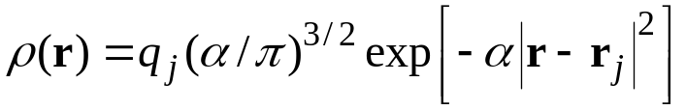
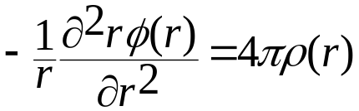
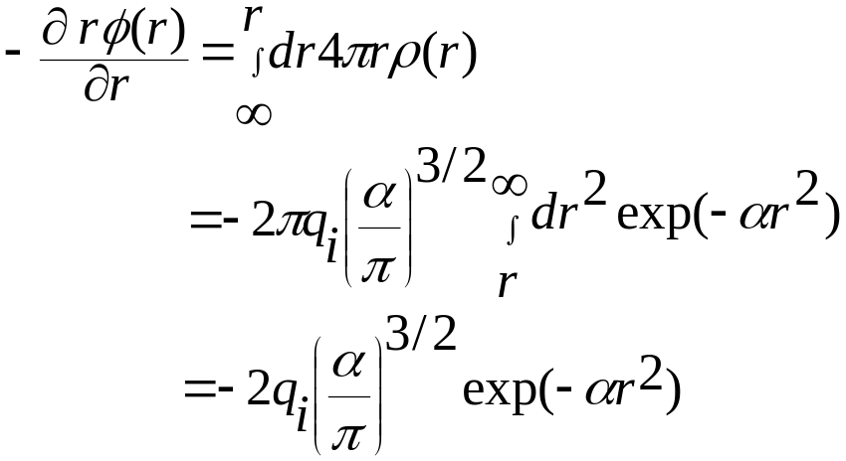
Ewald Sum. Self Interaction 2.
We work in real space to deal with the self term
  Poisson’s equation for the electrostatic potential due to a single smeared charge
In Spherical coordinate with the Gaussian charge density
Integration by parts

Slide 24
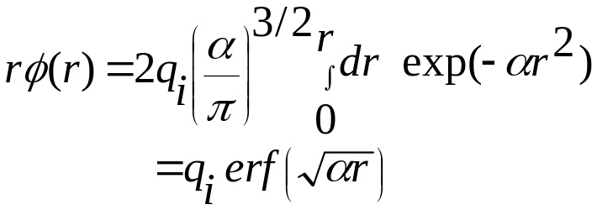
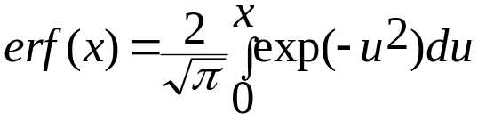
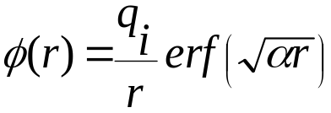
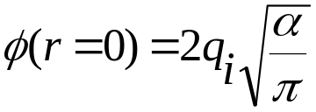
Second partial integration gives
Where the error function is defined as
So the potential at point r due to the Gaussian charge is
ϕ(r) at r=0 is the self-term to be subtracted

Slide 25

Ewald Sum. Self Interaction 2.
So the self-interaction contribution to the total energy is
independent of configuration

Slide 26

Ewald Sum. Real space contribution
We add the correct field and subtract the approximate one to correct for the smearing
This field is short ranged for large α (narrow Gaussians)
  can view as point charges surrounded by shielding countercharge distribution

Slide 27


Ewald Sum. Smearing Correction 2.
Sum interaction of all charges with field correction
  convenient to stay in real space
  usually α is chosen so that sum converges within central image
Total Coulomb energy
  each term depends on α, but the sum is independent of it
    if enough lattice vectors are used in the reciprocal- and real-space sums

Slide 28
Choice of parameters
Real space part of the energy involves evaluating (consider α^{1/2}= α
To ensure convergence of the real space part we need to choose α such that erfc is small at the real-space cutoff R. Suppose we specify small to be exp(-p). So p controls the accuracy. For large values of argument erfc behaves as exp(- α²r²). SO we demand
α²r²=p
or α=^{p1/2}/R (1)
Fincham, Mol. Simulation, 13,1-9 (1994)

Slide 29
For reciprocal space we need to compute the following
The rate of convergence is controlled by the factor exp(-k²/4 α²). Like before if we require the terms to have the value exp(-p) at the reciprocal cutoff K, then we have
p=K²/ 4 α²
or K = 2α ^{p1/2}=2p/R (2)
Equ. 1 and 2 specify the choice of parameters α and reciprocal cutoff K once the accuracy parameter p and real space cutoff R have been chosen

Slide 30


Time estimate for Ewald summation
The number of ions within the cutoff sphere is
4π/3R³n, n is the number density
Each of the N ions interacts with the other ions in the surrounding cutoff sphere , but each pair interactions needs to be considered only once. Thus T_{R}=1/2 N 4π/3R³nt_{R}
The value of reciprocal space within a cutoff K is
The reciprocal-space points are given by k=2π/L(l,m,n), where l, m, n are integers. The volume of each reciprocal point is (2π/L)³. The number of reciprocal points with the cutoff K is given by
Where n = N/L³
This grows as N as the density of points in k-space increases with system

Slide 31



For each k-points a sum over over N ions needs to be performed and the execution time is
So the total execution time for real space and k-space summation is given by
For fixed p and R, T_{R} varies as N and T_{F} varies as N²
To find the optimal value of R which minimizes the total execution time T we have dT/dR=0, which gives

Slide 32




This choice of optimal real-space cutoff gives the following optimal time
When optimized it is equally divided between real and reciprocal space parts calculation and it grows as N^{3/2}
Now introduce the following dimensionless parameter
Factor of 2π is included in the definition of so that corresponds to integer cutoff i.e. maximum value of (l²+m²+n²)^{1/2}

Slide 33


With the above definition optimized value of cutoff becomes
To get an estimate we assume p = π². This gives exp(-p) = 5.2x10⁻⁵ .This gives

Slide 34

Particle-Mesh Ewald Method
  Break the sum in two parts each of which should converge rapidly
The first part should f(r)/r goes to zero very fast beyond some cutoff R so that the summation up to the cutoff is a good approximation to this contribution to the electrostatic potential
The second part (1-f(r))/r is a slowly varying function for all r, so that its Fourier transform can be be represented by only few k-vectors within the cutoff K. This permits an efficient computation of this part in reciprocal space

Slide 35



Particle Mesh based approaches rely on the use of fixed cutoff on the direct space sum together with an FFT based approximation of the reciprocal space sum that scales as N log(N)
We have reciprocal part of the electrostatic energy
Fourier space charge density
Recall that Fourier transformed Green’s function

Slide 36



In terms of these reciprocal part of the energy is written as
where
is the electrostatic potential due to the 2nd term in the identity
Fourier transform of which is given by
As discussed earlier, products in reciprocal space correspond to convolutions in real space. So the reciprocal component of the electrostatic potential is due to the original charge distribution ρ(r) convoluted by a Gaussian smearing function γ(r)

Slide 37
PME implementations
Performing Fourier transformation in the reciprocal space by FFT routines involves following complicacy
Charge assignment: The point charge with continuous coordinates have to be replaced by a grid based charge density, since FFT is a discrete and finite transformation.
Solving Poisson’s equ: Poisson's equation for the discrete charge distribution has to be solved by FFT. However, It is not obvious nor true that the best grid approximation to the continuum solution of the Poisson equation is achieved by using the continuum Green function.
Force assignment: Once the electrostatic energy has been obtained from the solution of Poisson's equation the forces have to be calculated and assigned back to the particles in our system. The procedure of assigning the forces calculated on the mesh back to the actual particles can -under certain circumstances-lead to unwanted violations of Newton’s third law.

Slide 38

Charge assignment
The purpose of the charge assignment is to substitute the actual charge density of point particles with a mesh based charge density. Consider first 1-d case: Define an even function W(x) such that the fraction of charge which is assigned to the mesh point x_{p} due to unit charge at position x is given by W(x-x_{p}). If the charge density of the system is ρ(x), then the mesh based charge density ρ_{M} can be written as convolution
h=L/N_{M} is the spacing of grid points and N_{M} is the number of grid points, x_{p} are the mesh points with p = 0, 1, …N_{M-1}
Three dimensional charge assignment function W(r) can be written as W(r) = W(x)W(y)W(z)

Slide 39


Sketch of the 1-d charge assignment. A suitable fraction of a charge residing at some position within the interval [0:L] is assigned to its five nearest grid points of an 8-mesh. The fractions (gray) are determined by a charge assignment functions( dashed curve).
In three dimension mesh charge density can be written as
M Deserno, PhD thesis, MPIP

Slide 40
Function W should have the following properties:
Charge conservation: the fractional charges of one particle, which have distributed to the surrounding grid points, sum up to the total charge of the particle.
Finite and if possible small, support (essentially the range of values for which the function is non-zero), since the computational cost increases with the number of mesh points among which the charge of each particle is distributed.
Localization of discretization errors: inaccuracies in the force between two particles due to the discretization should become small with increasing particle separation.
Large degree of smoothness: the fractional charge of particle I which is assigned to some mesh point x_{p} should be smoothly varying function of the position of the particle i.
Minimization of aliasing errors: the charge assignment function should decay sufficiently rapidly in the Fourier space

Slide 41
Solving Poisson Equation
Recall the Fourier space contribution to the electrostatic energy
In PME implementation it is assumed that the above equation is valid for the discrete case also with the charge density ρ(k) replaced by the Fourier transform of the mesh based charge density

Slide 42


Fourier transforming gives
is the sum over three dimensional mesh in real space and the k-vectors are from the corresponding Fourier space mesh. In this scheme continuum Coulomb Green function is best accompanied by a Lagrange interpolation scheme for the charge assignment.

Slide 43



Charge assignment scheme by Essmann et. al
Consider a single term in the Fourier sum
This term can not be used in a discrete Fourier transform because r does not, in general correspond to a mesh point. However, we can interpolate
in terms of values of the complex exponential at mesh points
As in the earlier case consider 1-d sysetm: x varies between 0 and L and there are M equidistant Mesh points in this interval. The particle coordinates x_{i} is located between mesh points [Mx_{i}/L] and [Mx_{i}/L]+1 where […] denotes the integer part of the real number. Let us denote
u_{i} = Mx_{i}/L.

Slide 44

Then we can write order-2p interpolation of the exponential as
W_{2p} are the interpolation coefficients. Strictly speaking the sum over j contains only M terms. To account for the periodic boundary conditions, we have written it as -∝<j< ∝. For an interpolation of order 2p only the 2p mesh points nearest to x_{i} contributes to the sum. For all other points, W_{2p} vanish. Fourier transform of the total charge density now becomes

Slide 45


Above expression can be viewed as a discrete FT of a meshed charge density
W_{2p} act as charge assignment coefficients
With the Lagrangian interpolation the exponential can be written as
JCP 103, 8577

Slide 46

Reciprocal part of the Coulomb energy is given by

Slide 47

B-spline interpolation

Slide 48

Back-interpolation
Back interpolation is done in a similar way as the distribution of charges to the mesh via some assignment function W. The force on a particle i is given by

Slide 49



Slide 50


Optimal CPU time is achieved at the smallest cutoff and 5th order interpolation

Slide 51

RMS fluctuation in total energy is δt2, where δt is the time step. Direct sum cutoff is 8 Å and a cubic interpolation for the Coulombic reciprocal sum.

Slide 52

Structure of water
For TIP3P water
H=0.417
O=-0.834
LMP2 charges
For SPC/E water
H=0.4238
O=-0.8476
Quantum Mulliken charges averaged from cluster solvation in water dielectric, single point
6-311g** DFT=Becke_3_Parameter/HF+Slater+Becke88+PW91+PW-GGAIIC (B3GGA-II)
Charges: H = 0.36433 O = -0.72866

Slide 53

Structure of Liquid water

Slide 54


Slide 55



Slide 56
Various schemes for calculating atomic charges for Ewald summations

Slide 57


The electrostatic potential can be determined from a wave function using
The electrostatic potential is a continuous property and is not easily represented by an analytical function. So it is necessary to to derive a discrete representation for use in numerical analysis.
The objective is to derive the set of partial charges the best produce the QM electrostatic potential at a series of points surrounding the molecule.
Ref: Cox and Williams, Journal of Computational Chemistry, 2, 304(1981)
Electrostatic pot. at each of the chosen points calculated from wave function
Least-squares fitting procedure to get set of charges to fit electrostatic potential
Sum of the partial charges should give the total molecular charge

Slide 58




One of charges dependent on the values of others (because sum must be equal to Z. The N-th charge has a value given by
The electrostatics pot. Due to the charges q_{j} at the point i is given by
At a minimum value of the error function, R, the first derivative is equal to zero with respect to all charges q_{k}
The above equation can be written in the following form

Slide 59
When expressed in this way, then the set of equation can be recast as a matrix equation of the form Aq = a
The charges q are then determined using the standard matrix methods via q = A⁻¹ a
Molecular mechanics is used to model systems containing thousands of atoms such as polymers, DNA, liquid crystal. How then can charges be derived for such species? One can not routinely perform quantum mechanical calculations. So it must be broken into fragments of a suitable size.

Slide 60





Aside: Fourier Series
Consider periodic function on -L/2, +L/2
A Fourier series provides an equivalent representation of the function
The coefficients are
One period

Slide 61


Fourier Series Example
f(x) is a square wave

Slide 62

Fourier Series Example
f(x) is a square wave
n = 1

Slide 63

Fourier Series Example
f(x) is a square wave
n = 1, 3

Slide 64

Fourier Series Example
f(x) is a square wave
n = 1, 3, 5

Slide 65

Fourier Series Example
f(x) is a square wave
n = 1, 3, 5, 7

Slide 66

Fourier Representation
The set of Fourier-space coefficients b_{n} contain complete information about the function
Although f(x) is periodic to infinity, b_{n} is non-negligible over only a finite range
Sometimes the Fourier representation is more convenient to use

Slide 67


Convergence of Fourier Sum
If f(x) = sin(2πkx/L), transform is simple
  b_{n} = 1 for n = k
  b_{n} = 0 otherwise
Converges very quickly!

Slide 68
Observations on Fourier Sum
Smooth functions f(x) require few coefficients b_{n}
Sharp functions (square wave) require more coefficients
Large-n coefficients describe high-frequency behavior of f(x)
  large n = short wavelength
Small-n coefficients describe low-frequency behavior
  small n = long wavelength
  e.g., n = 0 coefficient is simple average of f(x)

Slide 69







Fourier Transform
As L increases, f(x) becomes less periodic
Fourier transform arrives in limit of L → ∞
Compact form obtained with exponential form of cos/sin
Useful relations
  derivative
  convolution
inverse
forward
a_{n} = real part of transform
b_{n} = imaginary part

Slide 70





Fourier Transform Example
Gaussian
Transform is also a Gaussian!
Width of transform is reciprocal of width of function
  k-space is “reciprocal” space
  sharp f(x) requires more values of F(k) for good representation
  δ(x-x_{o}) transforms into a sine/cosine wave of frequency x_{o}:

Slide 71
Fourier Transform Relevance
Many features of statistical-mechanical systems are described in k-space
  structure
  transport behavior
  electrostatics
This description focuses on the correlations shown over a particular length scale (depending on k)
Macroscopic observables are recovered in the k → 0 limit
Corresponding treatment is applied in the time/frequency domains

