Slide 1
Various charge schemes

Slide 2
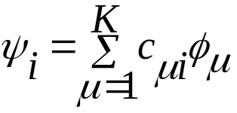
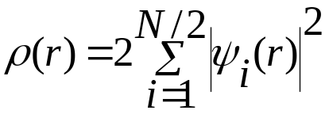
In molecular simulations we are usually concerned with the ground states of molecules, most of which has closed-shell configurations. In a closed shell system containing N electrons in N/2 orbitals, there are two spin orbitals associated with each spatial orbital ψ_{i}: ψ_{i α} and ψ_{iβ}
Each molecular spin orbital is expressed as a linear combination of atomic orbitals (LCAO)
ψ_{I} is spatial molecular orbital and ϕ_{μ} is one of K atomic orbitals (basis functions) and c_{iμ} is coefficient.
For a system of N electrons occupying N/2 real orbitals we can write the electron density ρ(r) at any point r as

Slide 3
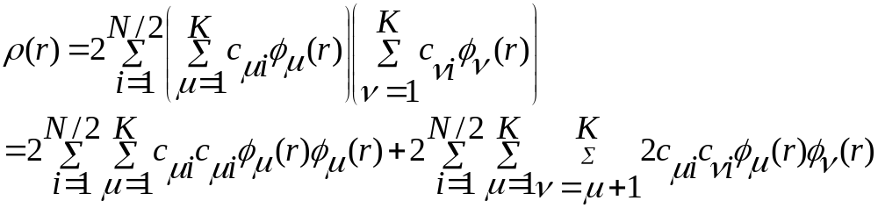
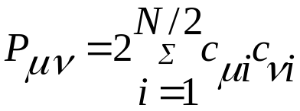
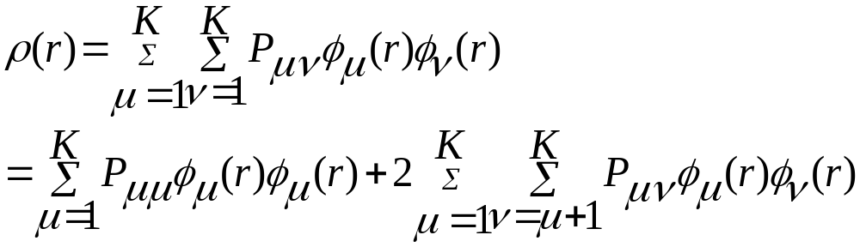
If we express the molecular orbital ψ_{i}(r) as a linear combination of basis functions
Now define the charge density matrix as
In terms of charge density matrix

Slide 4

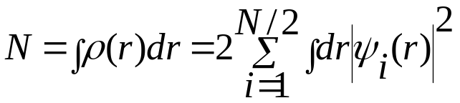
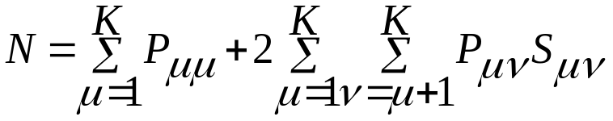
Now define the overlap between the orbitals
Also the total number of electrons N is given by
This equation is solved to calculate electron density and can be visualized.

Slide 5
Population analysis
We need to have scheme to partition the electron density on each nucleus so that each nucleus has a number of electrons which in turn can give the partial atomic charge on each nucleus. This partial charge description can be used in the molecular simulation. There is no QM operator associated with the atomic charge and all the partitioning scheme is arbitrary.
Mulliken Population analysis

Slide 6
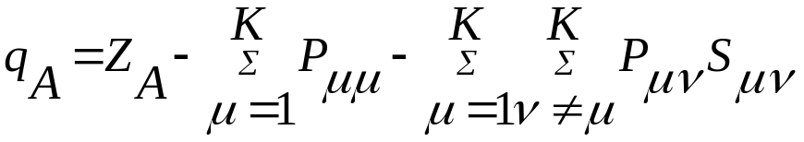
All of the electron density P_{μμ} in an orbital is allocated to the atom on which ϕ_{μ} is located.
Remaining electron density is associated with the overlap population
ϕ_{μ} ϕ_{ν}
For each element of the ϕ_{μ} ϕ_{ν} half the density is assigned to the atom on which ϕ_{μ} is located and half to the atom on which ϕ_{ν} is located.
The net charge on an atom A is then calculated by subtracting the number of electrons from the nuclear charge Z_{A}

Slide 7
Problems with Mulliken analysis
Balanced basis set: ensure an equivalent number of basis function is present on each atom. For example for water it is possible to calculate wave function in which all of the basis function reside on Oxygen atoms. In that case Mulliken analysis will put all the charge only on Oxygen atom.
Mulliken analysis assumes that each basis functions can be associated with an atomic center and so will not work if basis functions not centered on the nuclei are used. This means it depends on how the atoms are bonded together in the molecule.
Atomic charges depend very much on the type of basis set used. For example carbon of isobutene has a charge +0.1 with 6-31G* but charged to +1.0 with 6-311++G**

Slide 8
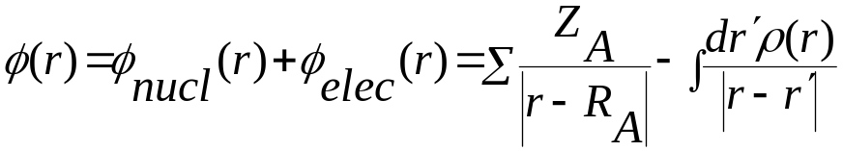
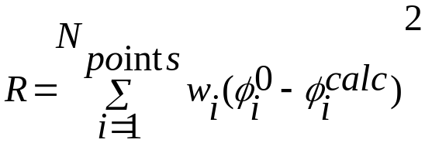
The electrostatic potential can be determined from a wave function using
The electrostatic potential is a continuous property and is not easily represented by an analytical function. So it is necessary to to derive a discrete representation for use in numerical analysis.
The objective is to derive the set of partial charges the best produce the QM electrostatic potential at a series of points surrounding the molecule.
Ref: Cox and Williams, Journal of Computational Chemistry, 2, 304(1981)
Electrostatic pot. at each of the chosen points calculated from wave function
Least-squares fitting procedure to get set of charges to fit electrostatic potential
Sum of the partial charges should give the total molecular charge

Slide 9
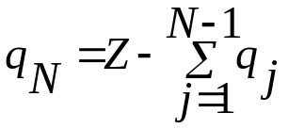
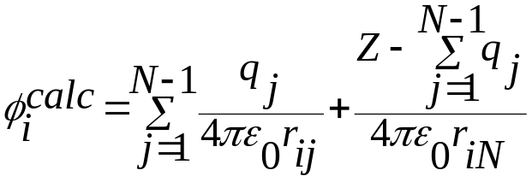
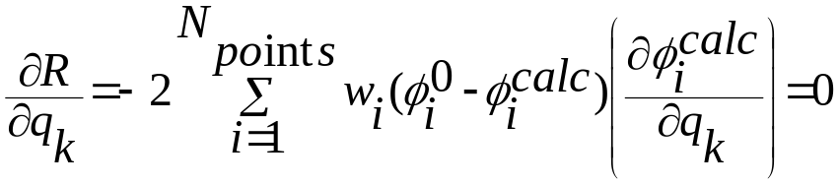
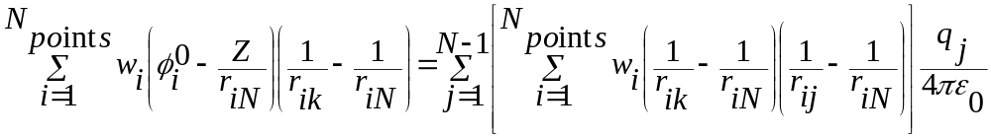
One of charges dependent on the values of others (because sum must be equal to Z. The N-th charge has a value given by
The electrostatics pot. due to the charges q_{j} at the point i is given by
At a minimum value of the error function, R, the first derivative is equal to zero with respect to all charges q_{k}
The above equation can be written in the following form

Slide 10
When expressed in this way, then the set of equation can be recast as a matrix equation of the form Aq = a
The charges q are then determined using the standard matrix methods via q = A⁻¹ a
Molecular mechanics is used to model systems containing thousands of atoms such as polymers, DNA, liquid crystal. How then can charges be derived for such species? One can not routinely perform quantum mechanical calculations. So it must be broken into fragments of a suitable size.

Slide 11
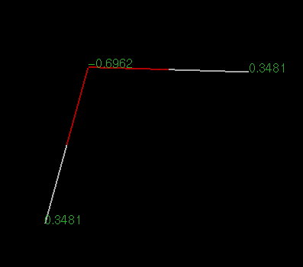
Structure of water
For TIP3P water
H=0.417
O=-0.834
LMP2 charges
For SPC/E water
H=0.4238
O=-0.8476
Quantum Mulliken charges averaged from cluster solvation in water dielectric, single point
6-311g** DFT=Becke_3_Parameter/HF+Slater+Becke88+PW91+PW-GGAIIC (B3GGA-II)
Charges: H = 0.36433 O = -0.72866

Slide 12
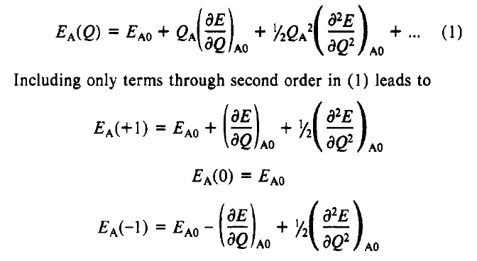
Charge equilibration (qEq method)
Series expand the atomic energy as a function of charge (neutral reference point)
Truncate after 2nd order and consider three specific states:
Neutral (0)
+ve (+1)
-ve(-1)
Rappe and Goddard JPC, 95, 3358

Slide 13
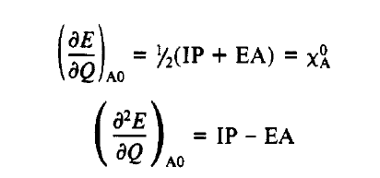

Energy of the positive species is ionization potential (IP) and energy of the negative species is minus the electron affinity(EA)
χ_{A} is the electronegativity
To understand the physical significance of the second-derivative
∂²E/ ∂Q² consider a simple case of neutral atom with a singly occupied orbital ϕ_{A}, that is empty for the +ve ion and double occupied for the –ve ion. For such system the difference between ionization potential and electron affinity will be equal to the Coulomb repulsion between the two electrons placed in that orbital.

Slide 14

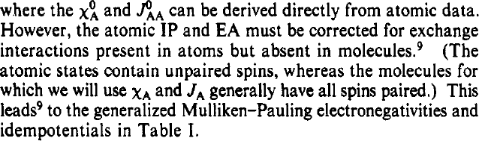
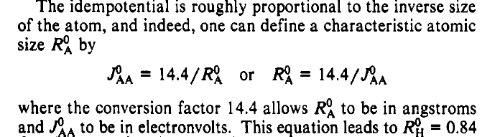

Slide 15
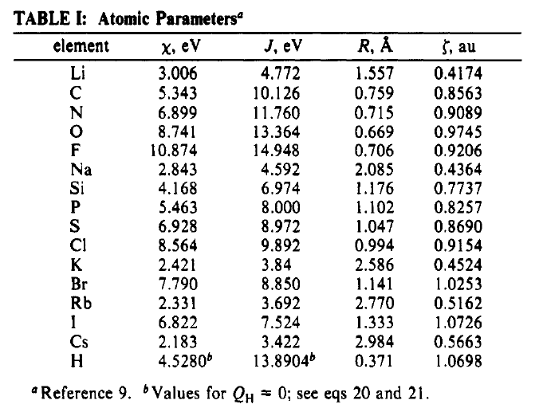

Slide 16

Now for a molecule with N atoms the total electrostatic energy is given by
J_{AB} is the Coulombic interaction between the unit charges on centers A and B. This depends on the inverse of the distance between A and B : RAB. This simple Coulomb law is not valid for atoms whose charge distribution overlap. In such cases there is a significant shielding corrections.
With the fact that J_{AB}→J_{AA} as R_{AB} →0, we can write the above equation as

Slide 17



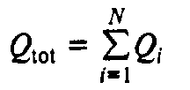
Taking the derivative of E wrt to Q_{A} leads to an atomic scale chemical potential
or
At equilibrium these chemical potentials will be equal. Electrons move from region of low electronegativity (high electrochemical potential) to regions of low electronegativity (low electrochemical potential).
This leads to N-1 equations
Another constrain is the total charge
Together we have N simultaneous equations to be solved for self-consistent charges for a given structure.

Slide 18
