Slide 1
Calculation of Binding Energy for Folding of Synthetic Macromolecules Using Molecular Simulation
Swati De
Inorganic & Physical Chemistry Dept
IISc, Bangalore

Slide 2
What is Foldamers ?
Gellman’s definition:
“Any polymer with a strong tendency to adopt a specific compact conformation”
Gellman, S. Acc. Chem. Res. 1998, 31, 173
Structure Formation
Mainly oligomers, very few polymeric system

Slide 3
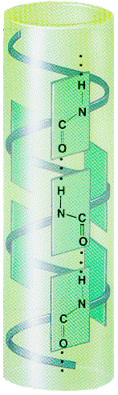
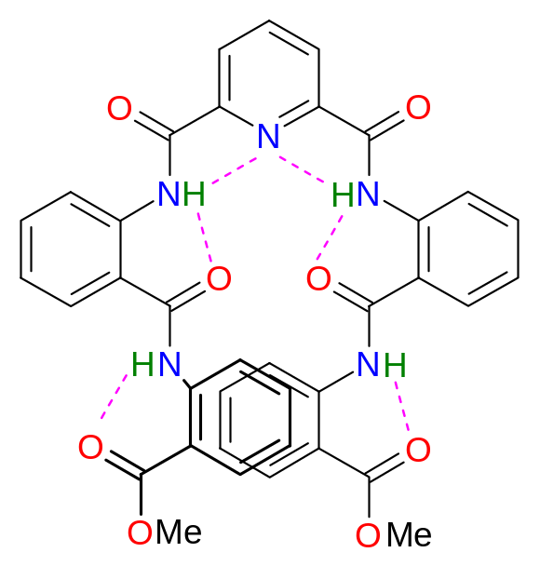
Nature has done just that …
Strong directional interactions (H-bonding) between periodically spaced subunits along the polymer chain, aided by a chirality- induced preference causes the self-assembly and therefore the generation of a folded (secondary) structure.
Helical conformation due to H-bonding in chloroform
Adapted from www.people.virginia.edu/~rjh9u/prot2ndstruct.html
Hamilton and co-workers, J. Am. Chem. Soc. 1996, 118, 7529

Slide 4
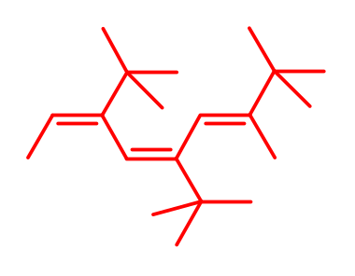
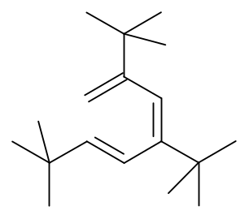
Folding of synthetic macromolecules
Due to steric compulsions
1)Polyacetylene
black color due to extended conjugation
all-trans conformation
2)Poly(tert-butyl acetylene)
Conformational transition due to steric bulk
white powder due to loss of conjugation
cis-transoid
cis-cisoid

Slide 5
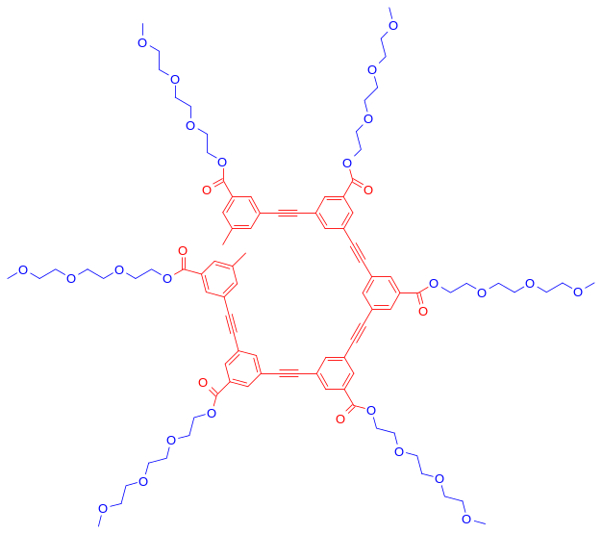
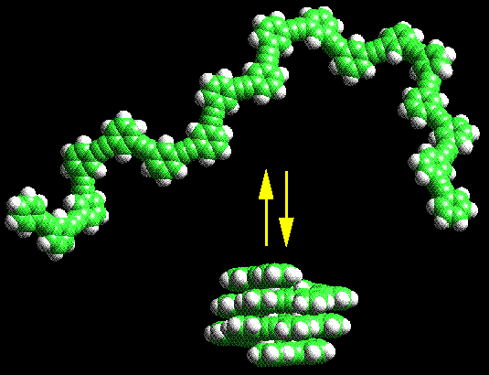
Due to bond-angle constraints
Oligo(m-phenylene ethynylene)s
Bond angle constraint, imposed by the all-meta linkage, aided by solvophobic exclusion affects the folding
Moore and co-workers, Science 1997, 277, 1793

Slide 6
All helical polymers are not foldamer
Helical polymers
Helix is the only conformation; Doesn’t have any conformational flexibility
Foldamers
Folded conformation is one of the many possible conformations
Unfolded
Folded
Depends on solvent, ionic strength, temperature, pH etc.

Slide 7
Foldamer Design
Isotropic
interactions
Self-aggregation
Directional
interactions
Intra-molecular Inter-segment Interaction
Self-assembly

Slide 8
Thermodynamic Aspects:
Unfolded Structure
Folded Structure
More Ordered
ΔG = Δ H -T Δ S
-T Δ S = positive
Δ G to be negative Δ H has to be negative
Loss Of Entropy
Δ S = negative
Non Covalent Forces
Hydrogen Bonding
Solvophobic & Solvophilic Interactions
Bond angle constraint
Steric interaction
Charge Transfer
Metal Ion

Slide 9
Foldamer Design By Non covalent Forces:
Donor-Acceptor interaction Iverson
Solvophobic interaction Moore
Hydrogen bonding Hamilton, Lehn, Bing-gong, Huc , Meijer

Slide 10
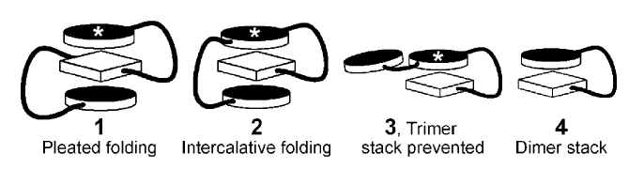
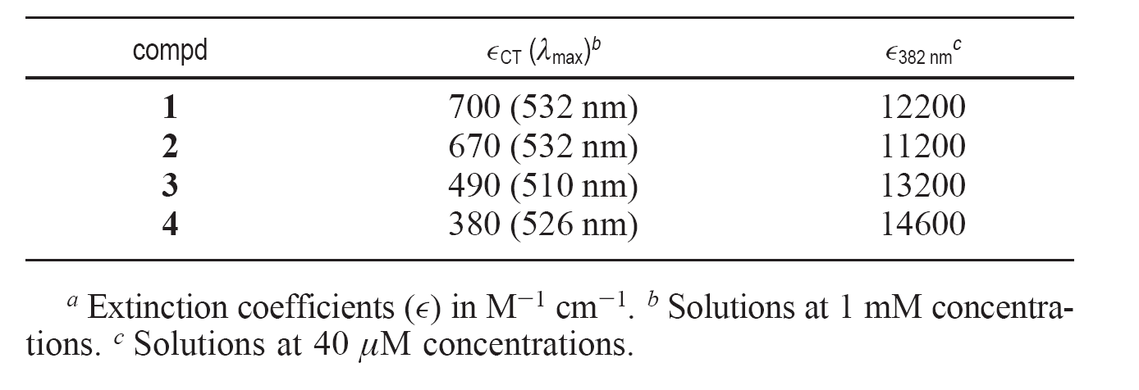
Different folding pattern:
Iverson and co-workers, J. Am. Chem. Soc 2005

Slide 11
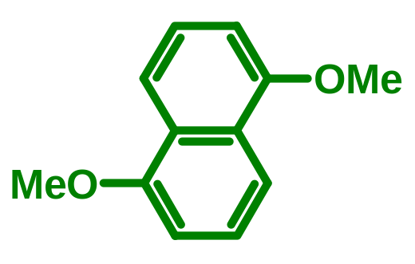
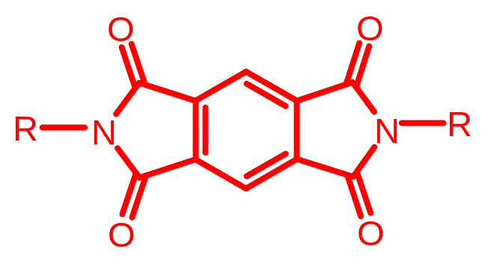
Charge Transfer Interaction:
+
Donor Acceptor
Charge Transfer complex
C-T Interaction has been exploited in Supramolecular Chemistry
Donor
Acceptor

Slide 12
Work done in our lab:
1)Folding studies with Donor-Acceptor Polymer
2)Small Molecule-induced folding of a synthetic polymer

Slide 13
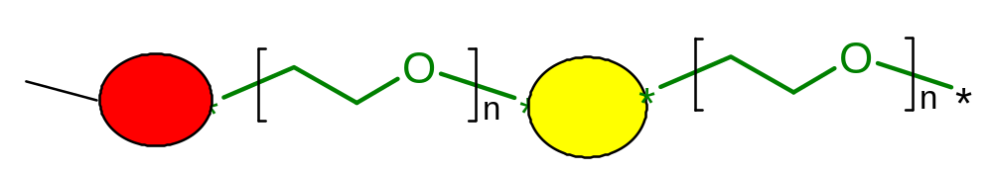


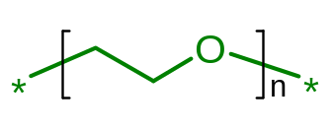
Folding studies with Donor-Acceptor Polymer:
Synthesis of Polymers having alternate Donor-Acceptor Moieties Linked Via Flexible oligo-ethyleneoxy Spacer
Donor
Acceptor
Flexible Spacer, n can be changed to modulate the folding property

Slide 14
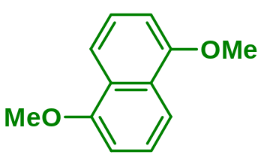
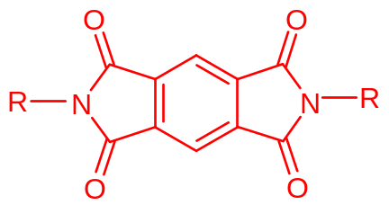
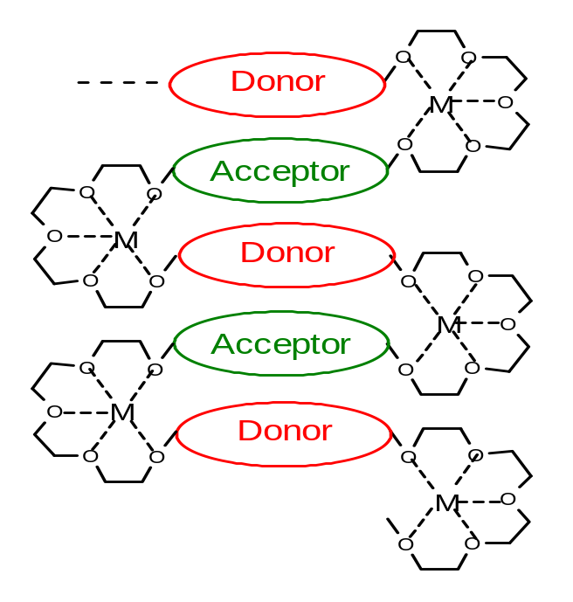
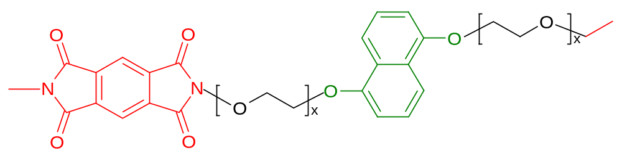
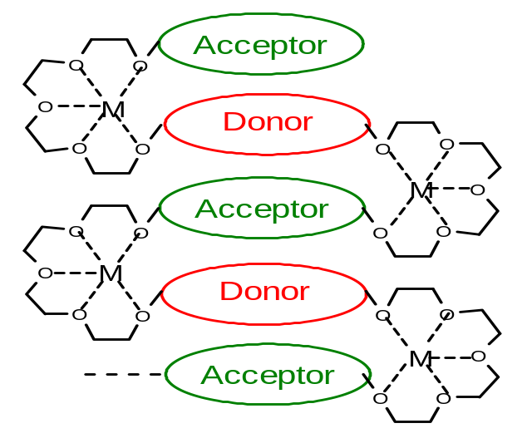
Donor
Acceptor
polymer
x = 3, PDA-4OE
x = 4, PDA-5OE
x = 5, PDA-6OE

Slide 15
Folding studied by C-T band in UV and NMR spectroscopy
Effect of the flexible spacer length
Effect of solvent polarity
Effect of metal-ion complexation
Effect of temperature
1)Spacer’s length effect ---- folding propensity of DAD-4OE>
DAD-5OE from NMR and UV-Vis studies
2)Metal ion selectivity ---- 1) for 5OE containing model compounds
effective metal ion binding Li+> Na+> K+
2) for 6OE containing model compounds effective metal ion binding K+>Na+>Li+
Ghosh, S.; Ramakrishnan, S. Angew. Chem. Int. Ed. 2004, 43, 3264
Ghosh, S.; Ramakrishnan, S. Macromolecules 2005, 38, 676-686

Slide 16
Small Molecule-induced folding of a synthetic polymer:
Donor
Acceptor

Slide 17
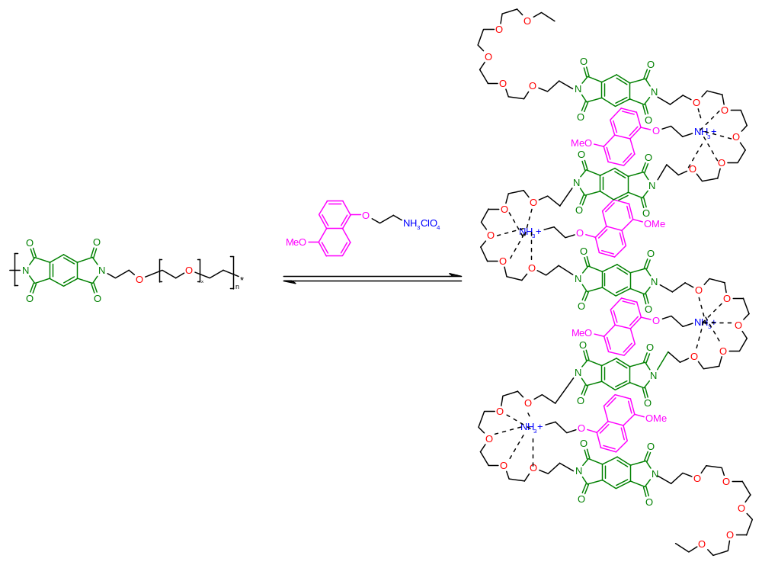
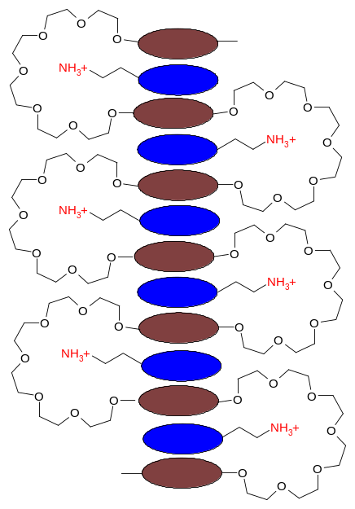


Charge-transfer interaction & complexation of ammonium ion with the hexaethyleneoxy loop operating together.
Donor
Acceptor
Ghosh, S.; Ramakrishnan, S. Angew. Chem. Int. Ed.
2005, 44, 5441 –5447

Slide 18
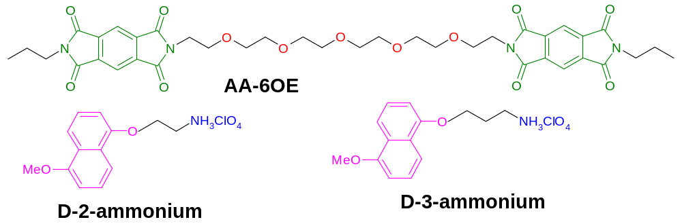
D-2-NH₃⁺ is more effective folding agent than D-3-NH₃⁺

Slide 19
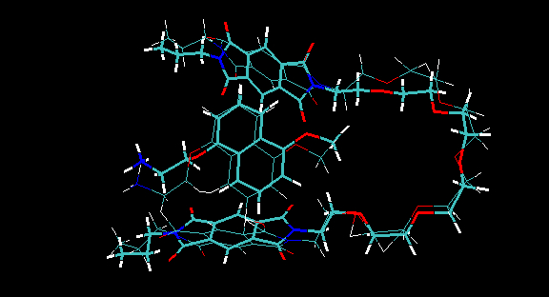
My Work
Minimized Structure is shown along with initial structure.

Slide 20
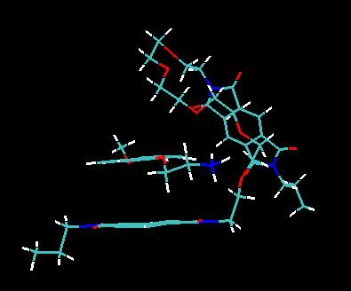
Structure of the complex after equilibration for 100ps in NVT ensemble using implicit solvent
Temp regulation : Langevian dynamics with collision frequency =1.0
Cut =16.0Å long range interactions = Ewald summation method

Slide 21
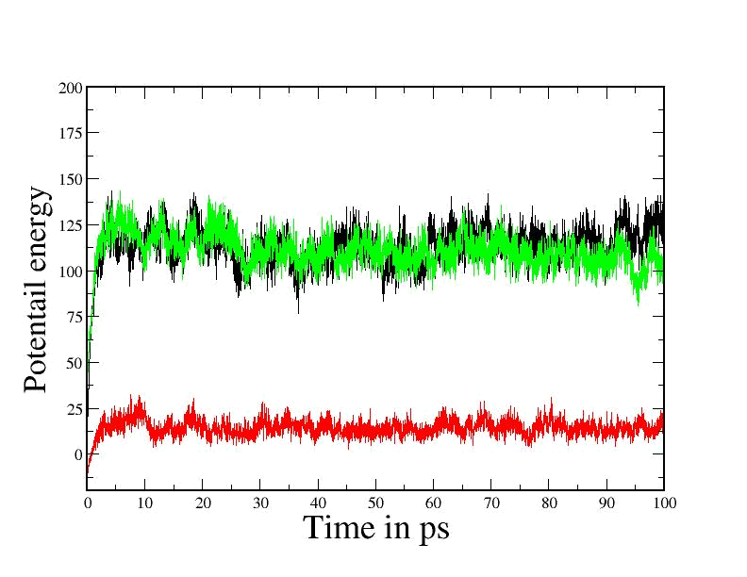
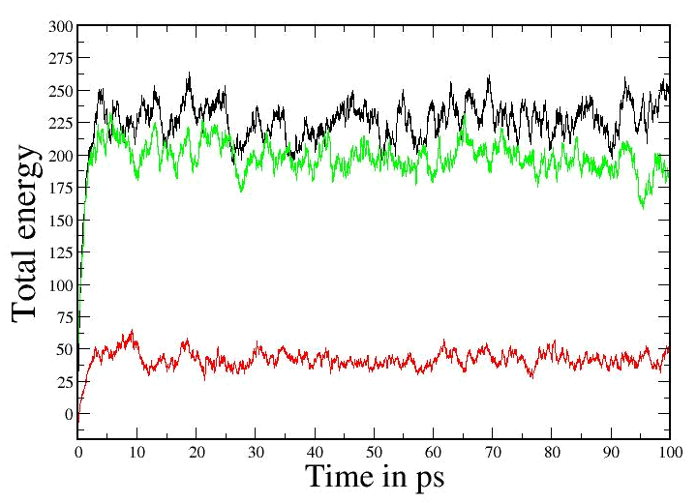
NVT ensemble :
Acceptor
Complex
Donor
Acceptor
Complex
Donor

Slide 22
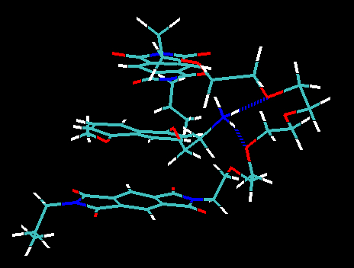
Final structure of the complex after 500ps
Hydrogen bond

Slide 23
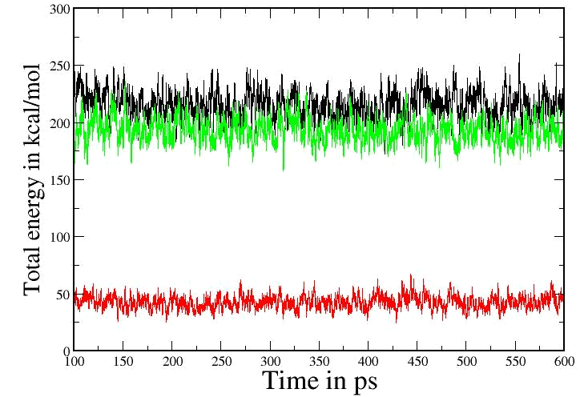
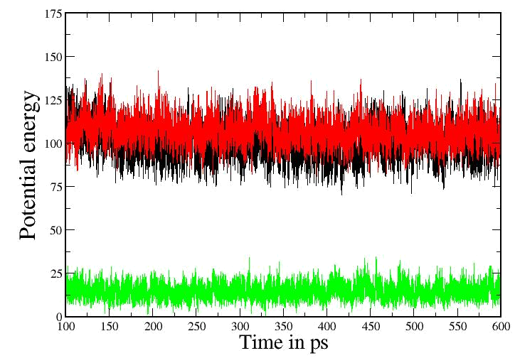
Acceptor
Complex
Donor
Acceptor
Complex
ΔE_{Binding}= E_{complex} – ( E_{Donor}+ E_{Acceptor} )
Donor

Slide 24
Donor energy
A V E R A G E S O V E R 500000 S T E P S
NSTEP = 500000 TIME(PS) = 600.000 TEMP(K) = 311.53 PRESS = 0.0
Etot = 42.7110 EKtot = 27.8584 EPtot = 14.8526
BOND = 11.5190 ANGLE = 11.6837 DIHED = 9.9388
1-4 NB = 10.1020 1-4 EEL = 113.9801 VDWAALS = -1.4399
EELEC = -75.5600 EGB = -65.3711 RESTRAINT = 0.0000
Acceptor energy
NSTEP = 500000 TIME(PS) = 600.000 TEMP(K) = 304.15 PRESS = 0.0
Etot = 193.2177 EKtot = 86.1289 EPtot = 107.0888
BOND = 34.8710 ANGLE = 101.9606 DIHED = 30.8447
1-4 NB = 14.9463 1-4 EEL = 244.7926 VDWAALS = -26.7170
EELEC = -248.9748 EGB = -44.6346 RESTRAINT = 0.0000
Donor-acceptor complex
NSTEP = 500000 TIME(PS) = 600.000 TEMP(K) = 302.36 PRESS = 0.0
Etot = 215.0290 EKtot = 114.4616 EPtot = 100.5674
BOND = 45.9663 ANGLE = 112.5759 DIHED = 39.2369
1-4 NB = 25.6156 1-4 EEL = 374.6547 VDWAALS = -40.7333
EELEC = -384.6826 EGB = -72.0661 RESTRAINT = 0.0000
ΔE_{Binding}= {100.6 –(107.1+14.9)} = -21.4 Kcal

Slide 25
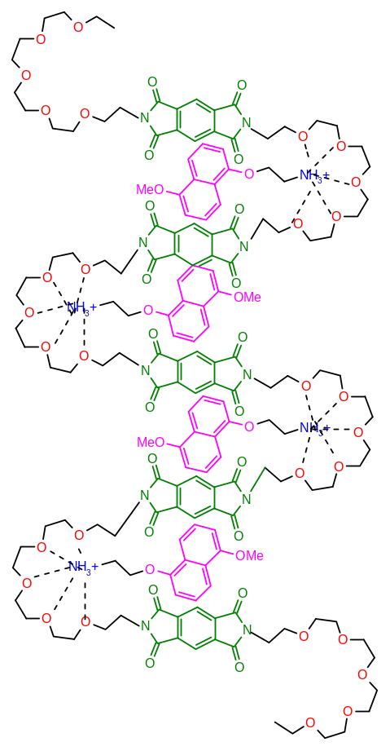
FUTURE PLAN:
Using Molecular Simulation
1) How the nature and structure of D-A complex varies depending upon the relative size of the metal-ion and the Ethylene Glycol loop?
2) How the length of linker segment between the donor ring and the ammonium ion have significant impact on the folding process?

Slide 26
Acknowledgements
Prof. S. Ramakrishnan
Dr. Suhrit Ghosh
Special Thanks to
Dr. Prabal K. Maiti
Usha
Kakali
Suman, Dibyendu and Santosh

Slide 27
Thank You

Slide 28
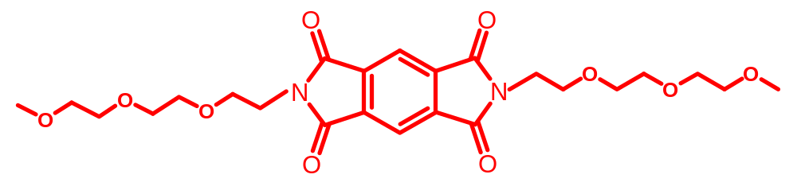
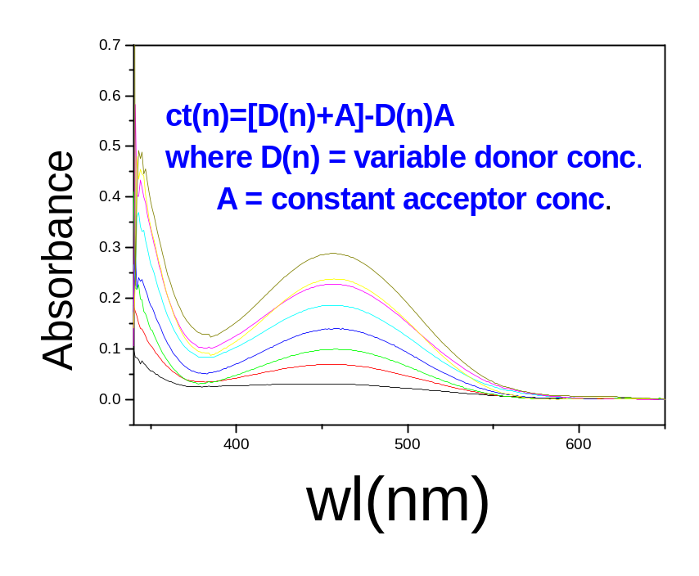
Determination of the formation constant of the Charge Transfer Complex:
+
A₀/A = 1/K.E^{AD} * 1/D₀ + 1/E^{AD}
A₀ = Concentration of the Acceptor
D₀ = Concentration of the Donor
A = Absorbance of the C-T Band
E^{AD} = Extinction coefficient of the Charge Transfer Band
K = Equilibrium Constant
Condition D₀ >>> A₀
A₀/A Vs 1/D₀ plot
K = 20 mol⁻¹

Slide 29
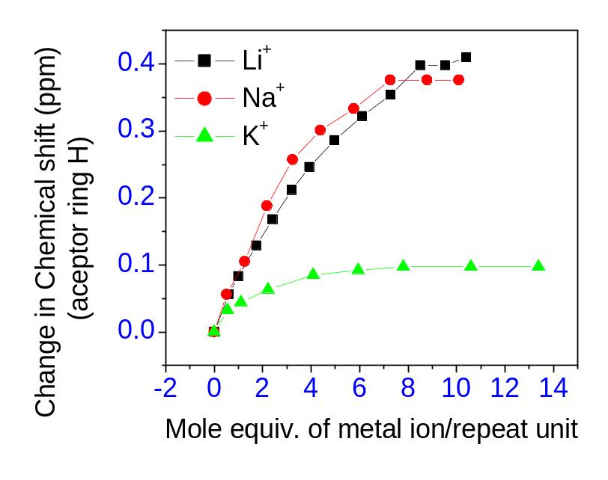
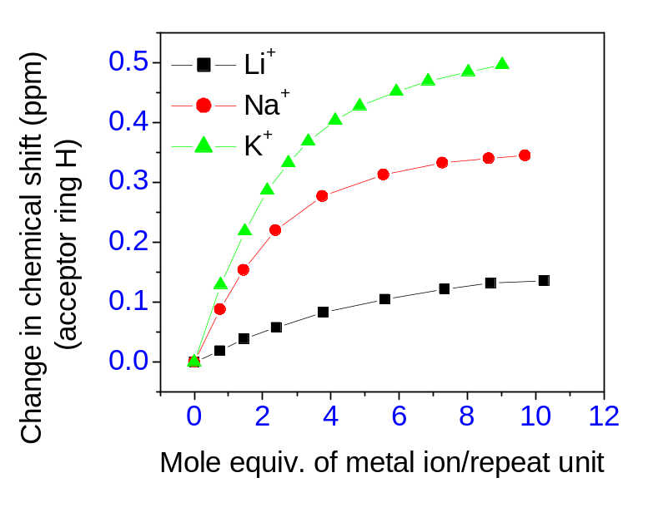
Selectivity of metal ion complexation
Variation of metal ion – Li⁺, Na⁺ and K⁺: PDA-5OE & PDA-6OE
PDA-5OE
PDA-6OE
Similar trends in ion size dependent complexation have been observed in the UV-Vis study as well.

Slide 30
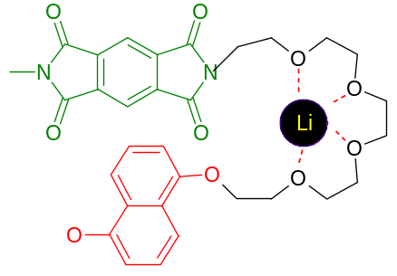
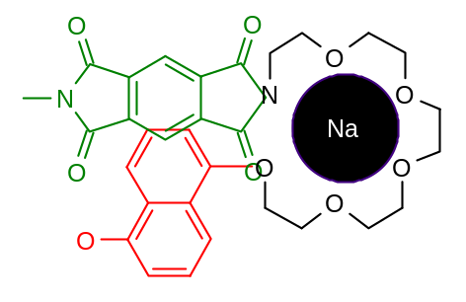
Does the geometry of the D-A complex depend on the size of the metal ion?
In the case of Na⁺, the formation of the D-A complex (both in DAD as well as DA models) causes a strong differentiation between the two aromatic rings of the naphthalene unit, while in the case of Li⁺ this differentiation is very limited, if any.
Geometry is dictated by metal ion complexation
Optimum geometry for CT interaction

Slide 31
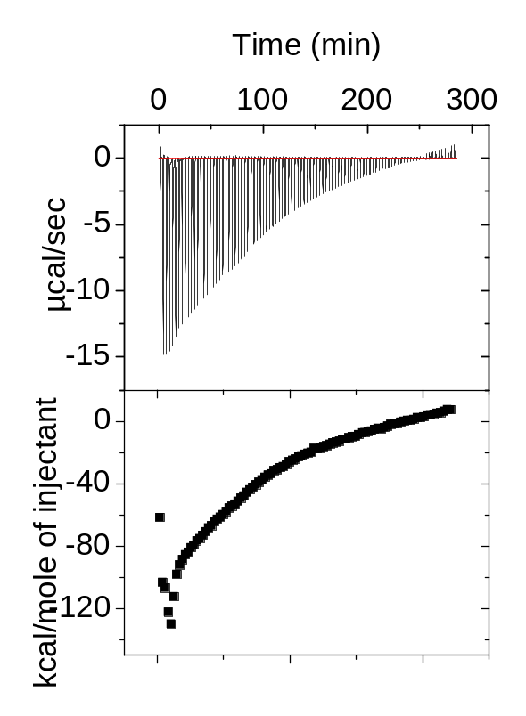
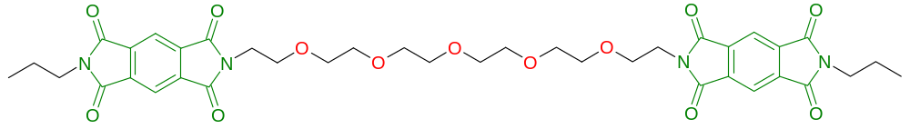
Association constant
Isothermal Calorimetry
Solvent 1:1 CHCl₃/ CH₃CN (v/v)
System | From ITC | From NMR
D + NH₄⁺ | - | 45 M⁻¹
D-2-NH₄⁺ | 1100 M⁻¹ | 850 M⁻¹
D-3-NH₄⁺ | - | 600 M⁻¹
Association constant is enhanced by ~ 25 times due to linking

Slide 32
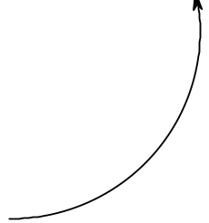
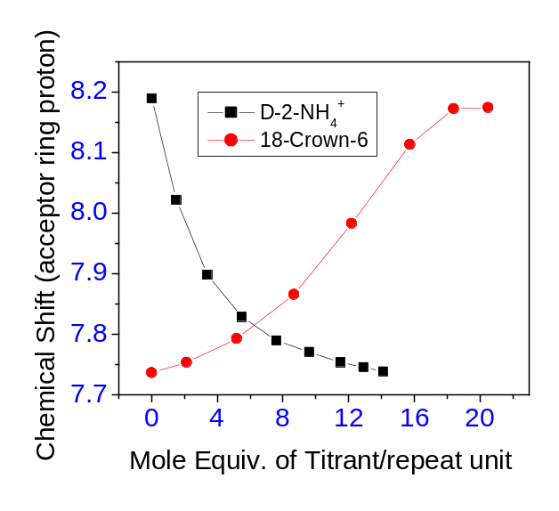
Folding is reversible
Acceptor
The association constant of NH₄⁺ with 18-crown-6 is in the order of 10⁶ M⁻¹
N
O
O
O
N
donor
O
NH₄⁺ ion
O
O
O
O
O
N
O
O
18-crown-6
N
O
¹H NMR study
O
Folding is reversible

Slide 33
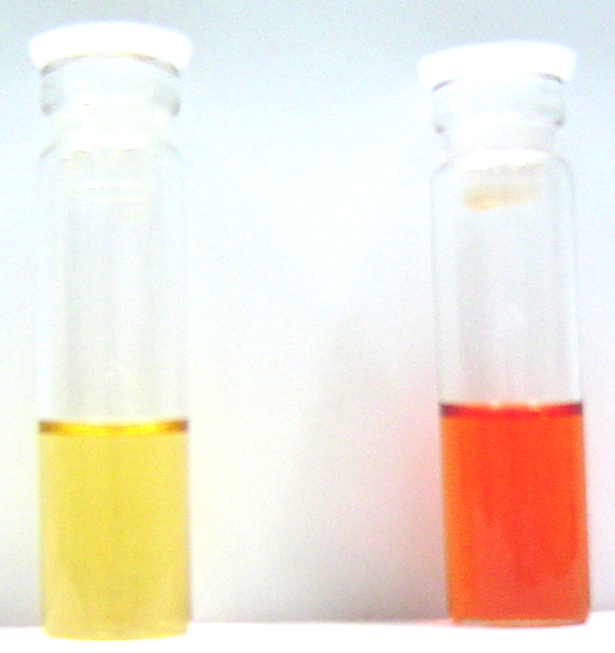
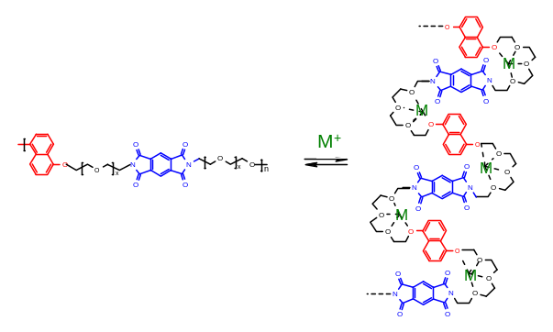
Achievements
“While oligomeric-sized molecules are relatively easy to generate, the preparation of high molecular weight hetero-polymers of a specific sequence represents one of the today’s unsolved synthetic challenges. Until this barrier can be over-come, there are certainly valuable properties to be found and fundamental discoveries to be made in the foldamer themselves. At least for today, the oligomer- the chemist’s middle child-comes to the fore”
Moore and co-workers, Chem. Rev. 2001, 101, 3893
Unfolded Folded
In 2004 we have shown
By proper design, flexible synthetic macromolecules can be made to fold under the influence of relatively weak intra-chain inter-segment interactions

Slide 34
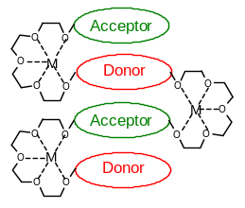
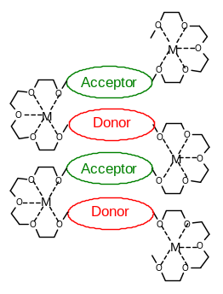
Limitations
Length scale of the D-A stack ?
Model compound approach might not be sensitive beyond a certain extent !
Vs
Folding exceeds more than simple D-A pairing!

Slide 35
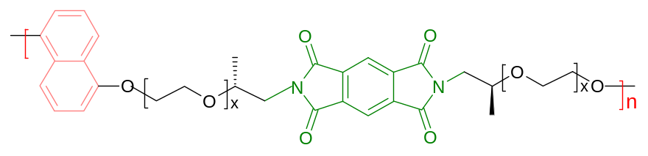
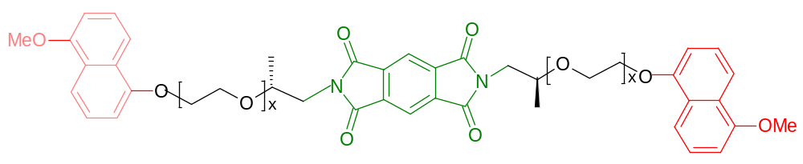
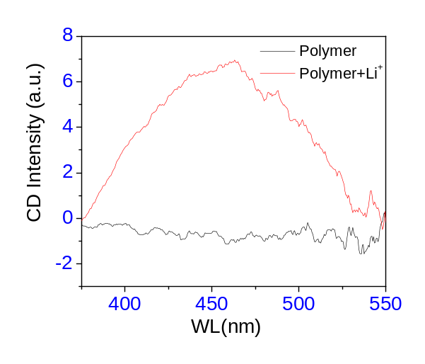
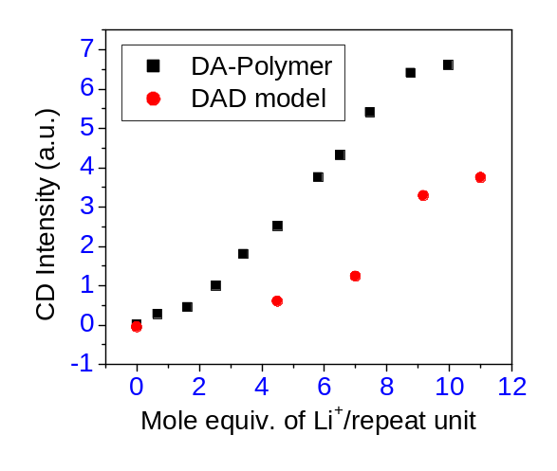
Attempt to address the issue
CD Study
Polymer-5OE
Mn = 4000
DAD model-5OE
Solvent 1:1 CHCl₃/CH₃CN, metal ion - Li⁺

Slide 36
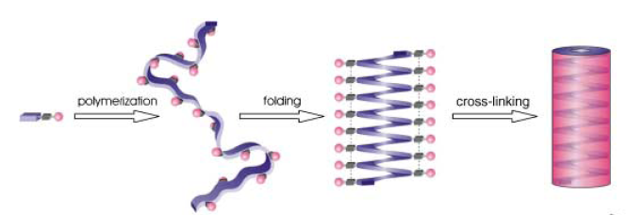
Future directions
New design
Can they perform ?
Organic nano-tube
Hecht & co-workers , Angew. Chem. Int. Ed. 2003, 42, 6021

