Slide 1
Surface Tension calculation of a LJ liquid-vapour interface
  Chaitanya Krishna A
  Bhaskar Jyoti Borah
  Solid State and Structural Chemistry Unit
  IISc, Bangalore

Slide 2
Outline of The Talk
Introduction
Molecular theory of surface tension
Literature review
Our work
Results and conclusion

Slide 3
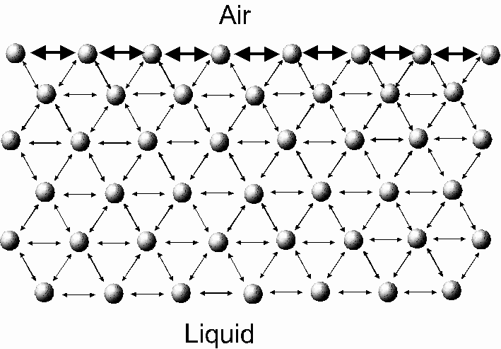
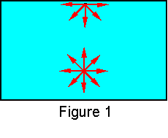
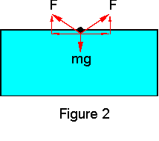
Introduction
Surface tension is a measure of the cohesive energy present at an interface.
Imbalance force at the surface leads to the presence of free energy.
http://www.woodrow.org/teachers/bi/1998/waterstrider/student_lab.html
http://www.ksvinc.com/surface_tension1.htm

Slide 4
Need for Simulation
Accurate determination of Surface Tension is difficult.
Microscopic structure at the interface is difficult to probe. e.g. a two component mixture.
It gives the coexisting liquid and vapor densities, interface thickness, surface tension, surface energy.

Slide 5
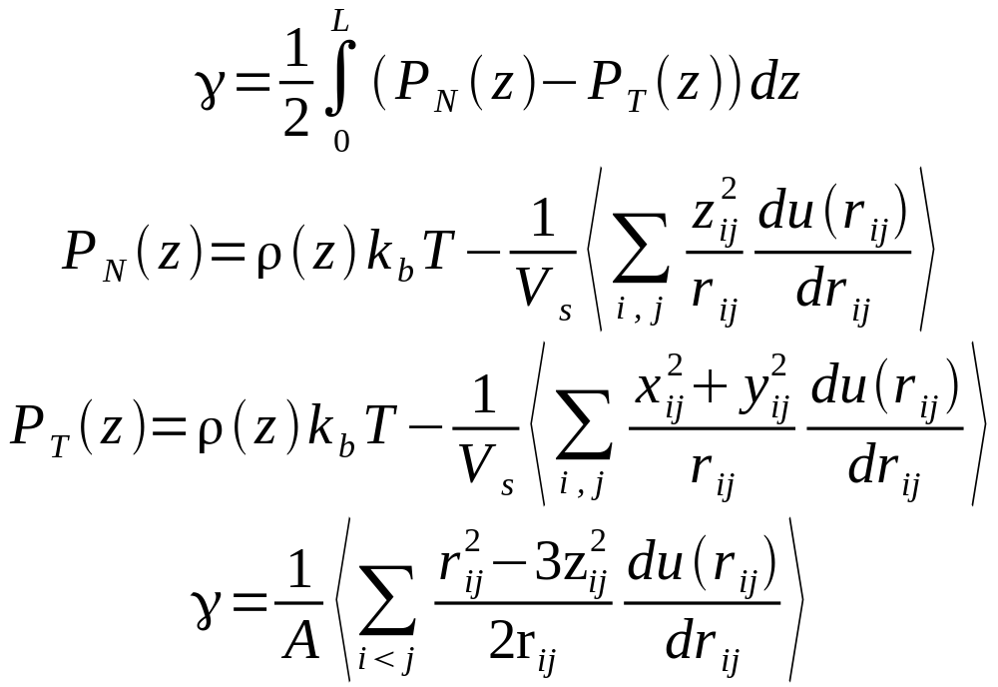
Molecular Theory of Surface Tension
From Kirkwood-Buff theory the surface tension can be given as
Kirkwood, et.al., JCP, 1949

Slide 6
Simulation Model
Interaction Potential – Lennard Jones
Equilibration of homogeneous liquid.
Addition of two empty boxes at the top and bottom giving rise to two interfaces.
Production of the liquid-vapor interface

Slide 7
Our Work
Two sets of simulations
NVT Ensemble
4000 particles
Velocity – Verlet Algorithm
Time Step 0.01
Equilibration of homogeneous liquid phase 10000 steps
Production of the liquid-vapor interface 40000 steps

Slide 8
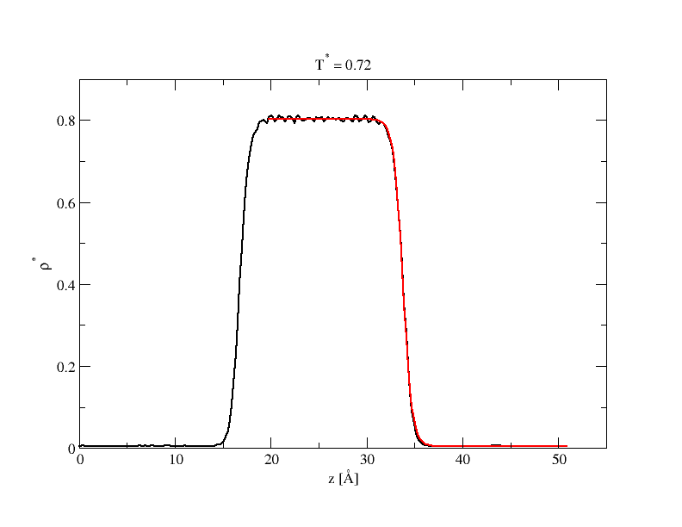

Slide 9
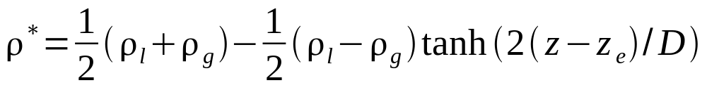
Curves fitted with the following empirical equation
to determine the coexisting densities and the
interface thickness.

Slide 10
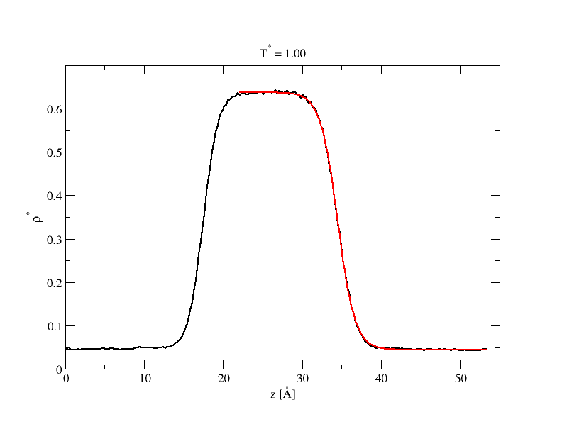

Slide 11
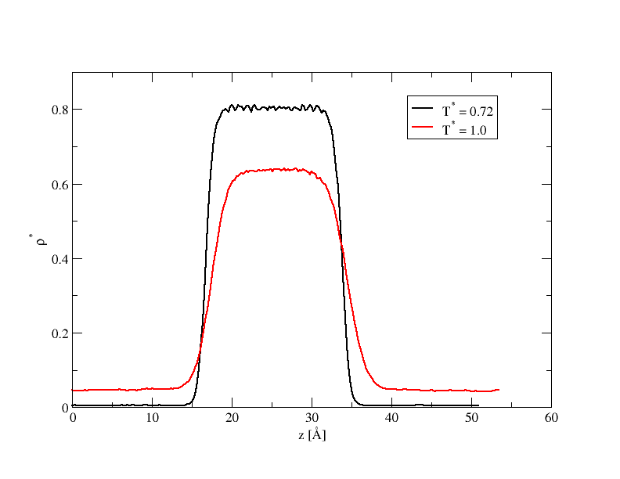

Slide 12
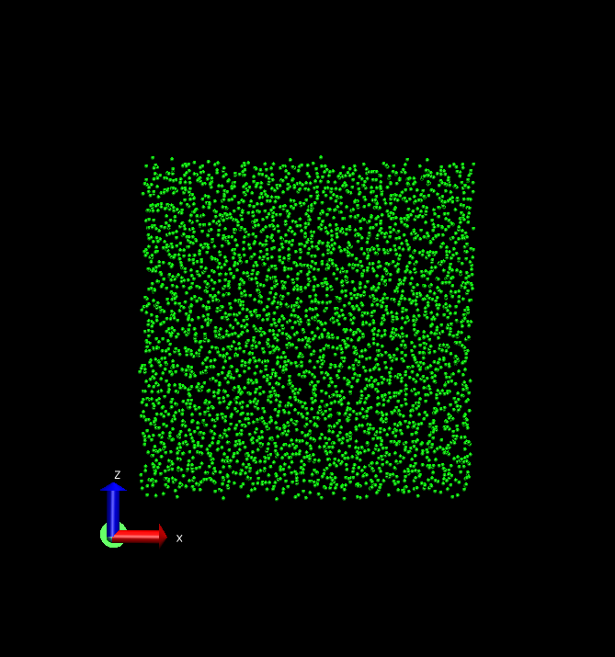
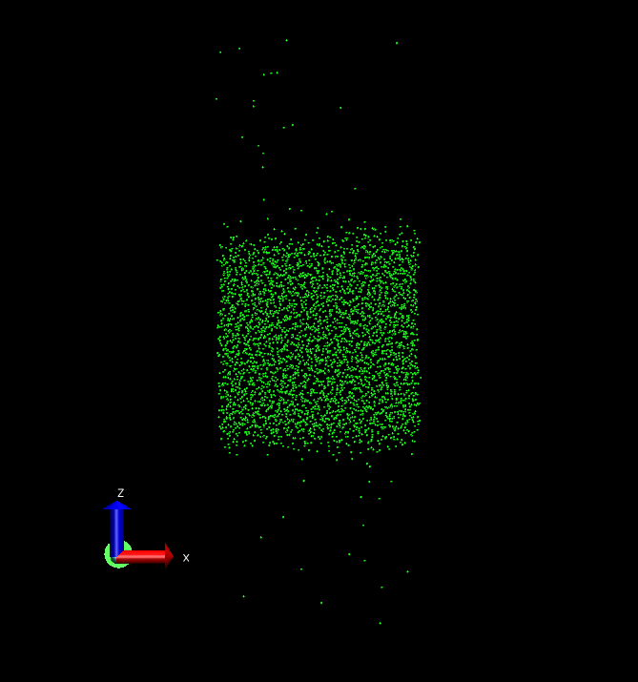
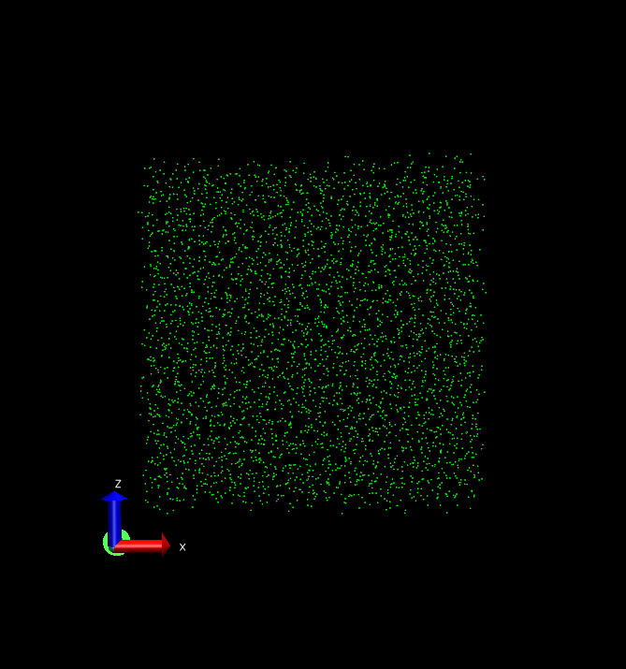
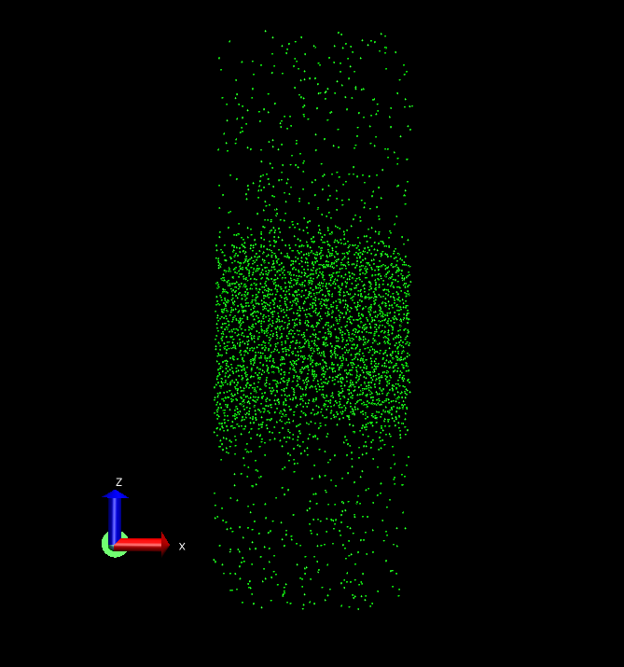

Slide 13
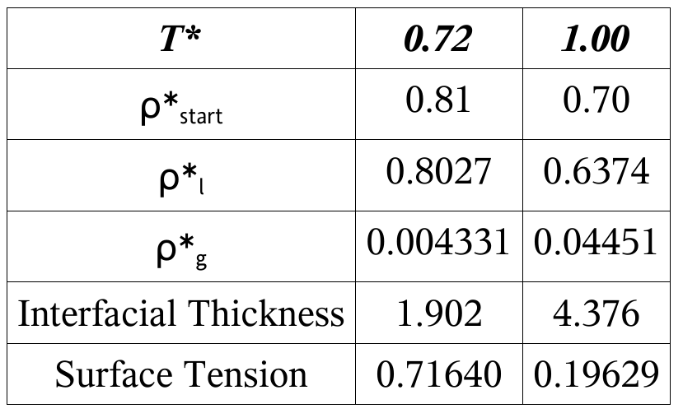

Slide 14
Acknowledgments
Prof. Prabal Maiti
Biswajit

