Slide 1
SIMULATING WATER DIFFUSION IN A CARBON NANORING
N. RAGHU MEETEI
DEPT. OF PHYSICS , IISc.

Slide 2
OUTLINE
MOTIVATIONS
CARBON NANOTUBE (CNT)
MAKING A CARBON NANORING
WATER DIFFUSION IN CNT
PUTTING WATER INSIDE A NANORING
WATER DIFFUSION IN A NANORING
CONCLUSION

Slide 3
MOTIVATIONS
Investigating the spatial arrangement of the water molecules confined inside the carbon nanoring.
Understanding the mode of diffusion of water inside the nanoring.
Observing the behaviour of confined water molecules.
Comparison of confined water to the bulk water.
It provides clues in the understanding of water diffusion across biological pores (aquaporins)/ion channels present in cell membranes.

Slide 4
REVIEW OF CNT
Hollow cylinder formed by rolling over a graphite sheet.
Rolling the graphite sheet along CHIRAL VECTOR “C”.
A CNT is uniquely characterized by “C” in terms of a set of two integers (n,m) corresponding to graphite lattice vectors a₁ and a₂:
C = na₁ + ma₂ ≡ (n,m)
a = |a₁| = |a₂| = 2.46 A
CNT is constructed by rolling up the sheet s.t. the two end-points of the vector C are superimposed.

Slide 5
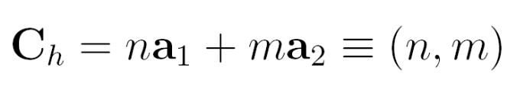
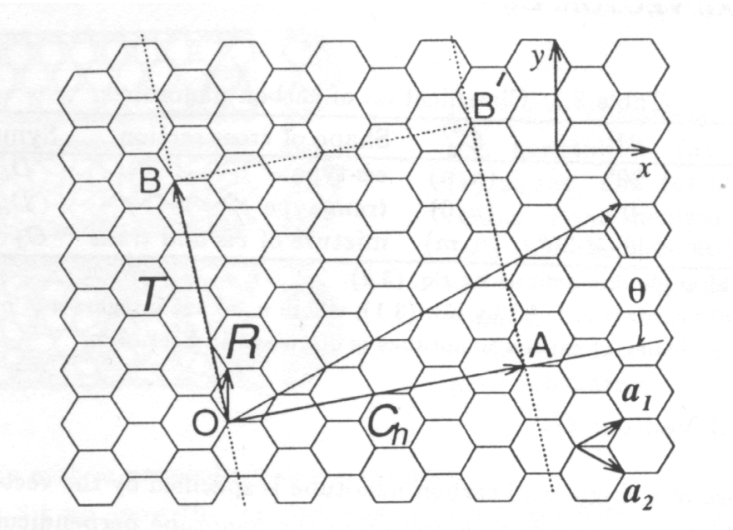
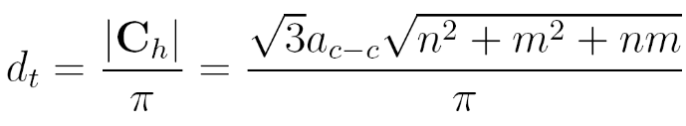
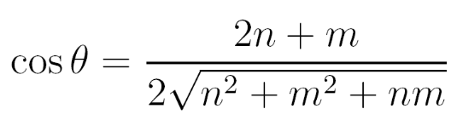



Structure
The Chiral Vector, the Chiral Angle
Arm Chair (n,n)
Zigzag (n,0)
Chiral (n,m)

Slide 6
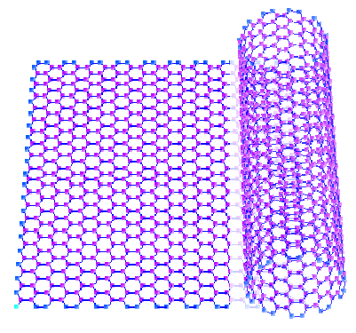
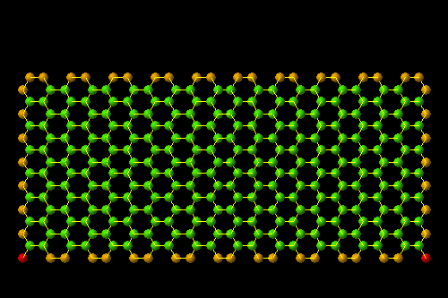
Structure
Visualized as a Rolled Graphene Sheet
http://www.photon.t.u-tokyo.ac.jp/~maruyama/wrapping3/wrapping.html

Slide 7
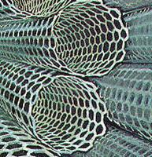
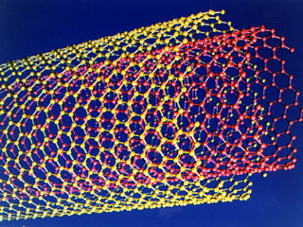
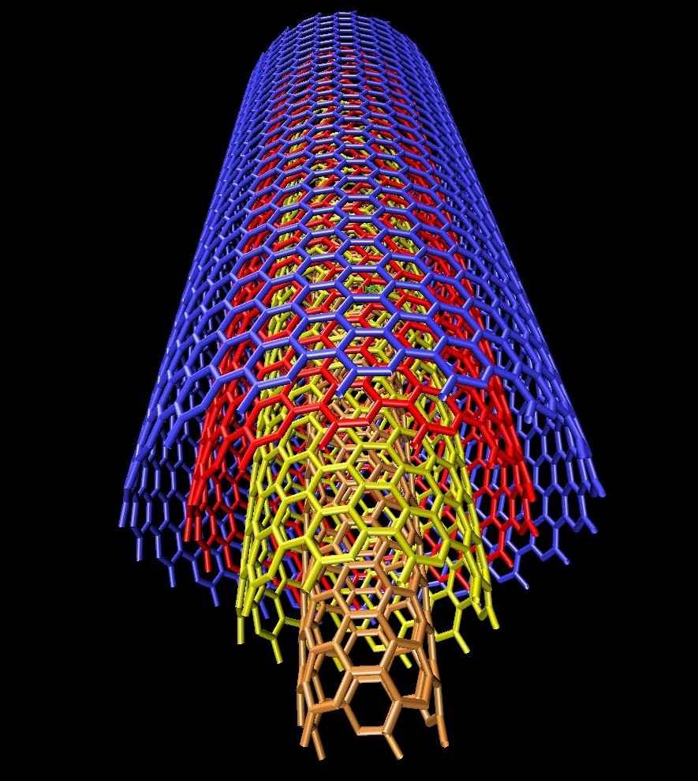
Structure
Classification Based on the Number of Concentric Tubes
SWNT
DWNT
MWNT

Slide 8
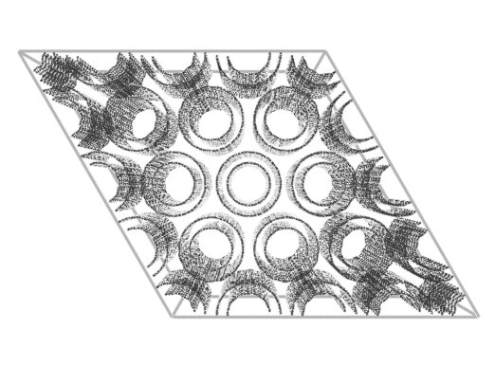
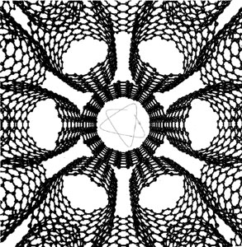
Structure
Carbon Nanotube Bundles

Slide 9
ELECTRICAL PROPERTIES
The (n,m) CNTs are metallic, if n-m is a multiple of 3.
Semiconducting otherwise.
The armchair CNTs (n, n) are always metallic.
The zigzag CNTs (n, 0) requires an n multiple of 3.

Slide 10
UNIQUENESS OF CNTs
Bonding in CNT is sp².
But when a graphite sheet is rolled,the sp² hybrid orbital
is deformed for rehybridisation of sp² towards sp³ orbital
or σ -π bond mixing.
This rehybridisation structural factor together with π electron confinement gives CNT unique,extraordinary in electronic,mechanical,chemical,thermal,magnetic,and optical properties.

Slide 11
MAKING A CARBON NANORING
Generally, two possible ways to make a nanoring from a straight tube:
(1) Geometric folding of a CNT,connecting the ends of the tube and then followed by an energy minimization procedure.
Short tubes do not stay closed. L_{c} = 180 A
(2) Adiabatic folding of a CNT untill it closes onto itself.
The structures of this method are more stable.

Slide 12
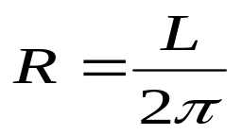
DETAILS OF MAKING A NANORING
We want to construct a nanoring out of a straight tube of length L
Radius of the nanoring :
The axis of the tube is along the z-axis
We determine the the positions of each atom in cylindrical coordinates
( ρ,φ,z)
We are assuming the ring we are constructing is lying in the xy-plane and z-coprdinates will be the axis of ring
We pick up an atom,take its z-coordinate and determine angle φ
Then, z_{f} = ρsinφ ; ρ = ( x² +y² )^{1/2} ; ρ’ = ρ cos φ ; R’ = R + 2ρ’
x_{f} = R’cos φ
y_{f} = R’sin φ

Slide 13
WHY NANORING AND ITS OPEN ISSUES
Nanorings may be used as building blocks of small electromagnetic devices
They can be used to fabricate networks that are extremely flexible and offer a high strength-to-density ratio
What is the global minimum-energy configuration of the closed-ring structure?
Can a continuum elastic shell model predict the proper structure of these materials?
What is the kinetic stability of these materials?

Slide 14
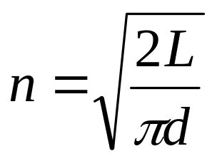
ELASTIC SHELL MODEL
When a SWNT is bent to form a nanoring, one expects that the resulting high-energy structure will relax into a closed polygon that is characterized by many buckles
The number of apexes depends on the length and diameter
The number of apexes is given by :
L= length of the tube
d=diameter of the tube
L→ ∞; the number of apexes will aproach infinity
⇒ Perfect ring structure

Slide 15
SIMULATIONS/MINIMIZATION OF NANORINGS
When we fold a nanotube into a nanoring,the structure obtained is obviously not a minimum-energy configuration
There is an excess tension in the inner radius of the ring due to contraction of the carbon-carbon bonds
And there is no compensation from the outer radius where extension of the carbon-carbon bonds occurs
In order to find a local minimum-energy structure of the ring configuration we utilize the CG minimization method

Slide 16
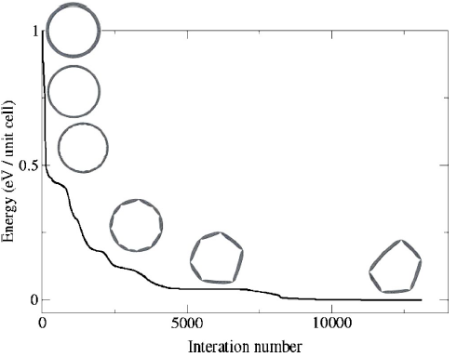
MINIMIZATION OF NANORINGS
The results of the CG minimization for a 10×10×270 nanoring are shown in figure 1
The minimization path initially tends to relieve the tension by quenching the inner and outer walls of the ring toward each other
Further minimization procedure breaks the cylindrical symmetry of the ring, and produces a polygonal shape, with a large number of apexes
FIGURE 1
The sides of the polygon resemble that of a normal carbon nanotube
Further minimization results in a reduction of the number of apexes
Oded Hod et al. PRB 67,2003

Slide 17
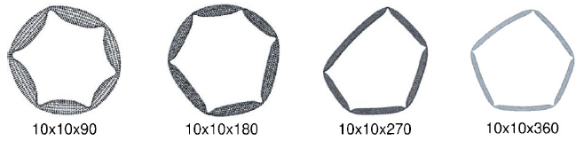
Figure 2 shows several polygonal structures that were formed following the above-outlined minimization procedure.
FIGURE 2
This procedure produces closed-ring structure with five-six buckles.
The only systematic behavior observed is that the number of buckles, and thus the number of apexes, are independent of the length of the original nanotube
Contradiction to the elastic shell model

Slide 18
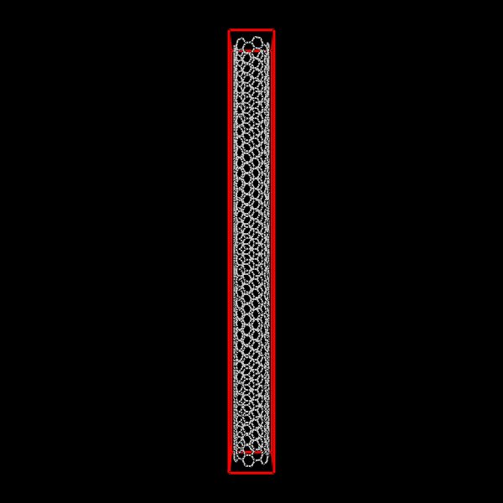
ORIGINAL CNT
CHIRALITY=(6,6)
LENGTH=100 A
NO.OF UNIT CELLS=40
ENERGY=18692.9 Kcal/mole

Slide 19
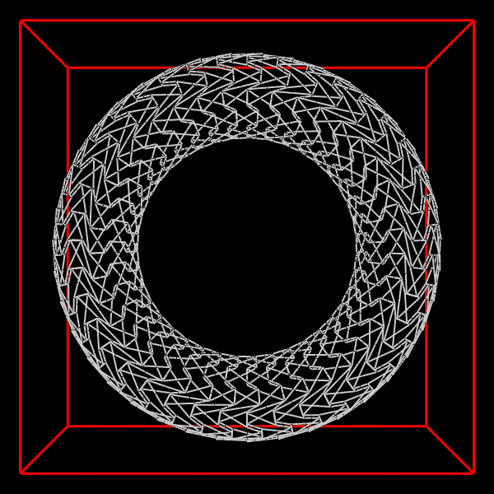
ORIGINAL NANORING
RADIUS=16 A
ENERGY=4.4731E+06 Kcal/mol

Slide 20
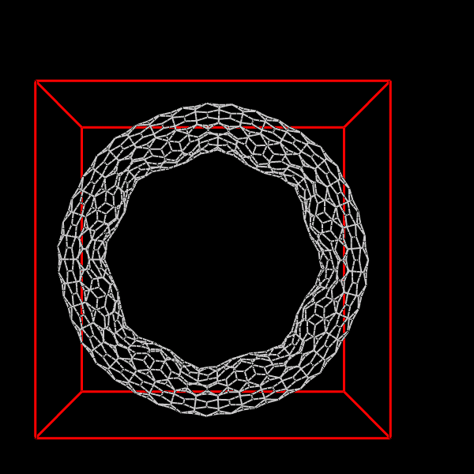
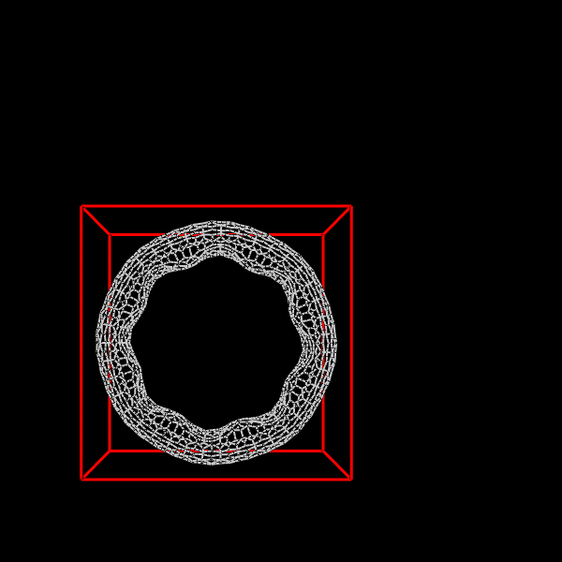
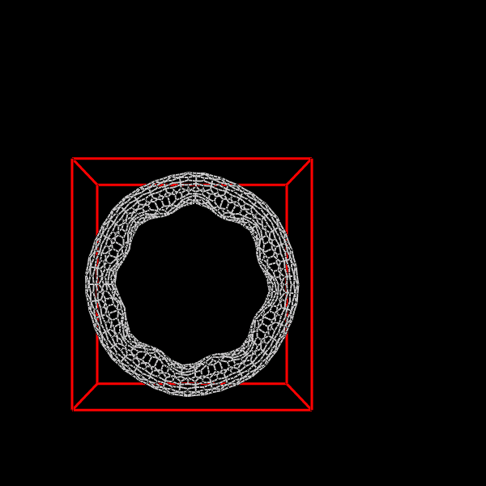
ENERGY=4.4731E+06 Kcal/mol
3000 STEPS
30,000 STEPS
1,00,000 STEPS ;
ENERGY=19247.4 Kcal/mol

Slide 21
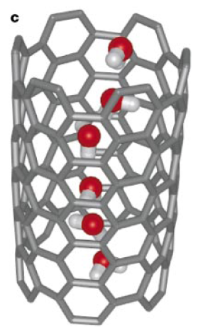
WATER DIFFUSION IN A CNT
Despite having a hydrophobic
pore water spontaneously fills
a nano-tube ?
These water molecules form a
hydrogen bonded chain.
Number of water inside depends sensitively on the VDW interaction between water and carbon.
L= 13.4 A ; D = 8.1 A
Hummer. et. al. Nature 2001

Slide 22
WATER DIFFUSION IN A CNT
The diffusion of water in bulk solutions occurs through a Fickian-type mechanism according to which the mean square displacement (msqd) scales linearly with time.
When confined water molecules move in a highly coordinated fashion, the diffusion occurs through a ballistic mechanism,
in which the msqd scales with the square of time.
The diffusion of confined water is often expected to obey the Fickian dependence, provided that the molecular motion is chaotic and that water molecules can pass each other in the direction of motion.
When water molecules are confined in a narrow one-dimensional channel, they are prevented from passing each other, and the diffusion could become of the single file (SFD) type in which the msqd scales with the square root of time.

Slide 23
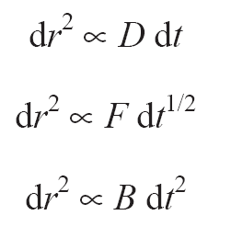
The three diffusion mechanisms are mathematically described as :
FICKIAN
SINGLE-FILE
BALLISTIC
The mechanism of diffusion is reflected on the scaling behavior of the msqd as a function of time.
The goal is to understand the mechanism of water diffusion through carbon nanorings.
Understanding whether the transport properties of confined water differ from those of simple fluids.

Slide 24
Alberto Striolo; NanoLetters 2006 Jan
WATER DIFFUSION THROUGH A CNT : REVIEW
Analysis of water confined within (8,8) SWNTs. D = 1.08 nm
Demonstrated the mean square displacement follows a ballistic-type dependence on time for upto 500 ps.
When the mean square displacement is analyzed beyond 1 ns,the diffusion mechanism changes and becomes Fickian.
Surprisingly,it is found no evidence of single-file diffusion.

Slide 25
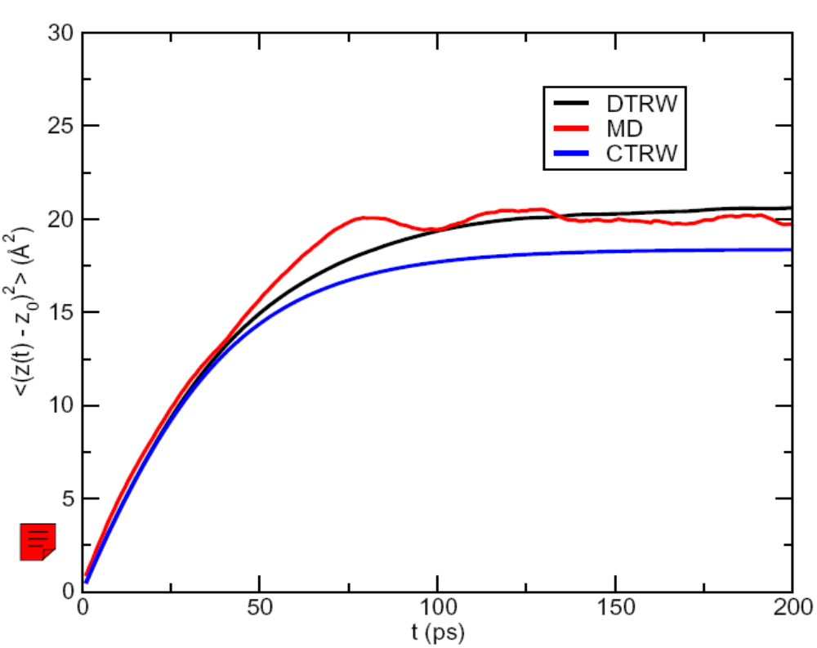
CNT(6,6) 14A

Slide 26
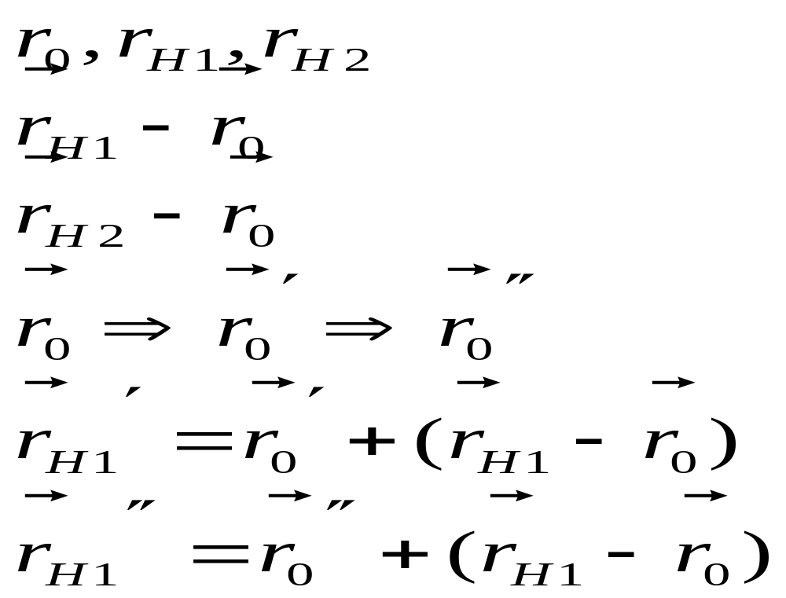
PUTTING WATER INSIDE OUR NANORING
From the straight tube simulation,a water molecule is chosen.
Determine
Find

Slide 27
WATER DIFFUSION IN OUR NANORING
Nobody has studied this system yet.
We expect the mode of water diffusion to be different depending on the density of water molecules.
Initially,we expect ballistic diffusion.
Followed by normal diffusion and then single-file diffusion.
Ultimate goal is to check whether there is single-file diffusion or not.

Slide 28
CONCLUSION
The elastic shell model fails to predict the minimum-energy structure of the nanoring configurations.
The large energy associated with the nanoring leads to assume that this structures are unstable kinetically.
Simulations indicate their stability on the microscopic time scale.
We expect single-file diffusion of water through the nanoring in due course.
We expect deviations in the properties of confined water from the bulk water.

Slide 29
REFERENCES
Oded Hod et al. PRB 67,2003
Lei liu et al. PRB 64,2001
V.Meunier et al. PRB,57,1998
G.Hummer et al. Nature,414,2001
Alberto Striolo NanoLetters,6,2006
Binhua Lin et al. Con-Mat,2005
K.Hahn et al. J.Phys.Chem.B,102,1998
Nan Chen et al. PRB,72,2005

Slide 30
THANK YOU

