Slide 1
Potential of Mean Force to Compute
Chemical Rate Constants
Ramya Gamini

Slide 2
“Rare Events “
Events for instance, Chemical reactions, Ligand binding, Protein folding are processes in biological systems occur rapidly, but infrequently because an energy barrier must be overcome.
Challenges !
These events typically take place on a slower time scale(ns to μs)
than accessible with standard molecular dynamics methods.
To understand these processes fully, a close examination of the
underlying free energy behaviour is often necessary.
Sampling of such, so-called rare events is routinely ‘Enhanced’
(sampling high energy states) if not made ‘Global’(all possible
configurations-astronomically large –impractical!) using free
energy methods; Umbrella sampling
These methods compute Potential of Mean force – The Free energy profile along a well chosen reaction coordinate

Slide 3
Overview
Description of the system:
Ligand-TMA Binding an Enzyme(Protein) AChE
(McCammon et al., 2003)
PMF illustration for free energy landscape of
ligand binding protein
Umbrella Sampling (Non-Boltzman Sampling)
Weighted Histogram Analysis (WHAM)
Computation of Chemical Rate Constants from the PMF
Kramers Rate Theory

Slide 4



In the cannonical, (N,V,T), ensemble, the Helmoltz Free Energy is
defined by
Boltzmann constant,
Temperature, for N particle system
is its 6N-dimensional Partion function:
is the classical Hamiltonian describing the system
Probability to find the system in the unique microscopic state
characterized by the position and momentum :
Consequence of this expression - low energy regions of the phase space
will be sampled predominantly, according to Boltzmann weight

Slide 5



The Free Energy can be rewritten as:
The factor implies high- energy regions of phase space
cannot be ignored!!
Umbrella Sampling:
The weight of the high-energy regions of the phase space is made
significant by introducing a biasing potential to ensure sampling of these
high-energy regions

Slide 6


Reaction Coordinate and Potential of Mean Force
Probability distribution to find the system at a given value, ,along
that reaction coordinate:
=>
Potential of mean force is the free energy along the reaction coordinate
Umbrella Potential:
is Biased Potential, is the Unbiased Potential
is Harmonic Restraining Potential (Biasing Potential) of the form:

Slide 7





Probability distribution is:
Probability distribution in terms of biased potential:
in terms of
Potential of Mean force
PMF evaluated from the Probability distribution of TMA along the
Reaction coordinate– How to Compute this Probability Distribution?!

Slide 8
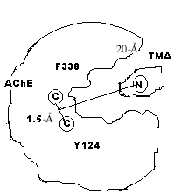
Generating a representative collection of configurations at the
bottleneck region using Umbrella Sampling:
Choose reaction coordinate : Distance between the center of mass of Y124(c) and F338(c) of Enzyme-AChE and N atom of ligand-TMA
Seven windows were placed along the reaction coordinate at 0.6Å intervals from
= 9.9-13.5 Å

Slide 9
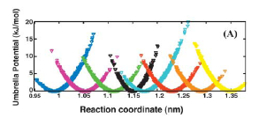
To find the probability distribution of the TMA along the reaction coordinate
Harmonic restraining potential with force constant
k = 50 kJ mol⁻¹Å⁻² was used to confine the TMA in each window
For configurations away from equilibrium state (in each window), umbrella potential will be large, and so in a simulation using modified potential, will be biased along some relevant coordinate away.

Slide 10
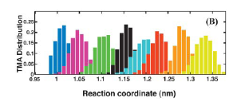
A 1.0 ns of dynamics sampling was performed and the Probability distribution for values for each window was determined using a bin width 0.1Å
.
Umbrella sampling simulations over 7 windows of 0.6 Å
1 ns per Window; Total time = 7 ns
Total Histograms = 37
The TMA distributions did not adequately overlap between window at
11.1Å and at 11.7Å. An additional window placed in between at 11.4Å
with force constant k = 100 kJmol⁻¹Å⁻² to restrain TMA in this bin.

Slide 11
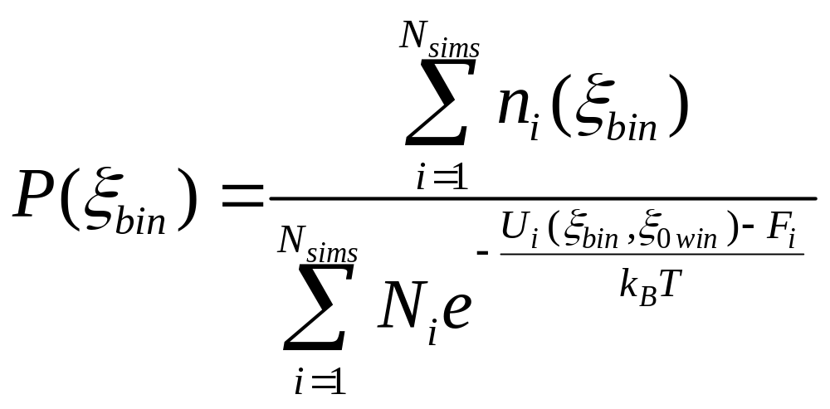
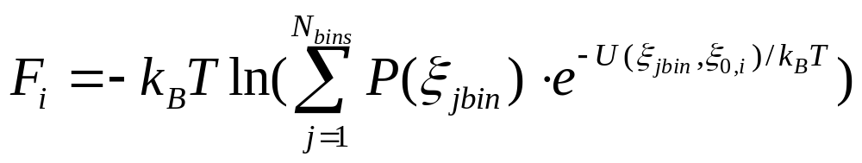
Weighted Histogram Analysis Method (Benoit Roux, 1995)
New Problem: The result is a biased Probability Distribution
Solution: Apply the Weighted Histogram Analysis Method to solve for the real probability (Unbias the Probability)

Slide 12
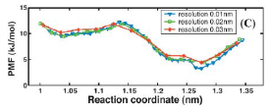
Also, to form a continuous distribution of the ligand, consecutive
windows were pieced together by a method proposed by Shen et al;
(Shen and McCammon, 1991)
The PMF is computed from this probability distribution

Slide 13
Results from the Free Energy Profile:
The peak of the barrier is at 11.3 Å from the center of mass of the
enzyme and is located in the bottle neck region (20 Å ).
The energy profile also shows, the incoming ligand has to cross an
energy barrier of 8-10 kJ mol⁻¹ to reach the active site of the enzyme
The barrier for the incoming ligand is surprisingly low (not expected so from the static crystal structure).
The constricted region of the gorge lined with bulky aromatic residue side chains seem to hinder the motion of the charged ligand only slightly.

Slide 14
Dynamics of Barrier Crossing:
(Evolution of TMA distance with Time )
Forward and Reverse Trajectories:A set of Phase space points within
the bottleneck region was chosen from umbrella sampling simulations
as the initial phase
To mimic absence of harmonic potential, Phase space points that had
zero restraint potential ( 9.9, …13.5 Å)were selected as starting points
The trajectories were propagated once with the velocities of all atoms
in the initial states generated by umbrella sampling as Forward
trajectory and once with the negative of these velocities as Reverse
trajectory.
Reverse trajectories are appended to the start of the forward trajectory
to give one “ full-trajectory”of an attempted crossing of the barrier.

Slide 15
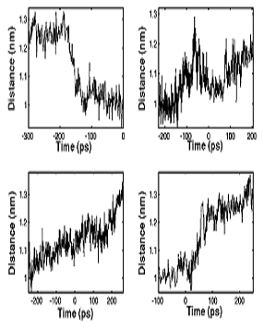
12 full trajectories of 600 ps each were conducted;
Any trajectory in which TMA moved from 10.5 Å on one side of the
barrier to 12.5 Å on the other side was called a successful trajectory
Only 4 of them (fig) show successful crossing of TMA -characterize the crossing to be in high friction regime
It takes 50-200 ps for the TMA to cross the barrier –exhibit a
stochastic crossing behavior of TMA

Slide 16


Computation of Chemical Rate Constants from PMF
Free energy profile of the TMA in the bottleneck region has been
determined, the kinetic rate constant, k, of passage over the barrier can
be obtained from reaction rate theory
Kramers Expression for Rate of Reaction:
K_{kramers} = m * w_{b} /f is the Transmission coefficient
m = mass of ligand
= Barrier Peak
W_{b}² = = Squared frequency of crossing at the barrier
= is the second derivative of the PMF at barrier peak
f = frictional coefficient due to vicosity in medium

Slide 17
K_{kramers} was estimated from by stokes scaling to be 0.17
w_{i} is the angular frequency of oscillation associated with the
initial well ~ 10¹¹ s⁻¹
Estimation of barrier-crossing rate constant:
For Barrier height 8kJ/mol,
k₂ is Rate constant for the incoming ligand (rate of barrier crossing)
would be ~10⁸ s⁻¹
K₋₁ also estimated from using the stokes law with the gorge viscosity
The first passage time for TMA to travel away from the bottle neck
region and escape to the bulk is 10 ^{–8} s; this yields k₋₁ ~10 ⁸ s⁻¹
Hence k₂ and k₋₁ are comparable
Effective forward rate K_{eff} = k₁ k₂ /k₋₁+k₂ is the rate at which substrate
and enzyme encounter is consistent with experimental kinetic data.

Slide 18
References:
Bui, J.M., R.H.Henchman, and J.A.McCammon. The Dynamics of Ligand Barrier Crossing inside the Acetylcholineesterase Gorge. Biophys. J. 85:2267-2272, 2003.
Tai, K., T. Y. Shen, R. H. Henchman,Y. Bourne, P. Marchot, and J. A. McCammon. Analysis of a 10ns Molecular Dynamics Simulation of mouse Acetylcholineesterase. Biophys. J. 81:715-724, 2001.
Torrie, G. M. and Valleau, J. P.
Non-physical sampling distributions in Monte Carlo free energy estimation: Umbrella sampling. J. Comput. Phys. 23:187-199, 1977.
Shen, J and J.A. McCammon. Molecular Dynamics Simulation of Superoxide interacting with Superoxide-dismutase. Chem. Phys. 158:
191-198, 1991.

Slide 19
Benoit Roux, The Calculation of the Potential of mean force using
Computer Simulations. Comp.Phys.Comm.91:275-282, 1995
Allen, M. P., Tildesley, D. J. Computer Simulation of Liquids.
Clarendon Press: Oxford, 1987.

