Slide 1
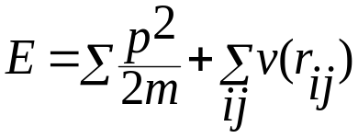
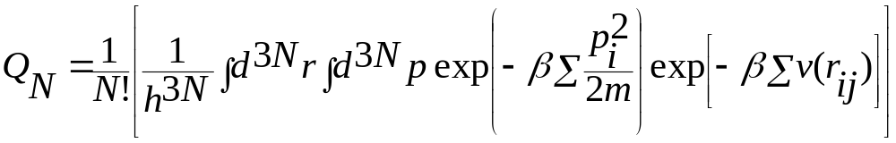
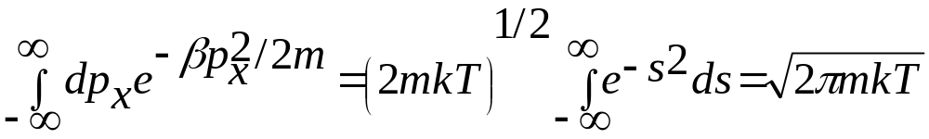
For pair wise interaction the energy of the system of N particles is given by
Partition function is given by
The momentum integral can easily be carried out

Slide 2
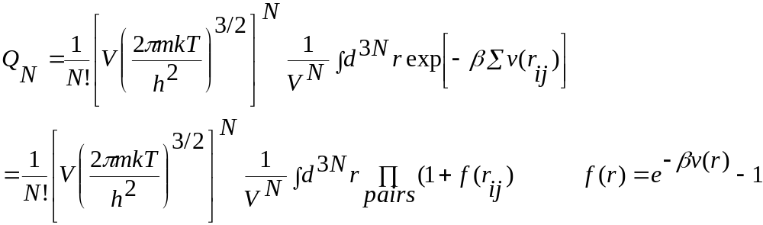
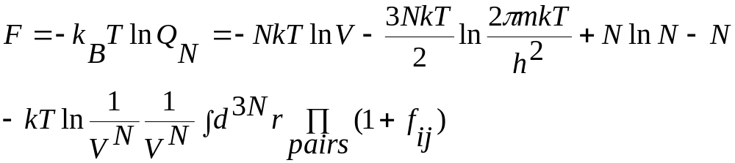
So the partition function becomes
The Free energy can be written as

Slide 3
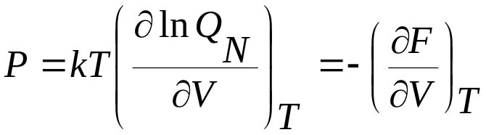
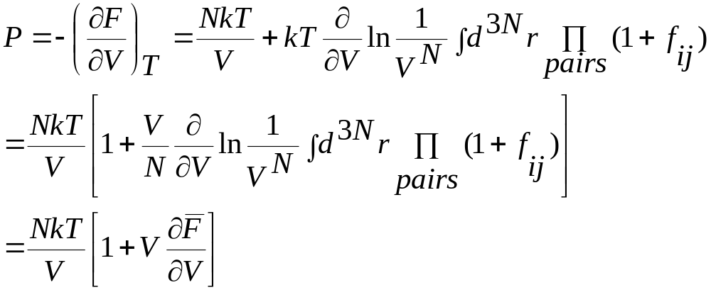
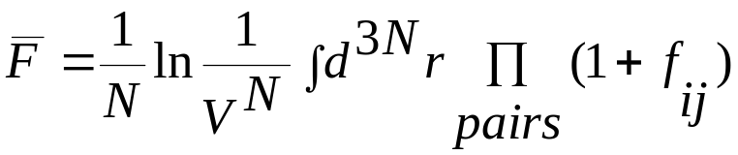
Thermodynamically pressure is defined as
where

Slide 4
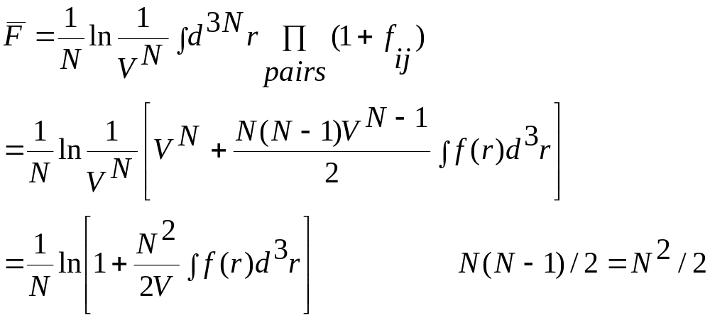
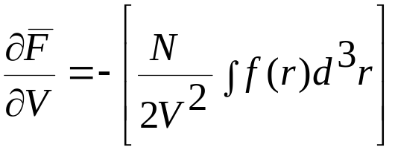
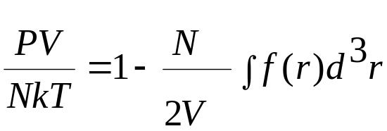
In general we can not evaluate the above expression exactly for any v(r_{ij}). If we assume v(r_{ij}) is small and so is f(r_{ij}). Then we can simply the above equation keeping only first order terms
Taking derivative and keeping first order term we have
Virial equation

Slide 5
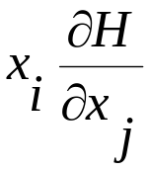
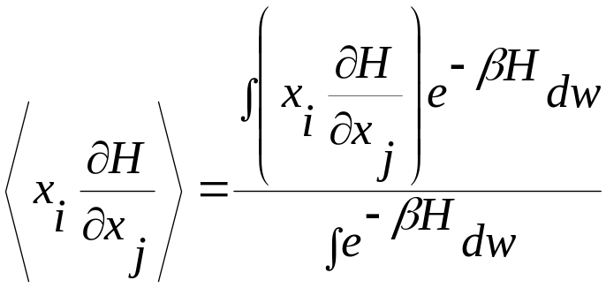
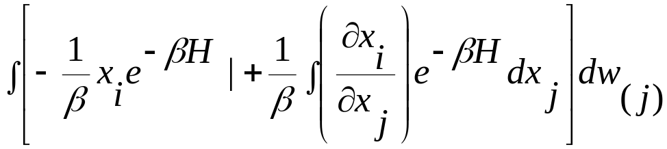
Equipartition and virial theorem
We want to compute the expectation value of In the canonical ensemble it is given by
Integrate by parts over x_{j} (the numerator only)
First part vanishes because whenever any of the coordinates takes an extreme value the Hamiltonian of the system becomes infinite.

Slide 6
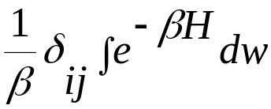
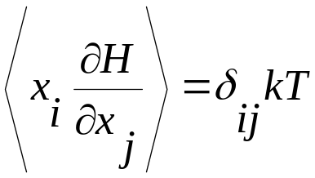
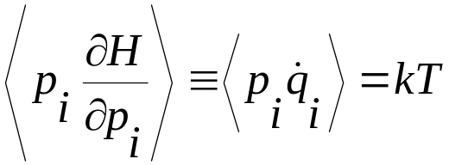
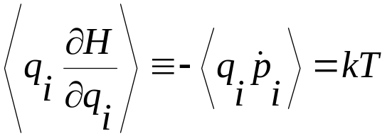
Second term becomes
So the expectation value becomes
This gives

Slide 7
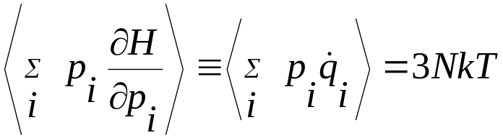
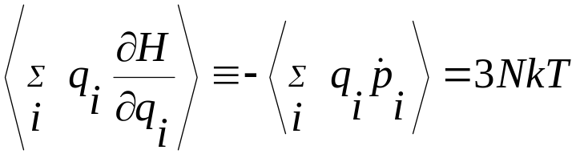
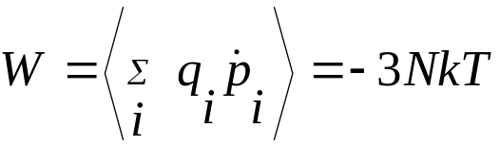
Summing over all i from i=1.. 3N
Virial theorem states that
Virial has two component: one from the external forces W^{ext} (like the pressure exerted by the wall of the container) and W^{int} arising from the forces between the particles.

Slide 8
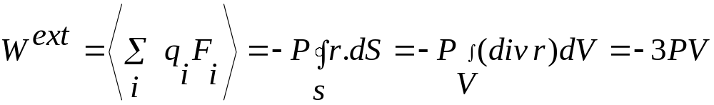
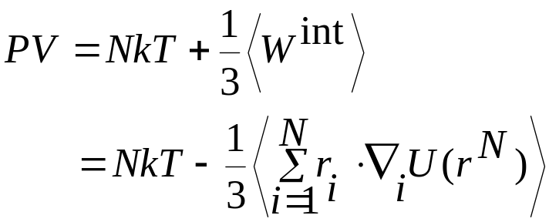
So we have virial equation

Slide 9
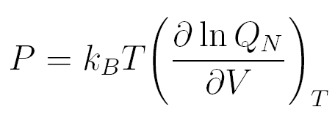

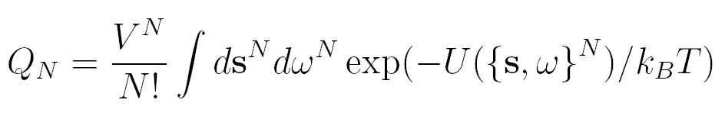
Computation of the pressure for the rigid molecules
The thermodynamic definition of the pressure
In order to derive the molecular expression for the pressure we explicit the volume dependence of the configurational integral by introducing dimensionless positional variable s_{i}, defined as
for i = 1, … N
In terms of this new variable the partition function becomes

Slide 10
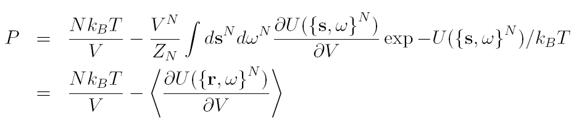
We have the pressure expression given by

