Slide 1
ORIENTATION OF LIQUID CRYSTAL ON GRAPHITE SURFACE
By
Mantu Santra
Int.Ph.D.
Chemical Science
(2nd year)

Slide 2
Outline
Introduction
Brief literature review
My work
Conclusion

Slide 3
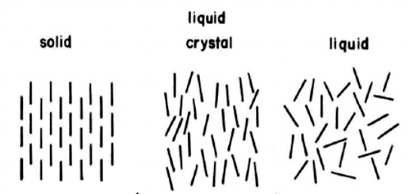
Introduction
Liquid crystals have more degrees of freedom than crystals but less than liquid.
It usually have small latent heat of transition.
Usually phases are described by the average orientation of the molecules.

Slide 4

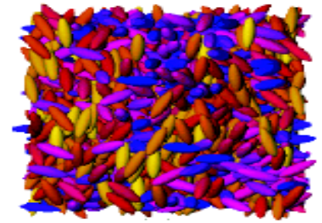
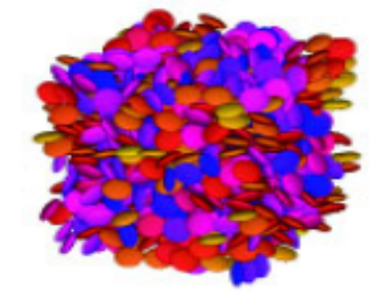
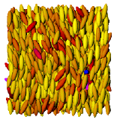
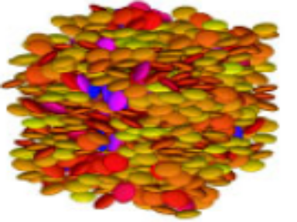
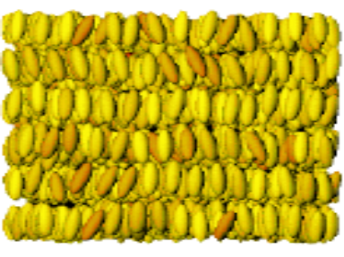
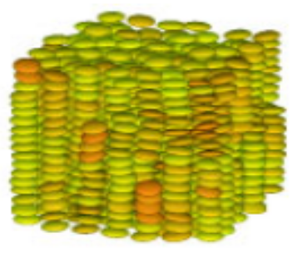
Mesophases of liquid crystals
Calimatic system
Discotic system
Isotropic
Isotropic
Nematic
Nematic
Smectic
Columnar

Slide 5
Transition between mesophases may happen due to
1) by increasing pressure
2) by decreasing temperature
Transition between mesophases can be characterized by
1) order parameter variation
2) orientational correlation function
3) pattern of orientational non-Gaussian parameter

Slide 6
The operation of most liquid crystal devices is dependent on the anchoring
What is anchoring?
It is defined as the orientational of the bulk phase ,as induced by the surface

Slide 7
Liquid Crystal Alignment
There are three types of alignments
Planar (homogeneous) : The molecules lie parallel to the aligning substrate
Perpendicular ( homeotropic ) : The molecules lie perpendicular to the aligning substrate
Third one is tilted at some intermediate angle

Slide 8
Techniques of modifying anchoring behavior
Rubbing polymer surfaces to induce planar structure
Creation of vertical structures on otherwise flat substrate to induce perpendicular alignment
Grafting short alkyl chains onto a glass substrate ,by means of carboxylato-chromium complex

Slide 9
System studied
5CB(5-cyano bi phenyl ) was taken as liquid crystal molecule
Five atomic layers of graphite
C-17 alkane was grafted artificially on the graphite surface

Slide 10
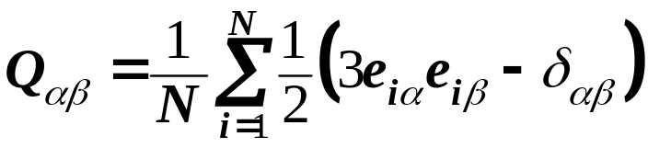
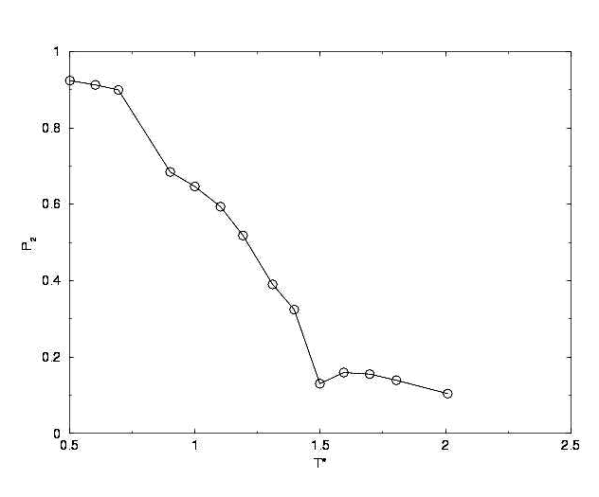
Orientational order parameter
we can define a tensor Q for the liquid crystalline system
P₂ = highest positive eigenvalue of Q

Slide 11
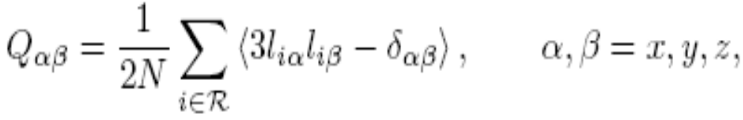
The nematic order parameter in a slice,R,parallel to tha surfaceis given by diagonalising:
where the sum is taken over the N molecules whose centre lie in the slice R

Slide 12
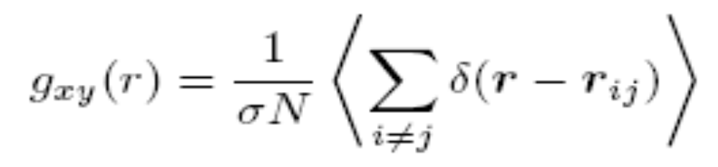
S is given by the maximum eigen value and the local director director by the corresponding eigen vector
To aid phase identification the two dimensional pair correlation function

Slide 13
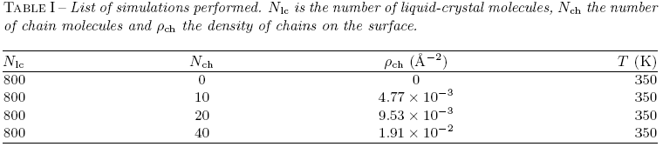
Result

Slide 14
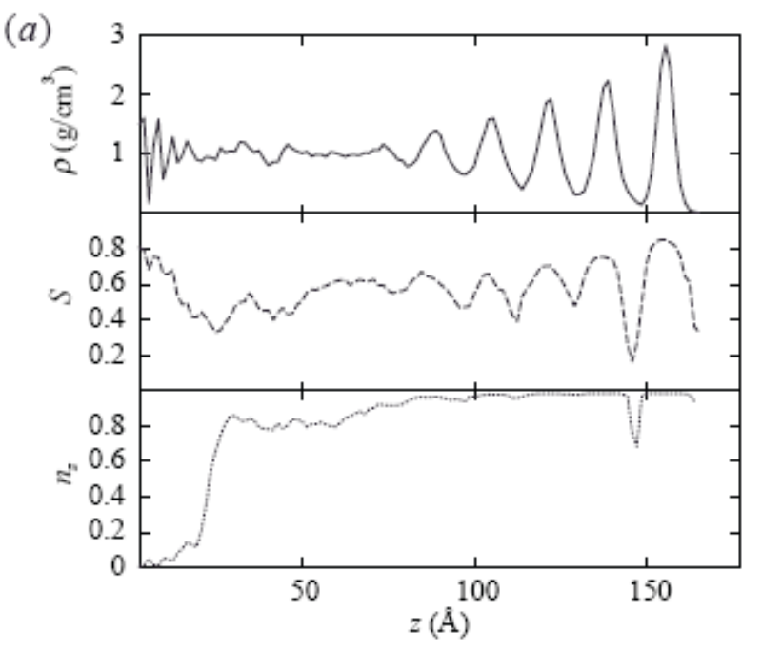



Layering of molecules close to the surface can be seen by the successive peaks in density
The pair distribution functions in the region z=0-5A show a smectic ordering in the plane of surface
The z-component of director is rotated from planar at the solid surface to perpendicular at the free surface

Slide 15
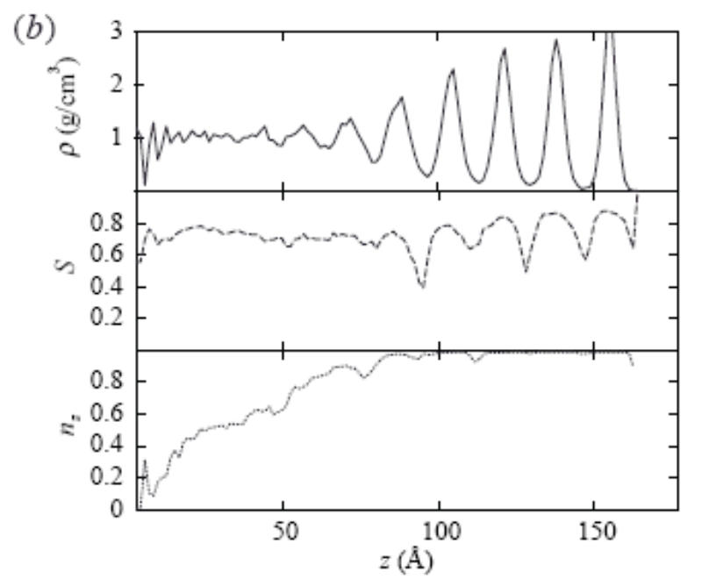


Relaxation along z-direction happens over a long range
A bulk nematic phase can be seen in the region between surface and z =
The order parameter takes on relatively high value through the profile

Slide 16
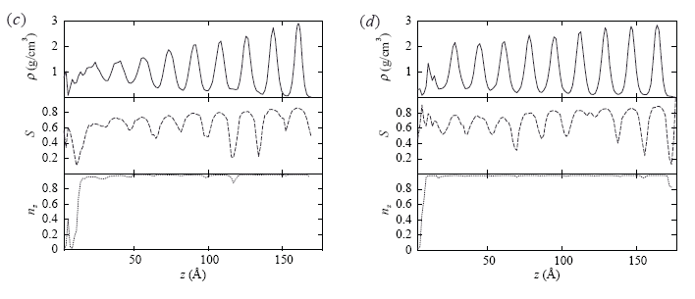


Slide 17
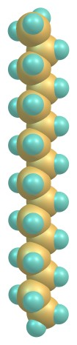
My system
System is consist of spherocylinder
which mimics hexadecane molecule
Mono-layer of graphite
the potential between the sphero-
cylinders is Gay-Berne potential

Slide 18









Gay-Berne potential
Positions: , with and
Interparticle unit vector:
Directions (unit vectors):
,
Width: (side-by-side), Length: (end-to-end).

Slide 19
The simulation system consisted of a slab geometry with periodic boundary conditions in the xy plane and free boundary condition in the z-direction .
Simulation was run for primary 10⁶ MD steps at constant temperature for thermal equilibration and then 10⁶ MD steps at constant energy for energy equilibration.

Slide 20
After equilibration data were collected. Each MD step time = 1pS.
The mass of the particle taken to be unity .In Gay-Berne potential the parameters σ₀ and ε₀ taken to be unity.

Slide 21
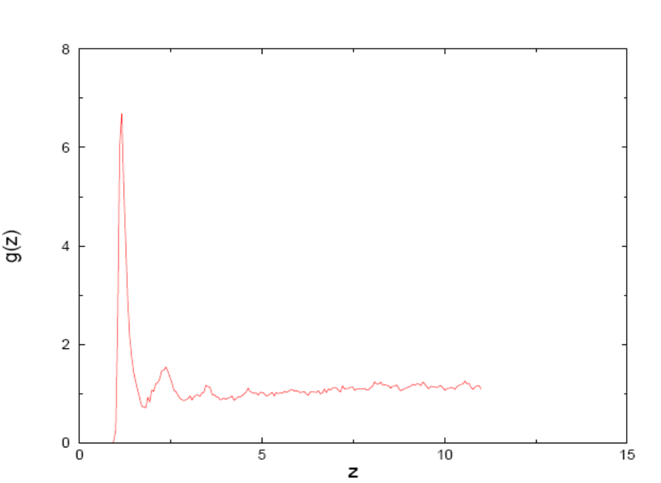

Slide 22
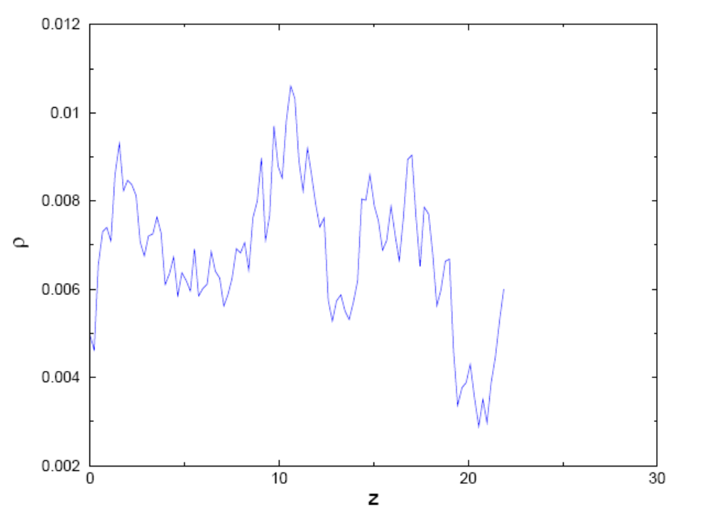

Slide 23
Conclusion
Orientation of liquid crystal on solid surface is strongly dependent on the presence of surface modifying molecules
Surface also determines how the anchoring of liquid crystal molecule changes ,as the distance of a layer from surface is changed

Slide 24
THANK YOU

