Slide 1
Simulating hard fluids

Slide 2


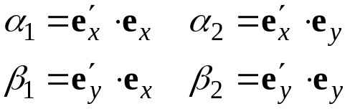



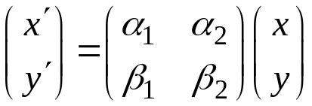

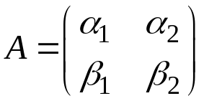



Orientation 1.
Orientation described in terms of rotation of molecule frame
Direction cosines can be used to describe rotation
Relation between same point in two frames
Rotation matrix
Kinematics of rigid-molecule rotation described in terms of rotation of the molecule coordinate frame (i.e. the direction cosines)

Slide 3

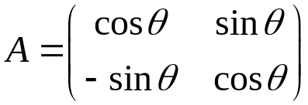
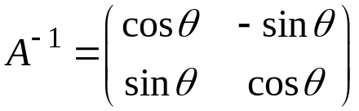

Rotation in 2-d
We also need to invert the relation
  get the simulation-frame coordinate from the molecule frame value
Direction cosines are not independent
  in 2D, all can be described by just one parameter
  use rotation angle θ
  inverse can be viewed as replacing θ with -θ

Slide 4













Euler Angles
Euler angles are defined in terms of a sequence of rotations of a set of Cartesian coordinate axes about the origin.
First rotation through an angle ψ about z-axis.
This is followed by by a rotation of θ about the new x-axis.
Finally another rotation of φ about the new z-axis.
Rotation matrix : A=R(ψ)R(θ)R(φ)

Slide 5
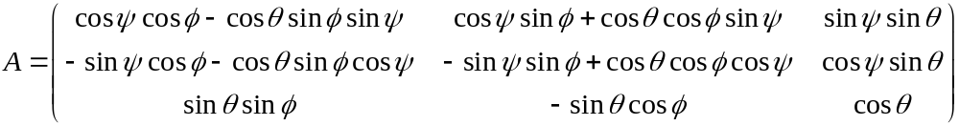

3D Rotation Matrix
Rotation matrix expressed in terms of Euler angles
To get space-fixed coordinate, multiply molecule-fixed vector by A⁻¹
  again, A⁻¹ = A^{T}
A=R(ψ)R(θ)R(φ)

Slide 6

Rotational Dynamics
For completely rigid molecules, only translation and rotation are performed
Translational dynamics uses methods described previously, but now applied to the COM
Rotational dynamics must consider angular velocities and accelerations
Can treat via rotation of the molecule-frame coordinates in the spaced-fixed frame
  changes in angular velocity are given via torque on molecule
Angular velocity

Slide 7
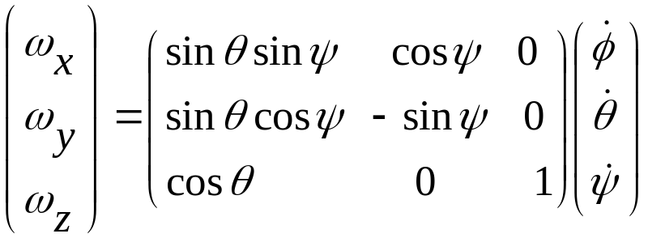
Rigid body dynamics deals with two coordinate frames:
one fixed in space
Other attached to the principal axis of the rotating body
The expression for the angular velocity ω measured in the body fixed frame in terms of Euler angles can be written as
The matrix is singular when sinθ =0 (when θ = 0 or π). The solution is to use quaternions.

Slide 8
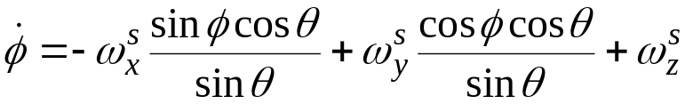
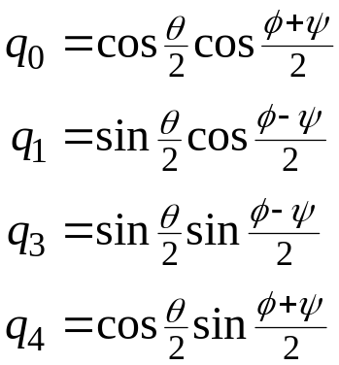

Quaternions
Rate of change of the Euler angles looks like this
A problem arises when θ is near 0
  no physical significance, but very inconvenient to integration of equations of motion
Quaternions can be used to circumvent the problem
  describe orientation with 4 (non-independent) variables
  rotation matrix, equations of motion simply
  expressed in terms of these quantities
  note:

Slide 9
Random Vector on a Sphere
Acceptance-rejection method of von Neumann
Iterate
  (a) Generate 3 uniform random variates, r₁, r₂, r₃ on (0,1)
  (b) Calculate z_{i} = 1-2r_{i}, i=1,3, so that the vector z is distributed uniformly in a cube of side 2, centered on the origin
  (c) Form the sum z² = z₁² + z₂² + z₃²
  (d) If z² < 1, take the random vector as (z₁/z, z₂/z, z₃/z) and quit
  (e) Otherwise, reject the vector and return to (a)
See appendix A4 of Rapaport. Also Ann. Math. Stat. 43, 645 (1972)

Slide 10
Generating trial rotation
do {
mag2 = 0.0;
for (i = 1; i < 4; ++i){
q[i] = (2.0 * ran3(i_ran) - 1.0) * du_max;
mag2 += SQR(q[i]);
} } while (mag2 > 1.0);
q[0] = sqrt(1 - mag2);
/* Compute the elements of the rotation matrix. */
a11 = SQR(q[0]) + SQR(q[1]) - SQR(q[2]) - SQR(q[3]);
a12 = 2.0 * q[1] * q[2] + 2.0 * q[0] * q[3];
a13 = 2.0 * q[1] * q[3] - 2.0 * q[0] * q[2];
a21 = 2.0 * q[1] * q[2] - 2.0 * q[0] * q[3];
a22 = SQR(q[0]) - SQR(q[1]) + SQR(q[2]) - SQR(q[3]);
a23 = 2.0 * q[2] * q[3] + 2.0 * q[0] * q[1];
a31 = 2.0 * q[1] * q[3] + 2.0 * q[0] * q[2];
a32 = 2.0 * q[2] * q[3] - 2.0 * q[0] * q[1];
a33 = SQR(q[0]) - SQR(q[1]) - SQR(q[2]) + SQR(q[3]);

Slide 11
Rigid body Monte Carlo
Sphere
Cylinder
Prolate ellipsoid
disk
spherocylinder
Each MC moves consists of translation and rotation of molecules. Rotation is performed through Quaternion.
Move is accepted with Boltzmann criteria if there is no overlap
Whole exercise is to devise efficient algorithm to do the overlap check

Slide 12
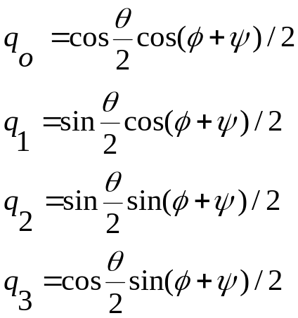
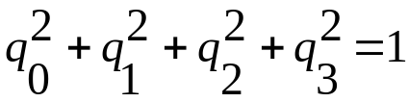
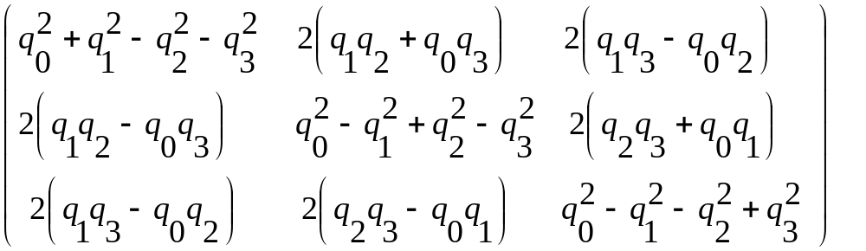
Quaternion dynamics
The quaternion are related to the Euler angles as follows:
The quaternion satisfy the
constraint
The Euler angle rotation matrix can be written as

Slide 13
Overlap test for sphere
Two hard spheres of radius R₁ and R₂ overlap if the distance between the center of the two spheres r₁₂ is less than σ₁₂= R₁+R₂
In simulation we do not compare r₁₂ with σ₁₂ but r²₁₂ with σ²₁₂. Later test is cheaper computationally.
R₂
R₁
In general above test can be decomposed into sequence of several smaller test. In this case the steps are
What happens if we have molecules composed of n hard spheres : In this case the overlap between two molecules can be broken down into n2 hard sphere tests
Ref: Hard convex body fluids, M. P. Allen et. al Advances in Chemical Physics, Volume LXXXVI, 1-165 (1993) (edited by I Prigogine and S. A. Rice)

Slide 14
Overlap test for spherocylinders
Just as a sphere can be defined as the set of points that are within a distance R from a given origin (center of sphere). The spherocylinder can be thought of as set of points that are within a distance R from a line segment of length L. We can draw around every point on this line segment a sphere of radius R that contains all points that are within a distance R from that point.
So a spherocylinder can be considered as the union of all spheres around points on a line segment L The test for the overlap between two spherocylinders can be done by computing the shortest distance between two line segments that from the core of the spherocylinders. If this distance of closest approach is less than D₁₂ = R₁ +R₂, the two spherocylinders overlap.
Main task is to determine the distance of closest approach for the two line

Slide 15



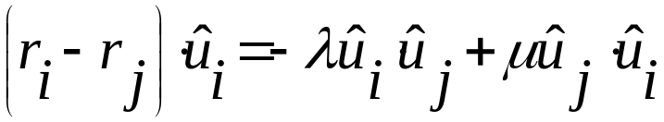
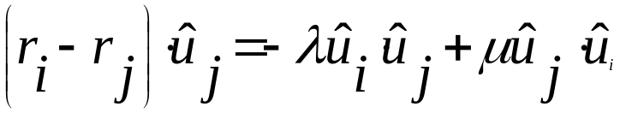
We want to determine the minimum distance between two finite line segments i and j with orientations û_{i} and û_{j} and centers r_{i} and r_{j}. We can describe any point on line i parametrically as
Line j is given by
The vector distance between these two points is given by
Now we want to determine the values of λ and μ for which the distance r_{ij} is minimum. A simple method to find these values of λ and μ is the following. Construct the dot product of r_{ij} with û_{i} and û_{j}. The shortest distance vector must be perpendicular to both û_{i} and û_{j}
Our task is to solve the following equations

Slide 16
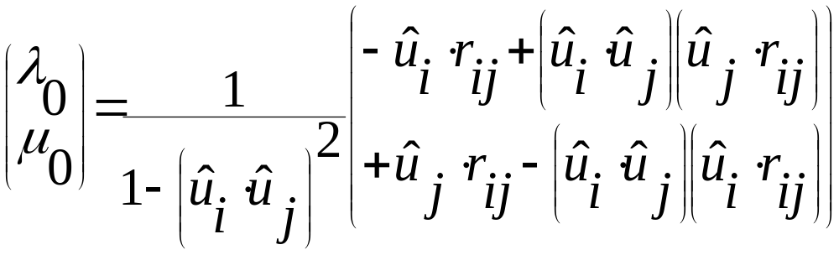
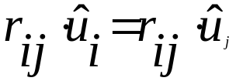
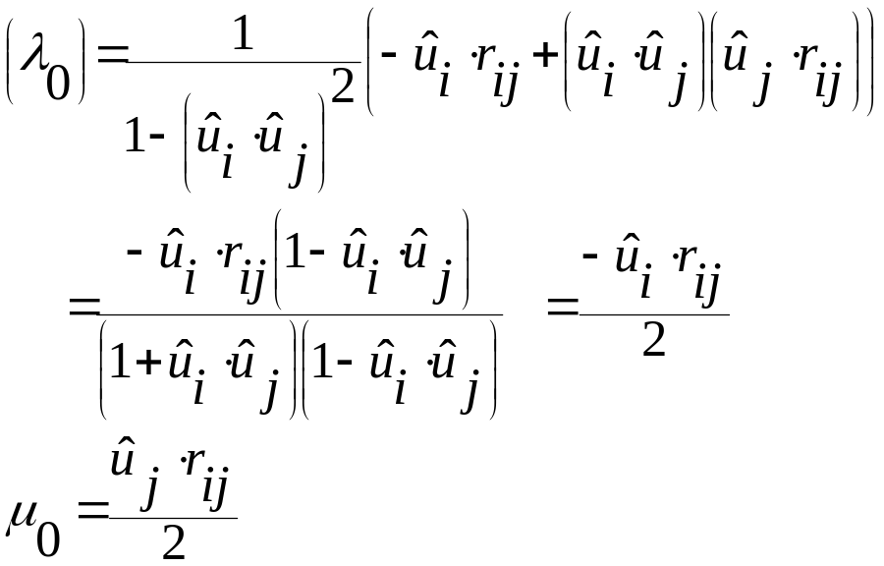
Solving for λ and μ we have
If the spherocylinders are parallel

Slide 17
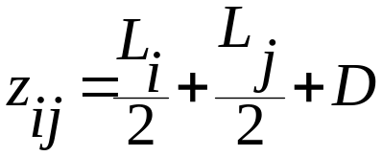
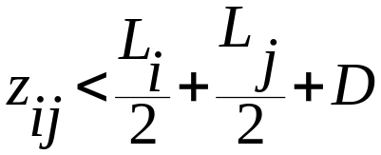
If the spherocylinders are perpendicular
If
they overlap
z_{ij}
r_{ij}
If r_{ij} <D they overlap

Slide 18
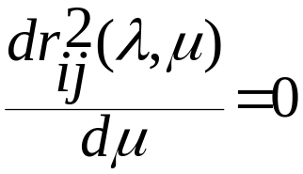
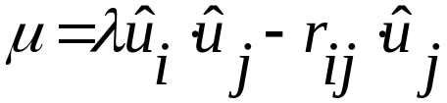
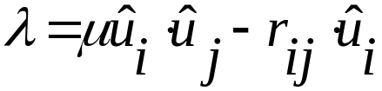
Various cases: set λ=|L/2| and find out μ
leads to
Similarly set μ=|L/2| and find out λ

Slide 19
Overlap test for right cylinders composed of the following steps
Very complex
First is similar to the computation of the distance between closest approach between spherocylinders
However, we can only use the above test if the shortest vector between axes of two cylinders intersects both cylinders
Otherwise we must test if the flat faces of the cylinders overlap
In the final test, we check if the flat face of one cylinder intersects the cylindrical part part of the other.

Slide 20

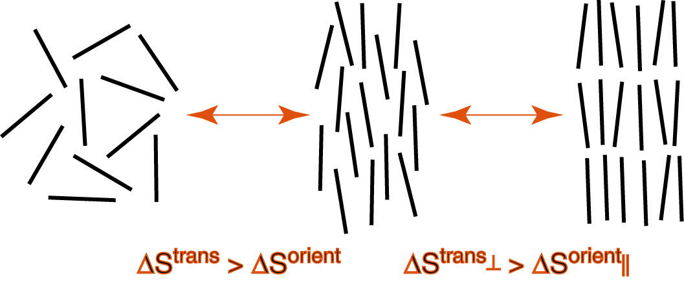
Hard-core spherocylinders
Phase transition driven only by entropic effects, at a given
density:

