Slide 1
Potential of Mean Force between two colloidal particles in LJ fluid using Umbrella Sampling
Bharat V. Adkar
SSCU
Sr # 04072

Slide 2
outline
Potential of Mean Force
Umbrella Sampling
My work
Results

Slide 3
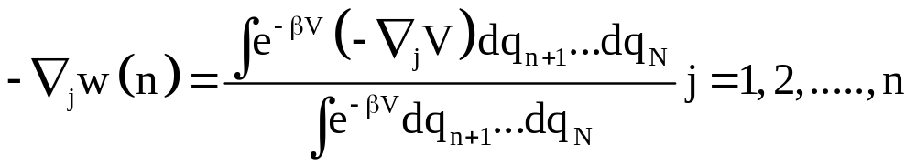
Potential of Mean Force
In a system of N particles, when 1….m particles are kept fixed, the average force over all the configurations of m+1….N particles acting on j is known as PMF
http://klingon.uab.es/prat/Thesis/node5.html

Slide 4
Usefulness
Can be used to know free energy changes
PMF is calculated for physical processes.
examples: rates in chemical reactions, enzymatic reactions

Slide 5
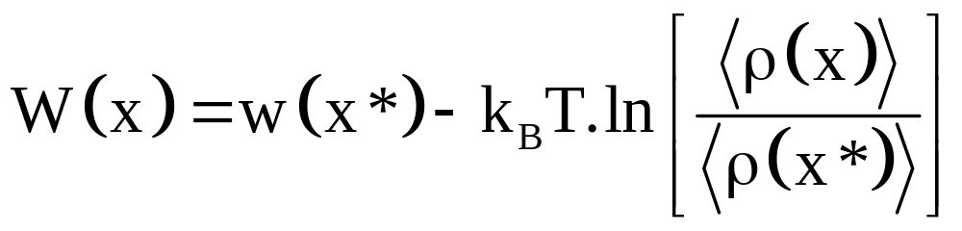
PMF in MD simulations

Slide 6
Umbrella Sampling
A method of sampling certain unfavorable configurations in phase space by applying certain harmonic-potential
U

Slide 7
My work
System: 500 particles in FCC lattice
Density: 0.85
Box size: 8.75
Atoms 149 and 349
Initial distance = 3.4
Restrained at 3.2, 3.0, 2.8, 2.6, 2.4, 2.2

Slide 8
Simulation details
Nsteps = 10000
dt = 0.002
cutoff = no
T* = 1.2
Force Constant = 50.0

Slide 9
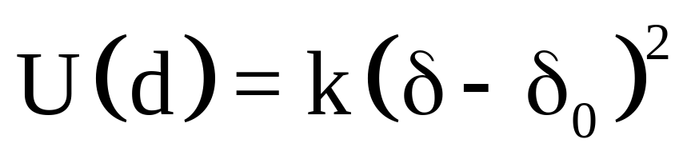
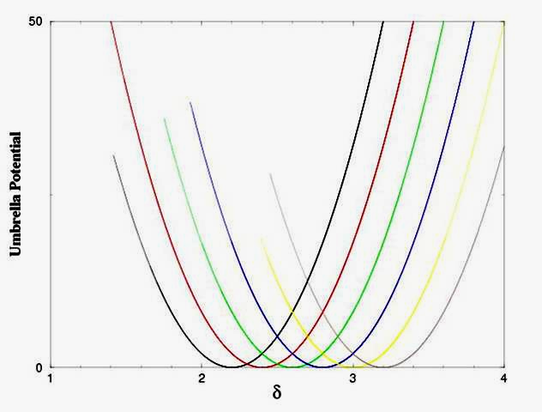

Slide 10
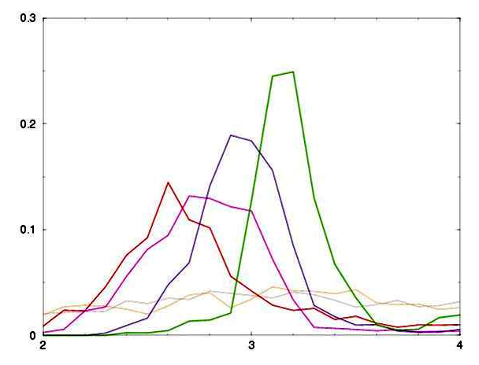
ρ*
δ
Overlapping histograms

Slide 11
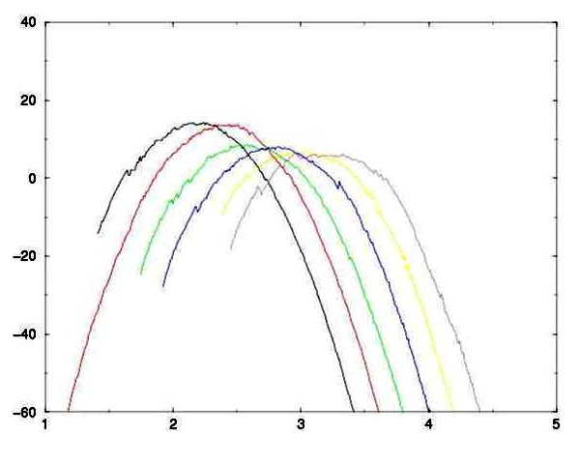
PMF
δ

Slide 12
Acknowledgements
Prof. Prabal Maiti
Biman Jana
Bob

