Slide 1


Who We Are (mission statement)

Slide 2
BUSINESS NEED
IMPORTANCE TO SOCIETY AND EDUCATION

Slide 3
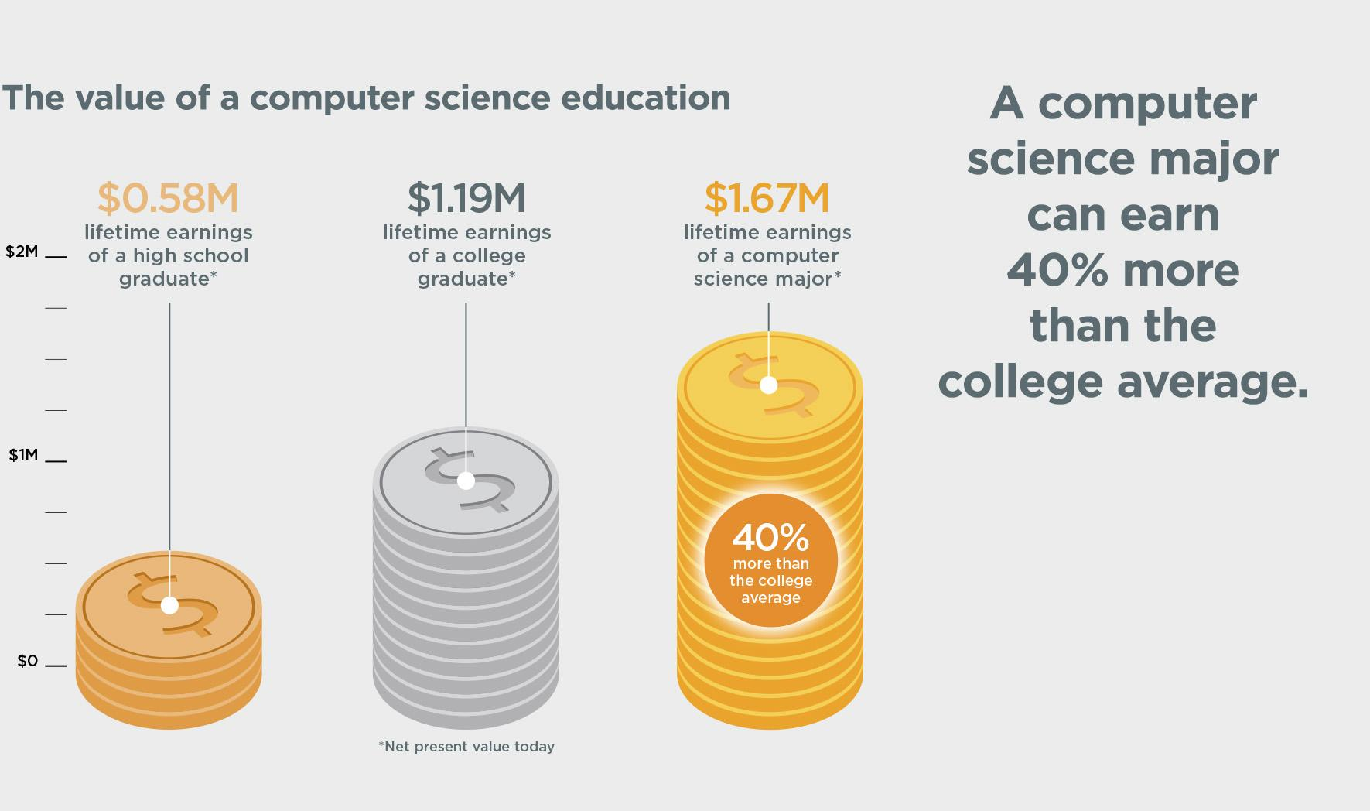

Slide 4


Slide 5
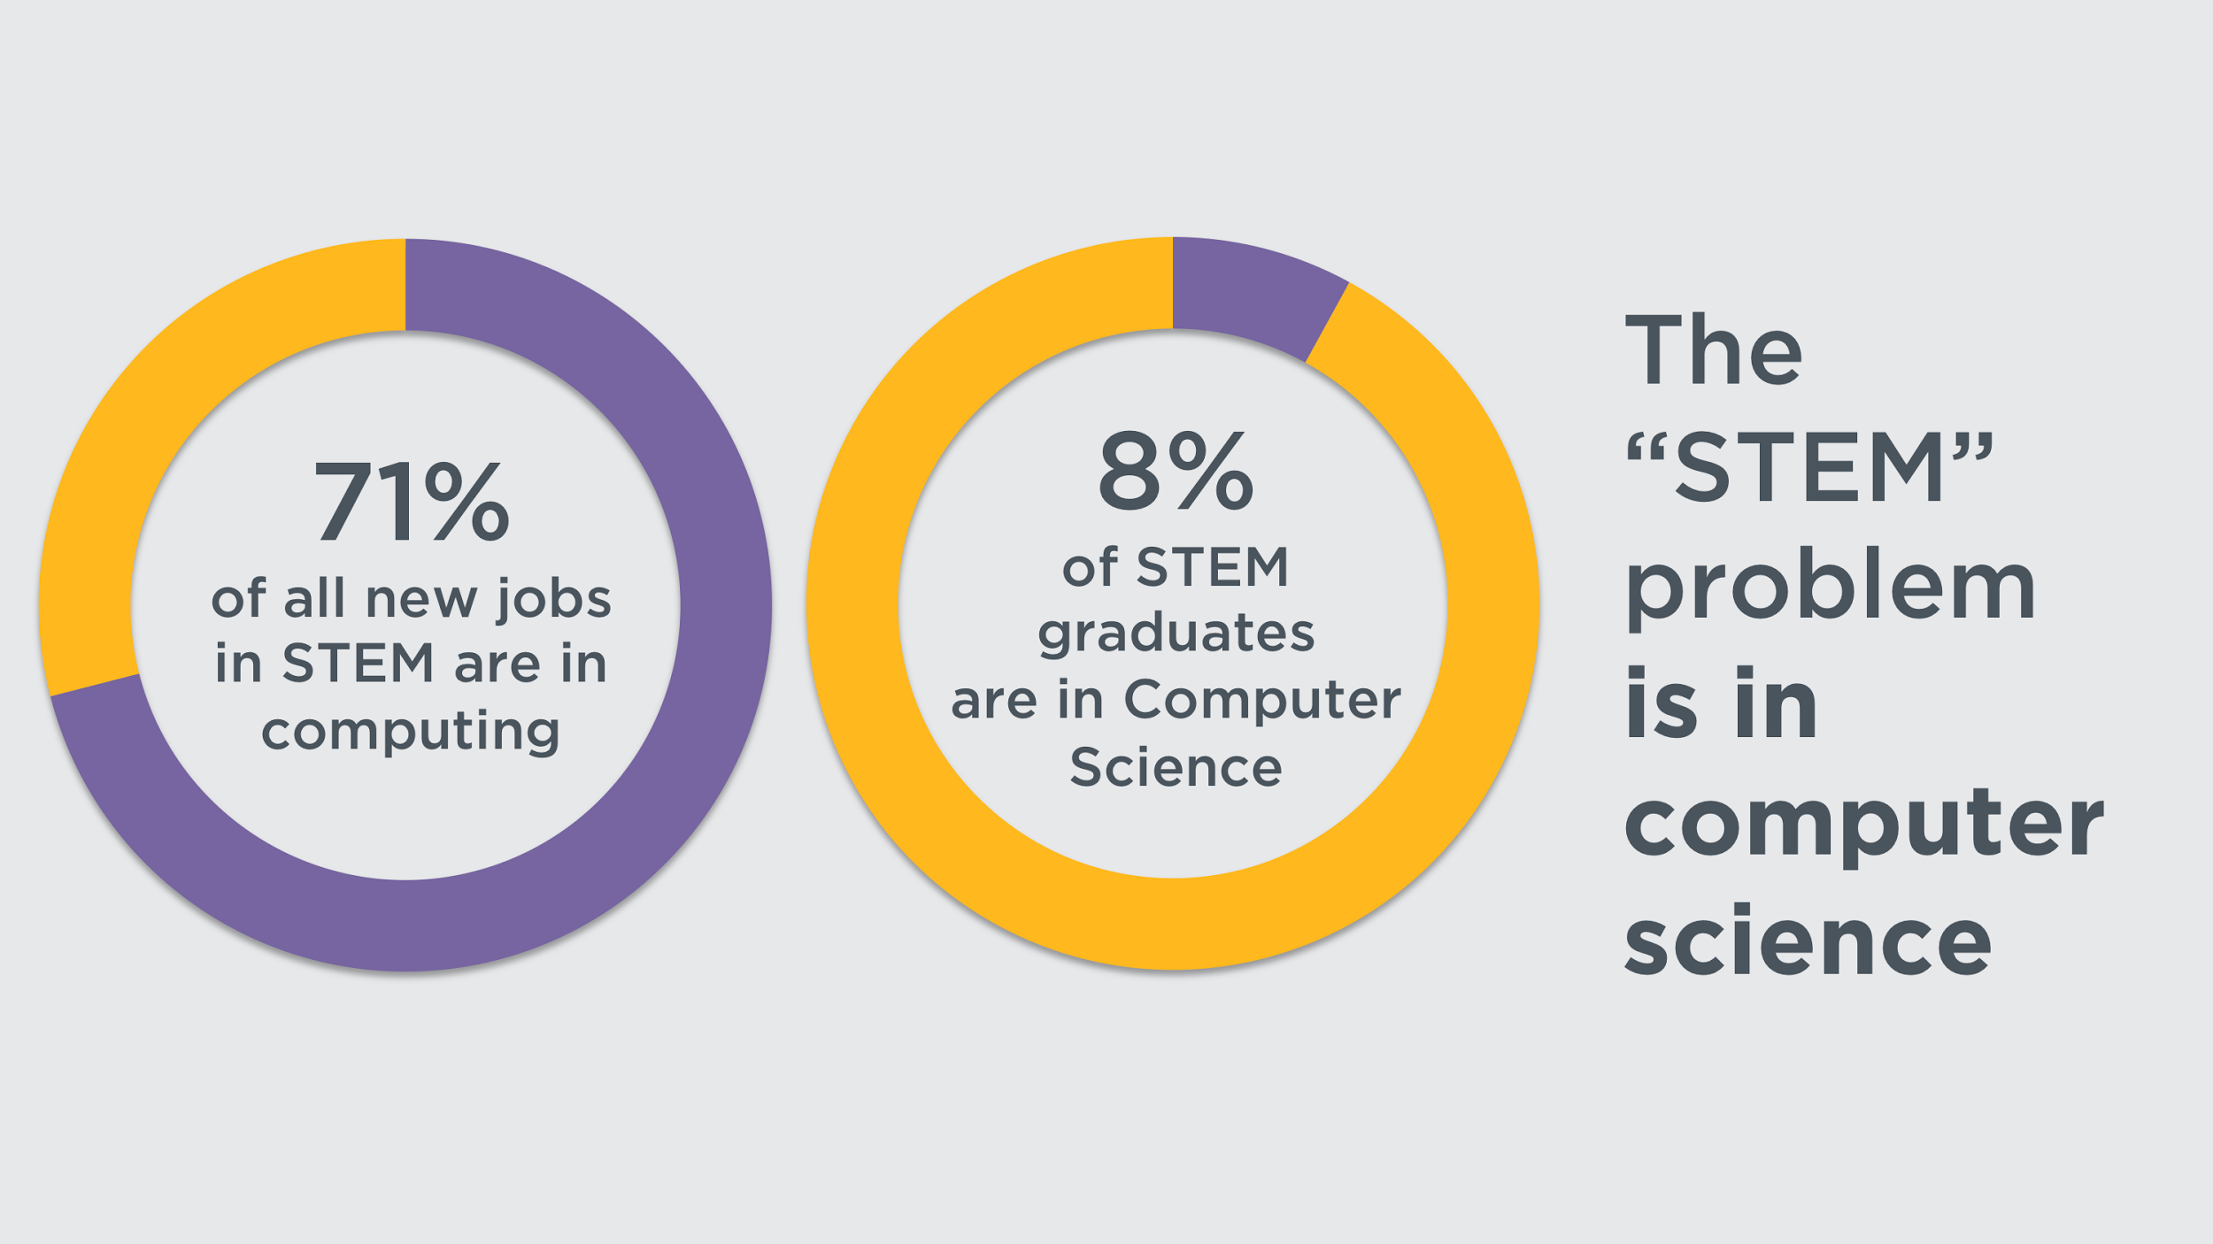

Slide 6
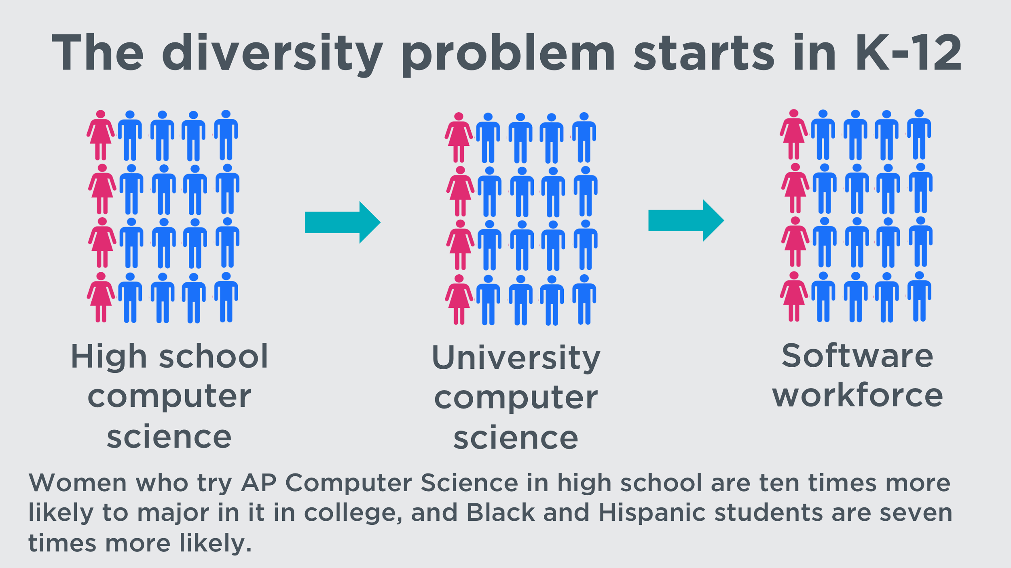

Slide 7
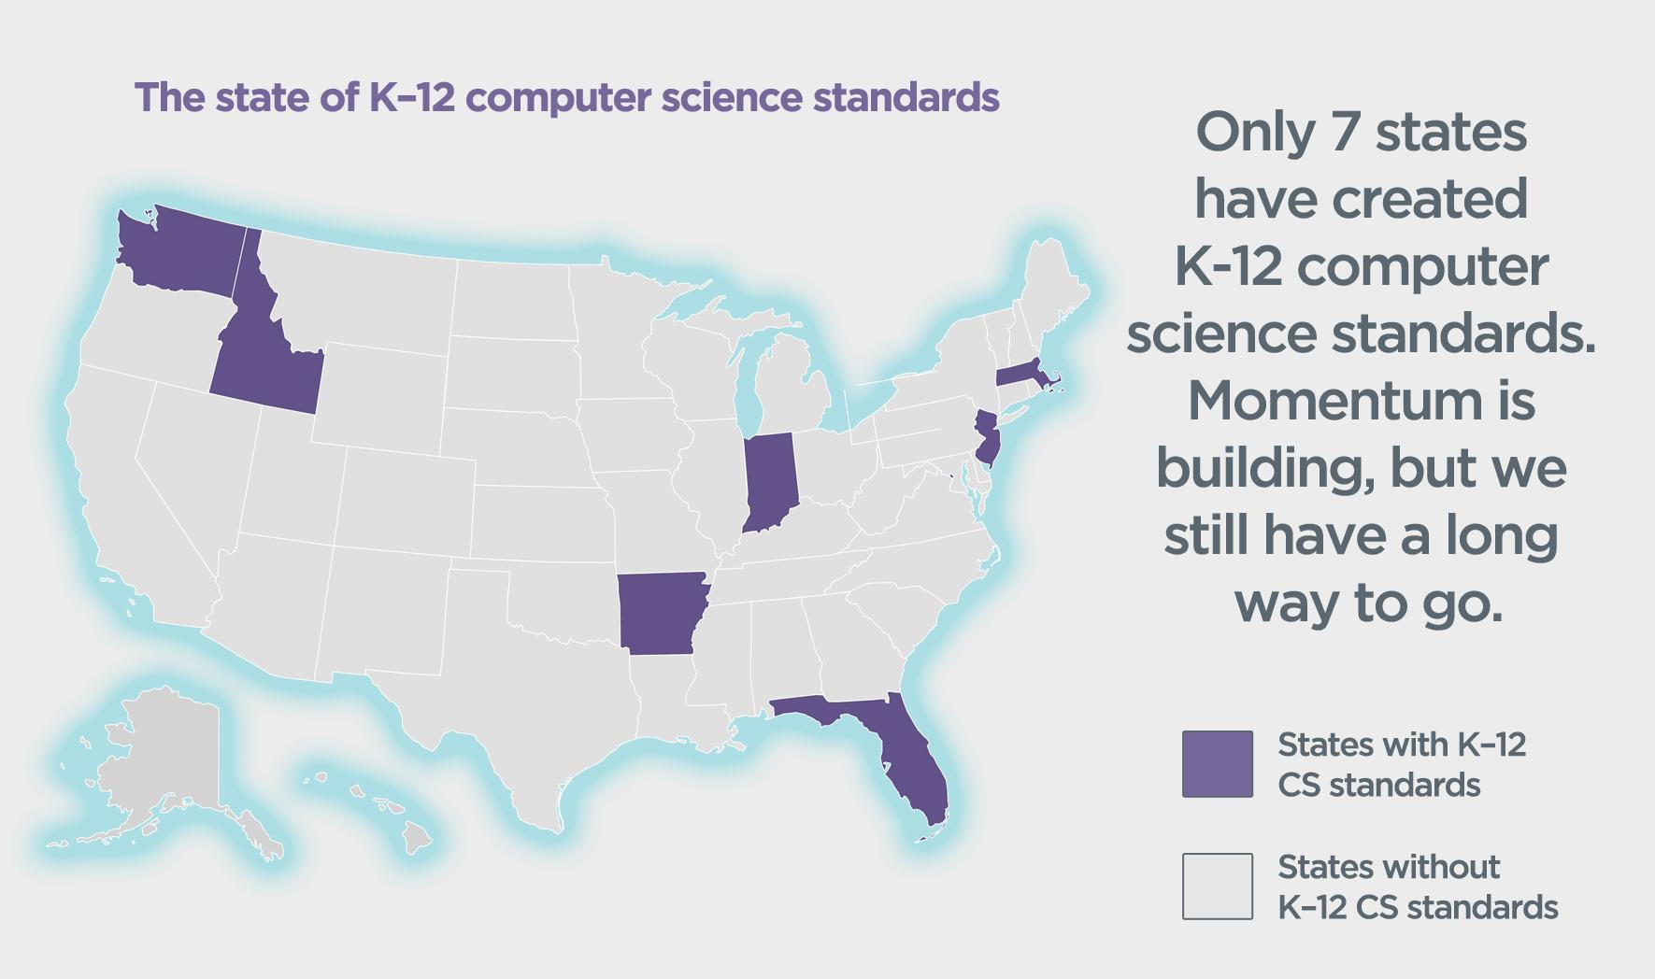

Slide 8
SOLUTION
EDUCATION AND INCLUSION THROUGH GAMES

Slide 9
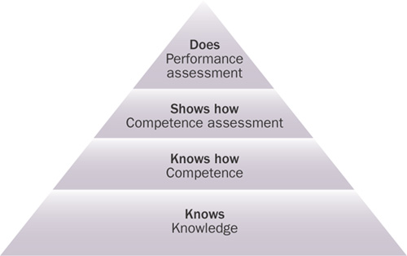
Miller’s Pyramid of Learning
Notes:
Learn from textbook & lecture - knows & knows how (sometimes)
Shows how - tests & BAD educational games (interactive quizzes gamified to show high score & cute animations)
Does - unless they’re pursuing the topic for higher education it’s difficult to allow situations in which student can DO what they’ve learned without fear of failure… games provide a great
Learn from experience - push boundaries & sate curiosity

Slide 10
Learning & Play
Play incorporates learning by allowing the...
Freedom to fail
Freedom to experiment
Freedom to fashion identities
Freedom of effort
Freedom of interpretation
“ We can harness the spirit of play to enable players to build new cognitive structures and ideas of substance. ”
Notes:
Game play requires: attitude oriented toward risk-taking, meaning creation, non-linear navigation, problem-solving, an understanding of rule structures, and an acknowledgement of agency within that structure

Slide 11

Coder’s Creed:
Unity

Slide 12

GAME as SOLUTION
Designer goals:
Portray STEM & Programming as...
Fun - play as a superhero-programmer
Powerful - see how problems can be solved through programming
Inclusive - relatable female protagonist
Player goals:
Have fun
Learn programming concepts and syntax through problem-solving with code

Slide 13
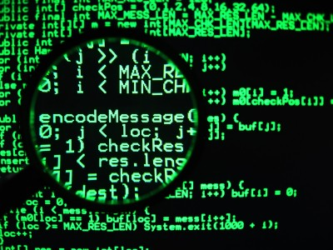
Summary:
Player can explore their environment, interact with NPCs, find collectibles, and discover problems
Player solves puzzles through coding
[Coders as Superheroes]

Slide 14
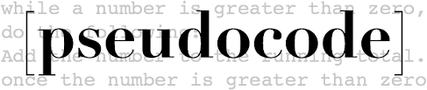
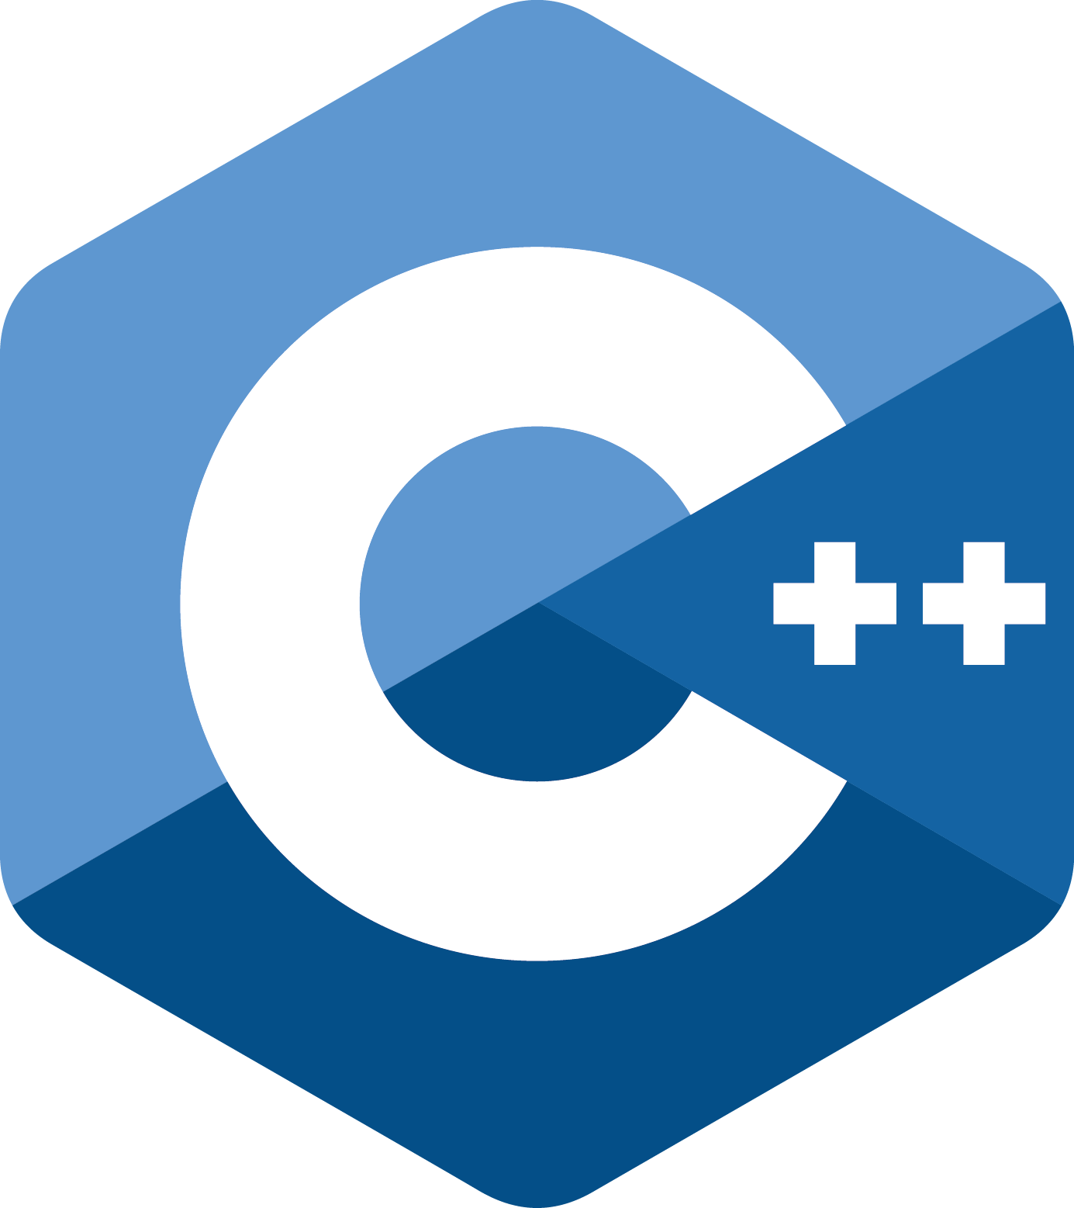


Languages:
pseudocode
javaScript
Java
Python
C++
… and more!!

Slide 15




Overview and Characters
Ava Lovelace “The Hardcoder”
Gracie Hopper “The Debugger”
Alec Turing “The Compiler”
The Troll

Slide 16
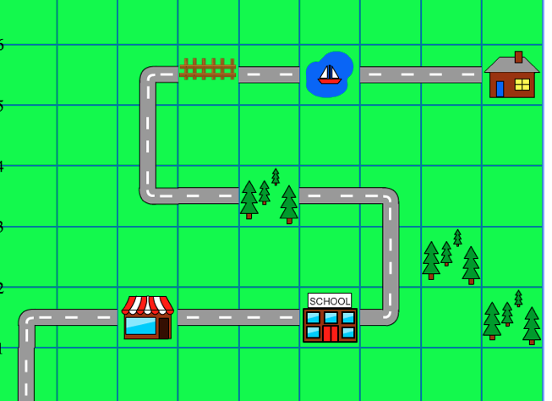

Slide 17
Walkthrough
School Level
Time limit
Player is given a prompt
Friend starts code for them
Player needs to finish code before report cards come out
Friend’s code is different each time
EX: Friend’s code has some errors, you must find them and fix them
SCENARIO: Troll wiped out the computer letter grading system and the computer does not know what grades to hand out. It would take too long to assign each student a letter grade by hand, so you must write a series of if-else statements telling the computer to assign proper letter grades to student’s numeric grades.

Slide 18
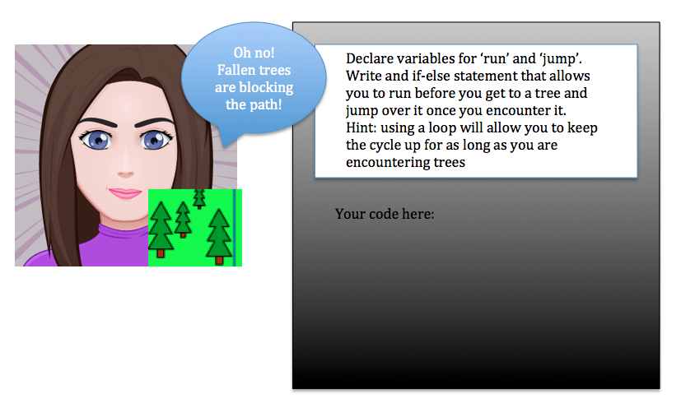

Slide 19
BUDGET
$500,000
Total Cost of Project: $489,013
Cost of employees: $313,000
Open source after first year
Cost of gaming platforms: $3,323 (for first year)
Additional cost of $200 from Xbox Live and App Store per year
Cost of equipment: $27,584
Cost of game engine: free
Cost of server maintenance: $2000 for 5 year plan
$400 per year
Administrative Cost: $51, 586.05
Administrative cost = 15% of total program
Social Media Marketing (Manager) Cost: $90,520
$45,260 per year for two years

Slide 20
Dionysus | Cost Analysis Summary
Costs (Capital & Expense) | One-Time Costs | Year 1 | Year 2 | Year 3 | Year 4 | Year 5 | Total
Labor | $ - | $ 313,000 | $ - | $ - | $ - | $ - | $ 313,000
Hardware | $ 27,584 | $ - | $ - | $ - | $ - | $ - | $ 27,584
Social Media Marketing | $ - | $ 45,260 | $ 45,260 | $ - | $ - | $ - | $ 90,520
Software Licenses | $ 3,323 | $ 200 | $ 200 | $ 200 | $ 200 | $ 200 | $ 4,323
Administrative/Supplies | $ - | $ 51,586 | $ - | $ - | $ - | $ - | $ 51,586
Game Engine (Unreal Engine4) | $ - | $ - | $ - | $ - | $ - | $ - | $ -
Other (Server maintenance) | $ - | $ 400 | $ 400 | $ 400 | $ 400 | $ 400 | $ 2,000
Total | $ 30,907 | $ 410,446 | $ 45,860 | $ 600 | $ 600 | $ 600 | $ 489,013

Slide 21
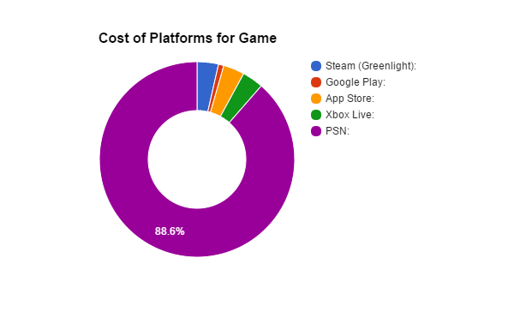
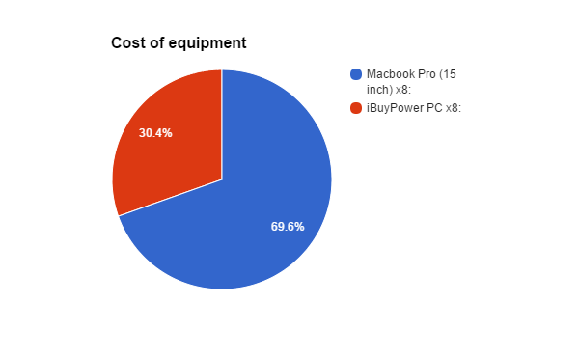
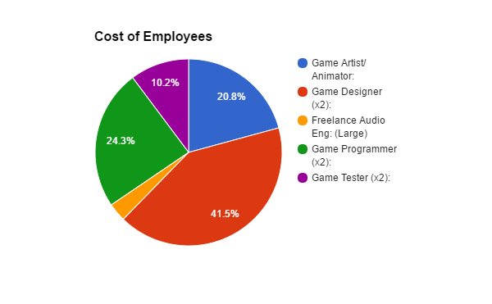
Platforms for game |  | Cost
Steam (Greenlight): |  | $100
Google Play: |  | $25
App Store: |  | $99
Xbox Live: |  | $99
PSN: |  | $2,500
Equipment |  | Cost
Macbook Pro (15 inch) x8: |  | $19,192
iBuyPower PC x8: |  | $8,392
Job Title |  | Cost
Game Artist/Animator: |  | $65,000
Game Designer (x2): |  | $130,000
Freelance Audio Eng: (Large) |  | $10,000
Game Programmer (x2): |  | $76,000
Game Tester (x2): |  | $32,000

Slide 22
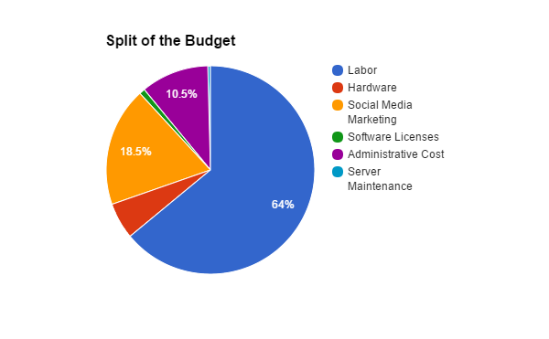

Slide 23
Partnerships

Slide 24
SOCIAL MEDIA & MARKETING

Slide 25
WEBSITE
laverty.me/gat

Slide 26
COMPETITIVE EDGE
Else Heart.Break() VS Coder’s Creed: Unity

Slide 27
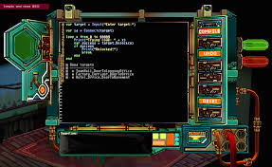
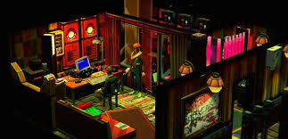
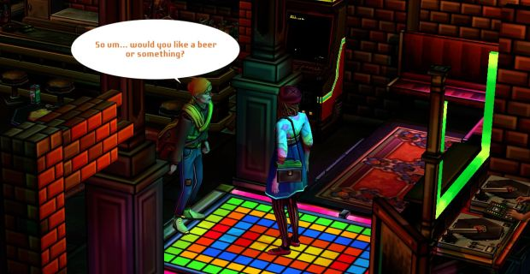

Else Heart.Break()

Slide 28
Else Heart.Break()
Coder’s Creed: Unity
Can only be played with one programming language (Sprak is based off BASIC)
Only available through Steam
$24.99
Stars and focuses solely on male protagonist, Sebastian
Follows tropes
Can choose between several languages
From pseudocode → C++
Will be published to multiple platforms and vendors
$7.99 ← Projected, may go lower
Main protagonist is female, but every character gets a chance in the limelight.

