Slide 1
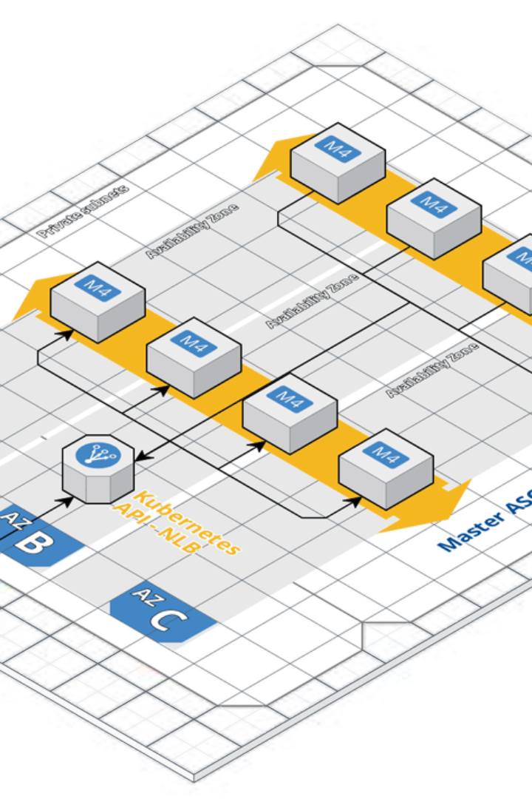

AWS DevOps: A Comprehensive Guide
Learn about the integration of Amazon Web Services (AWS) and DevOps, combining the best practices and tools to automate infrastructure, manage code deployments, and increase the speed and reliability of software delivery.
B
by Bathina Siva Prasad Reddy

Slide 2
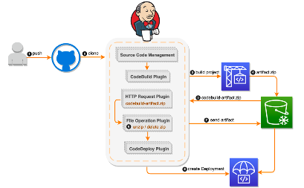
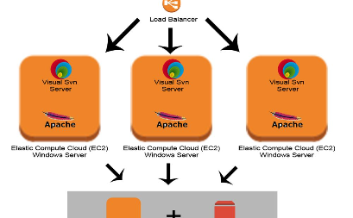
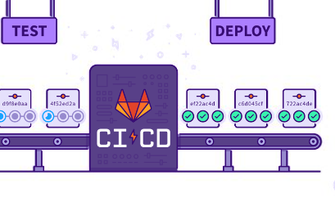
Continuous Integration and Delivery (CI/CD)
Automated Workflows
Deployment Automation
Toolchain Integration
Understand the benefits of implementing CI/CD pipelines on AWS, enabling rapid and reliable delivery of applications through automation of software release processes.
Explore the automated deployment of applications to AWS, ensuring consistency and reducing the risk of errors associated with manual deployment processes.
Discover the integration of AWS tools to facilitate continuous integration, automated testing, and continuous delivery, optimizing the software development and deployment lifecycle.

Slide 3

Infrastructure as Code (IaC)
Scalability and Consistency
Resource Optimization
Learn how IaC on AWS provides the ability to manage and provision infrastructure through code, improving scalability and ensuring consistency across environments.
Discover the efficient use of AWS resources through IaC, enabling the provisioning and configuration of infrastructure elements using code-based definitions.
Environment Replication
Understand how IaC facilitates the reproducibility of AWS environments, ensuring consistency and reducing the risk of configuration drift.

Slide 4

Monitoring and Logging
1
Real-Time Visibility
2
Automated Alerts
3
Log Analysis and Insights
Discover how AWS tools provide real-time visibility into the performance and health of applications and infrastructure for efficient troubleshooting and monitoring.
Explore the configuration of automated alerts for AWS resources, ensuring proactive response to performance issues and potential infrastructure failures.
Understand the utilization of AWS services for log analysis and insights, providing actionable data for optimizing application performance and security.

Slide 5
Security in AWS DevOps
99.9%
Encryption at Rest
50+
Security Uptime
Data Protection
Security Compliance
Explore the high availability and durability of security measures in AWS, ensuring 99.9% uptime and resilience against potential threats.
Learn about the use of AWS encryption tools to protect data at rest, maintaining the integrity and confidentiality of sensitive information.
Discover the availability of over 50 compliance certifications and accreditations in AWS, ensuring the adherence to industry-specific security standards and regulations.

Slide 6
Cost Optimization in AWS DevOps
Right Sizing
Explore the optimization of AWS resource utilization and costs by aligning infrastructure with actual workload requirements.
Reserved Instances
Understand the strategic use of reserved instances in AWS to achieve significant cost savings for predictable workloads.
Auto Scaling
Learn about dynamic scaling in AWS, automatically adjusting resource capacity to maintain performance at the lowest possible cost.

Slide 7

AWS DevOps Best Practices
Automation
Collaboration
Explore the importance of automation in AWS DevOps, streamlining repetitive tasks and enhancing efficiency across the software development lifecycle.
Understand the value of collaboration within DevOps teams, fostering effective communication and knowledge sharing to drive continuous improvement.
Reliability
Learn about the emphasis on reliability in AWS DevOps, ensuring consistent performance, fault tolerance, and quick recovery from failures.

Slide 8

DevOps Culture and Continuous Improvement
1
Cultural Transformation
Explore the journey towards a DevOps culture, promoting transparency, experimentation, and continuous learning within organizations.
2
Continuous Feedback
Understand the significance of continuous feedback loops in DevOps, enabling continuous improvement and iterative development processes.
3
Adoption of Best Practices
Discover the adoption of industry best practices in DevOps, ensuring efficient delivery and operational excellence in AWS environments.

Slide 9




DevSecOps and Automation
Security Integration
Explore the integration of security practices within the DevOps pipeline, ensuring the proactive and automated implementation of security measures.
Compliance Automation
Understand the automation of compliance management in DevSecOps, ensuring adherence to regulatory and internal policies throughout the software delivery process.
Tools and Technology
Discover the utilization of advanced tools and technologies for automated security testing and vulnerability assessments within AWS DevSecOps processes.

Slide 10
Case Studies and Lessons Learned
Use Case Examples
Lessons for Implementation
Continuous Improvement
Explore real-world case studies demonstrating the successful implementation of AWS DevOps practices, highlighting the impact on productivity, scalability, and innovation.
Gain insights from lessons learned in AWS DevOps deployments, understanding best practices and potential challenges in integrating DevOps culture within organizations.
Learn from the continuous improvement strategies applied in AWS DevOps, driving agility, customer value, and operational excellence through iterative enhancements.

