Slide 1
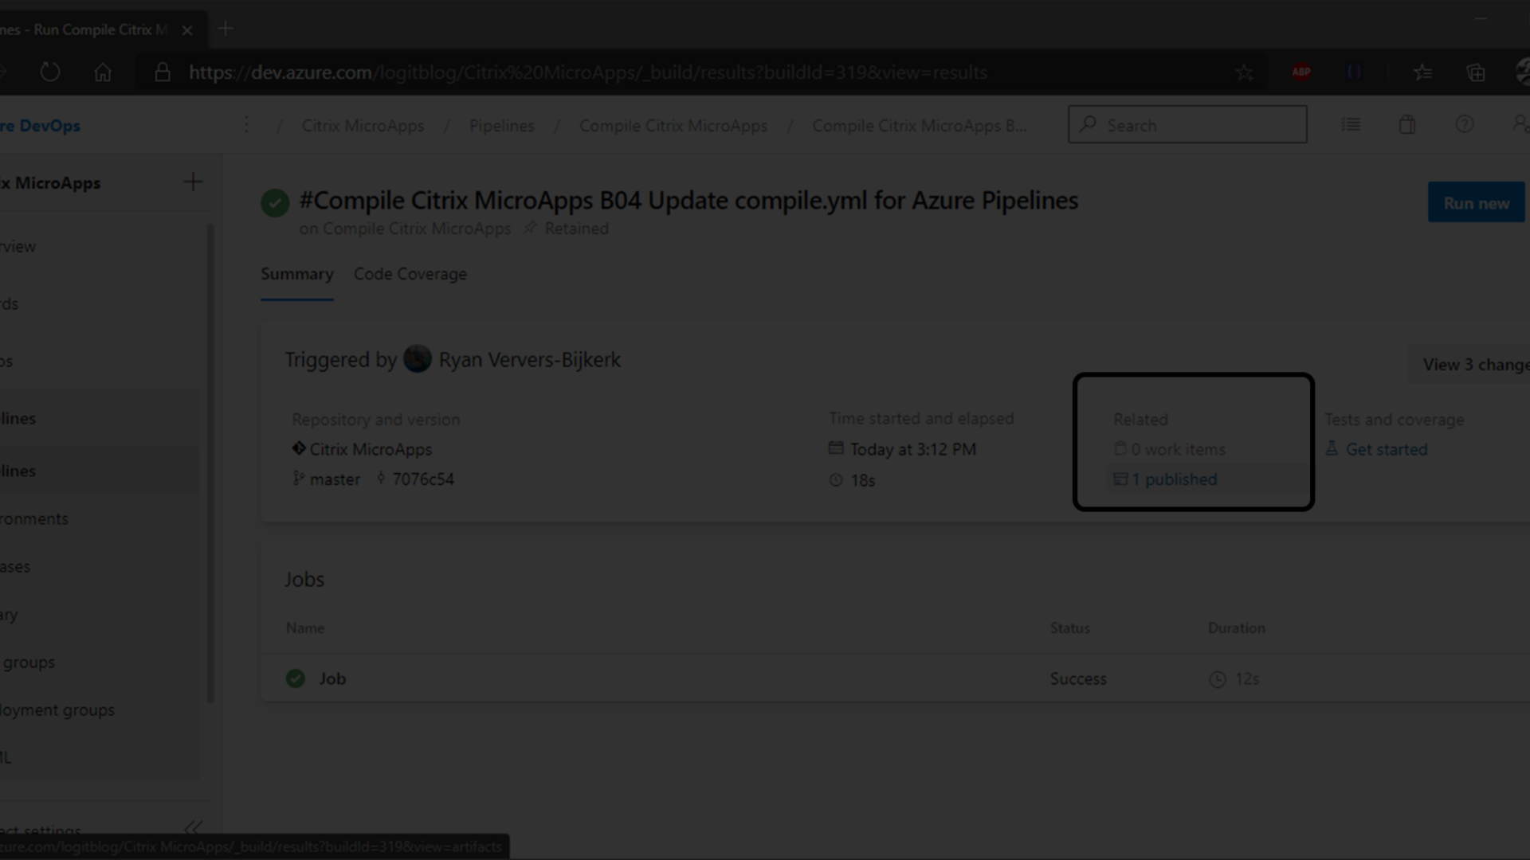

Azure DevOps: A Comprehensive Overview
Azure DevOps is a powerful platform that enables seamless collaboration, continuous integration, and delivery. It offers a full suite of development tools and is designed to provide robust support for end-to-end DevOps workflows.

Slide 2
Planning and Tracking
Backlog Management
Agile Boards
Scrum Boards
Efficiently manage and prioritize your product backlog using intuitive tools.
Visualize and track work items, sprints, and backlogs using Agile project management tools.
Utilize Scrum methodologies for sprint planning and tracking progress.

Slide 3
Code Version Control
1
Git Repositories
2
Branch Policies
Collaboratively develop and manage code using Git repositories with unlimited cloud-hosted, private repositories.
Enforce branch policies to ensure high code quality and implement pull requests for peer reviews.
3
Code Search
4
Code Reviews
Find and explore code across your repositories using powerful search tools.
Conduct thorough code reviews to maintain high-quality code and foster knowledge sharing.

Slide 4

Continuous Integration and Deployment
1
Automated Builds
Set up automated builds to compile, test, and validate your code.
2
Continuous Deployment
Automatically deploy your applications to different environments with minimal manual intervention.
3
Release Pipelines
Orchestrate your release process with end-to-end traceability and monitoring.

Slide 5



Testing and Monitoring
Automated Testing
Application Insights
Live Metrics Stream
Execute automated tests to maintain high quality and shorten feedback cycles.
Gain deep insights into your applications' performance and usage.
Monitor your applications in real-time and troubleshoot issues proactively.

Slide 6
Security and Compliance
Data Security
Compliance Auditing

Slide 7
Integration with Azure Services
Azure Boards
Seamless tracking and planning integration with Azure Boards.
Azure Repos
Effortless code and repository management through Azure Repos integration.
Azure Pipelines
Streamlined CI/CD pipelines with Azure Pipelines integration.

Slide 8
Collaboration and Reporting
95%
99%
Team Collaboration
Reporting Capabilities

Slide 9
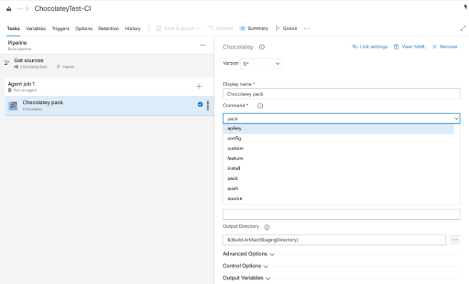
Customization and Extensibility
Custom Work Item Types
Create custom work item types tailored to your team's unique processes and methodologies.
Extensions Marketplace
Explore a rich ecosystem of extensions to enhance and customize Azure DevOps with specialized tools and integrations.

Slide 10
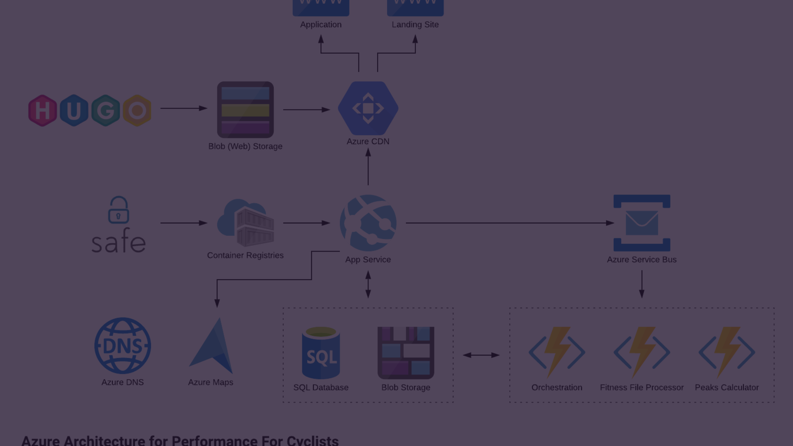


Migrating to Azure DevOps

