Slide 1
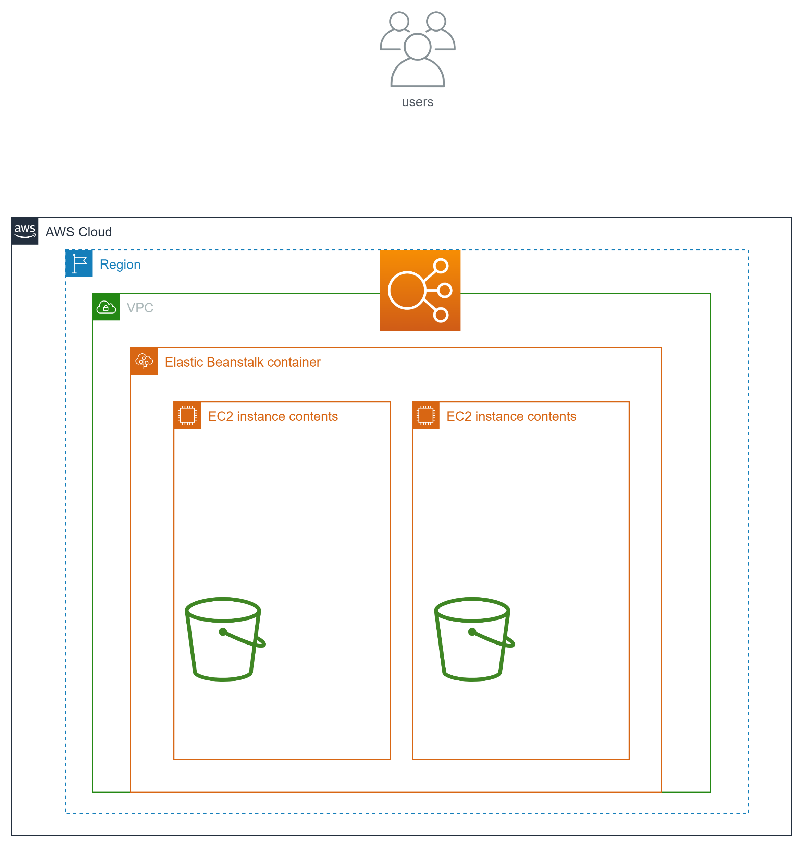

CREATED BY:-Pritish Kumar Tripathy
PKT CloudInfra
PKT CloudInfra

