Slide 1
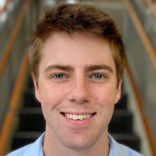


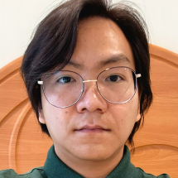
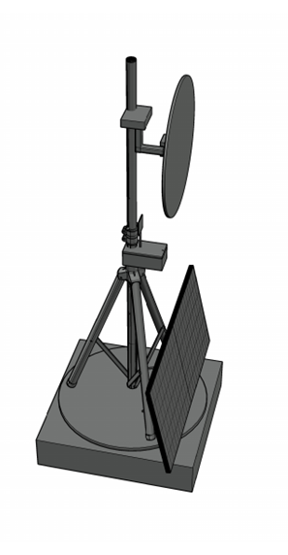
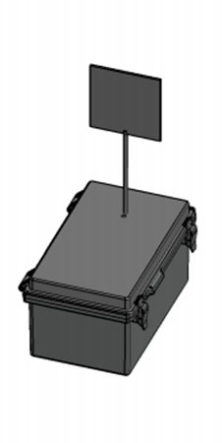
A.S.T.R.O.COM. Advanced Solar Tracking and Rover Observation Communication
Group 14’s
Members:
Alex Fiset | Pedro Kasprzykowski | Stephen Martin | Binh Pham
Electrical Engineering | Computer Engineering | Computer Engineering | Computer Engineering

Slide 2
Motivation and Background

Slide 3
Goals & Objectives

Slide 4
Specifications Table
Heliostat Tower
Minimum Temperature | -40°C
Reflector
Minimum size | 1ft diameter
Maximum size | 5ft diameter
Maximum Weight | 9kgs
Minimum Reflectivity | 90%
Response Time | 3 minutes
Tower Frame
Maximum total weight | 27kgs
Minimum Weight Capacity | 10kgs
Solar Panel
Minimum Power | 30W during sunlight hours
Maximum Voltage | 24V
Battery
Minimum Lifespan | 2 weeks without sun
Communication Tower
Minimum Enclosure Volume | 6.5"x6.5"x5"
Maximum Weight | 2kg
Minimum Network Range | 20m
Communication Rate | 2400MHz
Voltage input | 3.3V or 5V
Maximum Current Draw | 500mA
Minimum Temperature | -40°C
Latency | 1 second
Maximum Power | 5W

Slide 5
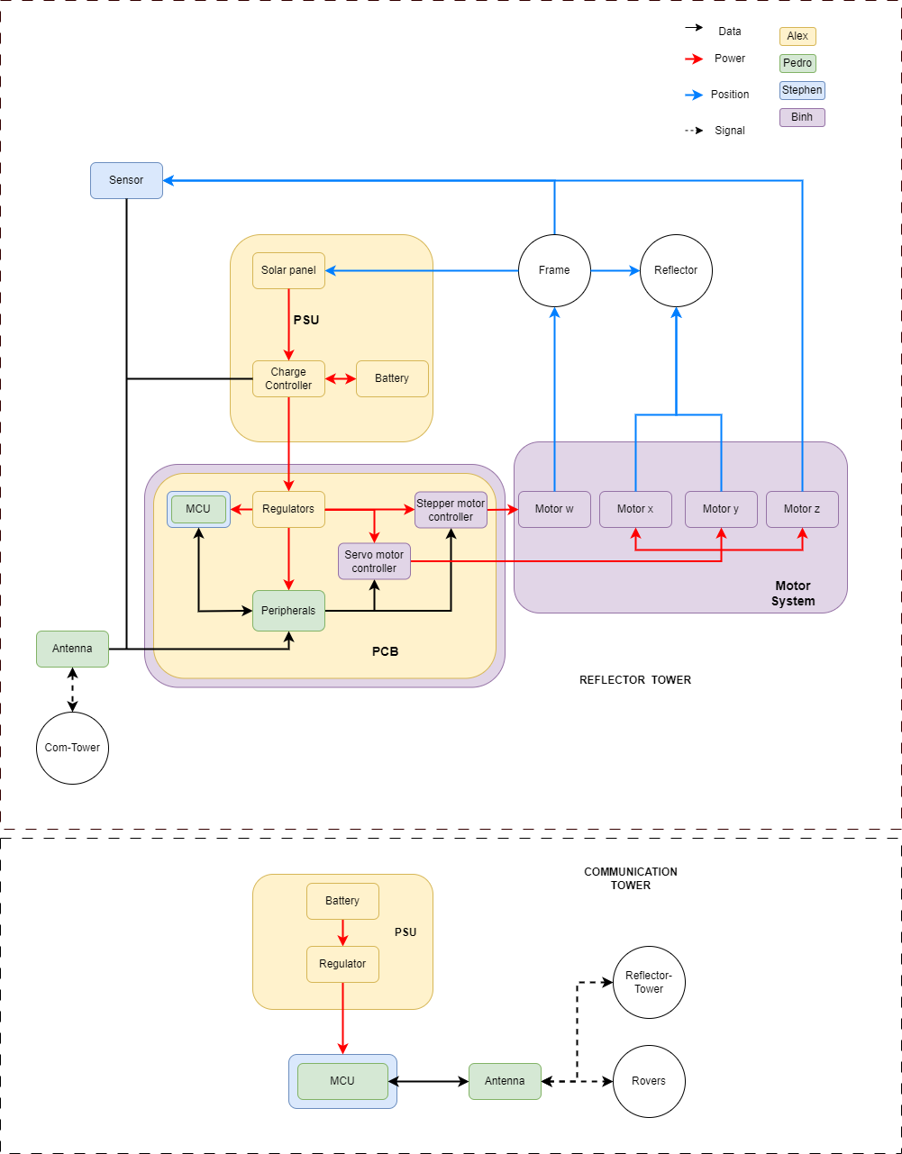
Hardware BlockDiagram

Slide 6
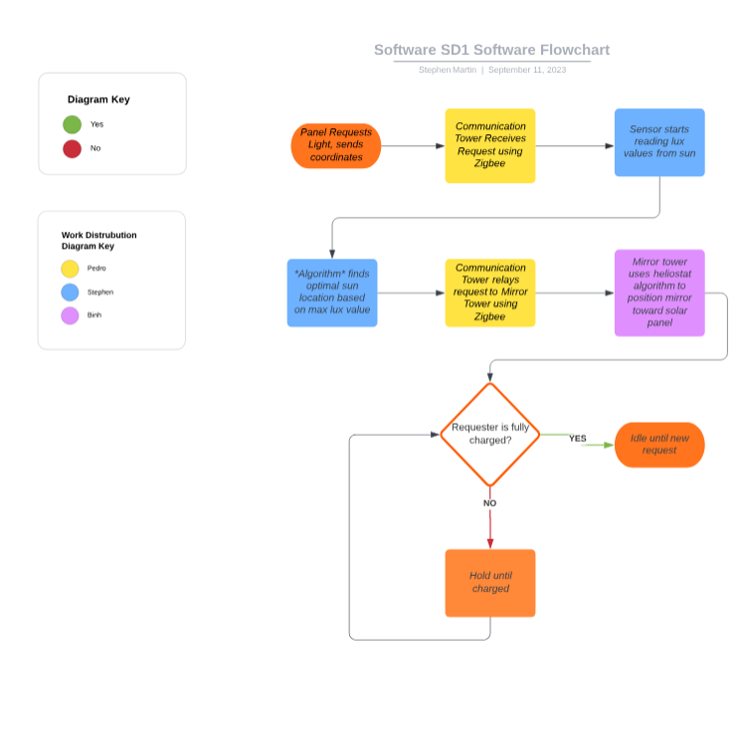
Software BlockDiagram

Slide 7
Comparison and Selection of Hardware

Slide 9
Comparison and Selection of Software

Slide 10
Hardware Design

Slide 11
Software Design

Slide 12
PCB Design

Slide 13
Administrative Contents

