Slide 1




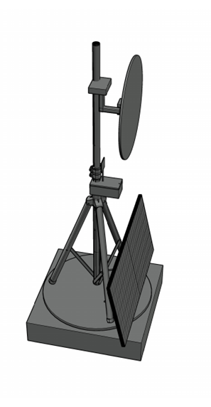
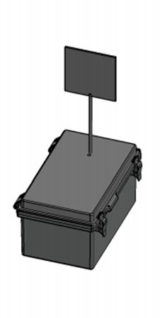
A.S.T.R.O.COM. Advanced Solar Tracking and Rover Observation Communication
Group 14’s
Members:
Alex Fiset | Pedro Kasprzykowski | Stephen Martin | Binh Pham
Electrical Engineering | Computer Engineering | Computer Engineering | Computer Engineering

Slide 2
Motivation and Background

Slide 3
Goals & Objectives

Slide 4
Specifications Table
Heliostat Tower
Minimum Temperature | -40°C
Reflector
Minimum size | 1ft diameter
Maximum size | 5ft diameter
Maximum Weight | 9kgs
Minimum Reflectivity | 90%
Response Time | 3 minutes
Tower Frame
Maximum total weight | 27kgs
Minimum Weight Capacity | 10kgs
Solar Panel
Minimum Power | 30W during sunlight hours
Maximum Voltage | 24V
Battery
Minimum Lifespan | 2 weeks without sun
Communication Tower
Minimum Enclosure Volume | 6.5"x6.5"x5"
Maximum Weight | 2kg
Minimum Network Range | 20m
Communication Rate | 2400MHz
Voltage input | 3.3V or 5V
Maximum Current Draw | 500mA
Minimum Temperature | -40°C
Latency | 1 second
Maximum Power | 5W

Slide 5
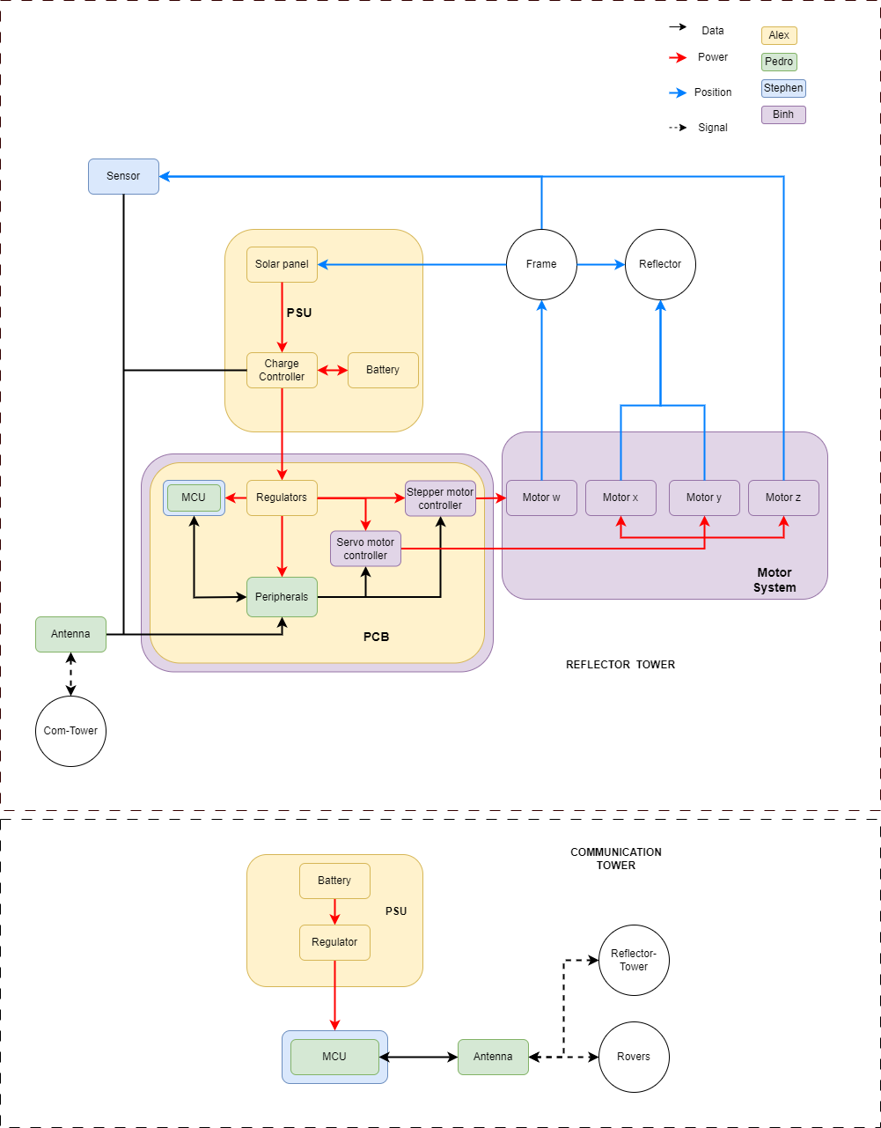
Hardware BlockDiagram

Slide 6
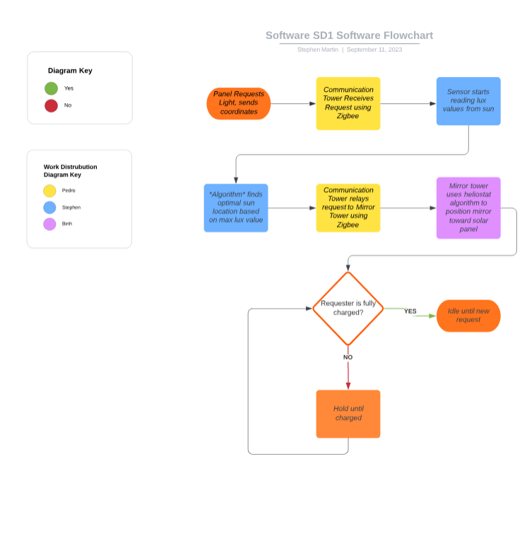
Software BlockDiagram

Slide 7
Comparison and Selection of Hardware

Slide 8
MCU

Slide 9
Solar Panels

Slide 10
MCU

Slide 11
Voltage Regulation

Slide 12
Charge Controller

Slide 13
Reflectors

Slide 15
Comparison and Selection of Software

Slide 16
Hardware Design

Slide 18
Software Design

Slide 19
PCB Design

Slide 20
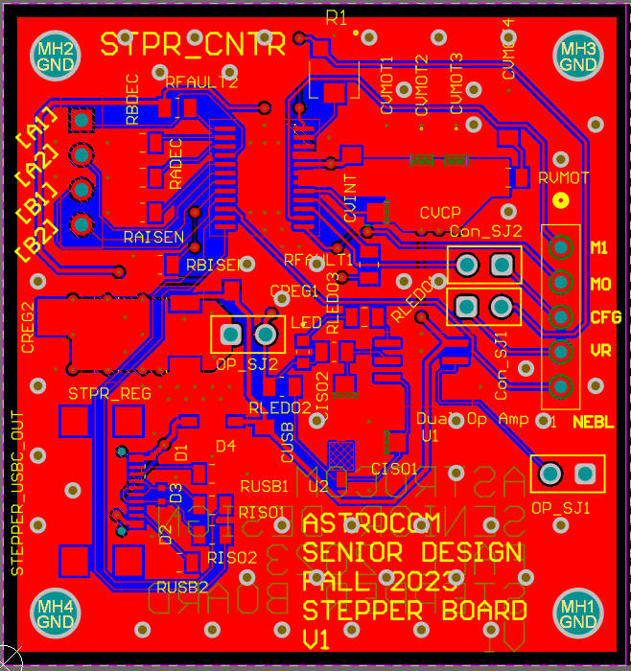
Stepper Motor Controller PCB

Slide 21
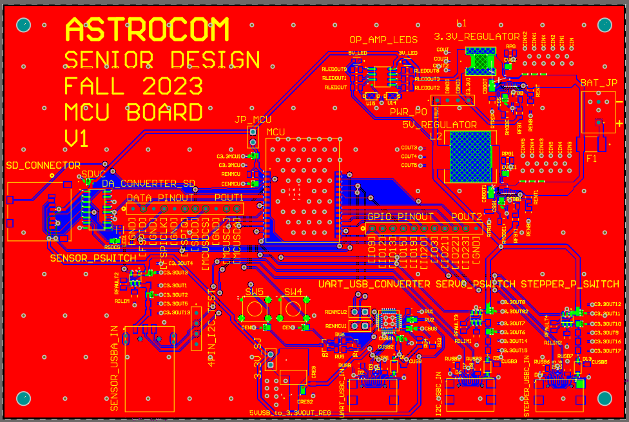
MCU PCB

Slide 22
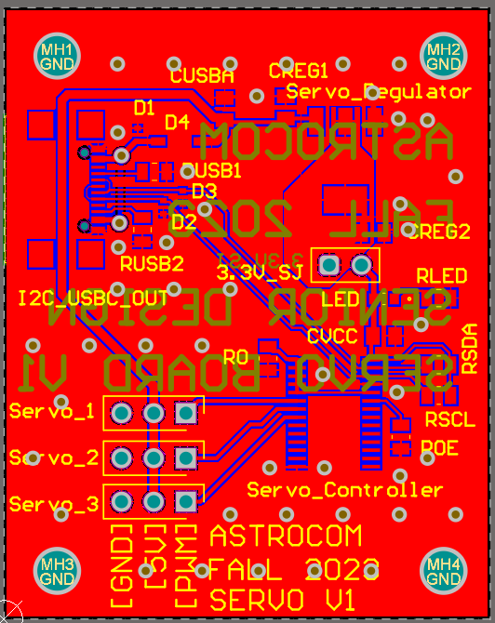
SErVo Motor controller PCB

Slide 23
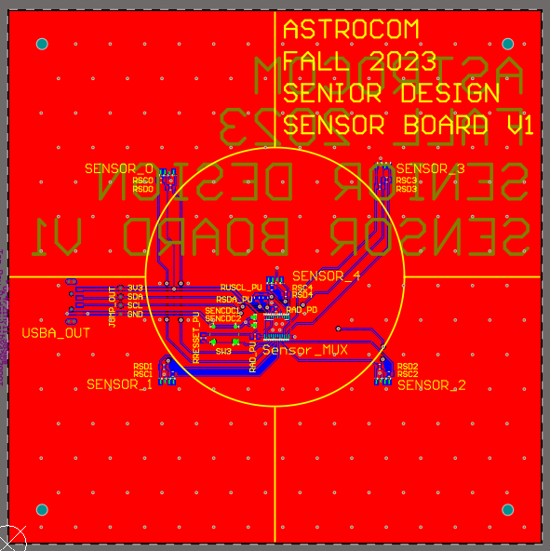
Sensors PCB

Slide 24
Administrative Contents

Slide 25
Overall Budget and Financing
Sub-System | Budget | Sponsor | Additional Budget
PSU and Solar | $ 150.00
Frame/Reflector | $ 200.00
PCBs and Electrical | $ 100.00
Total | $ 450.00

Slide 26
Mechanical's Budgets
Component | Name | Price/unit | Quantity
Mirror | 0.032" x 24" x 24", 3003-H14 Aluminum Sheet | $28.86 | 1
Mirror Coating | Mylar Sheet | $25.99 | 1
Frame | ADJ LTS-6 T-Bar Tripod Lightweight Lighting Stand | $54.99 | 1
Base Panels | Plywood Panels 4ftx8ft | $25.60 | 2
Communication Tower Box | Junction Box | $26.89 | 1
Wheel Hub Bearing | Rear Wheel Hub | $44.90 | 1

Slide 27
Electrical’s Budget
Component | Name | Price | Quantity
Battery | Howell Energy hw-4f7 | 32.99 | 1
Motor w | Nema 23 | $30.73 | 1
Motor x-y-z | 9.5-11kg*cm Servo Motor | $17.59 | 3
Charge Controller/BMS | Smaraad SR11004 | $39.99 | 1
Solar Panel | RNG-50D-SS | $49.99 | 1
Microcontroller | ESP32-C6-DEVKITC-1-N8 | $9.00 | 1
External Antenna | Wlaniot 2.4G | $17.98 | 2
MicroSD card | 5251 | $4.50 | 2
MicroSD card breakout board+ | 254 | $7.50 | 1

Slide 28
PCB’s Budget
Component | Name | Price | Quantity
Microcontroller for PCB | ESP32-C6-WROOM-1U | $3.48 | 1
Stepper Motor Controller | DRV8833PW | $2.84 | 1
Servos Motor Controller | PCA9685PW,112 | $2.64 | 1
3.3V Regulator | TPS54JA20 | $1.50 | 1
5V Regulator | TPS54JA20 | $1.50 | 1
USB-A Connector | 2057-USB-AP-S-RA-SMT-ND | $0.55 | 3
Sensor-MUX | TCA9548APWR | $1.78 | 1
Sensor | VEML7700 | $1.88 | 5
USB-to-UART Bridge Controller | CP2102N-A02-GQFN28 | $4.07 | 1
MicroSD Socket | 1660 | $1.95 | 1
Misc. | Resistors, Capacitors, Inductr, Jumpers, Etc.…. | ~$20.00

