Slide 1
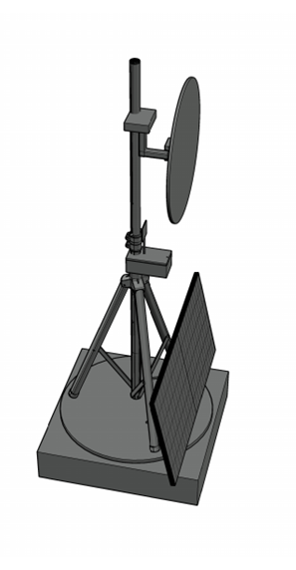
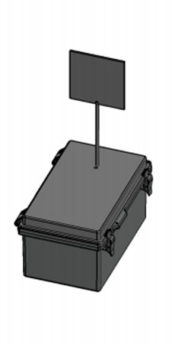






A.S.T.R.O.COM. Advanced Solar Tracking and Rover Observation Communication
Alex Fiset | Pedro Kasprzykowski | Stephen Martin | Binh Pham
Electrical Engineering | Computer Engineering | Computer Engineering | Computer Engineering
Project sponsored by Florida Space Institute (FSI)

Slide 2
Motivation and Background
South Pole of Moon is area of interest for researchers
Lunar south pole has many craters that are in permanent darkness due to the sun's path across the lunar south pole's sky
Approached by FSI to solve a few problems for lunar exploration:
Permanently dark locations on the moon are difficult to explore
Lack of power infrastructure on the moon limits exploration
Permanently dark locations are a valuable location for research
Communication on lunar surface is limited
Range of communication limits exploration of craters
Limited communication infrastructure on moon

Slide 3
Motivation and Background
Proposed Solution:
A heliostat tower
To reflect light from the sun into permanently dark locations
Equipped with communication capabilities
A smaller communication beacon
Carriable by rovers
Form a communication network with rovers

Slide 4
Goals
Overall Goals (High Level)
Build a tower to handle rover communication.
Build a tower to handle sunlight diversion to targets.
Stretch Goals
P2P Networking for communication and mirror tower with rovers.
Wireless charging and/or docking station for communication tower.

Slide 5
Objectives
Mirror Tower Objectives (Lower Level)
Identify optimal sun location based on lux value from sensor.
Receive requests from communication tower using protocols.
Create a heliostat algorithm to orient towards the target with motors.
Create a self-sustainable power supply using solar and battery power.
Communication Beacon Objectives (Lower Level)
Receive requests from target through mesh network protocols.
Relay requests to mirror tower using communication protocols.
Create a small and portable tower that can be moved by rovers.

Slide 6
Specifications Table
Heliostat Tower
Minimum Temperature | -40°C
Reflector
Minimum Reflectivity | 90%
Response Time | 3 minutes
Solar Panel
Minimum Power | 30W during sunlight hours
Maximum Voltage | 24V
Battery
Minimum Lifespan | 2 weeks without sun
A heliostat tower
Respond time to change reflection target estimated to be maximum 3 minutes
Minimum power can be usage to all component estimated to be 30W
Communication tower
Maximum power usage estimated to be 5W
Communication Tower
Minimum Network Range | 20m
Communication Rate | 2400MHz
Maximum Current Draw | 500mA
Latency | 1 second
Maximum Power | 5W

Slide 7
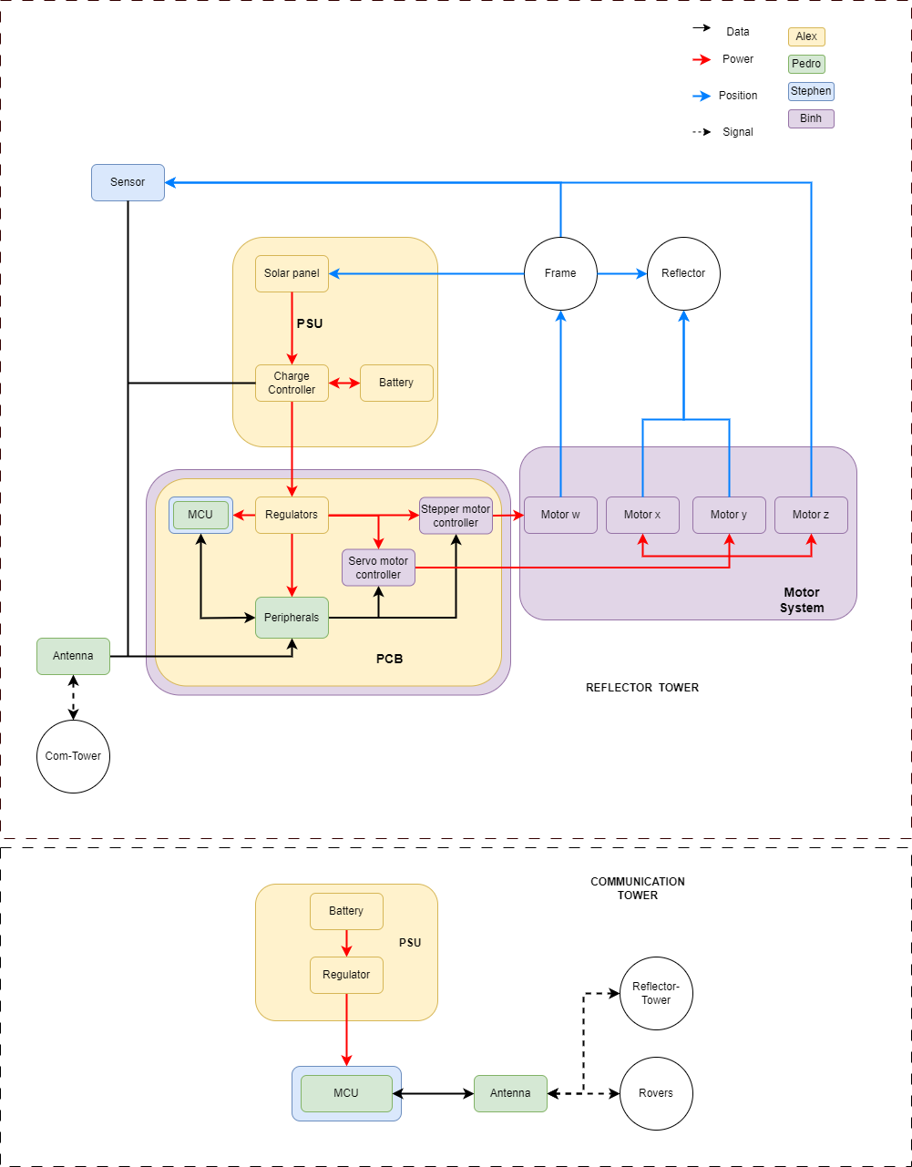
Hardware Block Diagram

Slide 8
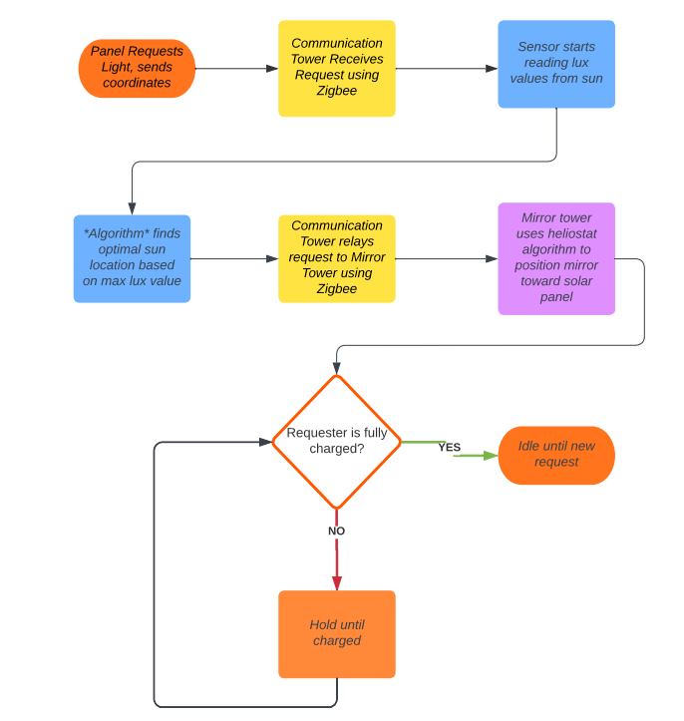
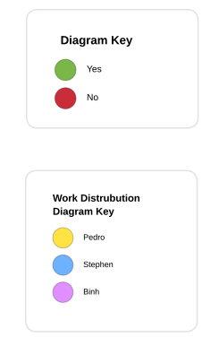
Software Block Diagram
Fully integrated code software flowchart
Perspective of Mirror Tower
Yellow is signal from Communication Beacon

Slide 9
MICROCONTROLLER UNIT
 | ESP32 | MSP430 | Raspberry Pi 0 | Arduino MKR1310 | Arduino MK1010
Cost (USD) | 9.18 | 20 | 15 | 46 | 38.6
Zigbee | Yes | No | Yes | No | No
I2C | Yes | Yes | Yes | Yes | Yes
Flash Memory | 4 MB | 128 KB | None | 256 KB | 256 KB
RAM | 520 KB | 2 KB | 512 MB | 32 KB | 32 KB
Power (W) | 1.3644 | 1 | 12.5 | 0.5082 | 0.5082
Microcontroller was chosen over FPGA
Low power consumption, cost, and high amounts of documentation.
ESP32 is low cost, low power and networking capabilities and all connections required.

Slide 10
Solar Panels
A monocrystalline 50W panel from Renogy was selected due to the low cost and high performance.
Model | RNG-50D-SS | HQST-50P-US | SP-52-L
Brand | Renogy | HQST | Solbian
Technology | Monocrystalline | Polycrystalline | Monocrystalline
Price | $ 59.99 | $ 65.99 | $ 499.00
Pmax at STC | 50 W | 50 W | 52 W
Voc | 22.3V | 23.3V | 10.9V
Vmp | 18.6V | 19.8V | 9.1V
Imp | 2.69A | 2.53A | 5.7A

Slide 11
Voltage Regulation
Specifications | Linear Regulators | Switching Regulators
 |  | Buck | Boost | Buck-Boost
Efficiency | Moderate | High
Heat | Moderate | Low
Voltage Output | Step-Down | Step-Down | Step-Up | Up or Down
Output Ripple | Low | Low | High | Low
Complexity | Low | Moderate | Moderate | High
Cost | Low | Moderate | Moderate | High
Switching Buck regulators were chosen for their simplicity and low cost, being commercially available cheaply from many manufacturers.

Slide 12
Voltage Regulation
Model | LM1085IT-5.0/NOPB | DROK MiniBuck Converter | LM2596 | TPS54JA20
Brand | Texas Instruments | DROK | Texas Instruments | Texas Instruments
Input Voltage | 2.6-26V | 2.5-24V | 3-40V | 2.7–16V
Output Voltage | 3.3 or 5 | 3.3 or 5 | 1.5 to 35 | 0.5 to 5.5V
Output Current | 3A | 3A | 3A | 12A
Price | 2.19 | 1.97 | 1.495 | 0.65
Type | LDO Buck | Buck | Buck | Buck
The TPS53JA2 was selected due to the high output current, supported the intended voltage input, and was high efficiency.

Slide 13
Charge Controller
Two broad categories of Solar Charge Controllers:
PWM
Basic pulse width modulation
Lower efficiency
Cheaper
MPPT
Tracks highest power producing operating point
Higher efficiency
Typically, more expensive

Slide 14
Charge Controller
Model | BQ25798RQMR | SR11004 | Adventurer
Brand | Texas Instruments | SMARAAD | Renogy
Input Voltage | 24V max | 26V max | 50V max
Output Voltage | 18.8V max, Programmable | 12/24V | 12/24V
Output Current | 5A | 10A | 30A
Price | 6.25 | 39.99 | 59.99
Power | Not Specified | 260W | 1500W
Type | MPPT | MPPT | PWM
The SR11004 from SMARAAD offered the right voltage output, and was compatible with the selected battery chemistry for the lowest price.

Slide 15
Reflectors
Material Chosen to fabricate:
Aluminum: high heat resistance, durable, and high reflectivity in the moon environment.
Mylar: increase reflectivity, high heat change resistance, won’t crack, and don’t reduce quality of refection
Proof of concept: Acrylic panel as cheaper alternative and easier to fabricate.

Slide 16
Motors
Stepper motor: Nema 23 robustness and strong torque to control the rotation of the whole tower. Can be used on DC system
Servo Motors: a cheaper alternative for smaller part movements.
Incorporated gearbox to increase movement range and control for stepper motor.
Types of Motors | AC | Stepper | Servo
Financial Cost | $200-$2,000 | $20-$200 | $10-$50
Torque | 203000Ncm-610000Ncm | 10-10000Ncm | 10-1000Ncm
Speed | 1800-3600 rmp | Low | High
Voltages requirement | 115V/208V/230V | 3V-100V | 3V-100V
Durability | High | High | Low

Slide 17
Motor Controllers
Stepper Controller TB6560-V2, cheap and can handle the at least 2 amperage from Nema23
PCA9685 PWM: Design specific for servo and can control all three servos planned in the system
Controller Models | DRV8434S, 2A Max. | TB6560 | Stepper Motor Driver 36v4 | HiLetgo PCA9685
Cost (USD) | $12.95 | $11.39 | $29.95 | $9
continuous current (A) | 1.2 | 3.5 | 4 | 3A
Micro stepping | 1/256 | 1/16 | 1/256 | I2C
Operating Voltage (V) | 4.5-48 | 10-35 | 8-50 | 5-10

Slide 18
Batteries
The battery selected was a Howell Energy LiFePO4 battery.
Higher amp hours
Lower weight
Smaller size
Higher price
Model | ML5-12 | HW-4F7 | PQ12V/6AH
Brand | Mighty Max Battery | Howell Energy | Power Queen
Voltage | 12 | 12 | 12.8V
Amp Hour | 5 | 7 | 6
Technology | SLA AGM | LiFePO4 | LiFePO4
Price | 16.99 | 32.99 | 19.59
Charging Requirements | CV | CC 3.5A, CV 14.6V, Built-in BMS | Not Specified, Built in BMS

Slide 19
Antenna
The combination of the certain gain range, circular polarization, high-efficiency and wideband characteristics made patch and helical antenna types the ideal choices.
The PC140’s circular polarization while also being above average in gain and efficiency made it the preferred antenna product.
The sponsor chose for us to replace the antenna with their choice of the wlaniot.
 | PC140 | WPC.25A | FXP74 | PC17 | FXP70
Avg Gain (dB) | -1.92 | -1.14 | -2 | -3.6 | -2
Peak Gain (dBi) | 1.67 | 5.15 | 4 | .9 | 1.1
Efficiency (%) | 64 | 76.9 | 50 | 44 | 63.7
VSWR | <2 | <2 | <2 | <1.5 | <1.5
Polarization | RHCP | Linear | Linear | Linear | Linear
Cost (USD) | $27.26 | $9.21 | $7.69 | $16.60 | $27.09

Slide 20
Sensor
Sensor Final 4 Options:
VL6180X and SI1145 include IR which is not needed
MAX44009 only has breakout board; does not work for PCB
VEML7700 best choice for price/ability
 | VL6180X | MAX44009 | SI1145 | VEML7700
Cost (USD) | $14.49 | $5.96 | $9.95 | $4.95
Measuring Principle | TOF/IR Laser Photodiode | Photodiode | IR-LED Photodiode | Photodiode
Max Lux | 100000 | 188000 | 128000 | 120000
Ambient Light Sensing | Yes | Yes | Yes | Yes
Operating Current (mA) | 0.3 | 0.003 | 7 | 0.045
I2C | Yes | Yes | Yes | Yes

Slide 21
Development Environment: Languages and Repositories
Programming Languages
C: best choice for MCU programming, low-level
Java: best for object-oriented programming, low-level
Python: best for existing libraries, high-level
Choice: C
Repositories
GitHub: most popular repo, widely used among many software devs
Bitbucket: Git based repo, includes task scheduling and team goal software
Choice: GitHub

Slide 22
Vectoring and Positioning / Solar Tracking Algorithm
Heliostat algorithm chosen as it is open source and availability. Good capability with ESP32-C6 and C language
Algorithms | Heliostat | Kalman Filtering | Ray Tracing
Financial Cost | Open Source | Ambiguous | Not available
Sensor | Ambient Light | Ambient Light | Ambient Light
Algorithm code library | Available on GitHub | Available in python | Available in Research paper
Efficiency | High | Low | Medium
MCU compatibility | Good (C Language) | Fair (Python) | Good (C Language)

Slide 23
Communication technologies
The combination of low power consumption, suitable range, options for frequency and high scalability made Zigbee the ideal communication technology to implement.
Criteria | Wi-Fi | Bluetooth | Zigbee | Z-Wave
Range (m) | 45 | 10 | 980 | 800
Data rate | 54 Mbps | 1 Mbps | 250 Kbps | 100 Kbps
Power consumption | 30 uA-250 mA | 9 uA-39 mA | 12 uA- 54 mA | 1 uA-23 mA
Max devices | 255 | 3-4 | 100 | 232
Scalability | ✓ | ✖ | ✓ | ✓
Frequency | 2.4/5/6 GHz | 2.4 GHz | 915 MHz/2.4 GHz | 908-916 MHz

Slide 24
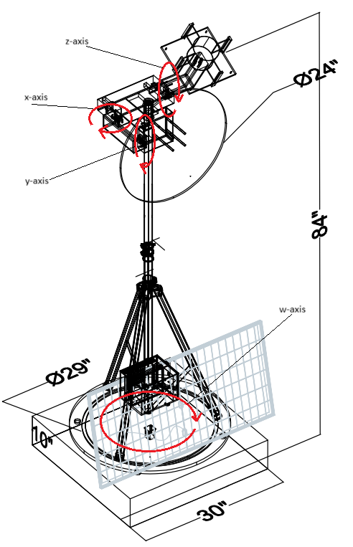
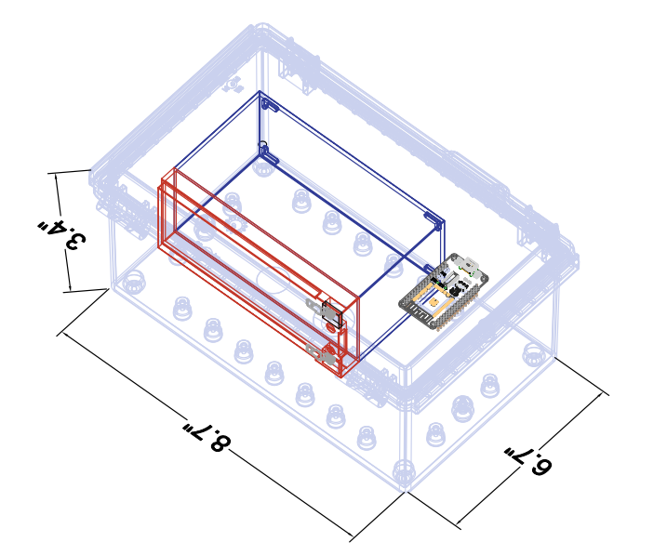
Hardware Design
Design two separate towers, each with their own design constraints
Majority of focus is on heliostat tower, as it is more complex
Schematics and PCB designs
Heliostat structure
Tripod on a "Lazy Susan"
Communication Beacon
Antenna on an enclosure

Slide 25
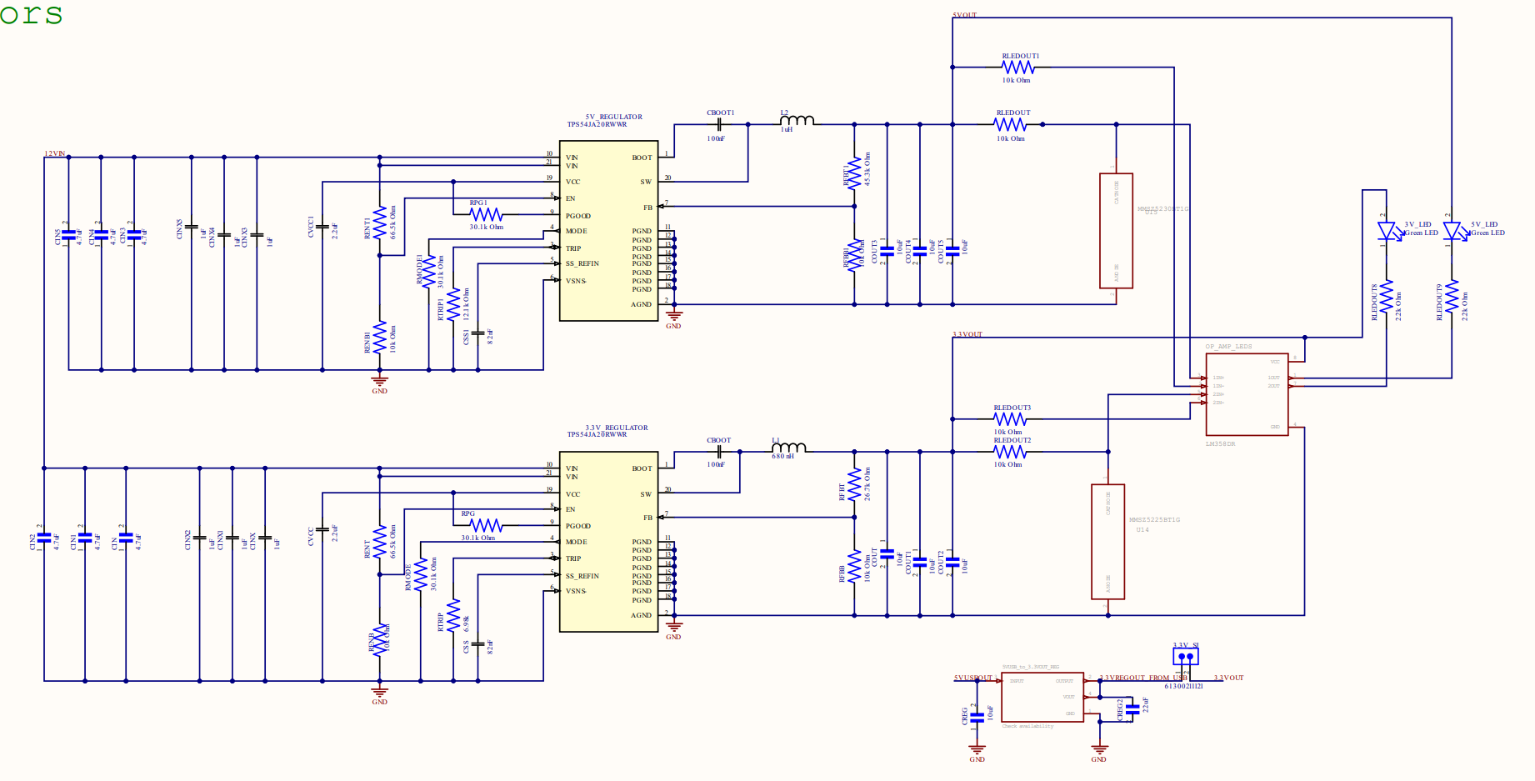
Power Delivery/ Electrical Power System

Slide 26
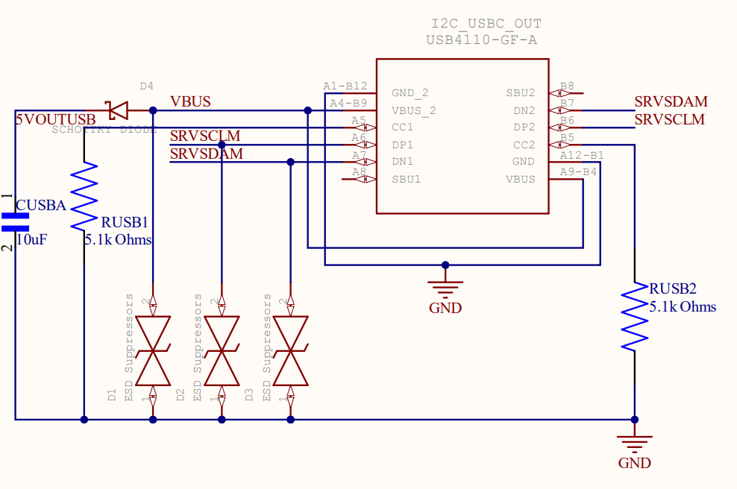
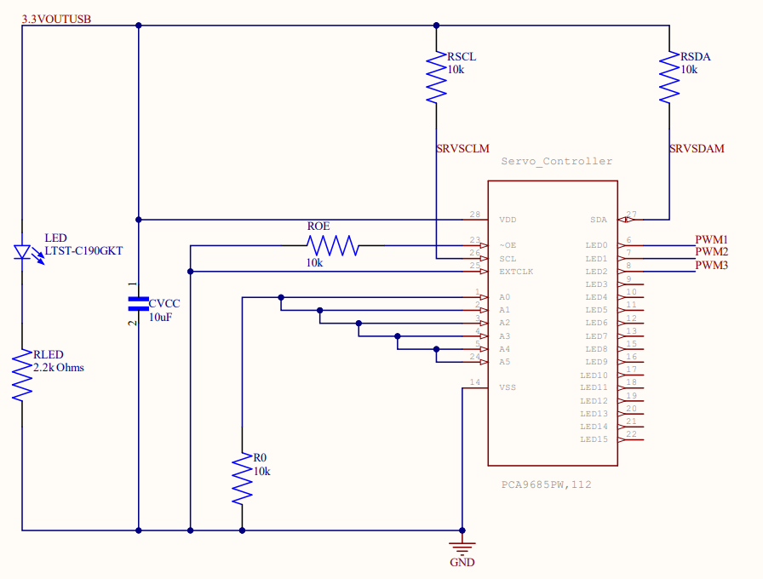
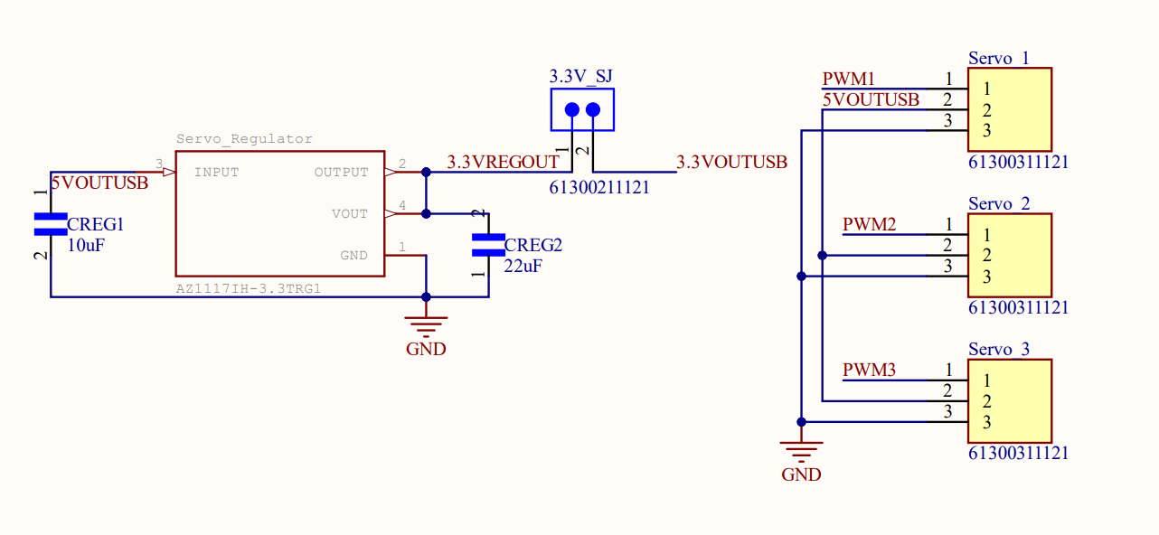
Servo Motor Controls

Slide 27
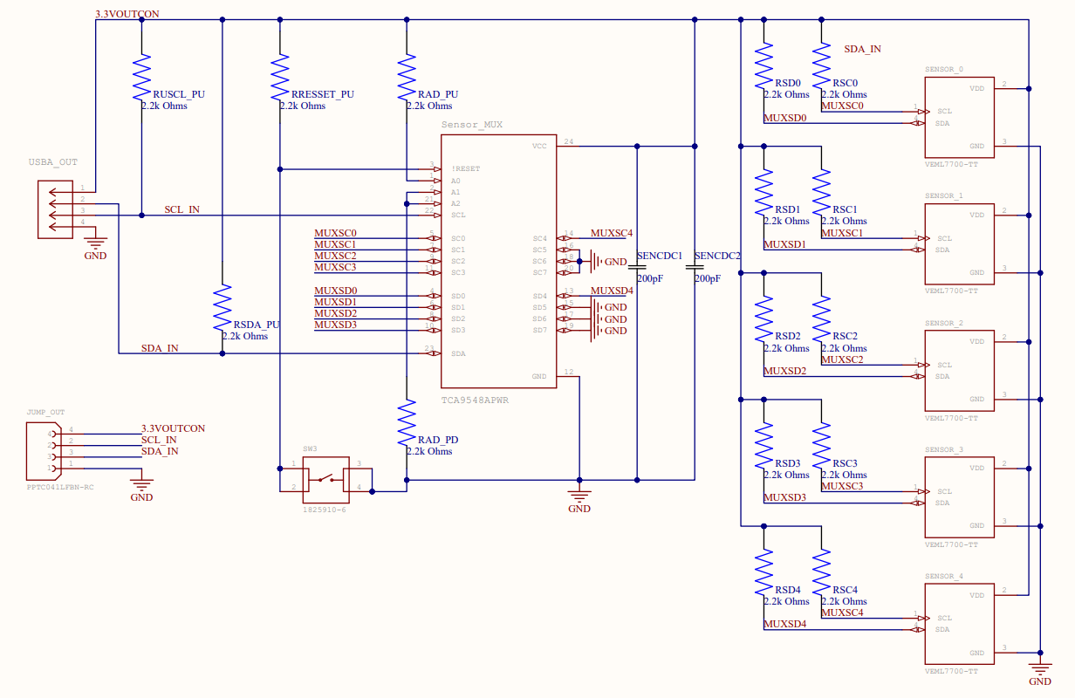
Sensor Control

Slide 28
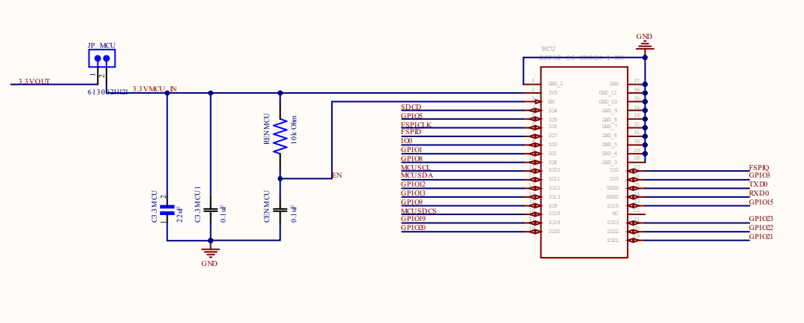
MCU System

Slide 29
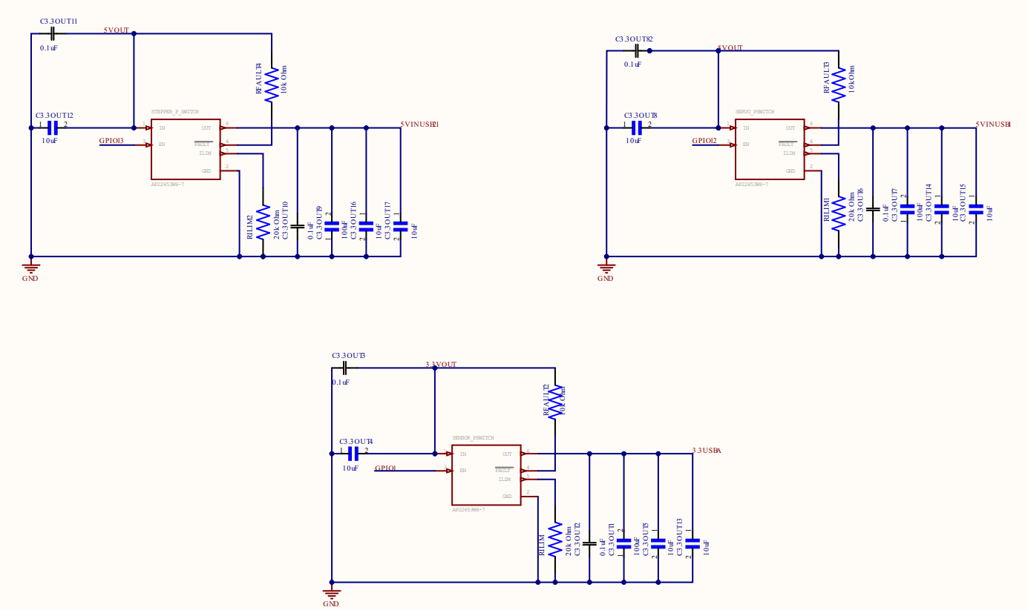
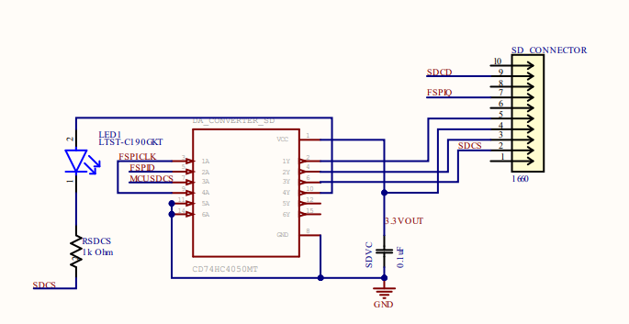
Lower-Level Subsystem

Slide 30
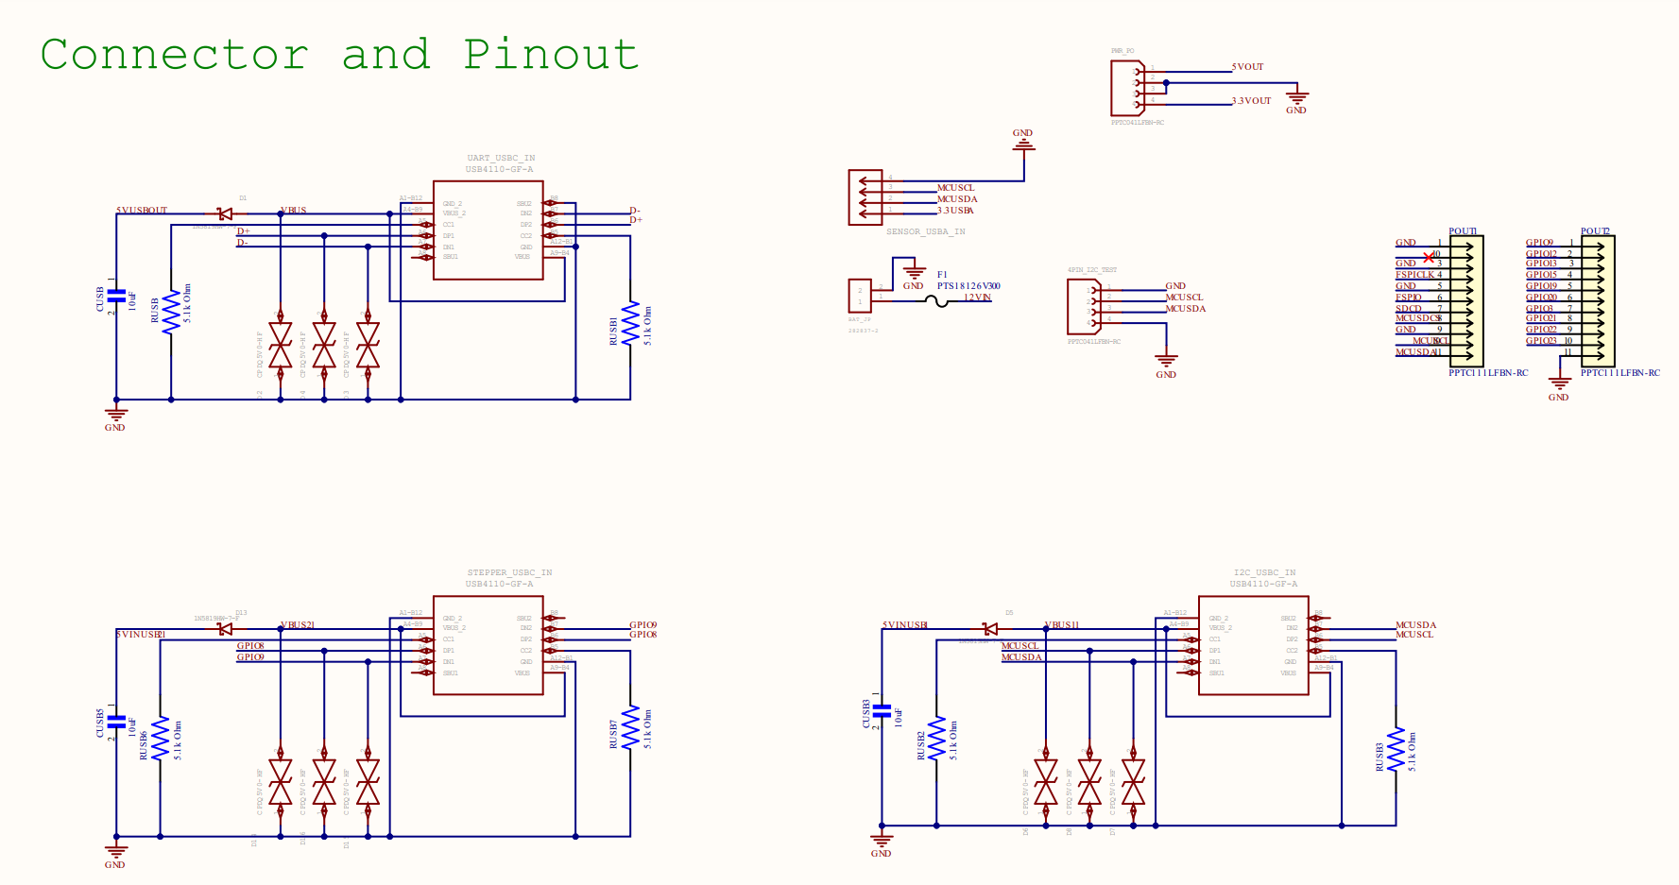
Lower-Level Subsystem

Slide 31
Power Control Algorithm
Goal was to reduce power consumption when the sun would not be visible
Reducing usage of non-essential components during these times would preserve battery charge
Component | Essential/Non-Essential | Low-Power Considerations
MCU | Essential | Low-Power Mode, only essential functions
Antenna | Essential | Receive only
Sensors | Essential | Sensors will be turned on periodically
Stepper Motor | Non-Essential
Servo Motors | Non-Essential

Slide 32
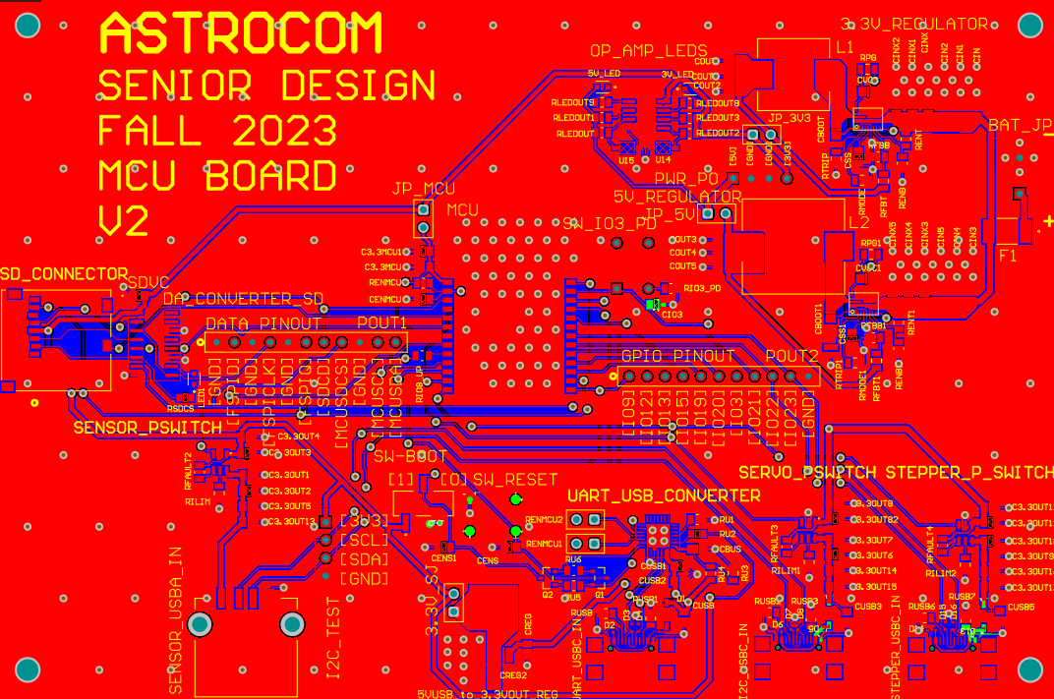
MCU PCB

Slide 33
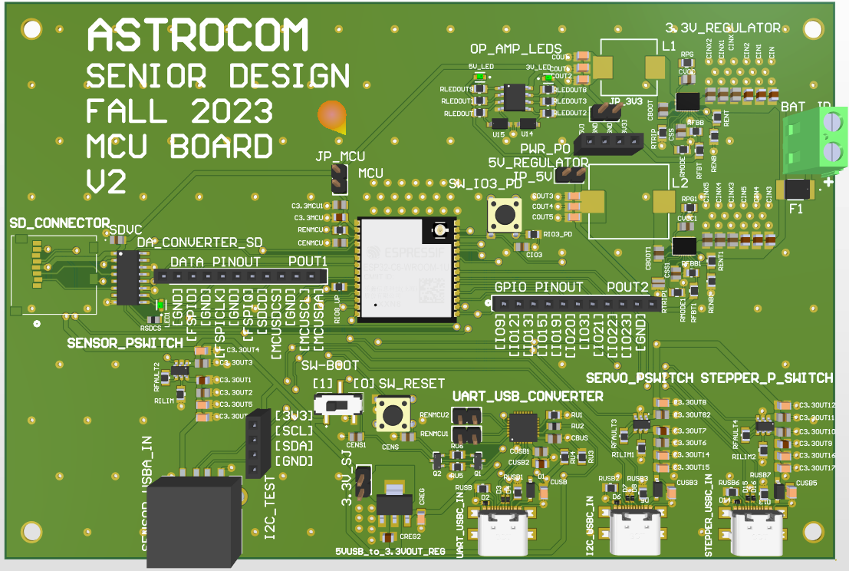
MCU PCB

Slide 34
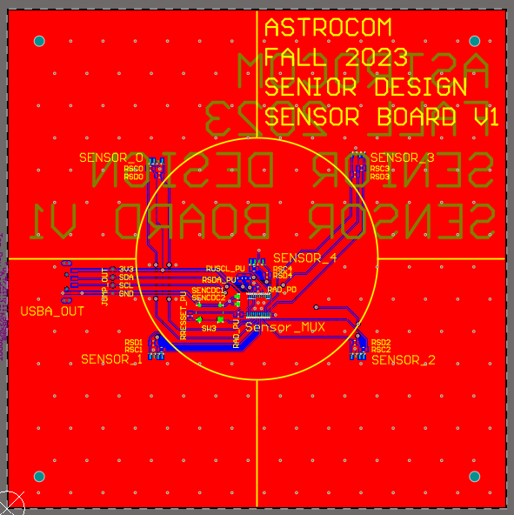
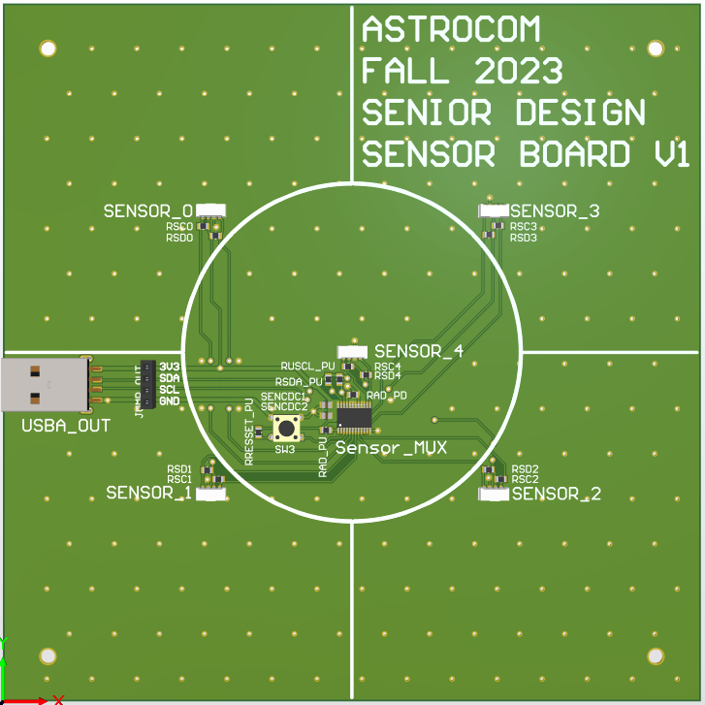
Sensors PCB

Slide 35
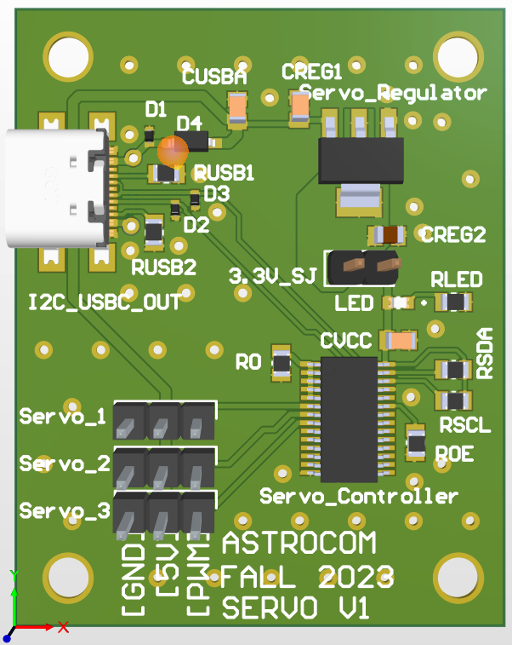
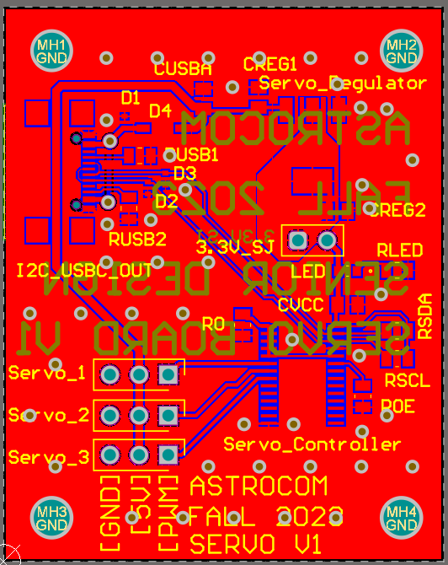
SErVo Motor controller PCB

Slide 36
Software Design
Details on software design for the overall system which includes:
Communications through the mesh network
Collecting sensor information
Positioning reflector to deliver sunlight to target
Represented with software diagrams

Slide 37
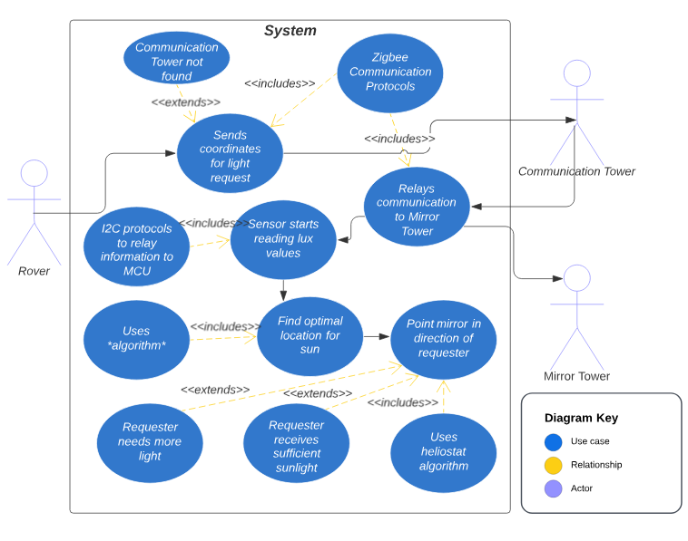
Case Diagram

Slide 38
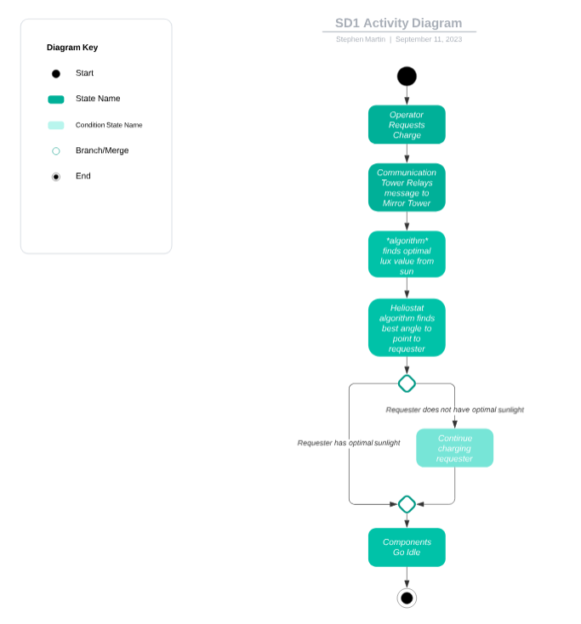
Activity Diagram

Slide 39
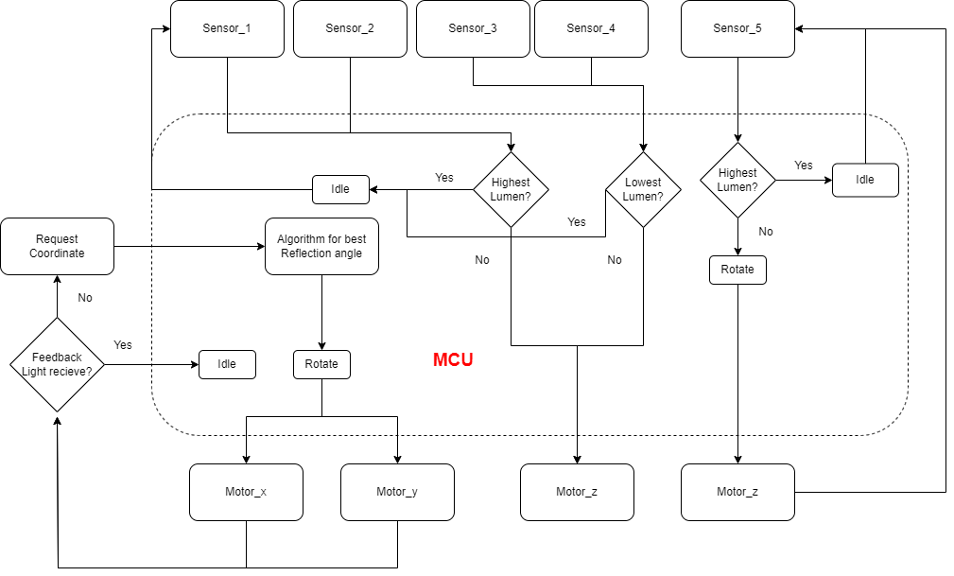
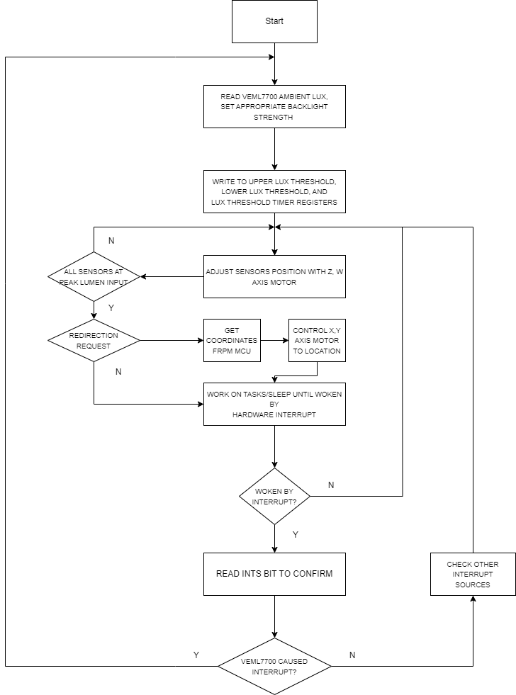
Motor positioning of Reflector based on light intensity algorithm.

Slide 40
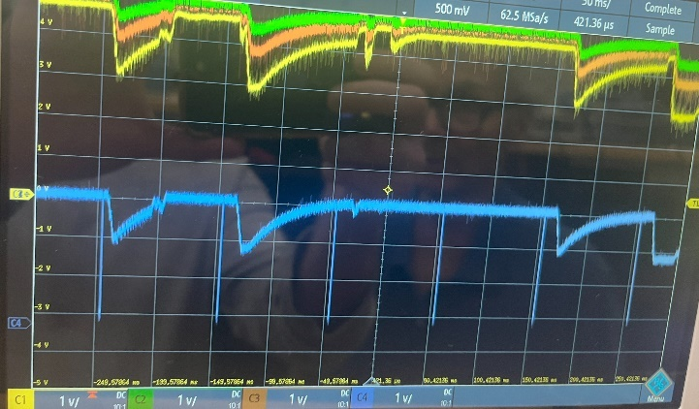
Hardware testing
Tested components and had great success.
Did have a few issues during implementation including:
Strapping pins and UART TX/RX mix-ups
Higher than expected channel capacitance causing low rise time for I²C
Voltage drop from servos, resetting the servo controller
These issues were resolved with a mix of software and hardware changes.

Slide 41
Software testing
Transforming individual parts code to integrated code
Included interrupts to handle events
Sensors in certain locations are averaged and divided by each other to dynamically track movements
Scaling operations were needed to transform step sizes from different servos
Zigbee operations included to switch targets
Created our own coordinator for testing but will use rover from G16 in live demo
This coordinator will relay information from communication box (Zigbee end device) to the reflector tower (Zigbee end device)

Slide 42
Administrative Contents
Electrical Engineering | Responsibilities
Alexandre Fiset | PSU Design and Implementation
 | PCB Design
 | MPPT Tracking Implementation
 | Administrative Documentation
Computer Engineering | Responsibilities
Binh Pham | Reflector Technology and Design
 | Motor and Motor Controls
 | Vectoring Technology
 | Project Lead
 | Positioning and Vectoring Algorithm
Computer Engineering | Responsibilities
Pedro Kasprzykowski | MCU Selection and Implementation
 | Software Design and Implementation
 | Antenna and Communications
 | Website Design and Management
Computer Engineering | Responsibilities
Stephen Martin | Sensor Selection and Implementation
 | MCU Selection and Implementation
 | Positioning and Vectoring Algorithm
 | Software Design and Implementation

Slide 43
Mechanical's Budgets
Component | Name | Price/unit | Quantity
Mirror | 0.032" x 24" x 24", 3003-H14 Aluminum Sheet | $28.86 | 1
Mirror Coating | Mylar Sheet | $25.99 | 1
Frame | ADJ LTS-6 T-Bar Tripod Lightweight Lighting Stand | $54.99 | 1
Base Panels | Plywood Panels 4ftx8ft | $25.60 | 2
Communication Tower Box | Junction Box | $26.89 | 1
Wheel Hub Bearing | Rear Wheel Hub | $44.90 | 1

Slide 44
Electrical’s Budget
Component | Name | Price | Quantity
Battery | Howell Energy hw-4f7 | 32.99 | 1
Motor w | Nema 23 | $30.73 | 1
Motor x-y-z | 9.5-11kg*cm Servo Motor | $17.59 | 3
Charge Controller/BMS | Smaraad SR11004 | $39.99 | 1
Solar Panel | RNG-50D-SS | $49.99 | 1
Microcontroller | ESP32-C6-DEVKITC-1-N8 | $9.00 | 1
External Antenna | Wlaniot 2.4G | $17.98 | 2
MicroSD card | 5251 | $4.50 | 2
MicroSD card breakout board+ | 254 | $7.50 | 1

Slide 45
PCB’s Budget
Component | Name | Price | Quantity
Microcontroller for PCB | ESP32-C6-WROOM-1U | $3.48 | 1
Stepper Motor Controller | DRV8833PW | $2.84 | 1
Servos Motor Controller | PCA9685PW,112 | $2.64 | 1
3.3V Regulator | TPS54JA20 | $1.50 | 1
5V Regulator | TPS54JA20 | $1.50 | 1
USB-A Connector | 2057-USB-AP-S-RA-SMT-ND | $0.55 | 3
Sensor-MUX | TCA9548APWR | $1.78 | 1
Sensor | VEML7700 | $1.88 | 5
USB-to-UART Bridge Controller | CP2102N-A02-GQFN28 | $4.07 | 1
MicroSD Socket | 1660 | $1.95 | 1
Misc. | Resistors, Capacitors, Inductr, Jumpers, Etc.…. | ~$20.00

