Slide 1




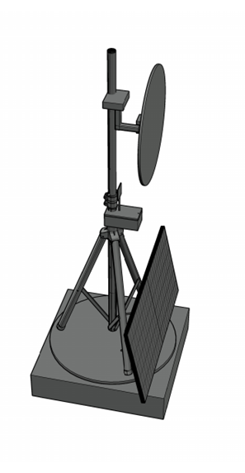
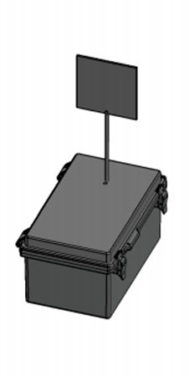
A.S.T.R.O.COM. Advanced Solar Tracking and Rover Observation Communication
Group 14’s
Members:
Alex Fiset | Pedro Kasprzykowski | Stephen Martin | Binh Pham
Electrical Engineering | Computer Engineering | Computer Engineering | Computer Engineering

Slide 2
Motivation and Background

Slide 3
Goals & Objectives

Slide 4
Specifications Table
Heliostat Tower
Minimum Temperature | -40°C
Reflector
Minimum size | 1ft diameter
Maximum size | 5ft diameter
Maximum Weight | 9kgs
Minimum Reflectivity | 90%
Response Time | 3 minutes
Tower Frame
Maximum total weight | 27kgs
Minimum Weight Capacity | 10kgs
Solar Panel
Minimum Power | 30W during sunlight hours
Maximum Voltage | 24V
Battery
Minimum Lifespan | 2 weeks without sun
Communication Tower
Minimum Enclosure Volume | 6.5"x6.5"x5"
Maximum Weight | 2kg
Minimum Network Range | 20m
Communication Rate | 2400MHz
Voltage input | 3.3V or 5V
Maximum Current Draw | 500mA
Minimum Temperature | -40°C
Latency | 1 second
Maximum Power | 5W

Slide 5
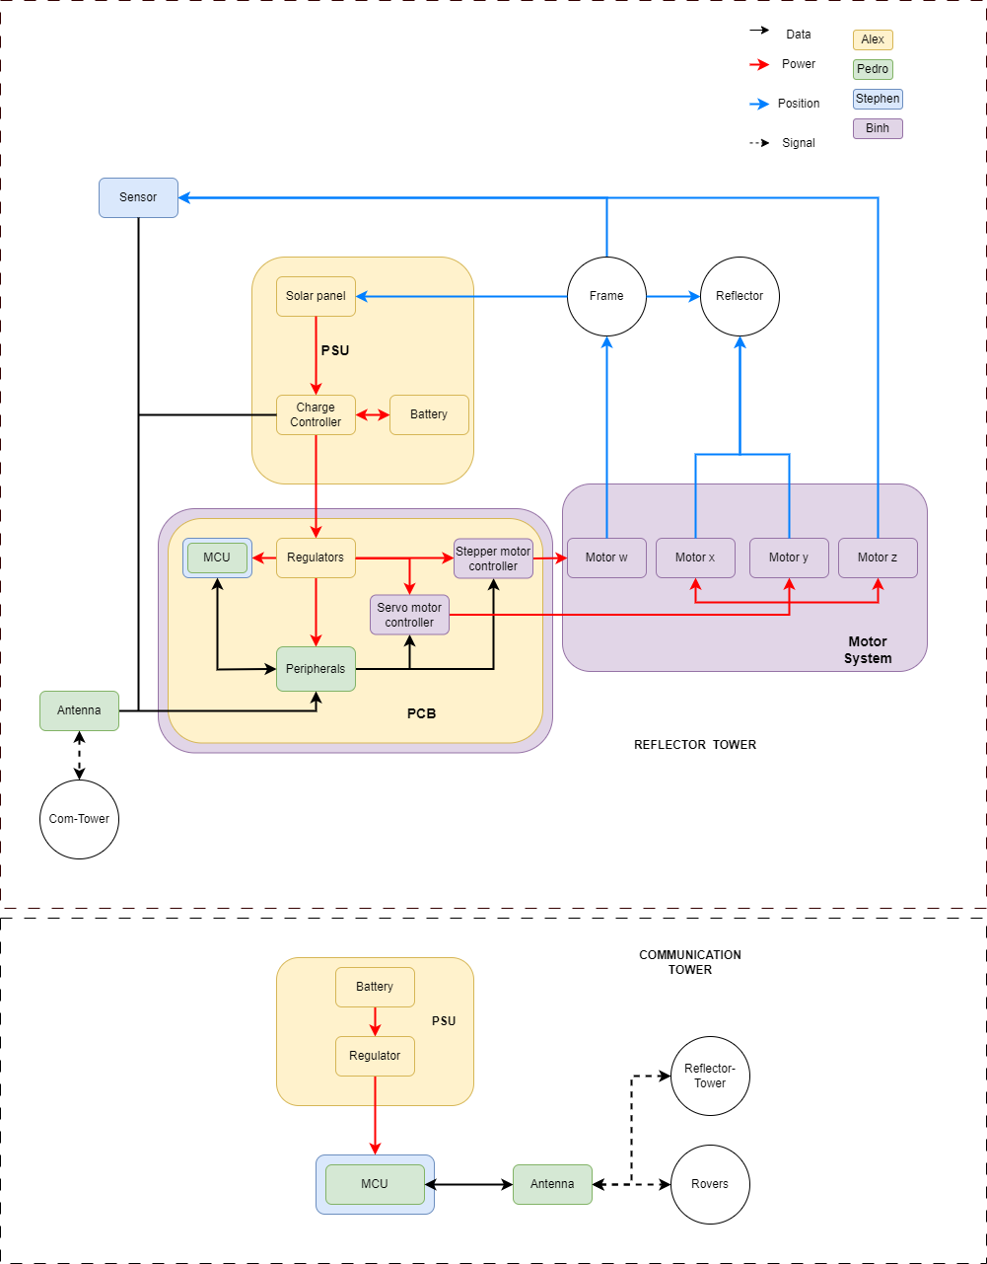
Hardware BlockDiagram

Slide 6
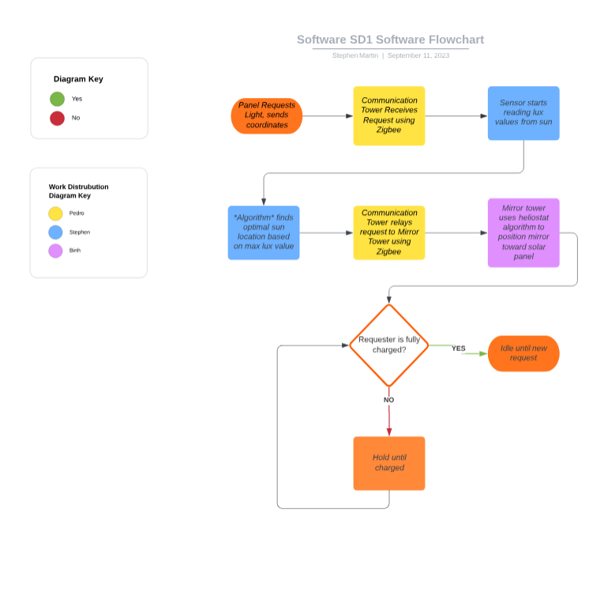
Software BlockDiagram

Slide 7
Comparison and Selection of Hardware

Slide 9
Comparison and Selection of Software

Slide 10
Hardware Design

Slide 12
Software Design

Slide 13
PCB Design

Slide 14
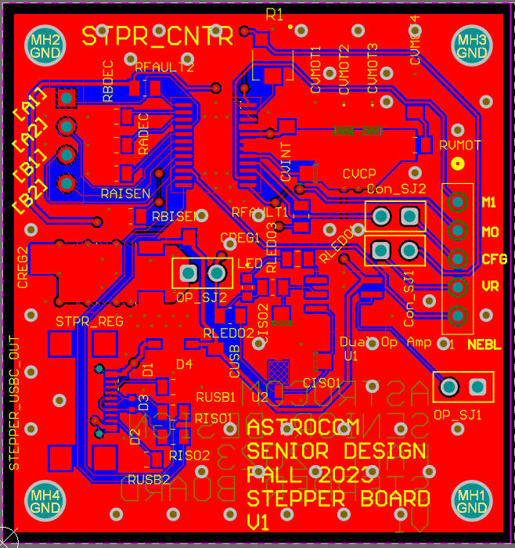
Stepper Motor Controller PCB

Slide 15
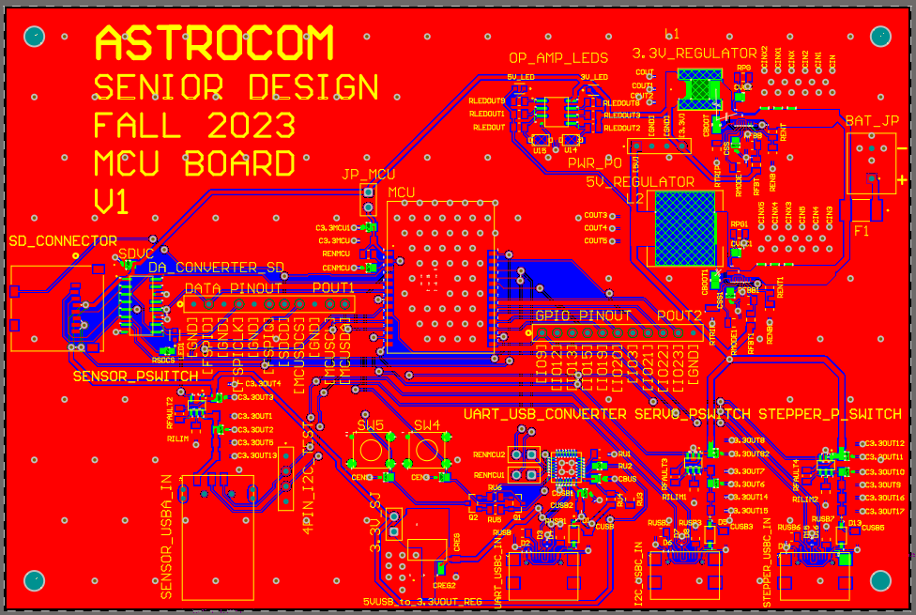
MCU PCB

Slide 16
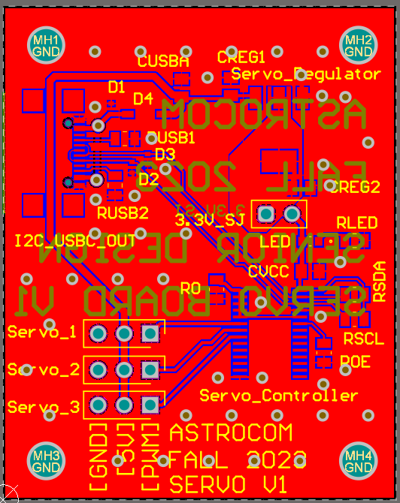
SErVo Motor controller PCB

Slide 17
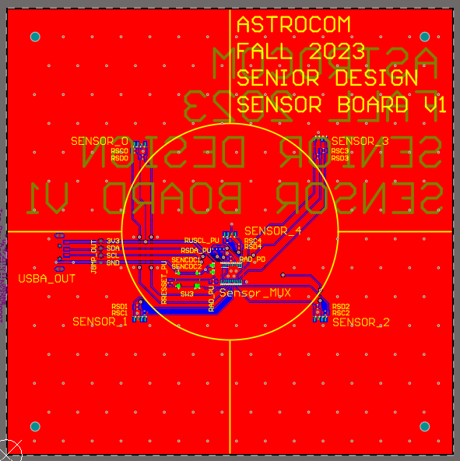
Sensors PCB

Slide 18
Administrative Contents

Slide 19
Overall Budget and Financing
Sub-System | Budget
PSU and Solar | $ 150.00
Frame/Reflector | $ 200.00
PCBs and Electrical | $ 100.00
Total | $ 450.00

Slide 20
Mechanical's Budgets
Component | Name | Price/unit | Quantity
Mirror | 0.032" x 24" x 24", 3003-H14 Aluminum Sheet | $28.86 | 1
Mirror Coating | Mylar Sheet | $25.99 | 1
Frame | ADJ LTS-6 T-Bar Tripod Lightweight Lighting Stand | $54.99 | 1
Base Panels | Plywood Panels 4ftx8ft | $25.60 | 2
Communication Tower Box | Junction Box | $26.89 | 1
Wheel Hub Bearing | Rear Wheel Hub | $44.90 | 1

Slide 21
Electrical’s Budget
Component | Name | Price | Quantity
Battery | Howell Energy hw-4f7 | 32.99 | 1
Motor w | Nema 23 | $30.73 | 1
Motor x-y-z | 9.5-11kg*cm Servo Motor | $17.59 | 3
Charge Controller/BMS | Smaraad SR11004 | $39.99 | 1
Solar Panel | RNG-50D-SS | $49.99 | 1
Microcontroller | ESP32-C6-DEVKITC-1-N8 | $9.00 | 1
External Antenna | Wlaniot 2.4G | $17.98 | 2
MicroSD card | 5251 | $4.50 | 2
MicroSD card breakout board+ | 254 | $7.50 | 1

Slide 22
PCB’s Budget
Component | Name | Price | Quantity
Microcontroller for PCB | ESP32-C6-WROOM-1U | $3.48 | 1
Stepper Motor Controller | DRV8833PW | $2.84 | 1
Servos Motor Controller | PCA9685PW,112 | $2.64 | 1
3.3V Regulator | TPS54JA20 | $1.50 | 1
5V Regulator | TPS54JA20 | $1.50 | 1
USB-A Connector | 2057-USB-AP-S-RA-SMT-ND | $0.55 | 3
Sensor-MUX | TCA9548APWR | $1.78 | 1
Sensor | VEML7700 | $1.88 | 5
USB-to-UART Bridge Controller | CP2102N-A02-GQFN28 | $4.07 | 1
MicroSD Socket | 1660 | $1.95 | 1
Misc. | Resistors, Capacitors, Inductr, Jumpers, Etc.…. | ~$20.00

