Slide 1
Scientific machine learning
Lecture notes in Chinese:
http://faculty.bicmr.pku.edu.cn/~huangdz/teaching.html

Slide 2

Scientific Computing
Applications: engineering design optimization, real-time control, uncertainty quantification, and so on
Partial differential equation (PDE) based model
Input: design shape, control parameters, etc.
Output : PDE solution, quantity of interests (QoIs), etc.
Challenges: high computational cost and many query problems

Slide 3
Surrogate Models
Applications: engineering design optimization, real-time control, uncertainty quantification, and so on
Data-driven model
Input: design shape, control parameters, etc.
Output : PDE solution, quantity of interests (QoIs), etc.
Challenges: high computational cost and many query problems

Slide 4

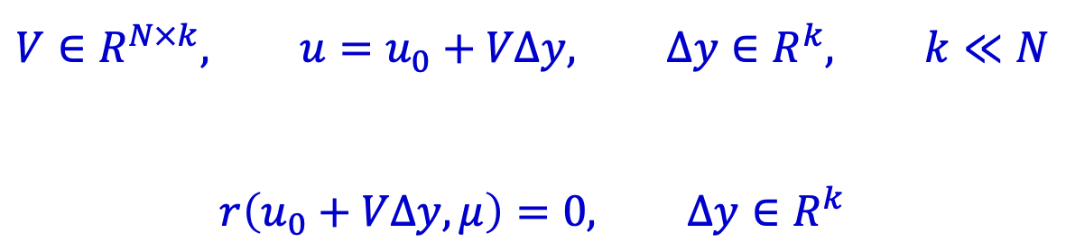
Surrogate Models
Projection-based reduced order model
PDE-based model (high dimensional model)
A low-dimensional model is constructed using target system knowledge to capture its main behavior
$$r\left(u,μ\right)=0, u∈R^{N}$$
$$V∈R^{N×k}, u=u_{0}+VΔy, Δy∈R^{k}, k≪N$$
$$r\left(u_{0}+VΔy,μ\right)=0, Δy∈R^{k}$$
basis matrix
Notes:
高维模型 N , 基于数据模型 k, 数据量n

Slide 5
Surrogate Models
Literatures
Linear reduced-order model: Antoulas, Athanasios C. " Approximation of large-scale dynamical systems." Society for Industrial and Applied Mathematics, 2005.
Nonlinear reduced-order model: Chaturantabut, Saifon, and Danny C. Sorensen. "Nonlinear model reduction via discrete empirical interpolation." SIAM Journal on Scientific Computing 32, no. 5 (2010): 2737-2764.
Nonlinear reduced-order model: Carlberg, Kevin, Charbel Bou‐Mosleh, and Charbel Farhat. "Efficient nonlinear model reduction via a least‐squares Petrov–Galerkin projection and compressive tensor approximations." International Journal for numerical methods in engineering 86, no. 2 (2011): 155-181.
Koopman operator: Mauroy, Alexandre, Yoshihiko Susuki, and Igor Mezić. "Introduction to the Koopman operator in dynamical systems and control theory." The koopman operator in systems and control (2020): 3-33.
Dynamic mode decomposition: Schmid, Peter J. "Dynamic mode decomposition of numerical and experimental data." Journal of fluid mechanics 656 (2010): 5-28.

Slide 6
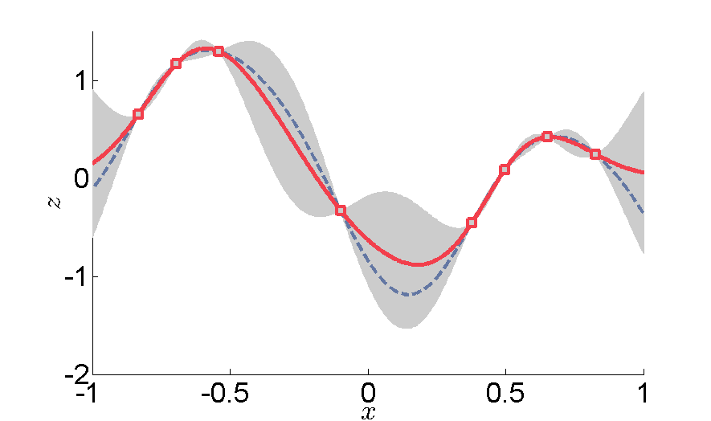
Surrogate Models
Gaussian Process Regression
Probabilistic Interpolation based on Gaussian processes with various kernels
Prediction and uncertainty quantification

Slide 7
Surrogate Models
Literatures
Textbook: C. E. Rasmussen & C. K. I. Williams, Gaussian Processes for Machine Learning, Chapter 5.
Textbook: Wendland, Holger. Scattered data approximation. Vol. 17. Cambridge university press, 2004.
Random feature method: Rahimi, Ali, and Benjamin Recht. "Random features for large-scale kernel machines." Advances in neural information processing systems 20 (2007).
Learning PDE solution map: Nelsen, Nicholas H., and Andrew M. Stuart. "The random feature model for input-output maps between banach spaces." SIAM Journal on Scientific Computing 43, no. 5 (2021): A3212-A3243.
Solving PDE: Zhang, Xiong, Kang Zhu Song, Ming Wan Lu, and X. Liu. "Meshless methods based on collocation with radial basis functions." Computational mechanics 26 (2000): 333-343.
Learning PDE solution map: Batlle, Pau, Matthieu Darcy, Bamdad Hosseini, and Houman Owhadi. "Kernel methods are competitive for operator learning." Journal of Computational Physics 496 (2024): 112549.

Slide 8
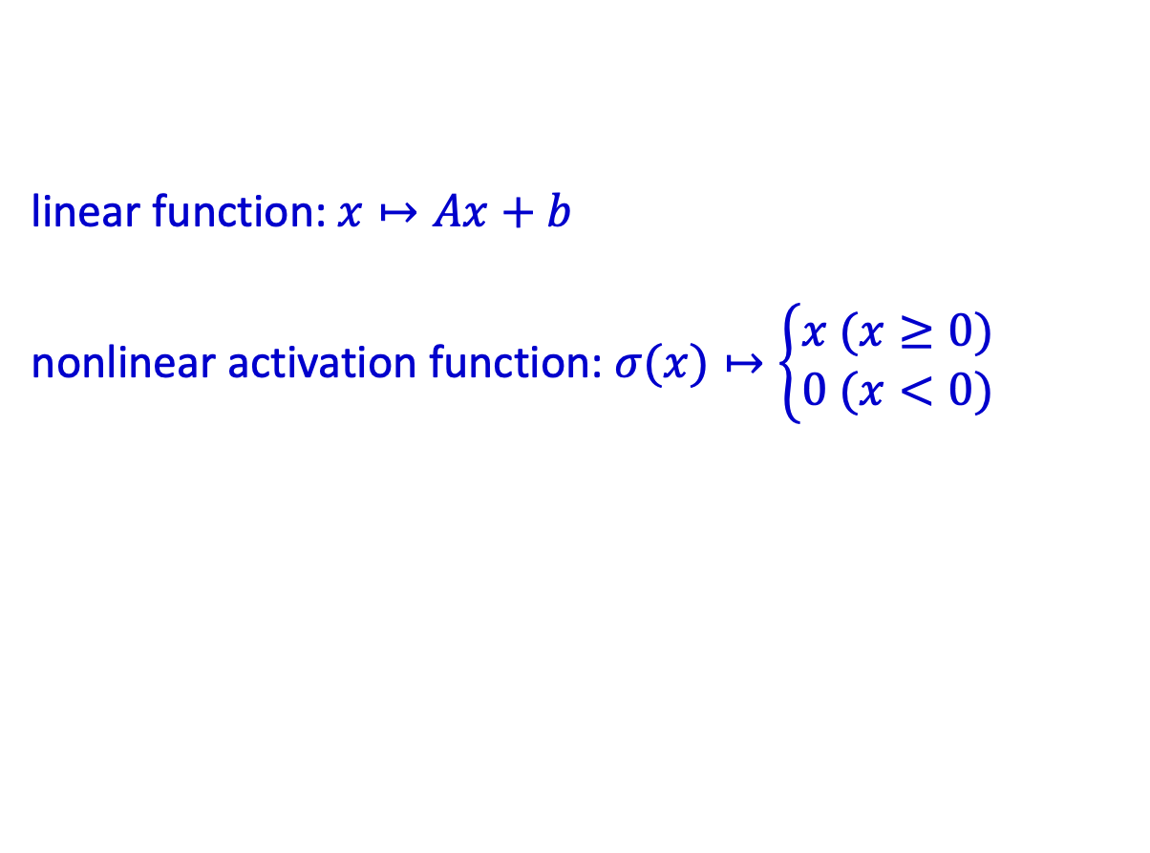
Surrogate Models
Neural Network/Operator
Effectively exploit high-dimensional and intricate relationships
Powerful software support and GPU acceleration
linear function: $x↦Ax+b$
nonlinear activation function: $σ(x)↦\left\{\begin{aligned}x (x≥0) \\ 0 (x<0)\end{aligned}\right.$

Slide 9
Surrogate Models
Literatures
CNN: Zhu, Yinhao, and Nicholas Zabaras. "Bayesian deep convolutional encoder–decoder networks for surrogate modeling and uncertainty quantification." Journal of Computational Physics 366 (2018): 415-447.
PCA-Net: Hesthaven, Jan S., and Stefano Ubbiali. "Non-intrusive reduced order modeling of nonlinear problems using neural networks." Journal of Computational Physics 363 (2018): 55-78.
FNO: Li, Zongyi, Nikola Kovachki, Kamyar Azizzadenesheli, Burigede Liu, Kaushik Bhattacharya, Andrew Stuart, and Anima Anandkumar. "Fourier neural operator for parametric partial differential equations." arXiv preprint arXiv:2010.08895 (2020).
DeepONet: Lu, Lu, Pengzhan Jin, Guofei Pang, Zhongqiang Zhang, and George Em Karniadakis. "Learning nonlinear operators via DeepONet based on the universal approximation theorem of operators." Nature machine intelligence 3, no. 3 (2021): 218-229.

