Slide 1
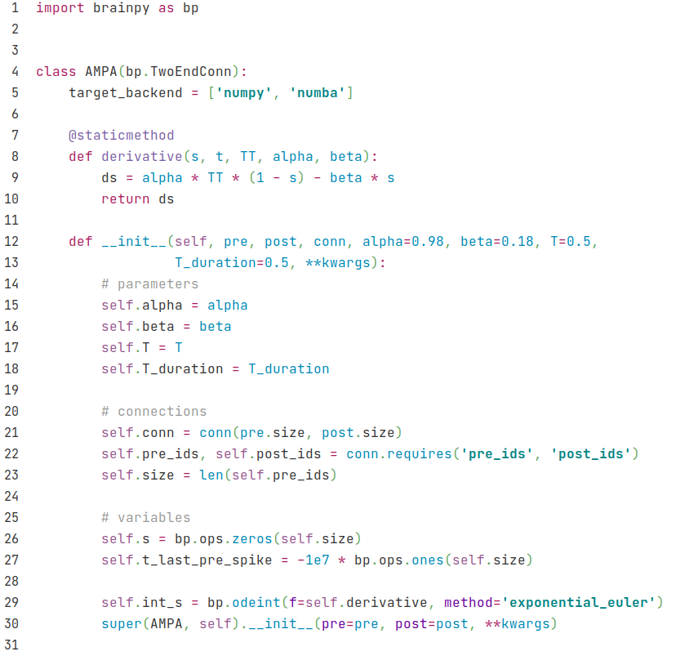
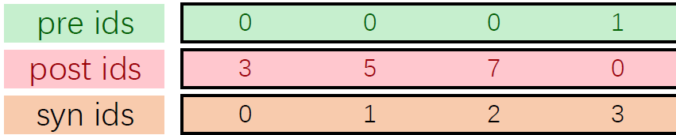
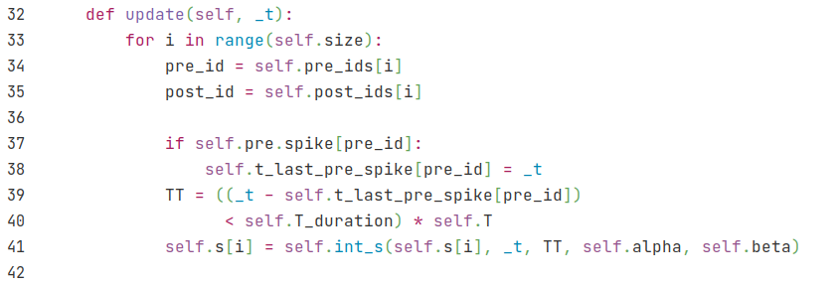
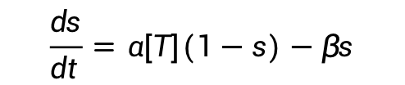
AMPA
bp.TwoEndConn class: Connections between two neuron groups
$$\frac{ds}{dt}=α[T](1−s)−βs$$
Regard [T] as a constant T, last for T_duration
Specify how the presynaptic and postsynaptic neuron groups connect to each other
For each single synapse
TT denotes [T], TT=T if pre neuron spikes within T_duration, otherwise TT=0.

Slide 2
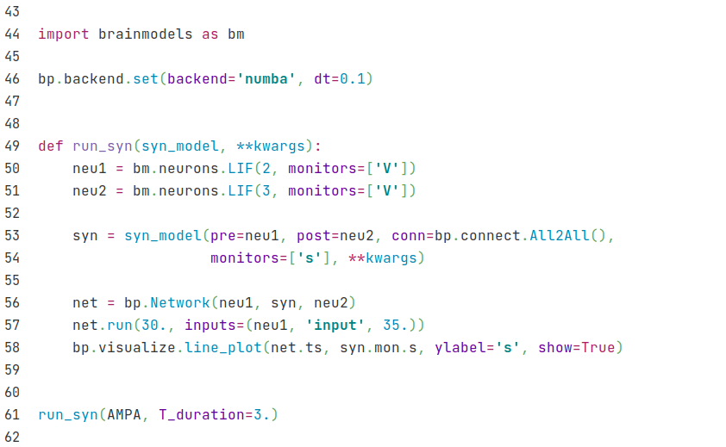
AMPA
Set numba backend
A method to run synapse
Get two LIF neuron groups from brainmodels package
Specify pre and post neurons and there connections. Here we use all to all connections provided by BrainPy.
Run AMPA synapse and set parameter T_duration to be 3.

Slide 3
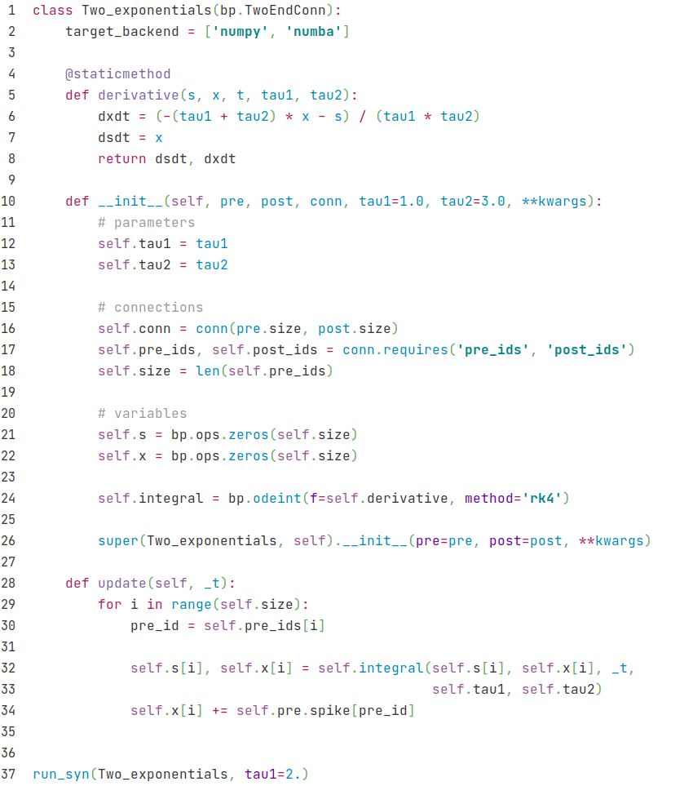
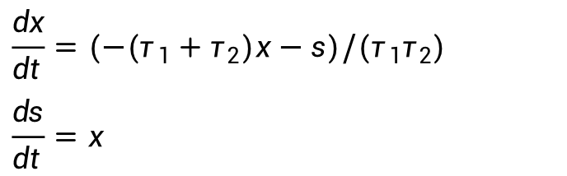
Two exponentials
$$\frac{dx}{dt}=(−(τ_{1}+τ_{2})x−s)/(τ_{1}τ_{2})$$
$$\frac{ds}{dt}=x$$
if (pre spike), then x = x + 1

Slide 4
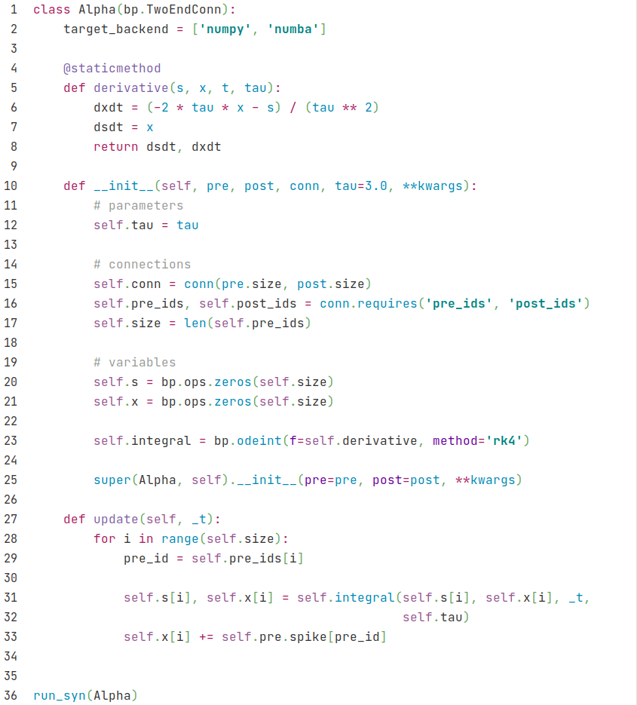
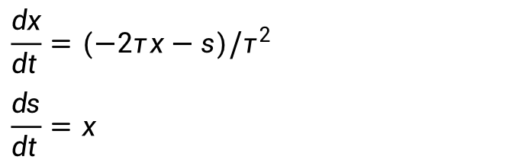
Alpha
$$\frac{dx}{dt}=(−2τx−s)/τ^{2}$$
$$\frac{ds}{dt}=x$$
if (pre spike), then x = x + 1

Slide 5
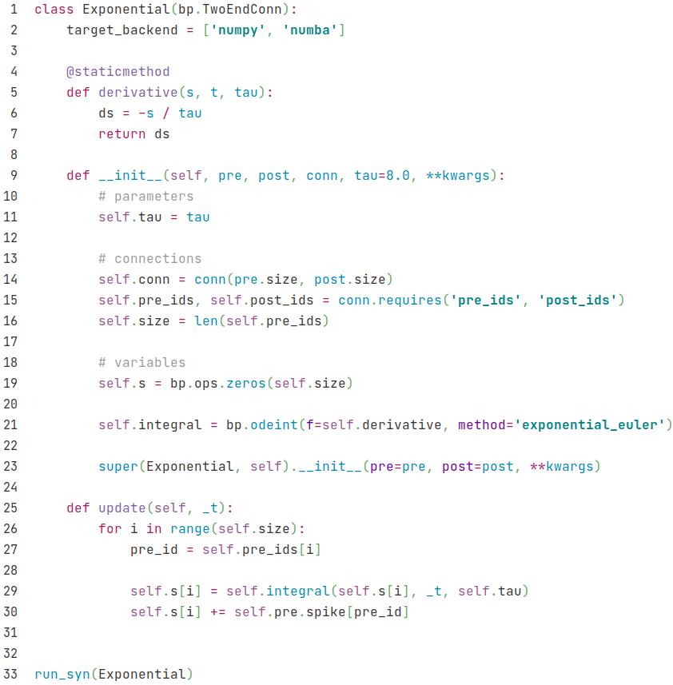
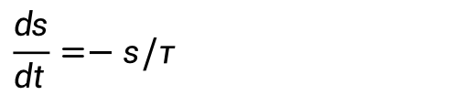
Exponentials
$$\frac{ds}{dt}=−s/τ$$
if (pre spike), then s = s + 1

Slide 6
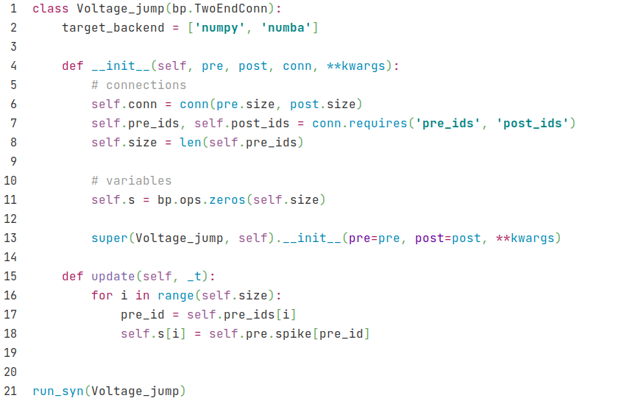
Voltage jump
if (pre spike), then s = s + 1

