Slide 1
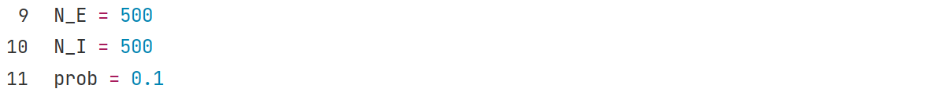
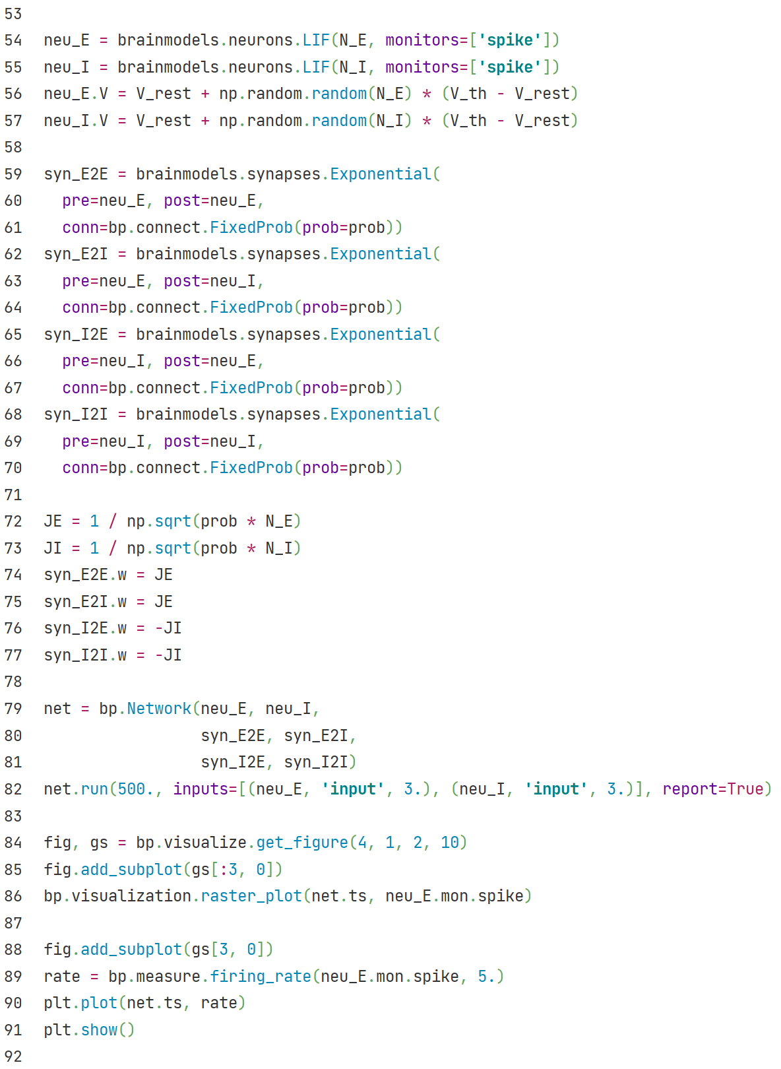
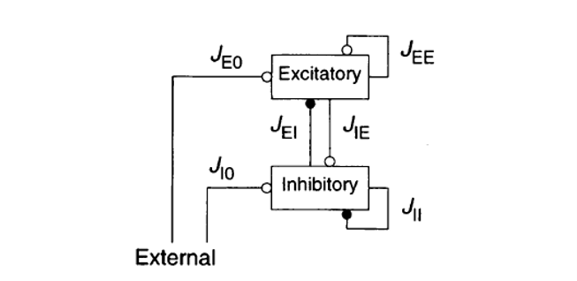
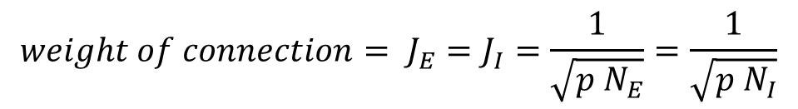
E-I balanced net
Import LIF neuron model from brainmodels.
Build excitatory neuron group and inhibitory
neuron group.
Import exponential synapse model from brainmodels.
Build E2E, E2I, I2E, I2I synapse connections between
neuron groups.
$$weight of connection= J_{E}=J_{I}=\frac{1}{\sqrt{p N_{E}}}=\frac{1}{\sqrt{p N_{I}}}$$
Simulate the network for 500ms,
give all neurons constant external
inputs with amplitude 3.
Paint the raster plot and firing_rate-t plot of excitatory neurons in E/I balanced network.

Slide 2
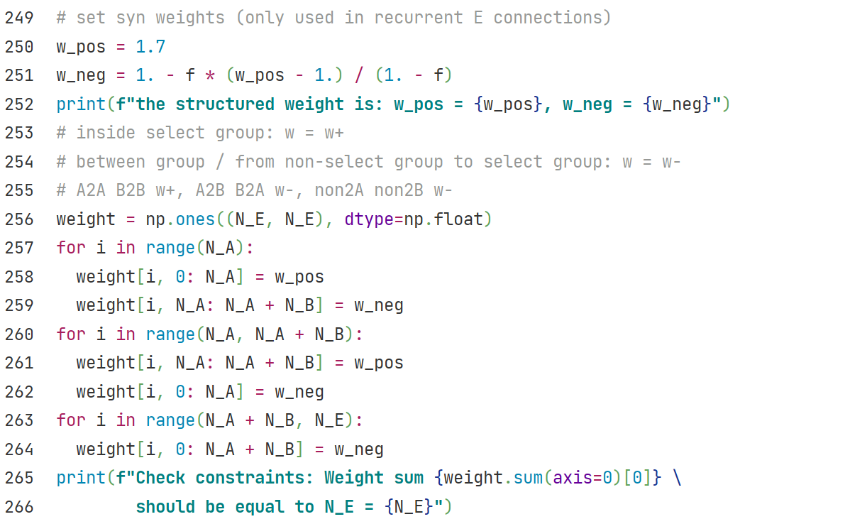
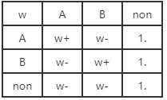


$$w+ = 1.7$$
$$w− = 1−f(x+−1)/1−f$$
Define structured weights for E2E conns.
Strong connection inside selective group,
weak connection for other synapses.

Slide 3
