Slide 1
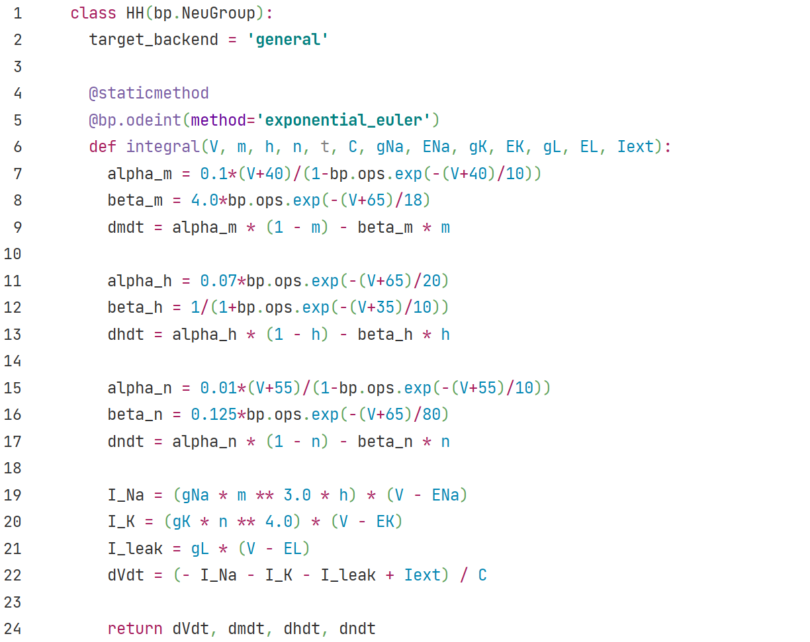

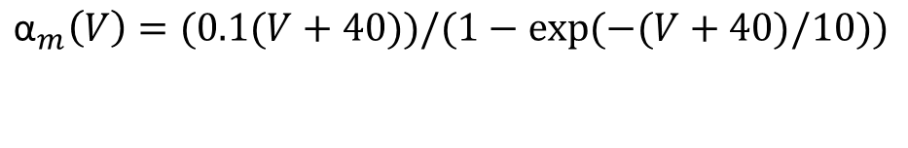
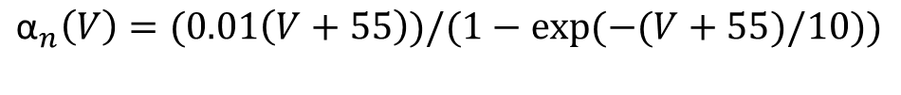
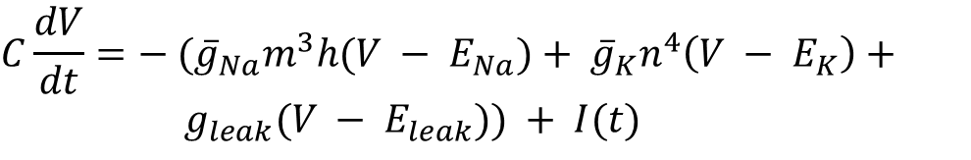





HH
bp.NeuGroup class:
Group of neurons
Set backend for model.
Call `bp.odeint` to integrate ODEs.
Set parameter `method` to choose
numerical integration methods.
$${\text{α}}_{m}\left(V\right)=(0.1(V+40))/(1−exp⁡(−(V+40)/10))$$
$$β_{m}\left(V\right)=4.0exp⁡(−(V+65)/18)$$
$$dx/dt=α\left(1−x\right)− βx, x=m$$
$${\text{α}}_{h}\left(V\right)=0.07 exp⁡(−(V+65)/20)$$
$$β_{h}\left(V\right)=1/(1+exp⁡(−(V+35)/10))$$
$$dx/dt=α\left(1−x\right)− βx, x=h$$
$${\text{α}}_{n}\left(V\right)=(0.01\left(V+55\right))/(1−exp⁡(−(V+55)/10))$$
$$β_{n}\left(V\right)=0.125exp⁡(−(V+65)/80)$$
$$dx/dt=α\left(1−x\right)− βx, x=n$$
$$C\frac{dV}{dt}=− ({\overline{g}}_{Na}m^{3}h(V − E_{Na})+ {\overline{g}}_{K}n^{4}\left(V − E_{K}\right)+$$
${ g}_{leak}(V − E_{leak})) + I(t)$

Slide 2
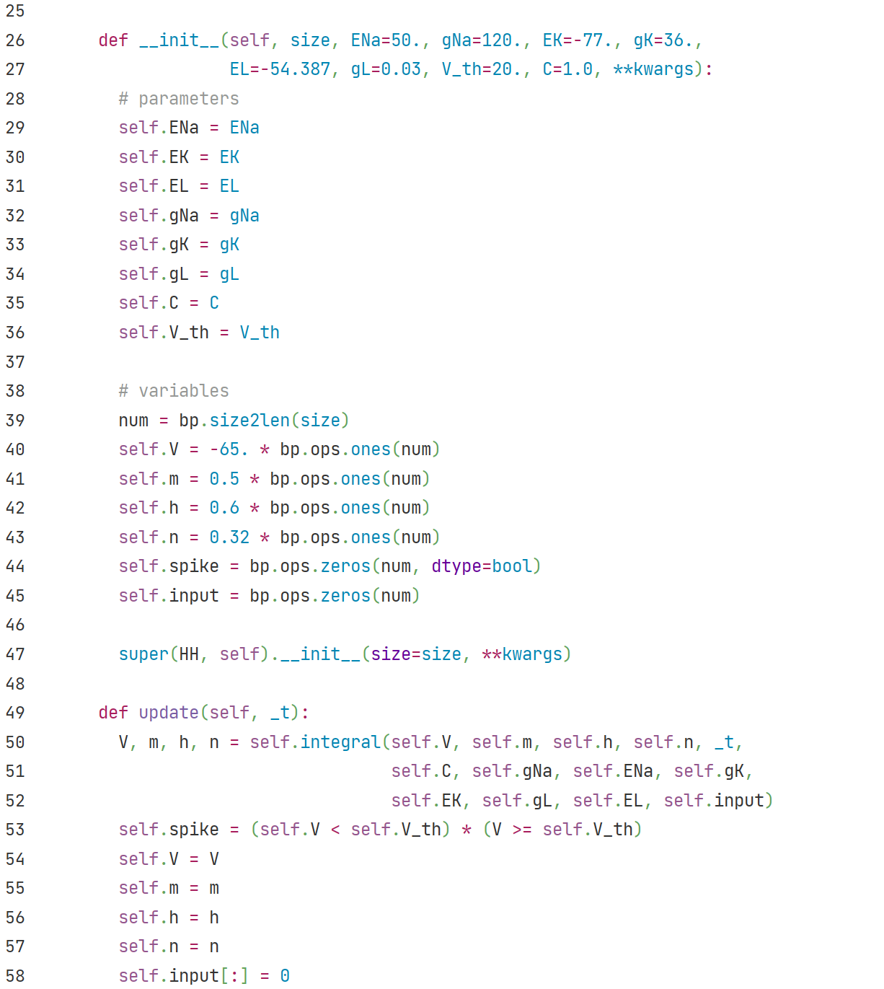
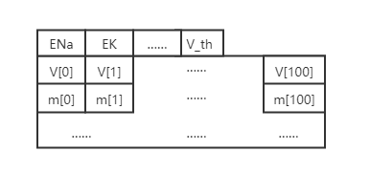
HH
Model parameters saved as
floating point numbers.
Model variables saved as vectors of
floating point numbers.
For example, if size = 100,
Pass `size` and `**kwargs` to
superclass bp.NeuGroup’s constrctor.
Update variables with
numerical integration
in vector form.
Judge if the neuron spikes.
Reset external input
for this time step.

Slide 3
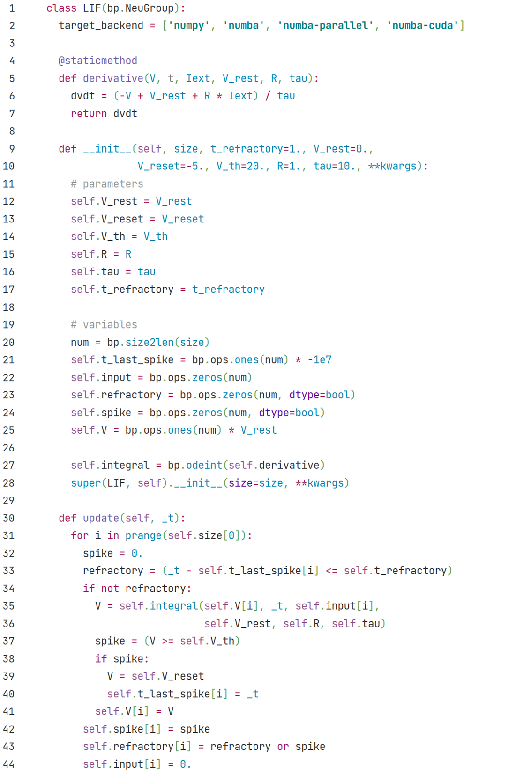

LIF
bp.NeuGroup class:
Group of neurons
Users may also set backend with a list of backend name.
$$τ\frac{dV}{dt}=− (V −V_{rest}) +RI(t)$$
Model parameters saved as
floating point numbers.
Model variables saved as vectors of
floating point numbers.
Call `bp.odeint` to integrate ODEs.
Parameter `method` is set to default value `euler`.
Pass `size` and `**kwargs` to
superclass bp.NeuGroup’s constrctor.
For each neuron in neuron group.
Check if neuron is
in refractory period.
Update variables
with numerical integration
one by one.
Check if neuron spikes.
Reset neuron.
Reset external input
for this time step.

Slide 4
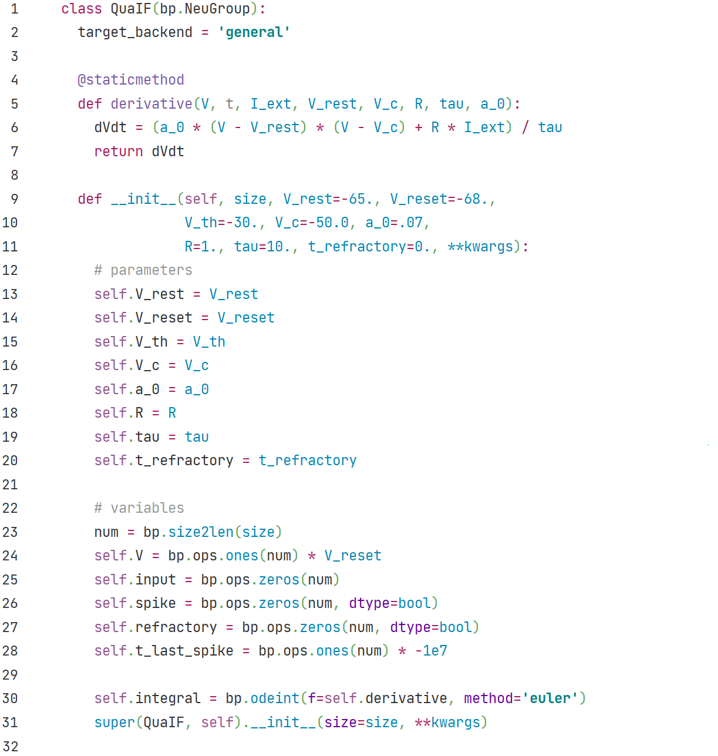

QuaIF
bp.NeuGroup class:
Group of neurons
$$τ\frac{dV}{dt}=a_{0}(V −V_{rest})(V−V_{c}) +RI(t)$$
Model parameters saved as
floating point numbers.
Model variables saved as vectors of
floating point numbers.
Call `bp.odeint` to integrate ODEs.
Set parameter `method` to choose
numerical integration methods.
Pass `size` and `**kwargs` to
superclass bp.NeuGroup’s constrctor.

Slide 5
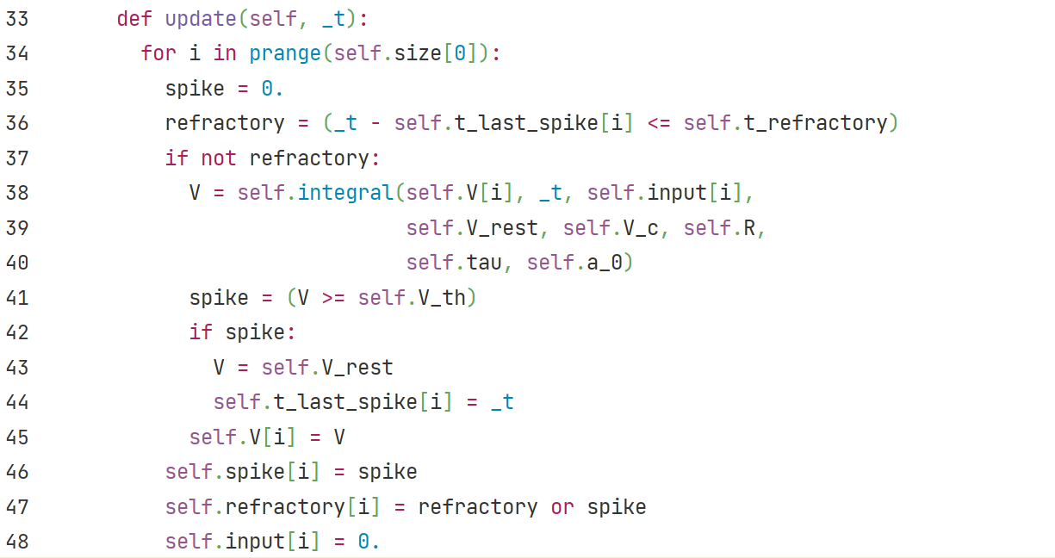
QuaIF
For each neuron in neuron group.
Check if neuron is
in refractory period.
Update variables
with numerical integration
one by one.
Check if neuron spikes.
Reset neuron.

Slide 6
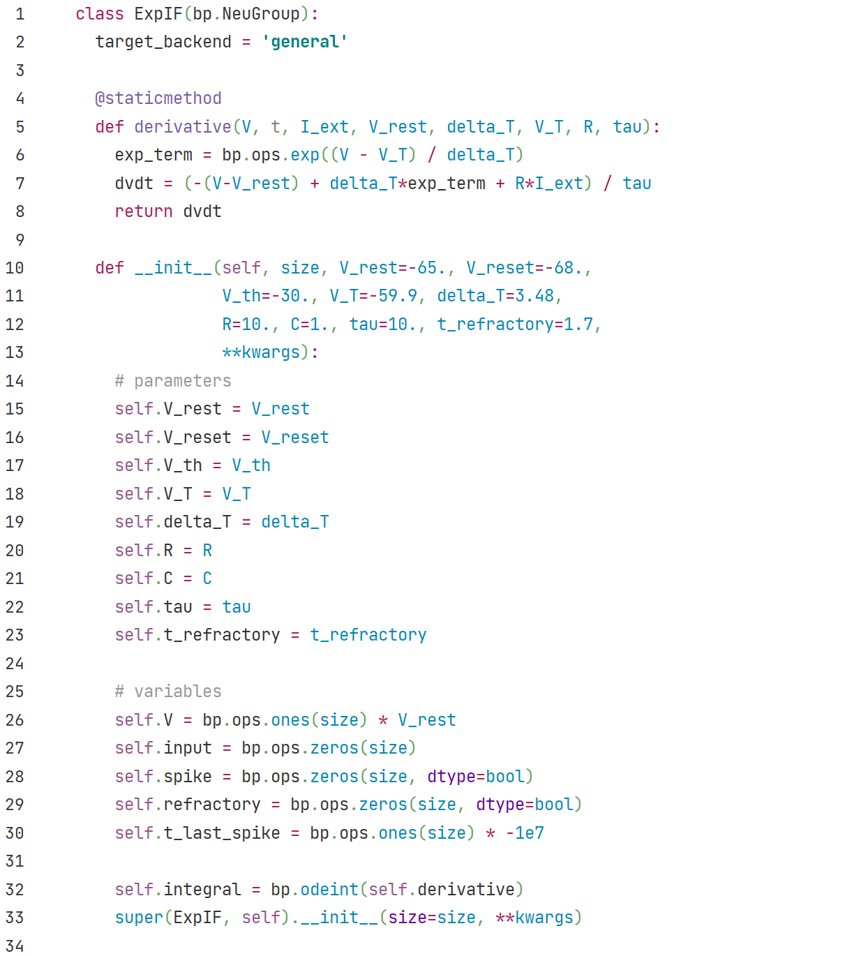

ExpIF
bp.NeuGroup class:
Group of neurons
$$τ\frac{dV}{dt}=− \left(V −V_{rest}\right)+Δ_{T}e^{\frac{V−V_{T}}{Δ_{T}}}+RI(t)$$
Model parameters saved as
floating point numbers.
Model variables saved as vectors of
floating point numbers.
Call `bp.odeint` to integrate ODEs.
Parameter `method` is set to default value `euler`.
Pass `size` and `**kwargs` to
superclass bp.NeuGroup’s constrctor.

Slide 7
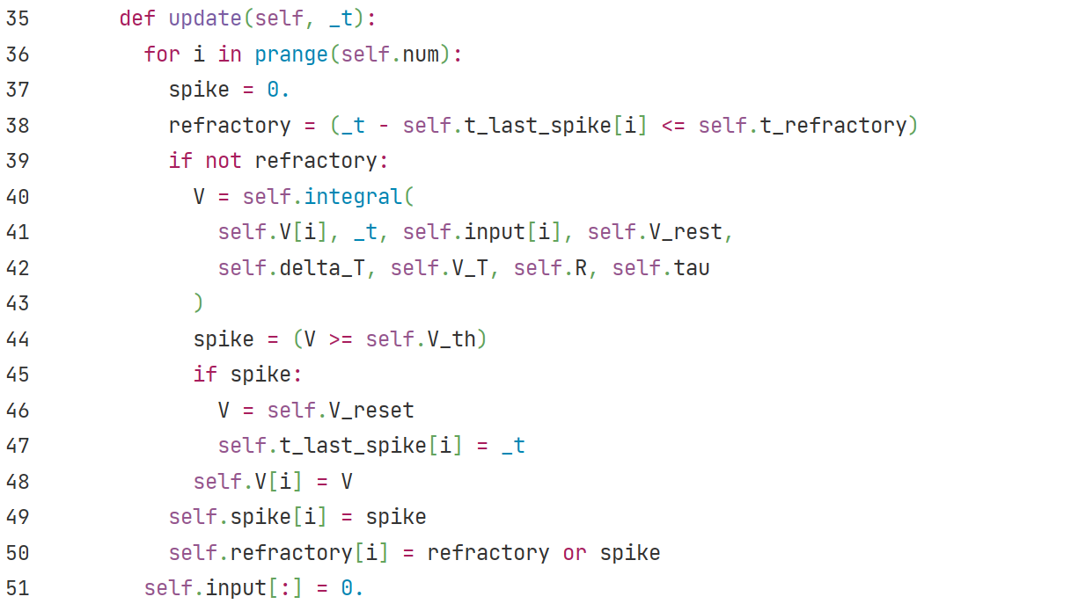
ExpIF
For each neuron in neuron group.
Check if neuron is
in refractory period.
Update variables
with numerical integration
one by one.
Check if neuron spikes.
Reset neuron.

Slide 8
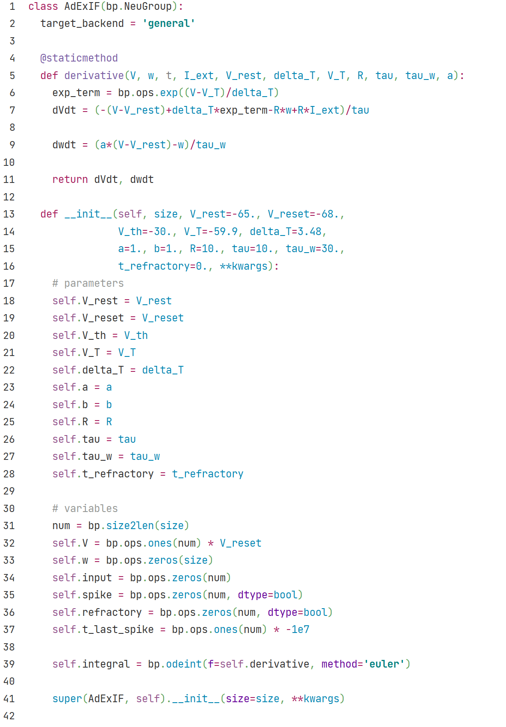


AdExIF
bp.NeuGroup class:
Group of neurons
$$τ\frac{dV}{dt}=− \left(V −V_{rest}\right)+Δ_{T}e^{\frac{V−V_{T}}{Δ_{T}}}+RI(t)$$
Model parameters saved as
floating point numbers.
Model variables saved as vectors of
floating point numbers.
Call `bp.odeint` to integrate ODEs.
Set parameter `method` to choose
numerical integration methods.
Pass `size` and `**kwargs` to
superclass bp.NeuGroup’s constrctor.

Slide 9
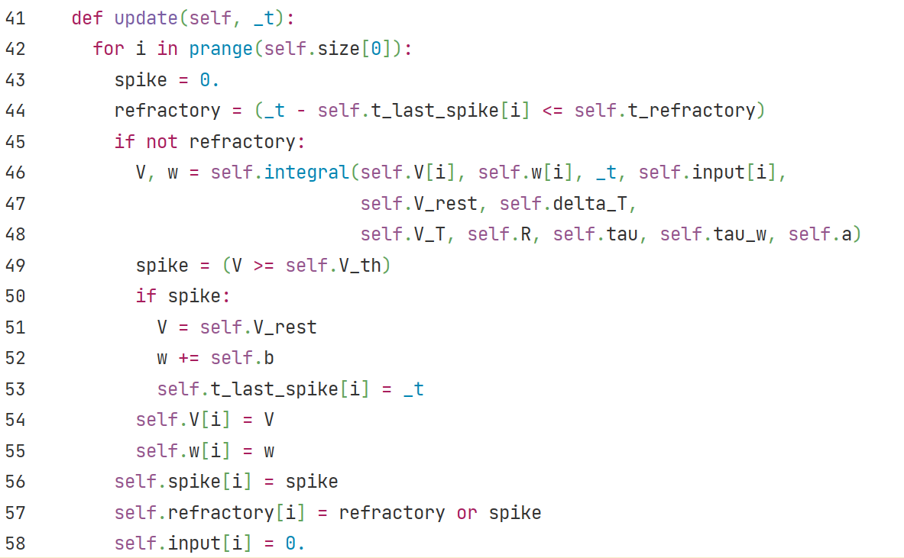

AdExIF
For each neuron in neuron group.
Check if neuron is
in refractory period.
Update variables
with numerical integration
one by one.
Check if neuron spikes.
Reset membrane potential,
add the Dirac δ term of w:

Slide 10
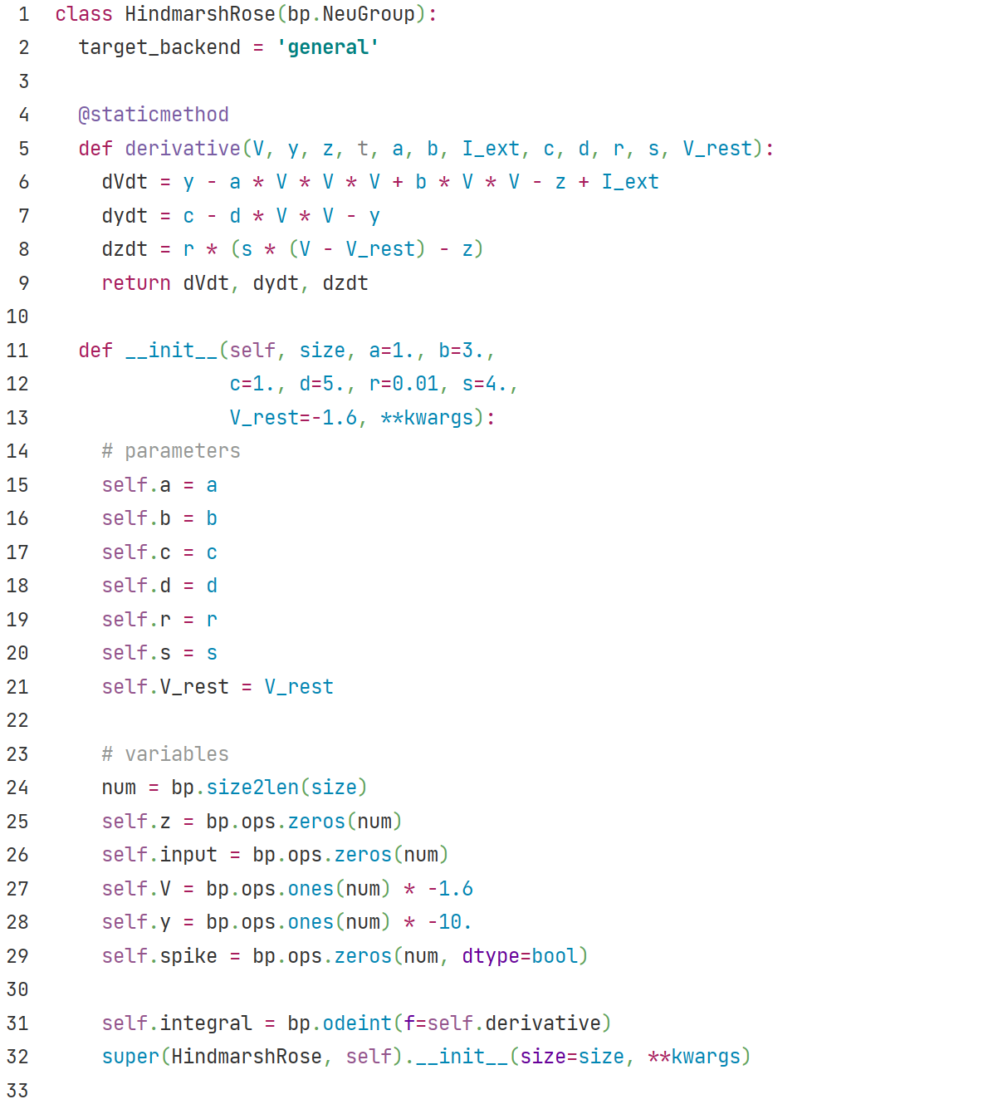
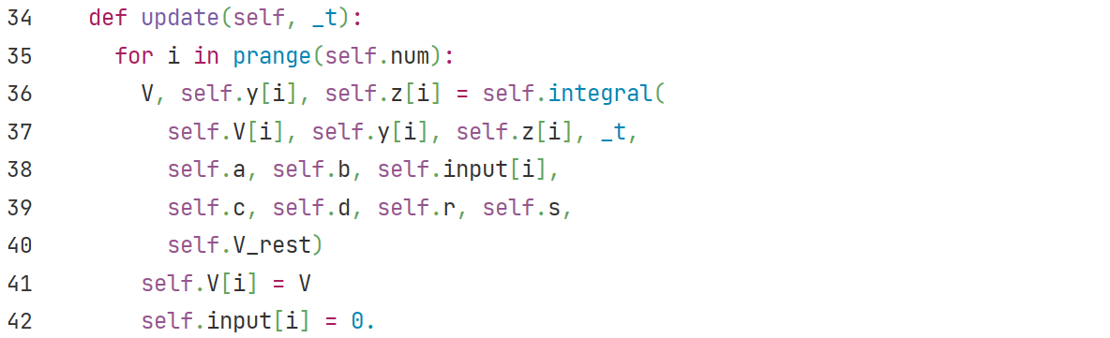
HindmarshRose
bp.NeuGroup class:
Group of neurons
$$dV/dt=y −aV^{3}+b V^{2} −z+I$$
$$dy/dt=c −dV^{2} −y$$
$$dz/dt=r(s\left(V −V_{rest}\right)−z)$$
Model parameters saved as
floating point numbers.
Model variables saved as vectors of
floating point numbers.
Call `bp.odeint` to integrate ODEs.
Parameter `method` is set to default value `euler`.
Pass `size` and `**kwargs` to
superclass bp.NeuGroup’s constrctor.
For each neuron in neuron group.
Update variables with
numerical integration
one by one.
Reset external input
for this time step.

Slide 11
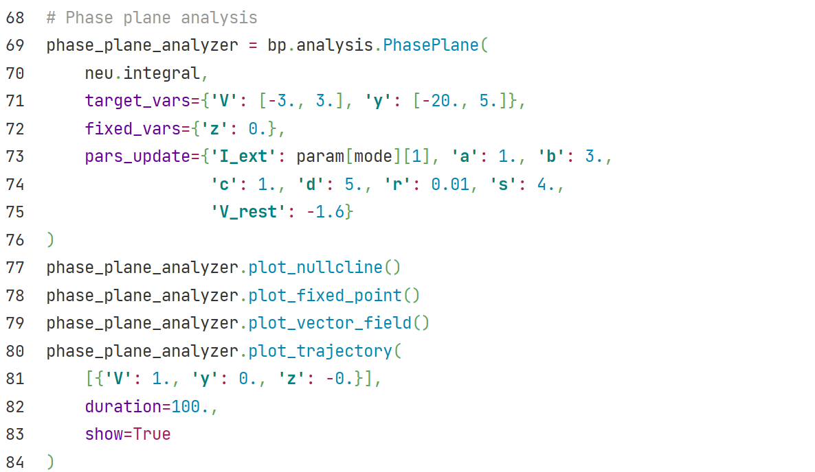
Dynamic system to be analyzed.
Variables to be showed in phase plane.
Variables to be fixed in phase plane.
Other parameters to be fixed.
Plot nullcline.
Plot fixed points.
Plot vector field.
Plot trajectory.
Define start point of trajectory and simulation duration.

Slide 12
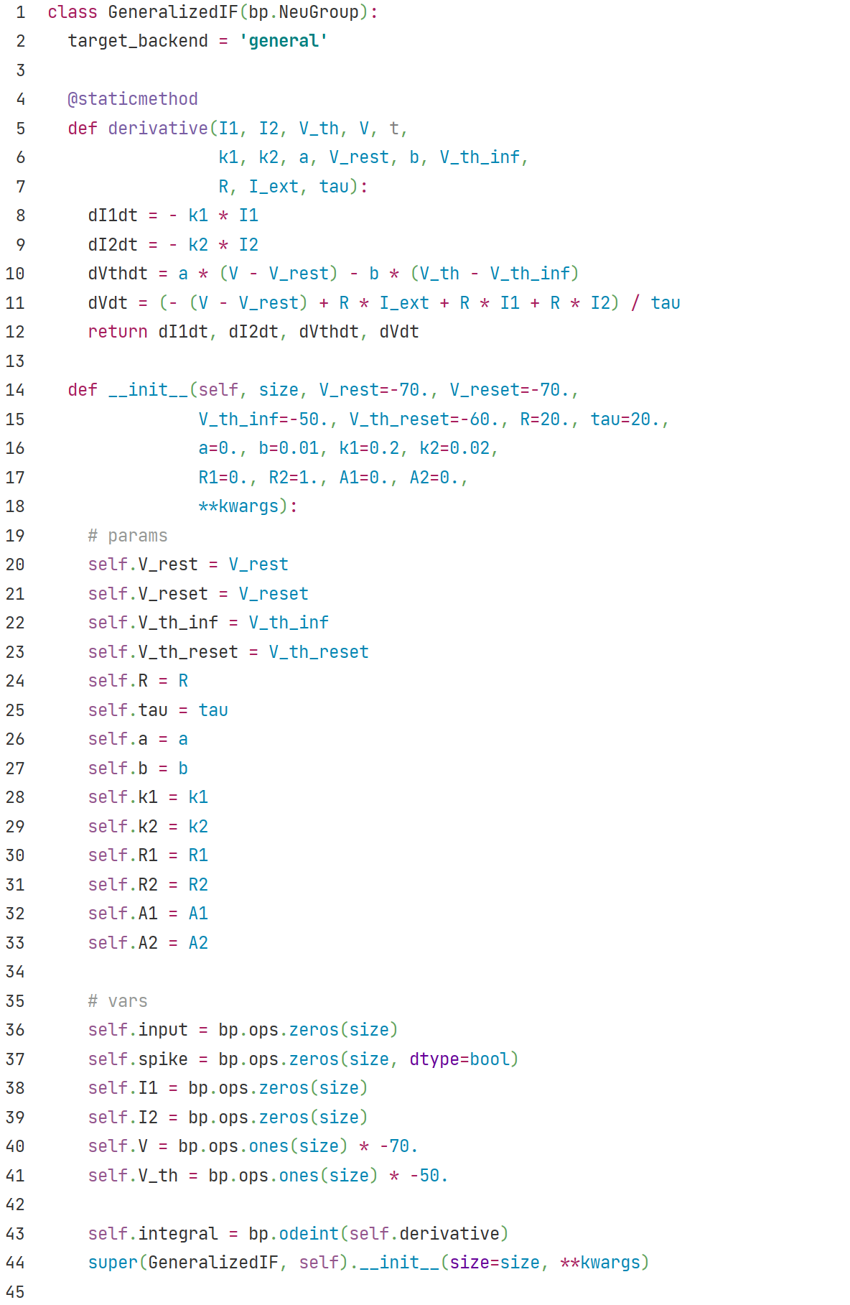

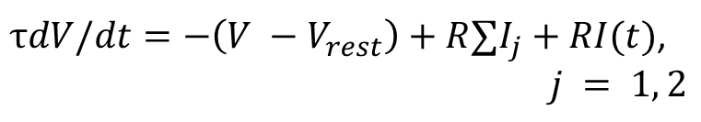

GeneralizedIF
bp.NeuGroup class:
Group of neurons
$$dI_{1}/dt=−k_{1}I_{1}$$
$$dI_{2}/dt=−k_{2}I_{2}$$
$$dV_{th}/dt=a\left(V −V_{rest}\right)−b(V_{th} −{V_{th}}_{∞})$$
$τdV/dt=−\left(V −V_{rest}\right)+R∑I_{j}+RI(t)$,
$$j = 1, 2$$
Model parameters saved as
floating point numbers.
Model variables saved as vectors of
floating point numbers.
Call `bp.odeint` to integrate ODEs.
Parameter `method` is set to default value `euler`.
Pass `size` and `**kwargs` to
superclass bp.NeuGroup’s constrctor.

Slide 13
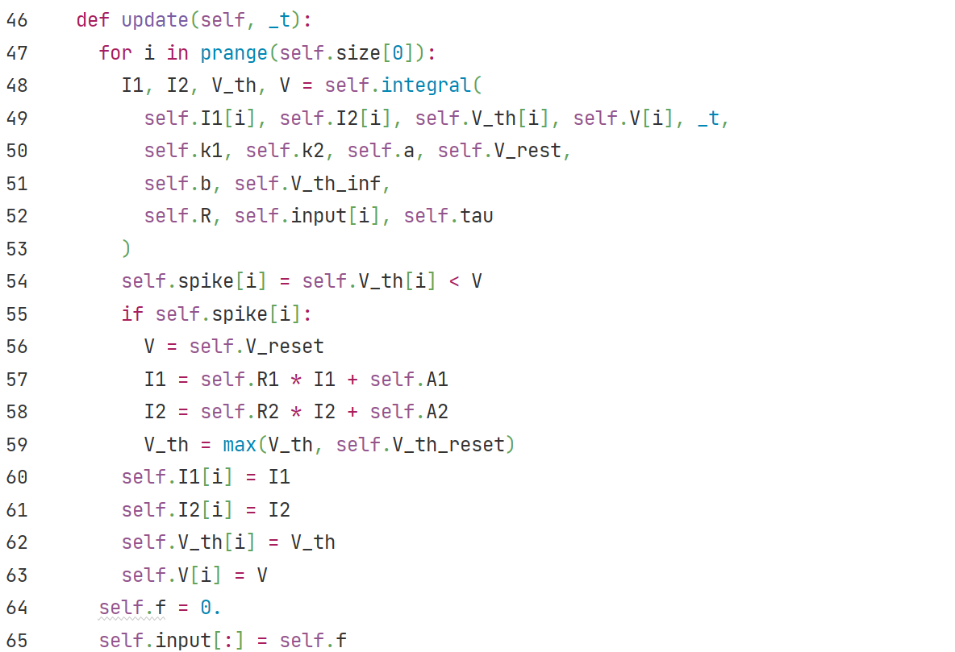

GeneralizedIF
For each neuron in neuron group.
Update variables with
numerical integration
one by one.
Check if neuron spikes.
Reset membrane potential
and threshold potential,
update I1, I2.
$$V=V_{reset}$$
$$I_{1}=R_{1}I_{1}+A_{1}$$
$$I_{2}=R_{2}I_{2}+A_{2}$$
$$V_{th}=max⁡(V_{th}, {V_{th}}_{reset})$$
Reset external input
for this time step.

Slide 14
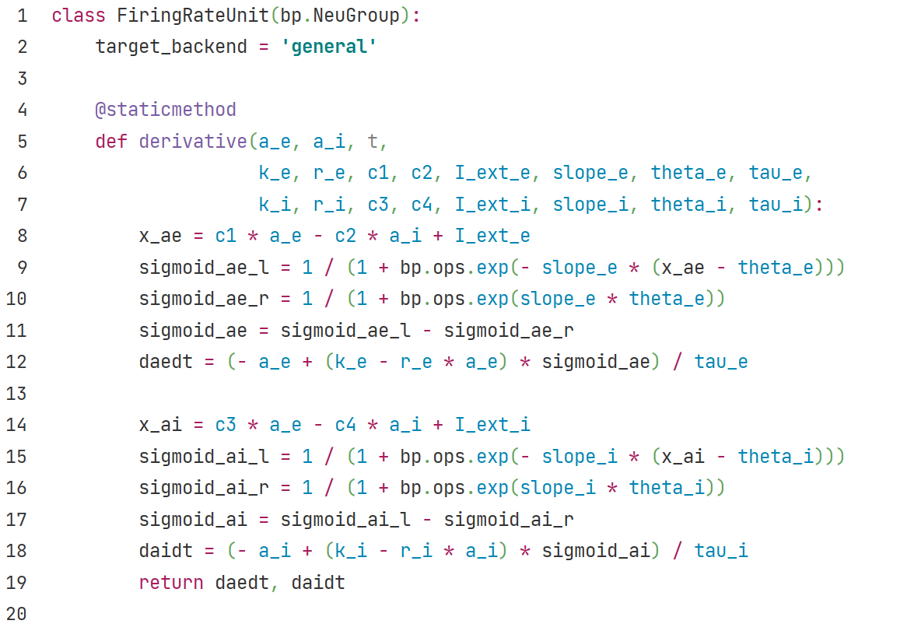
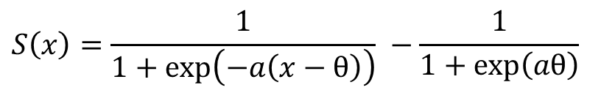
Firing Rate Unit
$$S\left(x\right)=\frac{1}{1+\exp\left(−a\left(x−θ\right)\right)} −\frac{1}{1+\exp\left(aθ\right)}$$
$$τ_{e}\frac{da_{e}}{dt}=−a_{e}+\left(k_{e}−r_{e}∗a_{e}\right)∗S_{e}(c_{1}a_{e}−c_{2}a_{i}+{I_{ext}}_{e})$$
$$τ_{i}\frac{da_{i}}{dt}=−a_{i}+\left(k_{i}−r_{i}∗a_{i}\right)∗S_{i}(c_{1}a_{e}−c_{2}a_{i}+{I_{ext}}_{i})$$

Slide 15
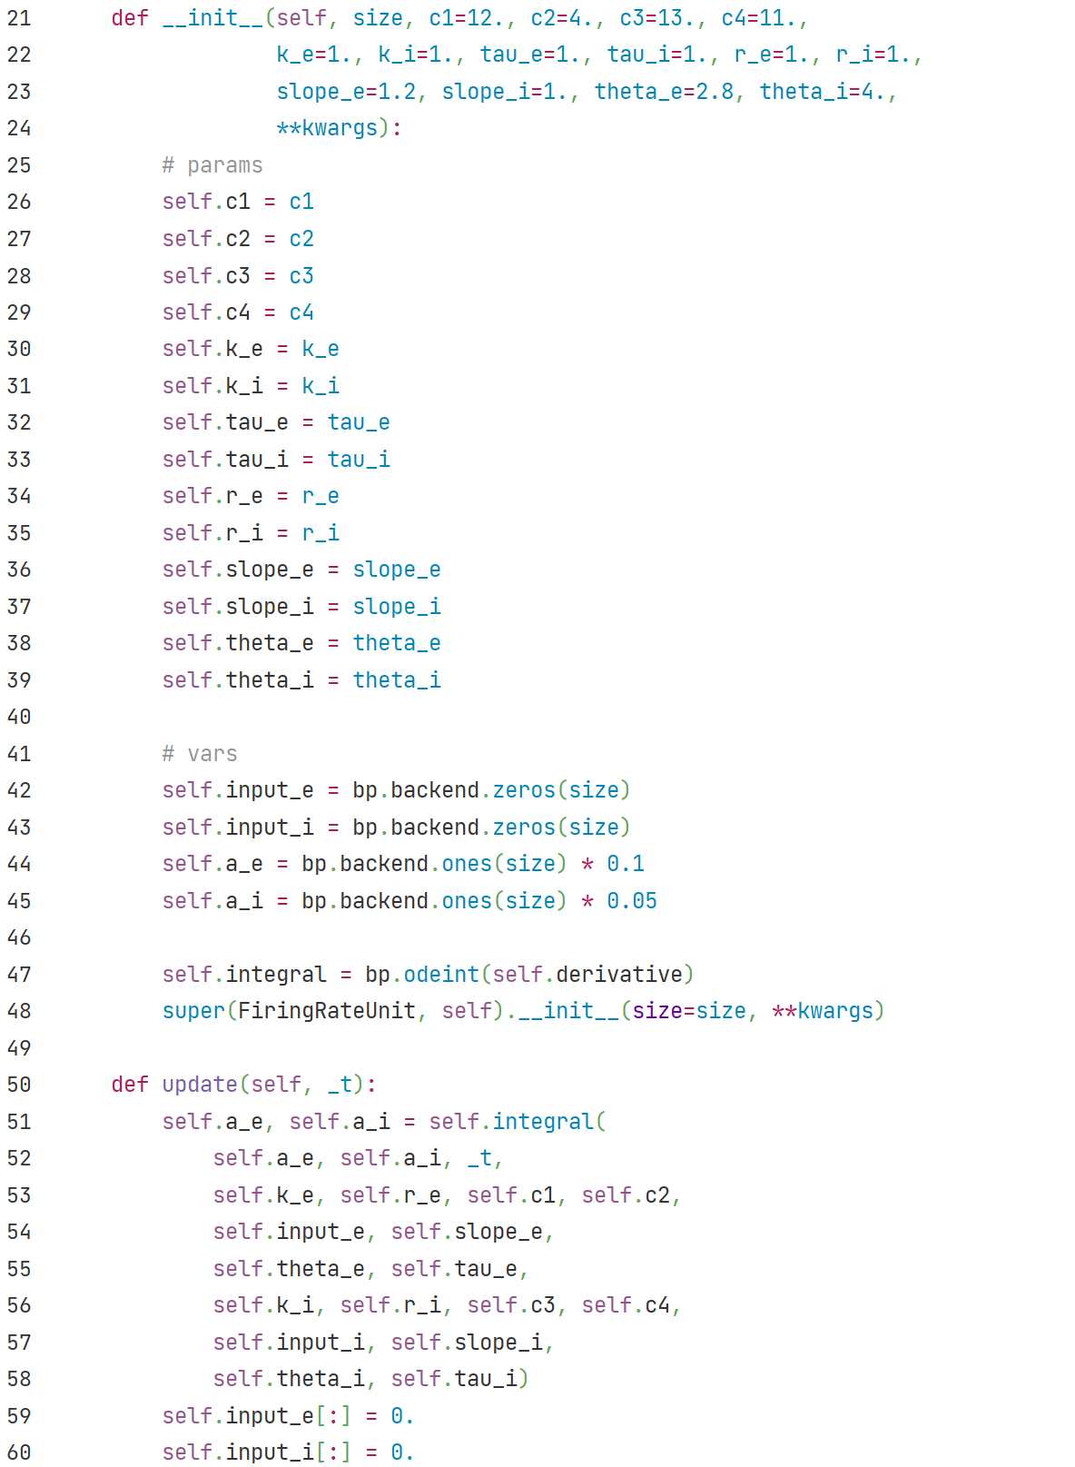
Firing Rate Unit
Model parameters saved as
floating point numbers.
Model variables saved as vectors of
floating point numbers.
Call `bp.odeint` to integrate ODEs.
Parameter `method` is set to default value `euler`.
Pass `size` and `**kwargs` to
superclass bp.NeuGroup’s constrctor.
Update variables with
numerical integration
in vector form.
Reset external input
for this time step.

