Slide 1
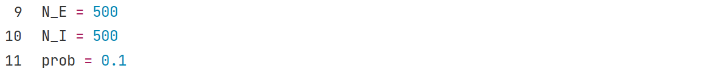
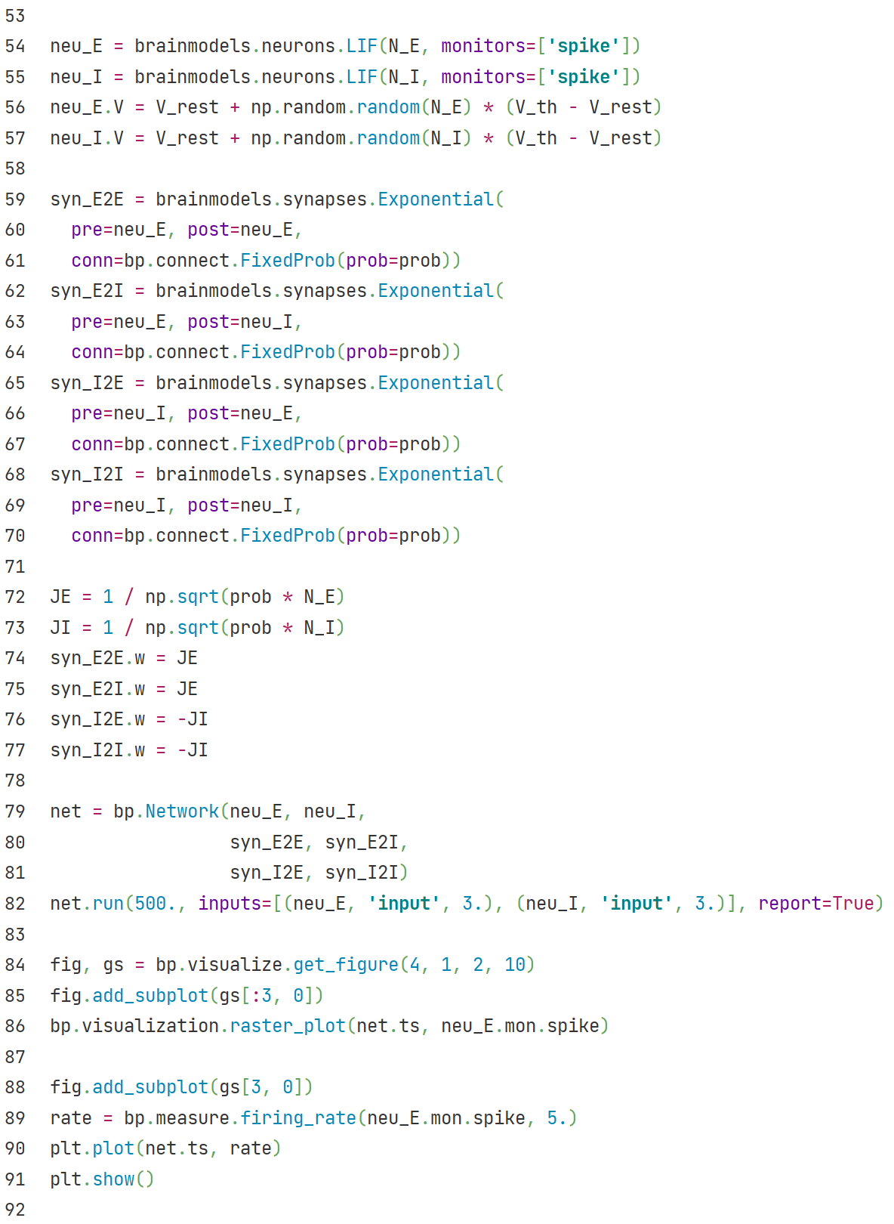
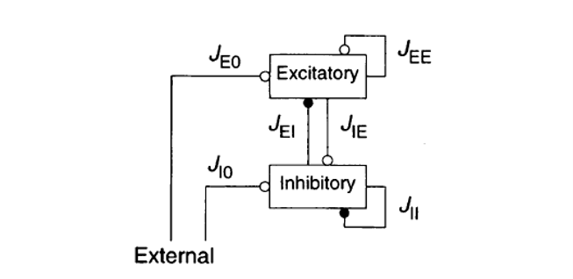
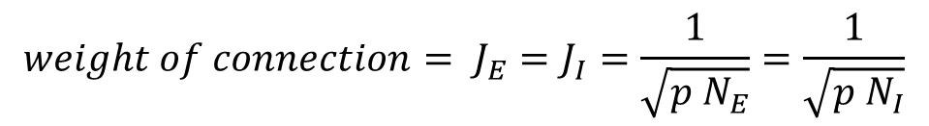
E-I balanced net
Import LIF neuron model from brainmodels.
Build excitatory neuron group and inhibitory
neuron group.
Import exponential synapse model from brainmodels.
Build E2E, E2I, I2E, I2I synapse connections between
neuron groups.
$$weight of connection= J_{E}=J_{I}=\frac{1}{\sqrt{p N_{E}}}=\frac{1}{\sqrt{p N_{I}}}$$
Simulate the network for 500ms,
give all neurons constant external
inputs with amplitude 3.
Paint the raster plot and firing_rate-t plot of excitatory neurons in E/I balanced network.

Slide 2
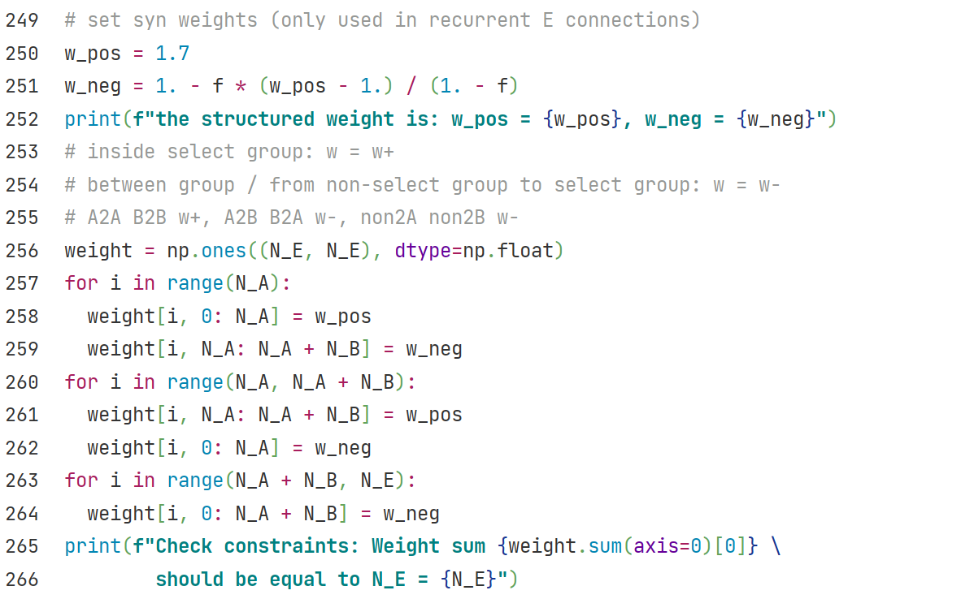
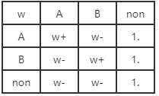


$$w+ = 1.7$$
$$w− = 1−f(x+−1)/1−f$$
Define structured weights for E2E conns.
Strong connection inside selective group,
weak connection for other synapses.

Slide 3
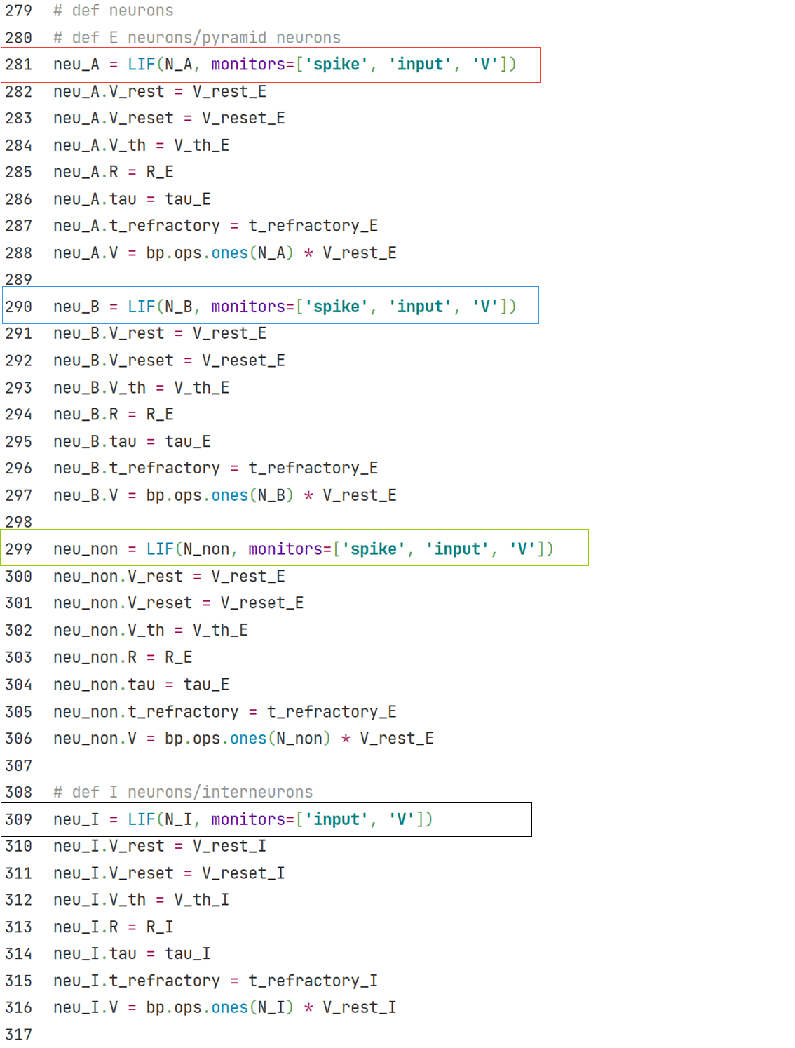
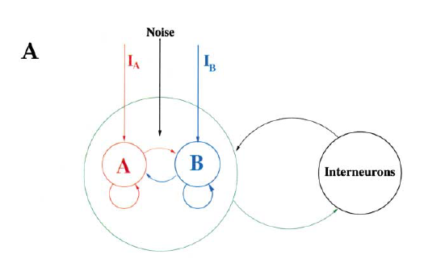

Slide 4
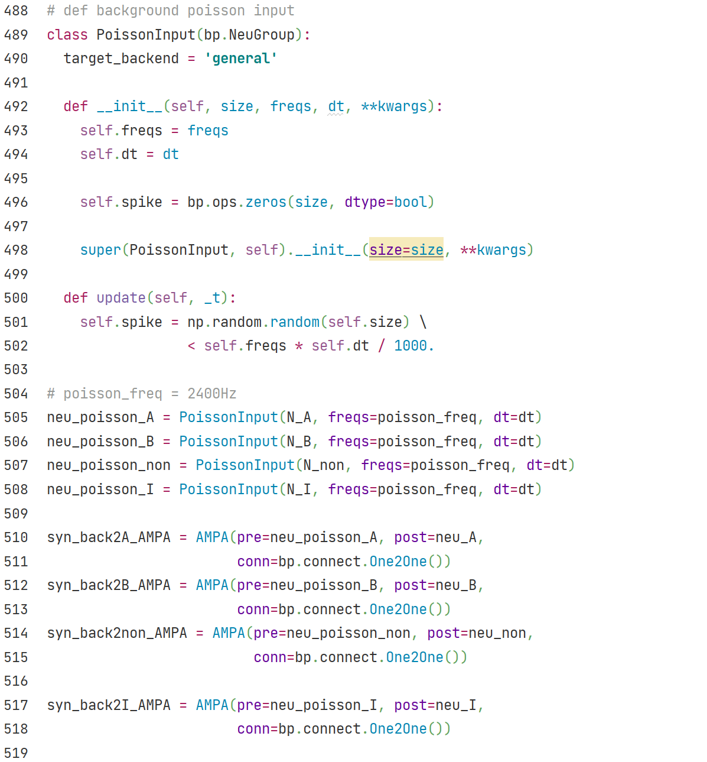
Generate spikes with a given Poisson frequency.
Define neurons that generate Poisson
background inputs for every neuron in the network.
Define AMPA synapses that send the Poisson background inputs to the neurons.

Slide 5
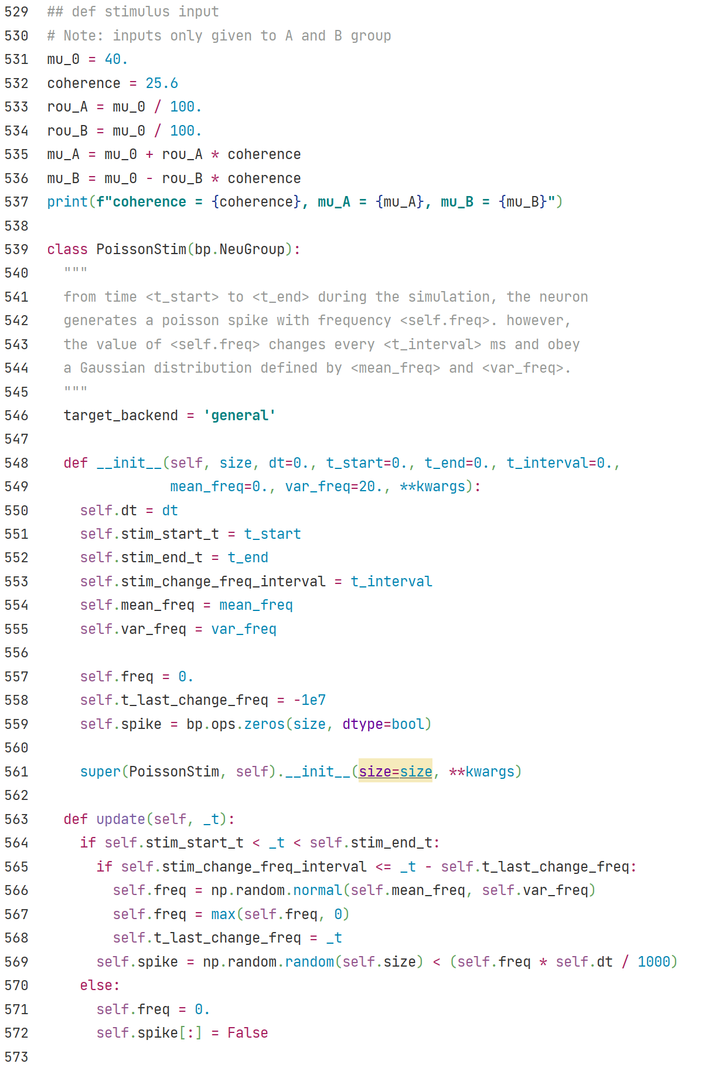
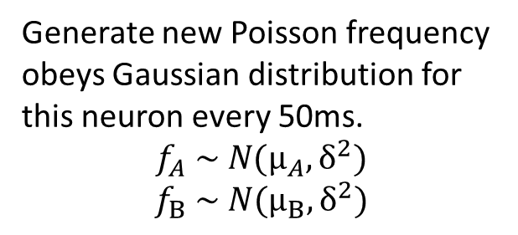
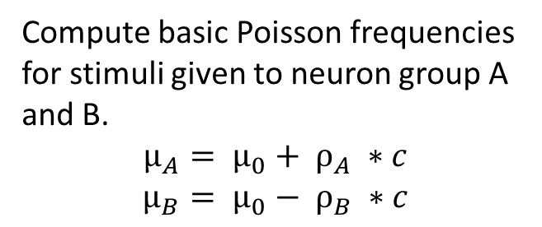
Compute basic Poisson frequencies for stimuli given to neuron group A and B.
$$μ_{A}= μ_{0}+ ρ_{A} ∗c$$
$$μ_{B}= μ_{0}− ρ_{B} ∗c$$
Save model parameters and variables.
Stimulus are only generated in simulation
between time period [stim_start_t, stim_end_t].
Generate new Poisson frequency obeys Gaussian distribution for this neuron every 50ms.
$$f_{A} \sim N(μ_{A}, δ^{2})$$
$$f_{B} \sim N(μ_{B}, δ^{2})$$
Generate Poisson inputs with the Poisson frequency of this neuron.

Slide 6
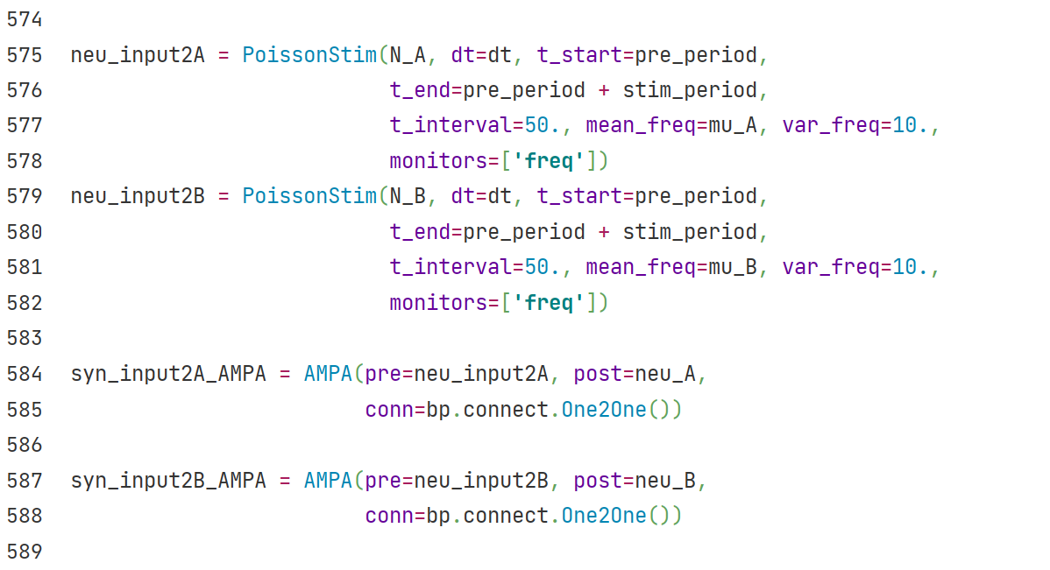
Define neurons that generate Poisson stimulus inputs for every neuron in group A and B.
Define AMPA synapses that send the Poisson stimulus inputs to the neurons.

