Slide 1
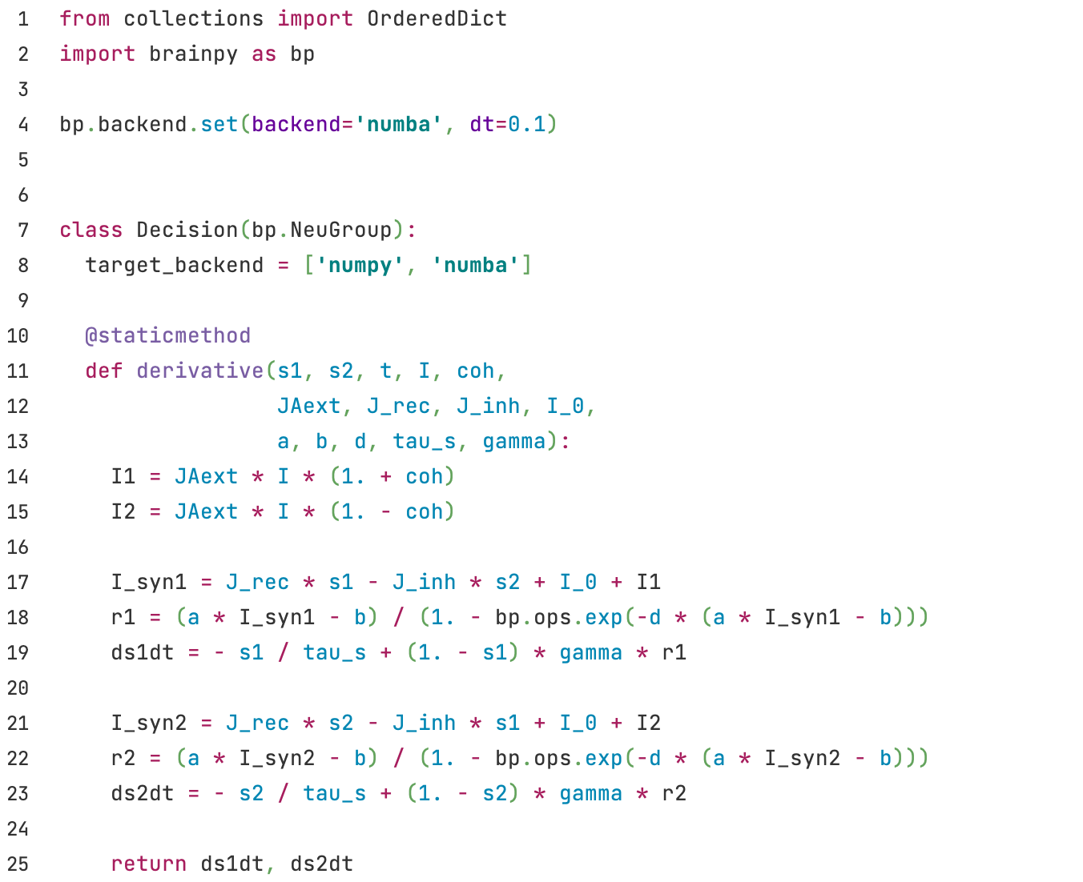
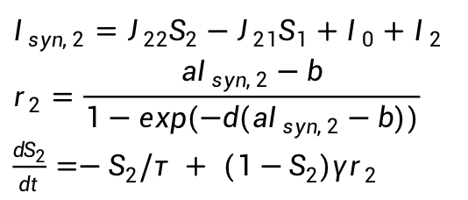
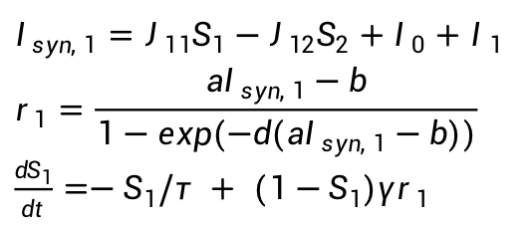

Decision
$I_{1}=J_{Aext}μ_{0}(1+c')$
$I_{2}=J_{Aext}μ_{0}(1−c')$
$I_{syn, 1}=J_{11}S_{1}−J_{12}S_{2}+I_{0}+I_{1}$
$$r_{1}=\frac{aI_{syn, 1}−b}{1−exp(−d(aI_{syn, 1}−b))}$$
$\frac{dS_{1}}{dt}=−S_{1}/τ + (1−S_{1})γr_{1}$
$I_{syn, 2}=J_{22}S_{2}−J_{21}S_{1}+I_{0}+I_{2}$
$$r_{2}=\frac{aI_{syn, 2}−b}{1−exp(−d(aI_{syn, 2}−b))}$$
$\frac{dS_{2}}{dt}=−S_{2}/τ + (1−S_{2})γr_{2}$

Slide 2
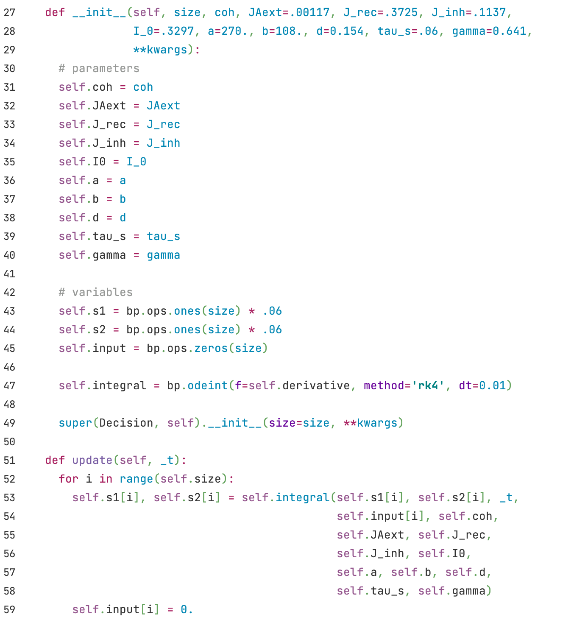
Decision

Slide 3
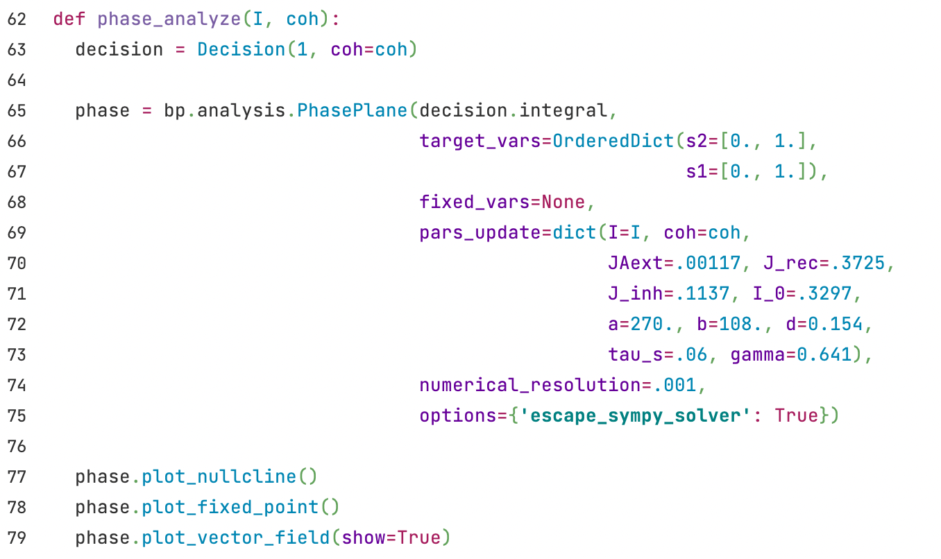
Decision
Functions defining the differential equations (from decision model)
Variables to be showed in phase plane.
Specify values of the parameters.
Since the differential equations in the model are very complicated, here we use numerical solutions, skip the analytical solutions provided by sympy, and set the numerical resolution.

Slide 4
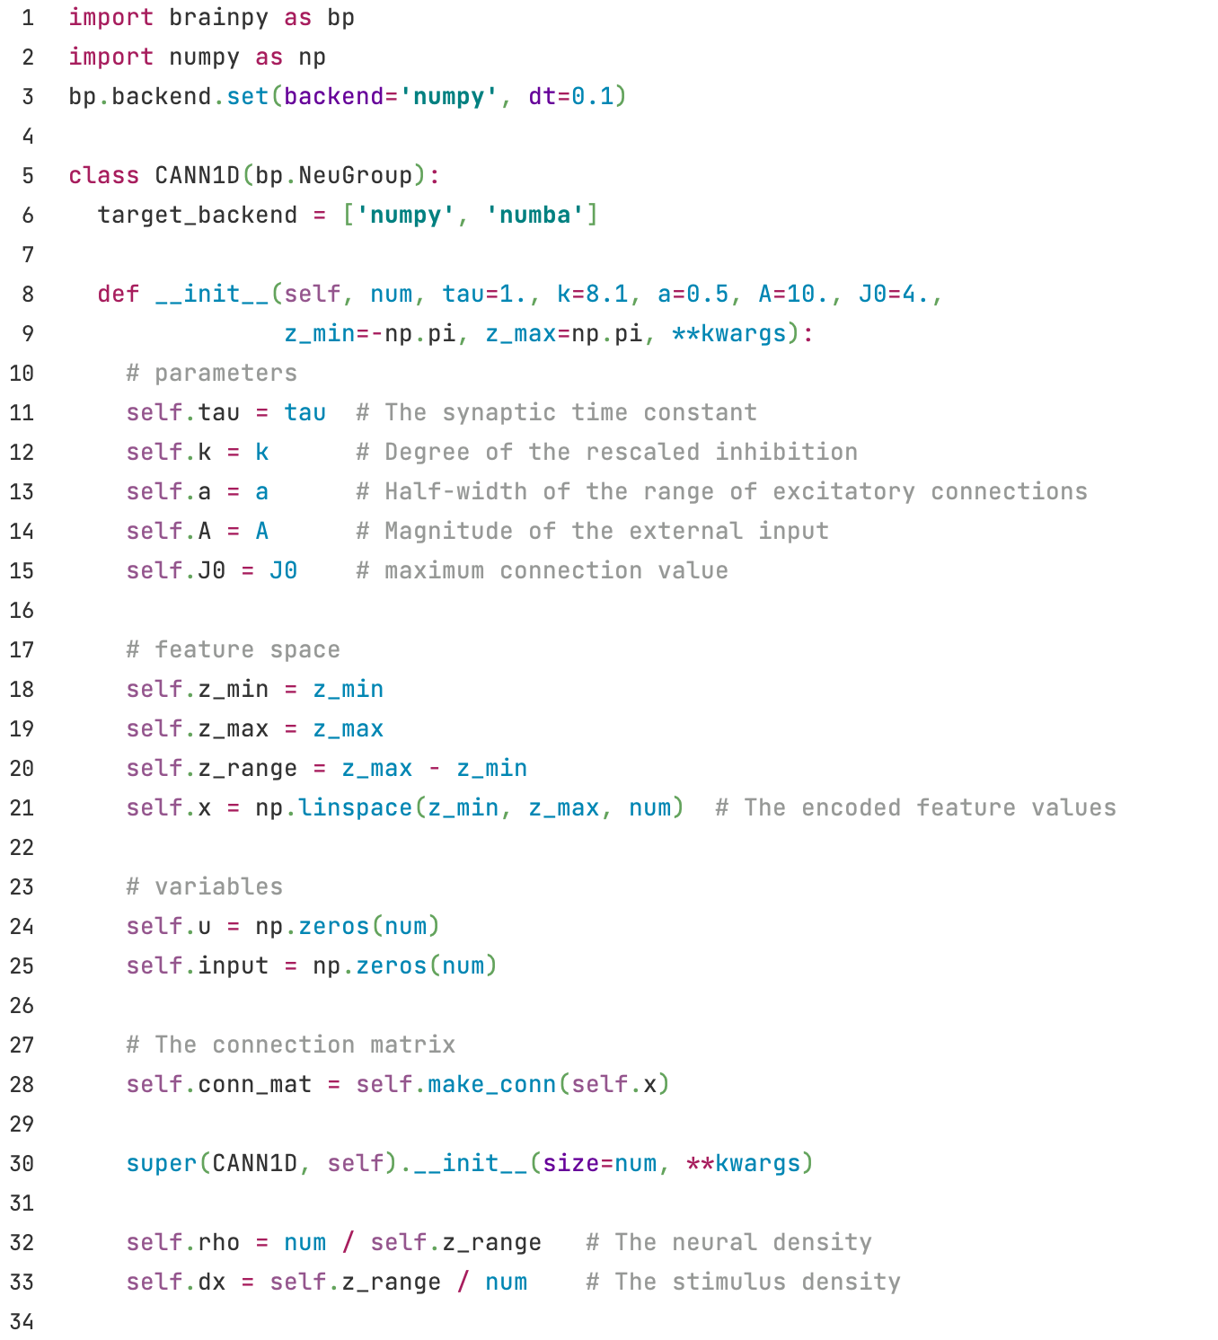
CANN
z_range denotes the range of x .
$ρ\int{dx'}$

Slide 5
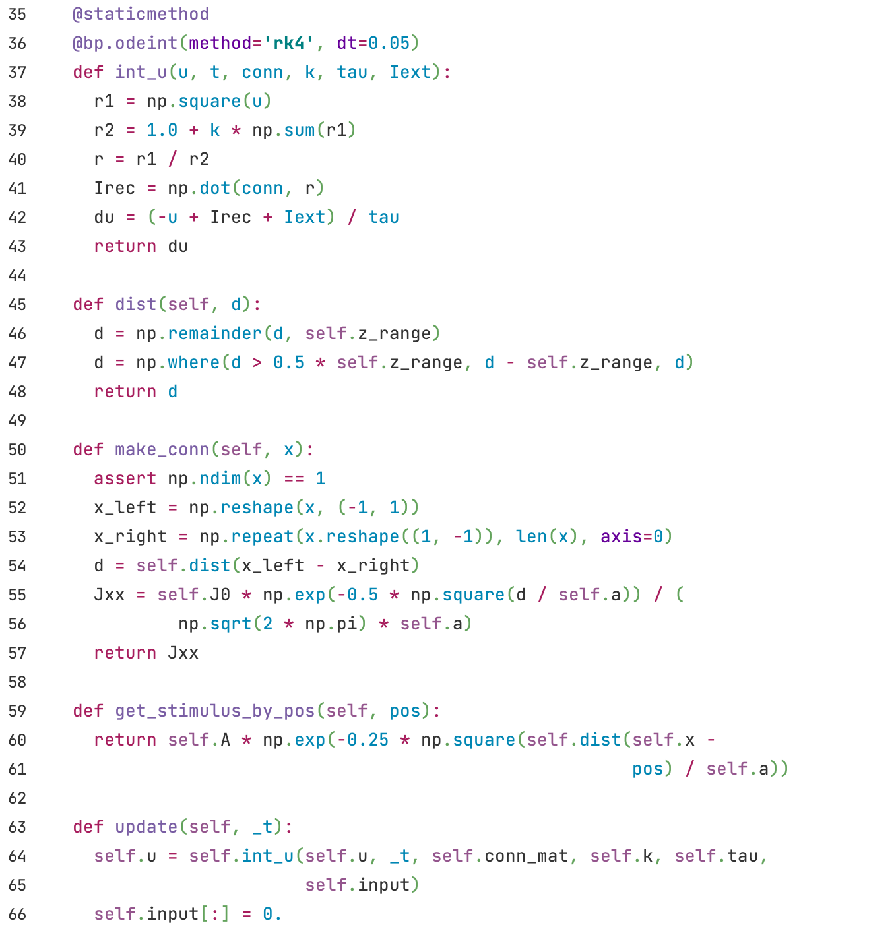
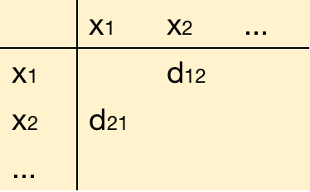
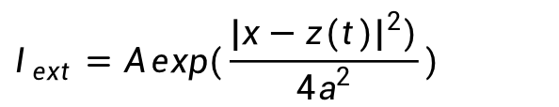
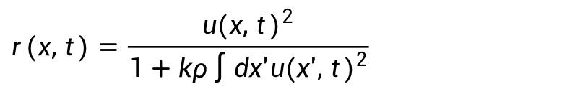
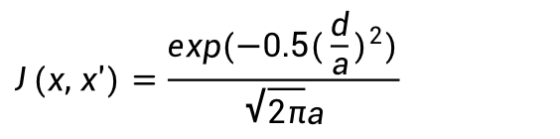
CANN
$$r(x, t)=\frac{u(x, t)^{2}}{1+kρ\int{dx'u(x', t)^{2}}}$$
$$\frac{du(x, t)}{dt}=−u(x,t) +ρ\int{dx'J(x,x')r(x',t)+I_{ext}}$$
Distances on the ring:
The farthest distance is half of z_range, so d should not exceed 0.5 * z_range
Compute the distance matrix (d=|x-x'|) for all positions
$$J(x, x')=\frac{exp(−0.5(\frac{d}{a})^{2})}{\sqrt{2π}a}$$
$$I_{ext}=A exp(\frac{|x−z(t)|^{2})}{4a^{2}})$$

