Slide 1
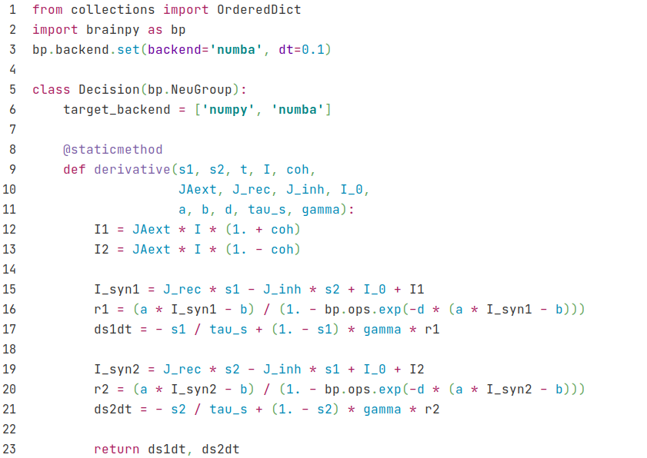
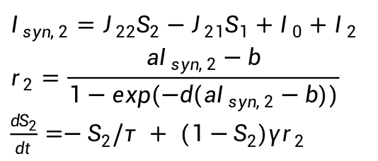
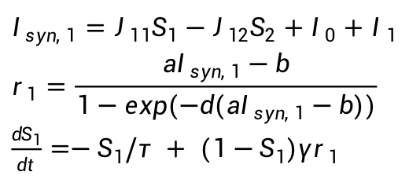

Decision
$I_{1}=J_{Aext}μ_{0}(1+c')$
$I_{2}=J_{Aext}μ_{0}(1−c')$
$I_{syn, 1}=J_{11}S_{1}−J_{12}S_{2}+I_{0}+I_{1}$
$$r_{1}=\frac{aI_{syn, 1}−b}{1−exp(−d(aI_{syn, 1}−b))}$$
$\frac{dS_{1}}{dt}=−S_{1}/τ + (1−S_{1})γr_{1}$
$I_{syn, 2}=J_{22}S_{2}−J_{21}S_{1}+I_{0}+I_{2}$
$$r_{2}=\frac{aI_{syn, 2}−b}{1−exp(−d(aI_{syn, 2}−b))}$$
$\frac{dS_{2}}{dt}=−S_{2}/τ + (1−S_{2})γr_{2}$

Slide 2
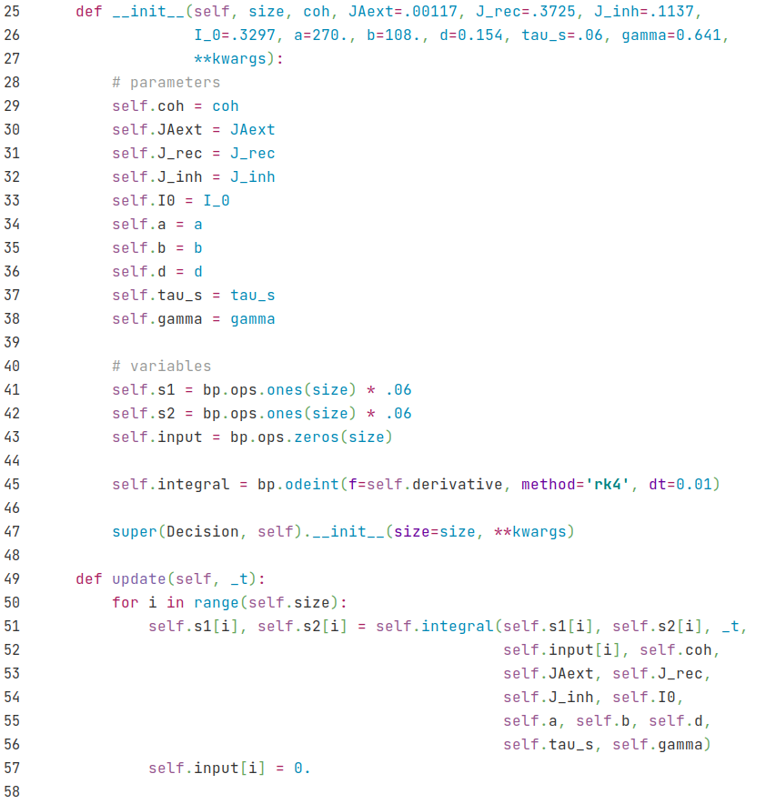
Decision

Slide 3
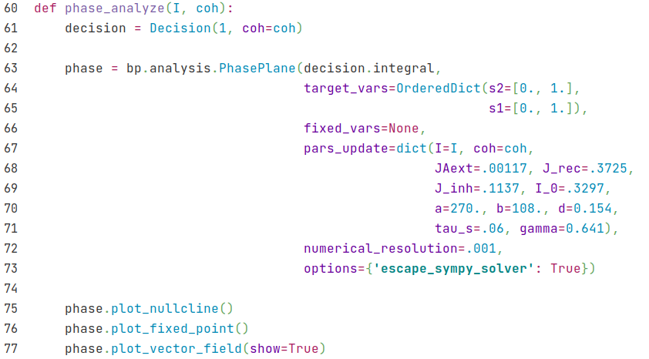
Decision

Slide 4
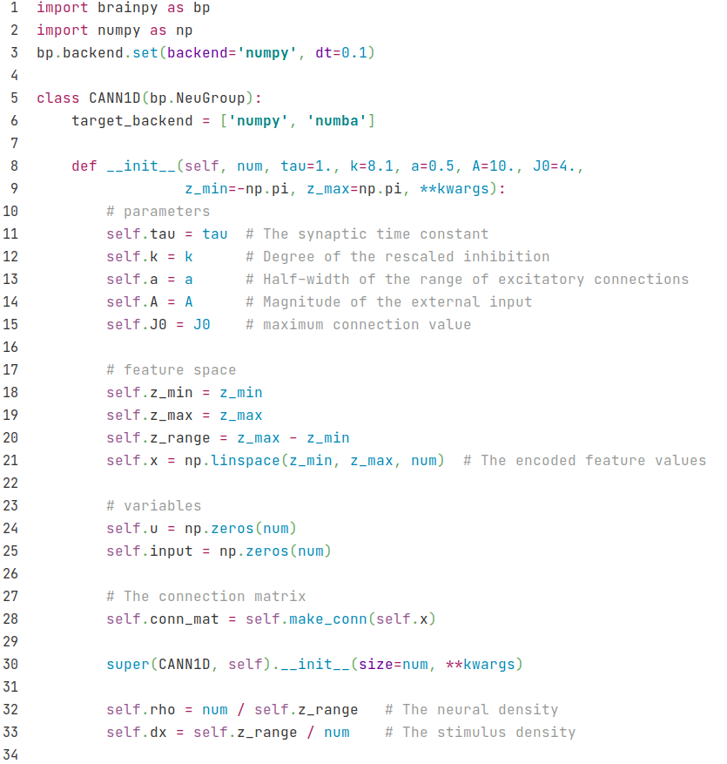
CANN

Slide 5
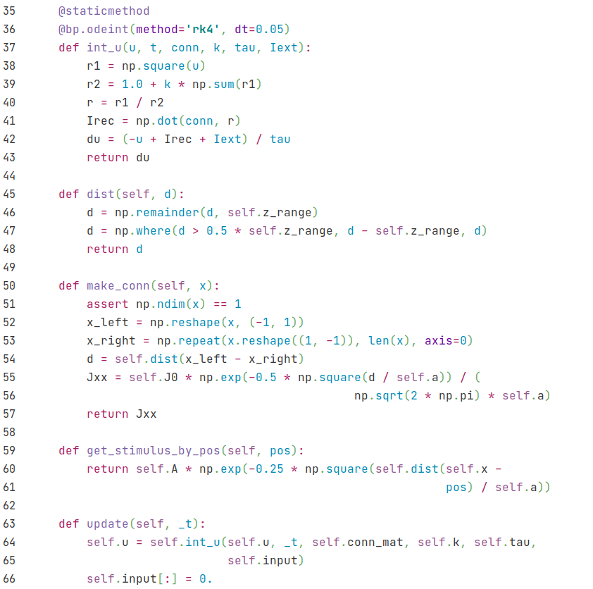
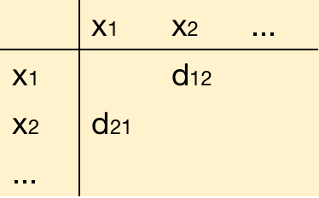
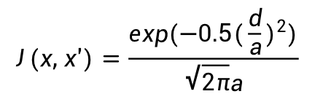
CANN
d=|x-x'|
Get a matrix of d for all positions
$$J(x, x')=\frac{exp(−0.5(\frac{d}{a})^{2})}{\sqrt{2π}a}$$

