Slide 1
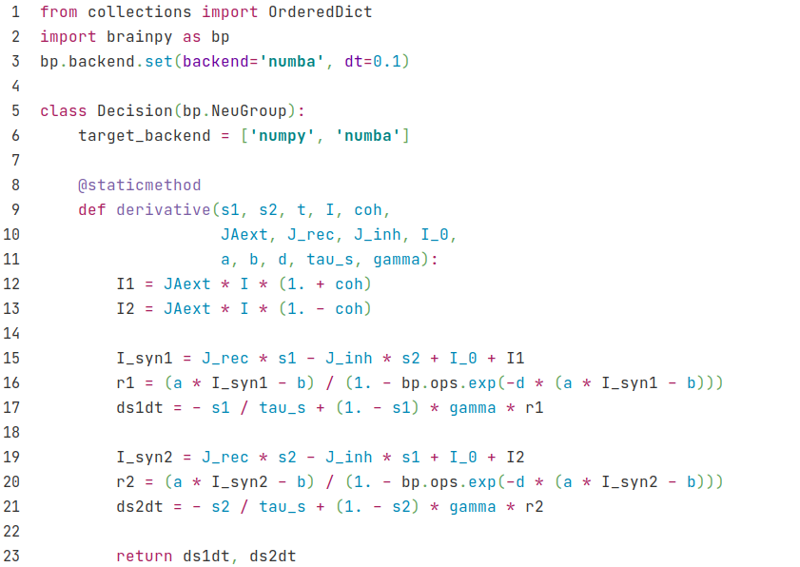
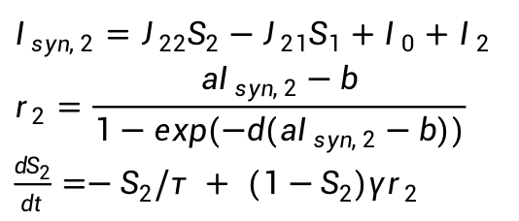
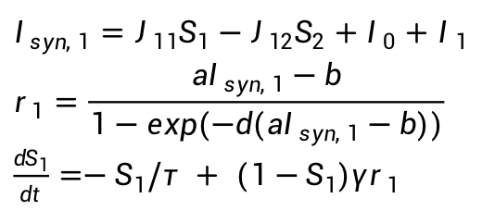

Decision
$I_{1}=J_{Aext}μ_{0}(1+c')$
$I_{2}=J_{Aext}μ_{0}(1−c')$
$I_{syn, 1}=J_{11}S_{1}−J_{12}S_{2}+I_{0}+I_{1}$
$$r_{1}=\frac{aI_{syn, 1}−b}{1−exp(−d(aI_{syn, 1}−b))}$$
$\frac{dS_{1}}{dt}=−S_{1}/τ + (1−S_{1})γr_{1}$
$I_{syn, 2}=J_{22}S_{2}−J_{21}S_{1}+I_{0}+I_{2}$
$$r_{2}=\frac{aI_{syn, 2}−b}{1−exp(−d(aI_{syn, 2}−b))}$$
$\frac{dS_{2}}{dt}=−S_{2}/τ + (1−S_{2})γr_{2}$

Slide 2
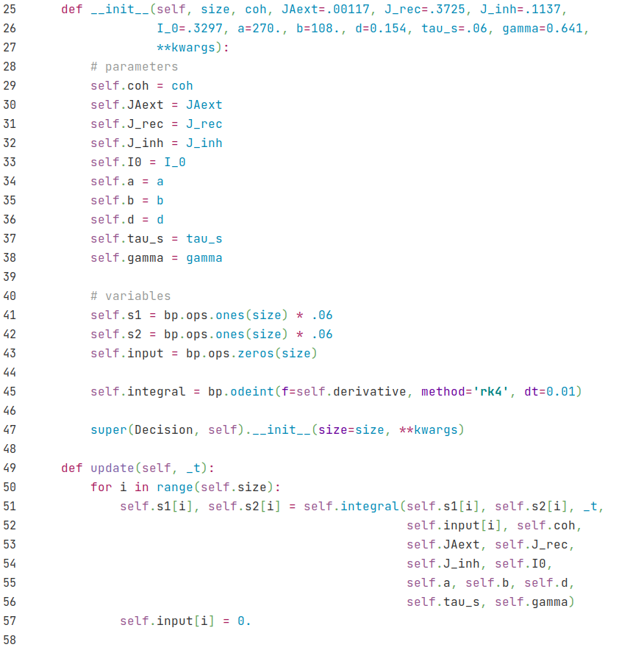
Decision

Slide 3
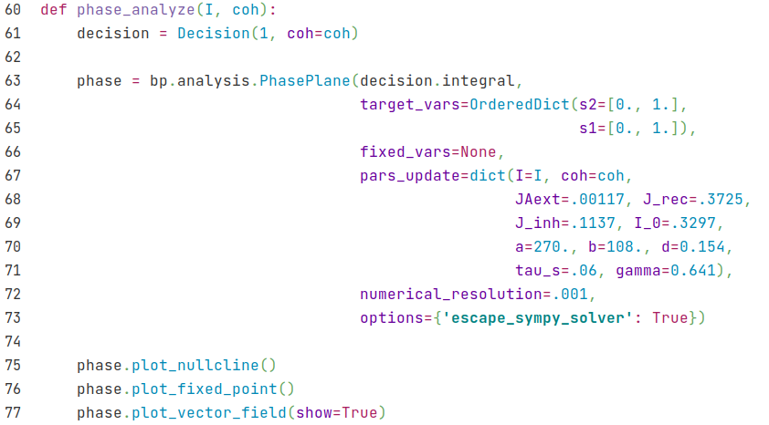
Decision
Functions defining the differential equations (from decision model)
Variables to be showed in phase plane.
Specify parameters.
We use numerical solution rather than analytic solution because the equations are so complex. Thus, we don't need to use the sympy solver .

Slide 4
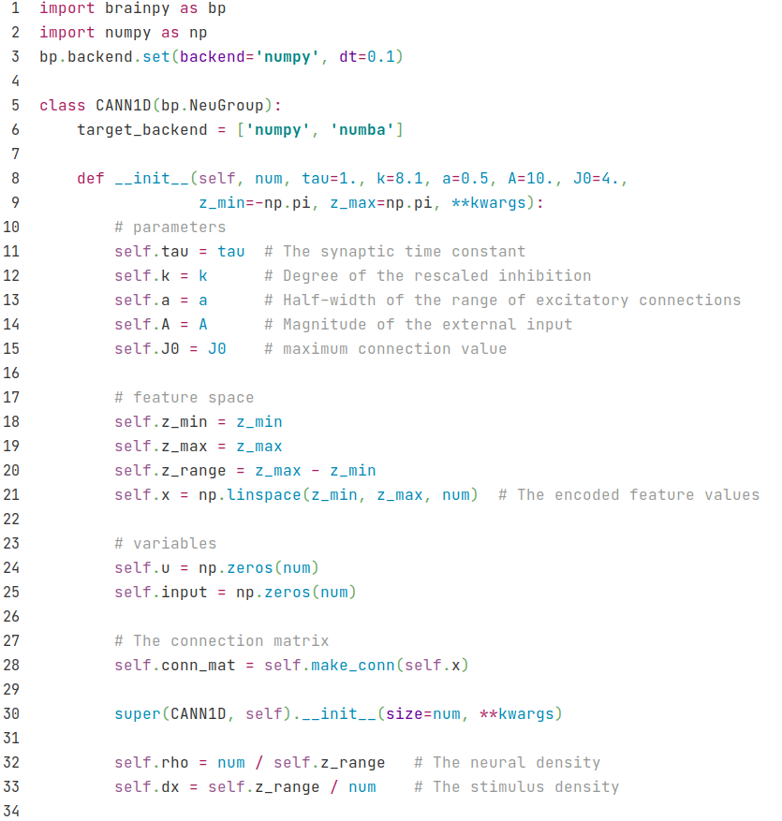
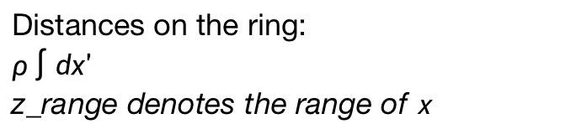
CANN
Distances on the ring:
$ρ\int{dx'}$
z_range denotes the range of x

Slide 5
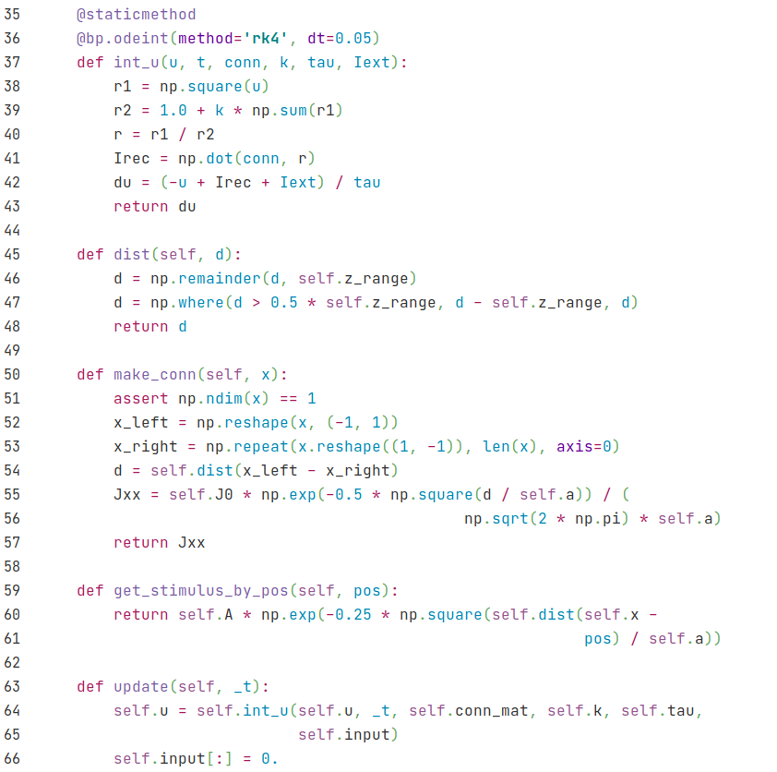
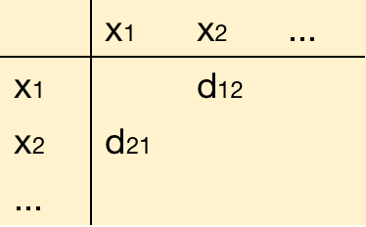
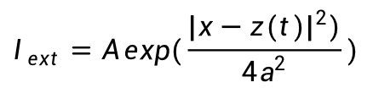
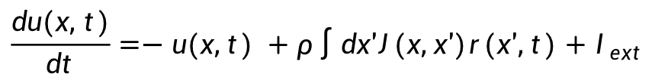

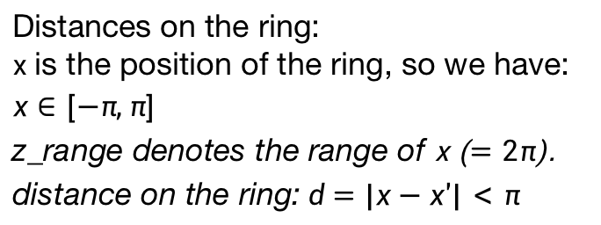
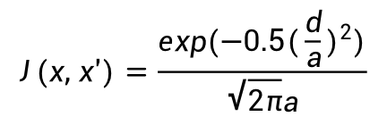
CANN
r$(x, t)=\frac{u(x, t)^{2}}{1+kρ\int{dx'u(x', t)^{2}}}$
$$\frac{du(x, t)}{dt}=−u(x,t) +ρ\int{dx'J(x,x')r(x',t)+I_{ext}}$$
Distances on the ring:
x is the position of the ring, so we have: $x∈[−π, π]$
z_range denotes the range of x ($=2π$).
distance on the ring:$d=|x−x'|<π$
d=|x-x'|
Get a matrix of d for all positions
$$J(x, x')=\frac{exp(−0.5(\frac{d}{a})^{2})}{\sqrt{2π}a}$$
$$I_{ext}=A exp(\frac{|x−z(t)|^{2})}{4a^{2}})$$

