Slide 1
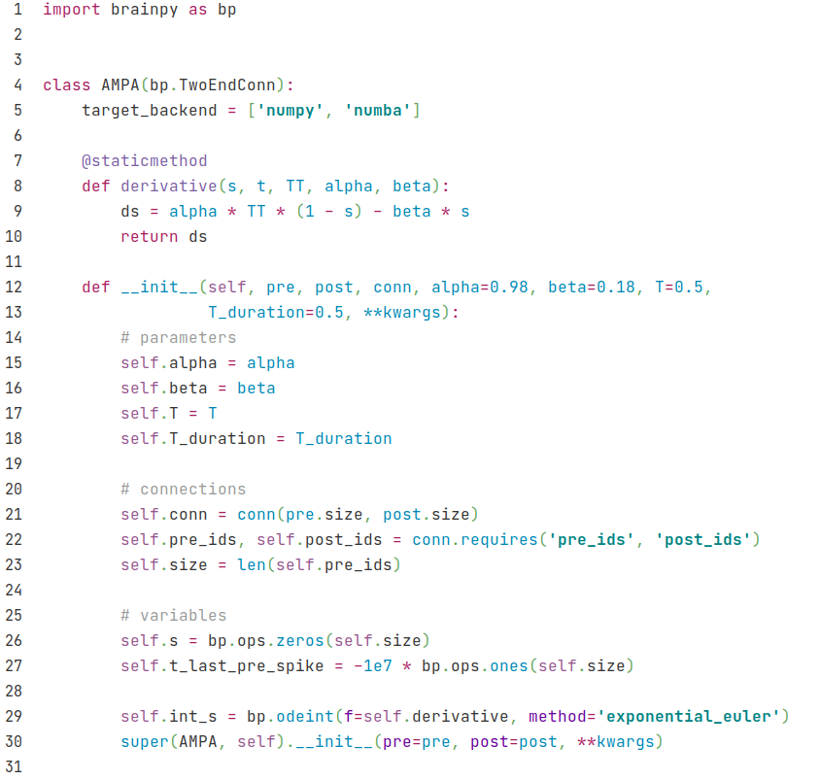
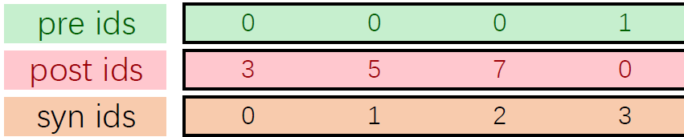
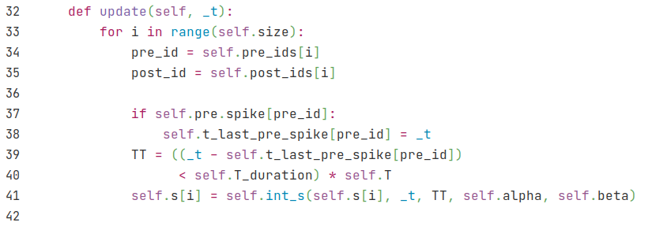
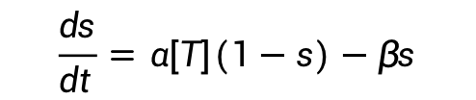
AMPA
bp.TwoEndConn class: Connections between two neuron groups
$$\frac{ds}{dt}=α[T](1−s)−βs$$
Regard [T] as a constant T, last for T_duration
Specify how the presynaptic and postsynaptic neuron groups connect to each other
For each single synapse
TT denotes [T], TT=T if pre neuron spikes within T_duration, otherwise TT=0.

Slide 2
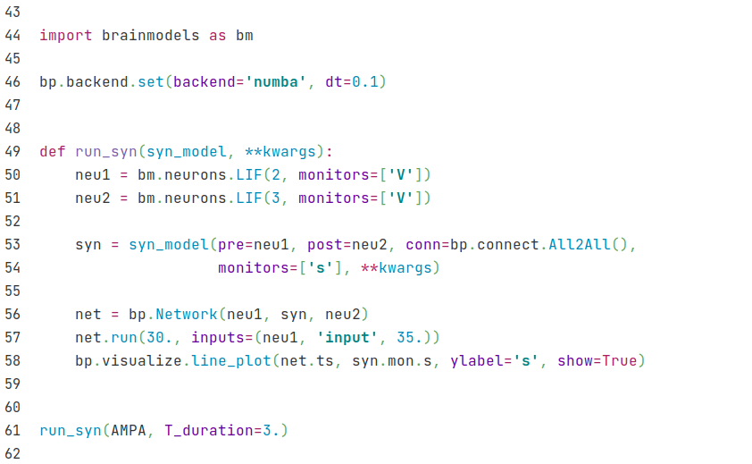
AMPA
Set numba backend
A method to run synapse
Get two LIF neuron groups from brainmodels package
Specify pre and post neurons and there connections. Here we use all to all connections provided by BrainPy.
Run AMPA synapse and set parameter T_duration to be 3.

Slide 3
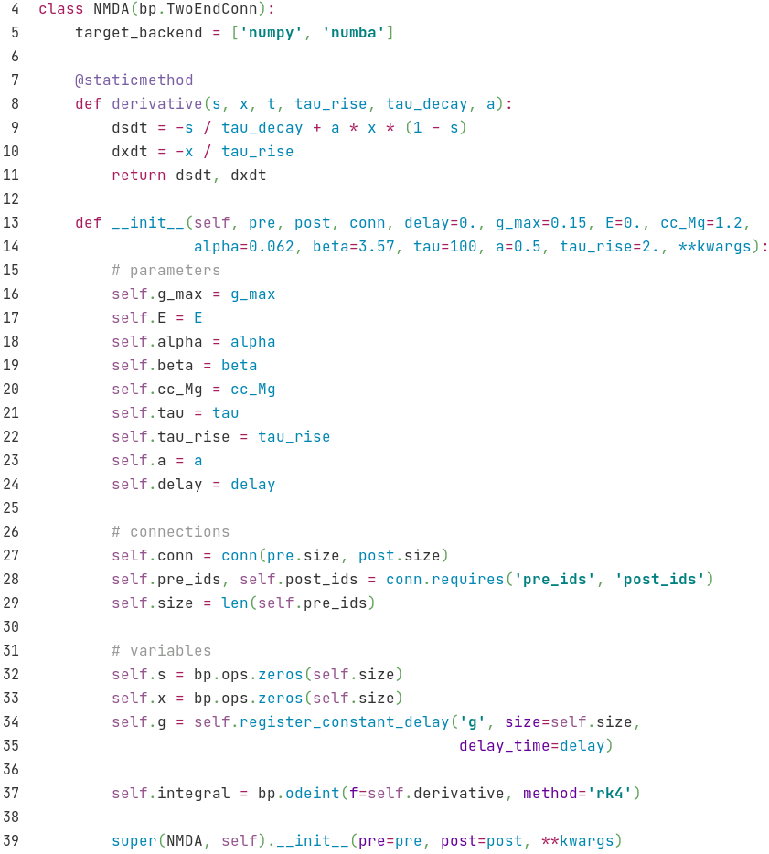
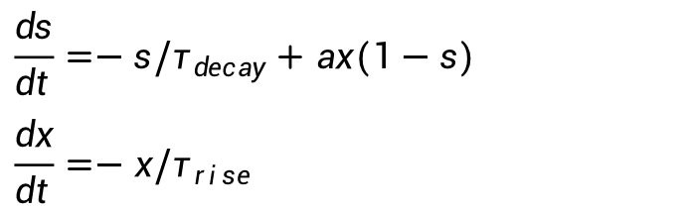
NMDA
$$\frac{ds}{dt}=−s/τ_{decay}+ax(1−s)$$
$$\frac{dx}{dt}=−x/τ_{rise}$$

Slide 4
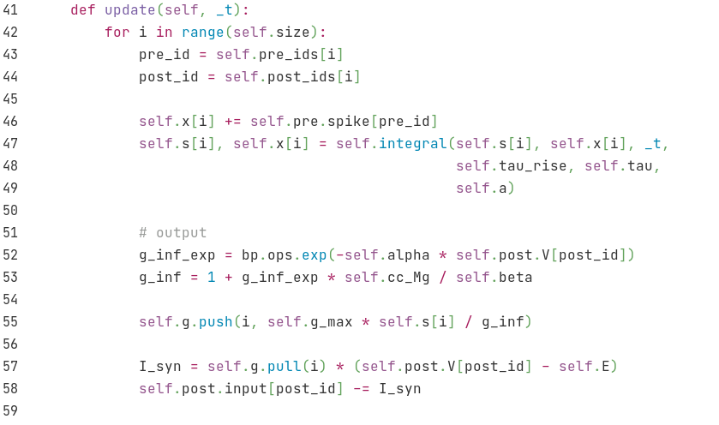


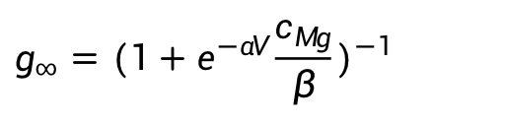
NMDA
if (pre spike), then x = x + 1
$$g_{∞}=(1+e^{−αV}\frac{c_{M g}}{β})^{−1}$$
$$g=\overline{g} g_{∞}s$$
$$I=g(V−E)$$

Slide 5
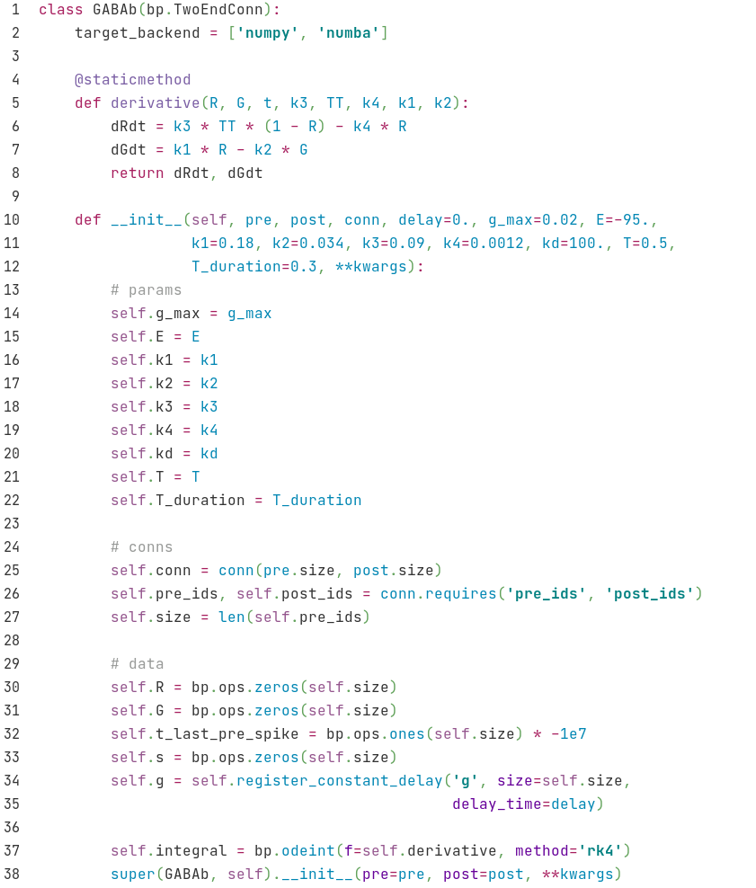
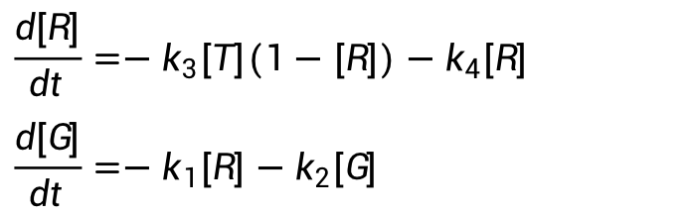
GABAb
$$\frac{d[R]}{dt}=−k_{3}[T](1−[R])−k_{4}[R]$$
$$\frac{d[G]}{dt}=−k_{1}[R]−k_{2}[G]$$
Regard [T] as a constant T, last for T_duration

Slide 6
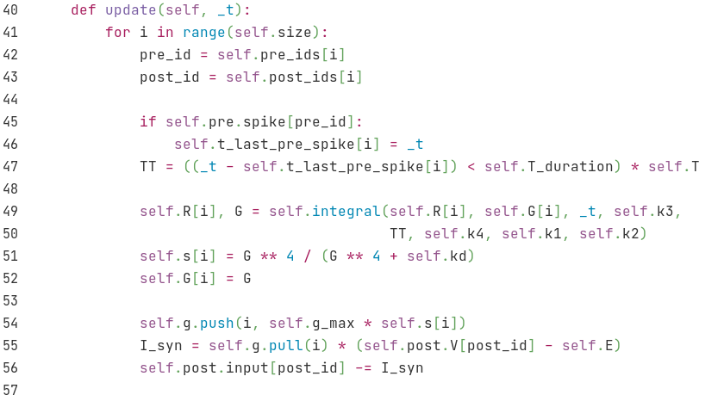



GABAb
TT denotes [T], TT=T if pre neuron spikes within T_duration, otherwise TT=0.
$$s={[G]}^{4}/({[G]}^{4}+K_{d})$$
$$g=\overline{g} s$$
$$I=g(V−E)$$

Slide 7
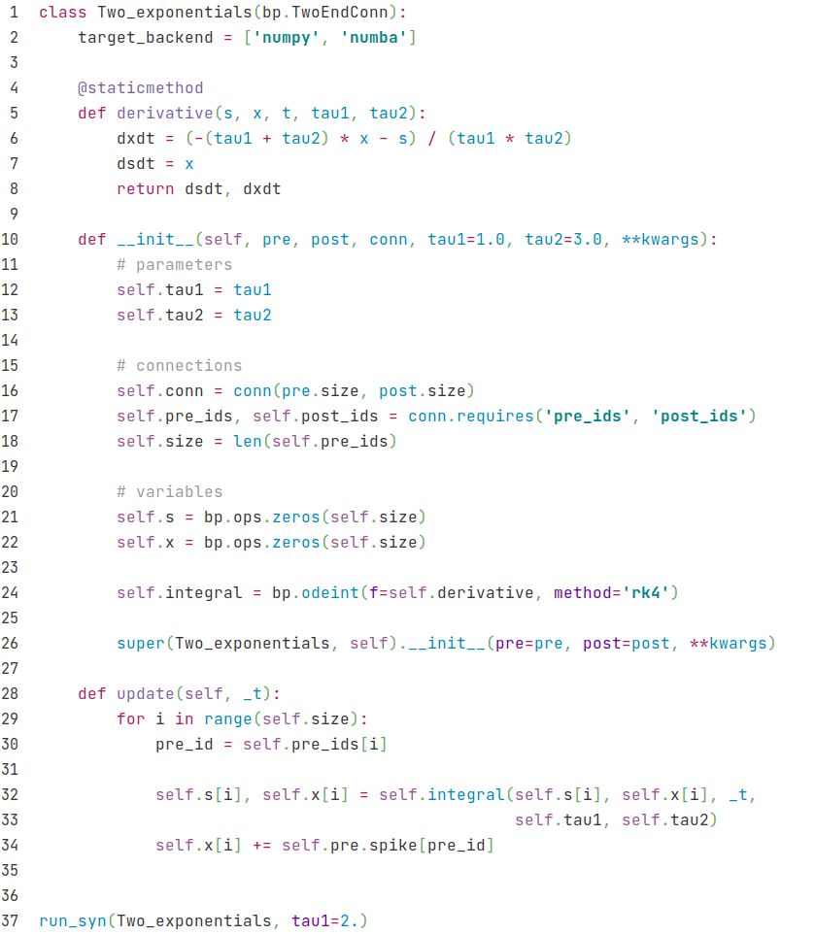
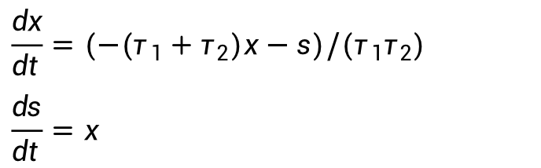
Two exponentials
$$\frac{dx}{dt}=(−(τ_{1}+τ_{2})x−s)/(τ_{1}τ_{2})$$
$$\frac{ds}{dt}=x$$
if (pre spike), then x = x + 1

Slide 8
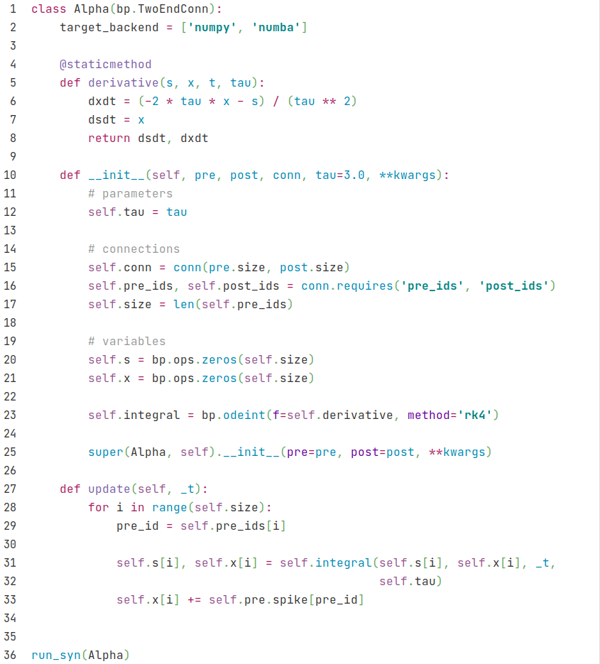
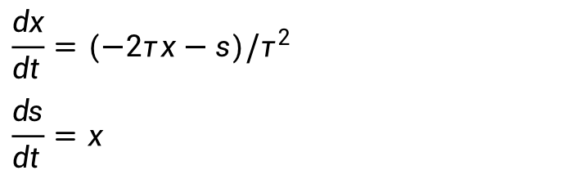
Alpha
$$\frac{dx}{dt}=(−2τx−s)/τ^{2}$$
$$\frac{ds}{dt}=x$$
if (pre spike), then x = x + 1

Slide 9
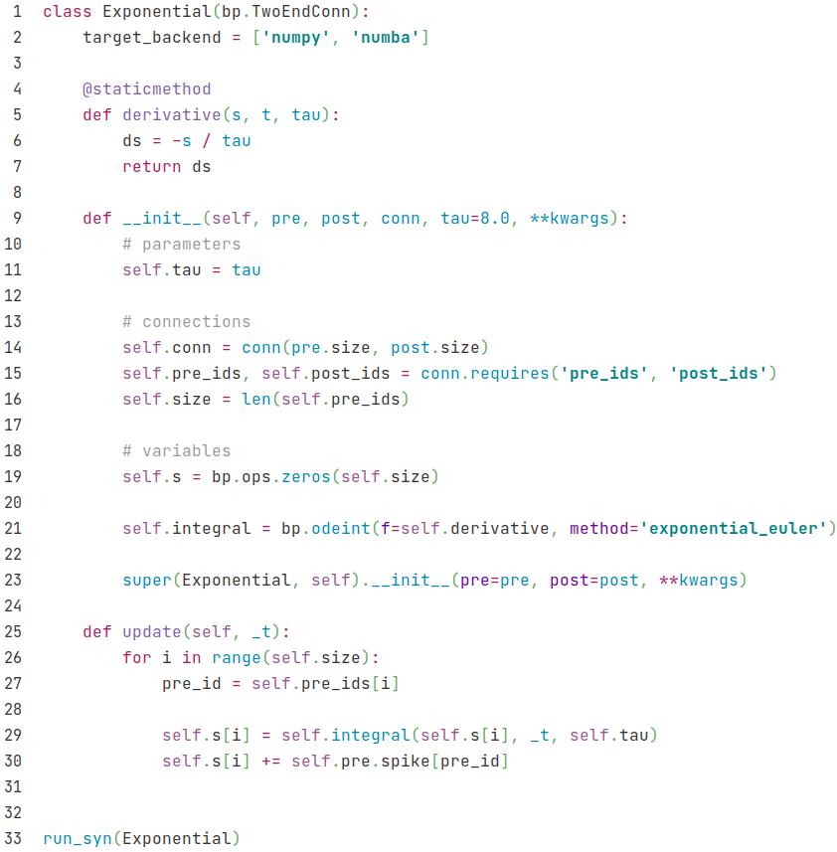
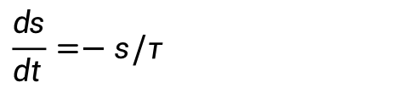
Exponentials
$$\frac{ds}{dt}=−s/τ$$
if (pre spike), then s = s + 1

Slide 10
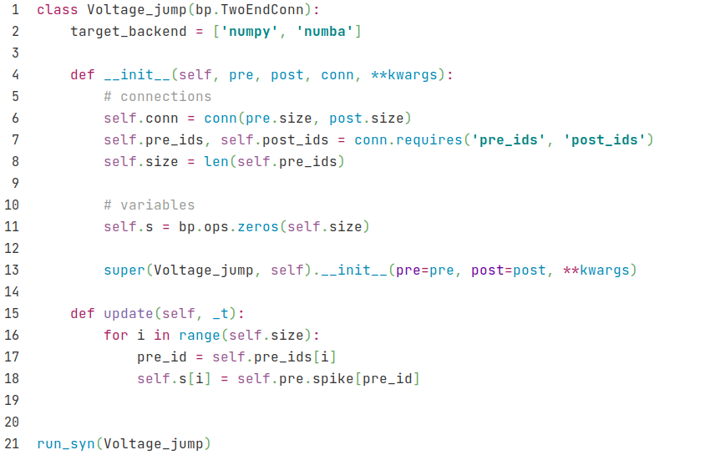
Voltage jump
if (pre spike), then s = s + 1

Slide 11
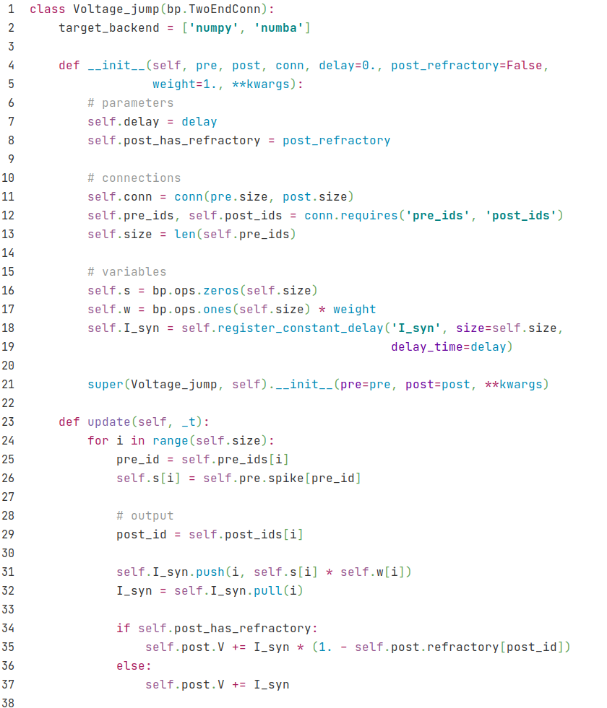
Voltage jump (V)
if (pre spike), then s = s + 1

Slide 12
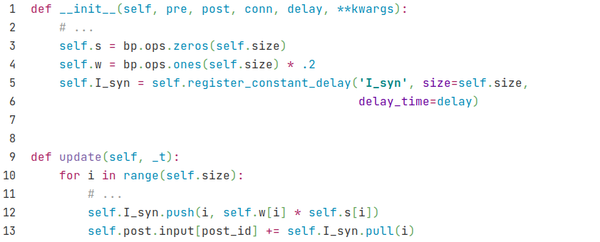
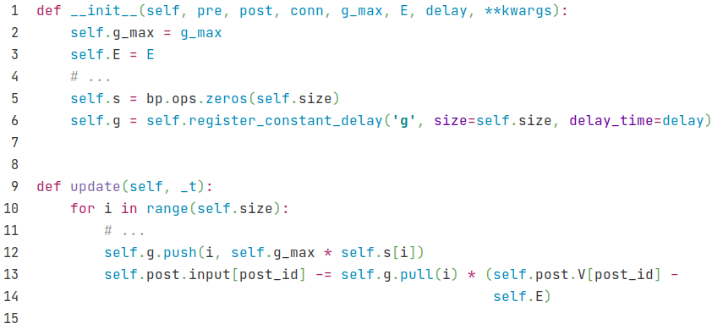

current & conductance based
set delay time before changing synaptic current by using the register_constant_delay method
use push and pull to set delay before applying synaptic current into postsynatic input.
set delay time before changing the conductance
$$g=\overline{g}s$$
$$I=g(V−E)$$

Slide 13
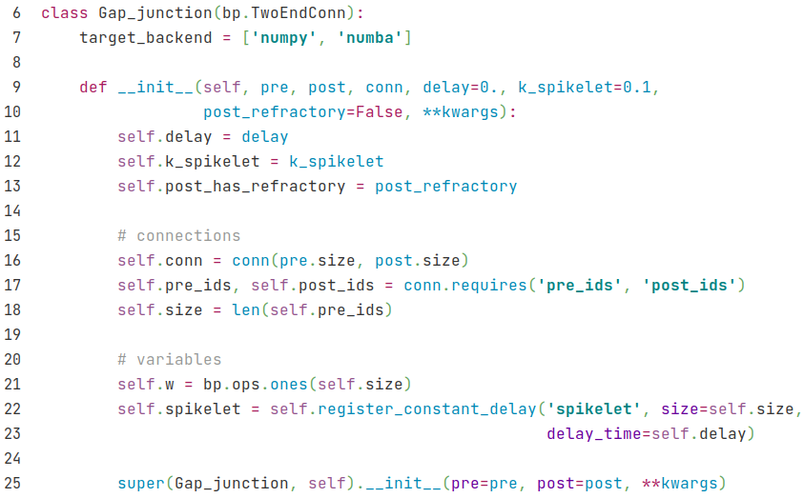
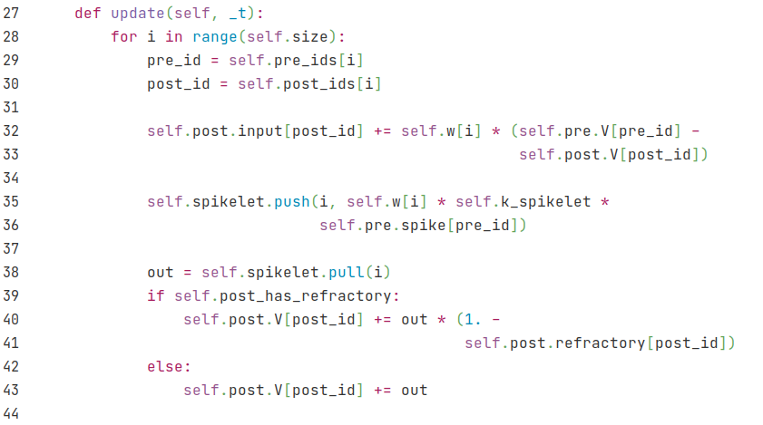

gap
$$I_{post}=w (V_{pre}−V_{post})$$

Slide 14
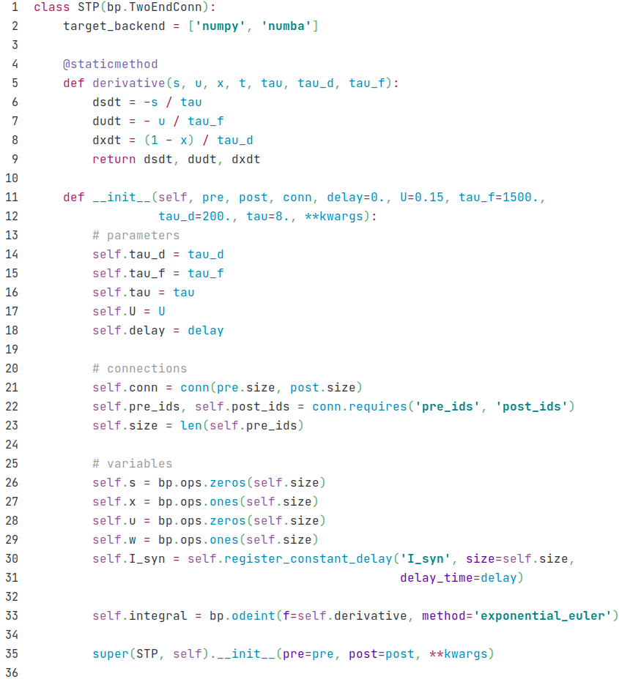

STP
$$\frac{ds}{dt}=−s/τ$$
$$\frac{du}{dt}=−u/τ_{f}$$
$$\frac{dx}{dt}=(1−x)/τ_{d}$$

Slide 15
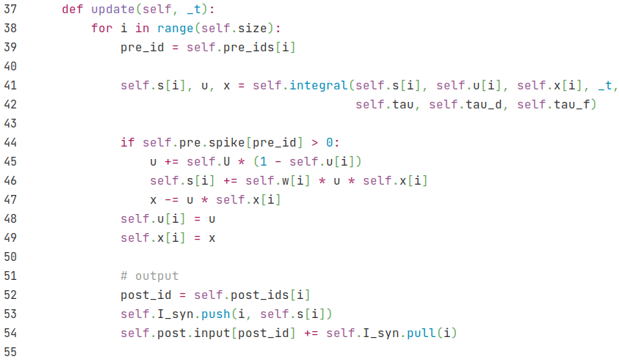
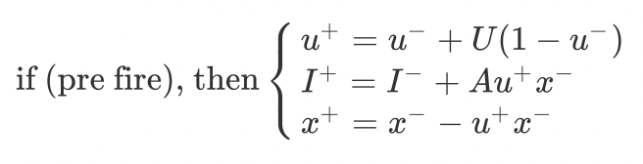
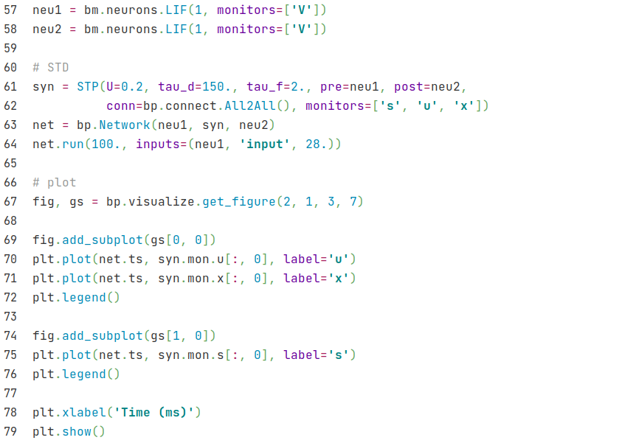
STP
set tau_d > tau_f to get STD

Slide 16
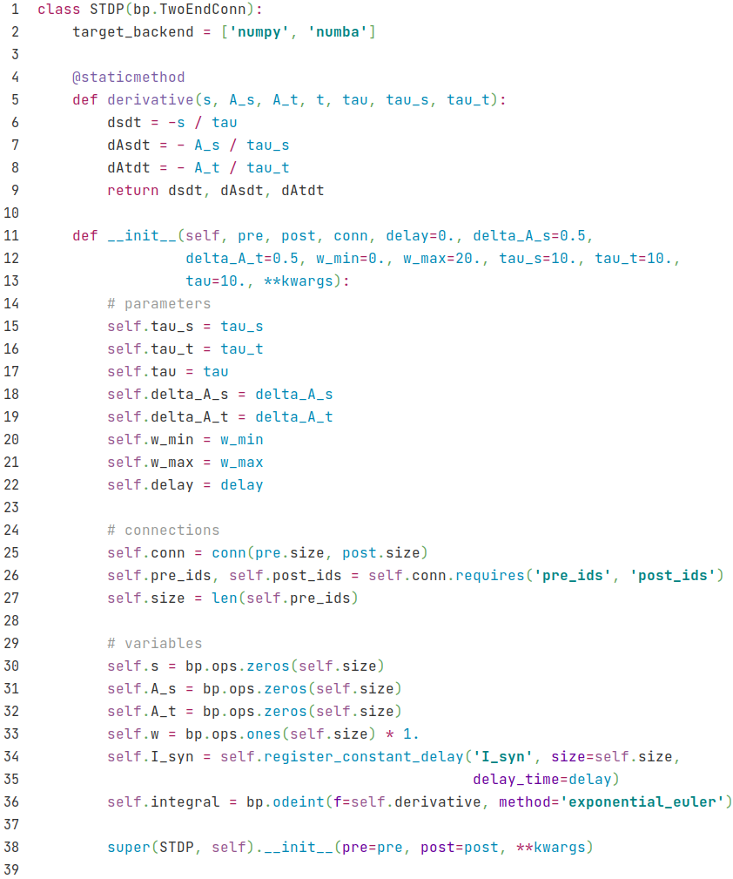

STDP
$$\frac{ds}{dt}=−s/τ$$
$$\frac{dA_{s}}{dt}=−A_{s}/τ_{s}$$
$$\frac{dA_{t}}{dt}=−A_{t}/τ_{t}$$

Slide 17
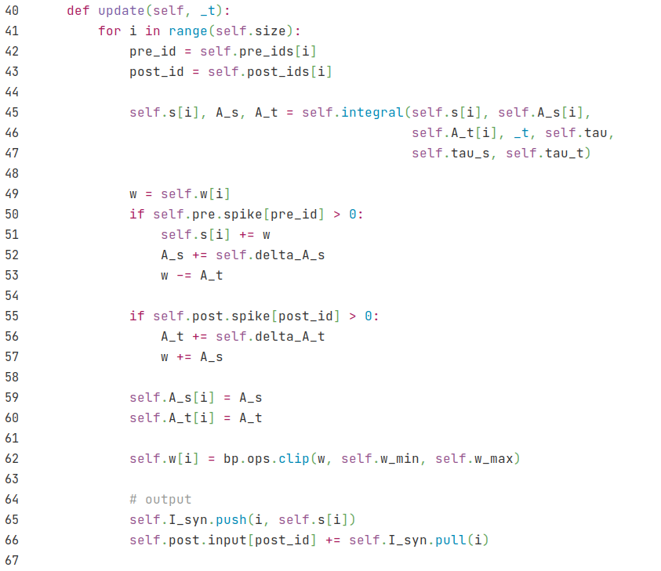
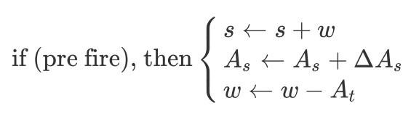
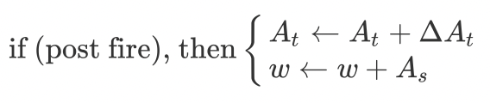
STDP
limit w

Slide 18
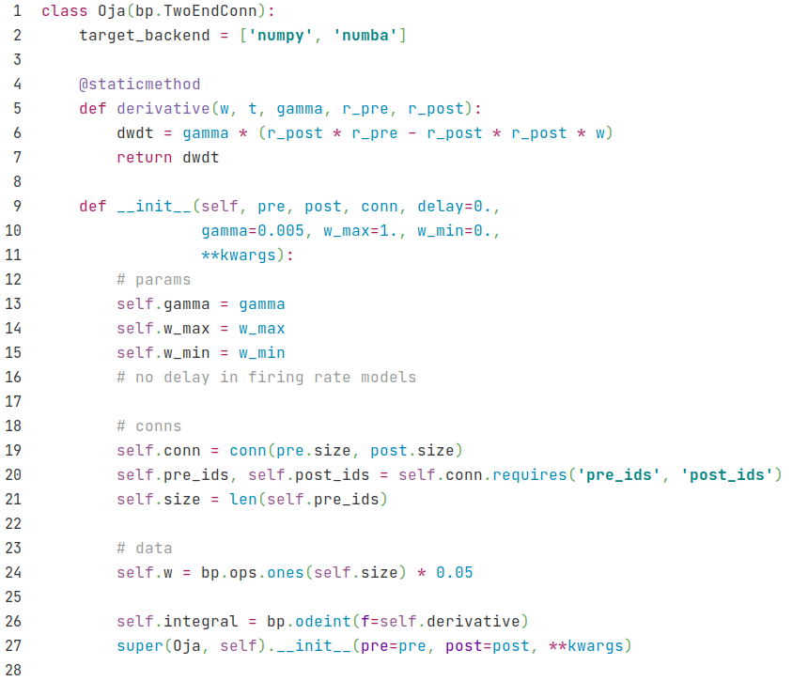
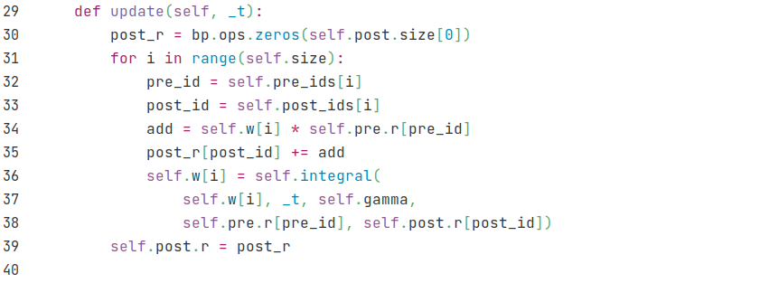




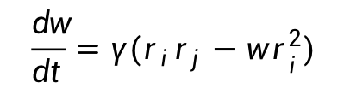
Oja
bp.TwoEndConn class: Learning rule occur between two neuron groups
$$\frac{dw}{dt}=γ(r_{i}r_{j}−w r_{i}^{2})$$
rate model:$r_{i}={\sum_{j}{w_{ ij}}}_{ }r_{j}$
$$let {add}_{j}={w_{ ij}r}_{j}$$
then $r_{i}={\sum_{j}{{add}_{j}}}_{ }$
use self.post.r, not post_r, see next line for the reason.
$r_{i}={\sum_{j}{{add}_{j}}}_{ }$
Note that the effects of pre groups are simultaneously, so we update post_r after the for loop

Slide 19
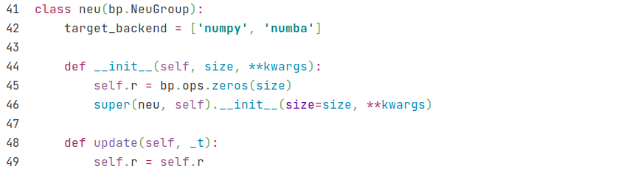
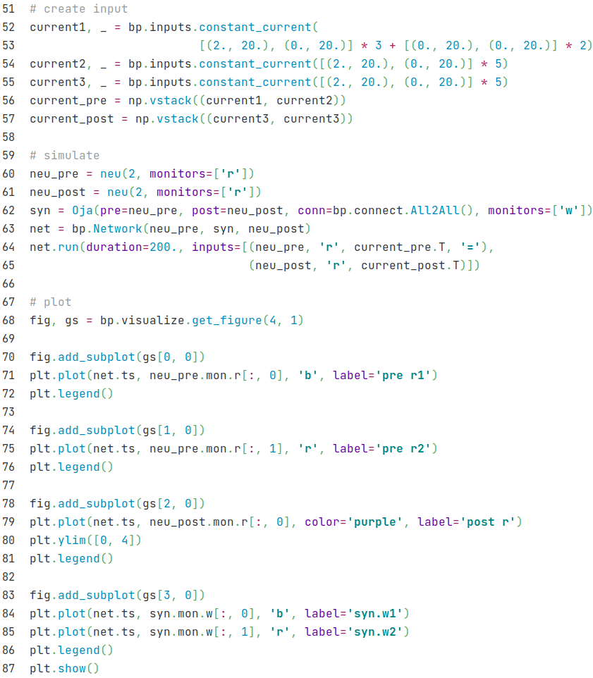
Oja
we need a firing rate neuron with parameter r
we only need a simple unit to test oja's rule.
current1: input to pre-group1
current2: input to pre-group2
current3: input to post group, the same as current2.(fire together)
simulation is like synapse model.
Here we give inputs to both pre-group and post-group.
index [:, 0], group 1
index [:, 0], group 2

Slide 20
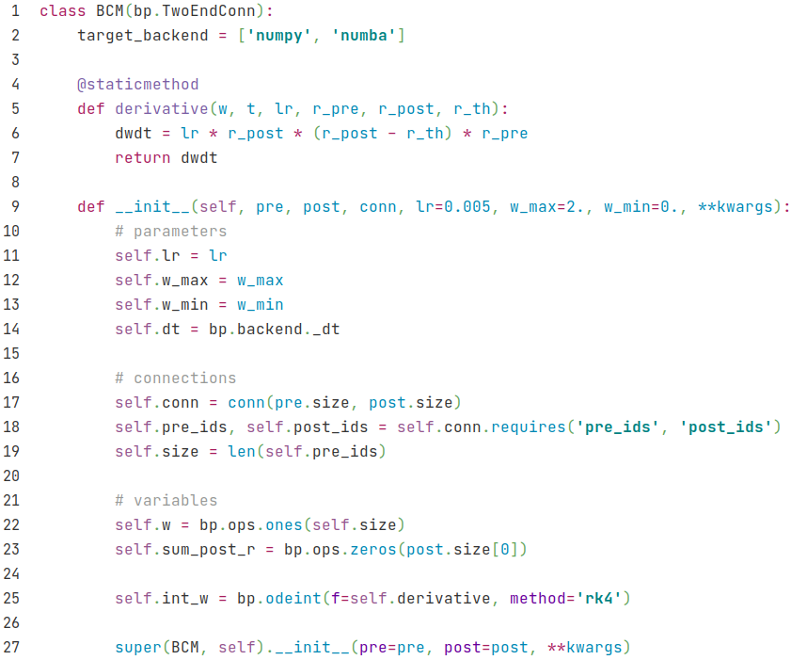
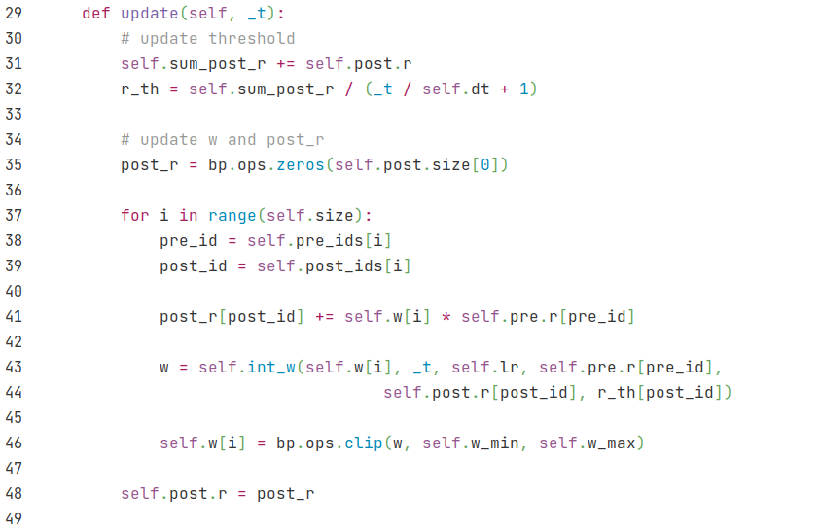

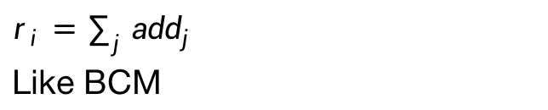

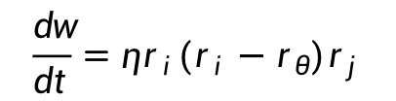
BCM
$$\frac{dw}{dt}=ηr_{i}(r_{i}−r_{θ})r_{j}$$
$$r_{θ} = \frac{\sum_{t}{{dtr}_{i}}}{T}$$
self.dt +1 here since self.dt begin with 0
rate model:$r_{i}={\sum_{j}{w_{ ij}}}_{ }r_{j}$
let ${add}_{j}={w_{ ij}r}_{j}$
then $r_{i}={\sum_{j}{{add}_{j}}}_{ }$
limit w
$r_{i}={\sum_{j}{{add}_{j}}}_{ }$
Like BCM

Slide 21
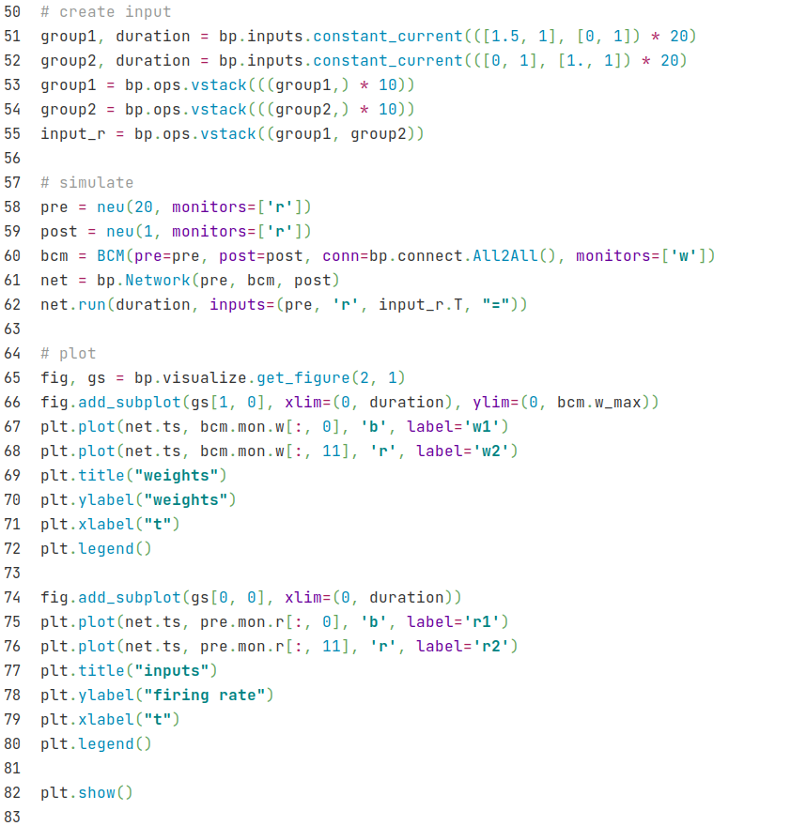
BCM

