Slide 1


Lab2: User Programs
TA Session
Prepare1 : Open up Pintos in your IDE/Text Editor
Prepare2 : Launch Pintos container
TA : zhongyinmin
Email : zhongyinmin@pku.edu.cn
Github : PKUFlyingPig

Slide 2
Some announcements:
Lab 2 Code will due next week
No grace day
Start early, Start early, Start early
You can complete Lab2 from a clean codebase

Slide 3
Contents
Pintos Disk and File System
System Call
Interrupt Handling
Lab2 tasks and suggestions

Slide 4

Where are the User Programs?
Source files are under /src/examples/ directory
Run `make` under /src/examples/
ELF files
Host File System
Host Disk
Pintos File System
Pintos Disk

Slide 5
Debug example:
Run `make && cd build` under /src/userprog/ directory
pintos --gdb --filesys-size=2 -p ../../examples/echo -a echo -- -f -q run 'echo iloveos’
Details on Lab Document
Debug mode
2MB Disk
Put
Host File
Pintos File
Quit
Actions
Format FS

Slide 6
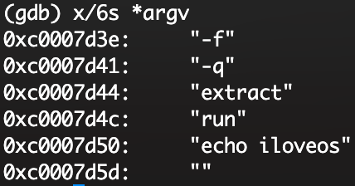
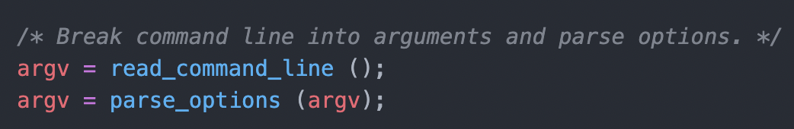
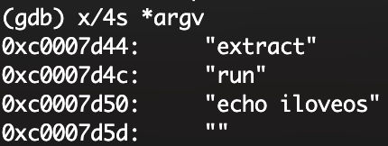
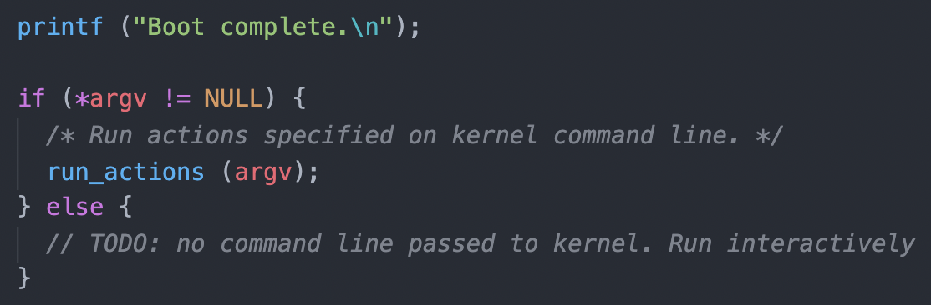
Action: run 'echo iloveos’
pintos_init():
Lab2 User Program
Lab0 Shell
Notes:
parse_options 会把 option去掉
extract 是一个特殊的 action，是在执行 pintos 的时候 –p 这个 option 添加的

Slide 7
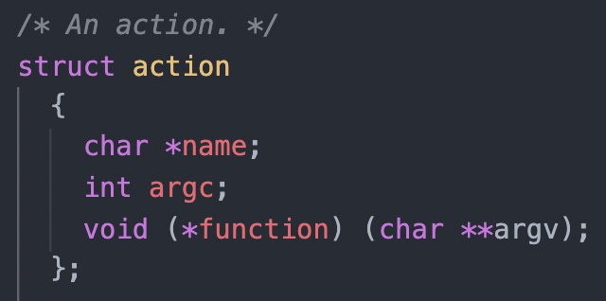
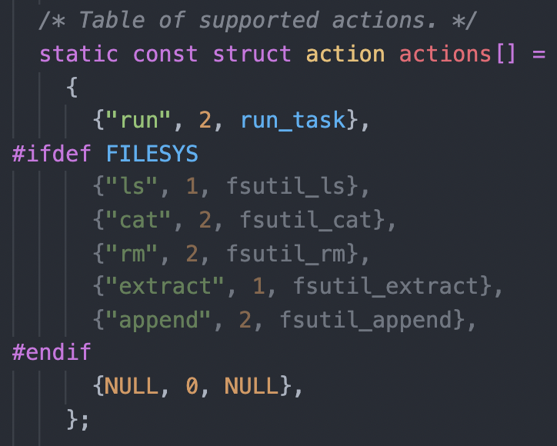
Action: extract run 'echo iloveos’
run_actions():

Slide 8
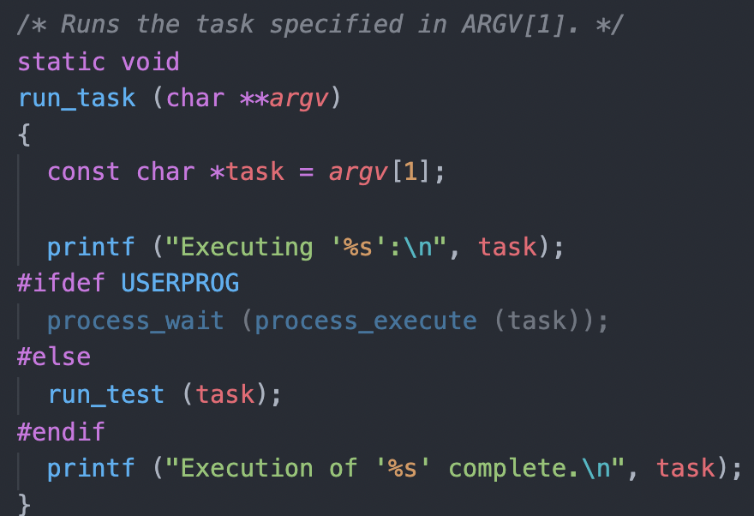
Action: extract run 'echo iloveos’
run_task():
Q1: What is ARGV[0] ?
Q2: What does run_test() do ?
Notes:
ARGV[0] = run
run_test() run the test cases in lab1

Slide 9
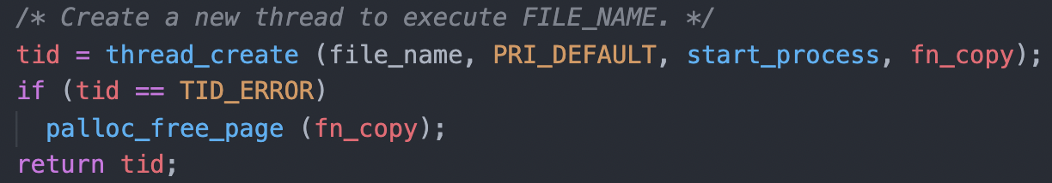
Action: run 'echo iloveos’
process_execute():
Main Thread:
Ready List:
start_process
T1
T2

Slide 10
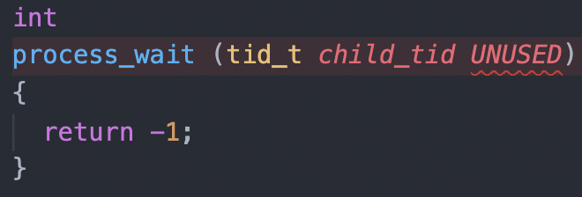
Main Thread
run_task():
Return Immediately !!

Slide 11
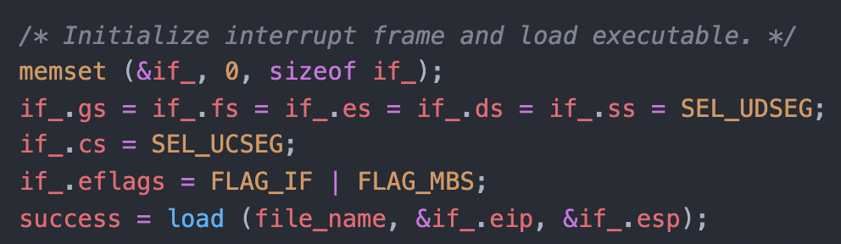
start_process:
Load the ELF file from Disk into memory
We are still in the kernel !!
Initialize interrupt frame (eip, esp, segment registers, eflags)
Start the user process by simulating a return from an interrupt
https://www.ibiblio.org/gferg/ldp/GCC-Inline-Assembly-HOWTO.html

Slide 12
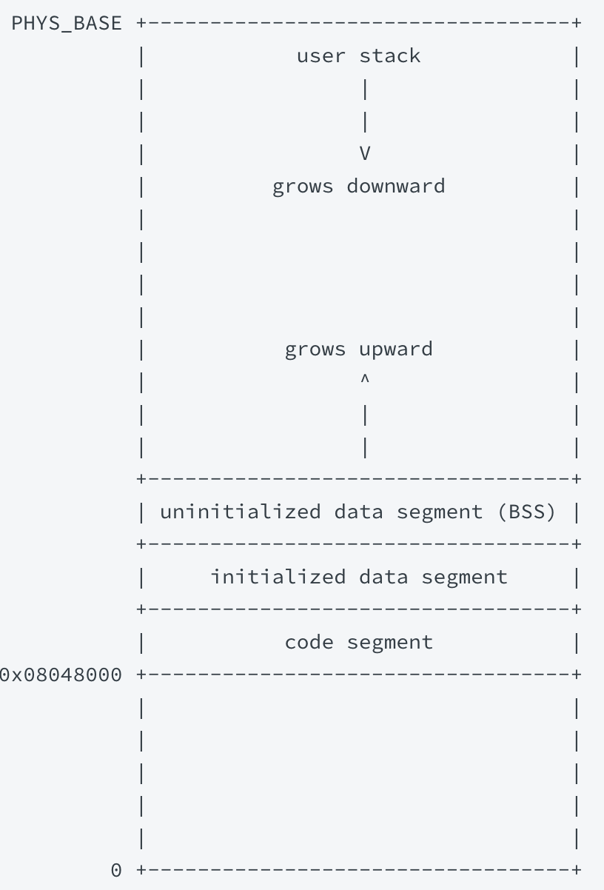
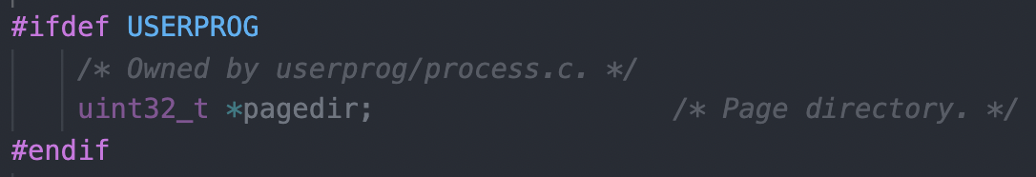
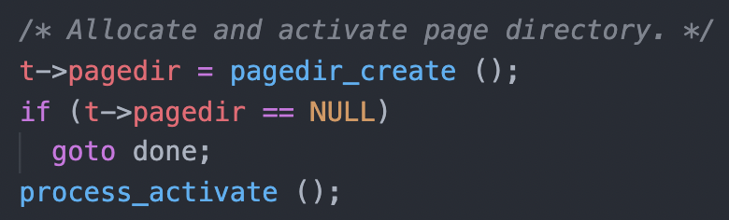
load:
PHYS_BASE + 64MB
Kernel Mappings
struct thread:
Create a new page directory:
NULL
init_page_dir
t->pagedir =
Others
Move t->pagedir into register CR3
Virtual Address Space

Slide 13
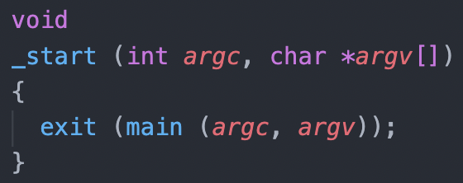
load:
PHYS_BASE + 64MB
Kernel Mappings
if_->esp
argv
argc
Read and verify ELF executable header
Read ELF program header and load segments (code, data ……)
Set up if_->stack (You will fix this in Exercise2: Argument Passing)
Set up if_->eip with the entry point in executable header
After loading, start the user process by simulating a return from an interrupt with interrupt frame if_
/src/lib/user/entry.c:
BSS
Data
if_->esp
Code
Virtual Address Space

Slide 14
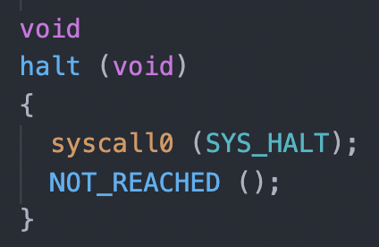
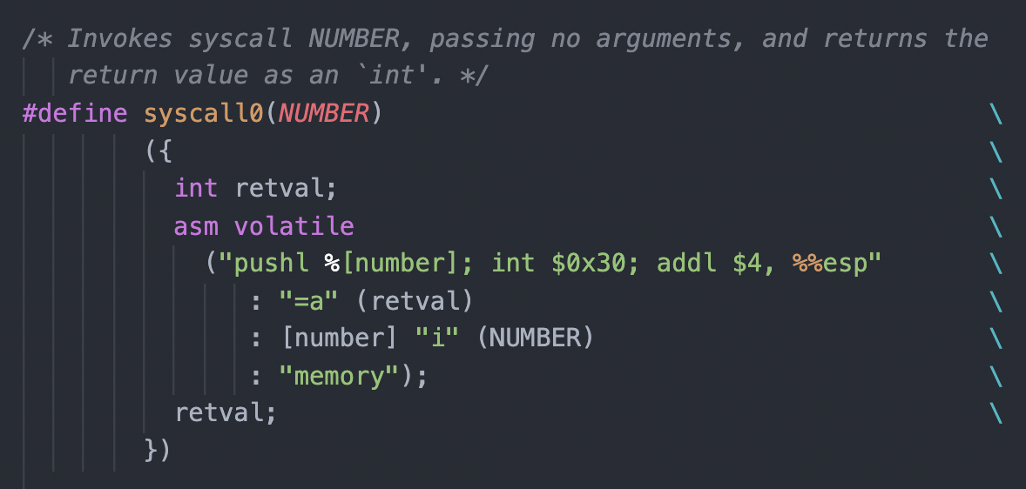
Wow, your process is running in User Space!
But, we want system call support !!
/src/lib/user/syscall.h:
/src/lib/user/syscall.c:

Slide 15
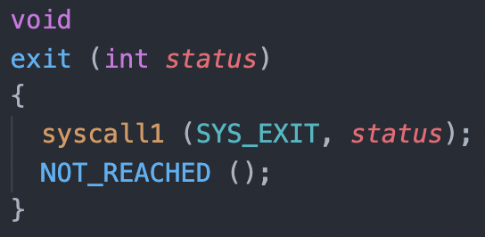
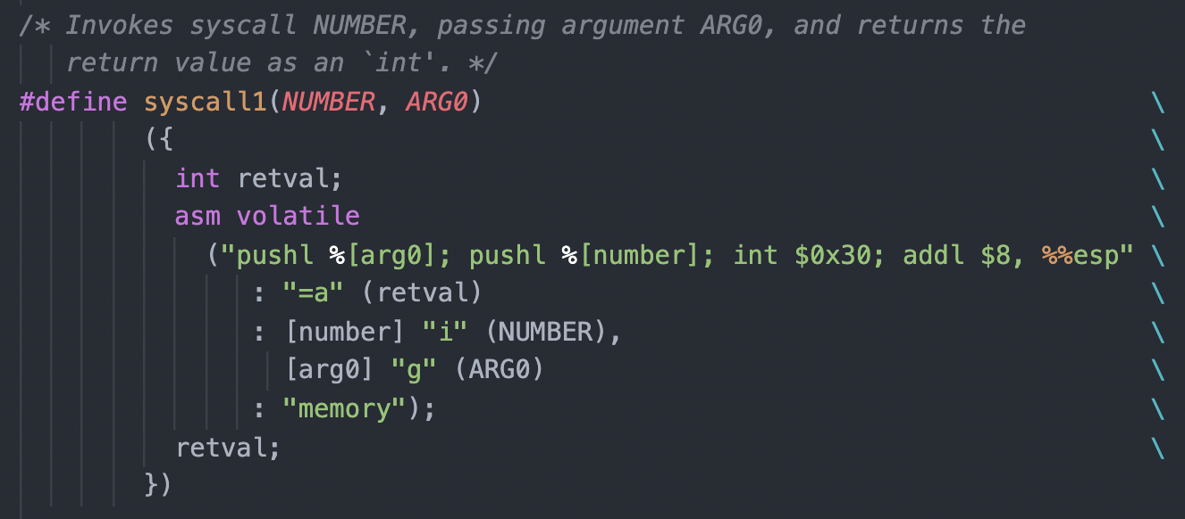
Wow, your process is running in User Space!
But, we want system call support !!
/src/lib/user/syscall.h:
/src/lib/user/syscall.c:

Slide 16
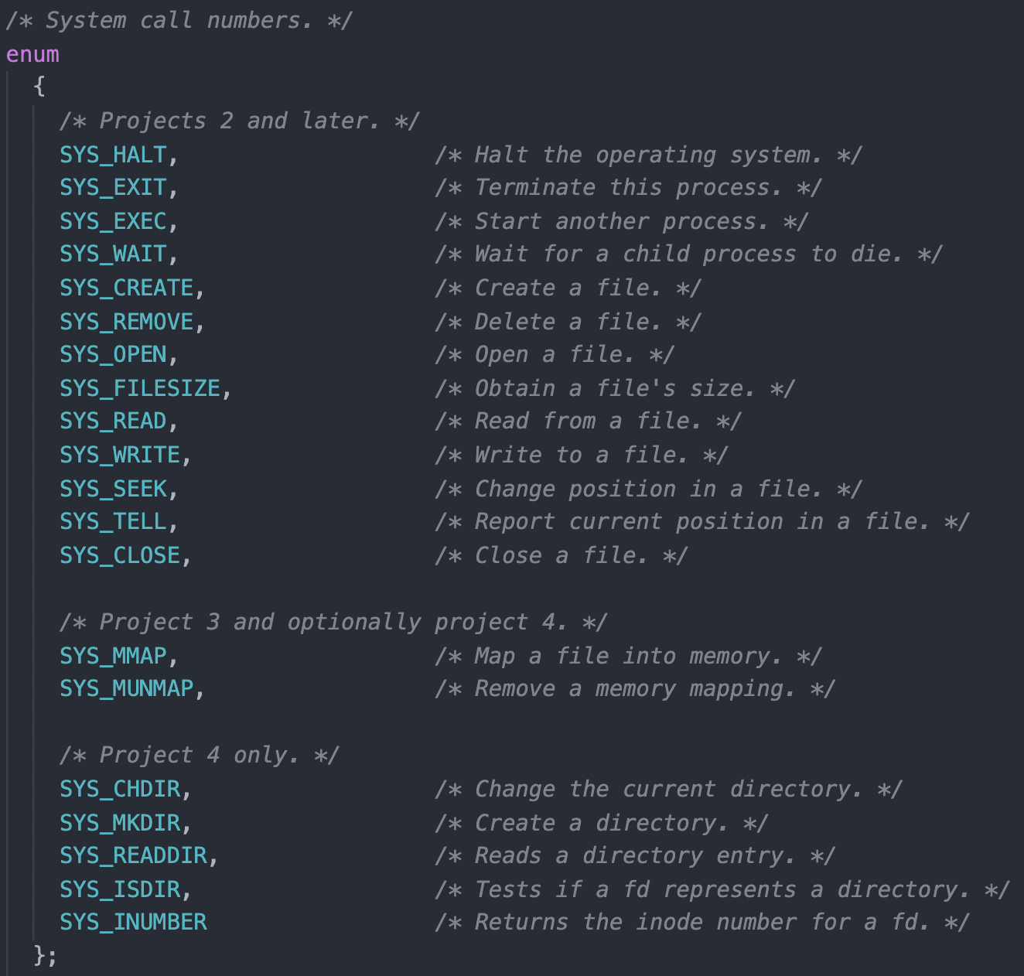
System Call Numbers:
/src/lib/syscall-nr.h

Slide 17
Now, all the magic is behind `int 0x30`
User Space
Kernel Space

Slide 18
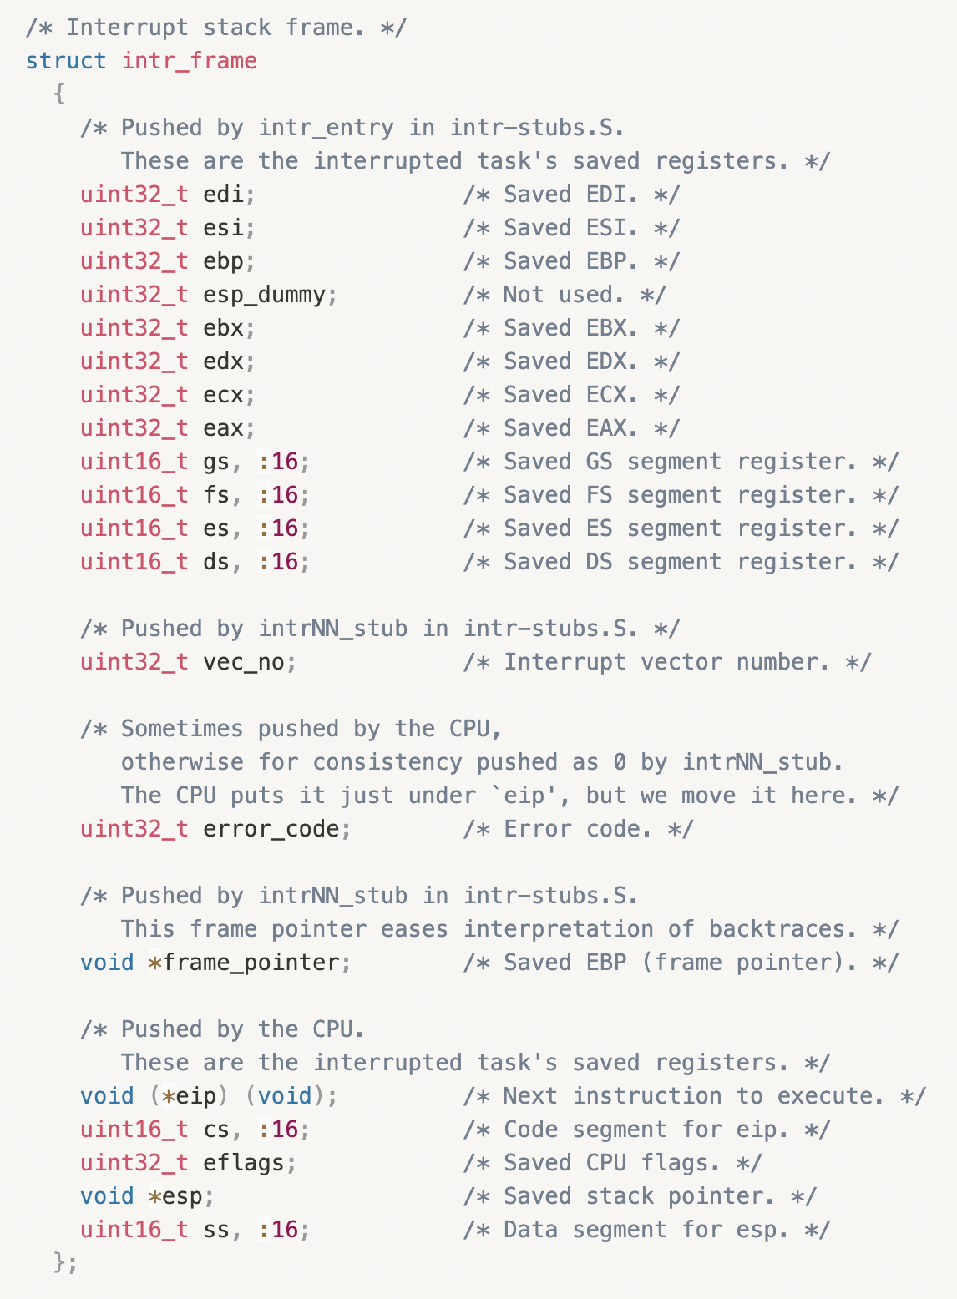

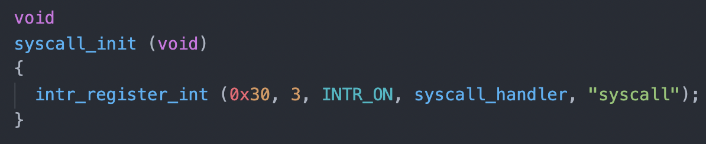
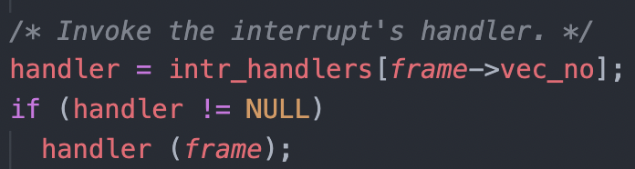
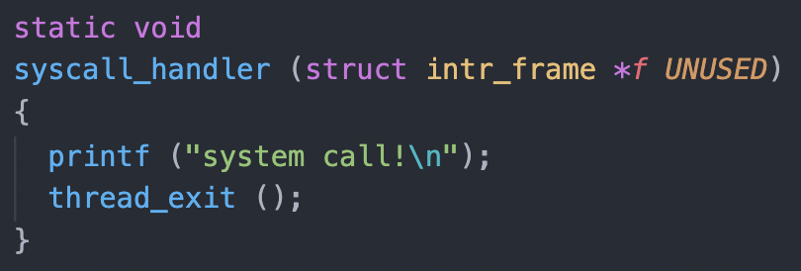
Interrupt Handler
Hardware (CPU) && Software (OS)
Details in Lecture Notes
save the context of the interrupted process into intr_frame
/src/threads/interrupt.c:
/src/userprog/syscall.c:
Implement in Lab2 ~~

Slide 19
Contents
Pintos Disk and File System
System Call
Interrupt Handling
Lab2 tasks and suggestions

Slide 20
Some useful tips:
Pintos exec == Unix fork + exec
You can use malloc in kernel (#include “threads/malloc.h”)
Useful GDB command: loadusersymbols
Reference to xv6 implementation
multi-oom testcase will take some time, be patient

Slide 21
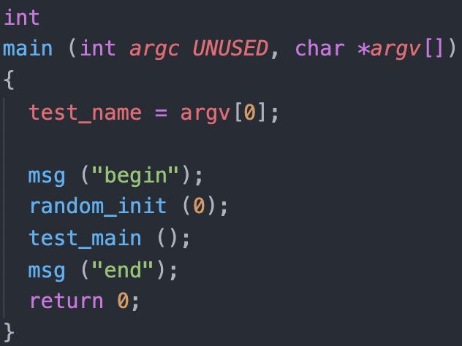
Suggested Order of Implementation:
Step1: Argument Passing
Set up the stack after loading
Argument Passing details in Lab Doc
Pass all the args-xxx tests
/src/tests/main.c:
Page Fault !!

Slide 22
Suggested Order of Implementation:
Step2: Halt System Call
Argument Passing
System Call Infrastructure

Slide 23
Suggested Order of Implementation:
Step3: Some temporal workaround
The exit system call (barely work is fine)
The write system call for writing to fd 1, the system console
change process_wait() to an infinite loop (one that waits forever)

Slide 24
Suggested Order of Implementation:
Step4: Accessing User Memory
User programs will pass arguments (char*, int, unsigned) into kernel
These arguments are on the user stack (esp is saved in intr_frame)
Ensure the address validity (in user page table)
Avoid repeating code !!
Two implementation suggestion (in Lab Doc)

Slide 25
Suggested Order of Implementation:
Step4: Process Control System Call
Step5: FS System Call
exit, exec, wait
Design all at first, they may share some data structures
No need to understand file system implementation
Read the interfaces in /src/filesys/file.c, /src/filesys/filesys.c
Pass all tests but rox-simple, rox-child, rox-multichild

Slide 26
Suggested Order of Implementation:
Step7: Denying Writes to Executables
Why?
Close a file will re-enable writes
Keep the executable file open during execution

Slide 27
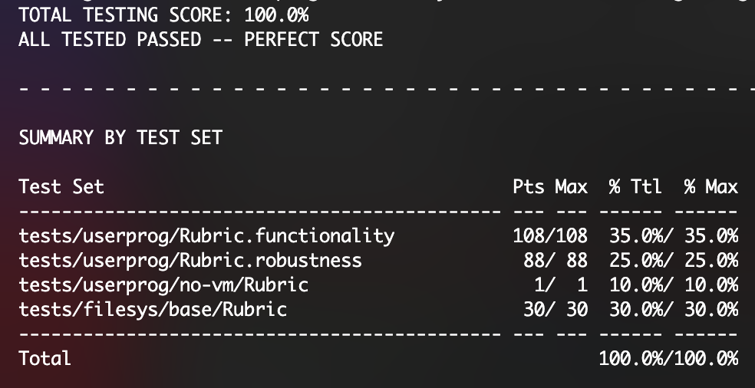
Suggested Order of Implementation:
Step8: Cheers !!!

Slide 28
Enjoy Your Pintos Journey ~~
Any Problem ?

