Slide 1
DCFEE
A Document-level Chinese Financial Event
Extraction System based on Automatically
Labeled Training Data
Huang Yang, YuBo Chen, Kang Liu
Institution of Automation,
University of Chinese Academy of Science

Slide 2
Event Extraction, aims at discovering event mentions, and extracting events which contain event triggers and event arguments from text
Event mentions: A sentence that mentions an event, including a distinguished trigger and involving arguments
Event Triggers: The word that most clearly expresses the occurrence of an event
Event arguments: The entities that fill specific roles in the event

Slide 3
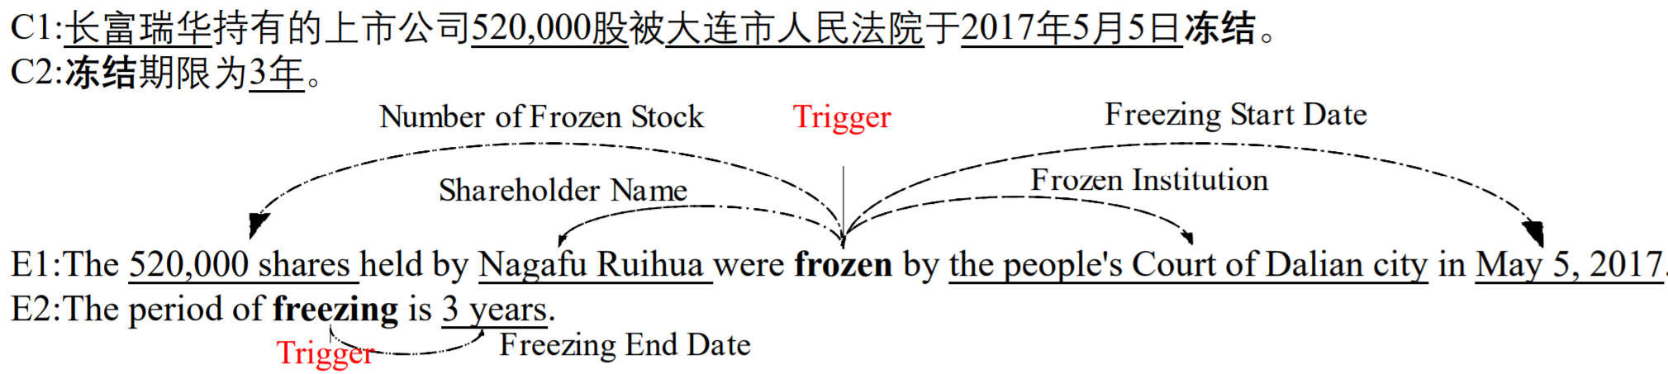
Event mention: Equity Freeze
Event Trigger: frozen, freezing
Event arguments( with different roles):
Nagafu Ruihua (Role=Shareholder Name)
520,000 shares (Role=Num of Frozen Stock)
People’s Court of Dalian city (Role=Frozen Institution),
May 5,2017 (Role=Freezing Start Date)
3 years (Role=Freezing End Date).

Slide 4
Two Challenges
Lack of data:
no labeled corpus for EE in the Chinese financial field
Document-level EE:
event arguments are distributed in the different sentences

Slide 5
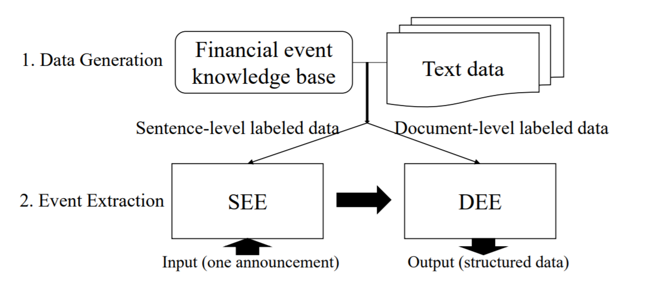
DCFEE Framework
Automatically generate large amounts of labeled data and extract document-level events from financial announcements.
Document level EE system mainly based on a neural sequence tagging model, a key-event detection model, an arguments-completion strategy.

Slide 6
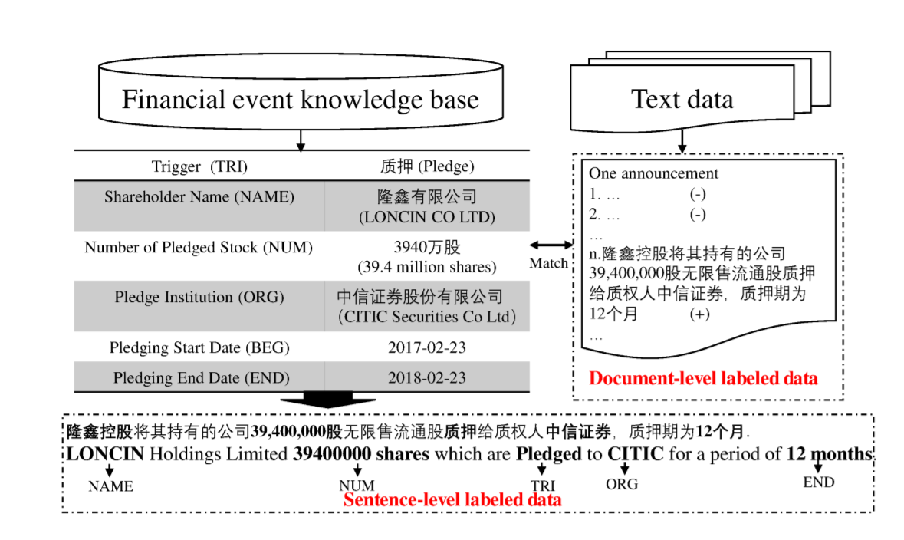
Data generation
Data source:
①financial event knowledge databases
Nine common financial event types contains key event arguments with roles
②The unstructured text data come from official announcements
Method of Generation:
One sentence contains the most event arguments and driven by a specific trigger is likely to be an event mention in an announcement

Slide 7
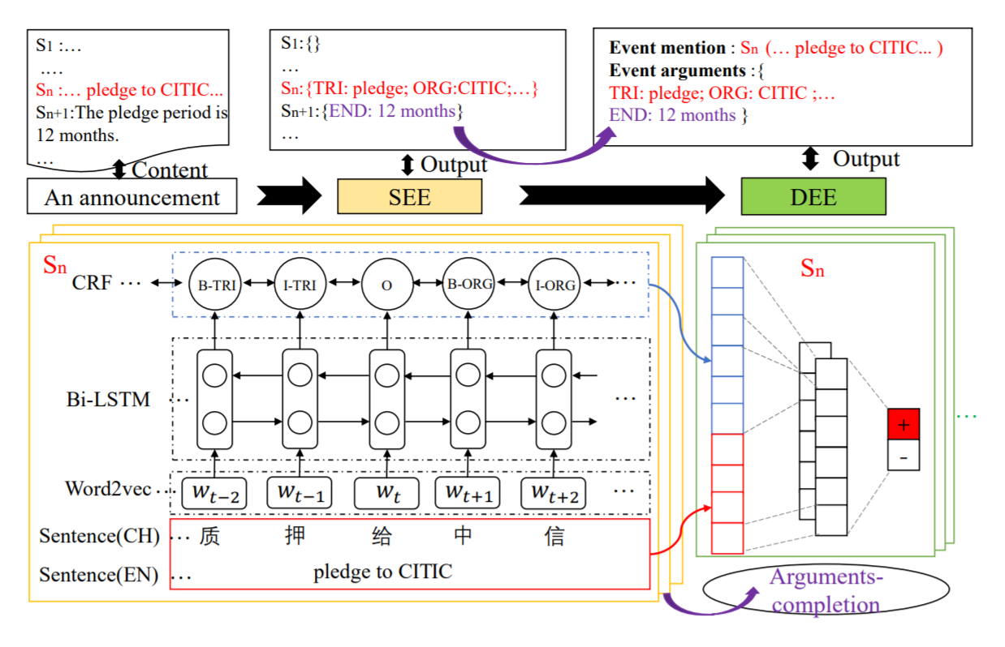
Event Extraction
SEE:
Use Bi-LSTM-CRF model
Sentences are represented in the BIO format
DEE:
①key event detection model:
one is representation of event arguments and event triggers
one is the vector representation of sentence
Classify: key event or not
②arguments completion strategy:
Pad the missing event

Slide 8
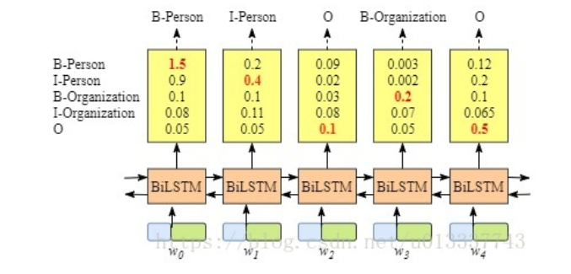
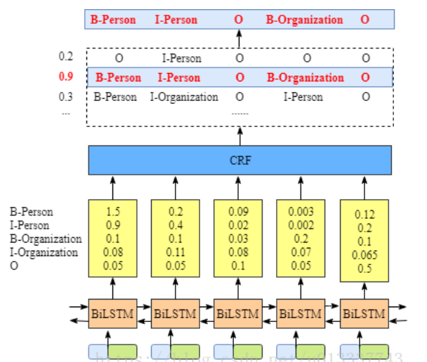
Bi-LSTM-CRF

Slide 9
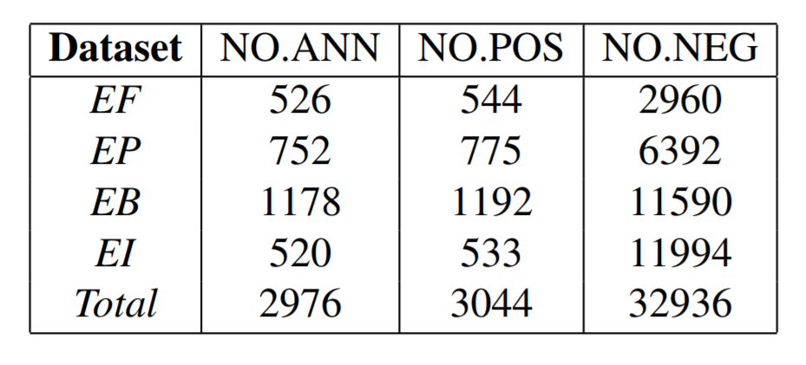
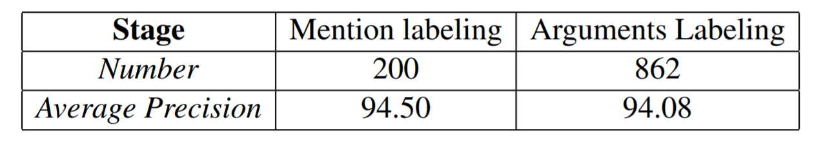

Slide 10
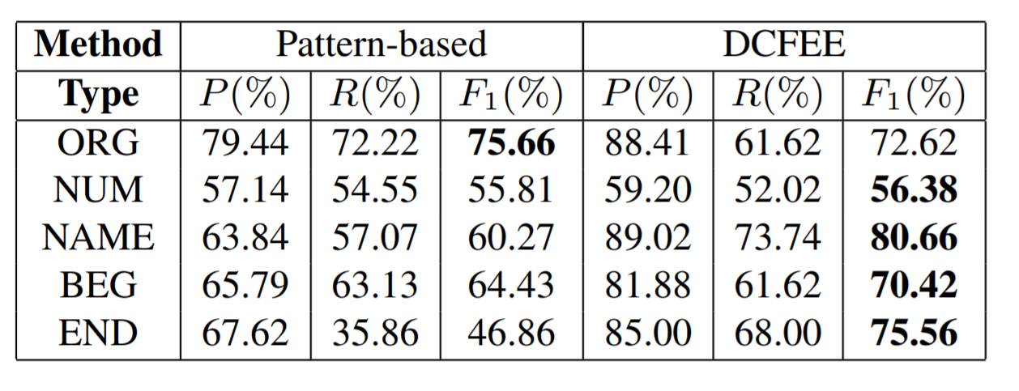
a pattern for a freeze event:
Frozen institution(ORG)+
Trigger word(TRI)+
Shareholder names(NAME)+
time
http://159.226.21.226/financial_graph/online-extract.html

Slide 11
Automatically Labeled Data Generation for
Large Scale Event Extraction
YuBo Chen, Shulin Liu, Xiang Zhang
Institution of Automation,
University of Chinese Academy of Science

Slide 12
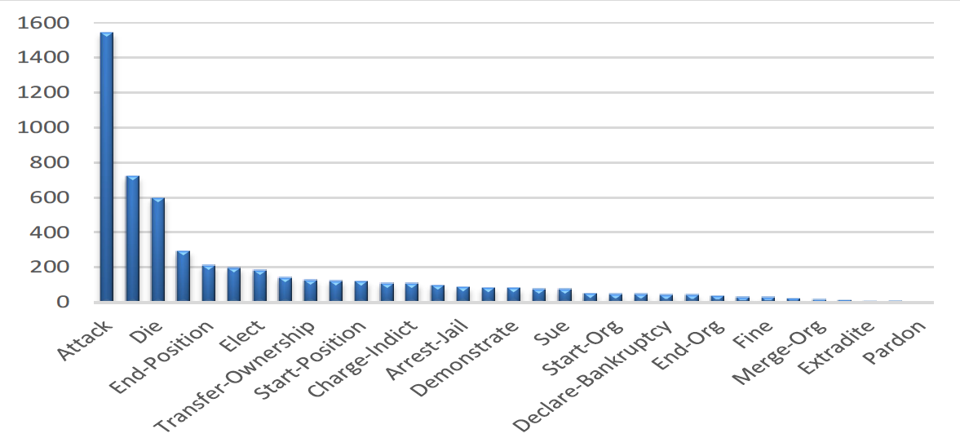
Solve data labeling problem
Automatically label training data via World knowledge and linguistic knowledge

Slide 13
Distant Supervision
Two entities have a relationship in a known knowledge base, the all sentences that mention these two entities will express that relationship in some way.
Two challenges
Triggers are not given out in existing knowledge bases
Arguments for a specific event instance are usually mentioned in multiple sentences.

Slide 14
Data Sources
Freebase： semantic knowledge base which makes use of mediators to merge multiple values into a single values
FrameNet: linguistic resource storing in formation about lexical and predicate argument semantics.
Wikipedia: a well known knowledge database with texts

Slide 15
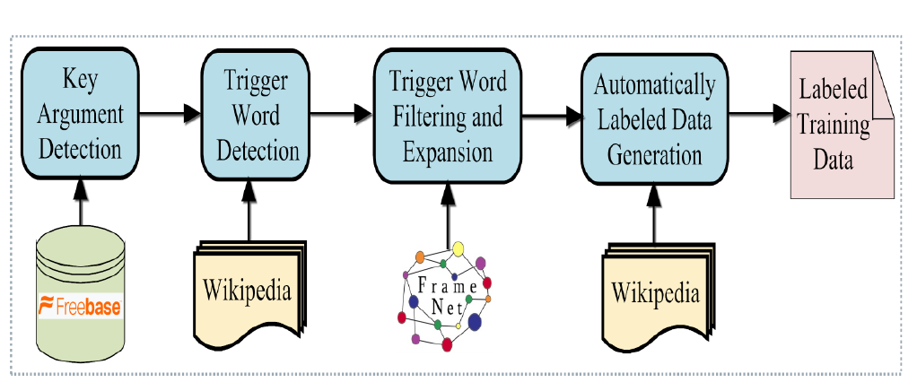
Method of Generating Training Data

Slide 16
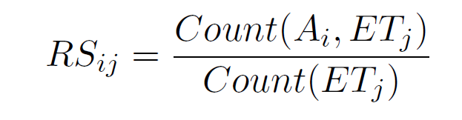
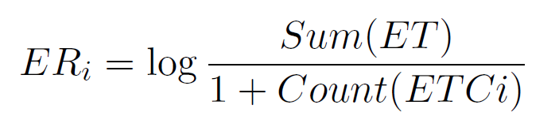
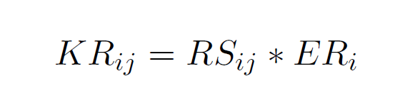
Key Argument Detection
detect key arguments for each event type via Freebase.
Use Key Rate (KR) to estimate the importance of an argument to a type of event
Role Saliency (RS):
Event Relevance (ER):

Slide 17
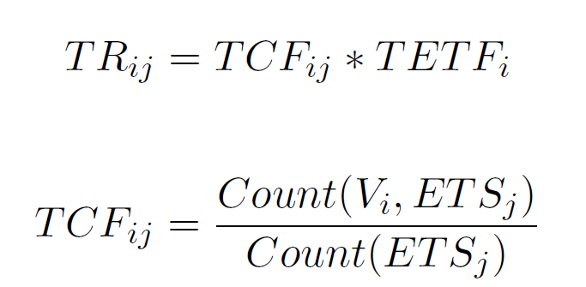
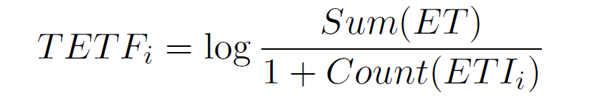
Trigger Word Detection
if a verb occurs more times than other verbs in the labeled sentences of one event type , the verb tends to trigger this type of event; and if a verb occurs in sentences of every event types, like is, the verb will have a low probability to trigger events.

Slide 18
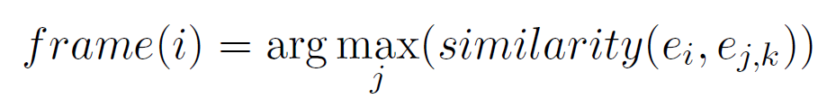
Trigger Word Filtering and Expansion
Specifically, we use the average word embedding of all words in i-th Freebase event type name ei and word embedding of k-th lexical units of j-th frame ej,k to compute the semantic similarity.
Automatically labeled data generation
Soft Distant Supervision
Any sentence corresponding rigger word is likely to express that event in some way. And arguments occurring in that sentence are likely to play the corresponding roles in that event

