Slide 1
Transformers in NLP
Yizhong Wang
2018.5.28

Slide 2
Key Motivations in Transformer
No recurrence -> Faster Speed
Multi-head Attention -> Different Rep. Subspaces
Self Attention -> Long-Range dependency
Position Embedding -> Sequential Information
Residual Connection
Layer Normalization
->
Tricks for Deep NNs

Slide 3
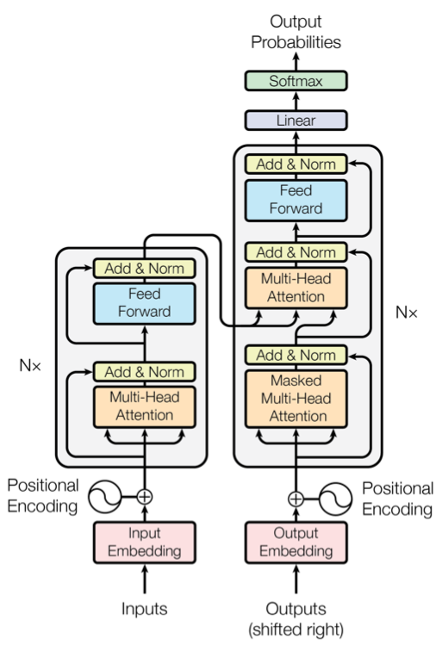
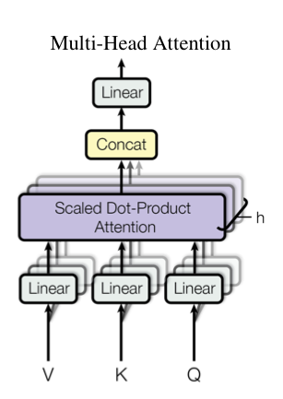
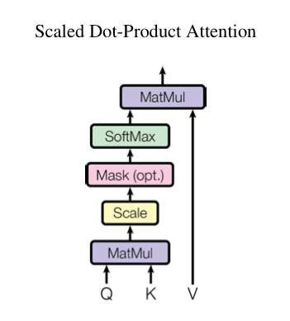
The original Transformer

Slide 4
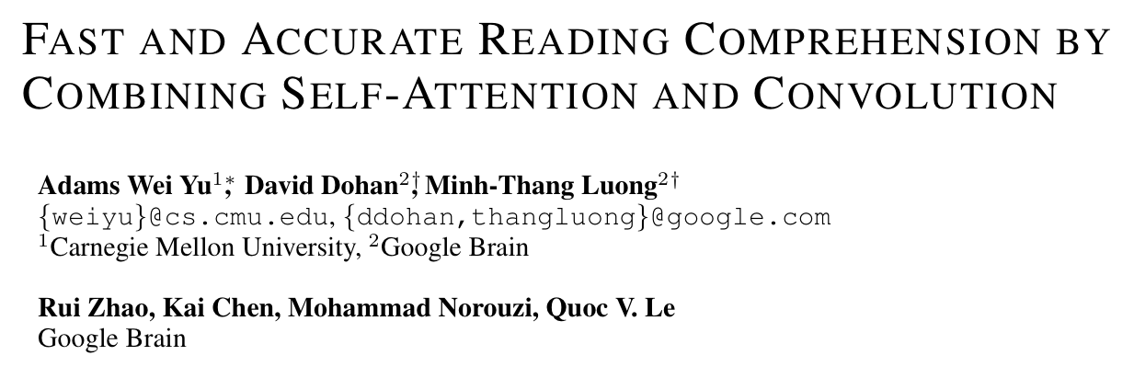
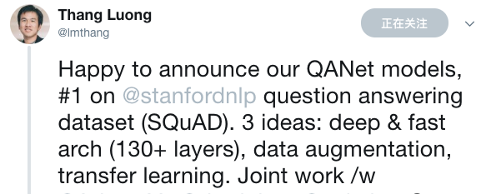
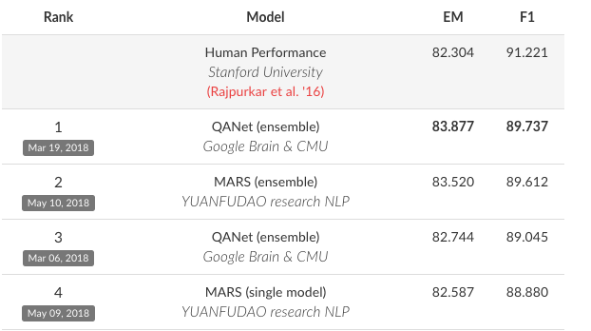
Transformer in MRC

Slide 5
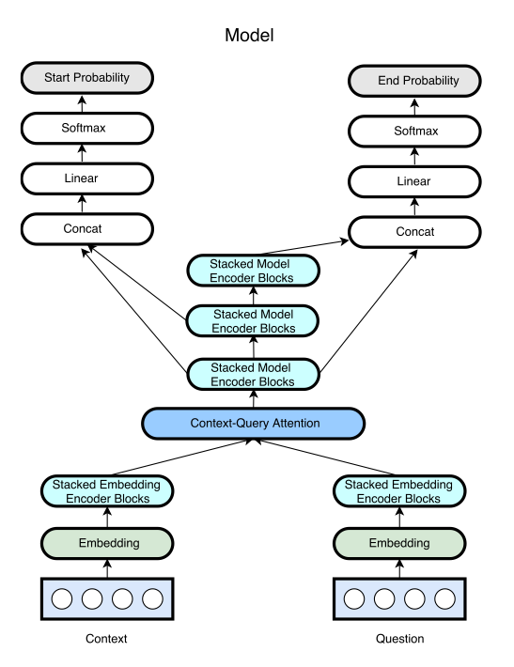
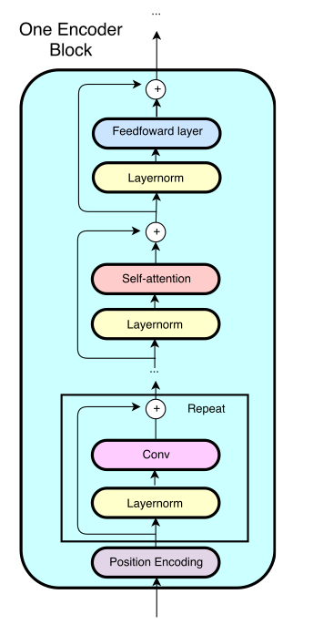
Model Architecture

Slide 6
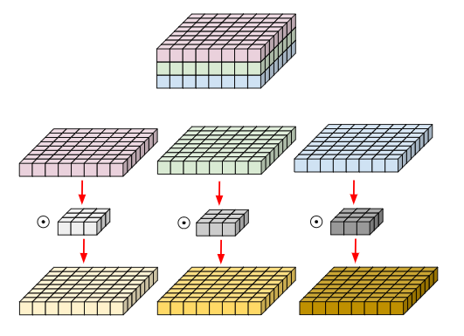

The Encoder Block
[convolution-layer × # + self-attention-layer + feed-forward-layer]
Use depthwise separable convolutions:
For an input $x$ and a given operation $f$, the output is:
$$f(layernorm(x))+x$$
Project the input to h=128, for the residual connection

Slide 7




The Context-Query Attention
Compute the similarities between each pair of context and query words, rendering a similarity matrix:
Context-to-query attention:
Query-to-Context attention:
The output:

Slide 8
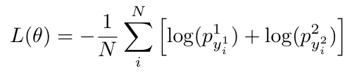
Output Layer
The probabilities of the starting and ending position are modeled as:
The objective function is deﬁned as the negative sum of the log probabilities of the predicted distributions indexed by true start and end indices, averaged over all the training examples:

Slide 9

Other Tricks
Character embedding (Max-pooling -> Convolution)
<UNK> is trainable.
Two-layer highway network for concatenation.
Dropout between layers and sublayers.
Layer dropout
Exponential moving average
ADAM optimizer with
learning rate warm-up scheme with an inverse exponential increase from 0.0 to 0.001 in the ﬁrst 1000 steps, and then maintain a constant learning rate

Slide 10
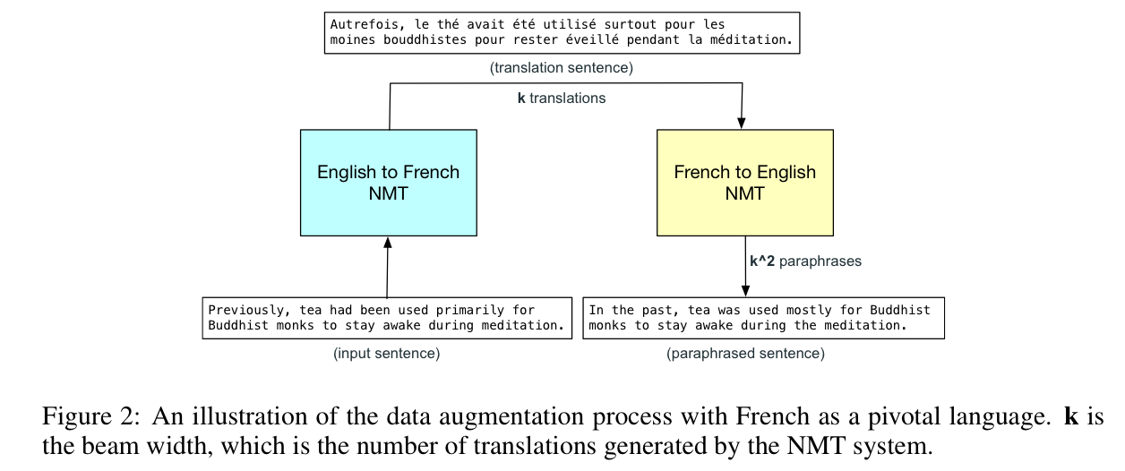
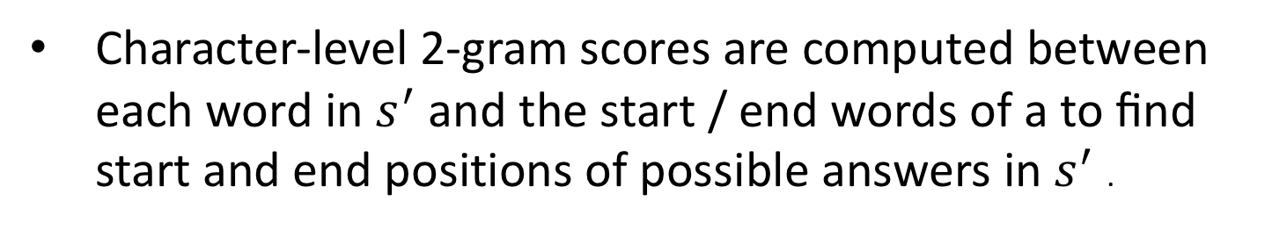
Data Augmentation
Character-level 2-gram scores are computed between each word in $s^{′}$ and the start / end words of a to ﬁnd start and end positions of possible answers in $s^{′}$ .

Slide 11
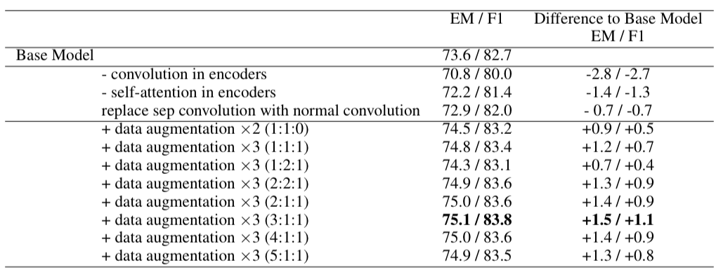
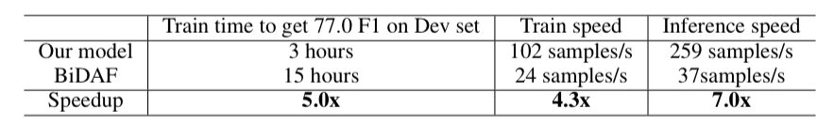
Results on SQuAD

Slide 12
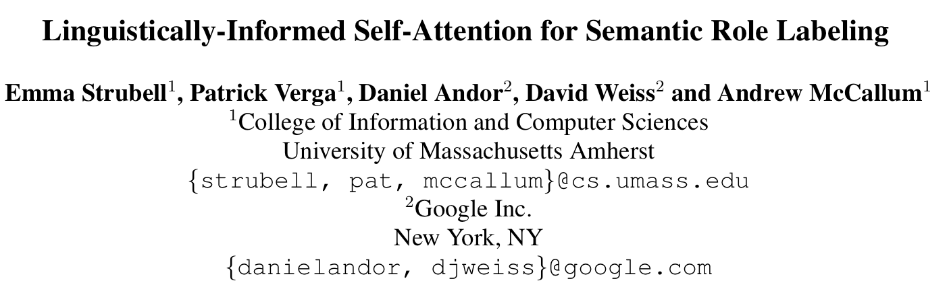
Transformer in Semantic Role Labelling
Semantic role labeling is the task of automatically finding the semantic roles of each argument of each predicate in a sentence.

Slide 13
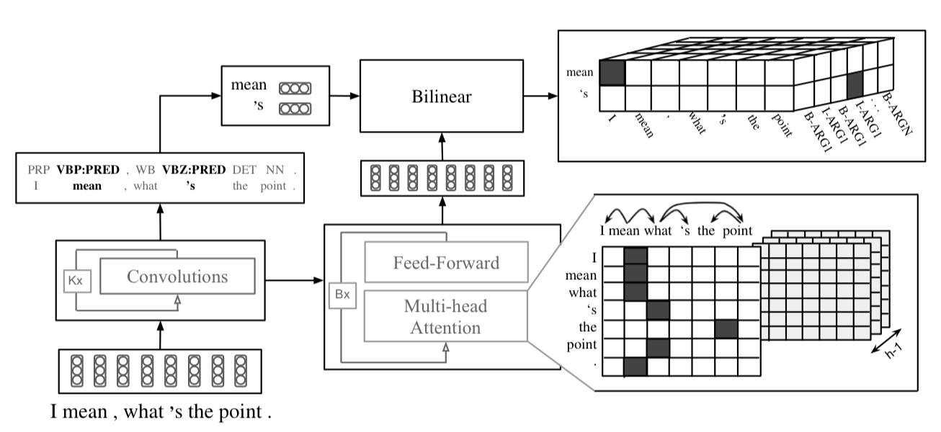
Model Architecture

Slide 14

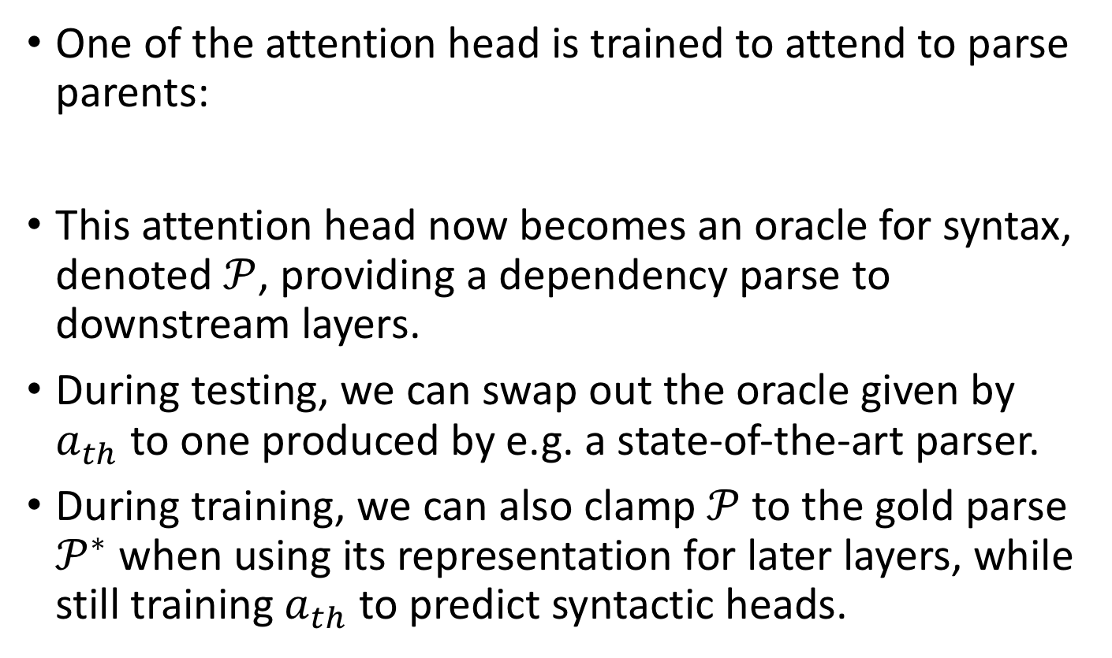
Syntactically-Informed Self-Attention
One of the attention head is trained to attend to parse parents:
This attention head now becomes an oracle for syntax, denoted $𝒫$, providing a dependency parse to downstream layers.
During testing, we can swap out the oracle given by $a_{th}$ to one produced by e.g. a state-of-the-art parser.
During training, we can also clamp $𝒫$to the gold parse $𝒫^{∗}$when using its representation for later layers, while still training $a_{th}$ to predict syntactic heads.

Slide 15
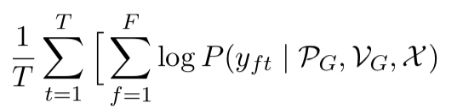


Multi-Task Learning
Semantic Role Labeling
POS Tagging
Predicate Detection
Dependency Parsing

Slide 16
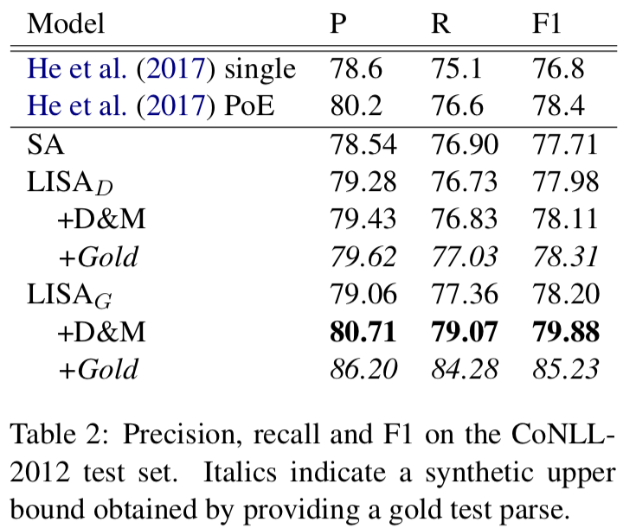
Performance

Slide 17
Conclusions
(Self Attention + Position Embedding) will replace recurrence.
We need better position embedding method.
The attention weights have their meanings and we can supervise them if necessary.
Convolution layer can be added to Transformer model when ngram is important.
Many deep learning tricks, especially in CNN, can be used in Transformer model.

