Slide 1
Generative models: applications
Wu Wenqin
School of Mathematical Sciences

Slide 2
1. Generating Classical Chinese Poems via Conditional Variational Autoencoder and Adversarial Training
Research purposes:
Create novelty and thematic consistency poems
Methods : conditional variational autoencoder with adversarial training
Methods:
conditional variational autoencoders (CVAE) ：novel terms
adversarial discriminator：thematic consistency

Slide 3
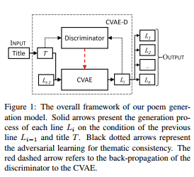
1.1 Framework
Input: a title T=(e_1,e_2,…,e_n)
Output: n-line poem
(L_1,L_2,…,L_n)

Slide 4
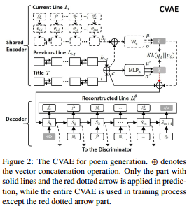

1.2 CVAE

Slide 5
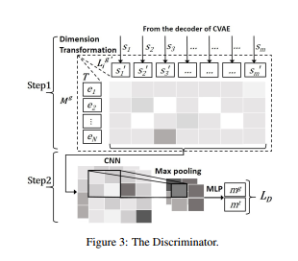


1.3 Discriminator

Slide 6

1.4 Training
The overall objective of CVAE-D is to minimize

Slide 7
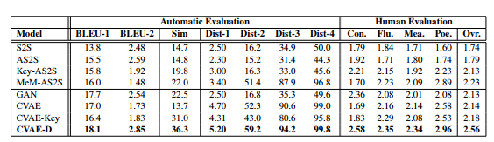
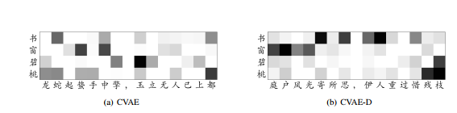
1.5 Experiment Results

Slide 8
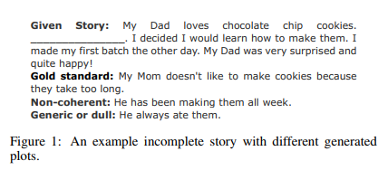
2. Transformer-Based Conditioned Variational Autoencoder for Story Completion
Research purposes:
Generating the missing plot for an incomplete story
Methods : Transformer-Based Conditioned Variational Autoencoder
Methods:
shared attention layers & a latent variable ：contextual clues
sampling：reasonable plots

Slide 9
2.1 Framework
Input: incomplete story
x={s_1,…,s_{k-1},s_{k+1}…,s_M}
Output: one-sentence plot
y=w_1^k…w_{n_i}^k

Slide 10
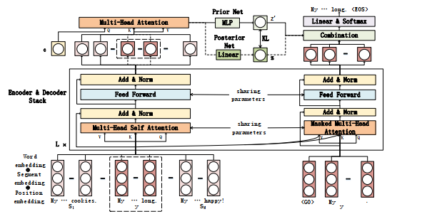
2.1 Framework

Slide 11


2.2 Transformer
Encoder:
Decoder:

Slide 12
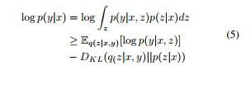


2.3 CVAE
q(z|x,y), posterior
p(z|x), prior

Slide 13

2.3 CVAE
Inference

Slide 14
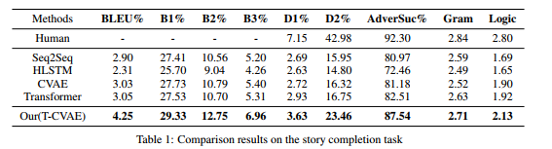

2.4 Experiment Results
Ablation study

Slide 15
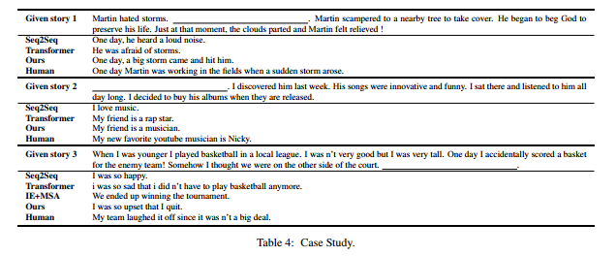
2.4 Experiment Results

Slide 16
3. Draft and Edit: Automatic Storytelling Through Multi-Pass
Hierarchical Conditional Variational Autoencoder
Research purposes:
Automatic Storytelling
Methods :multi-pass hierarchical conditional variational autoencoder
model

Slide 17
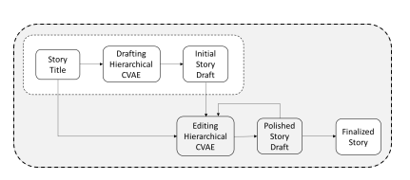
3.1 Framework
Input: the story title
T=(w_1,w_2,…,w_n)
Output: the story
S_1,S_2,…,S_N

Slide 18
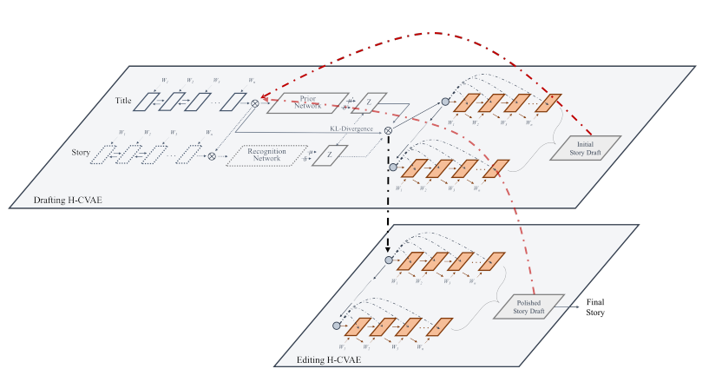
3.2 H-CVAE

Slide 19
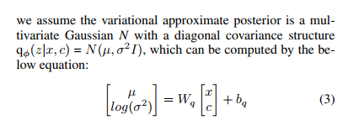
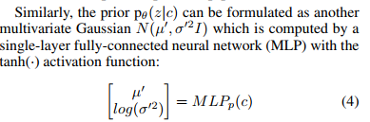
3.2 H-CVAE
Encoder

Slide 20


3.2 H-CVAE
Hierarchical decoder

Slide 21

3.3 Multi-pass

Slide 22
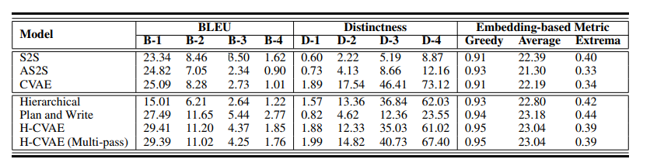
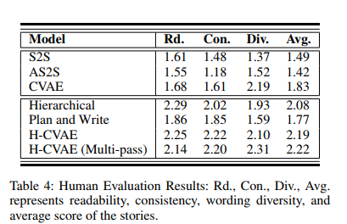
3.4 Experiment Results

Slide 23
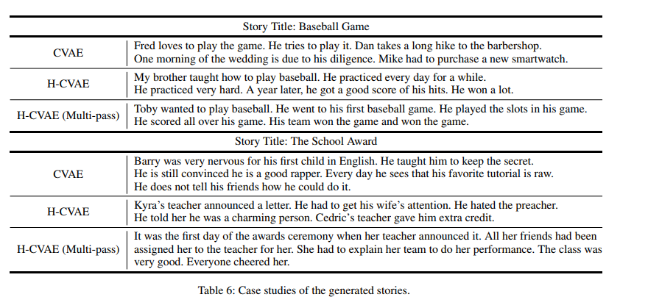
3.4 Experiment Results

Slide 24
4. Learning Discourse-level Diversity for Neural Dialog Models using
Conditional Variational Autoencoders
Research purposes:
Conversations generating
Methods :
  Knowledge-Guided CVAE (kgCVAE): discourse-level diversity
  bag-of-word loss: tackle the vanishing latent variable problem

Slide 25
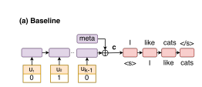
4.1 framework
Input: the preceding k-1 utterances; conversational floor; meta features
Output: next response

Slide 26

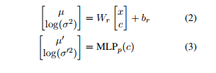
4.2 kgCVAE
Conventional CVAE

Slide 27
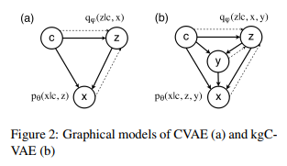

4.2 kgCVAE
Integrating with linguistic prior knowledge

Slide 28


4.3 bag-of-word loss
Softmax of f : the probability of each word appearing in the response
Solve the problems of latent variable vanishing
KL annealing, word drop out

Slide 29
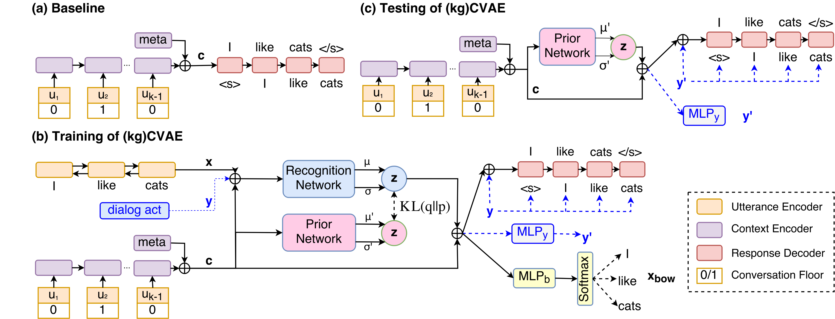
4.3 kgCVAE&bow

Slide 30
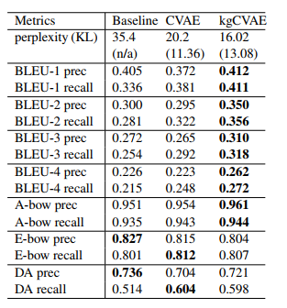
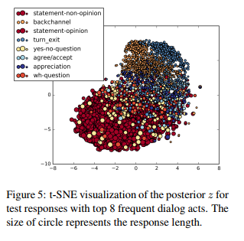
4.4 Experiment Results

Slide 31
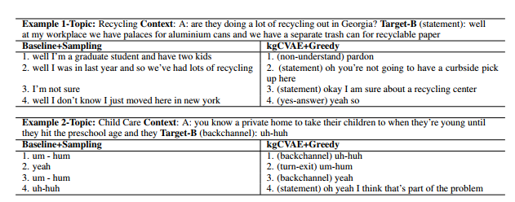
4.4 Experiment Results

Slide 32
Thank you!

