Slide 1
Representation learning for NLU
Peking University
School of Mathematical Sciences

Slide 2
1.Attention is all you need
Model:
Transformer
Result:
Provide the possibility of parallel computing
Capture words’ dependency relationship via Attention mechanism, showing better result than pure LSTM models

Slide 3
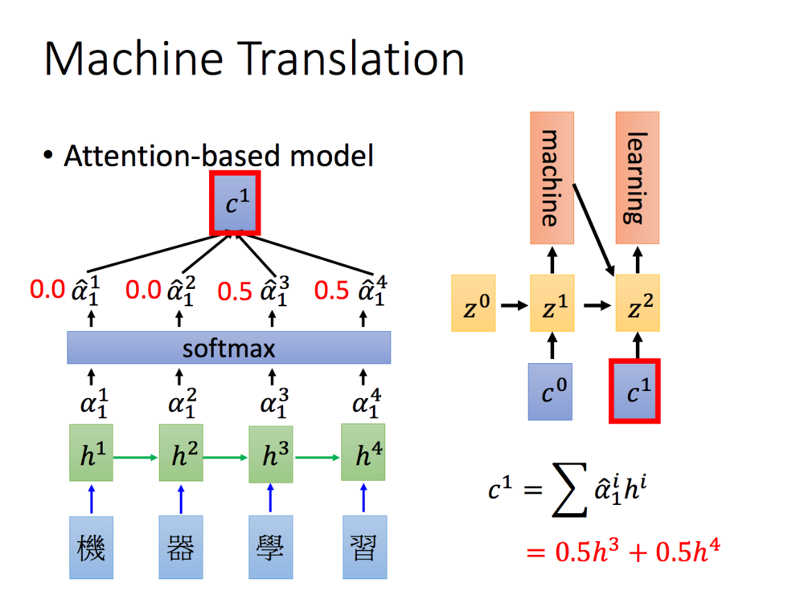
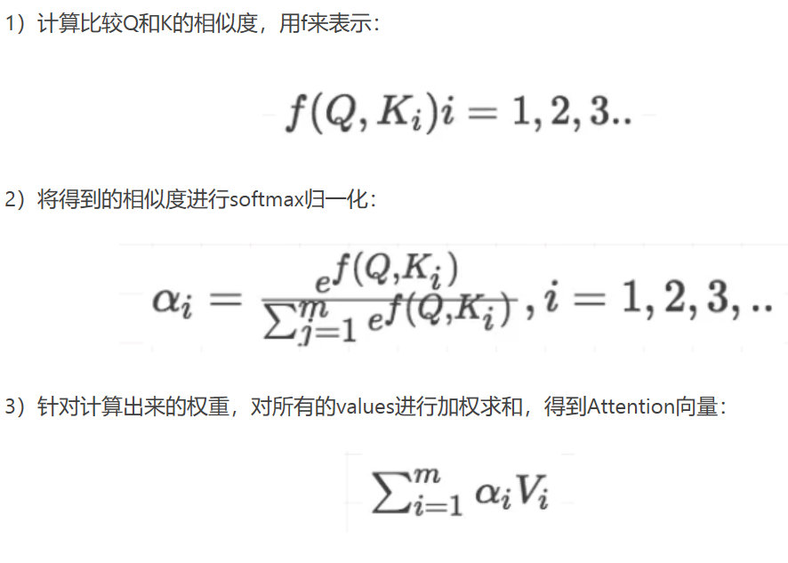
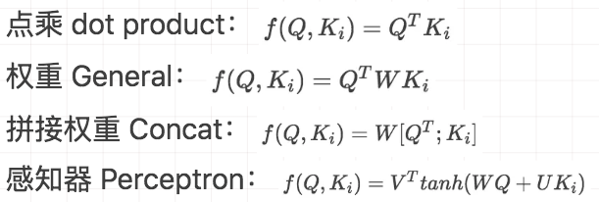
1.1 Attention mechanism

Slide 4
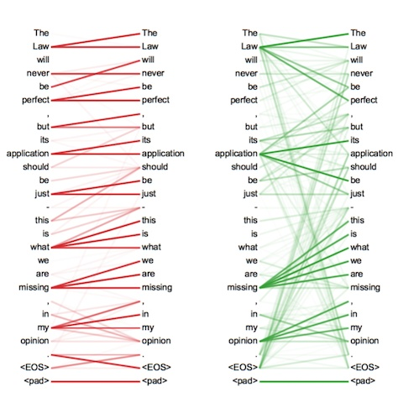
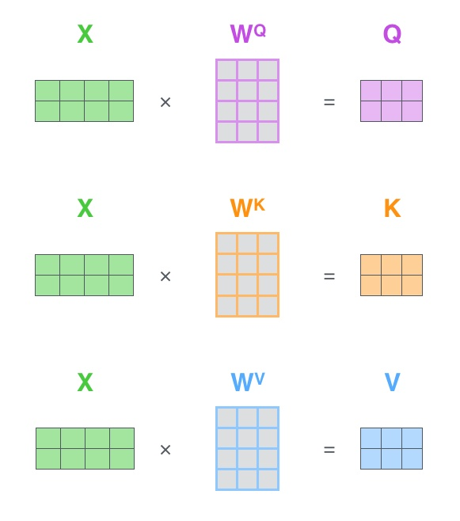
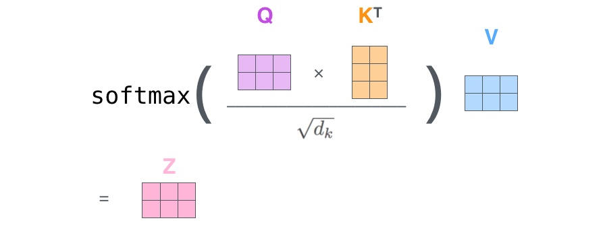
1.2 Self-Attention

Slide 5
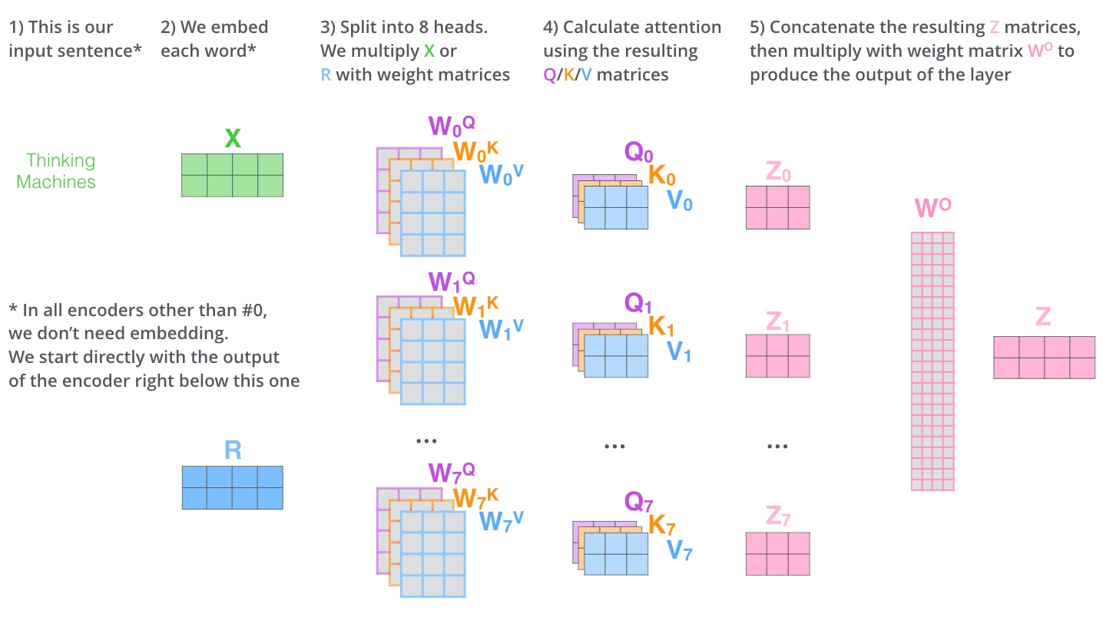
1.3 Multi-Head Attention
Transformer : The ability of feature extraction is better than LSTM!

Slide 6
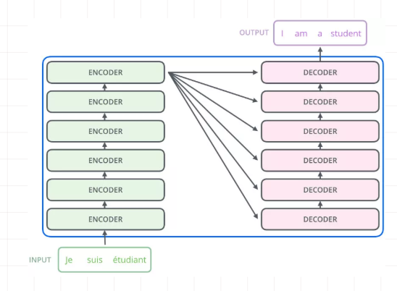
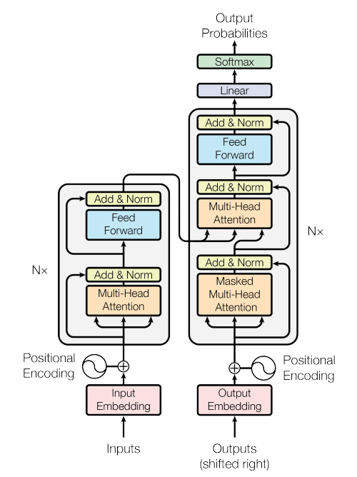
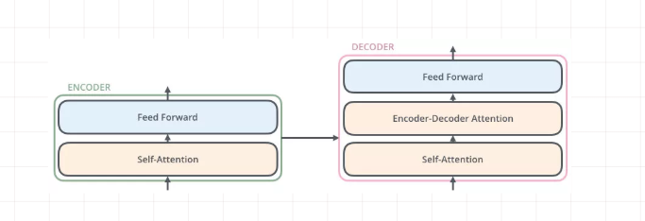
1.4 Transformer

Slide 7
2.Deep contextualized word representations(ELMo)
Objective:
complex characteristics of word use (syntax and semantics)
how these uses vary across linguistic contexts (polysemy)
Model:
biLM : pretrained on a large text corpus + ELMo
Result:
significantly improve the state of the art across six challenging NLP problems, including question answering, textual entailment and sentiment analysis.
allowing downstream models to mix different types of semi-supervision signals

Slide 8
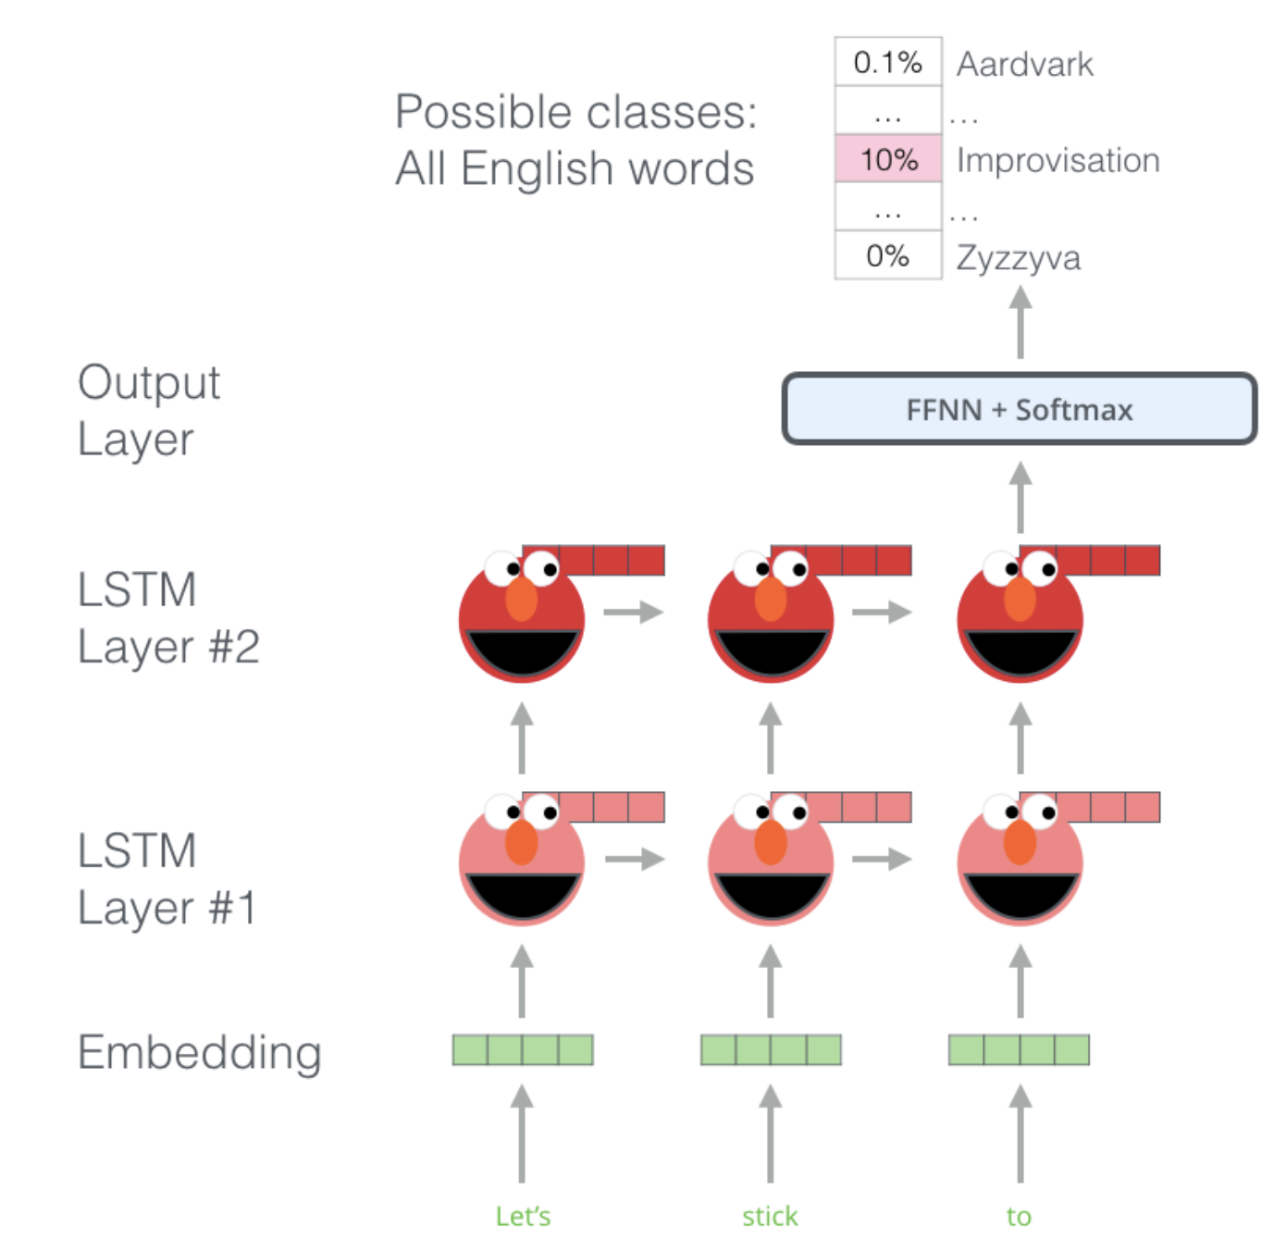
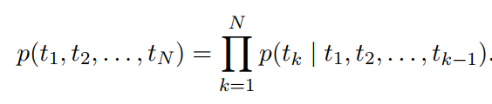
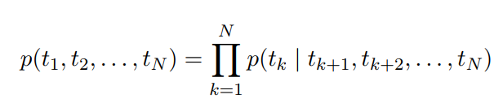
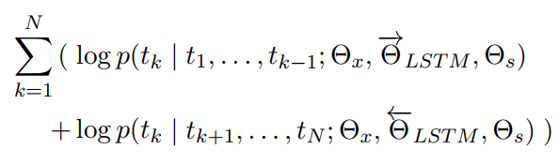
2.1 Bidirectional language models
Model : Bidirectional language models

Slide 9
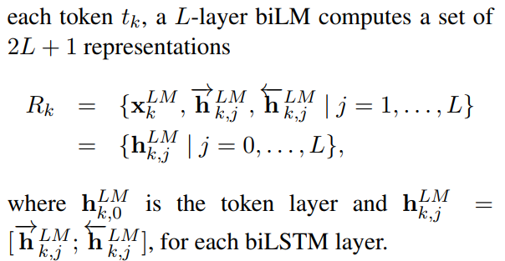
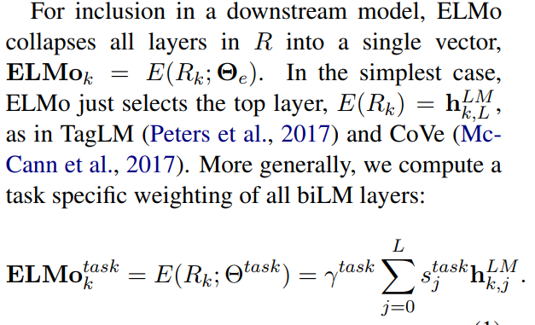
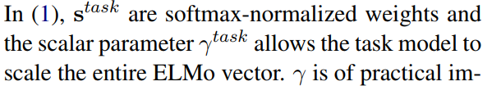
2.2 ELMo Model
Attention?

Slide 10
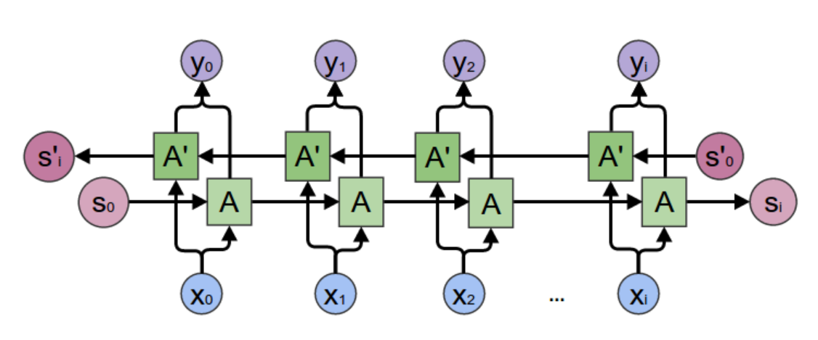
2.2 ELMo Model
Please imagine this is a deep neural network…↓

Slide 11
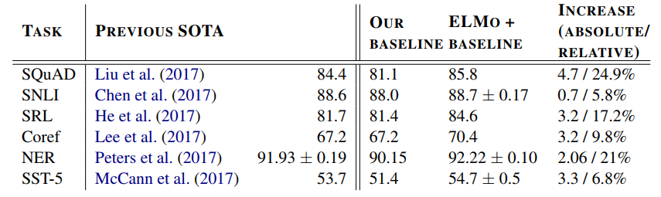
2.3 Adjust Parameters and Result

Slide 12
3. BERT: Pre-training of Deep Bidirectional Transformers for Language Understanding
Model:
Bidirectional Encoder Representation
Transformer
Result:
can be finetuned with just one additional output layer to create state-of-the-art models for a wide range of tasks, such as question answering and language inference, without substantial taskspecific architecture modifications
allowing downstream models to mix different types of semi-supervision signals

Slide 13
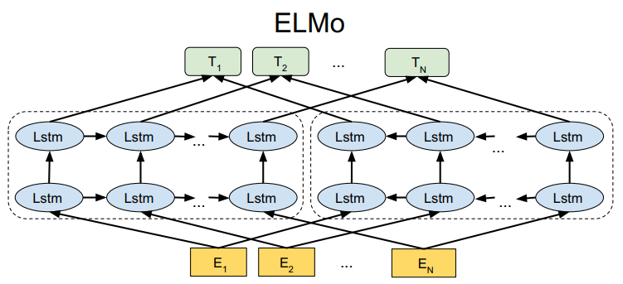
3.1 ELMo(feature-based)
Model : biLM + ELMo

Slide 14
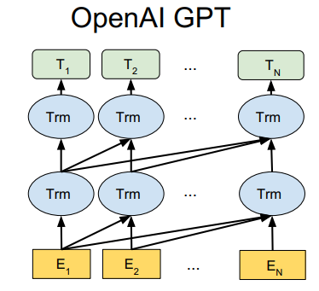
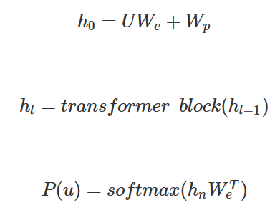


3.2 OpenAI GPT(fine-tuning)
Model : Transformer + feed forward

Slide 15
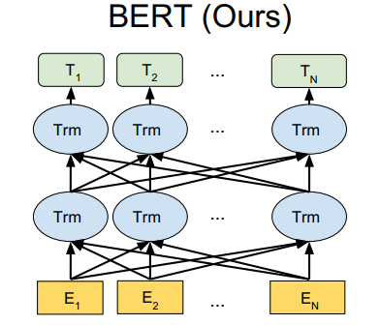
3.3 BERT
Model : Transformer , simultaneously?
ELMo:
+
BERT:
GPT :

Slide 16
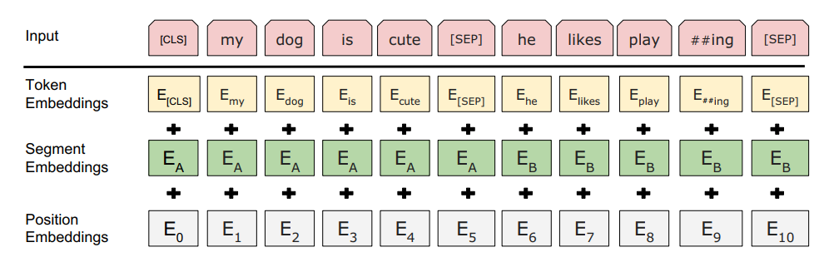
3.3.1 BERT – Input Representation
The input embeddings are the sum of the token embeddings, the segmentation embeddings and the position embeddings.

Slide 17
3.3.2 Pre-train
Masked LM(MLM)
Example : “See itself” ↑ in prediction task using biLM
Measure : Mask 15% of words in one sentence.
Defect : Make pre-train and fine-tuning imcompatible
The rate of convergence is too slow
Next Sentence Prediction : binary variable task

Slide 18
4. XLNet: Generalized Autoregressive Pretraining for Language Understanding
Compare with BERT:
BERT is bidirectional but can’t be generative model
Auto-regression LM is generative model but is unidirectional
→ improve BERT or Auto-regression LM?

Slide 19
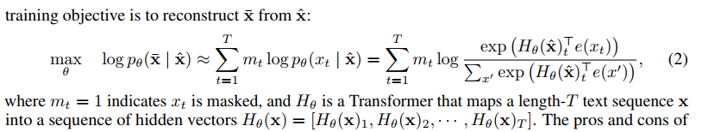
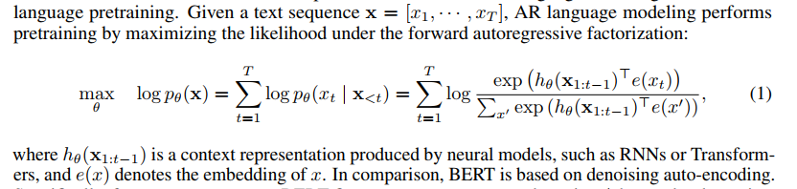
4.1 Loss Function
BERT:
Auto-Regression : To make it bidirectional→permutation LM

Slide 20
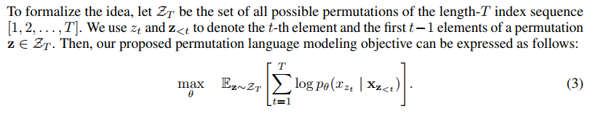
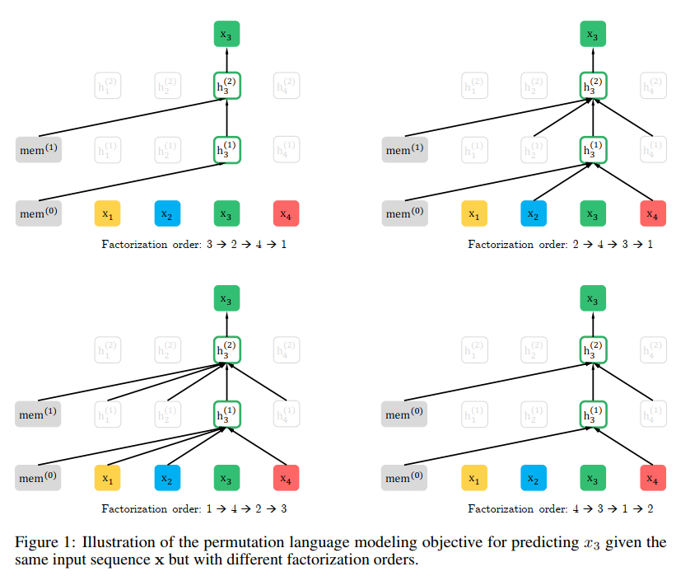
4.2 permutation LM

Slide 21
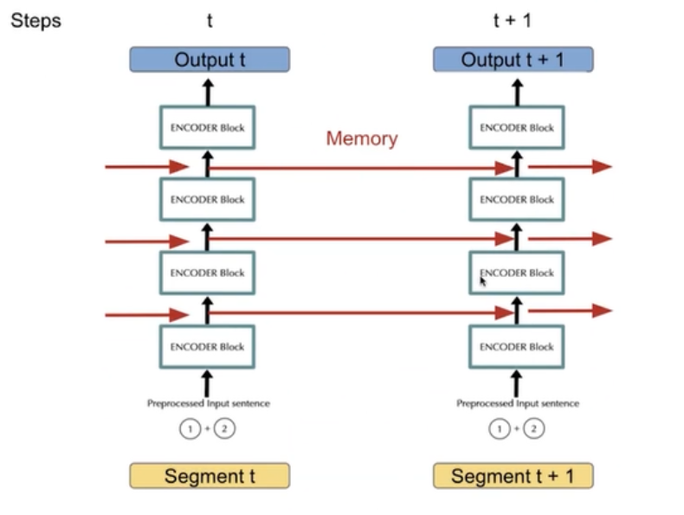
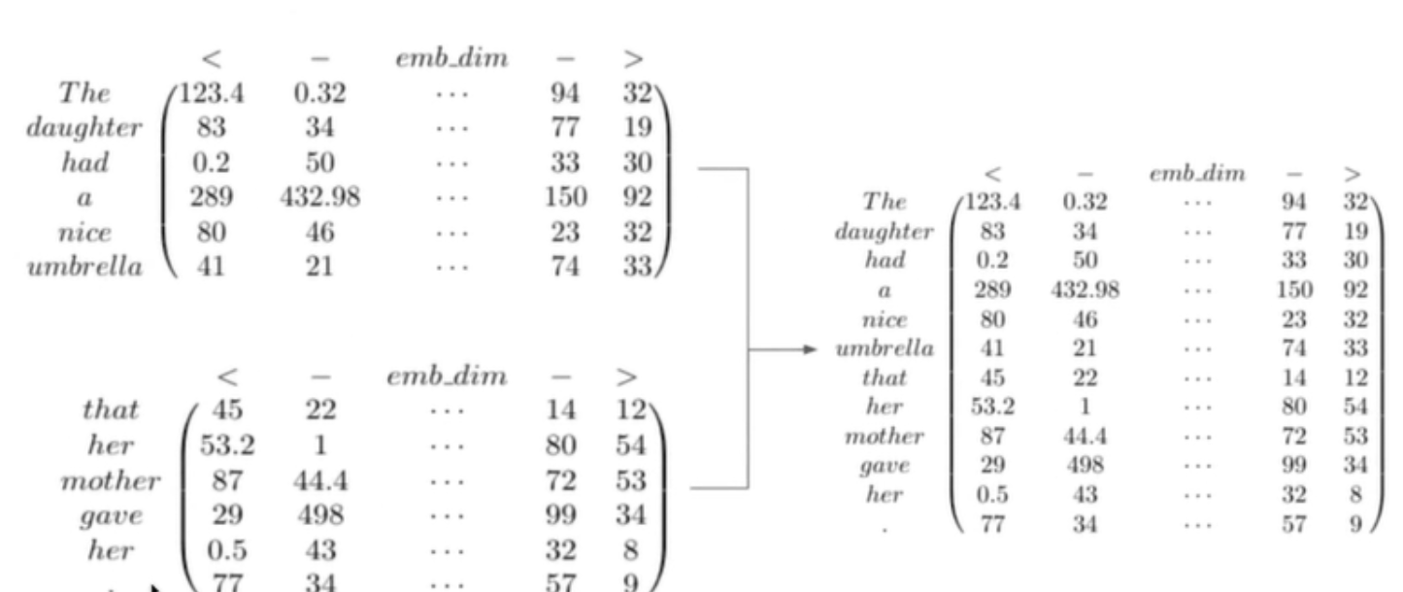
4.3 Transformer XL
The defect of Transformer : can’t dispose too long sequence in one time
→ RNN + Transformer

Slide 22
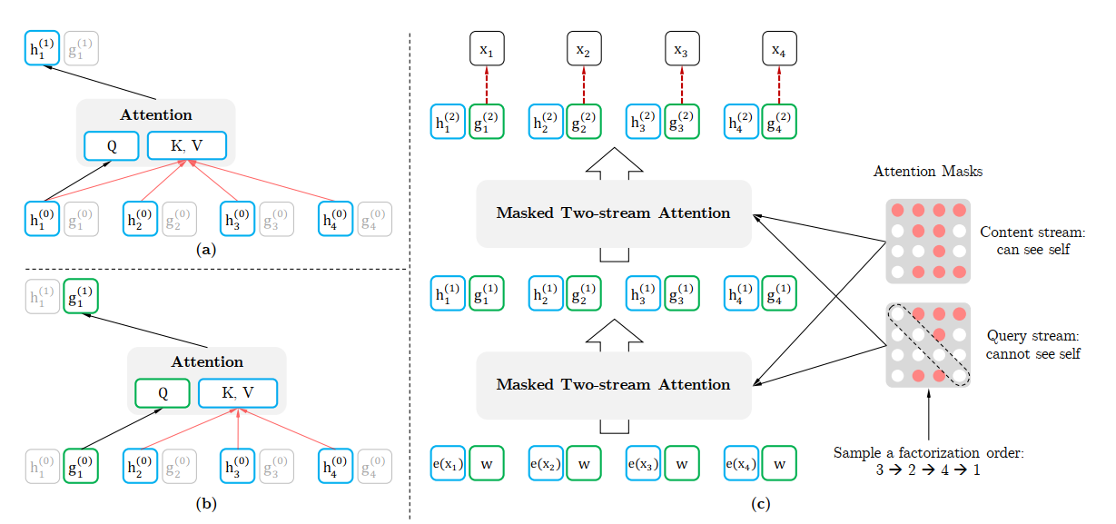
4.4 Two-Stream Self-Attention

Slide 23
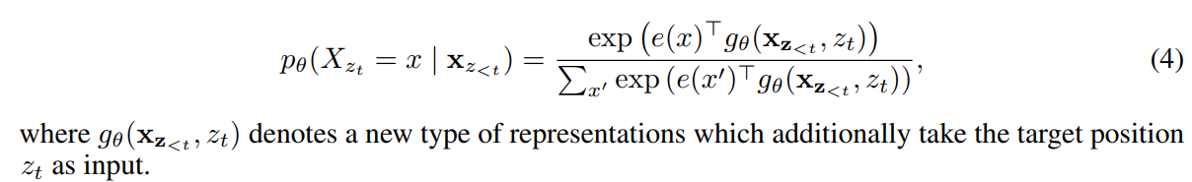
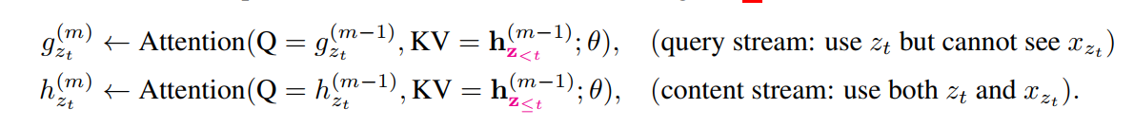
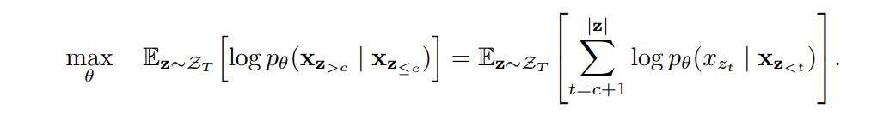
4.4 Two-Stream Self-Attention

Slide 24
谢谢

