Slide 1

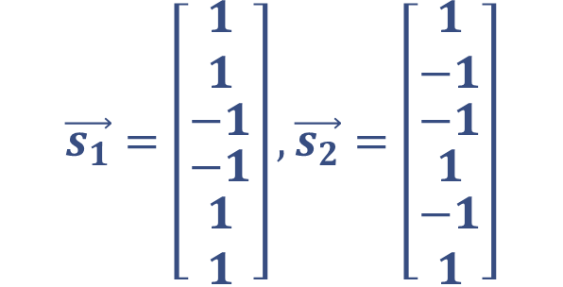


Pattern Matching for Delayed Signals
$$r[t]$$
Satellite signatures:
1
-1
-1 0 1 2 3 4 5 6 7 8 9 10 11 12 13 14 15
$$t$$
$$\vec{s_{1}}=\left[\begin{matrix}1 \\ 1 \\ \begin{matrix}−1 \\ \begin{aligned}−1 \\ \begin{matrix}1 \\ 1\end{matrix}\end{aligned}\end{matrix}\end{matrix}\right], \vec{s_{2}}=\left[\begin{matrix}1 \\ −1 \\ \begin{matrix}−1 \\ \begin{aligned}1 \\ \begin{matrix}−1 \\ 1\end{matrix}\end{aligned}\end{matrix}\end{matrix}\right]$$
$r[t]$ → 0 0 0 0 0 1 1 -1 -1 1 1

Slide 2




Trying to pattern match with $s_{1}\left[t\right]$
$$r[t]$$
Satellite signatures:
1
-1
-1 0 1 2 3 4 5 6 7 8 9 10 11 12 13 14 15
$$t$$
$$\vec{s_{1}}=\left[\begin{matrix}1 \\ 1 \\ \begin{matrix}−1 \\ \begin{aligned}−1 \\ \begin{matrix}1 \\ 1\end{matrix}\end{aligned}\end{matrix}\end{matrix}\right], \vec{s_{2}}=\left[\begin{matrix}1 \\ −1 \\ \begin{matrix}−1 \\ \begin{aligned}1 \\ \begin{matrix}−1 \\ 1\end{matrix}\end{aligned}\end{matrix}\end{matrix}\right]$$
$r[t]$ → 0 0 0 0 0 1 1 -1 -1 1 1
$$s_{1}[t]$$
1
-1
-1 0 1 2 3 4 5 6 7 8 9 10 11 12 13 14 15
$$t$$
$s_{1}[t]$ →1 1 -1 -1 1 1 0 0 0 0 0

Slide 3
Trying to pattern match with $s_{1}\left[t\right]$
$$r[t]$$
Satellite signatures:
1
-1
-1 0 1 2 3 4 5 6 7 8 9 10 11 12 13 14 15
$$t$$
$$\vec{s_{1}}=\left[\begin{matrix}1 \\ 1 \\ \begin{matrix}−1 \\ \begin{aligned}−1 \\ \begin{matrix}1 \\ 1\end{matrix}\end{aligned}\end{matrix}\end{matrix}\right], \vec{s_{2}}=\left[\begin{matrix}1 \\ −1 \\ \begin{matrix}−1 \\ \begin{aligned}1 \\ \begin{matrix}−1 \\ 1\end{matrix}\end{aligned}\end{matrix}\end{matrix}\right]$$
$$s_{1}[t]$$
1
-1
-1 0 1 2 3 4 5 6 7 8 9 10 11 12 13 14 15
$$t$$
$r[t]$ → 0 0 0 0 0 1 1 -1 -1 1 1
$s_{1}[t]$ →1 1 -1 -1 1 1 0 0 0 0 0

Slide 4
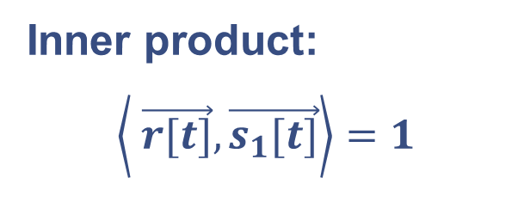
Trying to pattern match with $s_{1}\left[t\right]$
$$r[t]$$
Satellite signatures:
1
-1
-1 0 1 2 3 4 5 6 7 8 9 10 11 12 13 14 15
$$t$$
$$\vec{s_{1}}=\left[\begin{matrix}1 \\ 1 \\ \begin{matrix}−1 \\ \begin{aligned}−1 \\ \begin{matrix}1 \\ 1\end{matrix}\end{aligned}\end{matrix}\end{matrix}\right], \vec{s_{2}}=\left[\begin{matrix}1 \\ −1 \\ \begin{matrix}−1 \\ \begin{aligned}1 \\ \begin{matrix}−1 \\ 1\end{matrix}\end{aligned}\end{matrix}\end{matrix}\right]$$
$$s_{1}[t]$$
1
-1
Inner product:
$$\left\langle \vec{r[t]},\vec{s_{1}[t]}\right\rangle =1$$
-1 0 1 2 3 4 5 6 7 8 9 10 11 12 13 14 15
$$t$$
$r[t]$ → 0 0 0 0 0 1 1 -1 -1 1 1
$s_{1}[t]$ →1 1 -1 -1 1 1 0 0 0 0 0
0 0 0 0 0 1 0 0 0 0 0
+ + + + + + + + + + =1

Slide 5

How much should we shift $s_{1}\left[t\right]$ to get a perfect match?
$$r[t]$$
Satellite signatures:
1
-1
-1 0 1 2 3 4 5 6 7 8 9 10 11 12 13 14 15
$$t$$
$$\vec{s_{1}}=\left[\begin{matrix}1 \\ 1 \\ \begin{matrix}−1 \\ \begin{aligned}−1 \\ \begin{matrix}1 \\ 1\end{matrix}\end{aligned}\end{matrix}\end{matrix}\right], \vec{s_{2}}=\left[\begin{matrix}1 \\ −1 \\ \begin{matrix}−1 \\ \begin{aligned}1 \\ \begin{matrix}−1 \\ 1\end{matrix}\end{aligned}\end{matrix}\end{matrix}\right]$$
$r[t]$ → 0 0 0 0 0 1 1 -1 -1 1 1
$$s_{1}[t−5]$$
1
-1
-1 0 1 2 3 4 5 6 7 8 9 10 11 12 13 14 15
$$t$$

Slide 6

How much should we shift $s_{1}\left[t\right]$ to get a perfect match?
$$r[t]$$
Satellite signatures:
1
-1
-1 0 1 2 3 4 5 6 7 8 9 10 11 12 13 14 15
$$t$$
$$\vec{s_{1}}=\left[\begin{matrix}1 \\ 1 \\ \begin{matrix}−1 \\ \begin{aligned}−1 \\ \begin{matrix}1 \\ 1\end{matrix}\end{aligned}\end{matrix}\end{matrix}\right], \vec{s_{2}}=\left[\begin{matrix}1 \\ −1 \\ \begin{matrix}−1 \\ \begin{aligned}1 \\ \begin{matrix}−1 \\ 1\end{matrix}\end{aligned}\end{matrix}\end{matrix}\right]$$
$r[t]$ → 0 0 0 0 0 1 1 -1 -1 1 1
$$s_{1}[t−5]$$
1
-1
-1 0 1 2 3 4 5 6 7 8 9 10 11 12 13 14 15
$$t$$
$s_{1}[t−5]$ → 0 0 0 0 0 1 1 -1 -1 1 1

Slide 7

Perfect Match: Time Shift of $s_{1}\left[t\right]$: $k=5$
$$r[t]$$
Satellite signatures:
1
-1
-1 0 1 2 3 4 5 6 7 8 9 10 11 12 13 14 15
$$t$$
$$\vec{s_{1}}=\left[\begin{matrix}1 \\ 1 \\ \begin{matrix}−1 \\ \begin{aligned}−1 \\ \begin{matrix}1 \\ 1\end{matrix}\end{aligned}\end{matrix}\end{matrix}\right], \vec{s_{2}}=\left[\begin{matrix}1 \\ −1 \\ \begin{matrix}−1 \\ \begin{aligned}1 \\ \begin{matrix}−1 \\ 1\end{matrix}\end{aligned}\end{matrix}\end{matrix}\right]$$
$$s_{1}[t−5]$$
1
-1
-1 0 1 2 3 4 5 6 7 8 9 10 11 12 13 14 15
$$t$$
$r[t]$ → 0 0 0 0 0 1 1 -1 -1 1 1
$s_{1}[t−5]$ → 0 0 0 0 0 1 1 -1 -1 1 1

Slide 8

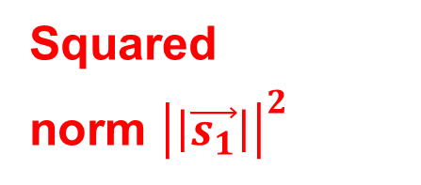
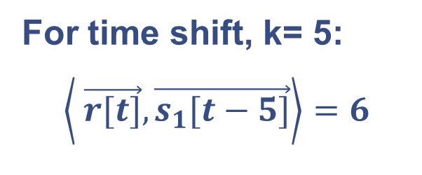
Perfect Match: Time Shift of $s_{1}\left[t\right]$: $k=$5
$$r[t]$$
Satellite signatures:
1
-1
-1 0 1 2 3 4 5 6 7 8 9 10 11 12 13 14 15
$$t$$
$$\vec{s_{1}}=\left[\begin{matrix}1 \\ 1 \\ \begin{matrix}−1 \\ \begin{aligned}−1 \\ \begin{matrix}1 \\ 1\end{matrix}\end{aligned}\end{matrix}\end{matrix}\right], \vec{s_{2}}=\left[\begin{matrix}1 \\ −1 \\ \begin{matrix}−1 \\ \begin{aligned}1 \\ \begin{matrix}−1 \\ 1\end{matrix}\end{aligned}\end{matrix}\end{matrix}\right]$$
Delay, $t_{d}=5$
$$s_{1}[t−5]$$
1
-1
For time shift, k= 5:
$$\left\langle \vec{r[t]},\vec{s_{1}[t−5]}\right\rangle =6$$
-1 0 1 2 3 4 5 6 7 8 9 10 11 12 13 14 15
$$t$$
$r[t]$ → 0 0 0 0 0 1 1 -1 -1 1 1
Squared
norm ${\left|\left|\vec{s_{1}}\right|\right|}^{2}$
$s_{1}[t−5]$ → 0 0 0 0 0 1 1 -1 -1 1 1
0 0 0 0 0 1 1 1 1 1 1
+ + + + + + + + + + =6

Slide 9


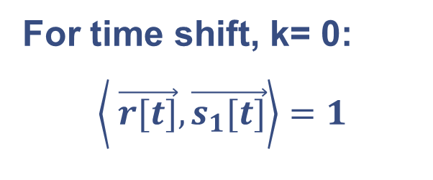
Scanning all possible time shifts: $k=0$
$$r[t]$$
Satellite signatures:
1
-1
$$\vec{s_{1}}=\left[\begin{matrix}1 \\ 1 \\ \begin{matrix}−1 \\ \begin{aligned}−1 \\ \begin{matrix}1 \\ 1\end{matrix}\end{aligned}\end{matrix}\end{matrix}\right], \vec{s_{2}}=\left[\begin{matrix}1 \\ −1 \\ \begin{matrix}−1 \\ \begin{aligned}1 \\ \begin{matrix}−1 \\ 1\end{matrix}\end{aligned}\end{matrix}\end{matrix}\right]$$
-1 0 1 2 3 4 5 6 7 8 9 10 11 12 13 14 15
$$t$$
Overlap window
$$s_{1}[t]$$
1
-1
For time shift, k= 0:
$$\left\langle \vec{r[t]},\vec{s_{1}[t]}\right\rangle =1$$
-1 0 1 2 3 4 5 6 7 8 9 10 11 12 13 14 15
$$t$$
$r[t]$ → 0 0 0 0 0 1 1 -1 -1 1 1
$s_{1}[t]$ →1 1 -1 -1 1 1 0 0 0 0 0
0 0 0 0 0 1 0 0 0 0 0
+ + + + + + + + + + =1

Slide 10

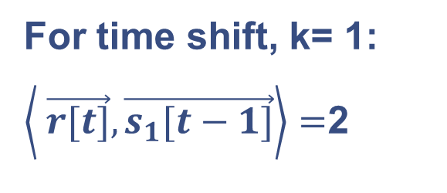
Scanning all possible time shifts: $k=1$
$$r[t]$$
Satellite signatures:
1
-1
$$\vec{s_{1}}=\left[\begin{matrix}1 \\ 1 \\ \begin{matrix}−1 \\ \begin{aligned}−1 \\ \begin{matrix}1 \\ 1\end{matrix}\end{aligned}\end{matrix}\end{matrix}\right], \vec{s_{2}}=\left[\begin{matrix}1 \\ −1 \\ \begin{matrix}−1 \\ \begin{aligned}1 \\ \begin{matrix}−1 \\ 1\end{matrix}\end{aligned}\end{matrix}\end{matrix}\right]$$
-1 0 1 2 3 4 5 6 7 8 9 10 11 12 13 14 15
$$t$$
Overlap window
$$s_{1}[t−1]$$
1
-1
For time shift, k= 1:
$\left\langle \vec{r[t]},\vec{s_{1}[t−1]}\right\rangle =$2
-1 0 1 2 3 4 5 6 7 8 9 10 11 12 13 14 15
$$t$$
$r[t]$ → 0 0 0 0 0 1 1 -1 -1 1 1
$s_{1}[t−1]$ →0 1 1 -1 -1 1 1 0 0 0 0
+ + + + + + + + + + =2
0 0 0 0 0 1 1 0 0 0 0

Slide 11

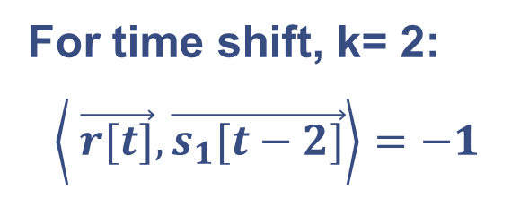
Scanning all possible time shifts: $k=2$
$$r[t]$$
Satellite signatures:
1
-1
$$\vec{s_{1}}=\left[\begin{matrix}1 \\ 1 \\ \begin{matrix}−1 \\ \begin{aligned}−1 \\ \begin{matrix}1 \\ 1\end{matrix}\end{aligned}\end{matrix}\end{matrix}\right], \vec{s_{2}}=\left[\begin{matrix}1 \\ −1 \\ \begin{matrix}−1 \\ \begin{aligned}1 \\ \begin{matrix}−1 \\ 1\end{matrix}\end{aligned}\end{matrix}\end{matrix}\right]$$
-1 0 1 2 3 4 5 6 7 8 9 10 11 12 13 14 15
$$t$$
Overlap window
$$s_{1}[t−2]$$
1
-1
For time shift, k= 2:
$$\left\langle \vec{r[t]},\vec{s_{1}[t−2]}\right\rangle =−1$$
-1 0 1 2 3 4 5 6 7 8 9 10 11 12 13 14 15
$$t$$
$r[t]$ → 0 0 0 0 0 1 1 -1 -1 1 1
$s_{1}[t−2]$ →0 0 1 1 -1 -1 1 1 0 0 0
0 0 0 0 0 -1 1 -1 0 0 0
+ + + + + + + + + + =-1

Slide 12

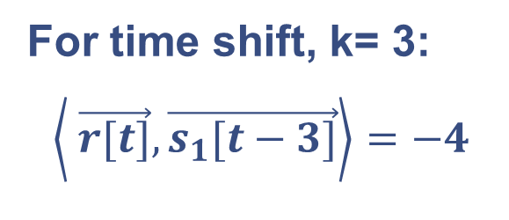
Scanning all possible time shifts: $k=3$
$$r[t]$$
Satellite signatures:
1
-1
$$\vec{s_{1}}=\left[\begin{matrix}1 \\ 1 \\ \begin{matrix}−1 \\ \begin{aligned}−1 \\ \begin{matrix}1 \\ 1\end{matrix}\end{aligned}\end{matrix}\end{matrix}\right], \vec{s_{2}}=\left[\begin{matrix}1 \\ −1 \\ \begin{matrix}−1 \\ \begin{aligned}1 \\ \begin{matrix}−1 \\ 1\end{matrix}\end{aligned}\end{matrix}\end{matrix}\right]$$
-1 0 1 2 3 4 5 6 7 8 9 10 11 12 13 14 15
$$t$$
Overlap window
$$s_{1}[t−3]$$
1
-1
For time shift, k= 3:
$$\left\langle \vec{r[t]},\vec{s_{1}[t−3]}\right\rangle =−4$$
-1 0 1 2 3 4 5 6 7 8 9 10 11 12 13 14 15
$$t$$
$r[t]$ → 0 0 0 0 0 1 1 -1 -1 1 1
$s_{1}[t−3]$ →0 0 0 1 1 -1 -1 1 1 0 0
0 0 0 0 0 -1 -1 -1 -1 0 0
+ + + + + + + + + + =-4

Slide 13

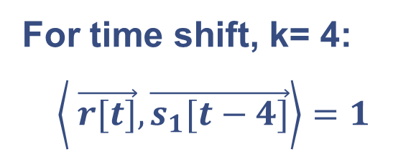
Scanning all possible time shifts: $k=4$
$$r[t]$$
Satellite signatures:
1
-1
$$\vec{s_{1}}=\left[\begin{matrix}1 \\ 1 \\ \begin{matrix}−1 \\ \begin{aligned}−1 \\ \begin{matrix}1 \\ 1\end{matrix}\end{aligned}\end{matrix}\end{matrix}\right], \vec{s_{2}}=\left[\begin{matrix}1 \\ −1 \\ \begin{matrix}−1 \\ \begin{aligned}1 \\ \begin{matrix}−1 \\ 1\end{matrix}\end{aligned}\end{matrix}\end{matrix}\right]$$
-1 0 1 2 3 4 5 6 7 8 9 10 11 12 13 14 15
$$t$$
Overlap window
$$s_{1}[t−4]$$
1
-1
For time shift, k= 4:
$$\left\langle \vec{r[t]},\vec{s_{1}[t−4]}\right\rangle =1$$
-1 0 1 2 3 4 5 6 7 8 9 10 11 12 13 14 15
$$t$$
$r[t]$ → 0 0 0 0 0 1 1 -1 -1 1 1
$s_{1}[t−4]$ →0 0 0 0 1 1 -1 -1 1 1 0
0 0 0 0 0 1 -1 1 -1 1 0
+ + + + + + + + + + =1

Slide 14

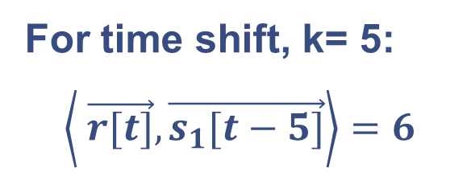
Scanning all possible time shifts: $k=5$
$$r[t]$$
Satellite signatures:
1
-1
$$\vec{s_{1}}=\left[\begin{matrix}1 \\ 1 \\ \begin{matrix}−1 \\ \begin{aligned}−1 \\ \begin{matrix}1 \\ 1\end{matrix}\end{aligned}\end{matrix}\end{matrix}\right], \vec{s_{2}}=\left[\begin{matrix}1 \\ −1 \\ \begin{matrix}−1 \\ \begin{aligned}1 \\ \begin{matrix}−1 \\ 1\end{matrix}\end{aligned}\end{matrix}\end{matrix}\right]$$
-1 0 1 2 3 4 5 6 7 8 9 10 11 12 13 14 15
$$t$$
Overlap window
$$s_{1}[t−5]$$
1
-1
For time shift, k= 5:
$$\left\langle \vec{r[t]},\vec{s_{1}[t−5]}\right\rangle =6$$
-1 0 1 2 3 4 5 6 7 8 9 10 11 12 13 14 15
$$t$$
$r[t]$ → 0 0 0 0 0 1 1 -1 -1 1 1
$s_{1}[t−5]$ →0 0 0 0 0 1 1 -1 -1 1 1
0 0 0 0 0 1 1 1 1 1 1
+ + + + + + + + + + =6

Slide 15

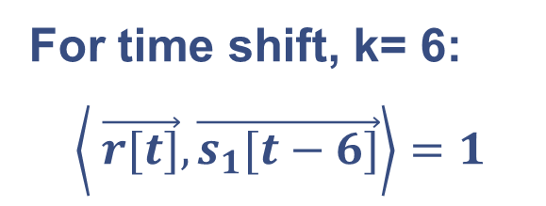
Scanning all possible time shifts: $k=6$
$$r[t]$$
Satellite signatures:
1
-1
$$\vec{s_{1}}=\left[\begin{matrix}1 \\ 1 \\ \begin{matrix}−1 \\ \begin{aligned}−1 \\ \begin{matrix}1 \\ 1\end{matrix}\end{aligned}\end{matrix}\end{matrix}\right], \vec{s_{2}}=\left[\begin{matrix}1 \\ −1 \\ \begin{matrix}−1 \\ \begin{aligned}1 \\ \begin{matrix}−1 \\ 1\end{matrix}\end{aligned}\end{matrix}\end{matrix}\right]$$
-1 0 1 2 3 4 5 6 7 8 9 10 11 12 13 14 15
$$t$$
Overlap window
$$s_{1}[t−6]$$
1
-1
For time shift, k= 6:
$$\left\langle \vec{r[t]},\vec{s_{1}[t−6]}\right\rangle =1$$
-1 0 1 2 3 4 5 6 7 8 9 10 11 12 13 14 15
$$t$$
$r[t]$ → 0 0 0 0 0 1 1 -1 -1 1 1 0
$s_{1}[t−6]$ →0 0 0 0 0 0 1 1 -1 -1 1 1
0 0 0 0 0 0 1 -1 1 -1 1 0
+ + + + + + + + + + + =1

Slide 16

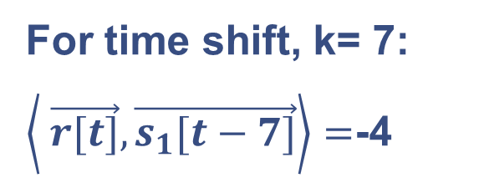
Scanning all possible time shifts: $k=7$
$$r[t]$$
Satellite signatures:
1
-1
$$\vec{s_{1}}=\left[\begin{matrix}1 \\ 1 \\ \begin{matrix}−1 \\ \begin{aligned}−1 \\ \begin{matrix}1 \\ 1\end{matrix}\end{aligned}\end{matrix}\end{matrix}\right], \vec{s_{2}}=\left[\begin{matrix}1 \\ −1 \\ \begin{matrix}−1 \\ \begin{aligned}1 \\ \begin{matrix}−1 \\ 1\end{matrix}\end{aligned}\end{matrix}\end{matrix}\right]$$
-1 0 1 2 3 4 5 6 7 8 9 10 11 12 13 14 15
$$t$$
Overlap window
$$s_{1}[t−7]$$
1
-1
For time shift, k= 7:
$\left\langle \vec{r[t]},\vec{s_{1}[t−7]}\right\rangle =$-4
-1 0 1 2 3 4 5 6 7 8 9 10 11 12 13 14 15
$$t$$
$r[t]$ → 0 0 0 0 0 1 1 -1 -1 1 1 0 0
$s_{1}[t−7]$ →0 0 0 0 0 0 0 1 1 -1 -1 1 1
+ + + + + + + + + + + + =-4
0 0 0 0 0 0 0 -1 -1 -1 -1 0 0

Slide 17

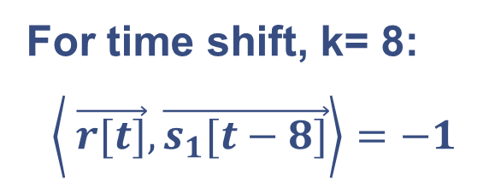
Scanning all possible time shifts: $k=8$
$$r[t]$$
Satellite signatures:
1
-1
$$\vec{s_{1}}=\left[\begin{matrix}1 \\ 1 \\ \begin{matrix}−1 \\ \begin{aligned}−1 \\ \begin{matrix}1 \\ 1\end{matrix}\end{aligned}\end{matrix}\end{matrix}\right], \vec{s_{2}}=\left[\begin{matrix}1 \\ −1 \\ \begin{matrix}−1 \\ \begin{aligned}1 \\ \begin{matrix}−1 \\ 1\end{matrix}\end{aligned}\end{matrix}\end{matrix}\right]$$
-1 0 1 2 3 4 5 6 7 8 9 10 11 12 13 14 15
$$t$$
Overlap window
$$s_{1}[t−8]$$
1
-1
For time shift, k= 8:
$$\left\langle \vec{r[t]},\vec{s_{1}[t−8]}\right\rangle =−1$$
-1 0 1 2 3 4 5 6 7 8 9 10 11 12 13 14 15
$$t$$
$r[t]$ → 0 0 0 0 0 1 1 -1 -1 1 1 0 0 0
$s_{1}[t−8]$ →0 0 0 0 0 0 0 0 1 1 -1 -1 1 1
+ + + + + + + + + + + + + =-1
0 0 0 0 0 0 0 0 -1 1 -1 0 0 0

Slide 18

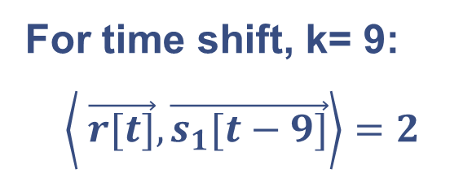
Scanning all possible time shifts: $k=9$
$$r[t]$$
Satellite signatures:
1
-1
$$\vec{s_{1}}=\left[\begin{matrix}1 \\ 1 \\ \begin{matrix}−1 \\ \begin{aligned}−1 \\ \begin{matrix}1 \\ 1\end{matrix}\end{aligned}\end{matrix}\end{matrix}\right], \vec{s_{2}}=\left[\begin{matrix}1 \\ −1 \\ \begin{matrix}−1 \\ \begin{aligned}1 \\ \begin{matrix}−1 \\ 1\end{matrix}\end{aligned}\end{matrix}\end{matrix}\right]$$
-1 0 1 2 3 4 5 6 7 8 9 10 11 12 13 14 15
$$t$$
Overlap window
$$s_{1}[t−9]$$
1
-1
For time shift, k= 9:
$$\left\langle \vec{r[t]},\vec{s_{1}[t−9]}\right\rangle =2$$
-1 0 1 2 3 4 5 6 7 8 9 10 11 12 13 14 15
$$t$$
$r[t]$ → 0 0 0 0 0 1 1 -1 -1 1 1 0 0 0 0
$s_{1}[t−9]$ →0 0 0 0 0 0 0 0 0 1 1 -1 -1 1 1
+ + + + + + + + + + + + + = 2
0 0 0 0 0 0 0 0 0 1 1 0 0 0

Slide 19

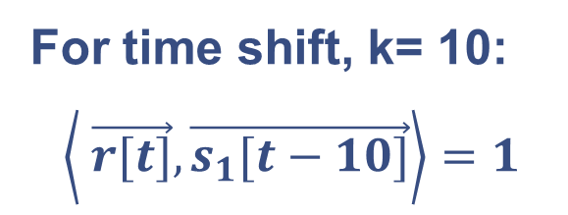
Scanning all possible time shifts: $k=10$
$$r[t]$$
Satellite signatures:
1
-1
$$\vec{s_{1}}=\left[\begin{matrix}1 \\ 1 \\ \begin{matrix}−1 \\ \begin{aligned}−1 \\ \begin{matrix}1 \\ 1\end{matrix}\end{aligned}\end{matrix}\end{matrix}\right], \vec{s_{2}}=\left[\begin{matrix}1 \\ −1 \\ \begin{matrix}−1 \\ \begin{aligned}1 \\ \begin{matrix}−1 \\ 1\end{matrix}\end{aligned}\end{matrix}\end{matrix}\right]$$
-1 0 1 2 3 4 5 6 7 8 9 10 11 12 13 14 15
$$t$$
Overlap window
$$s_{1}[t−10]$$
1
-1
For time shift, k= 10:
$$\left\langle \vec{r[t]},\vec{s_{1}[t−10]}\right\rangle =1$$
-1 0 1 2 3 4 5 6 7 8 9 10 11 12 13 14 15
$$t$$
$r[t]$ → 0 0 0 0 0 1 1 -1 -1 1 1 0 0 0 0 0
$s_{1}[t−10]$ →0 0 0 0 0 0 0 0 0 0 1 1 -1 -1 1 1
+ + + + + + + + + + + + + + + = 1
0 0 0 0 0 0 0 0 0 0 1 0 0 0 0 0

Slide 20



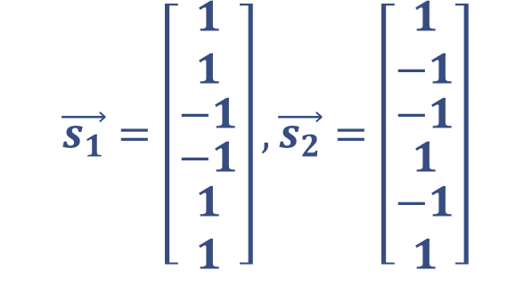
Can we plot $\left\langle \vec{r[t]},\vec{s_{1}}[t−k]\right\rangle$ vs $k$?
$$\left\langle \vec{r}[t],\vec{s_{1}}[t−k]\right\rangle$$
Satellite signatures:
$$\vec{s_{1}}=\left[\begin{matrix}1 \\ 1 \\ \begin{matrix}−1 \\ \begin{aligned}−1 \\ \begin{matrix}1 \\ 1\end{matrix}\end{aligned}\end{matrix}\end{matrix}\right], \vec{s_{2}}=\left[\begin{matrix}1 \\ −1 \\ \begin{matrix}−1 \\ \begin{aligned}1 \\ \begin{matrix}−1 \\ 1\end{matrix}\end{aligned}\end{matrix}\end{matrix}\right]$$
7
6
5
4
3
2
1
0
$$t_{d}$$
-1 0 1 2 3 4 5 6 7 8 9 10 11 12 13 14 15
$$k$$
-1
-2
-3
-4
-5
-6

Slide 21




Plot $\left\langle \vec{r}[t],\vec{s_{2}}[t−k]\right\rangle$ vs $k$
$$\left\langle \vec{r}[t],\vec{s_{2}}[t−k]\right\rangle$$
Satellite signatures:
$$\vec{s_{1}}=\left[\begin{matrix}1 \\ 1 \\ \begin{matrix}−1 \\ \begin{aligned}−1 \\ \begin{matrix}1 \\ 1\end{matrix}\end{aligned}\end{matrix}\end{matrix}\right], \vec{s_{2}}=\left[\begin{matrix}1 \\ −1 \\ \begin{matrix}−1 \\ \begin{aligned}1 \\ \begin{matrix}−1 \\ 1\end{matrix}\end{aligned}\end{matrix}\end{matrix}\right]$$
7
6
5
4
3
2
1
0
$$6$$
$s_{2}$is not present in r
-1 0 1 2 3 4 5 6 7 8 9 10 11 12 13 14 15
$$k$$
-1
-2
-3
-4
-5
-6
$$−6$$

