Slide 1
Uniform Modeling Language
Xiaoying Bai
Department of Computer Science and Technology
Tsinghua University, Beijing, China
November 5, 2015

Slide 2
Outline
Why requirements engineering is critical
The basic concepts
Uniform Modeling Language (UML)
Behavior-driven analysis
Summary

Slide 3
Why UML?
Software Development……

Slide 4
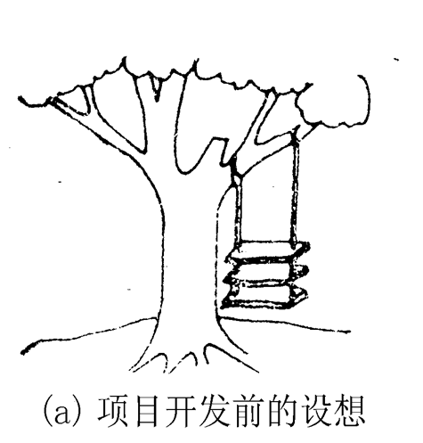
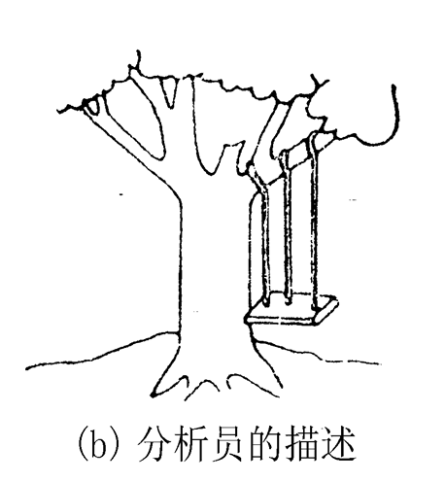

Slide 5
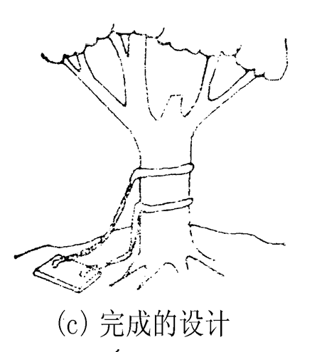
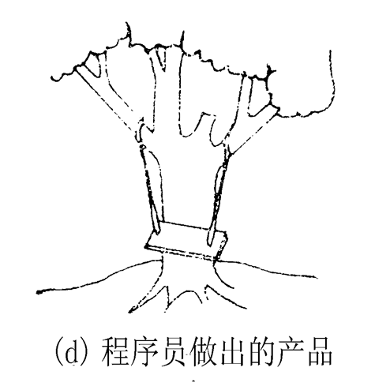

Slide 6
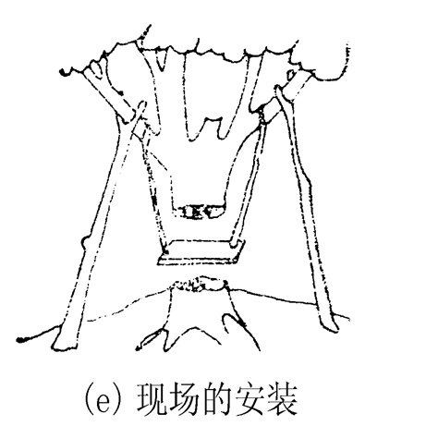
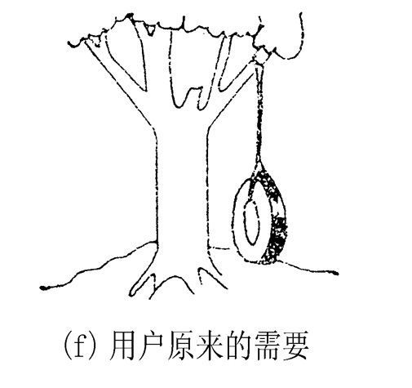

Slide 7



Slide 8
The diversity of OOAD Notations …….

Slide 9
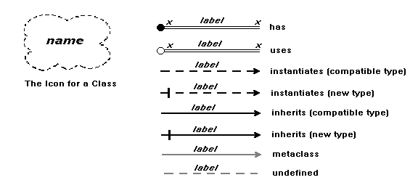
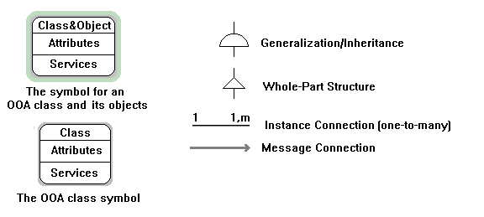
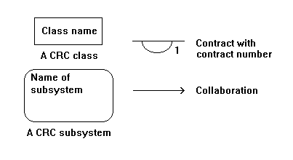
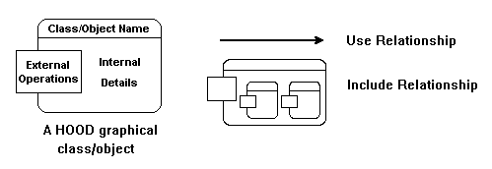
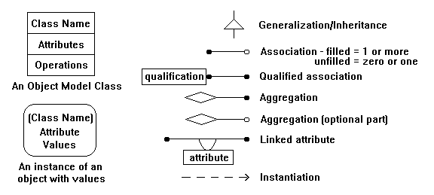
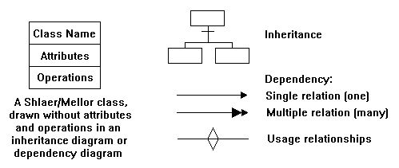
OOD,
Booch [91]
OOA,
Coad/
Yourdon [90]
HOOD
Robinson [92]
CRC,
Wirfs [90]
OMT,
Rumbaugh
[91]
OODLE,
Shlaer [92]

Slide 10
UML IS…
Unified Modeling Language：A graphical language for
Specifying
Visualizing
Constructing
Documenting
The artifacts of software systems
Three Amigos
Booch (Grady Booch) &
OMT (Janes Rumbaugh) &
OOSE (Ivar Jacobson)

Slide 11
A Brief History
Schlaer/
Mellor
Fusion
first try
Unified
Method
0.8
OMG
RFP
UML 1.0
OMG
Stand.
UML 1.x
UML 2.0
Booch
Rumbaugh
1994
1995
1996
1997
2003
2004
Jacobson
Booch and
Rumbaugh
Join Rational
Jacobson
Join
Rational
UML
Industry
Standard
Coad/
Yourdon

Slide 12
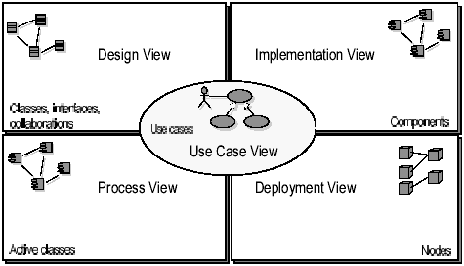
Architecture: “4+1” View

Slide 13
UML Building Blocks
Modeling Elements
Structural elements: Class, Interface, use case, etc.
Behavioral elements: action, state, etc.
Grouping elements: package
Annotational elements
Relationships
Dependency, association, aggregation, generalization, realization, composition, containment.
Diagram
Structural diagram: static modeling
Class diagram, component diagram, deployment diagram, object diagram, package diagram, composite structure diagram
Behavior diagram: dynamic modeling
Activity diagram, interaction diagram (sequence, communication, interaction overview, timing), use case diagram, statechart diagram.

Slide 14
Use Case Diagram

Slide 15
Requirements Elicitation
The difficulties of requirement elicitation
Problems of scope
The boundary of the system is ill-defined
Specify unnecessary technical details that may confuse, rather than clarify, overall system objectives.
Problems of understanding
Unclear of what is needed
Trouble communicating needs to engineers
Conflicting needs from different customer representatives
Ambiguous or untestable requirements
Problems of volatility
Requirements change overtime

Slide 16
Use Case Model
Purpose
Specify the context of a system
Show interactions between the system and the entities external to the system
Capture the requirements of a system
User’s point of view, black-box representations
Validate a system’s architecture
Drive implementation and generate test cases

Slide 17
Use Case Model
General rules
Built in early stages of development
Developed by analysts and domain experts
Confirmed by all the stakeholders
User-Appropriate Level of Detail
User-Appropriate Volume
No more than 70-80 use cases for very large systems, I. Jacobson, OOPSLA 1996, that is, average for 20-50

Slide 18
System Boundary
System
user
Other
System
External
Equipment

Slide 19
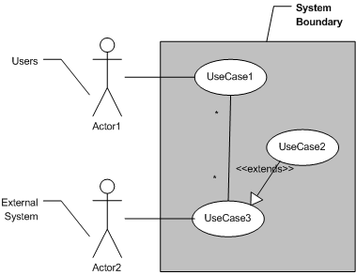
Use Case Model Example

Slide 20
UML Use Case Diagram
A use-case diagram is an illustration that shows the relationships among use cases and actors and among related use cases.
Use Case: System functionality
Actor: User or interactive system
System: A black-box of use cases

Slide 21
Use Case Description
Purpose and function briefing
Action sequence
Pre-condition：An observable status of the system before the use case starts.
Post-condition: An observable status of the system after the execution of the use case.
Basic event flow: “Happy Day” scenario, normal path
Extended event flow: abnormal branches

Slide 22
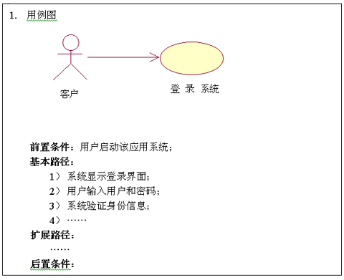

Slide 23
Scenario
Individual instances of use cases that traverse a specific path using specific data
start
Scenarios:
1：basic flow
2：basic flow, extended flow 1
3：basic flow, extended flow 1,
extended flow 3
4：basic flow, extended flow 2
5：basic flow, extended flow 2,
extended flow 3
6：basic flow, extended flow 3
Basic
flow
Extended
Flow 1
Extended
Flow 2
Extended
Flow 3
end

Slide 24
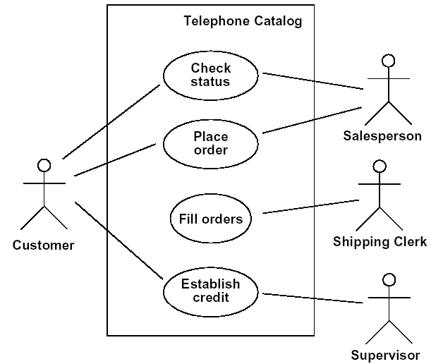
Use Case -- Actor Relationship
Association
A use case can interact with one or more actors
Active actor
Passive actor

Slide 25
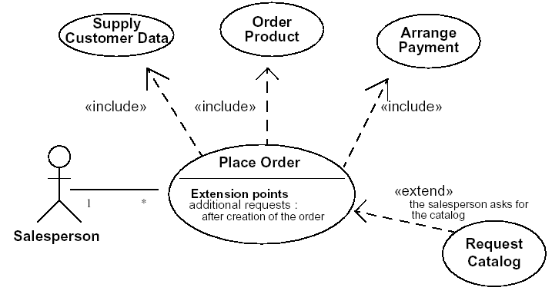
Use Case Relationship
Generalization
Include（use）
Extend

Slide 26
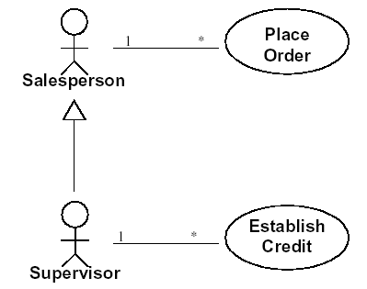
Actor Relationship
Association
Generalization

Slide 27
Analysis Process
Identify the Actors
Identify the Use Cases
Create Use Case Diagram
Use Case Review

Slide 28
Example-1: The Weather Station
A weather station is a package of software controlled instruments which collects data, performs some data processing and transmits this data for further processing. The instruments include air and ground thermometers, an anemometer, a wind vane, a barometer and a rain gauge. Data is collected every five minutes.
When a command is issued to transmit the weather data, the weather station processes and summarises the collected data. The summarised data is transmitted to the mapping computer when a request is received.

Slide 29
Example-1: The Weather Station
A weather station is a package of software controlled instruments which collects data, performs some data processing and transmits this data for further processing. The instruments include air and ground thermometers, an anemometer, a wind vane, a barometer and a rain gauge. Data is collected every five minutes.
When a command is issued to transmit the weather data, the weather station processes and summarises the collected data. The summarised data is transmitted to the mapping computer when a request is received

Slide 30
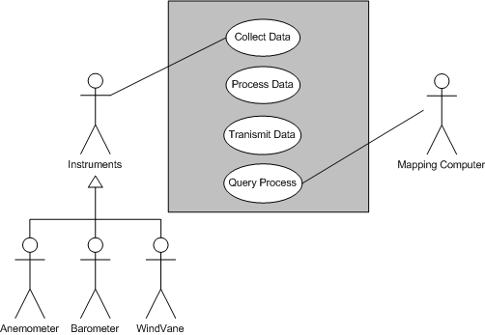
Example-1: Use Case Diagram

Slide 31
Example-2: A Library Support System
The library lends books and magazines to borrowers, who are registered in the system.
The library handles purchase of new titles. Popular titles are bought in multiple copies. Old books and magazines are often removed.
The librarian interacts with the customers.
A borrower can reserve a book or magazine that is not currently available in the library and will get a notification when the book is returned or purchased. The reservation is canceled in appropriate conditions.
The library can create, update, and delete information about titles, borrowers, loans, and reservations.
The system can run on popular technical environment and has a modern GUI.

Slide 32
Example-2: A Library Support System
The library lends books and magazines to borrowers.
The borrowers register in the system.
The library handles purchase of new titles.
The library brings popular titles.
The library removes Old books and magazines.
The librarian interacts with the customers.
The librarian reserves a book or magazine.
The librarian notifies the borrower when the book is returned or purchased.
A borrower cancel the reservation.
The library can create, update, and delete information about titles, borrowers, loans, and reservations.

Slide 33
Example-2: A Library Support System
The library lends books and magazines to borrowers.
The borrowers register in the system.
The library handles purchase of new titles.
The library brings popular titles.
The library removes Old books and magazines.
The librarian interacts with the customers.
The librarian reserves a book or magazine.
The librarian notifies the borrower when the book is returned or purchased.
A borrower cancel the reservation.
The library can create, update, and delete information about titles, borrowers, loans, and reservations.

Slide 34
Generic Rules
Actor
All the roles interacted with the system have been represented by Actors
Each actor is associated with at least one use case
Compose the actors if one actor includes the other
Decompose the actors if they are associated with different unrelated use cases

Slide 35
Generic Rules
Use Case
All the major functionalities of the system have been represented by use cases
Commonality analysis among use cases to identify new use cases and the extension, generalization and inclusion relationships among use cases
Decompose complex use cases

Slide 36
Behavior Modeling with UML Dynamic Models

Slide 37
Behavior Model
Understand the sequence of interaction within the systems
Identify events that drive the interaction sequence and understand how these events relate to specific classes
Create sequence diagram
Build a state diagram for each class and the system
Review to verify accuracy and consistency

Slide 38
UML Dynamic Models
Interaction Diagrams
Sequence Diagram
Collaboration Diagram
State Machine
Statechart Diagram
Activity Diagram

Slide 39
Interaction Diagram
Shows an interaction, consisting of a set of objects and their relationships, including the message that may be dispatched among them.
Sequence diagram shows time ordering of messages
Collaboration diagram shows structural organization of objects that send and receive messages
Semantically equivalent

Slide 40
Sequence Diagram
Illustrates the classes that participate in a use case
Shows the messages that pass between classes over time for one use case
Can be a generic sequence diagram, but more frequently one is drawn for a single scenario within the use case
Design diagrams are implementation specific – database objects or specific GUI components serve as classes

Slide 41
Sequence Diagram Notations
Defines event sequences that result in some desired outcome.
The messages sent between objects
The order in which messages occur
Two dimensions
Vertical, top down, the time sequence of messages/calls as they occur
Horizontal, left to right, the object instances that the messages are sent to

Slide 42
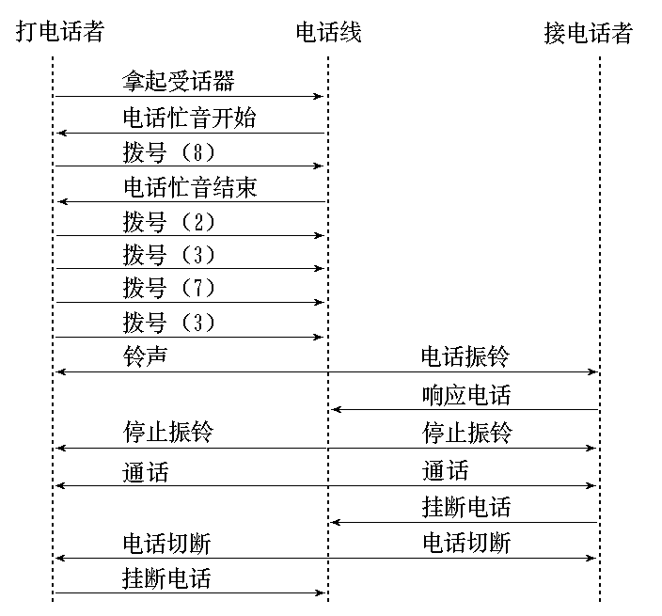

Slide 43
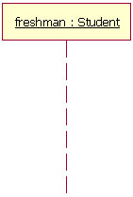
Basic Notations
Lifeline
Represents either roles or object instances that participate in the sequence being modeled.
Objects should be traced to classes in the class diagram
Drawn as a box with a dashed line descending from the center of the bottom edge.

Slide 44
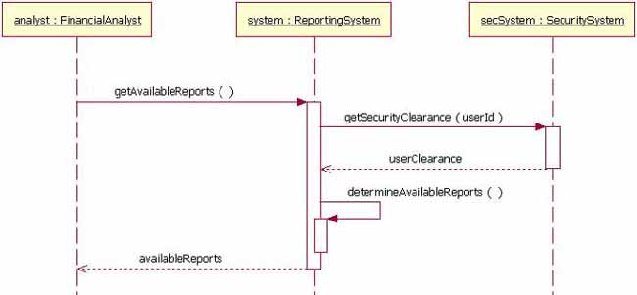
Basic Notations
ReportingSystem
SecuritySystem
Method/Message call
getAvailableReports()
determinAvailableReports()
getSecurityClearance
(userId)
Method Name
Synchronous call
Message sent to itself
[Optional] Return Message
Asynchronous call

Slide 45
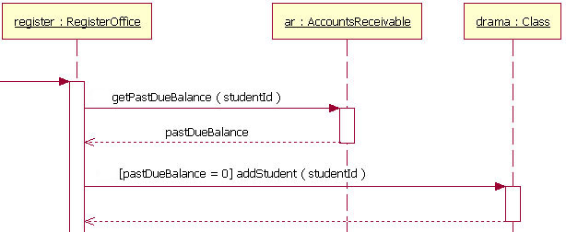
Basic Notations
Guards
Conditions must be met for a message to be sent to the object
Guards

Slide 46
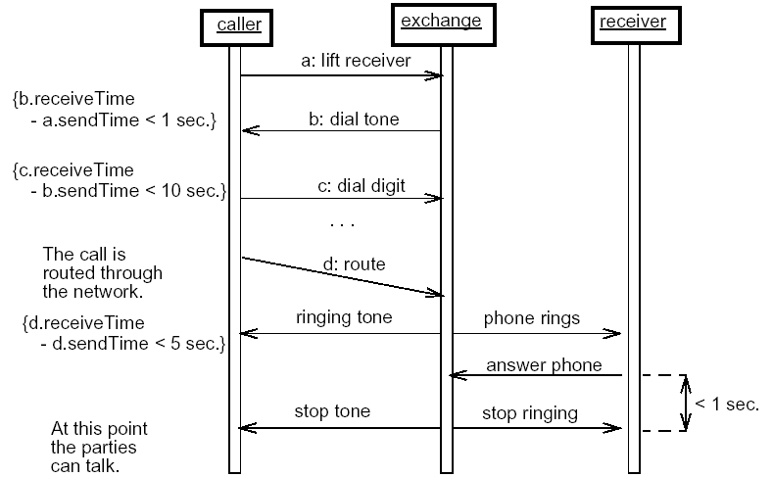
Example Sequence Diagram

Slide 47
Example: The ATM System
Request
(inquiry, withdraw )
ATM
Response
Bank

Slide 48
Card
Message
Bank
CardReader
CustomerConsole
ATM
Session
CashDispenser
ReceiptPrinter
Transaction
Receipt
Withdrawal
Inquiry
Account
Example class relationships: the ATM Simulator

Slide 49
：ATM
：Withdraw
：Bank
getAccount ()
getAmount ()
checkIfCashAvailable (amount)
initiateWithdraw
(account, amount)
dispenseCash ()
finishWithdraw ()
printReciept ()
Example ATM Sequence Diagram

Slide 50
Example
A weather data collection system is required to generate weather maps on a regular basis using data collected from remote, unattended weather stations and other data sources such as weather observers, balloons and satellites.
Weather stations transmit their data to the area computer in response to a request from that machine.
The area computer validates the collected data and integrates it with the data from different sources.
The integrated data is archived and, using data from this archive and a digitised map database a set of local weather maps is created.
Maps may be printed for distribution on a special-purpose map printer or may be displayed in a number of different formats.

Slide 51
Example: Weather System
A weather data collection system is required to generate weather maps on a regular basis using data collected from remote, unattended weather stations and other data sources such as weather observers, balloons and satellites.
Weather stations transmit their data to the area computer in response to a request from that machine.
The area computer validates the collected data and integrates it with the data from different sources.
The integrated data is archived and, using data from this archive and a digitised map database a set of local weather maps is created.
Maps may be printed for distribution on a special-purpose map printer or may be displayed in a number of different formats.

Slide 52
Example: Sequence Analysis
Weather stations collect data
area computer requests data from Weather stations
Weather stations transmit their data
area computer validates the collected data
area computer integrates data
area computer archives data
area computer uses map database
area computer creates weather maps
map printer prints Maps
area computer displays Maps

Slide 53
:Area
Computer
:Weather
Station
:Data
:Map
:Printer
Collect
Request
Transmit
Validate
Integrate
Archive
Create
Print
Display
Example Weather System Sequence Diagram

Slide 54
Summary
UML provides a standard notation for Specifying, Visualizing, Constructing, Documenting modeling elements.
Use-Cases capture the system functionalities from the actors’ point of view. An actor is a role that people or devices plan as they interact with the software.
The behavior diagrams models the interactions between objects that realize a use case.

Slide 55
Readings
“UML 2 and the Unified Process: Practial Object-Oriented Analysis and Design”, (2nd ed.), Jim Arlow and Ila Neustadt, 2005, Addison Wesley,
影印版，人民邮电出版社，2006.
“UML 2.0 in a nutshell”, Dan Pilone and Neil Pitman, 2005, O’Reilly,
影印版，东南大学出版社，2006.
OMG Unified Modeling Language Specification v2.0, 2005.
Philippe Kruchten, Architectural Blueprints – The “4+1” View model of Software Architecture, IEEE Software, 12 (6), Nov. 1995, pp. 42-50.
Thomas Behrens, Capturing Business Requirements Using Use Cases, IBM developerworks.

Slide 56

Thank you!
Xiaoying Bai
Ph.D, Associate Professor
Dept. DS&T, INLIST
Tsinghua University
Beijing, China, 100084
Phone: 86-10-62794935
Email: baixy@tsinghua.edu.cn

